Slide 1
Driver Drowsiness & Distraction Detection
Detecting drowsy and distracted drivers in the browser, on-device. Evaluated on 89 real people from three public datasets
Arnav Dugad & Sujal Kumar · ML Mini Project · Manipal Institute of Technology
Notes:
Introduce the project in one sentence: a browser app that watches the driver's face on-device and warns on drowsiness or distraction, with two neural networks trained and evaluated on public data from real people.

Slide 2
Fatigue and distraction kill thousands a year, and the law now requires warnings
3,208
633
1.19 M
people killed in US crashes involving distracted drivers, 2024 (NHTSA)
killed in drowsy-driving crashes, 2023 (NHTSA, via GHSA); modelled estimates run ~10x higher
road-traffic deaths worldwide each year (WHO, 2023)
EU Regulation 2019/2144
Driver drowsiness and attention warning has been mandatory on every new EU car since 7 July 2024; advanced distraction warning since 7 July 2026. Both need exactly what this project measures: eye closure, gaze and head pose over time.
Notes:
The point: drowsiness and distraction are temporal states visible on the face seconds before a crash, and regulators now mandate camera-based warnings.

Slide 3
One web app: pretrained perception, two models we trained, an explainable rule engine
1
2
3
4
5
Perceive
Measure
Learn
Decide
Warn
MediaPipe Face Landmarker: 478 landmarks, 52 blendshapes, head-pose matrix. EfficientDet-Lite0 for phones.
EAR, MAR, iris gaze, yaw/pitch/roll, aspect-corrected; personal 5-second calibration.
EyeNet CNN (15,290 params, int8) on eye crops; GRU over 30 s of 14 signals.
Time-weighted PERCLOS, yawn morphology, persistence and fusion into a 0-100 risk.
Voice in 6 languages, haptics, Drive Mode, counterfactual explanations.
Everything runs on the device. No frame, landmark or face template ever leaves the browser.
Notes:
Walk left to right. Highlight the amber step: the two networks trained in this project. Stress privacy: there is no server.

Slide 4
No data of our own: three public datasets of real people, split by person
UTA-RLDD
DMD
MRL Eye
60 people
13 drivers
4000 images
182 webcam/phone videos, self-rated alert, low-vigilant or drowsy (KSS). 1,087 clips of 30 s.
88,222 frames in a real car, every frame labelled open, closing, closed or opening; blinks and yawns marked.
Near-infrared eye crops from a different camera and population, never used for training.
Drowsiness models · official 5 folds
Eye CNN · signal and event checks
Out-of-domain test
Notes:
I could not record people myself, so everything is evaluated on public datasets with real participants. The rule throughout: nobody appears in both training and test data.

Slide 5
The offline experiments run the app's own code, so results transfer to the product
✓
Same perception
✓
Same maths
Videos go through the identical face_landmarker.task file and thresholds as the browser.
Python ports of the browser signals match JavaScript to 10^-4 on recorded MediaPipe output (parity test).
✓
Same rule engine
✓
Same shipped weights
The shipped JavaScript tracker is replayed over every clip, not re-implemented.
The CNN is scored after int8 quantisation, the GRU after temperature scaling; JS matches PyTorch in tests.
Notes:
Explain why this matters: offline numbers are only meaningful for the app if the same code produces them. Parity tests enforce this in CI.

Slide 6
Real data exposed a hidden bug: eye ratios were stretched by the camera's shape
MediaPipe divides x by frame width and y by frame height. On a 16:9 webcam an open eye read EAR ≈ 0.52 instead of ≈ 0.29; on a portrait phone it read too low. A calibration clamp hid it.
Fixing the maths alone lowered closed-eye F1, because the old threshold had silently compensated. Re-learning the cut by leave-one-driver-out cross-validation (0.26 → 0.52) gives correct geometry on every camera shape, and the best F1.
Lesson: fix the measurement, then re-learn the decision threshold from data, never by hand.
Notes:
The most important engineering lesson. Without real labelled data this bug would never have been found. The tuned bar is cross-validated: every driver is scored with a threshold chosen on the other drivers.

Slide 7
EyeNet: a 15.3k-parameter CNN that detects closed eyes on unseen drivers
0.998
Model | Parameters | Accuracy | F1 closed | ROC-AUC
Pixels + PCA + LogReg | 65,601 | 97.2% | 0.900 | 0.989
EyeNet-L (float) | 60,530 | 98.9% | 0.958 | 0.997
EyeNet-S (float) | 15,290 | 98.9% | 0.961 | 0.998
EyeNet-S int8 (shipped) | 15,290 | 98.9% | 0.959 | 0.998
ROC-AUC on held-out DMD drivers (int8, as shipped)
92.6%
accuracy on MRL infrared eyes: different camera, people and light
Five-fold cross-validation grouped by driver. Input: 32×32 landmark-aligned grayscale crops; four 3×3 conv blocks, global average pooling. BatchNorm is folded and weights quantised to int8 before scoring, so the table's last row is exactly what ships.
14.9 KB
of int8 weights, run in plain JavaScript
Notes:
The CNN clearly beats a pixel baseline and matches the 4x larger network. int8 quantisation costs almost nothing. The MRL result shows it transfers to infrared images it never saw.

Slide 8
Head-on, every closed-eye signal scores above 0.99 ROC-AUC on unseen drivers
Closed-eye detector | ROC-AUC | 95% CI over drivers | Best F1
EAR (geometry) | 0.993 | 0.982 – 0.999 | 0.954
Blink blendshape | 0.998 | 0.995 – 0.999 | 0.960
App fusion (EAR + blendshape) | 0.996 | 0.991 – 1.000 | 0.957
EyeNet CNN (ours) | 0.998 | 0.996 – 0.999 | 0.960
Stacked fusion (ours) | 0.996 | 0.991 – 0.999 | 0.960
Honest reading
The intervals overlap: on DMD's mostly frontal footage the CNN does not beat MediaPipe's own blink score. Its value is independence from landmarks and its infrared transfer (slide 7), which is why it runs beside the fusion rather than replacing it.
65,290 human-labelled frames; CNN and stacked scores are out-of-fold, so no driver was seen in training.
Notes:
This slide is deliberately honest: all detectors are excellent head-on and statistically tied. Do not oversell the CNN here; its strength is robustness and transfer.

Slide 9
On 60 unseen people the best model reaches 53.3%: drowsiness from 30-second clips is hard
0.761
alert vs drowsy ROC-AUC, logistic regression
48%–59%
95% interval, resampling people
The published HM-LSTM reads whole 10-minute videos of blink sequences; these models see 6 clips of 30 s per video. Every model, learned or rule-based, is well above chance and below the published model.
Notes:
Amber is our best model; teal and grey are the numbers published with the dataset. We are below the published HM-LSTM, which uses whole videos. Say this plainly.

Slide 10
We nearly fooled ourselves: a big gain from "fresh" calibration was a confound
Hypothesis
Calibrating on a face that is already tired hides tiredness, so calibrate once while alert.
First result
Carrying the whole alert baseline over raised mean accuracy 49% → 56%.
The catch
RLDD's three states are separate recordings, often with the camera moved: a carried-over head-pose baseline partly recognises the recording.
Controlled
Carrying only eyes and mouth: 49% → 51%. The app keeps per-session calibration.
Notes:
This is the methodological highlight. The first experiment looked like a big win. Before shipping it we asked what else a carried-over baseline could encode: camera placement. Controlling for it removed most of the gain, so the feature was not shipped. Catching your own confound is what good ML practice looks like.

Slide 11
Errors sit in the middle class; the GRU's confidence is calibrated by temperature scaling
Logistic regression: true ↓ / predicted → | Alert | Low vigilant | Drowsy
Alert | 72% (43) | 17% (10) | 12% (7)
Low vigilant | 42% (25) | 32% (19) | 27% (16)
Drowsy | 10% (6) | 34% (21) | 56% (35)
Per video. Alert and drowsy are usually right; low vigilance is confused with both, as in the original paper and for its human judges.
Notes:
Left: where the best model's errors fall. Right: a risk score is acted on, so its confidence must mean what it says. ECE 0.032 raw, 0.024 after temperature scaling.

Slide 12
Eyes carry the most signal on their own; the ablation shows what each group adds
Most important features
closure std (0.042)
blink mean (0.022)
closure p90 (0.018)
longest closure ms (0.012)
gaze deviation (0.010)
ear mean (0.009)
Permutation importance: drop in macro F1 when one feature is shuffled on held-out people. A group whose removal raises accuracy is adding noise for unseen people.
Notes:
Ablation answers which signals matter for new people. Read the orange bars as 'how far this group gets alone' and the grey bars as 'what is left without it'.

Slide 13
The rule engine's event detectors, checked against human annotations
Blinks
Yawns
87%
63%
186
70%
39%
16
precision
recall
false events / hour
precision
recall
false events / hour
1026 matched, 153 spurious, 609 missed
30 matched, 13 spurious, 46 missed
The unchanged JavaScript engine replayed over 16 DMD sessions (49 minutes). Yawn recall is limited by yawns behind a hand, which hide the mouth from any camera-only method; a stated limitation, not hidden.
Notes:
Event-level evaluation is what a driver experiences. Blinks are detected well. Yawn recall is low because many DMD yawns are covered by a hand.

Slide 14
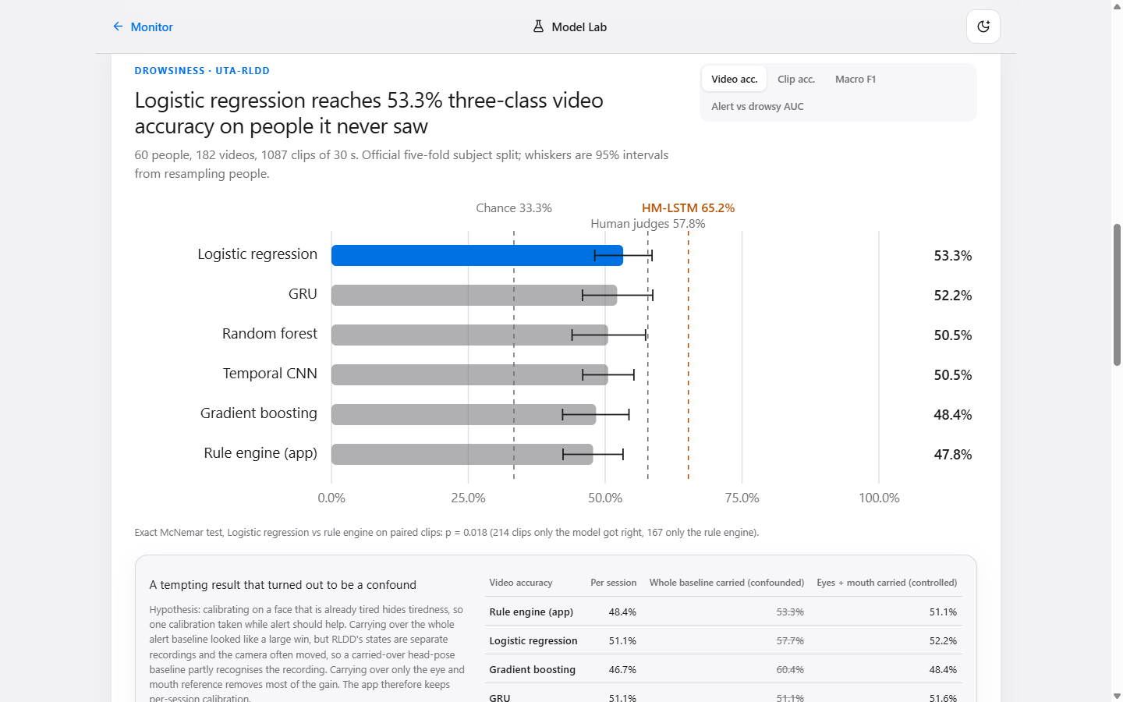
The Model Lab: every result live in the app, and all models side by side on your webcam
Shadow mode
Rule engine, EyeNet and GRU score the same frames in parallel, with the CNN's eye crops shown live.
Results explorer
Model comparison with intervals, confusion matrices, reliability, ablation; switch metric and model.
No hand-typed numbers
The page reads the same JSON the training scripts write.
Notes:
Demo the Lab here if time allows: start the camera, blink, close eyes for two seconds, look down.

Slide 15
What these results do not show
Not a crash predictor
Small DMD subset
Labels are self-rated sleepiness (RLDD) and eye state (DMD), not driving performance.
13 drivers in the public mirror; wide intervals for per-driver results.
Hard middle class
Camera-only
Low vigilance is confused with both neighbours, by models and by people.
Sunglasses, a hand over the mouth, night without IR, and extreme angles remain failure cases.
Next: a simulator study linking alerts to lane deviation, infrared night profiles, and per-driver fine-tuning from calibration.
Notes:
Being explicit about limitations is part of doing ML properly.

Slide 16
Summary
0.998
53.3%
0.948
eye-state AUC on unseen drivers
drowsiness video accuracy on 60 unseen people (published 65.2%)
closed-eye F1 after the aspect fix and a CV-tuned threshold
Two models trained and evaluated on 89 real people, a hidden bug found and a tempting confound caught by measuring, and an app that shows its own evidence.
Questions?
Notes:
Close on the three numbers and invite questions.

