Slide 1
INFORMATION RETRIEVAL ? PROJECT PRESENTATION
arXiv Scientific
Paper Search Engine
10,000
ARXIV PAPERS IN THE SAMPLE
A browser-based research search system using TF-IDF, cosine similarity, and category filters.
Search ? Rank ? Explore
TF-IDF
COSINE RANKING
FLASK WEB APP
GitHub: Arnav-Milmile/search_engine

Slide 2
01 ? MOTIVATION
Why build a paper search engine?
Research search should return useful papers first?not just documents that happen to contain a word.
The problem
Project objectives
A large research collection makes discovery difficult. Exact keyword matching can miss useful ranking signals and leaves readers to sift through results manually.
? Search paper titles and abstracts
? Rank results by query relevance
? Filter by arXiv category
? Evaluate retrieval quality
? Provide a simple browser interface
arXiv Scientific Paper Search Engine
02

Slide 3
02 ? DATA
Dataset and searchable fields
A manageable arXiv sample supports local indexing, evaluation, and interactive demos.
10,000 papers
Core fields
Broad coverage
Sample fetched from the public arXiv API.
doc_id ? title ? abstract ? categories
Computer science, physics, math, and related categories.
Search text = paper title + abstract
The CSV is included in the public repository; the downloader can refresh it from arXiv.
arXiv Scientific Paper Search Engine
03

Slide 4
03 ? DESIGN
System architecture
The backend prepares a TF-IDF index once, then transforms each submitted query for ranking.
01
02
03
04
05
arXiv sample
?
Text corpus
?
TF-IDF
?
Similarity
?
Web results
CSV records
Title + abstract
Document vectors
Cosine ranking
Filter + arXiv links
Flask serves the page and JSON APIs ? Scikit-learn handles vectorization and similarity
arXiv Scientific Paper Search Engine
04

Slide 5
04 ? PIPELINE
Preparing and indexing papers
Two related representations support the project: a manual inverted index and an ML text-vector index.
Inverted index scripts
Web search index
? Tokenize lowercase alphabetic words
? Count each term per document ID
? Save postings as inverted_index.json
? Plot the most frequent terms
? Combine title and abstract
? Fit TfidfVectorizer on the corpus
? Store document vectors in memory
? Transform user queries with the same vocabulary
arXiv Scientific Paper Search Engine
05

Slide 6
05 ? RETRIEVAL MODEL
TF-IDF: weighting useful terms
Term weighting makes distinctive vocabulary more influential than words appearing everywhere.
Term Frequency
Inverse Document Frequency
Project settings
How often a word appears in a document.
Reduces weight for words common across many documents.
English stopwords removed; min_df = 5.
Document text ? weighted vector ? user query
arXiv Scientific Paper Search Engine
06

Slide 7
06 ? QUERY RANKING
Ranking with cosine similarity
The query vector is compared with document vectors; higher scores appear earlier in the result list.
1 ? Transform query
2 ? Compare vectors
3 ? Sort results
Use the fitted corpus vectorizer to create a query vector.
Calculate cosine similarity between query and papers.
Filter optional category, then return top 10, 20, or 30.
Cosine similarity measures the angle-based alignment of two vectors.
arXiv Scientific Paper Search Engine
07

Slide 8
07 ? USER INTERFACE
A simple browser search experience
The interface keeps the main workflow direct: search, optionally filter, inspect, and open a paper.
Search
Enter a topic, method, or phrase.
Filter
Choose any category present in the sample.
Inspect
Read title, abstract, ID, category tags, and match score.
Continue
Open the selected paper on arXiv.
arXiv Scientific Paper Search Engine
08

Slide 9
08 ? EVALUATION
How retrieval is evaluated
Predefined queries are assessed using category membership as a practical, approximate relevance label.
P@5 / P@10
Recall@10
Relevant results in top 5 / top 10.
Relevant top-10 papers divided by relevant papers in the sample.
AP
MAP
Precision at each relevant rank, averaged for a query.
Mean Average Precision across the query set.
Category labels are a proxy; they are not human relevance judgments.
arXiv Scientific Paper Search Engine
09

Slide 10
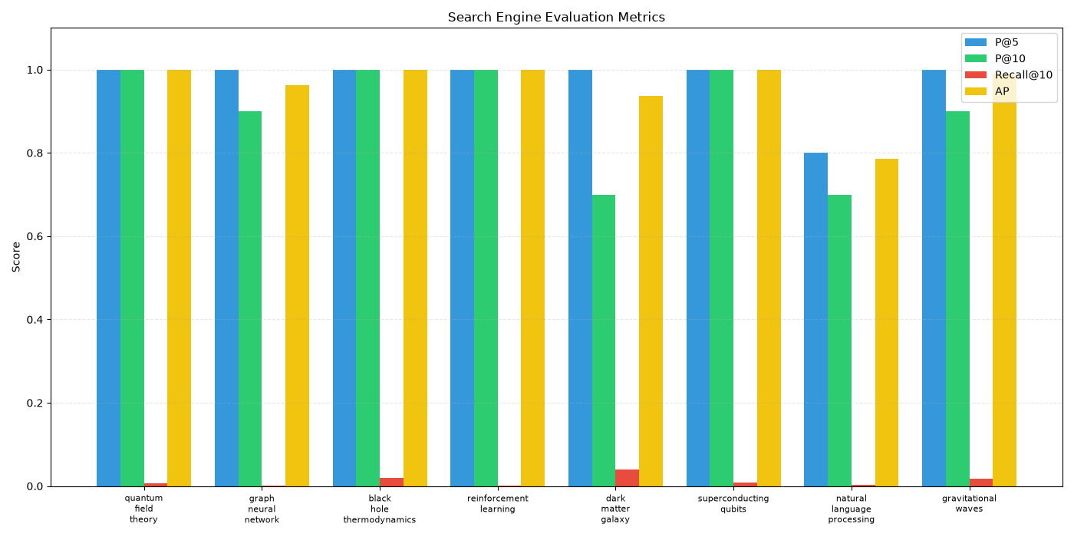
09 ? RESULTS
Observed baseline results
One recorded run over the 10,000-paper sample produced the following metrics.
0.9592
REPORTED GLOBAL MAP
Matrix shape
10,000 ? 12,084
Results depend on current query set and category-based evaluation.
Treat this as a project run result?not a manually validated benchmark claim.
arXiv Scientific Paper Search Engine
10

Slide 11
10 ? COMPARISON
Ablation: preprocessing choices
Recorded MAP values differ across the four tested configurations; interpretation is dataset-specific.
Configuration | MAP
Raw ? no preprocessing | 0.9471
Stopwords only | 0.9391
Stemming only | 0.9187
Stopwords + stemming | 0.9280
Raw text led in this run; this does not prove preprocessing is generally harmful.
arXiv Scientific Paper Search Engine
11

Slide 12
11 ? FEEDBACK EXPERIMENT
Rocchio relevance feedback
Rocchio adjusts the query toward relevant examples and away from non-relevant examples.
q_new = ? ? q_old + ? ? centroid(relevant) ? ? ? centroid(non-relevant)
Intended workflow
Important caveat
Run an initial search, label feedback documents, update query, rerank.
A previous run found 0 relevant feedback documents. Treat its reported AP change as unverified.
Validate category token matching and feedback labels before claiming an improvement.
arXiv Scientific Paper Search Engine
12

Slide 13
12 ? CRITICAL ASSESSMENT
Limitations and next improvements
The current project is a clear baseline; these upgrades would improve reliability and retrieval quality.
Current limitations
Future work
? 10,000-record sample, not full arXiv
? Categories approximate relevance
? Rocchio feedback labels need verification
? TF-IDF does not model semantic similarity
? Flask development server is local/demo use
? Fix and test exact category matching
? Use standard, validated AP/MAP tests
? Build a human-rated test set
? Compare BM25 and semantic embeddings
? Add pagination and date sorting
? Deploy with a production WSGI server
arXiv Scientific Paper Search Engine
13

Slide 14
13 ? DEMO
Run the project
The public repository includes the sample CSV; the virtual environment is intentionally not included.
python -m pip install -r requirements.txt
python app.py
Open http://127.0.0.1:5000
Demo query: ?graph neural network? ? try category cs.LG ? open a result on arXiv
arXiv Scientific Paper Search Engine
14

Slide 15
14 ? CONCLUSION
From research data to ranked results.
This project demonstrates an end-to-end baseline: prepare arXiv papers, represent text with TF-IDF, rank by cosine similarity, and explore results through a browser UI.
Next step: strengthen evaluation, then explore semantic retrieval and deployment.
Thank you ? Questions?
arXiv Scientific Paper Search Engine

