Slide 1

ELD411
Mid-Term Review — 2026
Autonomous robotic manipulator for AMR sampling (Petri Dish)
Arnav Panjla 2023EE10978
Manashvi Garg 2023EE11104

Slide 2
PROBLEM STATEMENT
02
The Challenge: Scaling AMR Surveillance
  Antimicrobial resistance (AMR) requires continuous surveillance.
  Rural/village-level sampling can generate many biological samples.
  Samples need to be collected, transported, incubated/processed and analyzed.
  Manual Petri-dish handling becomes a bottleneck as sample volume increases.
01
02
03
04
05
VILLAGES
COLLECTION
LAB
DISHES
BOTTLENECK
Distributed sampling
Repeated visits
Central processing
Handling + imaging
Manual repetition
OBJECTIVE
Repeated sampling creates high laboratory load.
Automate Petri-dish
handling + imaging
Dish transport, imaging and logging are repetitive.
Manual handling limits throughput and traceability.
IIT Delhi · ELD411 · Mid-Term Review 2026

Slide 3

MARKET AND SCALE ANALYSIS
03
From Village Sampling to Laboratory Load
~3000
2–3%
60–90
4–5
5–6
people / village
sampling fraction*
(people that get sick and actually need testing)
samples / village
field collectors
villages / collector / day
DESIGN TARGET
ASSUMPTION
~1200
PETRI DISHES / DAY
Planning value for workflow, storage and robot duty cycle
IIT Delhi · ELD411 · Mid-Term Review 2026

Slide 4
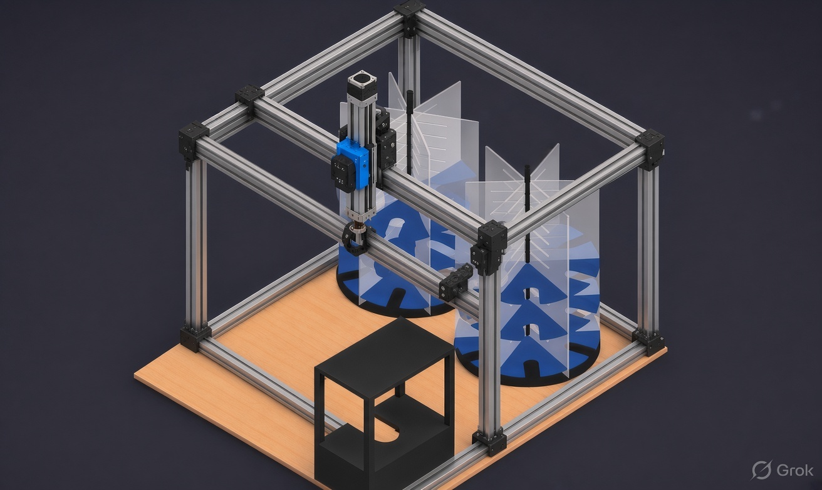
04
Iteration - I · 3D-printer / gantry frame
01
FULL XY GANTRY
Whole frame rides the gantry; nothing moves independently of it.
02
RESTRICTED REACH
Gripper travel is tied to the frame axis — cannot reach every individual dish slot at the carousel.
03
MATERIAL WASTE
Rails sized to the full base footprint even though only the carousel radius is used.
04
VERDICT: REJECTED
Frame motion, not the gripper, was the actual constraint. Scrapped before build.
IIT Delhi · ELD411 · Mid-Term Review 2026

Slide 5
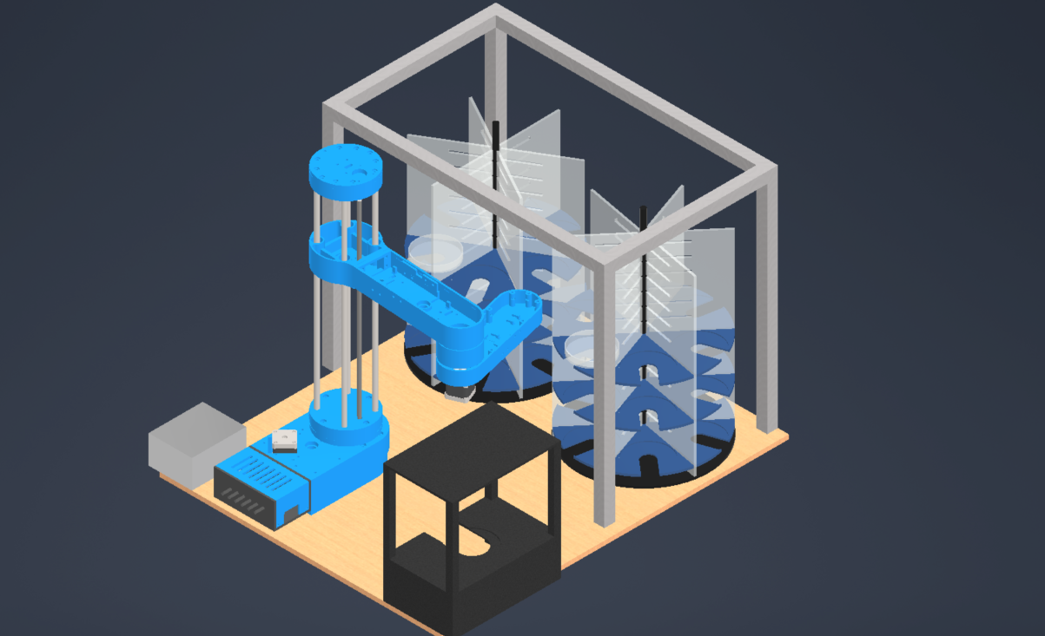
05
Iteration - II · SCARA arm
01
FULL WORKSPACE REACH
Arm swept the entire carousel; range of motion was exactly enough.
02
HARDER CONTROL MATH
Coupled joint angles replace simple XY moves — more complex than iteration I.
03
FULLY CUSTOM BUILD
Every link had to be designed and 3D-printed from zero — no off-the-shelf part fit.
04
VERDICT: TOO SLOW TO BUILD
Print-fit-reprint cycles on every joint made the build timeline the real blocker.
IIT Delhi · ELD411 · Mid-Term Review 2026

Slide 6
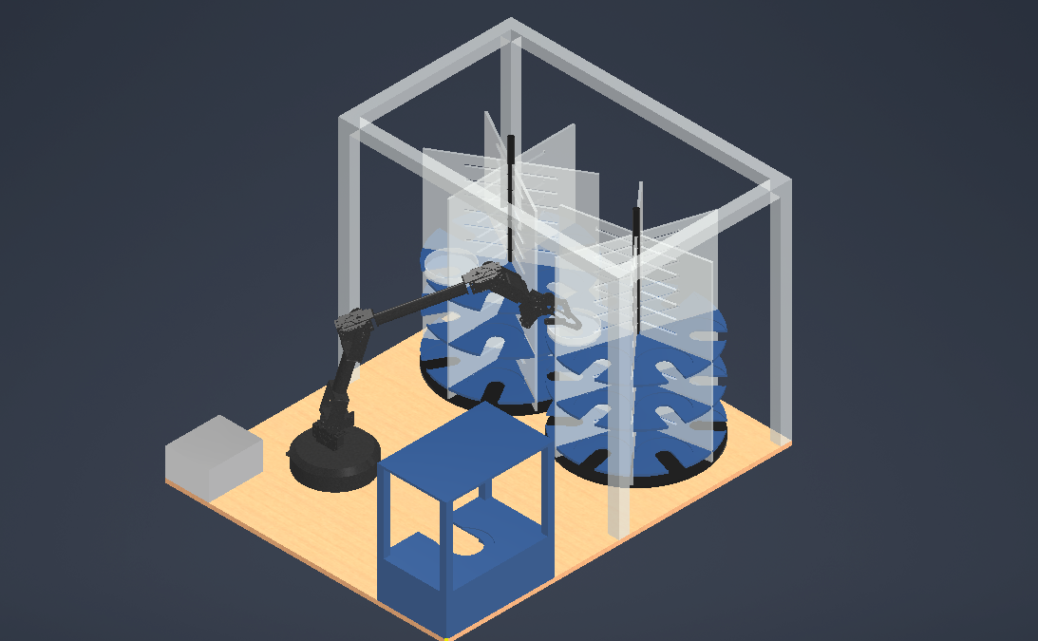
FULL-PROJECT LAYOUT
06
Final design · 6-DOF arm replaces the SCARA
1
Frame — aluminium extrusion cell
1
2
Carousel A — dish storage column
3
Carousel B — dish storage column
4
Robotic arm — 6-DOF (final swap-in)
2
3
5
Imaging station — staging table
6
Control box — drivers / electronics
4
7
Base plate — mounting deck
6
5
7
IIT Delhi · ELD411 · Mid-Term Review 2026

Slide 7
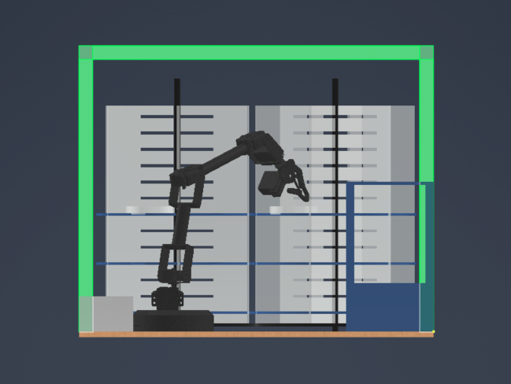
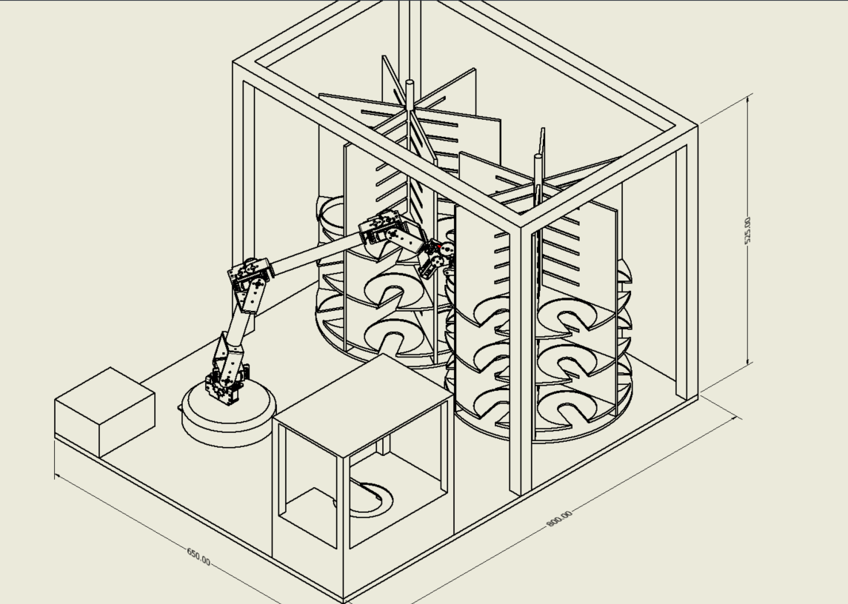
MANIPULATOR HARDWARE
07
Selected 6-DOF Robotic Arm
Elevation · reach check against carousel
Full assembly, dimensioned · 650 × 800 × 525 mm envelope
IIT Delhi · ELD411 · Mid-Term Review 2026

Slide 8
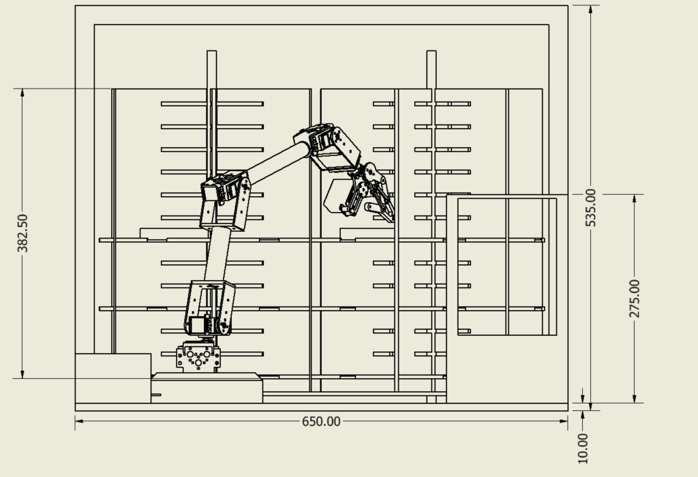
MECHANICAL ADAPTATION
08
Manipulator Modifications for Petri-Dish Reach
01
LONGER LINKS
Extend joints so the gripper clears the outer carousel ring
02
CAMERA MOUNT
Rigid mount above gripper, aligned with the QR scan axis
03
CABLE ROUTING
Slack CSI + power routing so cables survive full joint travel
04
WIDER BASE
Widen 2 base-side links so reach stays even across the full carousel span.
IIT Delhi · ELD411 · Mid-Term Review 2026
Notes:
new arm drawong wil all dimnesion

Slide 9
MECHANICAL ADAPTATION
09
Modified Arm — Dimensioned Drawing
MEASUREMENTS NEEDED
Link 1 — new length (mm)
Link 2 — new length (mm)
Base width — new (mm)
Joint offsets after extension
+
Updated reach vs carousel radius
DROP THE UPDATED ARM DRAWING HERE
Torque check at new lever arm
2 lengthened base-side links + wider base, with full dimensions
IIT Delhi · ELD411 · Mid-Term Review 2026

Slide 10
COMPUTE PLATFORM
10
Raspberry Pi Setup
01
02
03
UBUNTU SERVER
CAMERA TEST
SWITCH TO RASPBERRY PI OS
First OS on the Pi. Chosen because ROS 2 install and packaging is easier on Ubuntu.
Camera Module verified working under Ubuntu Server before anything else was built.
Final OS. The add-on HAT board is only supported on Raspberry Pi OS, not Ubuntu.
WHY RASPBERRY PI OS WON
HAT compatibility decided it: the camera/control HAT ships drivers for Raspberry Pi OS only. Ubuntu stayed useful for early ROS 2 experiments, but the deployed board runs Raspberry Pi OS.
IIT Delhi · ELD411 · Mid-Term Review 2026

Slide 11
VALIDATION
11
Simulation Recording — Gazebo
DROP THE GAZEBO SIM RECORDING HERE
Arm + dish carousel, pick-and-place cycle
IIT Delhi · ELD411 · Mid-Term Review 2026

