Slide 1
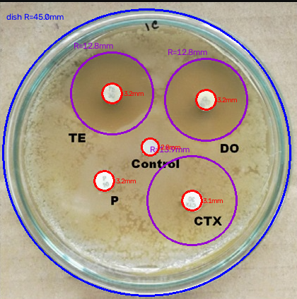
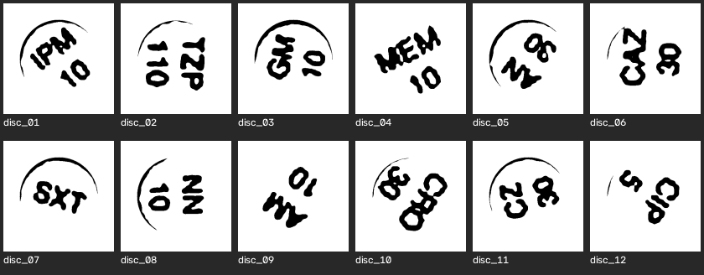
VISION
01
Two jobs on one plate
INNER DISK + OUTER ZONE
THE ANTIBIOTIC DISKS
Red = disk. Purple = inhibition zone. Blue = dish rim.
Each stamp is a second read. Circles do not give the code.
IIT Delhi · ELD411 · Mid-Term Review 2026

Slide 2
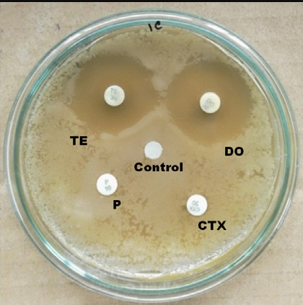
STEP 1 · CIRCLES
02
Before detection
INPUT
Raw plate. No circle is drawn yet.
cv2.cvtColor
BGR to gray
cv2.GaussianBlur
gray, (9, 9), 2
Blur is only here so speckle does not become a circle.
IIT Delhi · ELD411 · Mid-Term Review 2026

Slide 3
STEP 1 · CIRCLES
03
After detection
01 DISH RIM
cv2.HoughCircles
HOUGH_GRADIENT
Largest circle. Blue.
02 INNER DISK
HoughCircles again
radius 1.6–4.5 mm
Brightness gate. Red.
03 OUTER ZONE
Radial profile
Not Hough
Gray step around the disk. Purple.
IIT Delhi · ELD411 · Mid-Term Review 2026

Slide 4


STEP 2 · STAMP
04
Low-pass · Gaussian blur
cv2.GaussianBlur(gray, (15, 15), 4)
BEFORE
AFTER · GAUSSIAN BLUR
Low-pass. Agar grain and sensor noise become false edges if they reach Canny or Hough. The plate detector uses the same call at (9, 9), σ = 2.
IIT Delhi · ELD411 · Mid-Term Review 2026

Slide 5
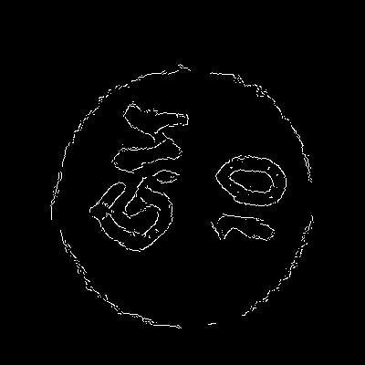
STEP 2 · STAMP
05
Edges · Canny
cv2.Canny(gray, 20, 60)
BEFORE
AFTER · CANNY
Canny edge detector: Sobel gradient, non-maximum suppression, hysteresis. It returns an edge map, not a character. Thresholds 60 / 160 drop these soft strokes.
IIT Delhi · ELD411 · Mid-Term Review 2026

Slide 6
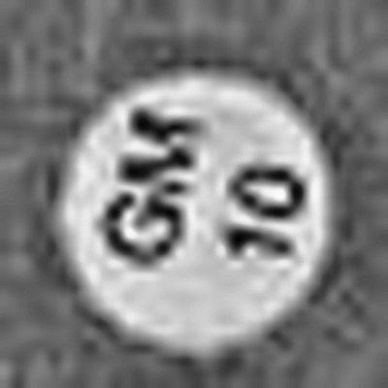
STEP 2 · STAMP
06
Local contrast · CLAHE
cv2.createCLAHE(clipLimit=2.0, tileGridSize=(8, 8)).apply(gray)
BEFORE
AFTER · CLAHE
Contrast-limited adaptive histogram equalization. Lifts stamp-versus-paper contrast inside small tiles without blowing the whole crop.
IIT Delhi · ELD411 · Mid-Term Review 2026

Slide 7
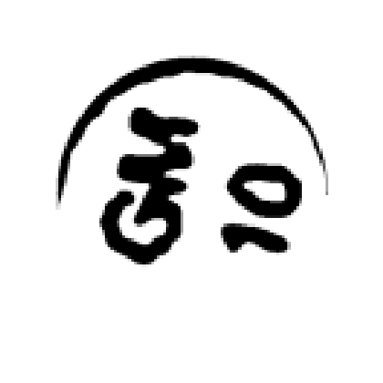

STEP 2 · STAMP
07
Morphology · opening
ker = cv2.getStructuringElement(cv2.MORPH_ELLIPSE, (7, 7)); cv2.morphologyEx(ink, cv2.MORPH_OPEN, ker, iterations=1)
BEFORE · OTSU
AFTER · MORPH OPEN
Opening is erosion, then dilation. Thin arcs break. Thick strokes stay. The binary input is Otsu: cv2.threshold(..., THRESH_OTSU). Still not a string.
IIT Delhi · ELD411 · Mid-Term Review 2026

Slide 8
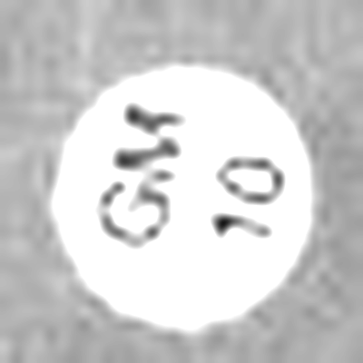
STEP 2 · STAMP
08
Brightness and contrast
cv2.convertScaleAbs(gray, alpha=1.7, beta=12)
BEFORE
AFTER · convertScaleAbs
out = saturate(alpha × pixel + beta). Alpha is contrast. Beta is brightness. Ink separates from the paper. The output is still an image.
IIT Delhi · ELD411 · Mid-Term Review 2026

Slide 9
STEP 2 · STAMP
09
Filters were not the reader
TRADITIONAL PATH
GEMMA 3 4B
Another image.
Never the code.
Reads the disk
in one call.
Gaussian blur — smoother pixels
Local model, gemma3:4b.
No hand-built filter chain on the stamp.
The model does the filtering and the read.
Canny — an edge map
CLAHE — local contrast
Morphology — thinner strokes
convertScaleAbs — brighter paper
Hough still finds the circles first.
Gemma does not replace that step.
IIT Delhi · ELD411 · Mid-Term Review 2026

Slide 10
DECISION LEFT OPEN
10
Two readers, one circle step
LOWER COMPUTE
HIGHER COMPUTE
Traditional filters
Gemma 3 4B
Gaussian, CLAHE, Canny, morphology, brightness / contrast, then an OCR engine.
One local vision-language call on the disk crop. Filtering and reading happen inside the model.
Fits the Raspberry Pi.
No large model.
Did not read these rotated stamps.
Heavier than the Pi filter path.
12 / 12 on the upright test1.png crops.
Kept, not locked in.
IIT Delhi · ELD411 · Mid-Term Review 2026

Slide 11
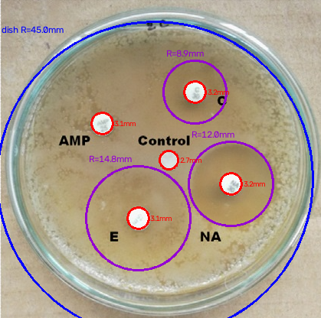
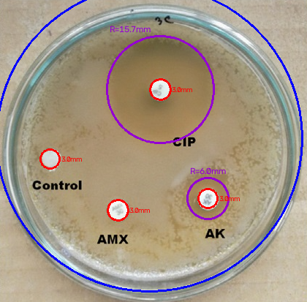
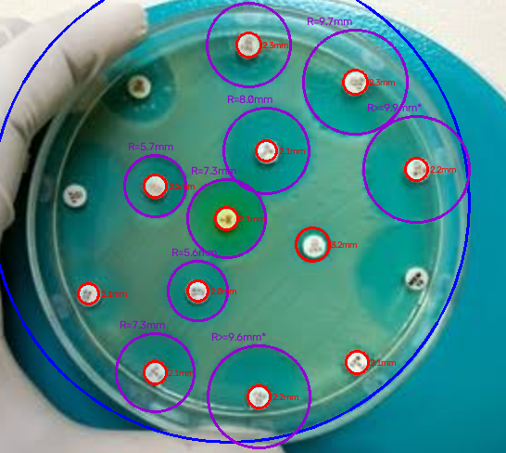
STEP 1 · CIRCLES
11
Same detector, other plates
s2 · AMP, E, NA
s3 · CIP, AMX, AK
s5 · denser plate
IIT Delhi · ELD411 · Mid-Term Review 2026

Slide 12
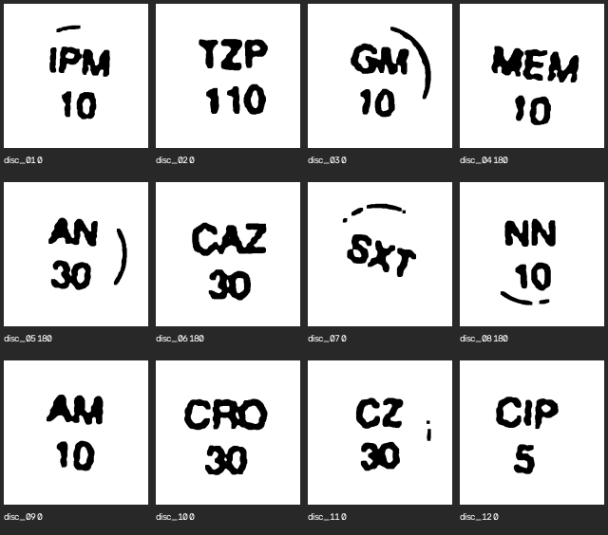
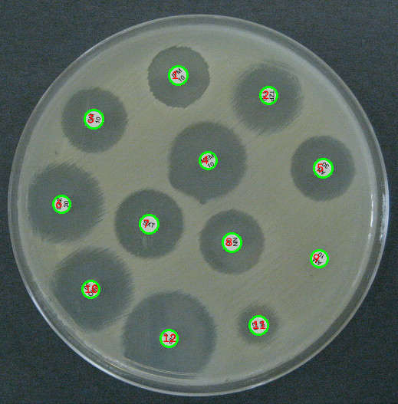
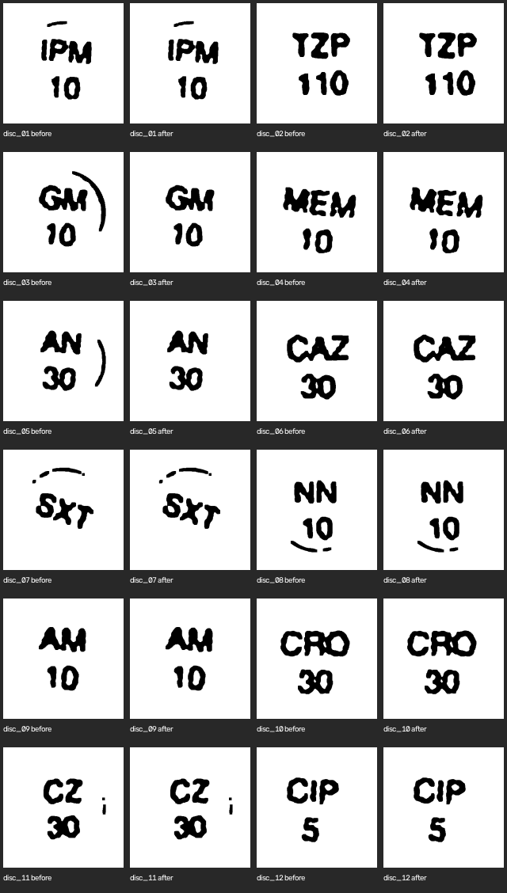
STEP 2 · STAMP
12
Images in front of the reader
Upright stamps · letters above, digits below
test1 · Hough disks
Rim ink stripped · before / after, all 12 disks
IIT Delhi · ELD411 · Mid-Term Review 2026

