Slide 1
ELD411 · MID-TERM REVIEW 2026
Autonomous Robotic
Manipulator for
AMR Sampling
Automated Petri Dish Handling, Imaging and Analysis
01
02
03
VILLAGE
DISHES
ROBOT
Arnav Panjla · 2023EE10978
Manashvi Garg · 2023EE1141
04
05
VISION
ANALYSIS
Indian Institute of Technology Delhi

Slide 2
PROBLEM STATEMENT
02
The Challenge: Scaling AMR Surveillance
01
02
03
04
05
VILLAGES
COLLECTION
LABORATORY
PETRI DISHES
BOTTLENECK
Distributed sampling
Repeated field visits
Central processing
Imaging + handling
Manual repetition
Large-scale AMR surveillance creates repeated biological sampling.
PROJECT OBJECTIVE
Rural collection feeds a distributed village-to-laboratory workflow.
Automate repetitive
Petri-dish operations
Laboratory work adds repetitive dish transport, imaging and logging.
Automation targets repeatability, traceability and operator workload.
robotic handling + controlled imaging
IIT Delhi · ELD411 · Mid-Term Review 2026

Slide 3
DESIGN SCENARIO
03
From Village Sampling to Laboratory Load
~100
2–5%
2–5
4–5
5–6
people / village
sampling fraction*
samples / village
field collectors
villages / day
DESIGN TARGET
ASSUMPTION
~100
PETRI DISHES / DAY
Planning value for sizing workflow, storage and robot duty cycle
*2–5% is a project design assumption, not an epidemiological estimate.
IIT Delhi · ELD411 · Mid-Term Review 2026

Slide 4
CAPACITY SIZING
04
Why a 600-Dish Processing Pipeline?
DAY 1
DAY 2
DAY 3
DAY 4
DAY 5
DAY 6
100
dishes / day
×
5–6
days
≈ 500–600
100
200
300
400
500
600
in process
in process
in process
in process
in process
in process
Multiple daily batches remain under observation simultaneously.
IIT Delhi · ELD411 · Mid-Term Review 2026

Slide 5
SYSTEM ARCHITECTURE
05
Proposed Autonomous Petri-Dish Processing System
RASPBERRY PI 5
CV · LOCALIZATION · PLANNING
ESP32
REAL-TIME CONTROL
MANIPULATOR
+ END EFFECTOR
PETRI DISH
INPUT
CAMERA
HIGH-LEVEL INTELLIGENCE
DETERMINISTIC CONTROL
Control split
Pi estimates what and where. ESP32 executes when and how.
IMAGING / STORAGE CAROUSEL
Feedback closes the loop after grip, transfer and release.
IIT Delhi · ELD411 · Mid-Term Review 2026

Slide 6
THREE-LAYER STACK
06
Hardware Selection
COMPUTATION
Raspberry Pi 5
01
02
Computer vision · planning · system logic
12 MP CAMERA
END EFFECTOR
Controlled image capture
Petri-dish gripping
CONTROL
ESP32 / controller
Timing · motor commands · feedback
03
04
CONTROLLED LIGHT
CAROUSEL / STORAGE
Repeatable illumination
Dish queue + controlled chamber
ACTUATION
Drivers + motors + SCARA
Dish handling · gripping · positioning
ROUGH POWER ENVELOPE
~95 W typical · ~145 W peak
Estimate only — verify with measured current after hardware integration.
IIT Delhi · ELD411 · Mid-Term Review 2026

Slide 7
COMPUTE PARTITIONING
07
Separating Perception from Real-Time Control
INTELLIGENCE
DETERMINISTIC CONTROL
Raspberry Pi 5
ESP32 + RTOS path
Computer vision
CONTROL COMMANDS
Motor-control timing
Image processing
Hardware interfaces
Position estimation
Command execution
High-level planning
Limit / feedback inputs
Camera interface
Zephyr evaluation planned
Current repository evidence: ESP32/Arduino prototypes; Zephyr remains an integration target.
IIT Delhi · ELD411 · Mid-Term Review 2026

Slide 8
MAKE-OR-BUY DECISION
08
Manipulator Selection & Procurement
BUILD FROM SCRATCH
EVALUATION PATH
High mechanical effort
Pre-built candidate
01
CAD + fabrication
Faster prototype start
02
Joint calibration
Focus on vision + control
03
Structural iteration
Known payload / repeatability
04
Longer integration path
ROS 2 / Gazebo support desirable
DECISION OPEN · Pre-built speed vs current custom SCARA BOM
IIT Delhi · ELD411 · Mid-Term Review 2026

Slide 9
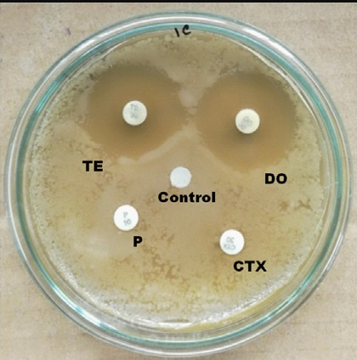
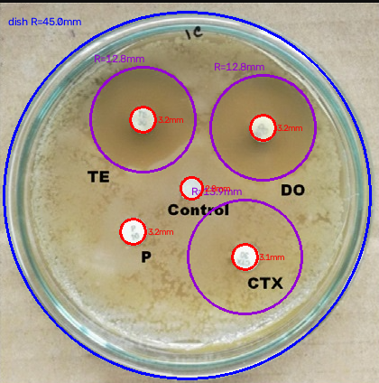
CURRENT EVIDENCE
09
Computer Vision for Petri-Dish Analysis
MEASURE
Dish radius
Inhibition-zone radius
Feature location
OpenCV baseline
01 RAW IMAGE
02 CIRCULAR ROI
03 DETECTION
PREPROCESS
DISH DETECT
ROI
ZONE DETECT
MEASURE
OCR*
*OCR for handwritten labels remains planned.
IIT Delhi · ELD411 · Mid-Term Review 2026

Slide 10
CALIBRATION GEOMETRY
10
Controlled Petri-Dish Imaging
CAMERA
01
FIXED POSITION
Simplifies calibration
02
CONTROLLED LIGHT
Reduces image variation
DIFFUSED LIGHT
CONTROLLED DISTANCE
CENTER + RADIUS
Localizes dish geometry
DIFFUSED LIGHT
03
04
ZONE RADIUS
Supports measurement
PETRI DISH
05
LABEL OCR
Future identification path
Target object: 90 mm plate · 12 MP Camera Module 3 listed in BOM
IIT Delhi · ELD411 · Mid-Term Review 2026

Slide 11
PLANNED SIMULATION WORKBENCH
11
From Robot Description to Gazebo Simulation
01
02
03
04
05
06
CAD
URDF
ROS 2
GAZEBO
CONTROL
PICK & PLACE
geometry
joints + links
interfaces
world + physics
sensors + joints
trajectories
SIMULATION VALIDATES
CURRENT STATUS
Workspace reach
Joint limits
Trajectory feasibility
Architecture defined
Collision behavior
Pick-place sequence
No Gazebo model or screenshot exists in repository yet.
Next artifact: URDF + workspace test
IIT Delhi · ELD411 · Mid-Term Review 2026

Slide 12
AUTONOMOUS PICK-AND-PLACE
12
Vision-to-Manipulation Pipeline
01
02
03
04
05
CAPTURE
DETECT
LOCALIZE
TRANSFORM
PLAN
camera
dish
x, y, θ
camera → robot
collision-aware
10
09
08
07
06
VERIFY
RELEASE
TRANSFER
GRIP
APPROACH
close loop
place dish
target pose
confirm hold
pre-grasp
PERCEPTION · LOCALIZATION · PLANNING · MANIPULATION · VERIFICATION
Verification prevents silent failures and enables retry / operator escalation.
IIT Delhi · ELD411 · Mid-Term Review 2026

Slide 13
BOM AND PROCUREMENT EVIDENCE
13
Prototype Hardware & Bill of Materials
COMPONENT
FUNCTION
STATUS
Raspberry Pi 5 · 4 GB
Vision / computation
BOM / SELECTED
Camera Module 3 · 12 MP
Petri-dish imaging
BOM / SELECTED
ESP32-CAM / controller
QR + control prototypes
PROTOTYPE CODE
SCARA manipulator
Dish handling
BOM / DESIGN
5× NEMA17 + drivers
Joint actuation
BOM / DESIGN
End effector + servo
Dish gripping
BOM / DESIGN
Lighting + fixtures
Repeatable imaging
BOM / DESIGN
POWER ENVELOPE
~95 W typical · ~145 W peak
Prices and supplier commitments are not recorded in repository BOM.
IIT Delhi · ELD411 · Mid-Term Review 2026

Slide 14
MID-TERM STATUS
14
Current Progress & Roadmap
COMPLETED
IN PROGRESS
UPCOMING
NEXT PHASE
Problem + system definition
CV robustness + calibration
URDF + Gazebo validation
01
Finalize manipulator
Initial hardware architecture
Manipulator selection
Vision-to-robot transform
02
Complete CV calibration
Pi camera workflow
Control-stack decision
Autonomous pick + place
03
Implement control path
OpenCV detection baseline
BOM finalization
Throughput testing
04
Validate ROS 2 + Gazebo
05
Integrate vision + arm
FINAL TARGET
06
Test throughput
Autonomous vision-guided Petri-dish handling
~100 DISHES / DAY
IIT Delhi · ELD411 · Mid-Term Review 2026

