Slide 1
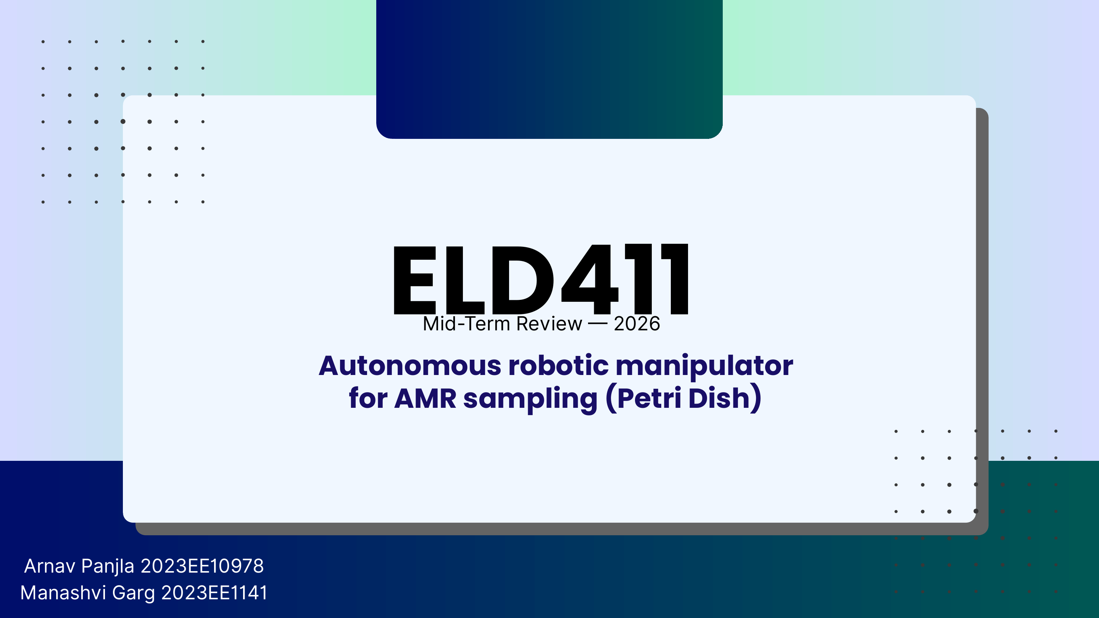

Slide 2
PROBLEM STATEMENT
02
The Challenge: Scaling AMR Surveillance
01
02
03
04
05
VILLAGES
COLLECTION
LAB
DISHES
BOTTLENECK
Distributed sampling
Repeated visits
Central processing
Handling + imaging
Manual repetition
Repeated sampling creates high laboratory load.
OBJECTIVE
Dish transport, imaging and logging are repetitive.
Automate Petri-dish
handling + imaging
Manual handling limits throughput and traceability.
IIT Delhi · ELD411 · Mid-Term Review 2026

Slide 3
MARKET AND SCALE ANALYSIS
03
From Village Sampling to Laboratory Load
~100
2–5%
2–5
4–5
5–6
people / village
sampling fraction*
samples / village
field collectors
villages / collector / day
DESIGN TARGET
ASSUMPTION
~100
PETRI DISHES / DAY
Planning value for workflow, storage and robot duty cycle
*Project design assumption; not epidemiological estimate.
IIT Delhi · ELD411 · Mid-Term Review 2026

Slide 4
CAPACITY SIZING
04
Why a 600-Dish Processing Pipeline?
DAY 1
DAY 2
DAY 3
DAY 4
DAY 5
DAY 6
100
dishes / day
×
5–6
days
≈ 500–600
100
200
300
400
500
600
Design assumption: each dish remains in processing / observation for 5–6 days.
IIT Delhi · ELD411 · Mid-Term Review 2026

Slide 5
ADD FINAL SYSTEM DIAGRAM
05
Proposed System Architecture
01
INPUT
Petri-dish queue
02
VISION
Pi + imaging camera
+
03
CONTROL
SYSTEM ARCHITECTURE / HANDOFF DIAGRAM
Manipulator + feedback
Replace with image / diagram
04
OUTPUT
Imaging / storage
IIT Delhi · ELD411 · Mid-Term Review 2026

Slide 6
FULL-PROJECT LAYOUT
06
Complete System CAD
+
DROP FULL-SIZE AUTOCAD IMAGE HERE
Use supplied full CAD render · replace blue SCARA with selected 6-DOF arm
IIT Delhi · ELD411 · Mid-Term Review 2026

Slide 7
MANIPULATOR HARDWARE
07
Selected 6-DOF Robotic Arm
+
DROP FULL-SIZE 6-DOF ARM IMAGE HERE
Keep arm large; add model / payload / reach only after procurement is final
IIT Delhi · ELD411 · Mid-Term Review 2026

Slide 8
MECHANICAL ADAPTATION
08
Manipulator Modifications for Petri-Dish Reach
01
LONGER LINKS
Extend selected joints for carousel reach
02
CAMERA MOUNT
Rigid mount above gripper
+
03
CABLE ROUTING
ADD ANNOTATED ARM / JOINT DIAGRAM
Protect CSI / power through motion
Show stock arm and proposed link-length changes
04
VALIDATION
Recheck torque, stiffness and collisions
IIT Delhi · ELD411 · Mid-Term Review 2026

Slide 9
5 MP RASPBERRY PI CAMERA
09
Gripper Camera: Identification + Position Feedback
01
SCAN
Read QR / barcode before pickup
02
ALIGN
Estimate dish center and gripper offset
+
03
PICK
Close gripper at corrected pose
ADD CAMERA-ON-GRIPPER DIAGRAM / PHOTO
Camera mounted above gripper, looking toward dish QR / barcode
04
VERIFY
Confirm dish moved; retry if needed
Same camera closes positioning loop; no separate alignment sensor needed.
IIT Delhi · ELD411 · Mid-Term Review 2026

Slide 10
VISION PIPELINE
10
Image Processing Has Two Independent Tasks
PART A
PART B
Circle detection
Antibiotic code reading
Locate dish boundary
Measure inhibition-zone diameter
Return center + internal radius
Crop circular antibiotic disc
Resolve rotation / orientation
Read printed character code
+
+
ADD RESULT
ADD MODEL OUTPUT
IIT Delhi · ELD411 · Mid-Term Review 2026

Slide 11
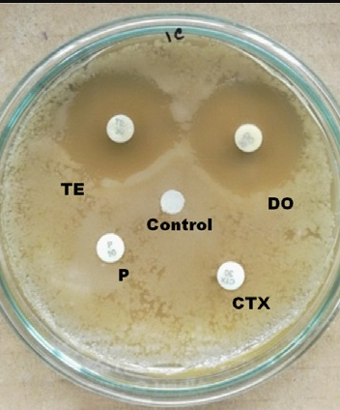
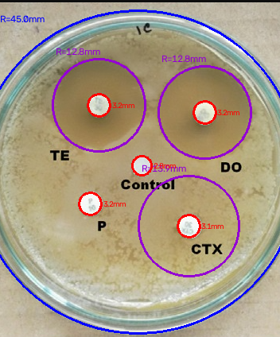
CIRCLE DETECTION
11
Part A: Petri-Dish and Inhibition-Zone Detection
+
ADD EXTRA TEST CASE
Use difficult plate / failed case
RAW IMAGE
DETECTED CIRCLES
DISH BOUNDARY
DISC CENTERS
ZONE DIAMETER
IIT Delhi · ELD411 · Mid-Term Review 2026

Slide 12
ORIENTATION WAS THE HARD PROBLEM
12
Part B: Reading the Antibiotic Code
Adaptive thresholding
Morphology
Contour filtering
Hough circle
PCA deskew
Template matching
ORB / SIFT features
Tesseract OCR
FINAL APPROACH
Gemma
running locally
+
ADD ROTATED DISC CROPS / FAILED ORIENTATION EXAMPLES
Main issue: rotate circular disc to consistent character orientation
Input: cropped disc image
Output: antibiotic code reading
Local inference keeps workflow offline.
IIT Delhi · ELD411 · Mid-Term Review 2026

Slide 13
VIDEO PLACEHOLDER
13
Gazebo Simulation
▶
+
INSERT GAZEBO SIMULATION VIDEO
Embed MP4 in PowerPoint, or use linked thumbnail in Canva
IIT Delhi · ELD411 · Mid-Term Review 2026

Slide 14
MID-TERM STATUS
14
Current Progress & Next Steps
DONE
NOW
NEXT
Scale + system definition
6-DOF arm integration
Gazebo validation
Initial CAD layout
Camera-on-gripper mount
Arm reach modification
Circle-detection baseline
Antibiotic code pipeline
Closed-loop pick-and-place
TARGET · Autonomous vision-guided Petri-dish handling at ~100 dishes/day
IIT Delhi · ELD411 · Mid-Term Review 2026

