Slide 1

VISION PIPELINE
10
Image Processing Has Two Independent Tasks
PART A
PART B
Circle detection
Antibiotic code reading
Locate dish boundary
Measure inhibition-zone diameter
Return center + internal radius
Crop circular antibiotic disc
Resolve rotation / orientation
Read printed character code
IIT Delhi · ELD411 · Mid-Term Review 2026

Slide 2
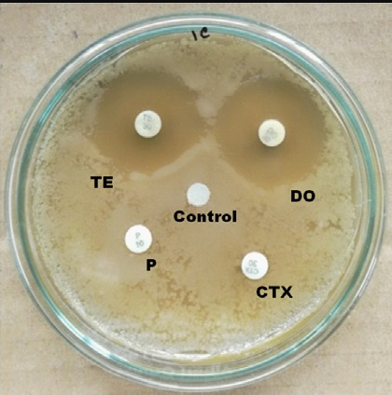
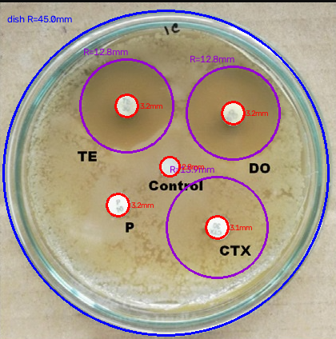
CURRENT EVIDENCE
09
Phase1 : Computer Vision for Petri-Dish Analysis
MEASURE
Dish radius
Inhibition-zone radius
Feature location
OpenCV baseline
01 RAW IMAGE
02 CIRCULAR ROI
03 DETECTION
PREPROCESS
DISH DETECT
ROI
ZONE DETECT
MEASURE
OCR*
*OCR for handwritten labels remains planned.
IIT Delhi · ELD411 · Mid-Term Review 2026
Notes:
mention accuracy and data,
simple openCV models

Slide 3
ORIENTATION WAS THE HARD PROBLEM
12
Part A: Reading the Antibiotic Code
Adaptive thresholding
Morphology
Contour filtering
Hough circle
PCA deskew
Template matching
ORB / SIFT features
Tesseract OCR
FINAL APPROACH
Gemma
running locally
+
ADD ROTATED DISC CROPS / FAILED ORIENTATION EXAMPLES
Input: cropped disc image
Output: antibiotic code reading
Main issue: rotate circular disc to consistent character orientation
Local inference keeps workflow offline.
IIT Delhi · ELD411 · Mid-Term Review 2026

Slide 4
CIRCLE DETECTION
11
Part B: Petri-Dish and Inhibition-Zone Detection
+
ADD EXTRA TEST CASE
Use difficult plate / failed case
RAW IMAGE
DETECTED CIRCLES
DISH BOUNDARY
DISC CENTERS
ZONE DIAMETER
IIT Delhi · ELD411 · Mid-Term Review 2026
Notes:
cahnge image

Slide 5
CIRCLE DETECTION
11
Part B: Petri-Dish and Inhibition-Zone Detection
IIT Delhi · ELD411 · Mid-Term Review 2026
Notes:
cahnge image

Slide 6
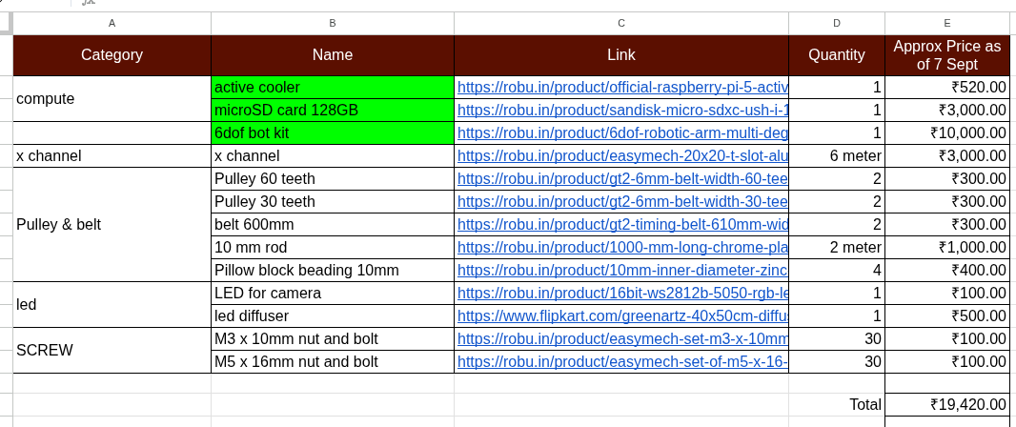
Bill of Materials & Procurement

Slide 7
Current Progress & Roadmap
MID-TERM STATUS
NEXT PHASE ROADMAP
Problem & system definition
COMPLETED
01
Finalize manipulator
Procurement + end-effector integration
Hardware architecture
COMPLETED
Complete perception
02
Dish localization + feature detection
Raspberry Pi + camera
COMPLETED
03
Implement robot control
Computer vision pipeline
IN PROGRESS
ESP32 / Zephyr + motor interface
04
Validate in Gazebo
ESP32 + Zephyr RTOS
IN PROGRESS
ROS 2 + trajectories + pick/place
Manipulator procurement
IN PROGRESS
05
System integration
Vision → coordinates → manipulation
Gazebo simulation
IN PROGRESS
Throughput testing
06
Target: ~100 dishes/day
Autonomous pick & place
UPCOMING
Notes:
+ market analyis
+ Hardware testing
+ failed iterations
+

