Slide 1

ELD411
Mid-Term Review — 2026
Autonomous robotic manipulator for AMR sampling (Petri Dish)
Arnav Panjla 2023EE10978
Manashvi Garg 2023EE11104

Slide 2
PROBLEM STATEMENT
02
The Challenge: Scaling AMR Surveillance
  Antimicrobial resistance (AMR) requires continuous surveillance.
  Rural/village-level sampling can generate many biological samples.
  Samples need to be collected, transported, incubated/processed and analyzed.
  Manual Petri-dish handling becomes a bottleneck as sample volume increases.
01
02
03
04
05
VILLAGES
COLLECTION
LAB
DISHES
BOTTLENECK
Distributed sampling
Repeated visits
Central processing
Handling + imaging
Manual repetition
OBJECTIVE
Repeated sampling creates high laboratory load.
Automate Petri-dish
handling + imaging
Dish transport, imaging and logging are repetitive.
Manual handling limits throughput and traceability.
IIT Delhi · ELD411 · Mid-Term Review 2026

Slide 3

MARKET AND SCALE ANALYSIS
03
From Village Sampling to Laboratory Load
~3000
2–3%
60–90
4–5
5–6
people / village
sampling fraction*
(people that get sick and actually need testing)
samples / village
field collectors
villages / collector / day
DESIGN TARGET
ASSUMPTION
~1200
PETRI DISHES / DAY
Planning value for workflow, storage and robot duty cycle
IIT Delhi · ELD411 · Mid-Term Review 2026

Slide 4
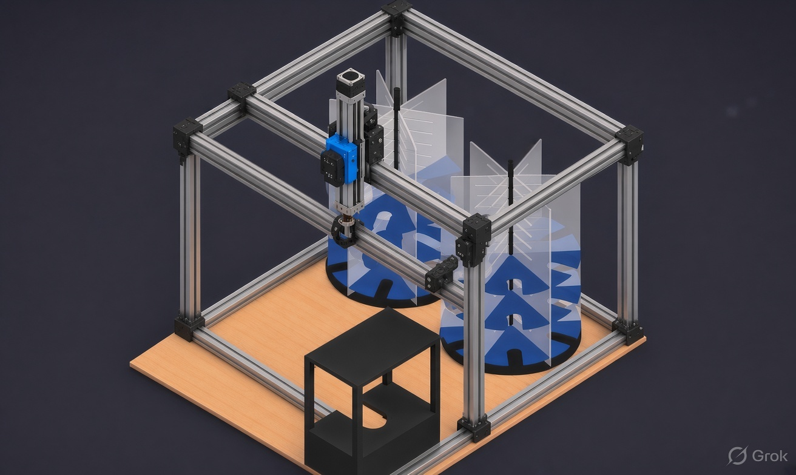
05
Iteration - I (3d printer style )
01
INPUT
Petri-dish queue
02
VISION
Pi + imaging camera
03
CONTROL
Manipulator + feedback
04
OUTPUT
Imaging / storage
IIT Delhi · ELD411 · Mid-Term Review 2026

Slide 5
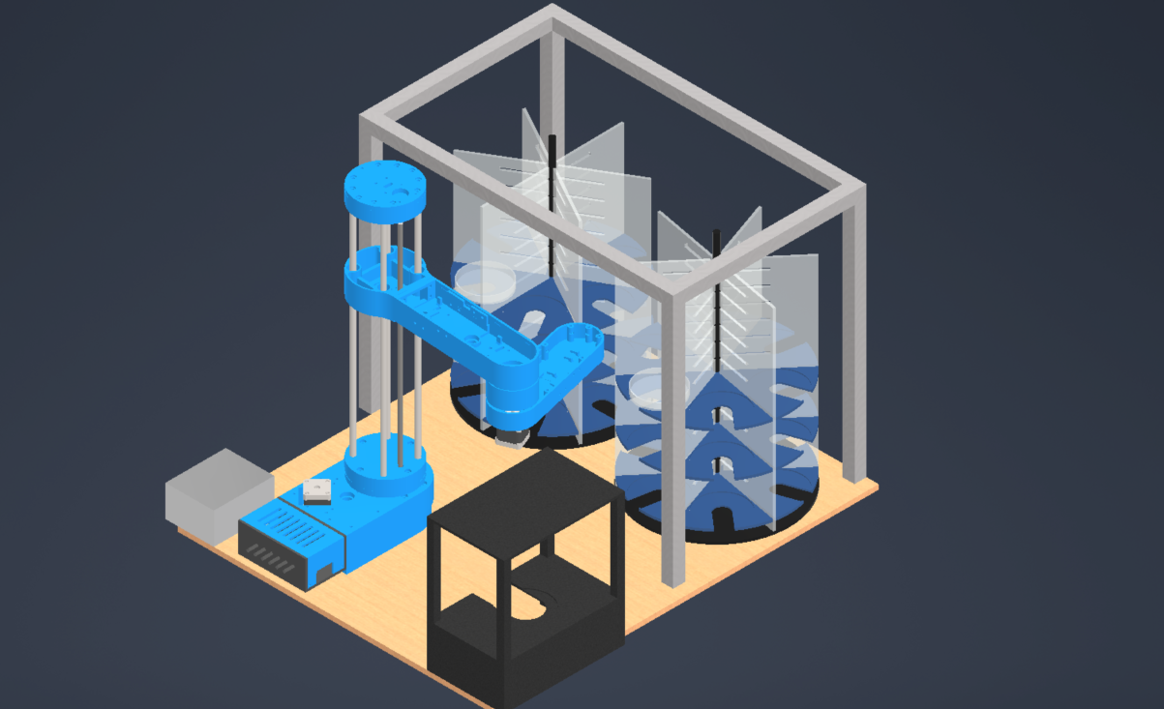
05
Iteration - II (scara bot)
01
INPUT
Petri-dish queue
02
VISION
Pi + imaging camera
03
CONTROL
Manipulator + feedback
04
OUTPUT
Imaging / storage
IIT Delhi · ELD411 · Mid-Term Review 2026

Slide 6
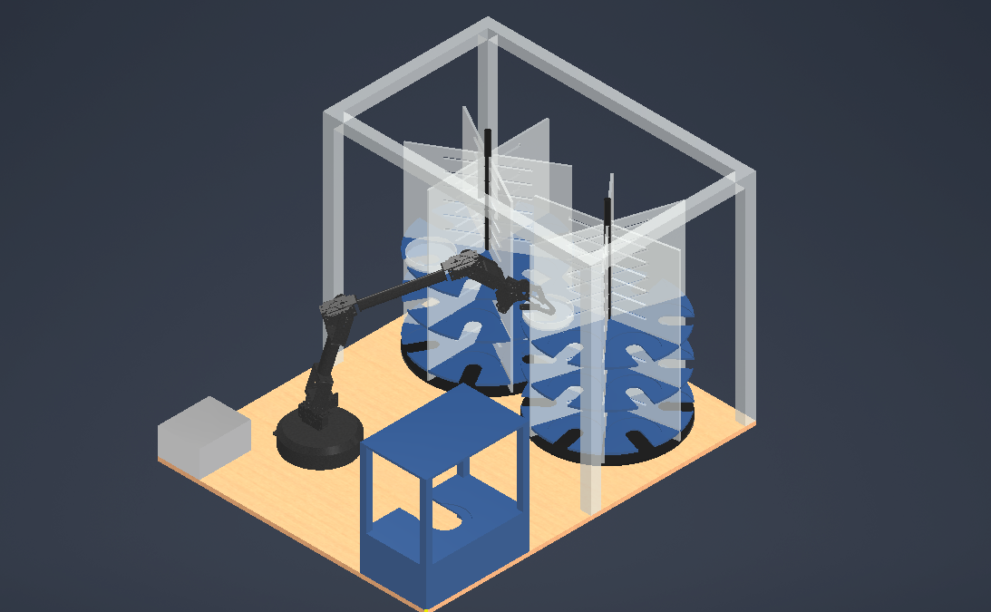
FULL-PROJECT LAYOUT
06
Final design
IIT Delhi · ELD411 · Mid-Term Review 2026

Slide 7
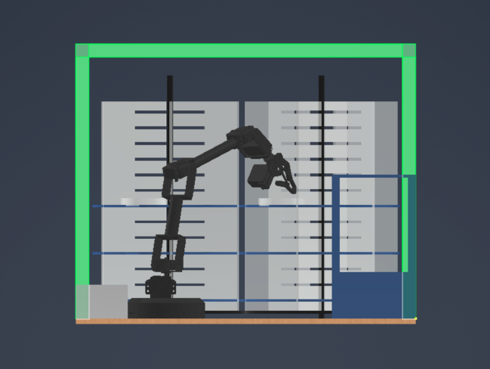
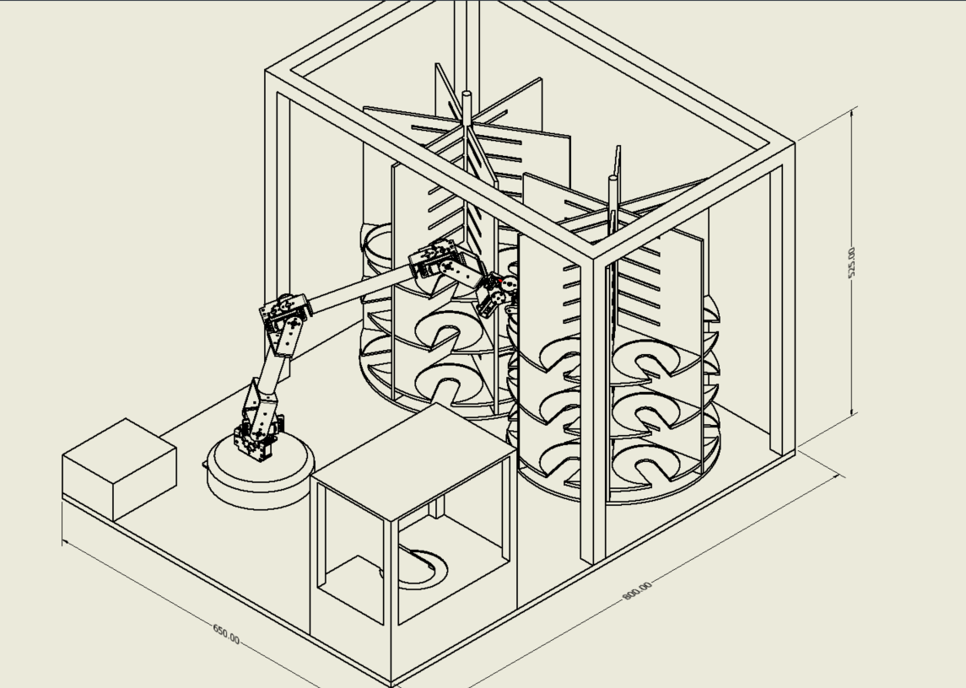
MANIPULATOR HARDWARE
07
Selected 6-DOF Robotic Arm
IIT Delhi · ELD411 · Mid-Term Review 2026

Slide 8
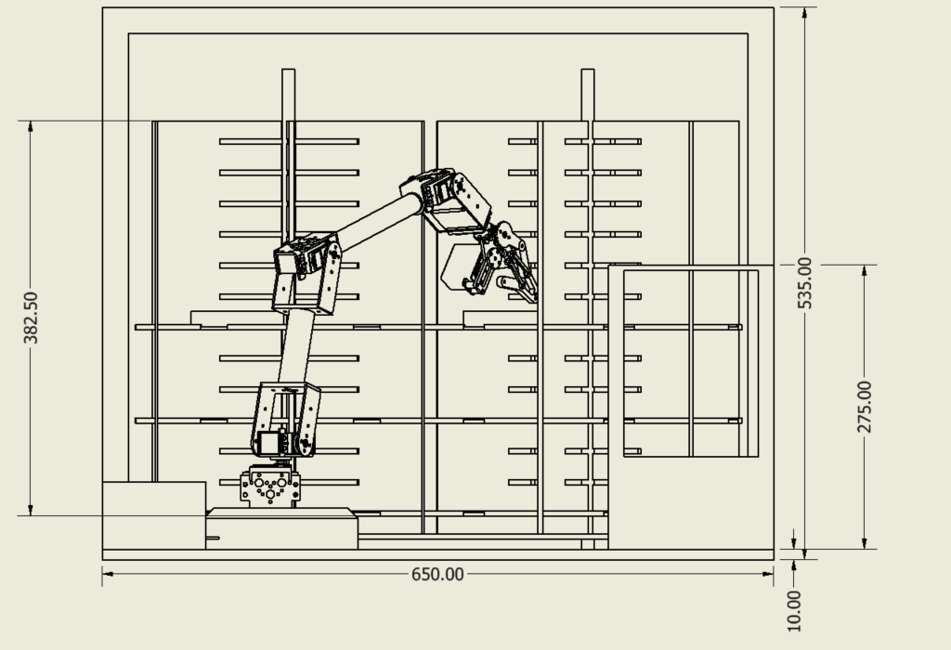
MECHANICAL ADAPTATION
08
Manipulator Modifications for Petri-Dish Reach
01
LONGER LINKS
Extend selected joints for carousel reach
02
CAMERA MOUNT
Rigid mount above gripper
03
CABLE ROUTING
Protect CSI / power through motion
IIT Delhi · ELD411 · Mid-Term Review 2026
Notes:
new arm drawong wil all dimnesion

