Slide 1
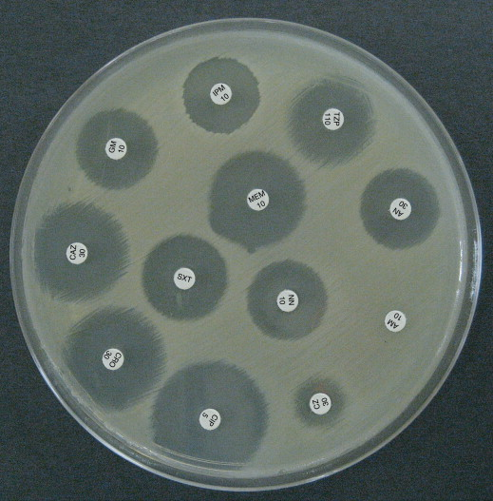
VISION PROBLEM
01
Read the stamp, not the page
TASK
Code + dose
on a round stamp.
Any rotation.
Thick embossed glyphs, not printed paragraphs.
Useful signal is 4–7 characters plus a rim.
Tesseract-style page OCR does not apply.
Ground truth on this plate was read by eye.
test1.png · 12 Kirby–Bauer discs
IIT Delhi · ELD411 · Mid-Term Review 2026

Slide 2
PRE-GEMMA TESTING
02
Four attempts. None of them was the reader.
TEXTBOOK FILTERS
01
A new picture. Never the string GM 10.
Invert, log, gamma, histogram, blur, Sobel, Otsu, FFT
TESSERACT + EASYOCR
02
Empty, or only after a manual −90° turn.
Page OCR, then scene OCR on a tight crop
ONE-SHOT DESKEW
03
4–7 glyphs. No baseline to measure.
Projection, Hough lines, PCA, minAreaRect
15° SPIN + EASYOCR
04
12/12 on tiny grey crops. Did not transfer.
Dense angle grid, then a vote
IIT Delhi · ELD411 · Mid-Term Review 2026

Slide 3
WHAT THOSE TESTS DECIDED
03
Computer vision can upright. It still cannot read.
01
02
03
04
FILTERS
OCR
GEOMETRY
SPIN
Change pixels. Do not output text.
Needs the stamp already upright.
Cannot find the line of 5–7 fat glyphs.
Only the deleted grey crops. Not this plate.
ARRIVED HERE
Local Gemma 3 4B
CV finds the disc and makes the rows upright.
Gemma reads the code and the dose.
No antibiotic-name dictionary.
IIT Delhi · ELD411 · Mid-Term Review 2026

Slide 4
WORKING ORDER ON TEST1
04
Computer vision uprights. Gemma reads.
01
02
03
HOUGH
OTSU
METHOD C
Find disc circles
Black letters, white disc
Rows horizontal
04
05
06
OPEN 5×5
LETTERS UP
GEMMA 3 4B
Separate thick strokes
Fix 0° vs 180°
Read code + dose
Locked order. Do not recompute method C. EasyOCR only checks 0° vs 180°.
IIT Delhi · ELD411 · Mid-Term Review 2026

Slide 5
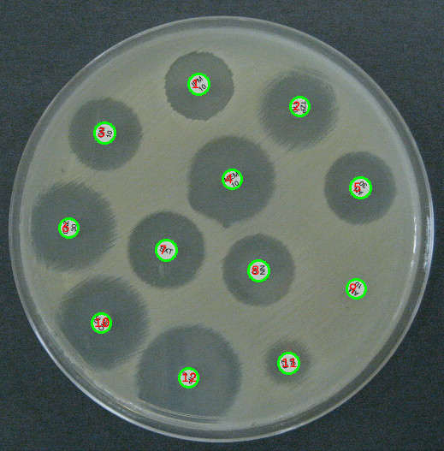
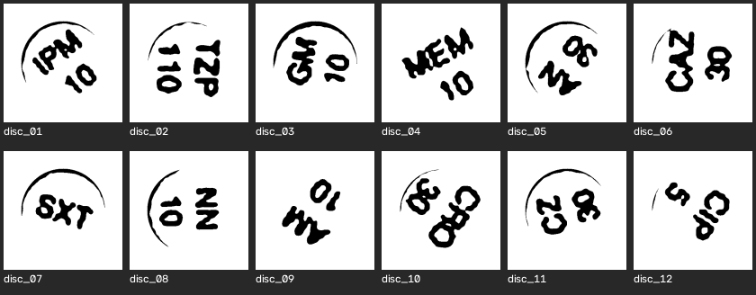
FIND THE DISCS
05
Hough circles, then a binary stamp
Hough on this plate
Otsu crops · radii tuned to test1
IIT Delhi · ELD411 · Mid-Term Review 2026

Slide 6
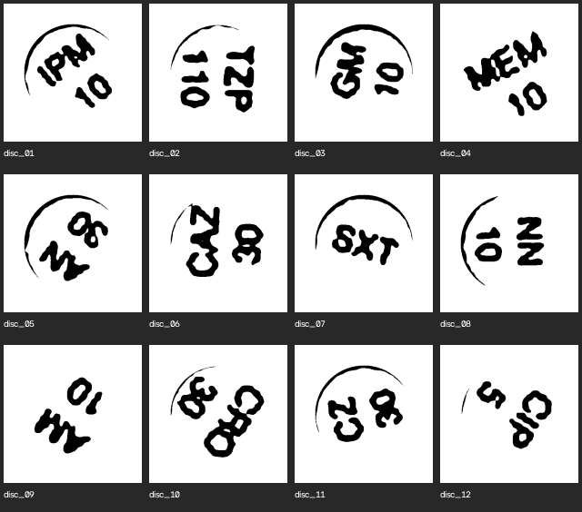
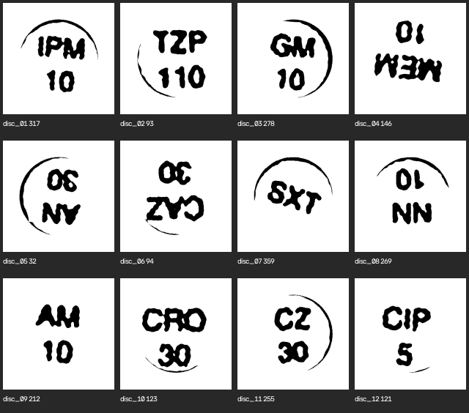
MAKE THE ROWS HORIZONTAL
06
One-shot deskew failed. Method C held.
Before alignment
Method C · two-line centroids · saved PNG
PROJECTION PROFILE
HOUGH LINES
PCA / MOMENTS
MINAREARECT
STILL 180° AMBIGUOUS
IIT Delhi · ELD411 · Mid-Term Review 2026

Slide 7
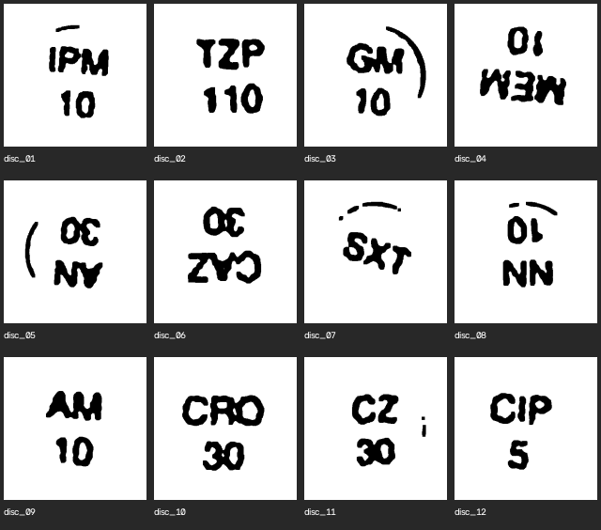
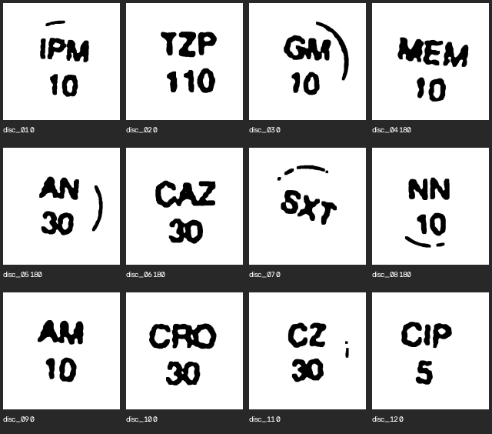
SEPARATE STROKES, THEN PUT LETTERS ON TOP
07
Morphology does not read the code
Open 5×5, two iterations
Letters above, digits below
Letter-only SXT is not flipped on junk. Load the saved C image. Do not rerun k-means.
IIT Delhi · ELD411 · Mid-Term Review 2026

Slide 8
STAMPS LOOK OBVIOUS. CLASSICAL READERS STILL FAIL.
08
Upright 1-bit discs from test1
5/12
5/12
4/12
1/12
EasyOCR
Tesseract
RapidOCR
Hausdorff
Adaptive threshold
Morphology
Contour filtering
Hough lines
PCA deskew
Template match
Gradient histogram
Tesseract OCR
15° search + Otsu + EasyOCR was 12/12 only on a deleted grey-crop set. It did not transfer here.
WHY
Engines expect thin horizontal type.
These stamps are fat, binary, and only a few glyphs long.
No drug-name dictionary was used to force a match.
IIT Delhi · ELD411 · Mid-Term Review 2026

Slide 9



GEMMA WAS RIGHT ONLY AFTER TWO IMAGE BUGS
09
Local gemma3:4b · no antibiotic dictionary
TZP → ZTP
Zoom / pan-and-scan
swapped letter order.
Native crop later read TZP 110.
Rim left · GMI
Rim stripped · GM
GM → GMI
Leftover rim arc
read as the letter I.
Keep letter-sized ink. Wipe the arc.
896 nearest zoom
IIT Delhi · ELD411 · Mid-Term Review 2026

Slide 10
NATIVE GEMMA + RIM STRIP
10
12 / 12 on this plate only
TEST1
01
02
03
12/12
IPM 10
TZP 110
GM 10
04
05
06
MEM 10
AN 30
CAZ 30
Eye-read ground truth.
n = 12 is not clinical accuracy.
07
08
09
SXT
NN 10
AM 10
Offline after
ollama pull gemma3:4b
10
11
12
CRO 30
CZ 30
CIP 5
IIT Delhi · ELD411 · Mid-Term Review 2026

Slide 11
OTHER PLATES: THE DETECTOR IS THE GAP
11
Same pipeline, watermarked stock photos
33
25
8
14
real discs
proper circles
missed
false circles
NOT AN OCR FAILURE
Hough radii tuned on test1 do not transfer.
test2: 7 real discs, 0 proper circles, 8 false hits.
Watermarks and false circles make Gemma say TAB / AM 500.
Hand-filtered good crops still miss under domain shift.
IIT Delhi · ELD411 · Mid-Term Review 2026

