Slide 1
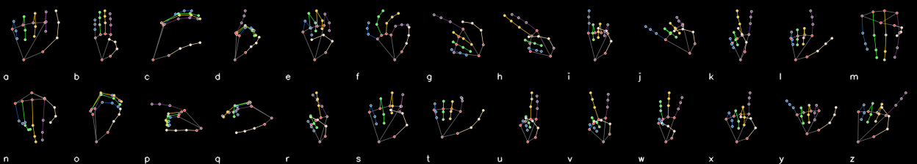
WELCOME | EDGE AI PROJECT
Real-Time ASL Translator
Reading sign language letters live from a webcam, running entirely on-device, and built with vibe coding.
Presented by Team no. 2
Notes:
Welcome everyone. Today our team of 10 will walk the board through a sign language recognition project: what it is for, why we chose it, how it works, which technologies we used, and how effectively vibe coding got us there. The skeleton strip at the bottom is what the AI actually sees: one hand skeleton per letter A to Z.

Slide 2
THE PROBLEM
Why we chose this topic
A real communication gap
A perfect Edge AI case
A good test for vibe coding
Millions of people use sign language, but most people around them do not. Everyday interactions (clinics, counters, classrooms) often need an interpreter who is not there.
Video of a person is sensitive. If the AI runs on the device itself, nothing is uploaded, response is instant, and it works with no internet.
It touches vision, ML training, deployment and UI. That makes it a demanding, honest test of how far AI-assisted coding can go.
Goal: a working system that turns hand signs into spelled-out text, in real time, on an ordinary computer.
2
Notes:
Three reasons. One: the communication gap is real. Two: sign language is a natural fit for edge AI because camera video of people is private, so processing on the device is a genuine benefit, not a buzzword. Three: it was a rich project to test vibe coding on, since it spans computer vision, model training, deployment and interface design.

Slide 3
USE CASE
What it does and where it helps
Live letter recognition
Spelling into words
Point a webcam at a hand; the app recognises the 26 letters A to Z of American Sign Language.
A letter is added after it is held steady for 10 frames with enough confidence. Letters build up into words on screen.
Handles J and Z
Transparent interface
These two letters are movements, so a motion tracker checks the last 1.5 seconds of hand path (hook for J, zigzag for Z).
One window shows camera, the skeleton the AI sees, its top 3 guesses, and the word buffer. Built to explain the AI, not hide it.
Use cases: accessibility tools, ASL learning and practice, kiosks and help desks, a base for full sign-language translation.
3
Notes:
The product itself. It recognises all 26 letters live, forms words, and uses a separate motion rule-set for J and Z, because those two are gestures rather than still poses. The interface deliberately shows the skeleton and top 3 predictions so anyone can see what the AI is thinking.

Slide 4
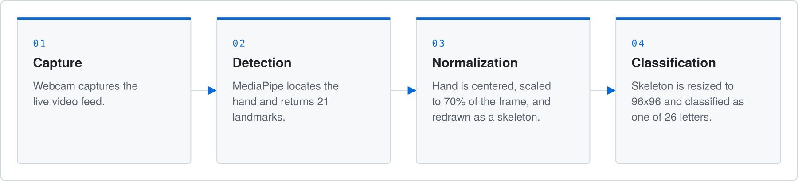
PIPELINE
How it works: four steps from camera to letter
Why a skeleton, not a photo?
Smoothing for stability
The AI never sees the camera image. Lighting, background, clothing and skin tone are removed, leaving only hand geometry.
A 1-euro filter calms landmark jitter: heavy smoothing when still, light when moving, so there is no lag during real gestures.
4
Notes:
Walk left to right. Webcam captures. MediaPipe finds 21 landmarks on the hand. We centre and scale them and redraw a clean skeleton. The CNN classifies that skeleton into one of 26 letters. The key design idea: the model only sees hand structure, so it is robust to lighting, background and skin tone. The 1-euro filter removes jitter without making fast gestures feel laggy.

Slide 5
TECH STACK
Technologies used
MediaPipe Hands
TensorFlow / Keras
ONNX + ONNX Runtime
Finds 21 hand landmarks per frame. Fast, runs on CPU.
Used to train our custom CNN from scratch on GPU (RTX 3050).
Trained model exported to ONNX; runs real-time on CPU, no GPU or TensorFlow needed.
OpenCV + NumPy
Python 3.11 / 3.12
Kaggle datasets
Webcam capture, skeleton drawing, and the single-window UI.
Two separate environments: training and live inference.
3 public ASL datasets, about 67,000 landmark samples.
Edge AI in one line: the whole model is about 1.2 MB with 308,602 parameters, and runs on a normal CPU.
5
Notes:
Detection: MediaPipe. Training: TensorFlow and Keras. Deployment: ONNX Runtime, which is what makes this edge AI, since the final model is only about 1.2 megabytes and runs on CPU. Two environments are needed because MediaPipe and current TensorFlow require conflicting protobuf versions.

Slide 6
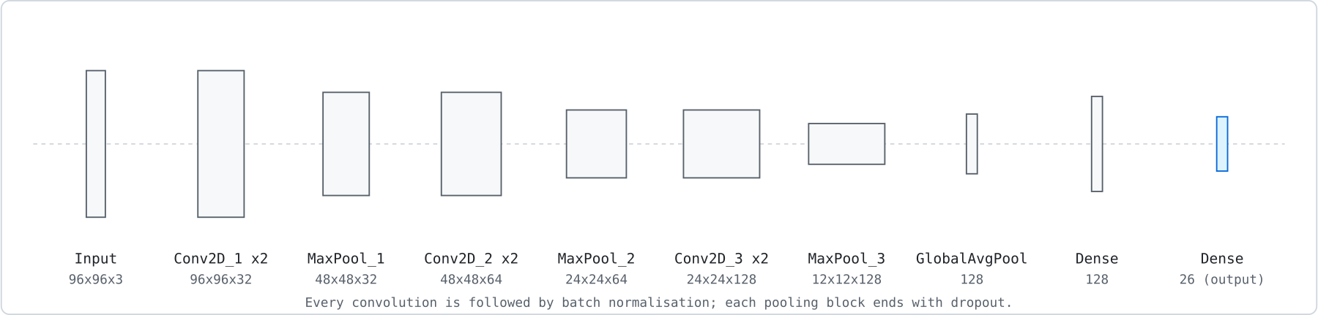
AI MODEL
The model: a compact CNN built for the edge
96x96x3
3 blocks
308,602
26
input skeleton image
double-conv, batch norm, dropout
parameters
output letters
6
Notes:
The network is small on purpose. Three convolution blocks with 32, 64 and 128 filters, global average pooling, a 128 unit dense layer, and 26 outputs. Small means fast on CPU, which is what edge deployment needs. After training, we converted it to ONNX and verified the conversion matches Keras to within 1e-5.

Slide 7
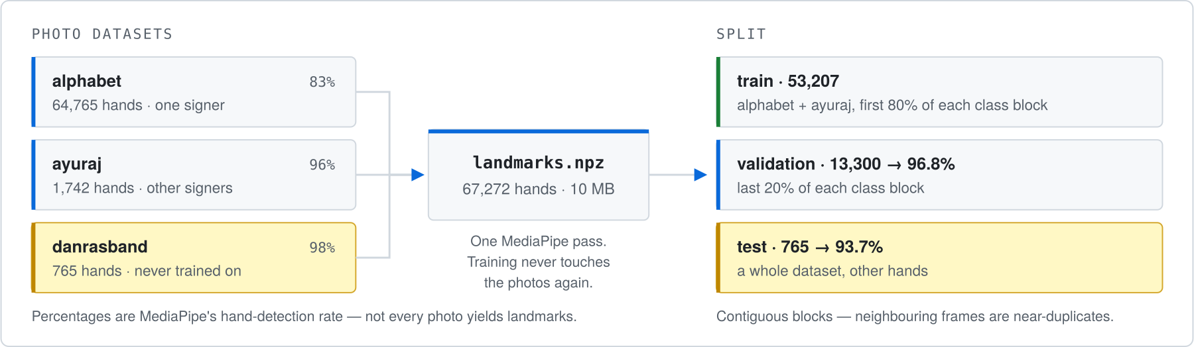
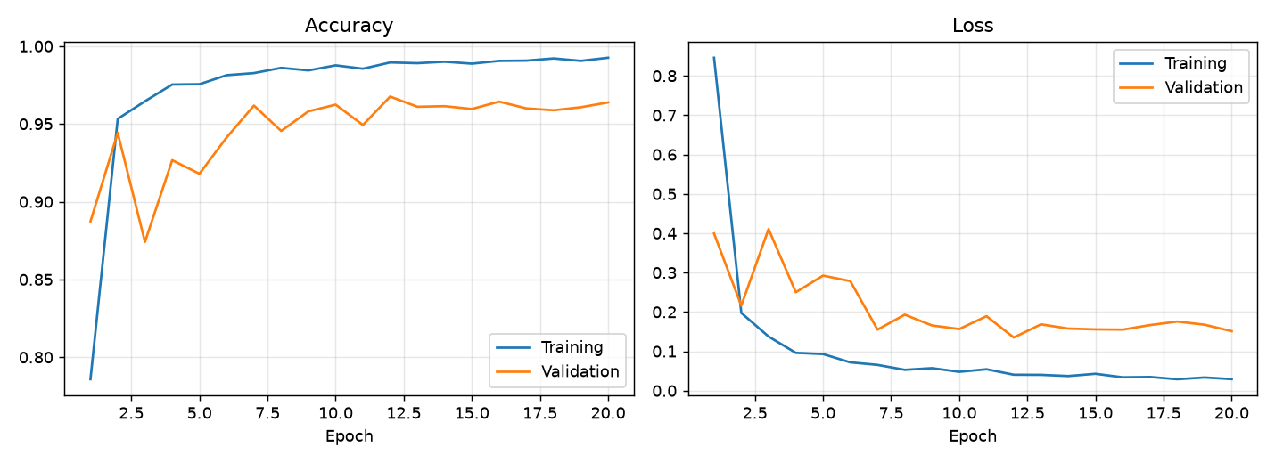
DATA
Data and training: an honest test
Held-out test set
One whole dataset (a different person, different lighting) was never shown to the model. That is the number that predicts real use.
96.8%
validation accuracy
93.7%
test accuracy (unseen signer)
7
Notes:
Landmarks were extracted once from about 78,000 photographs plus two other datasets. We split into 53,207 training, 13,300 validation, and 765 test samples where the test set is an entirely different dataset. Training stopped early at the best epoch, and the curves show training and validation staying close, which means the model is learning, not memorising. Honest result: 96.8 percent validation, 93.7 percent on unseen data.

Slide 8
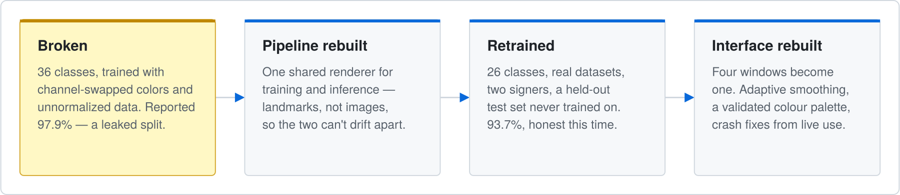
VIBE CODING
How it was built: vibe coding, with real debugging
What AI did well
Where it needed steering
Key lesson
Wrote about 2,600 lines across 11 Python modules: data prep, training, export, live app, UI, smoothing, motion tracking.
First version reported 97.9% from a leaky split and flickered live. We found it, rebuilt the pipeline and retrained.
Vibe coding is fast, but verification is the human job: honest test sets, parity checks, live testing.
8
Notes:
This is the vibe coding story. AI generated most of the code quickly. But the first version looked great on paper at 97.9 percent and failed on a live webcam, because near-duplicate video frames leaked into validation. Fixing that meant rebuilding the pipeline and measuring honestly. The takeaway for the board: vibe coding accelerates building, but human-led verification is what makes the result trustworthy.

Slide 9
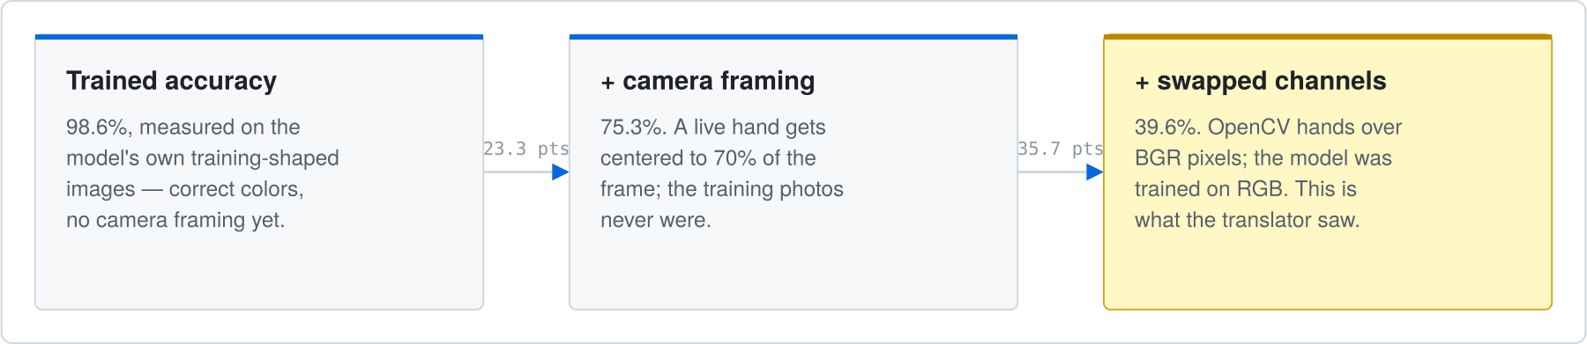
OUTCOME
Results, lessons and what is next
Live reliability
94.6% of hands get a committed letter
96.7% precision once committed
99.0% stable under jitter when correct
Training and live drawing disagreed (channel order, scale, framing): accuracy fell 98.6% to 39.6%. Fix: one shared renderer for both.
Known limits
Next steps
N is weakest (54% recall, confused with M). Only one main signer in training. J and Z use rules, not learning.
More signers and more N data, a learned model for J and Z, then whole words and phrases.
9
Notes:
Results are strong and honestly reported. Once the model commits a letter it is right about 97 percent of the time. Limits: the letter N is weak because M, N, S and T are all fists with the thumb in a different place, and N had the fewest training samples. Next steps are more signers, a learned temporal model for J and Z, and moving from letters to words.

Slide 10
Thank you
Edge AI that runs on the device | Built with vibe coding | Verified honestly
Questions and live demo
Notes:
Thank you. We are happy to take questions and run a live demo with the webcam.

