Slide 1

TapTrace
SAMSUNG PRISM · GENAI HACKATHON 3.0
From a vague complaint
to a verified fix,
in one tap.
A grounded troubleshooting engine for Samsung PRISM Theme 02: every step traced to its source, every Settings fix one exact deeplink away, every repeat answered from cache in milliseconds.
Evidence-locked
steps
Exact-screen
deeplinks
Relevance
gate
Contrastive
cache
THEME ID 02 | TEAM TAPTRACE | THAPAR INSTITUTE OF ENGINEERING & TECHNOLOGY | ARNAV JOSHI · ajoshi4_be23@thapar.edu
CODE github.com/Arnav020/Tap-Trace | LIVE DEMO taptrace.onrender.com
Notes:
[0:00-0:25] Hello, I am Arnav Joshi from Thapar Institute. TapTrace is my Theme 02 engine: it turns a vague device complaint into an ordered fix plan where every Settings change is one tap away and every step comes from the official support article. In seven minutes: the problem, the architecture, how it extends to Samsung, how it scales, and a short demo.

Slide 2

TapTrace
01 | UNDERSTANDING THE PROBLEM & CAVEATS
SAMSUNG PRISM · GENAI HACKATHON 3.0 · THEME 02
Vague complaints meet adversarial data: six caveats shaped every design decision.
Found by auditing all 578 catalog rows and 20 knowledge articles before writing any code.
THE PROBLEM
21
14
“My Nexa X1 screen inputs are delayed and the touch responsiveness is laggy…”
TV and appliance screens hidden in the phone catalog
catalog labels that name the wrong feature
Catalog Compiler quarantines them
Match screens, never trust labels
Today an agent reads the article, picks and orders the steps by hand (about 15 minutes per case), and the customer still hunts through nested Settings menus.
0.94
4 / 20
similarity of “won’t turn ON” and “won’t turn OFF”
knowledge articles are the wrong document
WHAT THE BRIEF DEMANDS
Ordered steps, only from the article
Polarity-aware resolver and cache
Relevance gate returns no_match
The exact Settings screen, one tap
DL-0022
12 words
Repeats in ≤ 300 ms, new in ≤ 8 s
is nearest to “factory reset”, but a different screen
in the official sample’s description (5–7 allowed)
Strict JSON contract, zero URL leaks
Abstain instead of guessing
Every field rule enforced in code
TIET · TAPTRACE · THEME 02 SMART GUIDED TROUBLESHOOTING
02 / 8
Notes:
[0:25-1:20] Customers rarely speak in technical terms; they say 'my touch is laggy'. Today an agent spends about fifteen minutes turning that into steps, and the customer still hunts through Settings. The brief asks for ordered steps taken only from the article, the exact Settings screen in one tap, repeats in under 300 milliseconds and a strict JSON contract. Before writing code I audited all the data and found six caveats: 21 TV and appliance screens hidden in the phone catalog, labels that name the wrong feature, on and off phrasings that are 0.94 similar to an embedding model, 4 of 20 articles that are the wrong document, a near-miss factory-reset screen, and even the official sample breaks the 5-to-7-word rule. Each caveat became a component, shown in amber.

Slide 3
TapTrace
02 | CORE ARCHITECTURE
SAMSUNG PRISM · GENAI HACKATHON 3.0 · THEME 02
Five stages: the LLM may select and name steps, but it never writes one.
Everything except the two LLM calls is deterministic, tested code (27 automated tests).
Fast path contrastive semantic cache answers repeats and paraphrases in 3.5 ms (P95), $0, no LLM call
Complaint
+ optional
support article
1
Understand
2
Ground
3
Resolve
4
Compose
5
Guarantee
Facet frame
symptom · part · on/off
Relevance gate
+ evidence-locked units
Catalog compiler
+ exact-screen resolver
Plan composer
auto → manual → critical
Output gate
schema · 0 leaks · cache
Stage A LLM
canonical query, 10 paraphrases, near misses
both LLM calls run in parallel
Stage B LLM
select, group and name; no step text
3.8 s new complaint, P95 (target 8 s)
3.5 ms repeat, P95 (target 300 ms)
$0.0003 per new complaint; repeats $0
100% · 0 schema-valid · URL leaks
TIET · TAPTRACE · THEME 02 SMART GUIDED TROUBLESHOOTING
03 / 8
Notes:
[1:20-2:20] The architecture has five stages. Repeats never reach them: the fast path, a contrastive semantic cache, answers paraphrases in 3.5 milliseconds with no LLM call. A new complaint goes through Understand, which builds a symbolic frame of the complaint; Ground, where the relevance gate checks the article actually fits and extracts candidate steps from its own sentences; Resolve, which maps each Settings step to the exact screen in the compiled catalog; Compose, which orders actions from safe settings to manual checks to critical resets; and Guarantee, which validates against the organisers' schema and writes the cache. The two LLM calls, shown in coral, run in parallel: one paraphrases the complaint for the cache, the other selects and names the extracted steps. Neither can write a step. Result: 3.8 seconds P95 for a new complaint and zero URL leaks.

Slide 4
TapTrace
03 | CORE TECHNOLOGY MODULES
SAMSUNG PRISM · GENAI HACKATHON 3.0 · THEME 02
Four modules carry the weight, and each one is proven by a measurement.
Measured by scripts/evaluate.py on the 20 provided scenarios and a frozen, never-tuned test set.
Evidence-locked extraction
3.00 / 3
Catalog compiler + resolver
Steps are cut from the article’s own sentences and keep their source id. The LLM only selects and names them.
step accuracy vs hand-annotated gold
578 noisy rows become 397 screens × on/off/open/set. Exact leaf label, then fuzzy with a margin, else abstain.
0
URL leaks across all outputs
exact deeplinks, 37-case benchmark
Relevance gate
4 / 20
Contrastive semantic cache
80%
Compares the complaint’s symptom and context with the article before extracting anything.
wrong articles answered with no_match
Each entry learns its own threshold from paraphrases and near misses; a symbolic guard blocks on/off flips.
unseen paraphrases hit (frozen test)
100%
32% → 4.5%
fit decisions match gold
false hits vs one global threshold (dev)
TIET · TAPTRACE · THEME 02 SMART GUIDED TROUBLESHOOTING
04 / 8
Notes:
[2:20-3:10] Four modules carry the design, and each has a number behind it. Evidence-locked extraction: steps come only from the article's sentences, so step accuracy against my gold annotations is 3.00 out of 3 with zero URL leaks. The catalog compiler and resolver: on a 37-case benchmark it maps every step to the exact screen, where a full-LLM mapper gets 81 percent and a hybrid retriever 46. The relevance gate catches the 4 wrong articles and answers no_match instead of inventing steps. And the contrastive cache hits 80 percent of unseen paraphrases on a frozen test set, while cutting false hits from 32 to 4.5 percent compared with a single global threshold.

Slide 5
TapTrace
04 | EXTENSION IN RELEVANCE TO SAMSUNG
SAMSUNG PRISM · GENAI HACKATHON 3.0 · THEME 02
The same engine fits four Galaxy support touchpoints, from call centre to device.
Mapped from the brief’s own inputs: SIIS articles, bixby:// Settings deeplinks and validation probes.
Customer-care agents
SIIS knowledge base
Samsung Members
self-service help
Bixby voice
spoken complaints
On-device worklet
Galaxy offline support
The agent pastes the complaint and gets an ordered plan, each step highlighted in the internal article.
The user describes the problem in the app and gets one-tap fixes; the validation probe confirms each one.
“My touch is laggy” becomes a plan, and Bixby opens the exact screen through the same deeplink scheme.
The 23 MB INT8 embedder, compiled catalog and cache run on CPU in about 150 MB of RAM.
complaint + article → plan + evidence
complaint → one tap → probe ✓
speech → text → plan → deeplink
cache on device; LLM only for new
~15 min of manual triage → 1.3 s (P50)
No more hunting through Settings
Voice in, verified tap out
Known issues answered offline
Why it transfers: the deeplink scheme, brand names and article format are configuration, not code (the provided data is masked as TechCorp / Nexa and voiceassist://). Next step: use validation-probe results as feedback on which fixes really work.
TIET · TAPTRACE · THEME 02 SMART GUIDED TROUBLESHOOTING
05 / 8
Notes:
[3:10-3:55] Where does this fit at Samsung? Four touchpoints. Customer-care agents get an ordered plan with every step highlighted in the internal SIIS article: about fifteen minutes of triage becomes 1.3 seconds. In Samsung Members, users describe the problem and get one-tap fixes that a validation probe confirms. With Bixby, a spoken complaint becomes a plan and Bixby opens the exact screen through the same deeplink scheme the brief uses. And because the embedder is 23 megabytes and runs on CPU, known issues can be answered on the device, offline. The provided data is masked as TechCorp and Nexa, so the scheme and brand names are configuration, not code.

Slide 6
TapTrace
05 | SCALABILITY TO NEW USE CASES
SAMSUNG PRISM · GENAI HACKATHON 3.0 · THEME 02
Covering a new scenario takes a knowledge article, not new code.
Never-seen Battery, Camera, Performance and Wi-Fi articles ran through the same pipeline unchanged.
HOW A NEW SCENARIO GETS COVERED
UNSEEN-DOMAIN TEST
A new complaint and its article arrive
gate and step extraction run automatically
8 / 8
Settings steps mapped to the exact screen with the right on/off variant, in articles the engine had never seen
1
2
Settings steps map to exact screens
compiled catalog; no retraining, no new rules
Battery
Camera
Performance
Wi-Fi
EXTENSION POINTS
3
One cold request, 1.3 s (P50)
about $0.0003 of LLM cost
New article or scenario
automatic
New Settings screens
re-run the Catalog Compiler
The plan is cached
every repeat and paraphrase: 3.5 ms (P95), $0
New vocabulary
facet lexicon entries (data)
4
10,000 scenarios
≈ $3 one-time LLM cost
Serving
495 req/s on one CPU container
TIET · TAPTRACE · THEME 02 SMART GUIDED TROUBLESHOOTING
06 / 8
Notes:
[3:55-4:40] Scalability: a new scenario needs a knowledge article, not new code. The gate and extraction run automatically, Settings steps map to exact screens through the compiled catalog, one cold request costs about 0.03 cents, and from then on every repeat is served from cache for free. I tested this on articles the engine had never seen, battery, camera, performance and Wi-Fi: all eight Settings steps mapped to the exact screen. New screens only need the catalog compiler re-run, new vocabulary is data, ten thousand scenarios cost about 3 dollars once, and one CPU container served 495 requests per second.

Slide 7
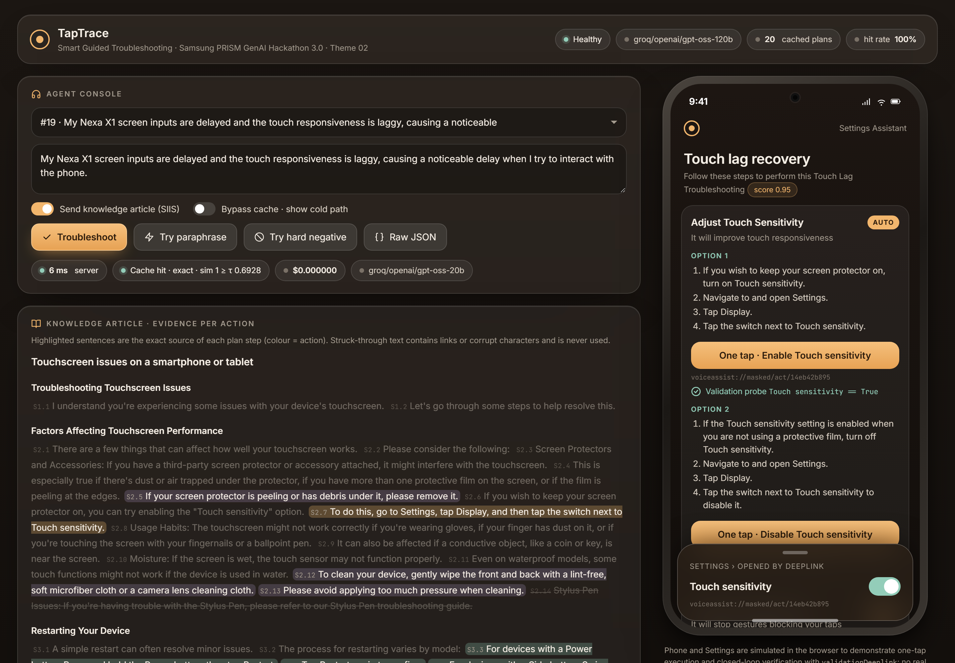
TapTrace
06 | DEMO VIDEO
SAMSUNG PRISM · GENAI HACKATHON 3.0 · THEME 02
Live on the deployed site: one complaint, from article to verified tap.
Screen recording of taptrace.onrender.com, 1:51.
WHAT TO WATCH FOR
A new complaint, end to end
evidence highlighted in the article, cost shown
0:00
One tap + validation probe
exact Settings screen opens; the probe confirms
0:36
Paraphrase hit, near miss refused
milliseconds from cache; the guard says why
1:00
Wrong article → no_match
an empty plan instead of invented steps
1:32
TIET · TAPTRACE · THEME 02 SMART GUIDED TROUBLESHOOTING
07 / 8
Notes:
[4:40-6:30] (If the video is not embedded yet: click the frame, Insert > Video > This Device, or rebuild with --video-file.) (Play the video, under 2 minutes. While it plays, stay silent or add one line per cue.) Cue 1: a new complaint with its article, bypassing the cache: evidence highlighted, cost shown. Cue 2: one tap opens the exact screen and the validation probe confirms it. Cue 3: a paraphrase is answered from cache in milliseconds, and a near miss is refused with its reason. Cue 4: a wrong article returns no_match.

Slide 8

TapTrace
Thank you. Questions?
Grounded steps, exact screens, honest answers when the knowledge does not fit, and a path into Galaxy support.
100%
80%
3.8 s
4/20
exact deeplinks
paraphrase cache hits
cold path, P95
wrong articles refused
ARNAV JOSHI · ajoshi4_be23@thapar.edu · THAPAR INSTITUTE OF ENGINEERING & TECHNOLOGY
CODE github.com/Arnav020/Tap-Trace | LIVE DEMO taptrace.onrender.com
Notes:
[6:30-6:45] To sum up: exact screens, grounded steps, honest no-match answers, and a clear path into Galaxy support. The code and the live demo are linked here. Thank you, I am happy to take questions.

