Slide 1

TapTrace
SAMSUNG PRISM · GENAI HACKATHON 3.0
From a vague complaint
to a verified fix,
in one tap.
A grounded troubleshooting engine for Samsung PRISM Theme 02: every step traced to its source, every Settings fix one exact deeplink away, every repeat answered from cache in milliseconds.
Evidence-locked
steps
Exact-screen
deeplinks
Relevance
gate
Contrastive
cache
THEME ID 02 | TEAM TAPTRACE | THAPAR INSTITUTE OF ENGINEERING & TECHNOLOGY | ARNAV JOSHI · ajoshi4_be23@thapar.edu | github link to be added

Slide 2

TapTrace
01 | THEME · THE PROBLEM
SAMSUNG PRISM · GENAI HACKATHON 3.0 · THEME 02
One vague sentence costs an agent ~15 minutes — and the customer still hunts through Settings.
Theme 02 asks for a REST engine that turns such complaints into a grounded, ordered, one-tap plan under hard latency, cost and hygiene rules.
THE INPUT
THE REQUIRED OUTPUT (SCHEMA.PY CONTRACT)
“My Nexa X1 screen inputs are delayed and the touch responsiveness is laggy, causing a noticeable delay when I try to interact with the phone.”
goal
Follow these steps to perform this Touchscreen Lag Troubleshooting
title
Touchscreen lag recovery
3.1 s
actionName
Configure Navigation Bar
description
It will stop gestures blocking your taps
input.txt, line 19 + SIIS ‘Touchscreen issues’ (9 sections)
category
auto
steps
Tap Display → Tap Navigation bar → Select Buttons to turn off full scree…
no setting names
no technical terms
no order
actionableDeeplink
voiceassist://masked/act/2f3dd95259
validationDeeplink
key = ‘Navigation bar’
HARD CONSTRAINTS WE ENFORCE IN CODE (THEME 2 PDF §4 AND §6)
0 URL leaks
regex gate on every field
5–7-word descriptions
validators + repair
Critical steps last
disruption-cost ordering
≤ 300 ms cached
P95, no LLM call
≤ 8 s cold
P95, two parallel LLM calls
TIET · TAPTRACE · THEME 02 SMART GUIDED TROUBLESHOOTING
02 / 12

Slide 3
TapTrace
02 | EXISTING SOLUTIONS & GAPS
SAMSUNG PRISM · GENAI HACKATHON 3.0 · THEME 02
The provided data is adversarial — a textbook RAG pipeline walks into six traps.
We audited all 578 catalog rows and 20 SIIS articles before writing code (docs/DATA_AUDIT.md).
TEXTBOOK PIPELINE
21
14
0.94
LLM writes the steps
TV & appliance screens hidden in the phone catalog
labels that name the wrong feature
cosine of “won’t turn ON” vs “won’t turn OFF”
Top-1 embedding match
DL-0468 … DL-0569
DL-0162 “Disable Grayscale” = mono audio
embeddings are polarity-blind
One global cache threshold
Catalog Compiler quarantines them
Match on screen labels, never messages
Facet guard + per-entry τ
Trust any SIIS article
4/20
DL-0022
12 words
Exact deeplinks, 37-case benchmark
SIIS articles are the wrong document
nearest entry to “factory data reset”
in the official sample description (5–7 allowed)
row_8: TV mirroring for a small phone screen
it is the AUTO reset after failed unlocks
sample_output.json
Relevance Gate → honest no_match
Abstain → dummy_positive
Every field rule enforced in code
TIET · TAPTRACE · THEME 02 SMART GUIDED TROUBLESHOOTING
03 / 12

Slide 4
TapTrace
03 | OUR SOLUTION & ARCHITECTURE
SAMSUNG PRISM · GENAI HACKATHON 3.0 · THEME 02
A five-stage pipeline where the LLM may select and name — but never write — a step.
Two LLM calls run in parallel on the cold path. Everything else is deterministic, tested code.
1
Understand
2
Ground
3
Resolve
4
Compose
5
Guarantee
Facet frame
symptom · part · component · on/off
Relevance Gate
full · partial · none → no_match
Catalog Compiler
397 screens × on/off/open/set
Stage B · LLM
select, group, name — no step text
Output gate
organisers’ schema · URI set · 0 leaks
Stage A · LLM
canonical query, 10 paraphrases, hard negatives
SIIS normaliser
span ids, leak & corrupt flags
Screen resolver
leaf label → fuzzy → abstain
Category & order
auto → manual → critical
Cache write
τ from own ± clouds
Contrastive cache
hit in 3 ms, $0, no LLM
Evidence units
verbatim steps + provenance
Polarity + probe
variant + validationDeeplink
Computed score
fit × grounding × mapping
REST API
/v1/troubleshoot · /health
LATENCY BUDGET (MEASURED)
Cache hit
normalise + facets
embed (INT8 ONNX)
ANN + guard
P95 3.2 ms · $0
$0.00064
per cold query
$0
per cache hit
2
LLM calls per cold query
Cold path
gate + units
Stage A ∥ Stage B (LLM)
resolve + compose + gate
P50 3.1 s · P95 5.1 s
TIET · TAPTRACE · THEME 02 SMART GUIDED TROUBLESHOOTING
04 / 12

Slide 5
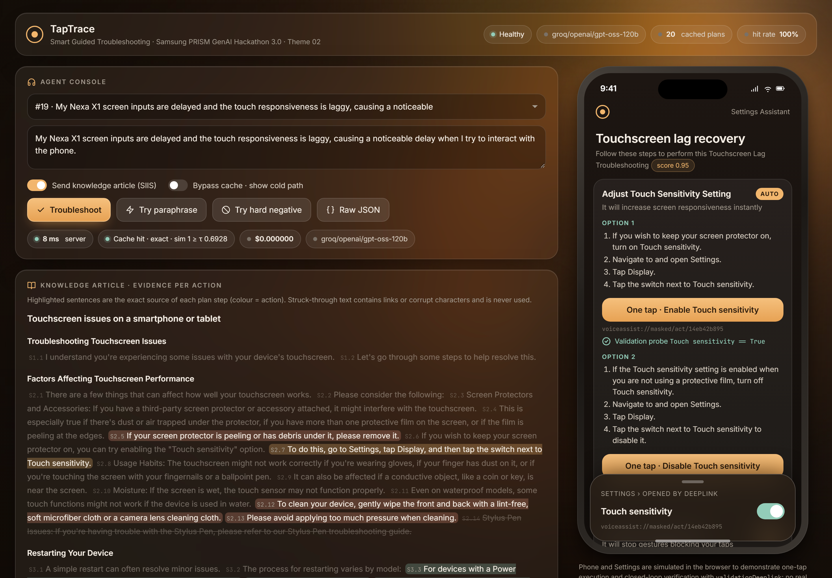
TapTrace
04 | DEMO & PRODUCT WALKTHROUGH
SAMSUNG PRISM · GENAI HACKATHON 3.0 · THEME 02
The live console shows every step’s source sentence and closes the loop with a probe.
Real screenshot of demo/ served by the same container (device simulated in the browser).
localhost:8000 · TapTrace console
1
2
Provenance
every plan step is highlighted in its source SIIS sentence, with span ids
Cache decision
exact or semantic hit with similarity ≥ per-entry τ at $0, or the guard that refused
2
4
3
4
One tap + probe
an auto step runs its deeplink; the validationDeeplink probe turns ✓
Conditional options
one screen, two step groups: ON with a screen protector, OFF without
3
WHAT THE PHONE RECEIVED (RESULTS.JSONL, LINE 19)
1
"actionName": "Adjust Touch Sensitivity Setting", "category": "auto",
"deeplink": "voiceassist://masked/act/14eb42b895", "originalType": "onURL",
"validationDeeplink": {"key": "Touch sensitivity",
"condition": "equal", "value": "True"}
TIET · TAPTRACE · THEME 02 SMART GUIDED TROUBLESHOOTING
05 / 12

Slide 6
TapTrace
05 | TOOLS AND TECH STACK
SAMSUNG PRISM · GENAI HACKATHON 3.0 · THEME 02
Small, CPU-only and reproducible — one container, no GPU, and it runs even without an API key.
Every dependency is pinned in requirements.txt; the INT8 embedder and pre-warmed cache ship in the image.
SERVING
INTELLIGENCE
DATA & QUALITY
23 MB
INT8 ONNX embedder, 0.97 cosine vs FP32
1.6 s
container cold start to healthy
FastAPI
Uvicorn
gpt-oss-120b
Groq API
Python 3.12
NumPy
495 req/s
16 concurrent clients, 0 errors
Pydantic
ORJSON
MiniLM-L6
ONNX Runtime
SQLite
pytest
20 gates
pytest: contract, traps, gate, cache, API
taptrace/ catalog.py · siis.py · facets.py · resolver.py · plan.py · cache.py · engine.py · api.py
scripts/ build_results · evaluate · stress_test · audit_report · build_deck
eval/ gold · mapping_benchmark · heldout + test paraphrases · hard_negatives
Dockerfile · docker-compose.yml · results.jsonl · metrics.md · tests/ (20 gates)
0 keys
needed to run: deterministic path + cache
TIET · TAPTRACE · THEME 02 SMART GUIDED TROUBLESHOOTING
06 / 12

Slide 7
TapTrace
06 | IMPACT & USE CASE
SAMSUNG PRISM · GENAI HACKATHON 3.0 · THEME 02
From ~15 minutes of manual triage to ~3 seconds — and $0 for every repeat complaint.
About 293× faster on a new complaint; a cache hit is served in 2 ms.
TIME TO AN ACTIONABLE PLAN (TO SCALE)
AT PRODUCTION SCALE: 10,000 SCENARIOS (BROCHURE TARGET)
Manual triage
≈ 15 min
Manual triage
2,500 agent-hours
at 15 min each
TapTrace first pass
≈ $6.40 LLM cost
8.5 h sequential; parallelisable
TapTrace, new
3.1 s
Every repeat after
$0 · milliseconds
served from the contrastive cache
TapTrace, repeat
2 ms
Mapping reuse
shared step-path memo
screens resolved once, reused everywhere
New-complaint time is the measured cold-path P50; repeat time is the measured cache-hit P50.
Customer
Support agent
Operations
BEFORE Reads text steps, then hunts nested menus.
BEFORE Reads, selects and orders steps by hand.
BEFORE Wrong articles turn into wrong advice.
AFTER Taps once: the exact screen and toggle state opens; a probe confirms the fix.
AFTER Gets an ordered plan with every step highlighted in its source article.
AFTER Wrong-document tickets return no_match; ≈$0.0006 per new scenario.
TIET · TAPTRACE · THEME 02 SMART GUIDED TROUBLESHOOTING
07 / 12

Slide 8
TapTrace
07 | INNOVATION HIGHLIGHTS, RESULTS AND LIMITATIONS
SAMSUNG PRISM · GENAI HACKATHON 3.0 · THEME 02
Every target in the brief is met — measured on the provided data and a frozen test set.
All numbers are produced by scripts/evaluate.py and artifacts/stress.json; nothing is typed by hand.
100%
0
3.00/3
100%
80%
5.1 s
schema-valid
target ≥ 99%
URL leaks
target 0
step accuracy
vs hand-annotated gold
exact deeplinks
37 cases, 5 domains
paraphrase hits
frozen test, target ≥ 80%
cold-path P95
target ≤ 8 s
INNOVATION HIGHLIGHTS
EXACT DEEPLINKS · SAME 37 INPUTS
LIMITATIONS (HONEST)
Evidence-locked steps the LLM can never author a step
Free-tier LLM: ~3 new scenarios per minute; overflow degrades to deterministic wording, never fails
Compiled catalog 397 screens × on / off / open / set
22% of unseen rewordings still miss or mis-hit (frozen test)
Relevance Gate honest no_match on wrong articles
Contrastive cache per-entry τ + symbolic facet guard
Facet lexicons cover six domains; new vocabulary relies on embeddings alone
Conditional polarity one screen, two step groups
Validation probes shown on a simulated device
Closed loop verbatim validation probes
TIET · TAPTRACE · THEME 02 SMART GUIDED TROUBLESHOOTING
08 / 12

Slide 9
TapTrace
08 | WHAT'S NEXT
SAMSUNG PRISM · GENAI HACKATHON 3.0 · THEME 02
From hackathon engine to Galaxy support worklet — every next step reuses what is built.
Each phase extends an existing component rather than adding a new system.
NOW
NEXT
THEN
LATER
WORKLET
TapTrace v1
Learn from probes
Live SIIS retrieval
Multilingual
On-device
REST API + cache + gate
validation results as labels
hybrid search over the store
Hindi / Hinglish complaints
~30 MB ONNX + ontology + cache
37/37 deeplink benchmark
rank actions by fix rate
gate already scores fit
multilingual embedder
voice in, confirmed taps out
metrics.md, Docker
per-model feedback
multi-document goals
lexicons are data
offline Galaxy support
Why it can become a worklet: the data audit, relevance gate and compiled ontology transfer to any catalog, and every decision is traceable for review.
TIET · TAPTRACE · THEME 02 SMART GUIDED TROUBLESHOOTING
09 / 12

Slide 10
TapTrace
09 | BROWNIE POINTS (DIFFERENTIATION)
SAMSUNG PRISM · GENAI HACKATHON 3.0 · THEME 02
Where TapTrace differs from a typical pipeline — with the evidence for each.
Each row points at code, data or a measurement in the repository.
CAPABILITY
TYPICAL
TAPTRACE
EVIDENCE
SEMANTIC CACHE · DEV SET
Hallucinated steps
possible
impossible by construction
taptrace/siis.py
Wrong-document article
extracts anyway
no_match on 4/20, all as gold
eval/gold.json
On / off twin deeplinks
coin flip
polarity picks the variant
resolver.py
Near-miss reset screen
DL-0022 (wrong)
abstains to dummy_positive
M20 in benchmark
Cache false hits
32% (dev)
5% (dev)
metrics.md §5
validationDeeplink
left null
verbatim probe + demo ✓
results.jsonl
Frozen test (never tuned on): 80% hits, 77.5% correct, 6.7% false hits.
Runs without API key
no
yes — deterministic + cache
TAPTRACE_OFFLINE=1
TIET · TAPTRACE · THEME 02 SMART GUIDED TROUBLESHOOTING
10 / 12

Slide 11
TapTrace
10 | CHECKLIST — UPDATED ON PUBLIC GITHUB
SAMSUNG PRISM · GENAI HACKATHON 3.0 · THEME 02
Everything the submission guideline asks for is in the tagged commit.
Release tag PRISM_GENAI_HACKATHON_Y2026 marks the judged commit.
Working prototype code — public or shared GitHub repo
github link to be added
TO ADD
README with reproducible setup: Docker, compose, venv, tests, evaluation
README.md
YES
Demo video, max 5 minutes (YouTube or Drive)
video link to be added
TO ADD
Presentation file named CollegeName_TeamName
submission/TIET_TapTrace.pptx + .pdf
YES
Release tag PRISM_GENAI_HACKATHON_Y2026 on the final commit
everything referenced is in the tagged commit
YES
results.jsonl · metrics.md · AI disclosure form · docs
repository root · submission/ · docs/
YES
TIET · TAPTRACE · THEME 02 SMART GUIDED TROUBLESHOOTING
11 / 12

Slide 12

TapTrace
Thank you.
Grounded steps. Exact screens. Honest answers when the knowledge does not fit.
100%
80%
0
4/20
exact deeplinks
paraphrase cache hits
URL leaks
wrong articles refused
ARNAV JOSHI · ajoshi4_be23@thapar.edu · THAPAR INSTITUTE OF ENGINEERING & TECHNOLOGY · github link to be added
Organised by the Language AI Team and the PRISM Team, Samsung R&D Institute India
Notes:
Closing slide. Add the Google Form URL and a contact email before sharing. Edition 2 organising team for reference: Language AI - Sourabh Tiwari, Gaurav, Sanjeeth Pothireddy, Gorang Maniar; PRISM - Binny Lakra, Prakhar Chandrakar, Vishu Kumar; Kick-off and mentors - Giridhar Jakki, Deepraj Prabhakar Patkar (Language AI), Srimanu Prasad Nagaraju, Ashish Kumar (Tech Strategy).

