Slide 1

Project Rakshak
AI-Powered Predictive Railway Safety System
Predict. Prevent. Protect.
A national-level hackathon project combining IoT, AI, and predictive analytics to transform railway safety.
TEAM RAKSHAK
HACKATHON 2024
Speaker Notes: Welcome the judges and introduce the team. Emphasize that Project Rakshak addresses a critical infrastructure challenge using modern AI and IoT technologies. Set the stage for a 5–7 minute presentation.

Slide 2
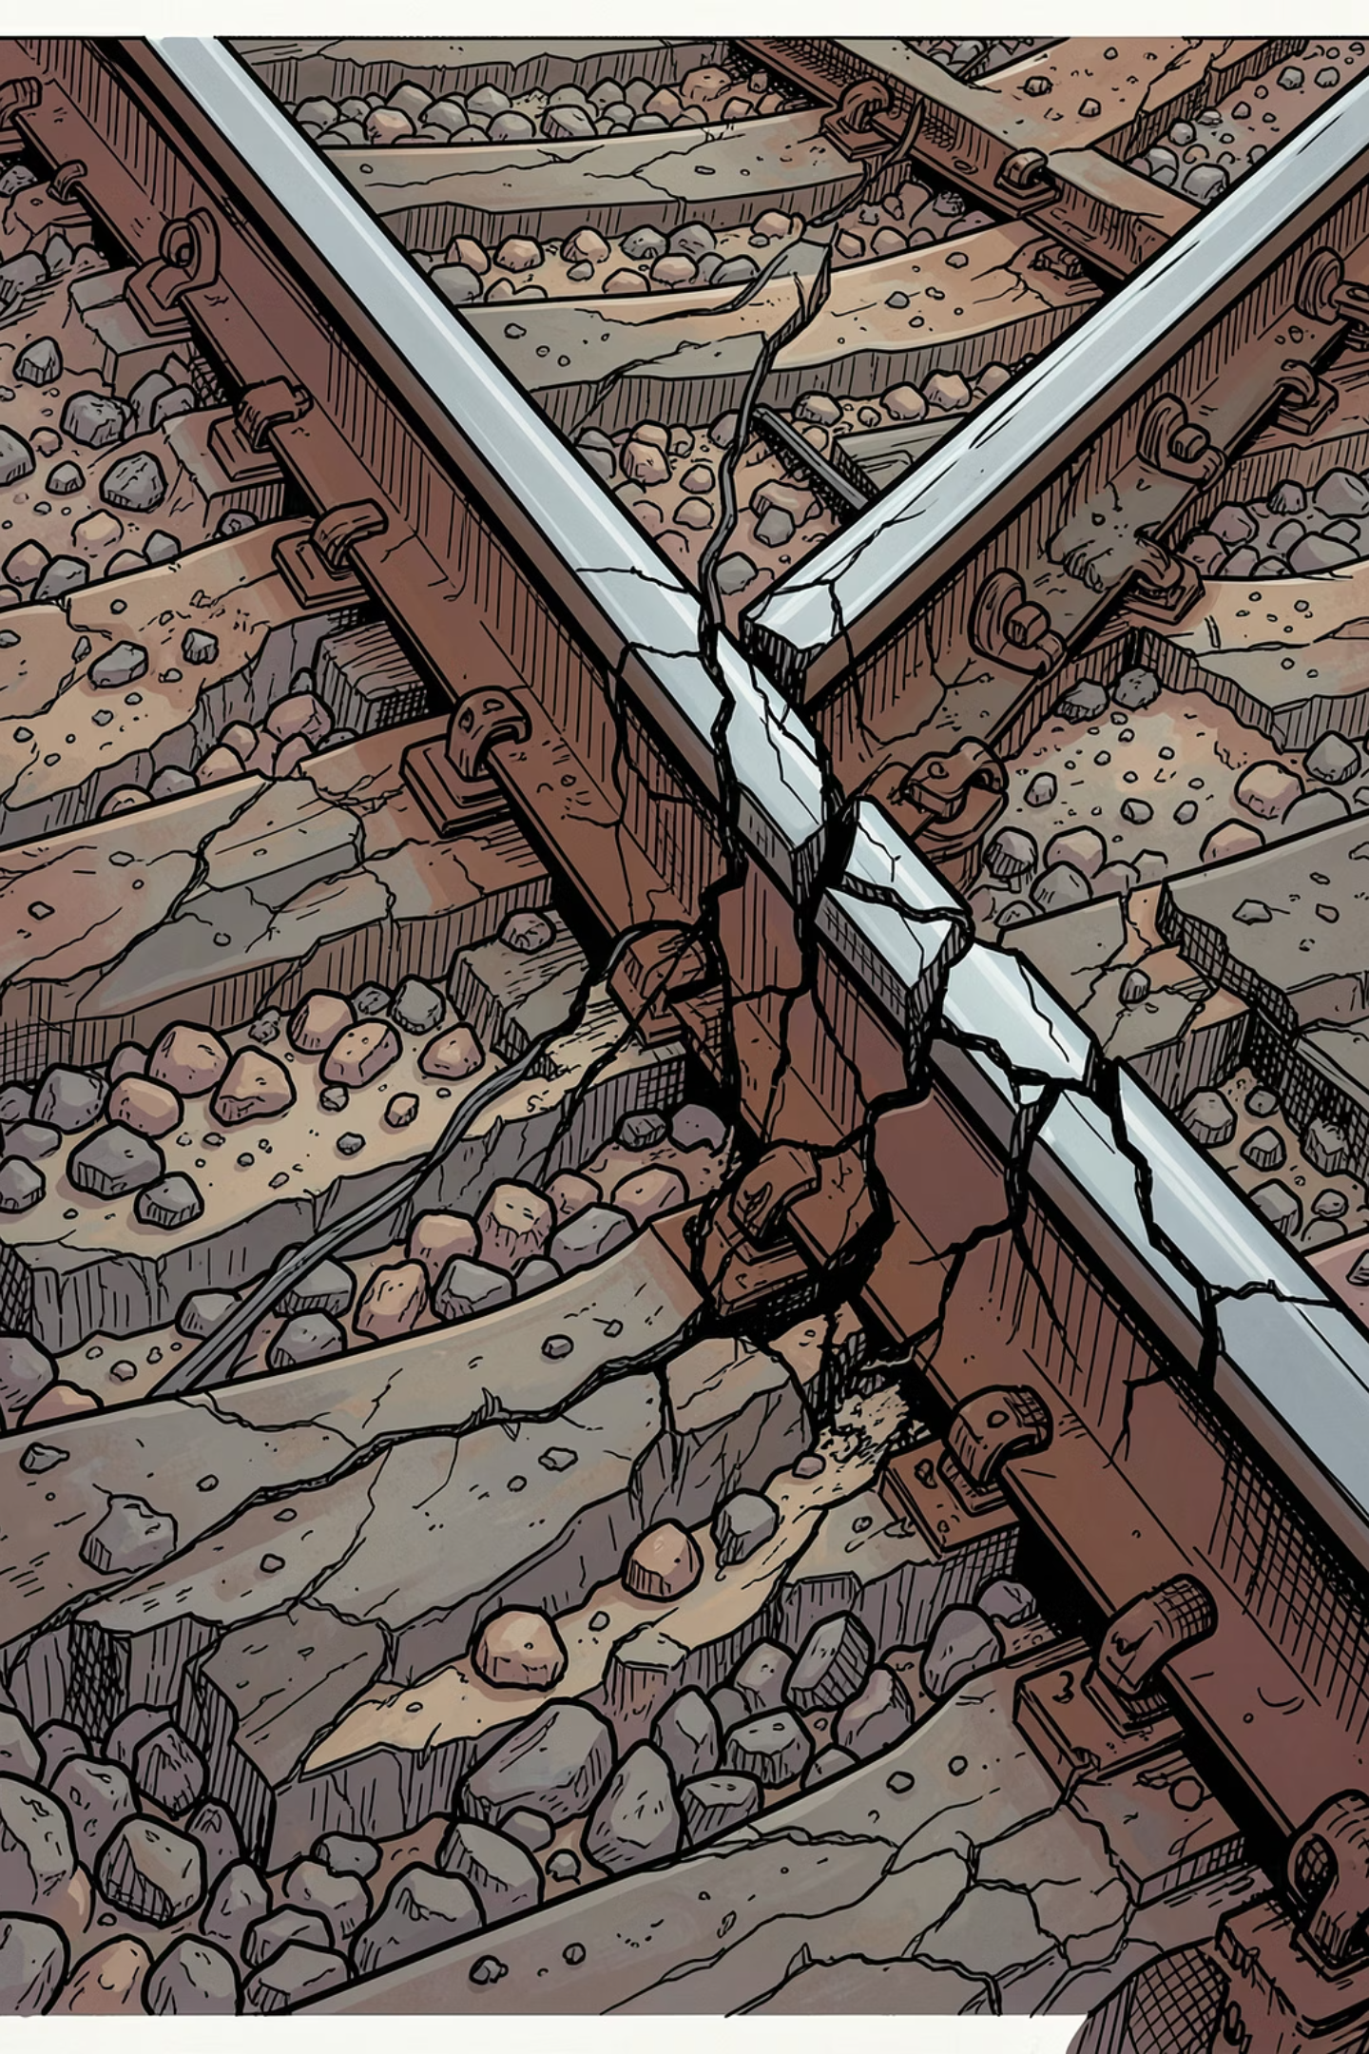

The Railway Safety Challenge
Railway infrastructure is under constant stress. Without proactive monitoring, hidden defects become catastrophic failures.
3,000+
70%
Annual Rail Incidents
Reactive Repairs
Globally attributed to track defects and delayed maintenance
Of maintenance work is performed after a failure is detected
$4B
Annual Cost
Estimated global cost of rail accidents and unplanned downtime
Speaker Notes: Open with the scale of the problem. These statistics underscore why reactive maintenance is unsustainable. Highlight that most incidents are preventable with the right technology — which is exactly what Rakshak delivers.

Slide 3
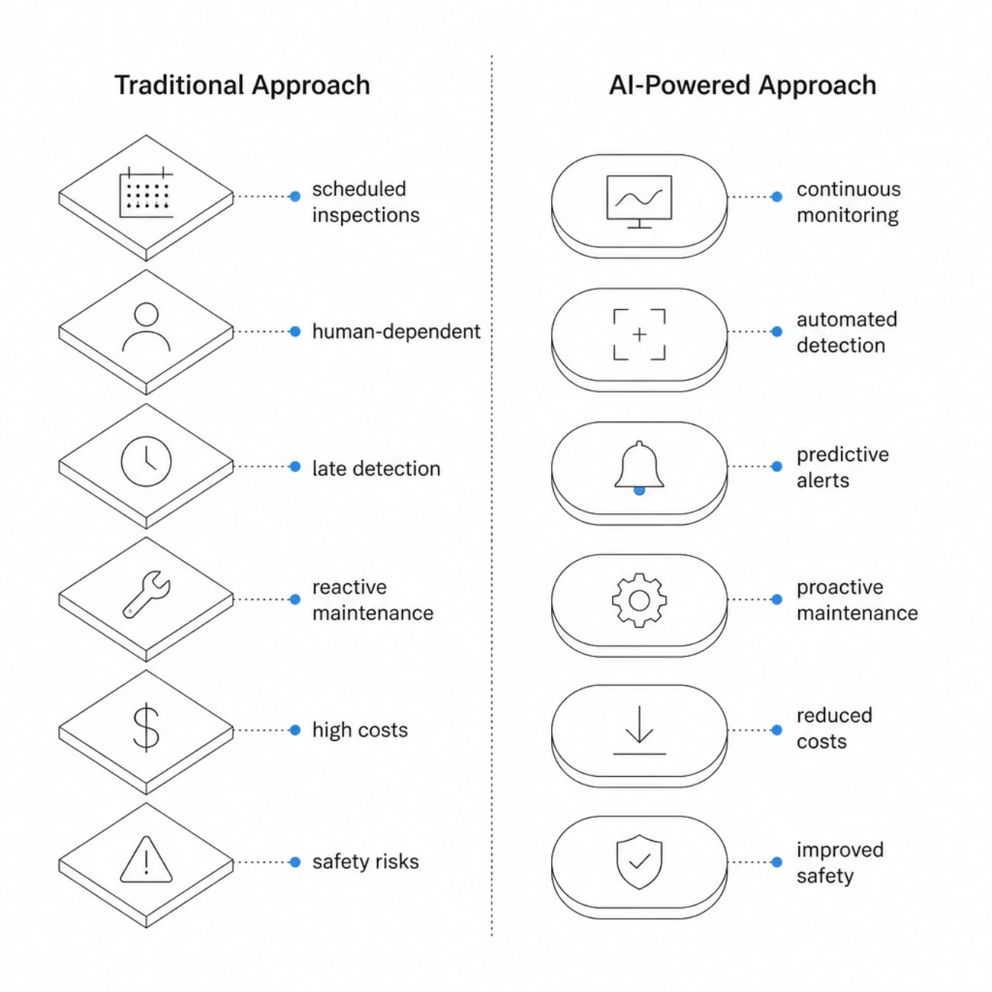

Limitations of Traditional Maintenance
Why the Old Model Fails
Traditional rail maintenance relies on fixed schedules and human inspectors — a model that is costly, slow, and inherently reactive. Defects are only found after they cause visible damage or service disruption.
Inspections occur weeks apart, missing rapid degradation
Human error introduces inconsistency
Resources are allocated inefficiently
Downtime is unplanned and expensive
Speaker Notes: Walk through the comparison. Emphasize that the traditional model is not just inefficient — it's dangerous. The split infographic makes the contrast clear: Rakshak flips the paradigm from reactive to proactive.

Slide 4


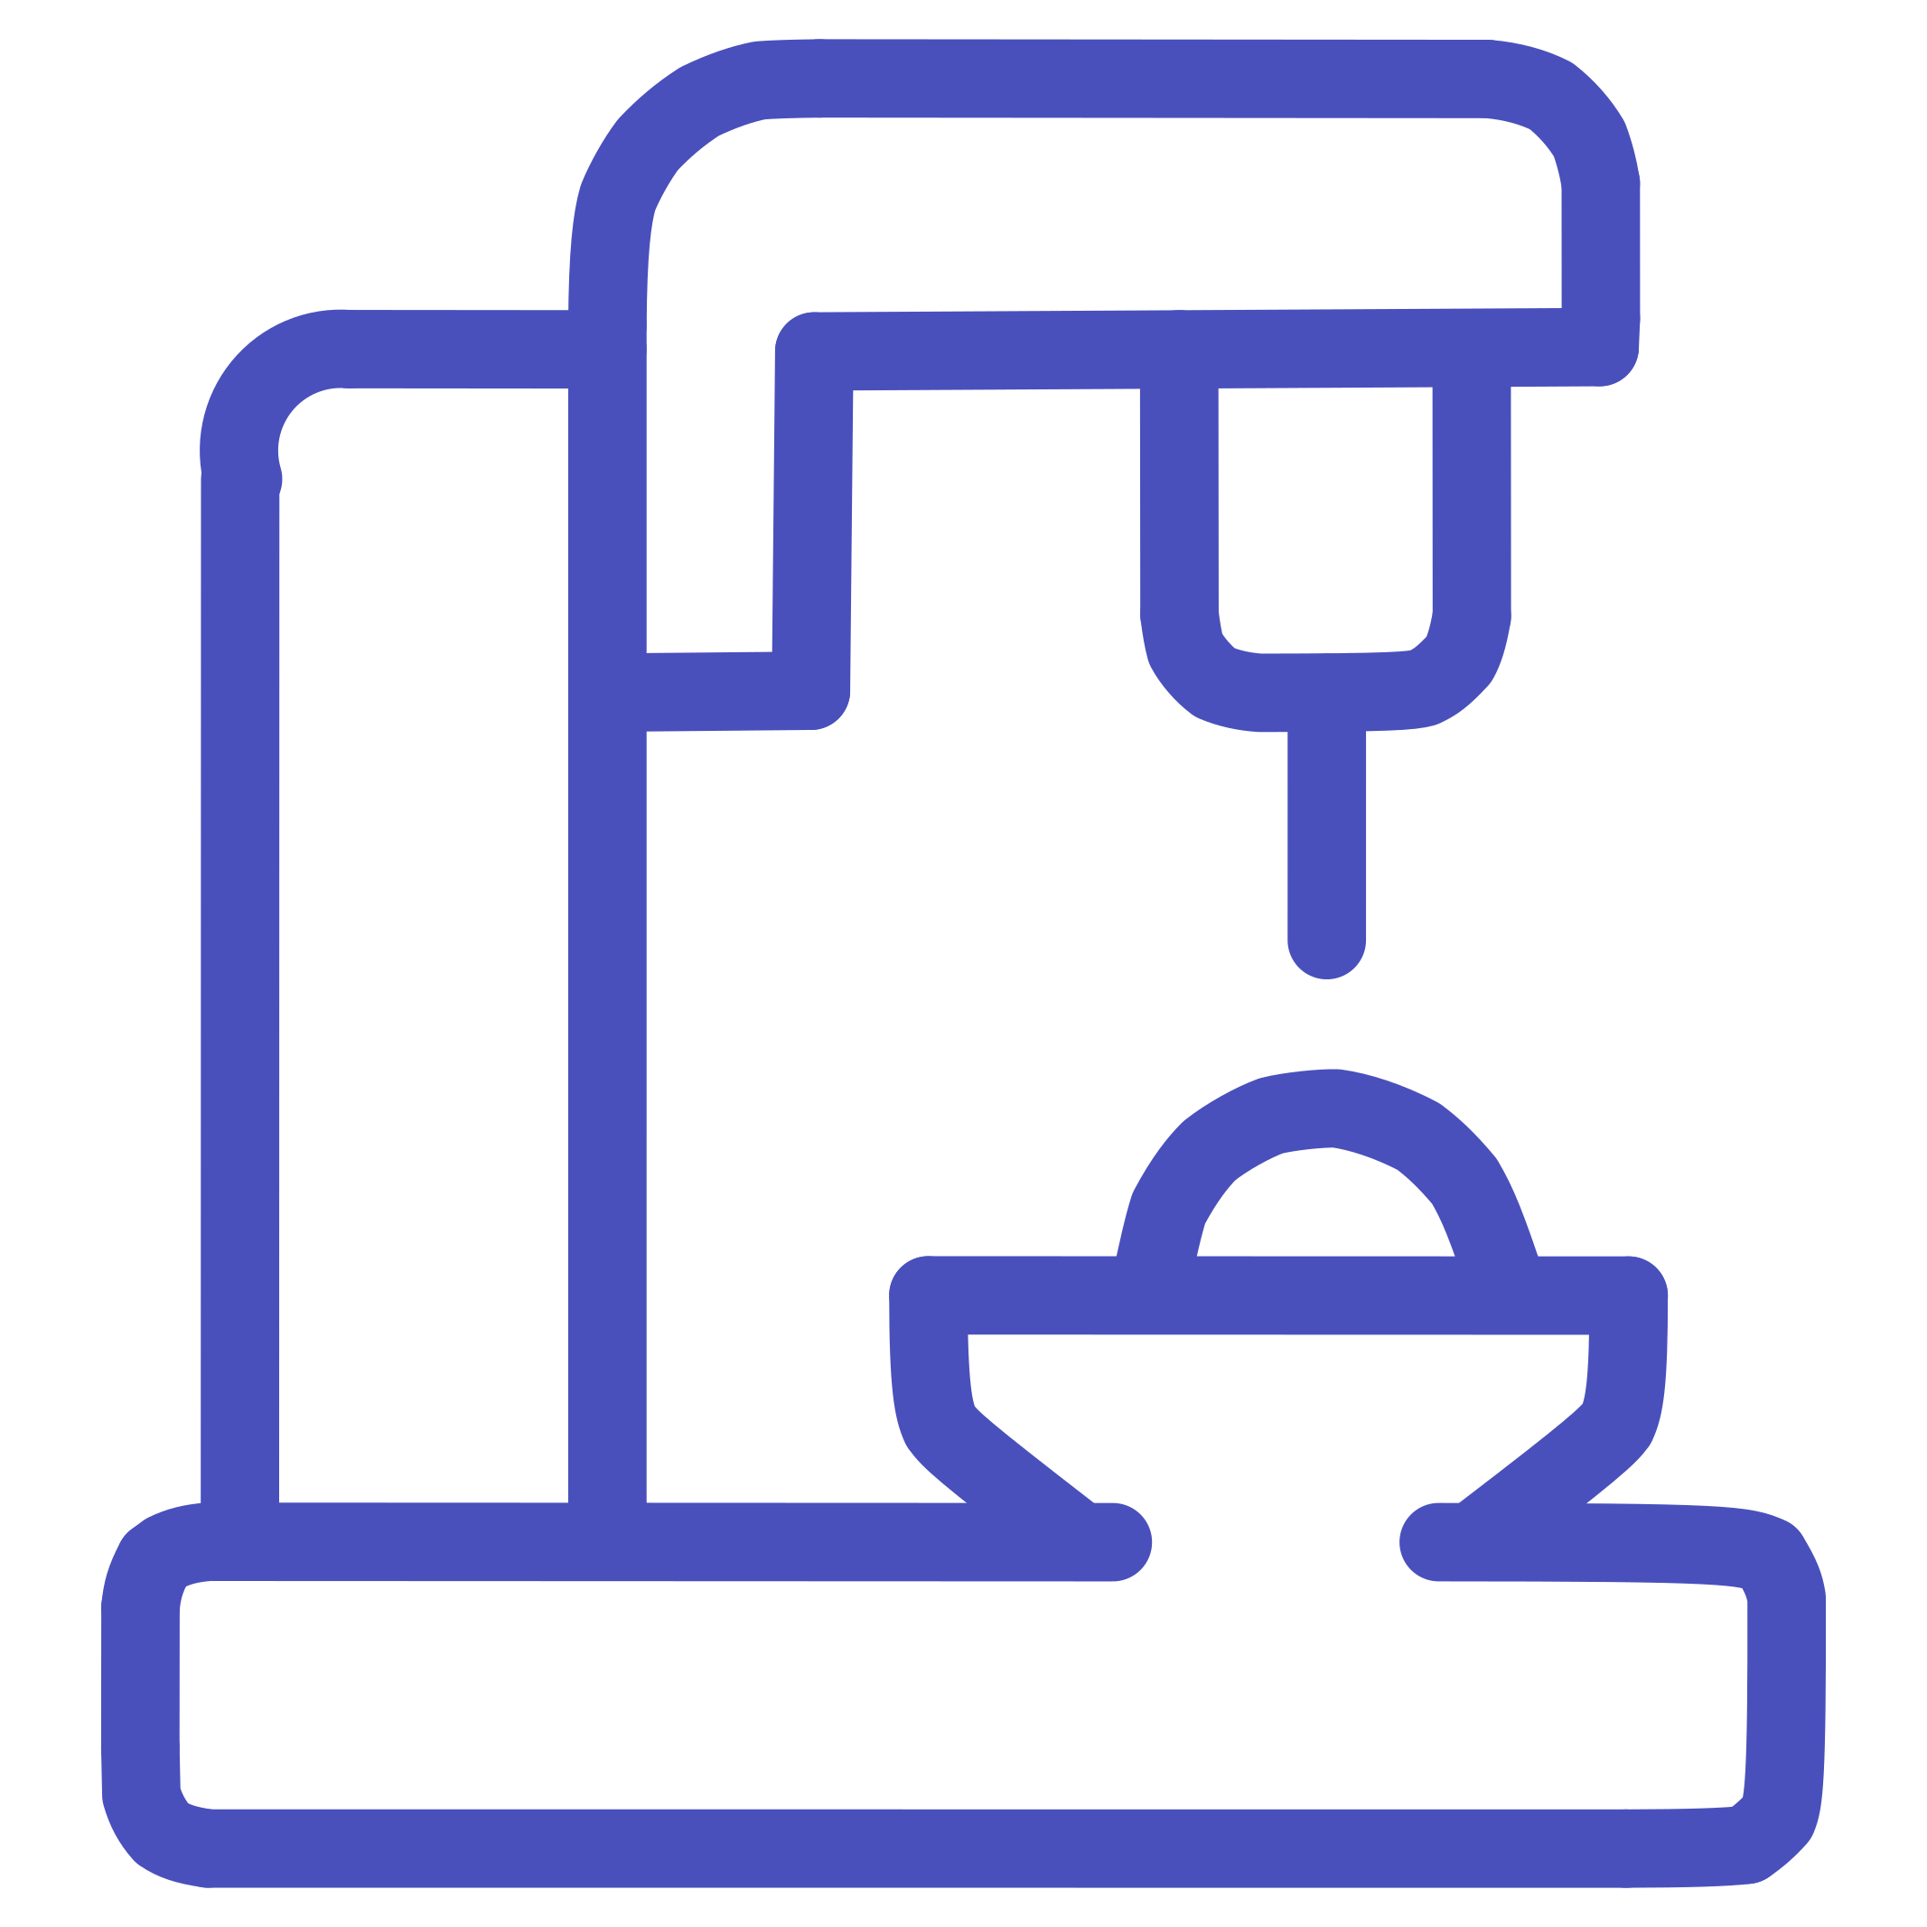



Introducing Project Rakshak
Rakshak is an end-to-end intelligent safety platform that continuously monitors railway infrastructure and predicts failures before they occur.
IoT Sensors
Real-Time Monitoring
Machine Learning
Vibration, temperature, and strain sensors deployed across track sections
Live data streams processed continuously with sub-second latency
AI models trained on historical failure data to detect anomalies
Predictive Analytics
Automated Alerts
Failure probability scores generated for every monitored track segment
Instant notifications and maintenance tickets triggered automatically
Speaker Notes: This is the core solution slide. Rakshak brings together five key capabilities into one unified platform. Each component plays a specific role — from data collection to action — creating a closed-loop safety system.

Slide 5
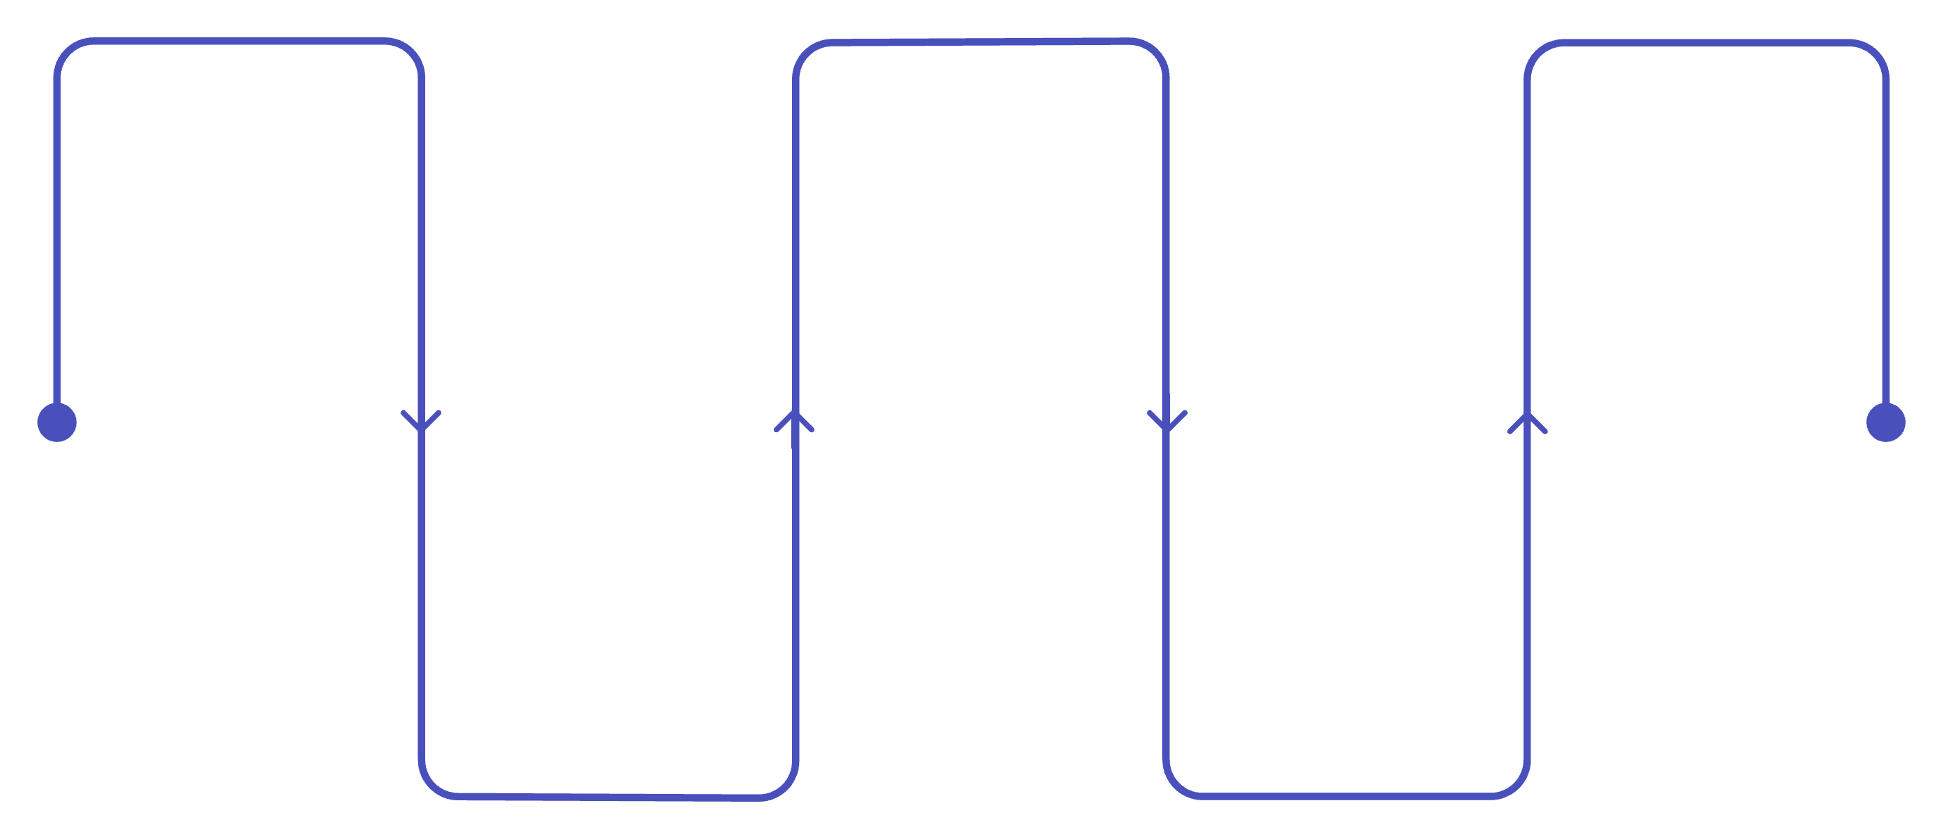
System Architecture
Data flows seamlessly from the physical railway environment through intelligent processing layers to actionable insights for maintenance teams.
Railway Sensors
Cloud Database
Alert Generation
Vibration, temperature, strain
PostgreSQL time-series storage
Threshold-based triggers
Data Collection
AI Prediction
Edge gateway using MQTT
SensorVAE and HGNN models
The architecture is designed for high availability and low latency — critical for safety-critical railway operations. Each layer is independently scalable and fault-tolerant.
Speaker Notes: Walk through the data pipeline from left to right. Emphasize that the architecture is modular — each layer can be upgraded independently. The AI Prediction Engine is the heart of the system, where raw sensor data becomes actionable intelligence.

Slide 6
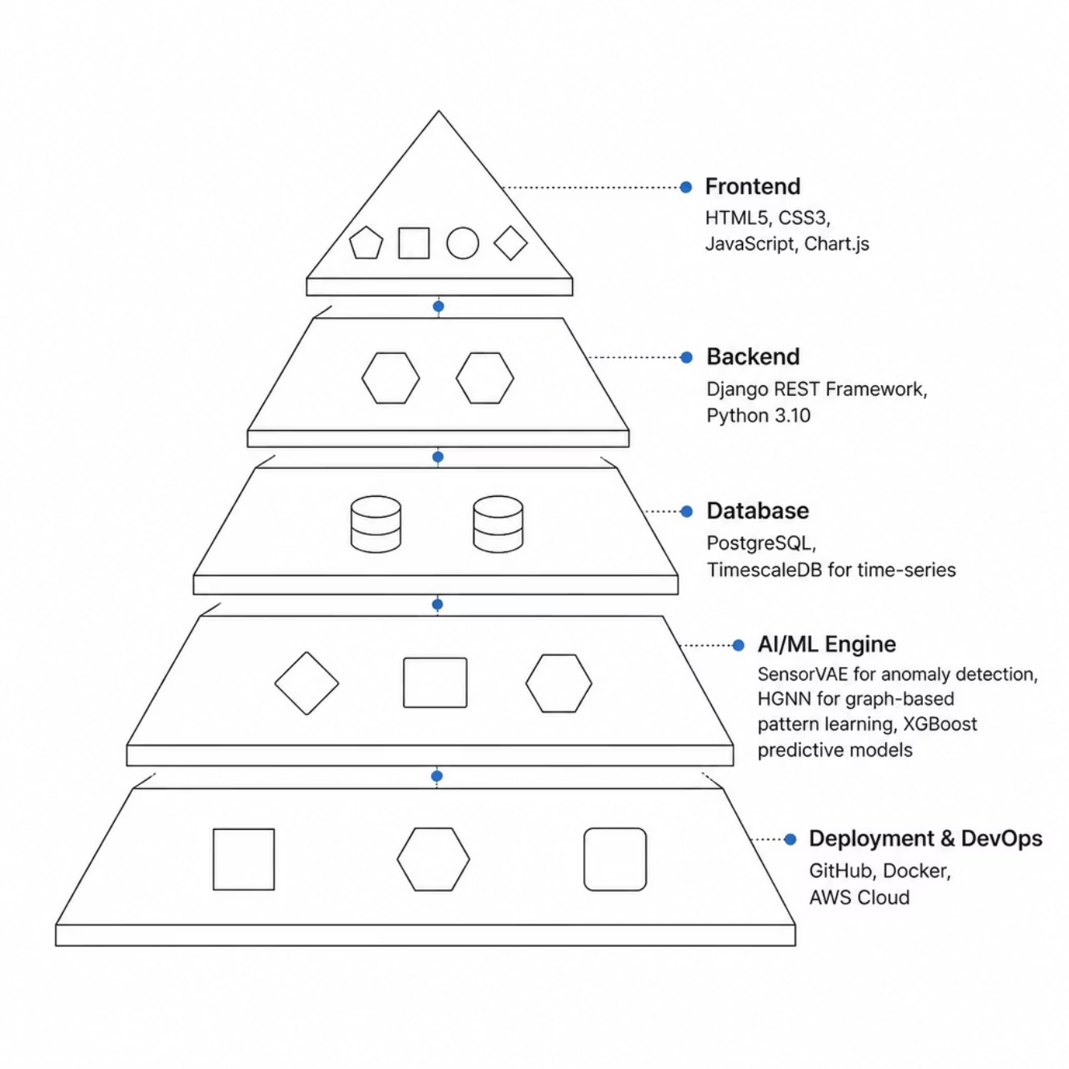
Technology Stack
Built for Scale and Reliability
Rakshak's stack is chosen for production readiness, open-source flexibility, and AI capability.
SensorVAE: Variational autoencoder for unsupervised anomaly detection
HGNN: Hypergraph neural network for multi-sensor correlation
Django + PostgreSQL: Proven, scalable backend for real-time workloads
GitHub: Version-controlled, CI/CD-ready deployment pipeline
Speaker Notes: Highlight the AI models specifically — SensorVAE and HGNN are the technical differentiators. These are not off-the-shelf solutions; they're purpose-built for multi-sensor railway data. The rest of the stack is enterprise-grade and battle-tested.

Slide 7






How the AI Works
The prediction engine transforms raw sensor signals into actionable failure forecasts through a five-stage intelligent pipeline.
Collect Data
Detect Anomalies
Analyze Patterns
Sensors stream vibration, temperature, and strain data
SensorVAE flags deviations from normal patterns
HGNN correlates multi-sensor signals across track segments
Predict Failures
Generate Alerts
ML models output failure probability scores
Automated tickets and notifications dispatched instantly
Key Insight: Failures are predicted days in advance — before any accident can occur.
Speaker Notes: This is the technical heart of the presentation. The five-stage pipeline shows how raw data becomes a safety action. Emphasize that the system predicts failures days in advance — that's the game-changer for railway safety.

Slide 8
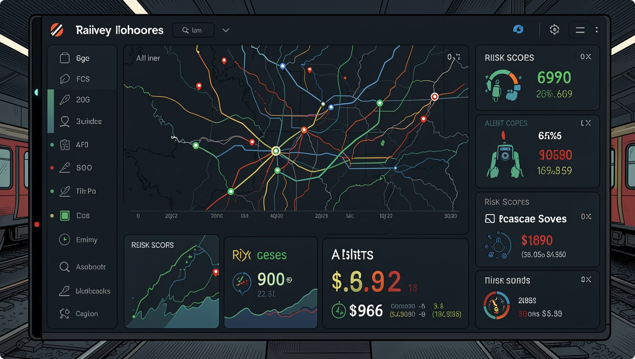

Smart Monitoring Dashboard
Command Center for Railway Safety
The Rakshak dashboard gives operators a single pane of glass across the entire rail network.
Real-Time Alerts
Risk Scoring
Maintenance Tickets
Network Health Overview
Priority-ranked notifications pushed instantly to field teams
Every track segment assigned a live failure probability score
Auto-generated work orders with location and severity data
System-wide status map with color-coded risk zones
Speaker Notes: The dashboard is the operator's daily interface. Walk through each feature — especially the risk scoring and auto-generated tickets. This is where AI predictions become real-world actions that maintenance teams can act on immediately.

Slide 9
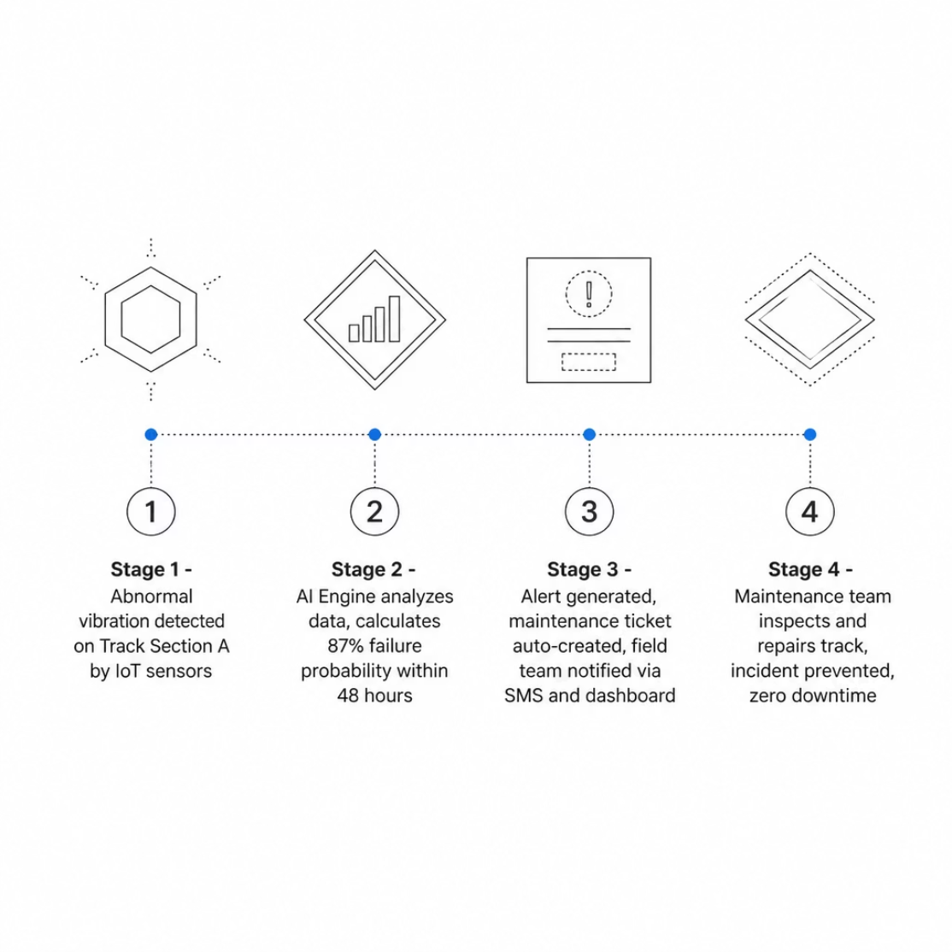

Failure Prediction in Action
A real-world scenario demonstrating how Rakshak prevents accidents before they happen.
Scenario: Track Section A
Sensors detect an anomalous vibration signature. Within seconds, the AI engine assesses the data and assigns an 87% failure probability within the next 48 hours.
⚡ Alert Generated
🎫 Ticket Created
✅ Issue Resolved
Instant notification to operations center
Auto-assigned to nearest maintenance crew
Repair completed before any incident occurs
Speaker Notes: This is the storytelling slide. Walk through the timeline step by step — from detection to resolution. The 87% failure probability is the key moment: the system doesn't just flag a problem, it quantifies risk and triggers action automatically.

Slide 10
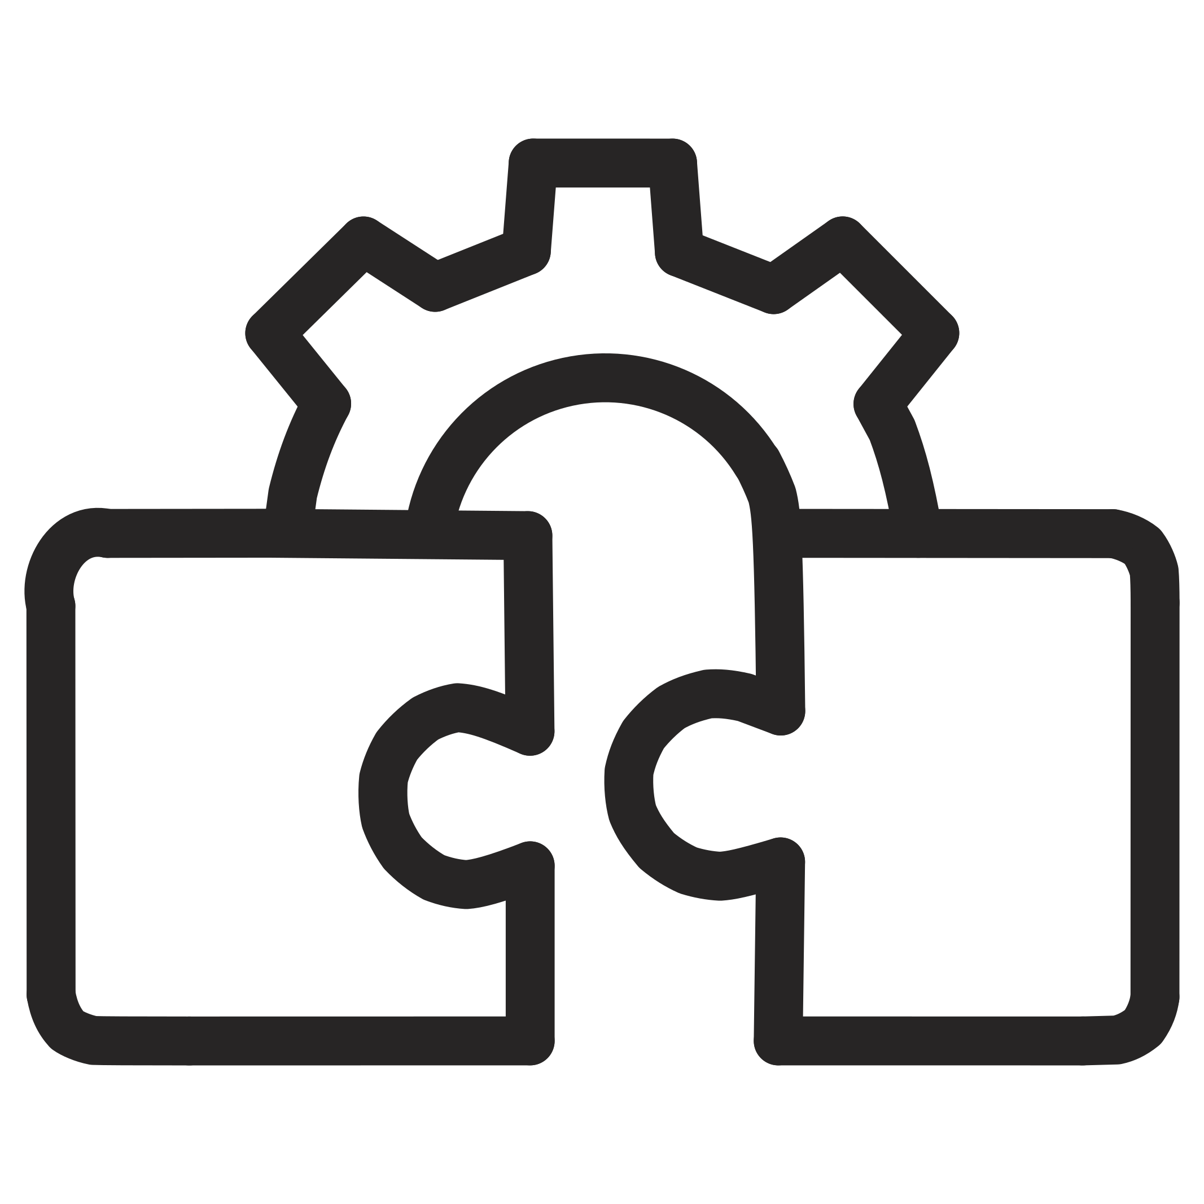
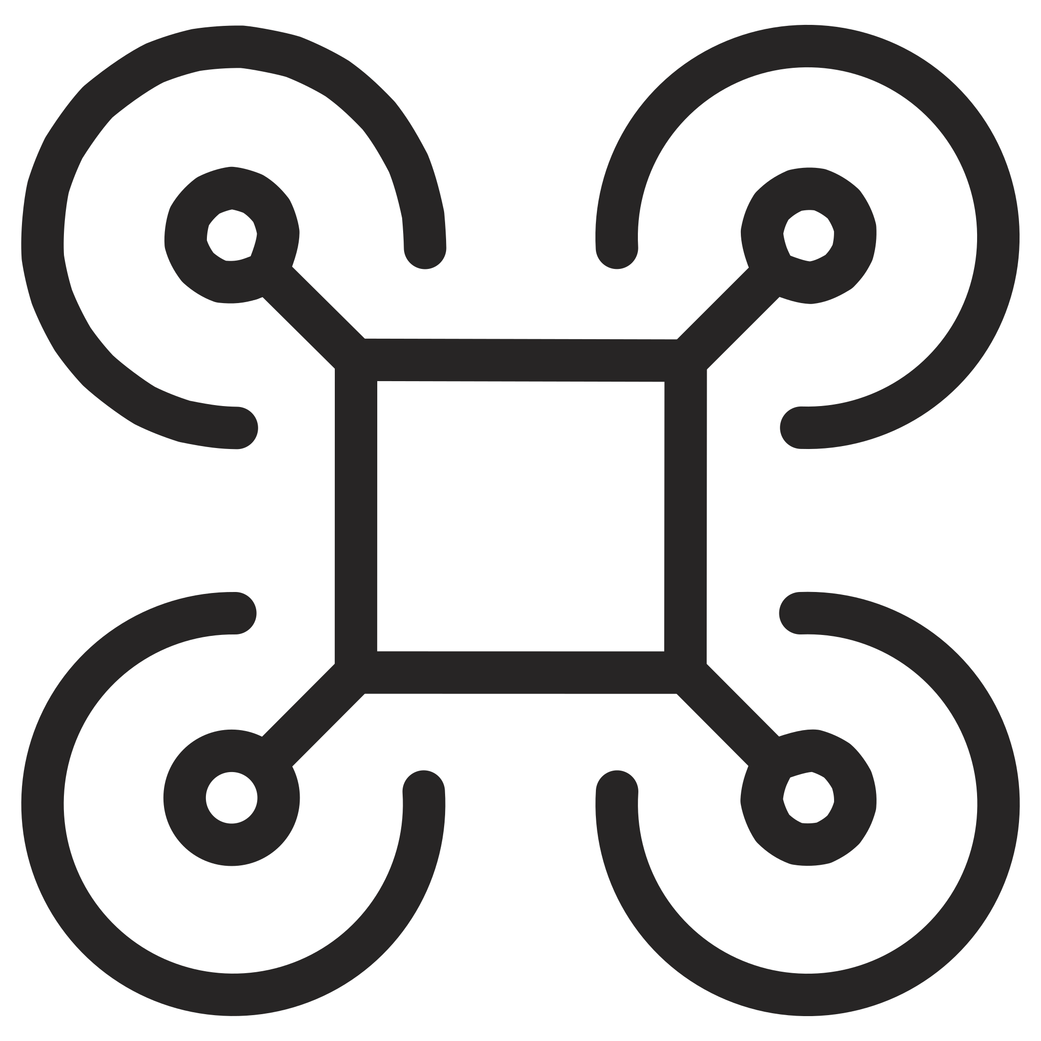

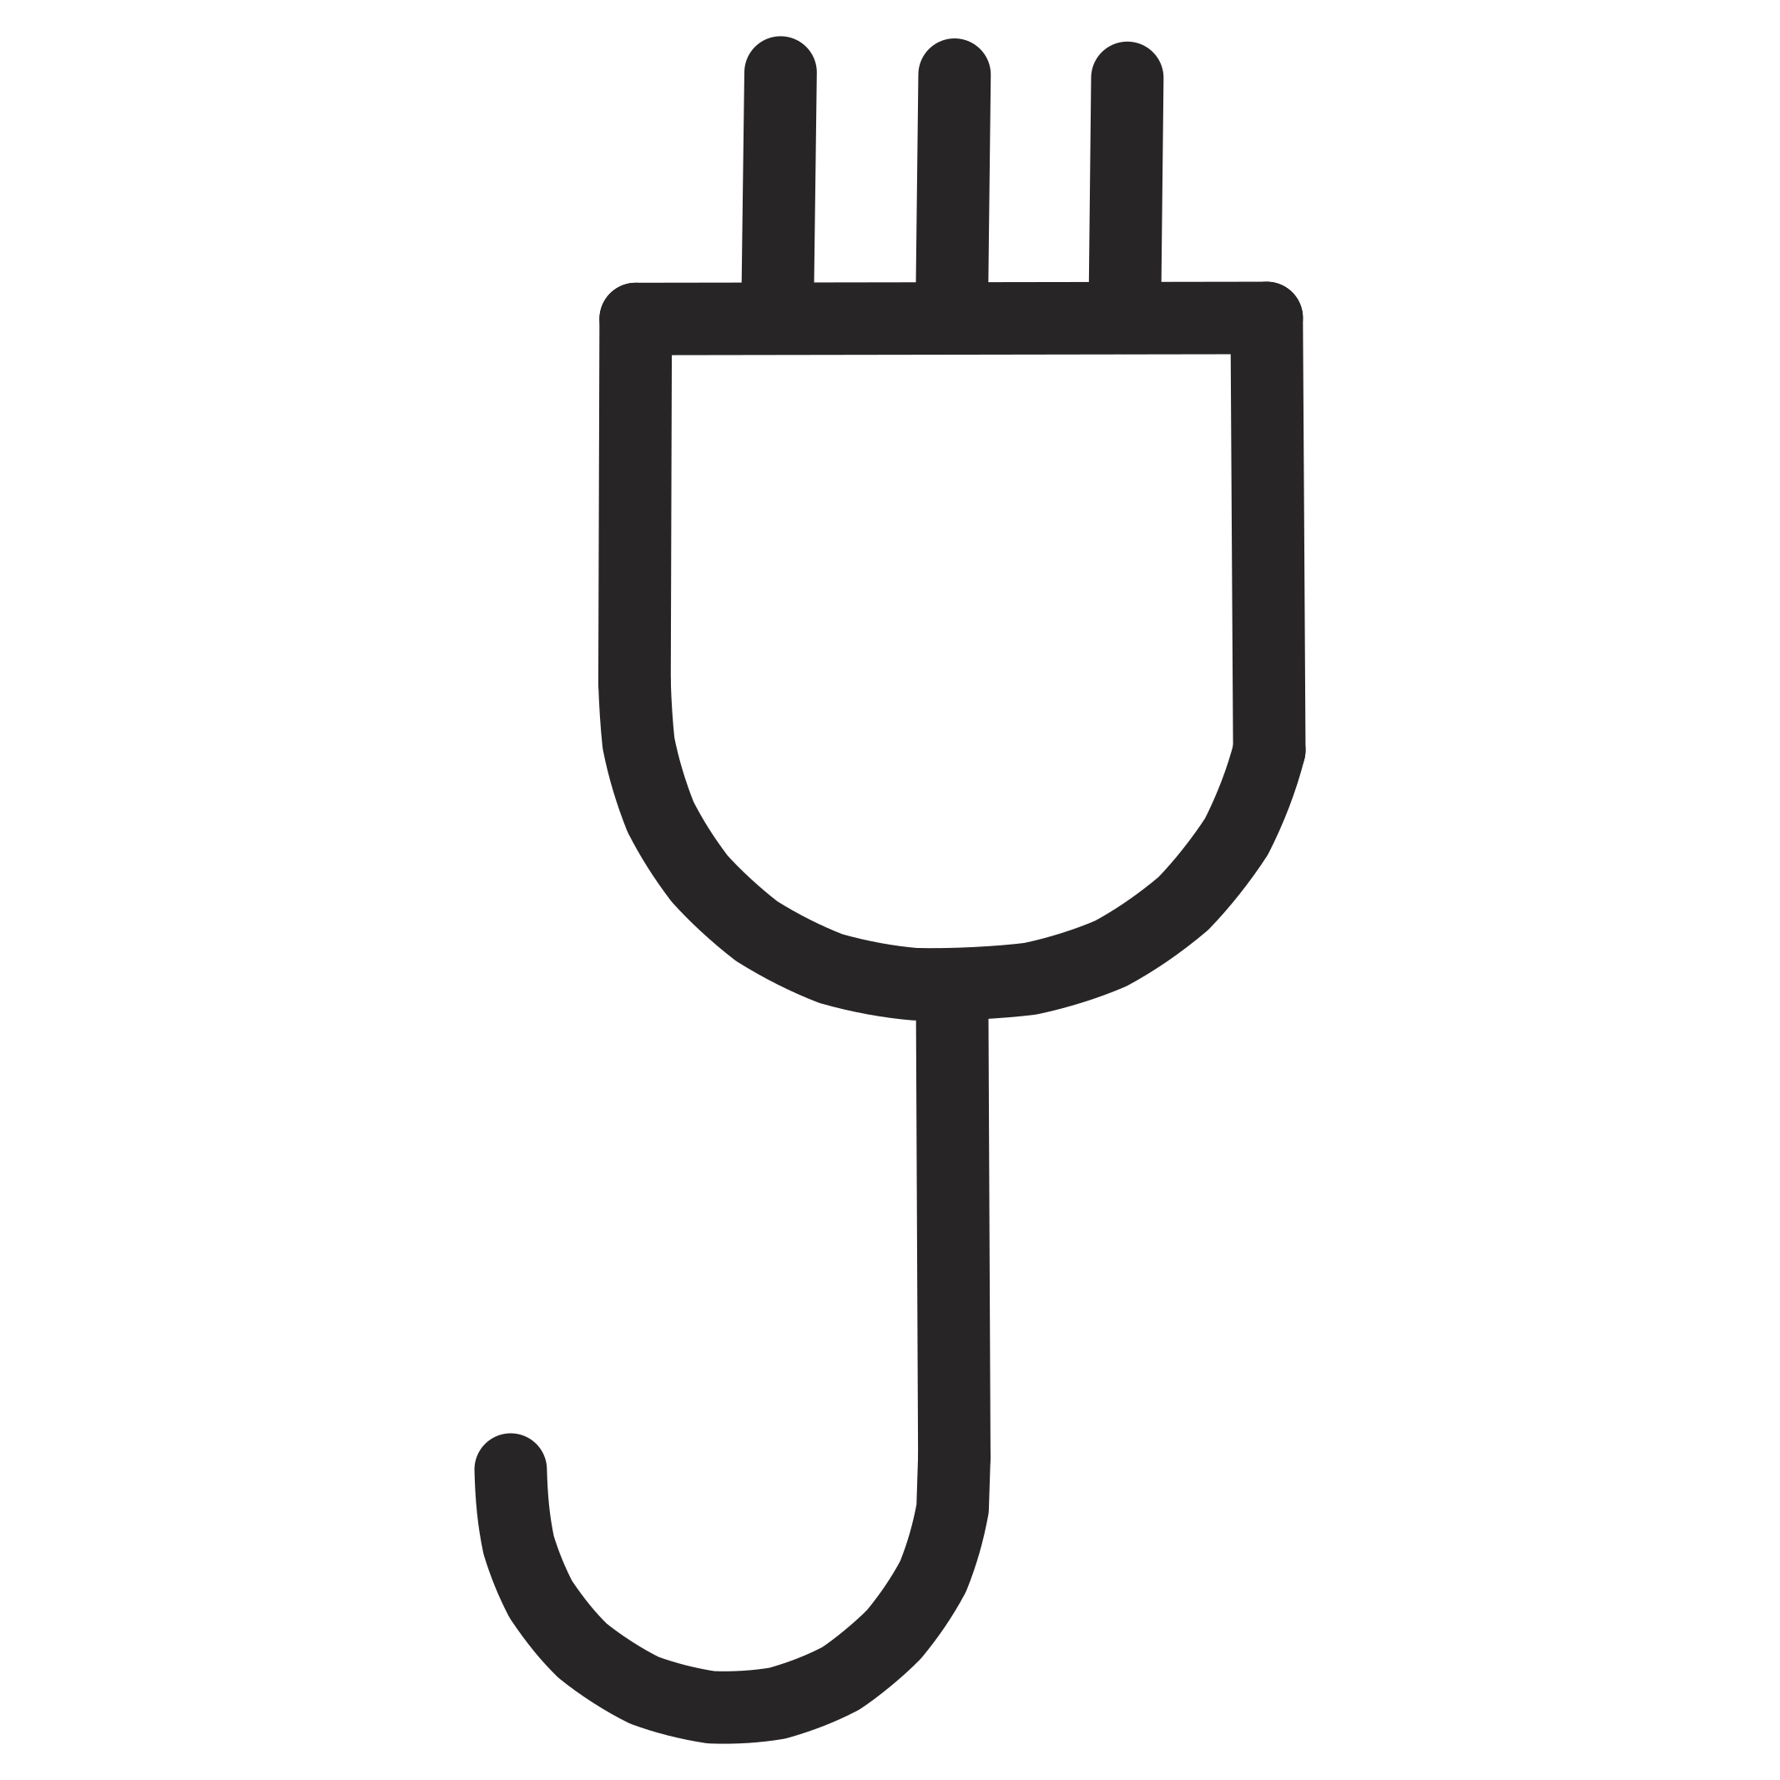
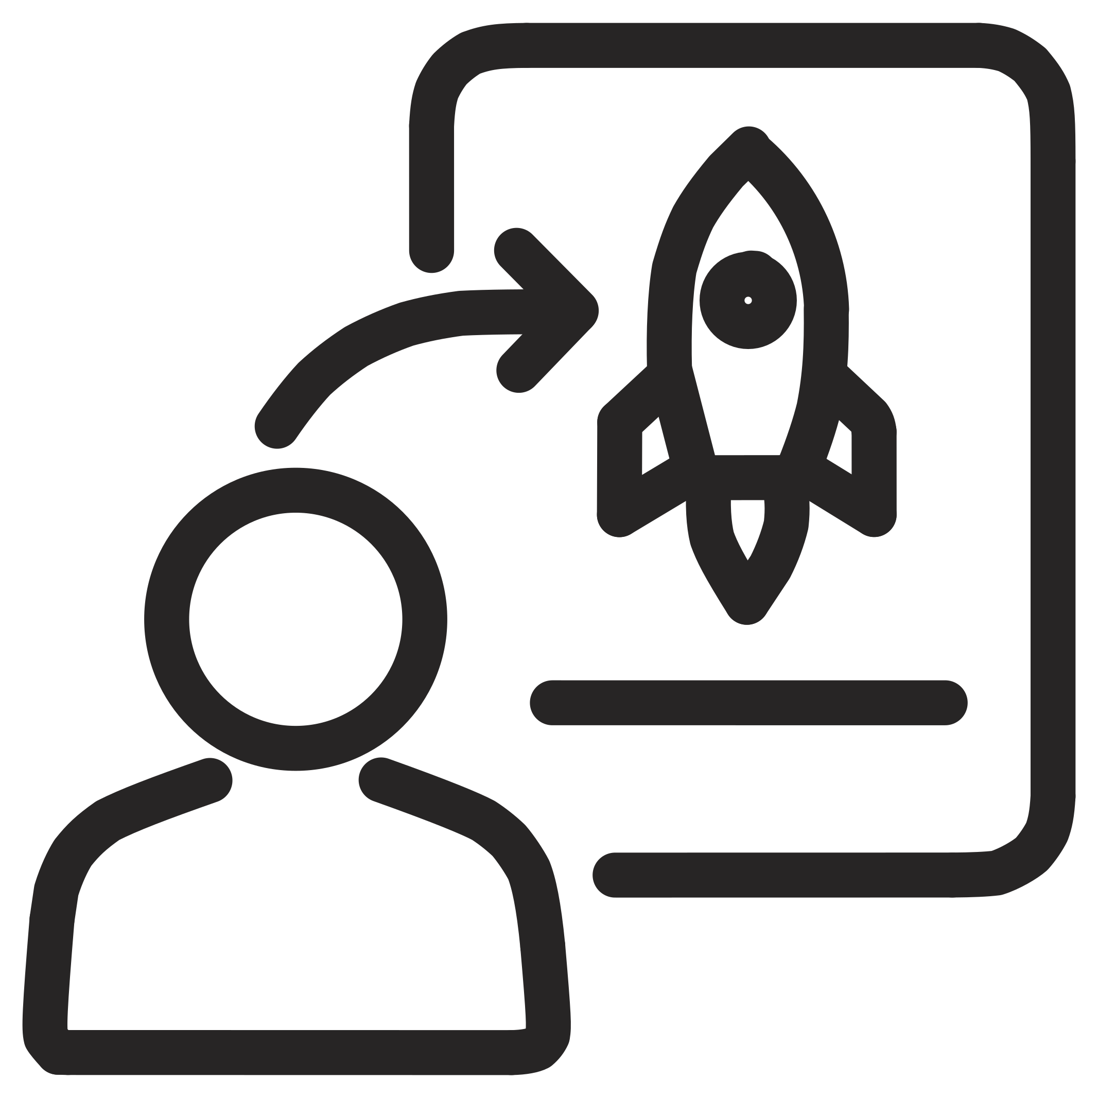
Impact & The Road Ahead
60%
40%
3x
Fewer Accidents
Lower Costs
Faster Response
Projected reduction through proactive defect detection
Estimated savings from reduced unplanned maintenance
Automated alerts accelerate maintenance team deployment
Future Enhancements
Live Railway Integration
Drone Inspection Support
Computer Vision Monitoring
Digital Twin Railway Network
National Scale Deployment
Thank You — Project Rakshak
Predict. Prevent. Protect.
"Building a safer railway network through AI-driven predictive intelligence."
GITHUB: /TEAM-RAKSHAK
CONTACT: TEAM@RAKSHAK.IO
Speaker Notes: Close with impact metrics and the vision for the future. The roadmap shows this isn't just a hackathon prototype — it's a platform designed for national deployment. End with the tagline and invite questions.

