Slide 1


TURBULENCE& Co.
18CSC301T
FORMAL LANGUAGE AND AUTOMATA
REGULAR EXPRESSION TO NFA
By:
ANKIT SINGH (RA2111026010105)
PRATHAM AGARWALLA (RA2111026010073)
ARNAV SHARMA (RA2111026010075)

Slide 2

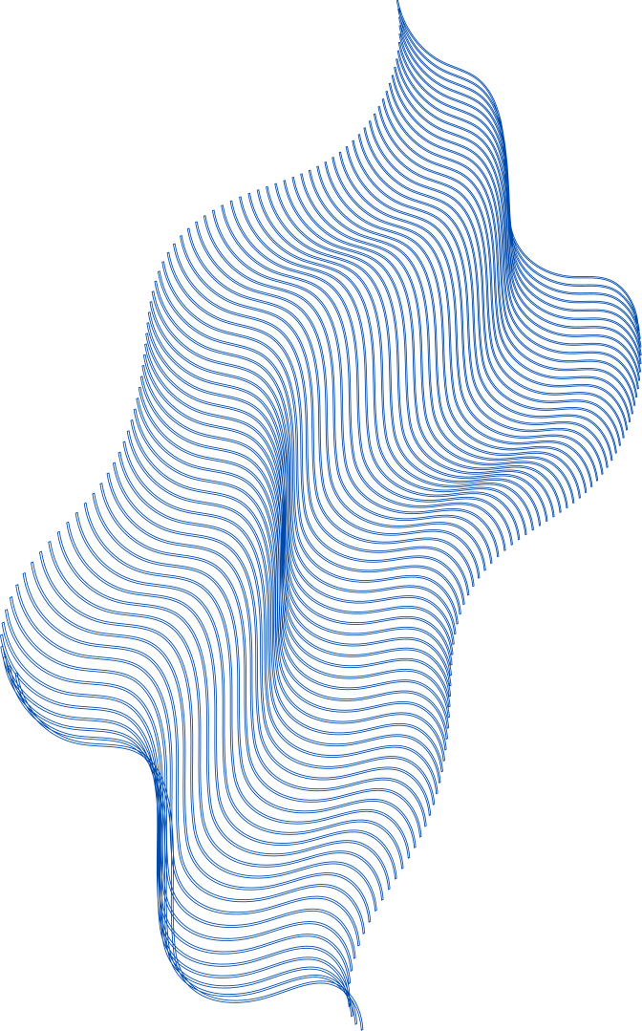
APPLICATION
OBJECTIVE
Text Search and Extraction: Regular expressions are commonly used for searching and extracting specific patterns or information from text documents.
Data Validation and Input Sanitization: Regular expressions and NFAs are employed to validate user input, ensuring it conforms to specific formats or constraints.
Information Retrieval: Users can define complex search patterns to retrieve specific documents or data from large databases or archives.
Natural Language Processing (NLP): They help identify and manipulate linguistic patterns within text data.
Text Parsing and Tokenization: Regular expressions and NFAs are used to break down text into meaningful units (tokens) in applications like parsing data formats (e.g., JSON, XML) or splitting text into words and sentences.
PATTERN MATCHING: NFAS ARE USED IN PATTERN MATCHING TO DETERMINE WHETHER A GIVEN INPUT STRING MATCHES THE REGULAR EXPRESSION.
Text Processing: help in breaking down input text into meaningful components based on the regular expression's rules.
Compiler and Parser Design: Converting regular expressions to NFAs is an intermediate step in creating lexical analyzers and parsers for programming languages.
Data Validation: NFAs can be employed to validate user input against specific formats or constraints.
Automating Text Manipulation: NFAs can be used to automate text manipulation tasks.

Slide 3
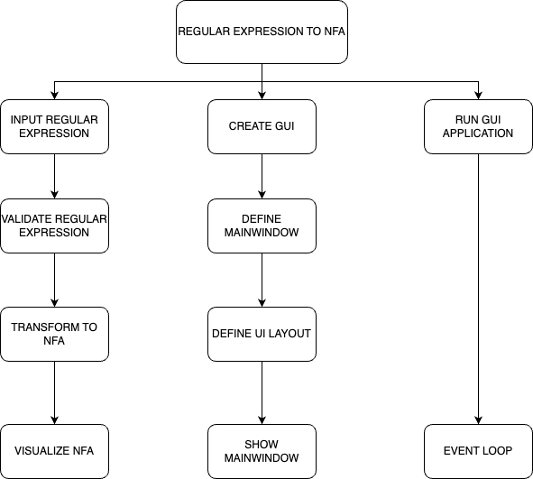
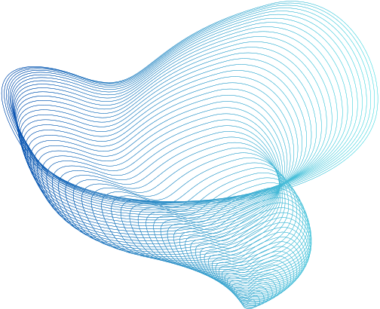
THE
PROCESS

Slide 4

EXPLANATION
Define the Regular Expression: Begin with a given regular expression that you want to convert to an NFA.
Parse the Regular Expression: Parse the regular expression to break it down into its constituent symbols and operators.
Thompson's Construction Algorithm
Final NFA: After applying Thompson's Construction Algorithm to each part of the regular expression, you should have a single NFA that represents the entire regular expression.
Visualize the NFA: To help with understanding and debugging, you can visualize the NFA using a graphical representation, such as Graphviz.

Slide 5
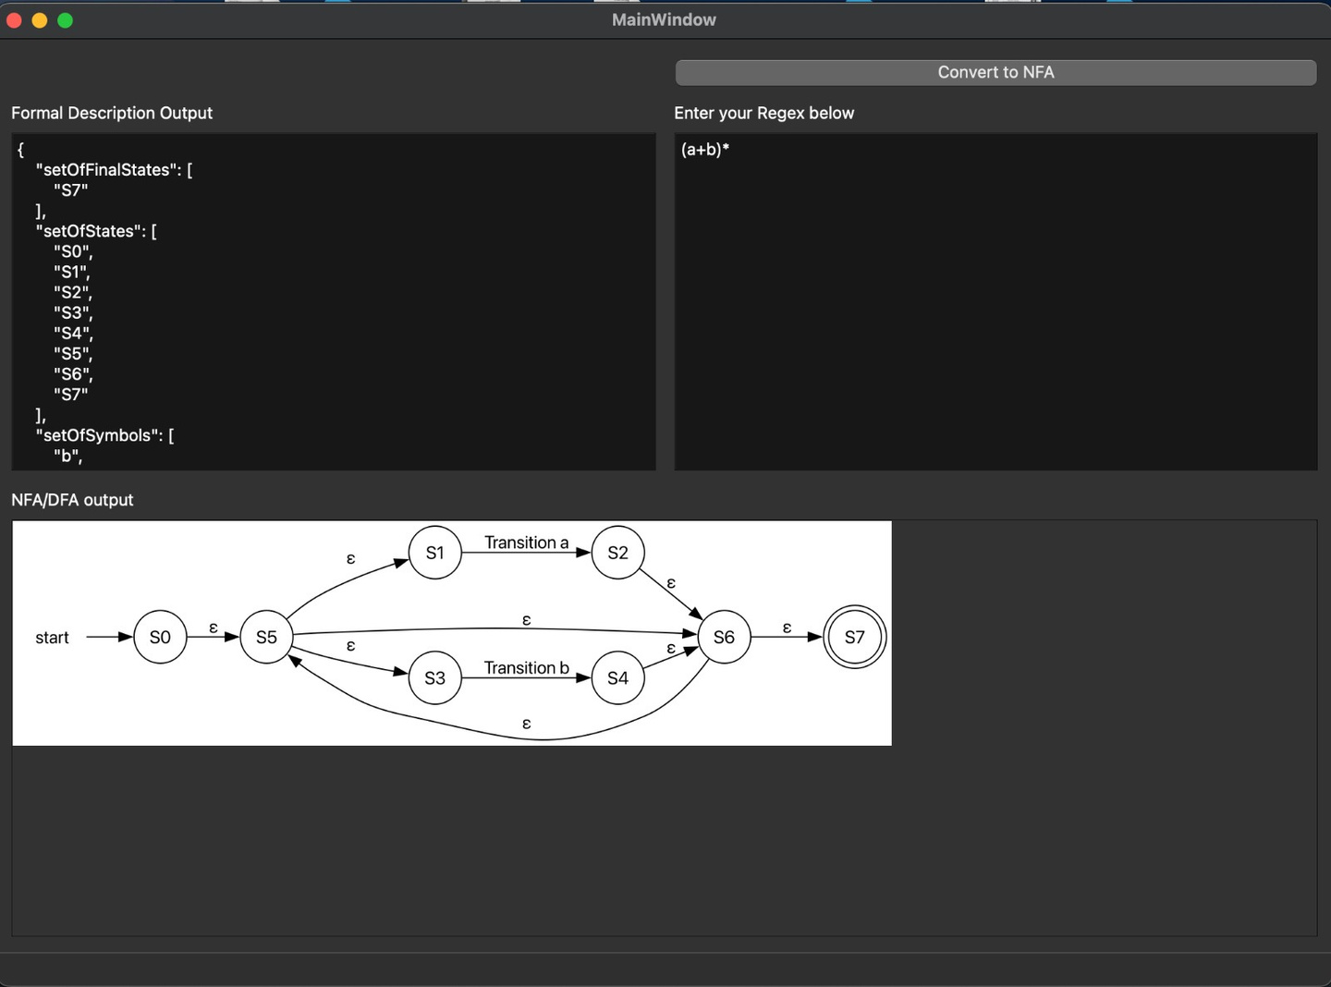
EXAMPLE PROBLEM

Slide 6

OUR TEAM
PRATHAM ANKIT ARNAV
WE HAVE COLLABORATELY DONE THE ENTIRE PROJECT WITH EQUAL CONTRIBUTIONS.

Slide 7
CONCLUSION
IN THIS PROJECT, WE HAVE DEVELOPED A REGULAR EXPRESSION TO NON-DETERMINISTIC FINITE AUTOMATON (NFA) CONVERSION TOOL. THE TOOL PROVIDES A VALUABLE BRIDGE BETWEEN HUMAN-READABLE REGULAR EXPRESSIONS AND MACHINE-UNDERSTANDABLE NFAS.
By leveraging the Thompson's Construction Algorithm and visualizations through Graphviz, our tool offers a user-friendly interface for transforming regular expressions into NFAs. Users can input a wide range of regular expressions and instantly visualize the corresponding NFA, aiding in comprehension and validation of regular expressions.
GITHUB: HTTPS://GITHUB.COM/ARNAV131003/FLA-ASSINGMENT-

