Slide 1

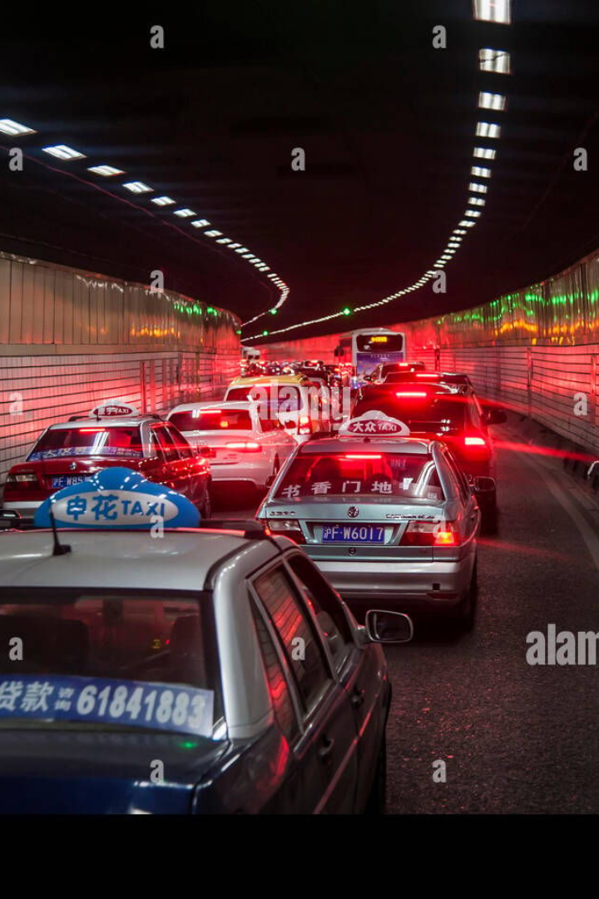
Tunnel Traffic and Safety Overcoming Challenges with AI Vision Cameras
Explore the importance of tunnel traffic and safety and the current challenges we face. Discover how AI vision cameras can revolutionize traffic analysis and enhance safety measures in tunnels.
Understanding the significance of tunnel traffic and safety is crucial for efficient transportation systems. Let's delve into the current challenges and how AI can be the solution.

Slide 2
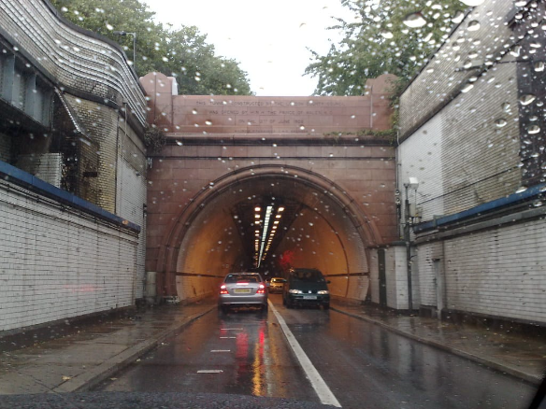
Traffic Analysis using AI Vision Cameras
AI-powered vision cameras provide accurate and real-time traffic analysis, revolutionizing the way we monitor and manage tunnel traffic. Discover the benefits they bring.
1
Improved Safety
2
Efficient Traffic Management
3
Cost Savings
AI vision cameras detect potential risks and hazards, enhancing overall safety for drivers and pedestrians.
By providing valuable insights for efficient resource allocation, AI vision cameras help save costs in tunnel management.
With real-time data and analytics, AI vision cameras help optimize traffic flow and reduce congestion.

Slide 3
Safety Measures using AI Vision Cameras
Detecting and Preventing Accidents
Enhancing Visibility and Monitoring
AI vision cameras enable real-time accident detection, alerting authorities and rescuers promptly for immediate intervention.
With AI, tunnels are equipped with advanced monitoring capabilities, ensuring optimal visibility even in challenging conditions.
Ensuring Public Safety
Improving Traffic Management
AI vision cameras help in maintaining public safety by detecting and preventing criminal activities, ensuring a secure environment for everyone.
By leveraging AI vision cameras, traffic congestion can be monitored and managed efficiently, leading to smoother traffic flow and reduced travel time.

Slide 4
AI Vision Cameras: Overcoming Challenges
1
Clear Footage in Low-Light
2
Accurate Alerts, No False Alarms
3
Real-Time Monitoring and Analysis
AI vision cameras adapt to low-light conditions, providing clear and reliable footage.
Advanced AI algorithms filter out false alarms caused by weather conditions, ensuring accurate alerts for potential risks.
AI vision cameras enable real-time monitoring and analysis of the surroundings, enhancing safety and security.

Slide 5

Conclusion
Recapping the benefits of AI vision cameras in tunnel traffic and safety, we envision safer and more efficient transport systems. Explore the future prospects and advancements in this empowering field.
1
Improved Incident Response Time
2
Enhanced Maintenance and Monitoring
3
Optimized Traffic Flow
By analyzing traffic patterns and congestion, AI vision cameras help optimize traffic flow and minimize delays.
AI vision cameras enable quick detection of incidents, reducing response time and ensuring timely interventions.
With AI-powered analytics, tunnel operators have access to real-time data for proactive maintenance and efficient monitoring.

