Slide 1
Advancements in Attendance Management : Integrating Face Recognition and Location Tracking via QR Code generation.
Initiate, Innovate and Inspire for a Smarter University

Slide 2
Introduction
Traditional attendance systems are often manual, time-consuming, and prone to errors.
By leveraging advanced face recognition technology, we can accurately identify and verify individuals in real-time and use this for marking attendance.
To further authenticate the face recognition based attendance system, we retrieve user location via google forms synchronized with Apps script code and compare with the classroom’s location.
“Say goodbye to tedious paperwork and manual data entry.”

Slide 3
Motivation
Manual Attendance
Systems.
Inefficiency and Inaccuracy.
Key factors inspiring us
Technological Advancements.
Real-time Insights.
Our project can also eliminate the possible malpractice of proxies in the traditional attendance system.
Our project is a greener approach to attendance management as it eliminates the need for paper-based attendance marking.

Slide 4
OBJECTIVES
Implement Face Recognition Technology.
Provide Real-time Insights
Streamline Attendance Tracking.
Integrate Automation.
Enhance Accuracy and Reliability.

Slide 5
Technology Stack
Face Recognition: OpenCV library.
QR Code Automation: qrcode library.
Web Development Framework: Flask web framework.
Data Storage and Management: MySQL database.
Frontend Technologies: HTML, CSS, JavaScript.
Additional Libraries and Tools: NumPy, Pandas, Joblib, scikit-learn, openpyxl, mysql.connector, cv2, os.

Slide 6
K-Nearest Neighbors (KNN) Algorithm
KNN : Supervised Learning Algorithm for regression/classification.
Predictions based on distances between test and training data.
Selects K closest training points to test data.
Calculates the probability of test data’s class based on the K points.
K = 5 in our project.

Slide 7
HOW KNN WORKS ?
Finds distance between query and all data samples.
Selects K closest examples to query.
For classification: Votes for the most frequent label.
For regression : Averages labels of K selected points.

Slide 8
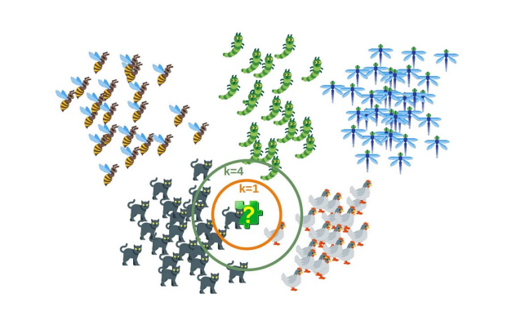
KNN ALGORITHM

Slide 9
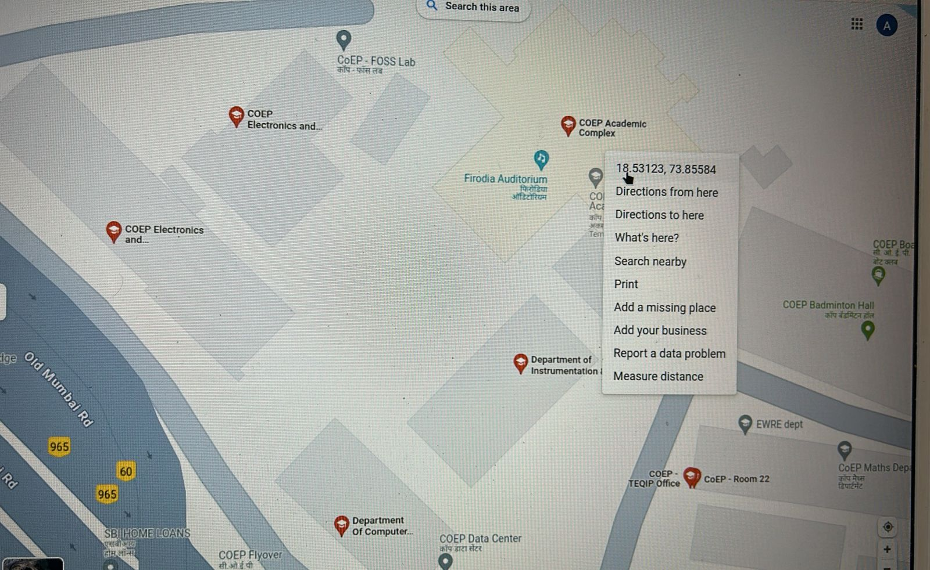
Latitude & Longitude

Slide 10
Challenges
Finding the direction for creating the layout and structure of the entire working.
Finding the sources required to implement the project topic.
Learning and implementation of K-Nearest Neighbors (KNN) Algorithm.
Integration of different webpages.

Slide 11
Learnings
Learning of python and its rich libraries.
Utilization of Flask Web framework for building multi-page websites.
The Ultimate KNN algorithm for face recognition.

Slide 12
Conclusion
Our project represents a significant advancement in attendance management, showcasing the transformative power of technology.
With our solution, attendance tracking becomes efficient, accurate, and user-friendly, paving the way for streamlined operations and improved productivity.
Let's continue to innovate and simplify attendance management for a brighter future.

Slide 13
TEAM MEMBERS
ARNAV PRASAD
SURABHI BANGAD
PRAJWAL BHOSALE
612203011
612203015
612203021

Slide 14
THANKYOU!

