Slide 1
KNOWLEDGE GRAPH
What, Why, and How

Slide 2
TABLE OF CONTENTS
01
03
02
04
Overview
Optimizations
Structures Used
Applications & Future Goals

Slide 3
01
OVERVIEW

Slide 4

INTRODUCTION
The Knowledge Graph ideology was popularized by Google in 2012 when they publicly attributed their search solution to Knowledge Graphs. Google defined its Knowledge Graph to serve the following objectives: Discoverability,
Knowledge Creation, Distinguishability, Speed

Slide 5
“A unit of knowledge can be defined as a piece of information that allows users to reach an outcome when confronted with specific questions. ”

Slide 6
Distinguishability:
Discoverability
Knowledge Creation
Speed
Intuitive search capability that understands the context around which the user is searching and presents results accordingly. For example, searching ‘Apple’ should present the Apple Company or the Fruit.
Make it easy for users to navigate billions of data points to discover specific Knowledge
Offer new or unexpected Knowledge to users through new connections or related results. Users are not looking for it, but it adds value to what they are looking for.
Surface relevant information within milliseconds.

Slide 7
KNOWLEDGE GRAPH
A knowledge graph is a semantic web of entities, relationships, and events. More fundamentally, it is a directed graph where every element is populated with rich information regarding itself and its relationships with other elements.

Slide 8
Every data problem is a knowledge transfer problem, and every knowledge transfer problem can be formalized as a graph. Therefore, every data problem can be formalized as a graph. ~ Stephen Bailey

Slide 9
02
STRUCTURES USED

Slide 10
OVERVIEW DIAGRAM
AVL Tree
Heap
DATA STRUCTURE
GRAPH
QUEUE
Insertion, deletion
To set priority of data set
Saturn is composed of hydrogen and helium
For transitive relation
For FIFO , priority transition

Slide 11
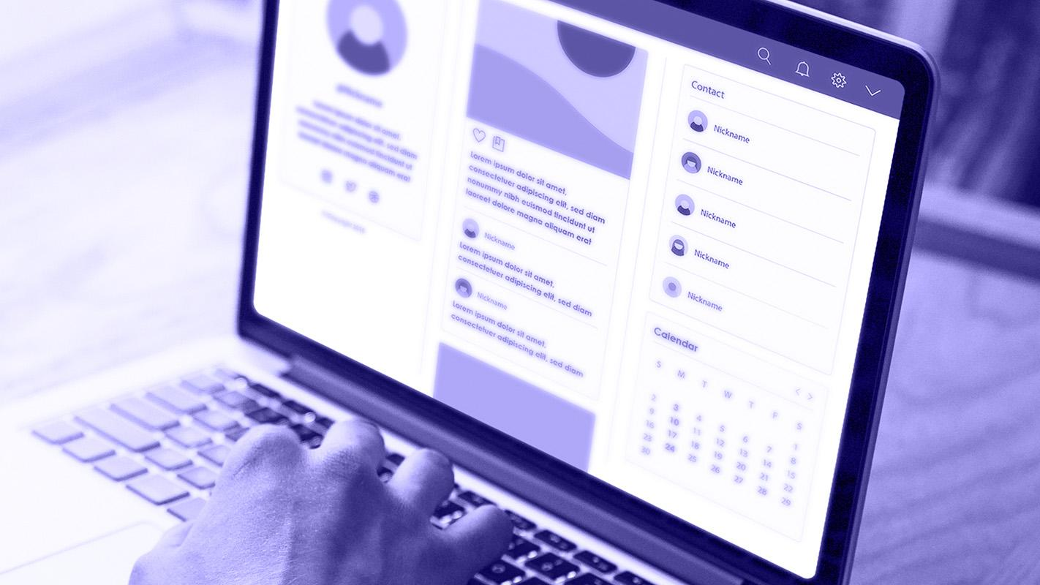
DATA STRUCTURE
"In our project, we juggled arrays, danced with linked lists, and played hide-and-seek with hash tables. But let's be real, the most important data structure was the 'Infinite Loop' of our minds, where bugs roamed free and ideas collided like bumper cars."
___

Slide 12
AVL TREE
70
50
100
30
60
80
120
75
90
LL,RR,LR,RL

Slide 13
MAX HEAP
​
60
30
40
20
10
5

Slide 14
03
OPTIMIZATIONS MADE

Slide 15

AVL
HEAP
"Our insertion function isn't just about adding nodes; it's a multitasking maestro! With a single swoop, it navigates the tree, searches for existing values, and seamlessly integrates new ones. Say goodbye to O(kn^2) complexity and hello to the streamlined efficiency of O(klnn)."
Code works well for input of more than a lakh sentence!
AVL
Code works well for input of more than a lakh sentence!

Slide 16
ARRAY/HEAP
AVL
With realloc(), our array grows on demand, sparing us from pre allocating a massive chunk of memory upfront.
Structure doesn't include concept of parent which makes it the most efficient!

Slide 17
OVERALL
Each part of the code has been crafted with care, each part is primed to handle the heavy lifting, effortlessly managing data sets of over a lakh"

Slide 18
PROCESS
Step 1
Step 2
Step 3
Step 4
Step 5
Step 6
Planning the layout of the project
Reading various research papers.
Deciding the data structures.
.
Learning how to write clean, efficient code
Compiling code and running it with huge data set
Preparing documentation

Slide 19
04
APPLICATIONS

Slide 20
OPERATIONALIZED DATA
Google built applications on top of their Knowledge Graph to add an additional layer for Insights.
For example:
When a user searches “restaurants near me,” it doesn’t just surface the specific detail (restaurant names) the user searched for. It also brings up review data, ratings, directions, and a plethora of well-curated insights that the user can instantly process to choose within seconds.

Slide 21
RELEVANCE
If billions of data points are produced for a specific object, and a user searches that object, which data point should surface?
This is solved through the Knowledge Graph’s capability to include peer insights (peer here means peer data assets).
SEO or Search Engine Optimization is the method to curate and surface information that, on a high level, has:
The right set of keywords (or tags)
Several data points that point to that data point as a relevant source of information (backlinks- peer validation)

Slide 22
05
FUTURE GOALS

Slide 23
SERIALIZATION()
FILE
DATABASE
OBJECT
STREAM OF BYTES
STREAM OF BYTES
MEMORY
SERIALIZATION
MEMORY
DESERIALIZATION

Slide 24
SOCKET PROGRAMING
SOCKET()
BIND()
SOCKET()
LISTEN()
ACCEPT()
CONNECT()
RECV()
SEND()
SEND()
RECV()
CLOSE()
CLOSE()

Slide 25
NLP : NATURAL LANGUAGE PROCESSING
OBJECT
VERB
SUBJECT
Thomas Jefferson was an American statesman, diplomat, lawyer, architect, philosopher and Founding Father who served as the third president of the United States from 1801 to 1809.

Slide 26
The goal of information extraction pipeline is to extract structured information from unstructured text. Image by the author.​
Albert Einstein is best known for developing the theory of relativity
Albert Einstein
Developed
Theory of relativity

Slide 27
THANK YOU!

