Slide 1
Analog and Digital Data
1
Notes:
Data Communication

Slide 2
Analog and Digital Data
Data can be analog or digital.
The term analog data refers to information that is continuous; digital data refers to information that has discrete states.
For example, an analog clock that has hour, minute, and second hands gives information in a continuous form; the movements of the hands are continuous.
On the other hand, a digital clock that reports the hours and the minutes will change suddenly from 8:05 to 8:06.
2
Notes:
Data Communication

Slide 3
Analog and Digital Data
Analog data, such as the sounds made by a human voice, take on continuous values.
When someone speaks, an analog wave is created in the air.
This can be captured by a microphone and converted to an analog signal or sampled and converted to a digital signal.
3
Notes:
Data Communication

Slide 4
Analog and Digital Data
Digital data take on discrete values.
For example, data are stored in computer memory in the form of 0s and 1s.
They can be converted to a digital signal or modulated into an analog signal for transmission across a medium.
4
Notes:
Data Communication

Slide 5
Analog and Digital Signals
Like the data they represent, signals can be either analog or digital.
An analog signal has infinitely many levels of intensity over a period of time.
As the wave moves from value A to value B, it passes through and includes an infinite number of values along its path.
A digital signal, on the other hand, can have only a limited number of defined values.
Although each value can be any number, it is often as simple as 1 and 0.
5
Notes:
Data Communication

Slide 6
Analog and Digital Signals
The simplest way to show signals is by plotting them on a pair of perpendicular axes.
The vertical axis represents the value or strength of a signal.
The horizontal axis represents time.
Figure illustrates an analog signal and a digital signal.
6
Notes:
Data Communication

Slide 7
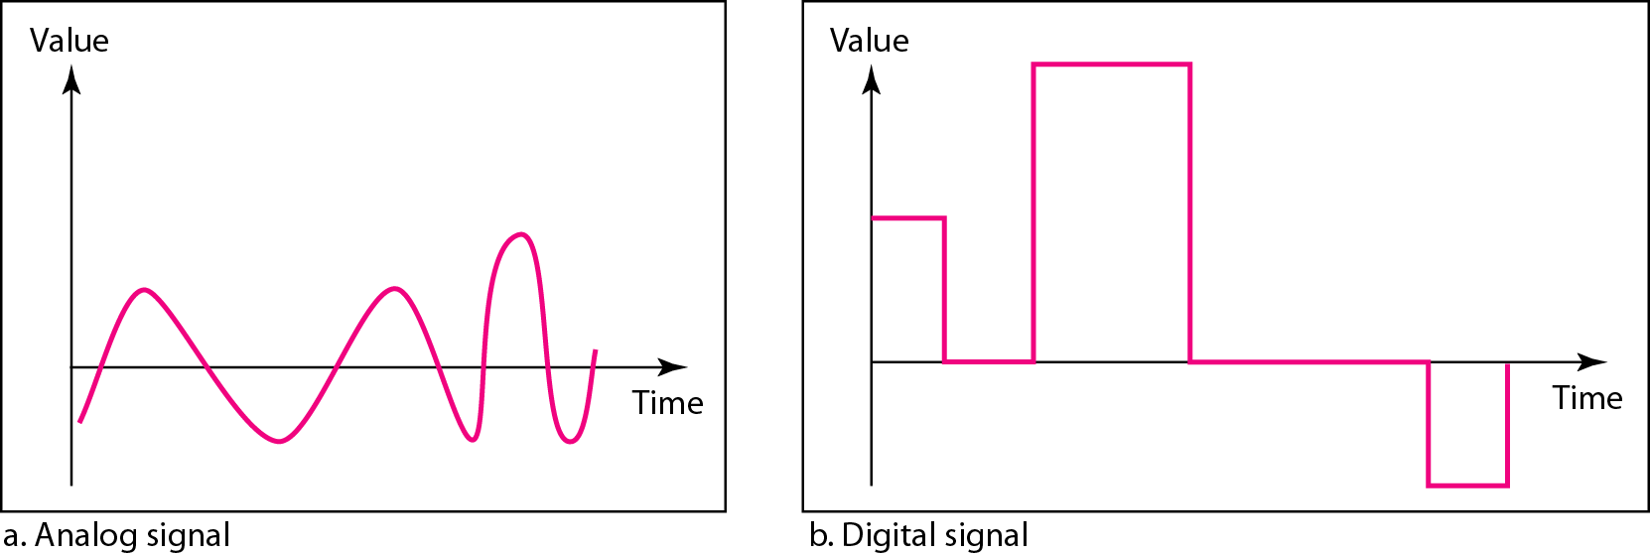
Analog and Digital Signals
Figure : Comparison of analog and digital signals
7
Notes:
Data Communication

Slide 8
Analog and Digital Signals
The curve representing the analog signal passes through an infinite number of points.
The vertical lines of the digital signal, however, demonstrate the sudden jump that the signal makes from value to value.
8
Notes:
Data Communication

Slide 9
Periodic and Non-periodic Signals
Both analog and digital signals can take one of two forms: periodic or non-periodic (sometimes refer to as aperiodic, because the prefix a in Greek means "non").
A periodic signal completes a pattern within a measurable time frame, called a period, and repeats that pattern over subsequent identical periods.
The completion of one full pattern is called a cycle.
A non-periodic signal changes without exhibiting a pattern or cycle that repeats over time.
Both analog and digital signals can be periodic or non-periodic.
9
Notes:
Data Communication

Slide 10
Periodic and Nonperiodic Signals
In data communications, we commonly use periodic analog signals (because they need less bandwidth) and non-periodic digital signals (because they can represent variation in data)
10
Notes:
Data Communication

Slide 11
Periodic Analog Signals
Periodic analog signals can be classified as simple or composite.
A simple periodic analog signal, a sine wave, cannot be decomposed into simpler signals.
A composite periodic analog signal is composed of multiple sine waves.
11
Notes:
Data Communication

Slide 12
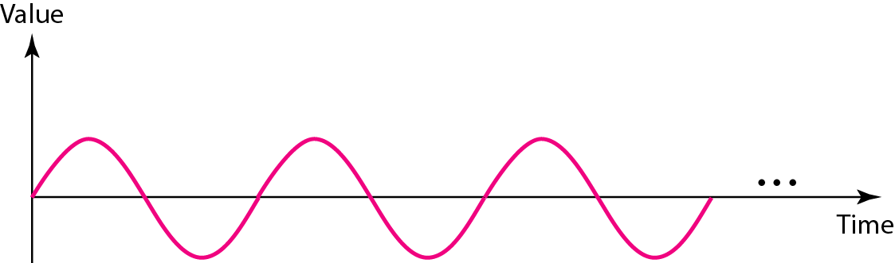
Sine Wave
The sine wave is the most fundamental form of a periodic analog signal.
When we visualize it as a simple oscillating curve, its change over the course of a cycle is smooth and consistent, a continuous, rolling flow.
Figure shows a sine wave. Each cycle consists of a single arc above the time axis followed by a single arc below it.
12
Notes:
Data Communication

Slide 13
Peak Amplitude
The peak amplitude of a signal is the absolute value of its highest intensity, proportional to the energy it carries.
For electric signals, peak amplitude is normally measured in volts.
Figure shows two signals and their peak amplitudes
13
Notes:
Data Communication

Slide 14
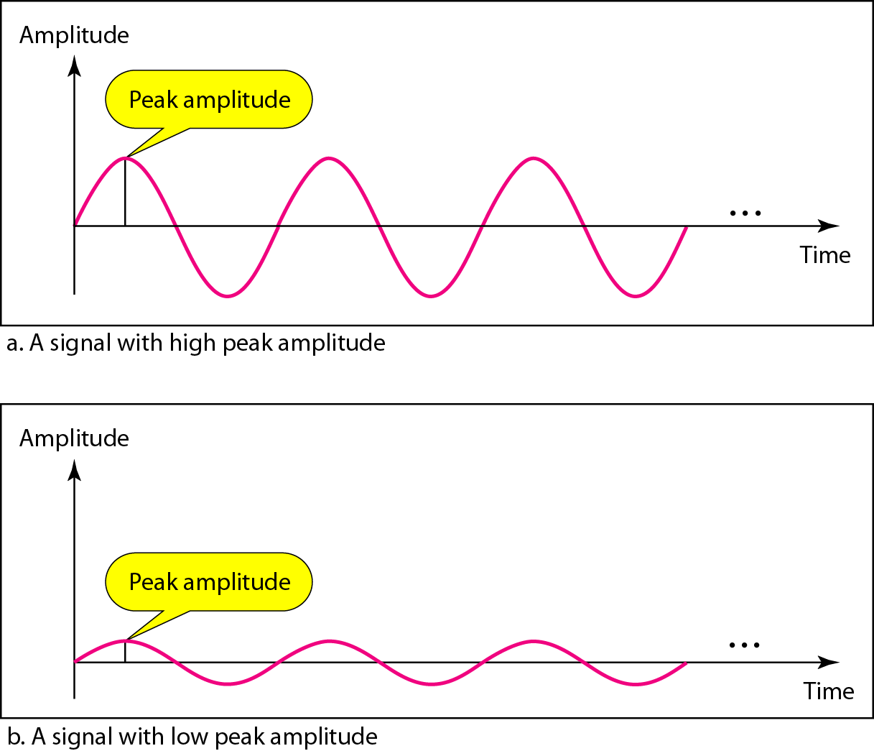
Peak Amplitude
14
Notes:
Data Communication

Slide 15

Period and Frequency
Period refers to the amount of time, in seconds, a signal needs to complete one cycle.
Frequency refers to the number of periods in 1 s.
Note that period and frequency are just one characteristic defined in two ways.
Period is the inverse of frequency, and frequency is the inverse of period.
15
Notes:
Data Communication

Slide 16
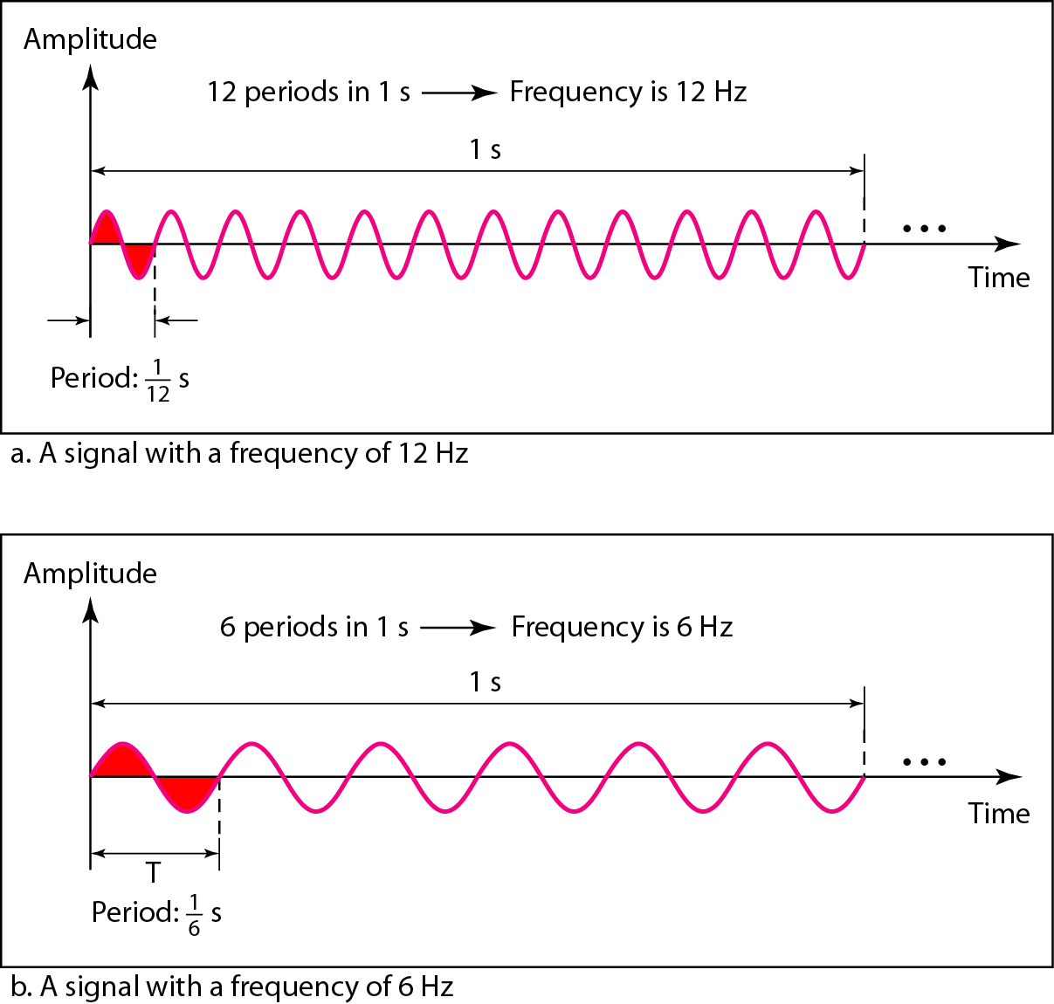
Period and Frequency
16
Notes:
Data Communication

Slide 17
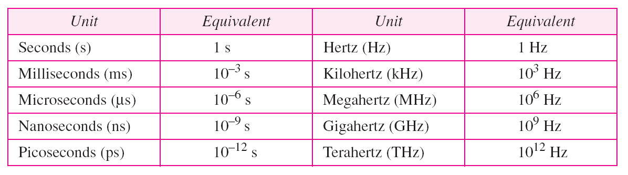
Period and Frequency
Period is formally expressed in seconds.
Frequency is formally expressed in Hertz (Hz), which is cycle per second.
Units of period and frequency are shown in Table.
17
Notes:
Data Communication

Slide 18
Bandwidth
The range of frequencies contained in a composite signal is its bandwidth.
The bandwidth is normally a difference between two numbers.
For example, if a composite signal contains frequencies between 1000 and 5000, its bandwidth is 5000 - 1000, or 4000
The bandwidth of a composite signal is the difference between the highest and the lowest frequencies contained in that signal.
18
Notes:
Data Communication

Slide 19
Digital Signal
In addition to being represented by an analog signal, information can also be represented by a digital signal.
For example, a I can be encoded as a positive voltage and a 0 as zero voltage.
A digital signal can have more than two levels.
In this case, we can send more than 1 bit for each level.
Figure shows two signals, one with two levels and the other with four.
19
Notes:
Data Communication

Slide 20
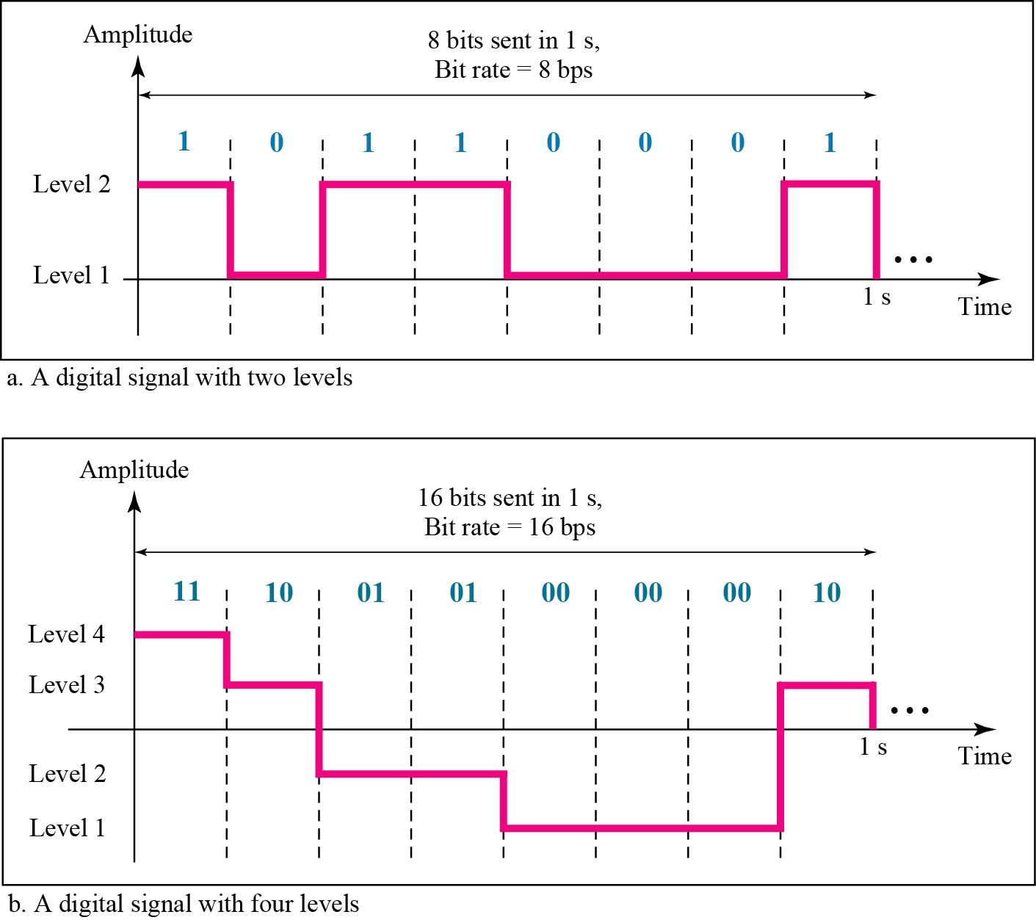
Digital Signal
20
Notes:
Data Communication

Slide 21
Bit Rate
The bit rate is the number of bits sent in 1second, expressed in bits per second (bps)
Assume we need to download text documents at the rate of 100 pages per minute. What is the required bit rate of the channel?
Solution
A page is an average of 24 lines with 80 characters in each line. If we assume that one character requires 8 bits, the bit rate is
21
Notes:
Data Communication

Slide 22
TRANSMISSION IMPAIRMENT
Signals travel through transmission media, which are not perfect.
The impetfection causes signal impairment.
This means that the signal at the beginning of the medium is not the same as the signal at the end of the medium.
What is sent is not what is received.
Three causes of impairment are attenuation, distortion, and noise.
22
Notes:
Data Communication

Slide 23
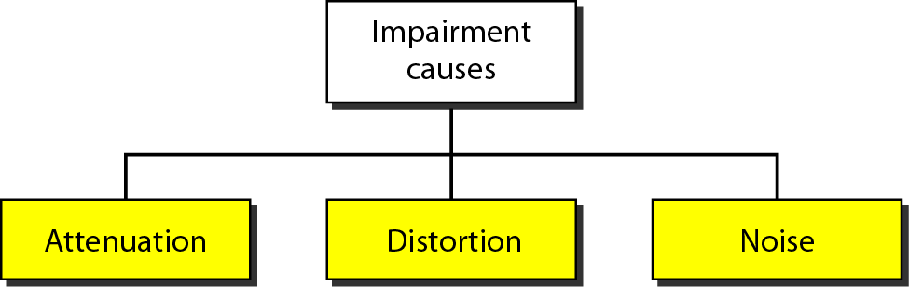
TRANSMISSION IMPAIRMENT
23
Notes:
Data Communication

Slide 24
Attenuation
Attenuation means a loss of energy.
When a signal, simple or composite, travels through a medium, it loses some of its energy in overcoming the resistance of the medium.
Why a wire carrying electric signals gets warm, if not hot, after a while.
Some of the electrical energy in the signal is converted to heat.
To compensate for this loss, amplifiers are used to amplify the signal.
Figure shows the effect of attenuation and amplification.
24
Notes:
Data Communication

Slide 25
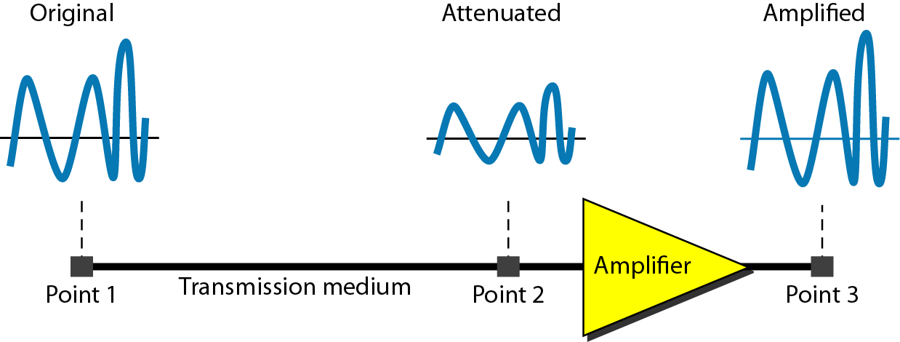
Attenuation
Notes:
Data Communication

Slide 26
Decibel
To show that a signal has lost or gained strength, engineers use the unit of the decibel.
The decibel (dB) measures the relative strengths of two signals or one signal at two different points.
Note that the decibel is negative if a signal is attenuated and positive if a signal is amplified.
dB= 10 log₁₀ (P2/P1)
Variables P1 and P2 are the powers of a signal at points 1 and 2, respectively.
26
Notes:
Data Communication

Slide 27

Decibel
Suppose a signal travels through a transmission medium and its power is reduced to one-half. This means that P2 is (1/2)P1. In this case, the attenuation (loss of power) can be calculated as
A loss of 3 dB (–3 dB) is equivalent to losing one-half the power.
27
Notes:
Data Communication

Slide 28

Decibel
A signal travels through an amplifier, and its power is increased 10 times. This means that P₂ = 10P₁ . In this case, the amplification (gain of power) can be calculated as
28
Notes:
Data Communication

Slide 29
Distortion
Distortion means that the signal changes its form or shape.
Distortion can occur in a composite signal made of different frequencies.
Each signal component has its own propagation speed through a medium and, therefore, its own delay in arriving at the final destination.
Differences in delay may create a difference in phase if the delay is not exactly the same as the period duration.
29
Notes:
Data Communication

Slide 30
Distortion
Signal components at the receiver have phases different from what they had at the sender.
The shape of the composite signal is therefore not the same.
Figure shows the effect of distortion on a composite signal.
30
Notes:
Data Communication

Slide 31
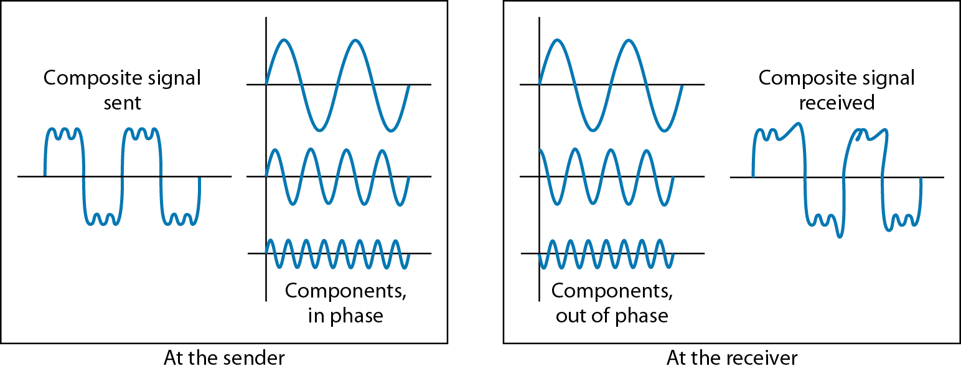
Distortion
31
Notes:
Data Communication

Slide 32
Noise
Noise is another cause of impairment.
Several types of noise, such as thermal noise, induced noise, crosstalk, and impulse noise, may corrupt the signal.
Thermal noise is the random motion of electrons in a wire which creates an extra signal not originally sent by the transmitter.
Induced noise comes from sources such as motors and appliances.
These devices act as a sending antenna, and the transmission medium acts as the receiving antenna.
32
Notes:
Data Communication

Slide 33
Noise
Crosstalk is the effect of one wire on the other.
One wire acts as a sending antenna and the other as the receiving antenna.
Impulse noise is a spike (a signal with high energy in a very short time) that comes from power lines, lightning, and so on.
Figure shows the effect of noise on a signal.
33
Notes:
Data Communication

Slide 34
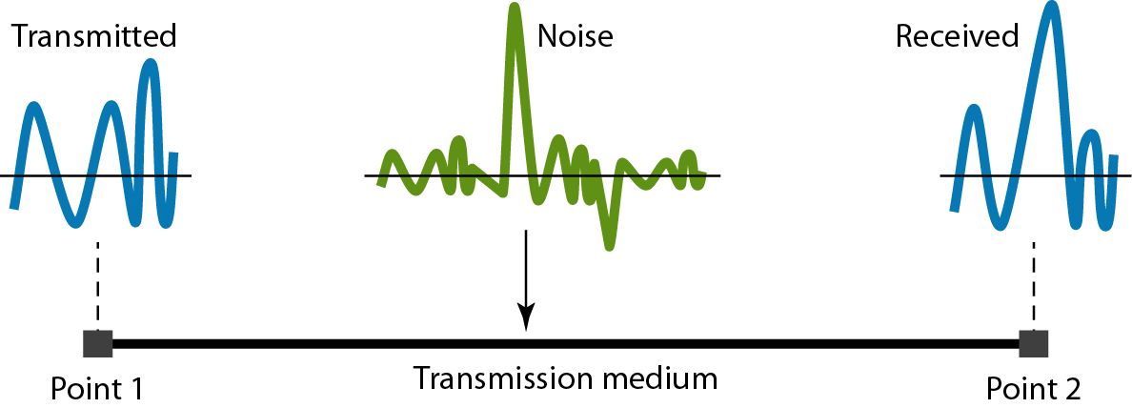
Noise
34
Notes:
Data Communication

Slide 35
Signal-to-Noise Ratio (SNR)
To find the theoretical bit rate limit, we need to know the ratio of the signal power to the noise power.
The signal-to-noise ratio is defined as
SNR= Avg Signal Power/Avg Noise Power
SNR is actually the ratio of what is wanted (signal) to what is not wanted (noise).
A high SNR means the signal is less corrupted by noise; a low SNR means the signal is more corrupted by noise.
35
Notes:
Data Communication

Slide 36
Signal-to-Noise Ratio (SNR)
Because SNR is the ratio of two powers, it is often described in decibel units, SNRdB, defined as
SNRdB=10 log₁₀ SNR
36
Notes:
Data Communication

Slide 37
Signal-to-Noise Ratio (SNR)
The power of a signal is 10 mW and the power of the noise is 1 μW; what are the values of SNR and SNR_{dB} ?
Solution
The values of SNR and SNRdB can be calculated as follows:
37
Notes:
Data Communication

Slide 38
Signal-to-Noise Ratio (SNR)
The values of SNR and SNRdB for a noiseless channel are
We can never achieve this ratio in real life; it is an ideal.
38
Notes:
Data Communication

Slide 39
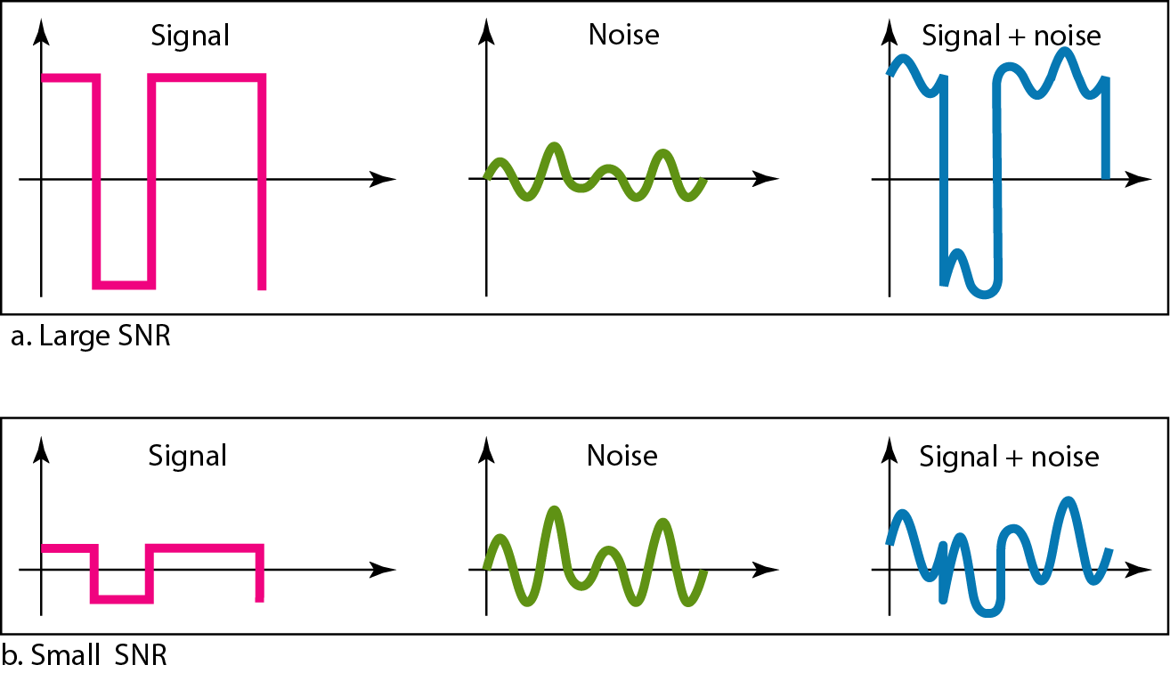
Signal-to-Noise Ratio (SNR)
39
Notes:
Data Communication

Slide 40
Data Rate Limits
A very important consideration in data communications is how fast we can send data, in bits per second. over a channel.
Data rate depends on three factors:
1. The bandwidth available
2. The level of the signals we use
3. The quality of the channel (the level of noise)
Two theoretical formulas were developed to calculate the data rate: one by Nyquist for a noiseless channel. another by Shannon for a noisy channel.
40
Notes:
Data Communication

Slide 41
Noiseless Channel: Nyquist Bit Rate
For a noiseless channel, the Nyquist bit rate formula defines the theoretical maximum bit rate
Bit Rate= 2 X Bandwidth log₂ L
bandwidth is the bandwidth of the channel, L is the number of signal levels used to represent data, and BitRate is the bit rate in bits per second.
41
Notes:
Data Communication

Slide 42
Noiseless Channel: Nyquist Bit Rate
Consider a noiseless channel with a bandwidth of 3000 Hz transmitting a signal with two signal levels. The maximum bit rate can be calculated as
42
Notes:
Data Communication

Slide 43
Noiseless Channel: Nyquist Bit Rate
Consider the same noiseless channel transmitting a signal with four signal levels (for each level, we send 2 bits). The maximum bit rate can be calculated as
43
Notes:
Data Communication

Slide 44
Noisy Channel: Shannon Capacity
In reality, we cannot have a noiseless channel; the channel is always noisy.
In 1944, Claude Shannon introduced a formula, called the Shannon capacity, to determine the theoretical highest data rate for a noisy channel:
Capacity =bandwidth X log₂ (1 +SNR)
44
Notes:
Data Communication

Slide 45
Noisy Channel: Shannon Capacity
Consider an extremely noisy channel in which the value of the signal-to-noise ratio is almost zero. In other words, the noise is so strong that the signal is faint. For this channel the capacity C is calculated as
45
Notes:
Data Communication

Slide 46
Performance
One important issue in networking is the performance of the network-how good is it?
We discuss quality of service, an overall measurement of network performance
Bandwidth
One characteristic that measures network performance is bandwidth.
However, the term can be used in two different contexts with two different measuring values: bandwidth in hertz and bandwidth in bits per second.
46
Notes:
Data Communication

Slide 47
Bandwidth in HZ
Bandwidth in hertz is the range of frequencies contained in a composite signal or the range of frequencies a channel can pass.
For example, we can say the bandwidth of a subscriber telephone line is 4 kHz.
47
Notes:
Data Communication

Slide 48
Bandwidth in Bits/Seconds
The term bandwidth can also refer to the number of bits per second that a channel, a link, or even a network can transmit.
For example, one can say the bandwidth of a Fast Ethernet network (or the links in this network) is a maximum of 100 Mbps. This means that this network can send 100 Mbps.
48
Notes:
Data Communication

Slide 49
Relationship
In networking, we use the term bandwidth in two contexts.
❏ The first, bandwidth in hertz, refers to the range of frequencies in a composite signal or the range of frequencies that a channel can pass.
❏ The second, bandwidth in bits per second, refers to the speed of bit transmission in a channel or link.
49
Notes:
Data Communication

Slide 50
Throughput
The throughput is a measure of how fast we can actually send data through a network.
Although, at first glance, bandwidth in bits per second and throughput seem the same, they are different.
A link may have a bandwidth of B bps, but we can only send T bps through this link with T always less than B.
The bandwidth is a potential measurement of a link; the throughput is an actual measurement of how fast we can send data.
50
Notes:
Data Communication

Slide 51
Throughput
For example, we may have a link with a bandwidth of 1 Mbps, but the devices connected to the end of the link may handle only 200 kbps.
This means that we cannot send more than 200 kbps through this link.
Imagine a highway designed to transmit 1000 cars per minute from one point to another. However, if there is congestion on the road, this figure may be reduced to 100 cars per minute. The bandwidth is 1000 cars per minute; the throughput is 100 cars per minute.
51
Notes:
Data Communication

Slide 52

Throughput
A network with bandwidth of 10 Mbps can pass only an average of 12,000 frames per minute with each frame carrying an average of 10,000 bits. What is the throughput of this network?
Solution
We can calculate the throughput as
The throughput is almost one-fifth of the bandwidth in this case.
52
Notes:
Data Communication

Slide 53
Latency (Delay)
It defines how long it takes for an entire message to completely arrive at the destination from the time the first bit is sent out from the source.
It is made of four components: propagation time, transmission time, queuing time and processing delay.
Latency = Propagation Time + Transmission Time + Queuing Time + Processing Delay
53
Notes:
Data Communication

Slide 54
Propagation Time
It measures the time required for a bit to travel from the source to the destination
It is calculated by dividing the distance by the propagation speed
The propagation speed of electromagnetic signals depends on the medium and on the frequency of the signal.
For example, in a vacuum, light is propagated with a speed of 3 x 10⁸ m/s. It is lower in air; it is much lower in cable.
54
Notes:
Data Communication

Slide 55
What is the propagation time if the distance between the two points is 12,000 km? Assume the propagation speed to be 2.4 × 10⁸ m/s in cable.
Solution
We can calculate the propagation time as
55
Notes:
Data Communication

Slide 56
Transmission Time
We don't send just 1 bit, we send a message.
The first bit may take a time equal to the propagation time to reach its destination; the last bit also may take the same amount of time.
There is a time between the first bit leaving the sender and the last bit arriving at the receiver.
The first bit leaves earlier and arrives earlier; the last bit leaves later and arrives later.
The time required for transmission of a message depends on the size of the message and the bandwidth of the channel.
56
Notes:
Data Communication

Slide 57
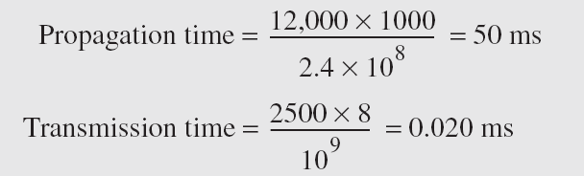
Transmission Time
Transmission Time= Message Size/BW
What are the propagation time and the transmission time for a 2.5-kbyte message (an e-mail) if the bandwidth of the network is 1 Gbps? Assume that the distance between the sender and the receiver is 12,000 km and that light travels at 2.4 × 10⁸ m/s.
Solution
57
Notes:
Data Communication

Slide 58
Transmission Time
What are the propagation time and the transmission time for a 5-Mbyte message (an image) if the bandwidth of the network is 1 Mbps? Assume that the distance between the sender and the receiver is 12,000 km and that light travels at 2.4 × 10⁸ m/s.
Notes:
Data Communication

Slide 59
Queuing Time
The time needed for each intermediate or end device to hold the message before it can be processed.
The queuing time is not a fixed factor; it changes with the load imposed on the network.
When there is heavy traffic on network, the queuing time increases.
An intermediate device, such as a router, queues the arrived messages and processes them one by one.
If there are many messages, each message will have to wait.
59
Notes:
Data Communication

Slide 60
Jitter
Another performance issue that is related to delay is jitter.
We can roughly say that jitter is a problem if different packets of data encounter different delays and the application using the data at the receiver site is time-sensitive (audio and video data, for example).
If the delay for the first packet is 20 ms, for the second is 45 ms, and for the third is 40 ms, then the real-time application that uses the packets endures jitter
60
Notes:
Data Communication

