Slide 1
Digital Transmission
Notes:
Data Communication

Slide 2
Digital-to-Digital Conversion
The conversion involves three techniques:
line coding,
block coding, and
scrambling.
Line coding is always needed - block coding and scrambling may or may not be needed
2
Notes:
Data Communication

Slide 3
Line Coding
It is the process of converting digital data to digital signals
We assume that data, in the form of text, numbers, graphical images, audio, or video, are stored in computer memory as sequences of bits.
Line coding converts a sequence of bits to a digital signals
At the sender, digital data are encoded into a digital signal; at the receiver, the digital data are recreated by decoding the digital signal.
Figure shows the process.
3
Notes:
Data Communication

Slide 4
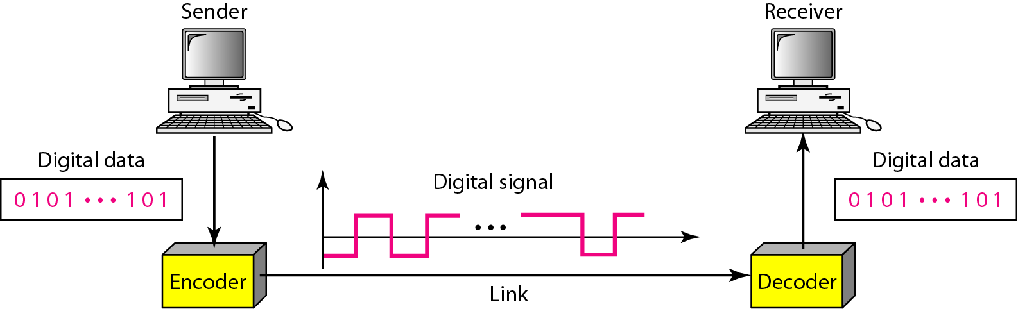
Line Coding
Line coding and decoding
4
Notes:
Data Communication

Slide 5
Signal Element Vs Data Element
A data element is the smallest entity that can represent a piece of information: this is the bit.
In digital data communications, a signal element carries data elements.
A signal element is the shortest unit (time wise) of a digital signal.
Data elements are what we need to send; signal elements are what we can send.
Data elements are being carried; signal elements are the carriers.
5
Notes:
Data Communication

Slide 6
Signal Element Vs Data Element
We define a ratio r which is the number of data elements carried by each signal element.
Figure shows several situations with different values of r.
6
Notes:
Data Communication

Slide 7
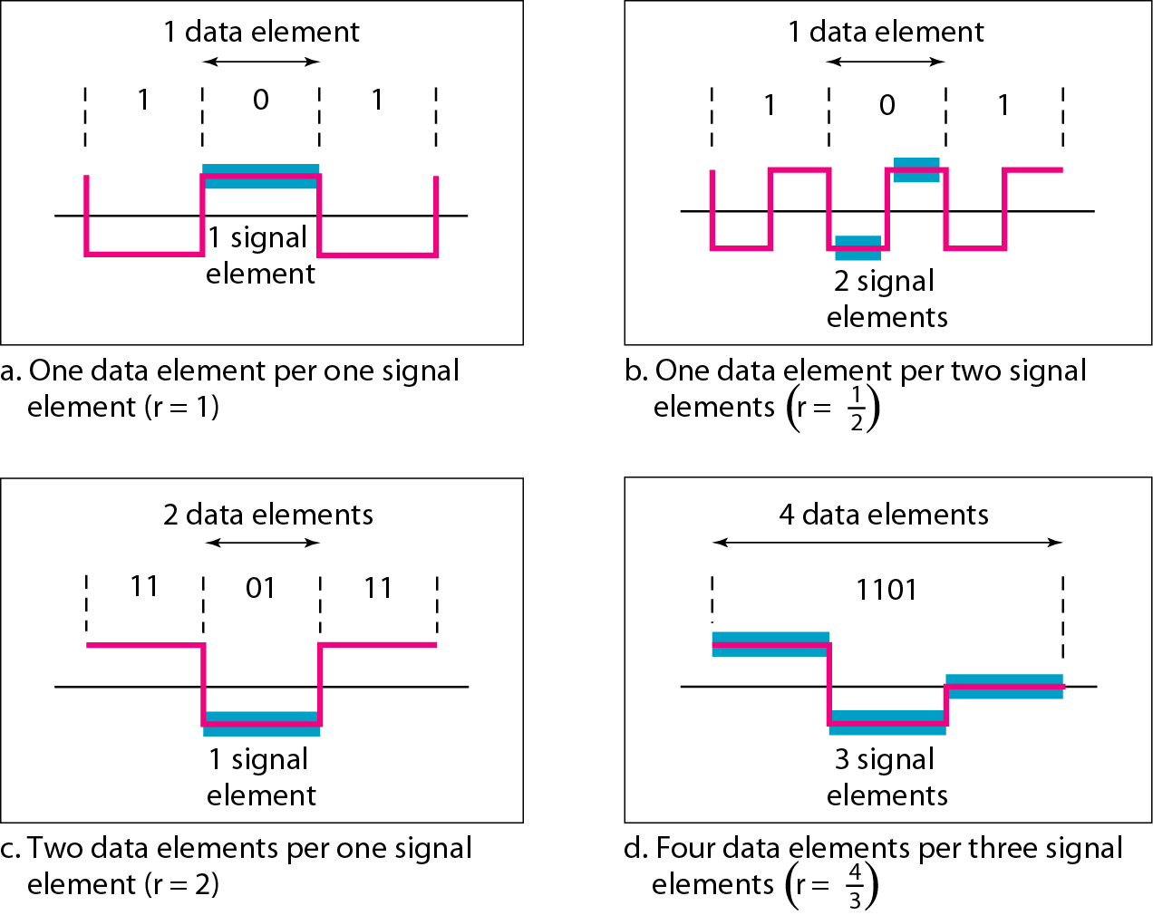
Signal Element Versus Data Element
7
Notes:
Data Communication

Slide 8
Data Rate Vs Signal Rate
The data rate defines the number of data elements (bits) sent in 1 s.
The unit is bits per second (bps).
The signal rate is the number of signal elements sent in 1s.
The unit is the baud.
The data rate is sometimes called the bit rate; the signal rate is sometimes called the pulse rate, the modulation rate, or the baud rate.
8
Notes:
Data Communication

Slide 9
Data Rate Vs Signal Rate
One goal in data communications is to increase the data rate while decreasing the signal rate.
Increasing the data rate increases the speed of transmission; decreasing the signal rate decreases the bandwidth requirement.
In our vehicle-people analogy, we need to carry more people in fewer vehicles to prevent traffic jams.
We have a limited bandwidth in our transportation system.
9
Notes:
Data Communication

Slide 10
Data Rate Vs Signal Rate
We can formulate the relationship between data rate and signal rate as
S= c * N *(1/r) baud
S= No. of signal elements
c= The case factor, which varies for each case
N= Data rate (bps)
r= No. of data elements carried by each signal element
10
Notes:
Data Communication

Slide 11
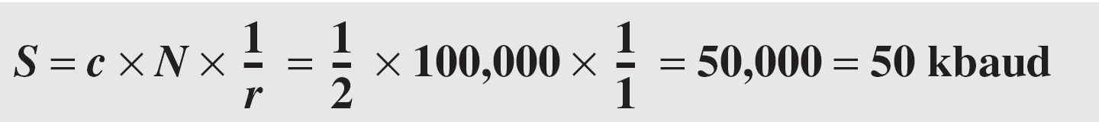
Data Rate Vs Signal Rate
A signal is carrying data in which one data element is encoded as one signal element ( r = 1). If the bit rate is 100 kbps, what is the average value of the baud rate if c is between 0 and 1?
Solution
We assume that the average value of c is 1/2 . The baud rate is then
11
Notes:
Data Communication

Slide 12
Bandwidth
Bandwidth of a digital signal is infinite, the effective bandwidth is finite
the bandwidth (range of frequencies) is proportional to the signal rate (baud rate).
The minimum bandwidth can be given as
Bmin = c * N * (1/r)
We can solve for the maximum data rate if the bandwidth of the channel is given
Nmax = (1/c) * B * r
12
Notes:
Data Communication

Slide 13
Baseline Wandering
In decoding a digital signal, the receiver calculates a running average of the received signal power.
This average is called the baseline.
The incoming signal power is evaluated against this baseline to determine the value of the data element.
A long string of 0s or 1s can cause a drift in the baseline (baseline wandering) and make it difficult for the receiver to decode correctly.
A good line coding scheme needs to prevent baseline wandering.
13
Notes:
Data Communication

Slide 14
DC ( Direct-Current) Components
When the voltage level in a digital signal is constant for a while, the spectrum creates very low frequencies (results of Fourier analysis).
These frequencies around zero, called DC (direct-current) components, present problems for a system that cannot pass low frequencies or a system that uses electrical coupling (via a transformer).
14
Notes:
Data Communication

Slide 15
Self-synchronization
To correctly interpret the signals received from the sender, the receiver's bit intervals must correspond exactly to the sender's bit intervals.
If the receiver clock is faster or slower, the bit intervals are not matched and the receiver might misinterpret the signals.
Figure shows a situation in which the receiver has a shorter bit duration. The sender sends 10110001, while the receiver receives 110111000011
15
Notes:
Data Communication

Slide 16
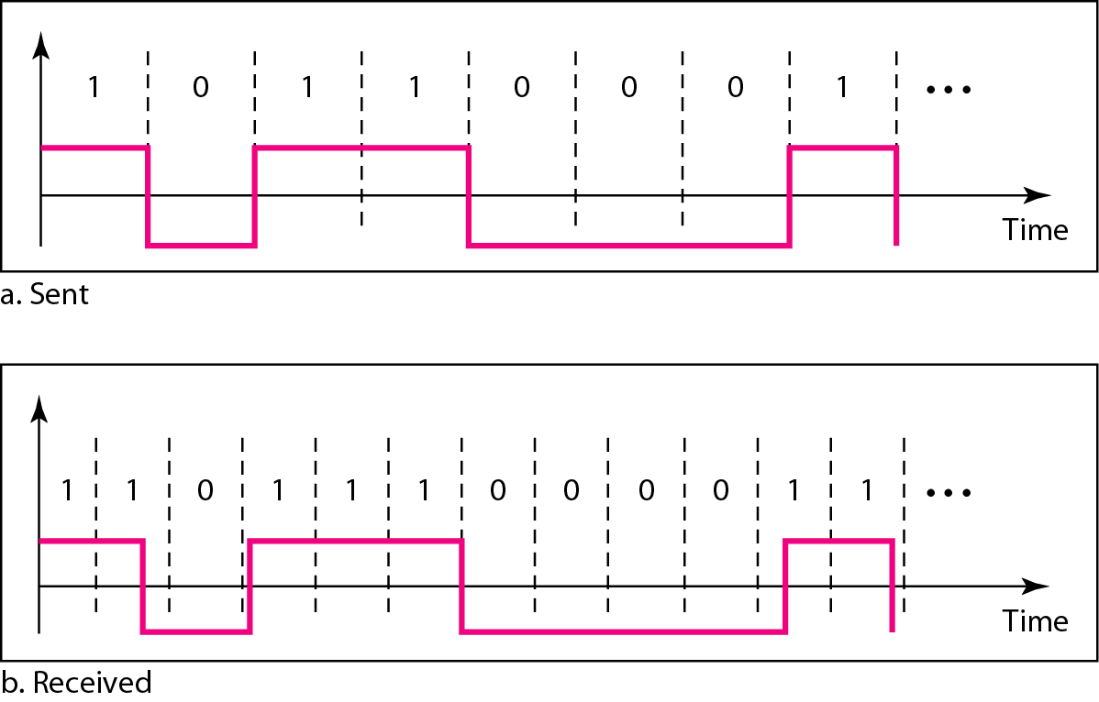
Self-synchronization
Effect of lack of synchronization
16
Notes:
Data Communication

Slide 17
Self-synchronization
A self-synchronizing digital signal includes timing information in the data being transmitted.
This can be achieved if there are transitions in the signal that alert the receiver to the beginning, middle, or end of the pulse.
If the receiver's clock is out of synchronization, these points can reset the clock.
17
Notes:
Data Communication

Slide 18
Self-synchronization
In a digital transmission, the receiver clock is 0.1 percent faster than the sender clock. How many extra bits per second does the receiver receive if the data rate is 1 kbps? How many if the data rate is 1 Mbps?
Solution
At 1 kbps, the receiver receives 1001 bps instead of 1000 bps.
At 1 Mbps, the receiver receives 1,001,000 bps instead of 1,000,000 bps.
18
Notes:
Data Communication

Slide 19
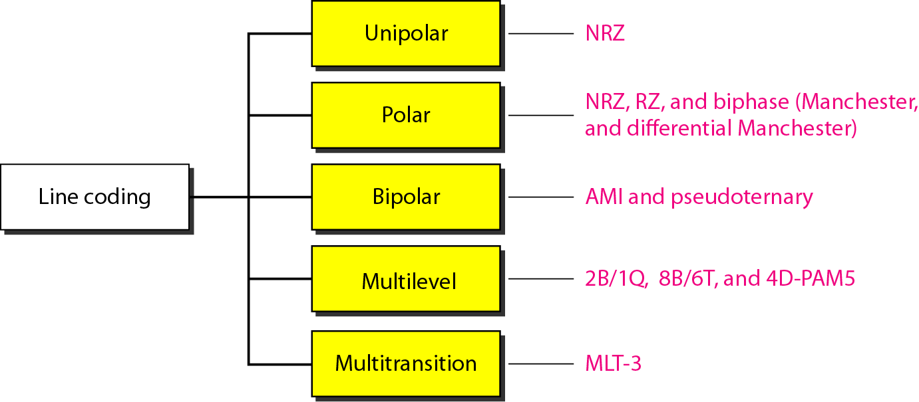
Line Coding Schemes
19
Notes:
Data Communication

Slide 20
Unipolar
All the signal levels are on one side of the time axis, either above or below
NRZ (Non-Return-to-Zero)
The positive voltage defines bit 1 and the zero voltage defines bit 0.
It is called NRZ because the signal does not return to zero at the middle of the bit.
Figure show a unipolar NRZ scheme.
20
Notes:
Data Communication

Slide 21
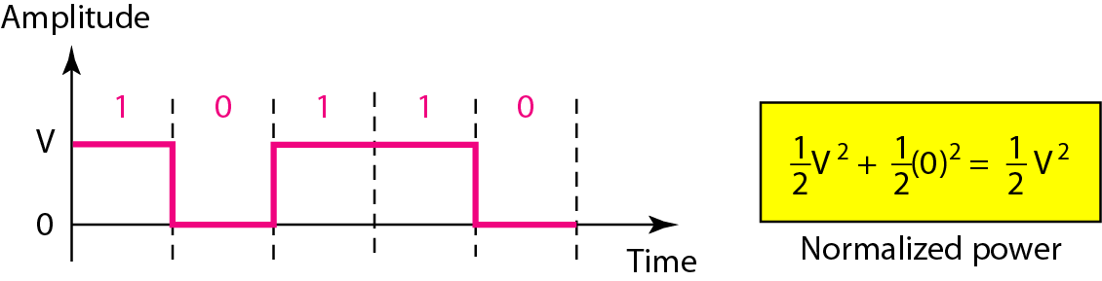
Unipolar- NRZ
21
Notes:
Data Communication

Slide 22
Polar Schemes
The voltages are on the both sides of the time axis.
Example : the voltage level for 0 can be positive and the voltage level for 1 can be negative.
Non-Return-to-Zero (NRZ)
In polar NRZ encoding, we use two levels of voltage amplitude.
We can have two versions of polar NRZ: NRZ-Level and NRZ-Invert, as shown in Figure.
22
Notes:
Data Communication

Slide 23
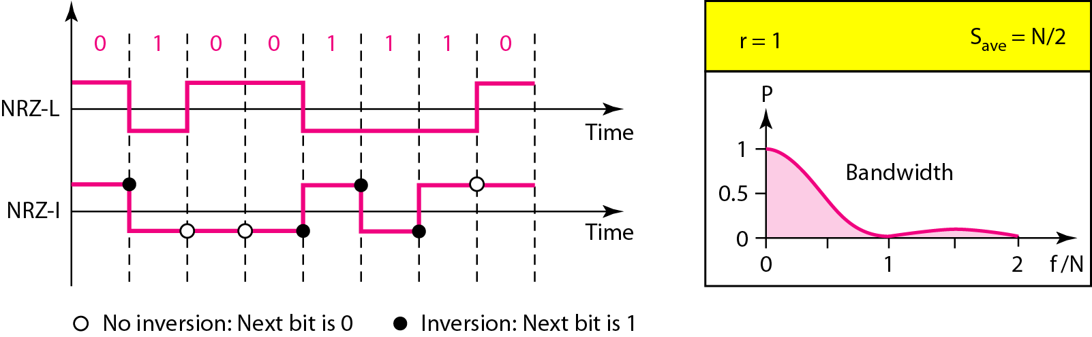
Non-Return-to-Zero (NRZ)
Polar NRZ-L and NRZ-I schemes
23
Notes:
Data Communication

Slide 24
Non-Return-to-Zero (NRZ)
The figure also shows the value of r, the average baud rate, and the bandwidth.
In the first variation, NRZ-L (NRZ-Level), the level of the voltage determines the value of the bit.
In the second variation, NRZ-I (NRZ-Invert), the change or lack of change in the level of the voltage determines the value of the bit.
If there is no change, the bit is 0; if there is a change, the bit is 1.
24
Notes:
Data Communication

Slide 25
NRZ – Baseline Wandering Problem
Although baseline wandering is a problem for both variations, it is twice as severe in NRZ-L.
If there is a long sequence of 0s or 1s in NRZ-L, the average signal power becomes skewed.
The receiver might have difficulty discerning the bit value.
In NRZ-I this problem occurs only for a long sequence of as.
If somehow we can eliminate the long sequence of as, we can avoid baseline wandering.
25
Notes:
Data Communication

Slide 26
NRZ – Synchronization Problem
The synchronization problem (sender and receiver clocks are not synchronized) also exists in both schemes.
Again, this problem is more serious in NRZ-L than in NRZ-I.
While a long sequence of as can cause a problem in both schemes, a long sequence of 1s affects only NRZ-L
26
Notes:
Data Communication

Slide 27
NRZ – Polarity
Another problem with NRZ-L occurs when there is a sudden change of polarity in the system.
For example, if twisted-pair cable is the medium, a change in the polarity of the wire results in all 0s interpreted as 1s and all 1s interpreted as 0s.
NRZ-I does not have this problem.
Both schemes have an average signal rate of N/2 Bd.
27
Notes:
Data Communication

Slide 28
NRZ – DC Component
The vertical axis shows the power density (the power for each 1Hz of bandwidth); the horizontal axis shows the frequency.
The bandwidth reveals a very serious problem for this type of encoding.
The value of the power density is very high around frequencies close to zero.
This means that there are DC components that carry a high level of energy
NRZ-L and NRZ-I both have a DC component problem
28
Notes:
Data Communication

Slide 29
NRZ – DC Component
Example : A system is using NRZ-I to transfer 10-Mbps data. What are the average signal rate and minimum bandwidth?
Solution
The average signal rate is S =N/2 =500 kbaud.
The minimum bandwidth for this average baud rate is Bmin = S = 500 kHz.
29
Notes:
Data Communication

Slide 30
Return to Zero (RZ)
The main problem with NRZ encoding occurs when the sender and receiver clocks are not synchronized.
The receiver does not know when one bit has ended and the next bit is starting.
One solution is the return-to-zero (RZ) scheme, which uses three values: positive, negative, and zero.
In RZ, the signal changes not between bits but during the bit.
In Figure, we see that the signal goes to 0 in the middle of each bit.
30
Notes:
Data Communication

Slide 31
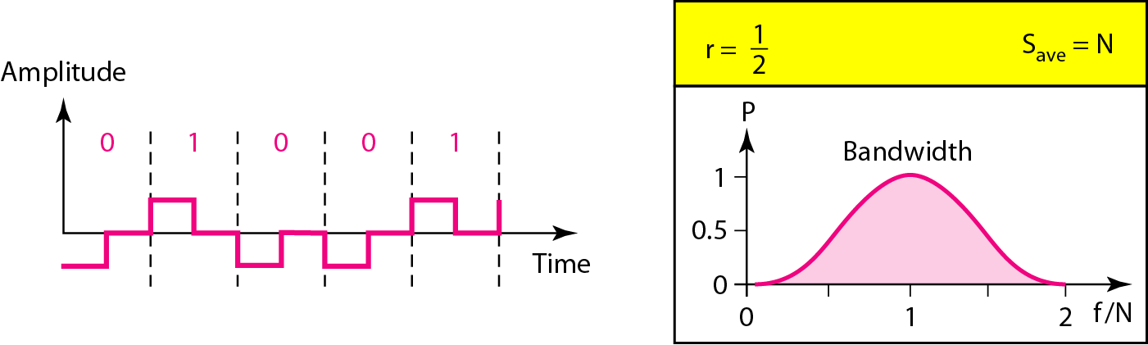
Return to Zero (RZ) – Polar RZ
31
Notes:
Data Communication

Slide 32
Return to Zero (RZ)
The main disadvantage of RZ encoding is that it requires two signal changes to encode a bit and therefore occupies greater bandwidth.
The same problem we mentioned, a sudden change of polarity resulting in all 0s interpreted as 1s and all 1s interpreted as 0s, still exist here
but there is no DC component problem. Another problem is the complexity
32
Notes:
Data Communication

Slide 33
Return to Zero (RZ)
RZ uses three levels of voltage, which is more complex to create and discern.
As a result of all these deficiencies, the scheme is not used today.
Instead, it has been replaced by the better-performing Manchester and differential Manchester schemes
33
Notes:
Data Communication

Slide 34
Biphase: Manchester and Differential Manchester
The idea of RZ and the NRZ-L are combined into the Manchester scheme.
In Manchester encoding, the duration of the bit is divided into two halves.
The voltage remains at one level during the first half and moves to the other level in the second half.
The transition at the middle of the bit provides synchronization.
Differential Manchester, on the other hand, combines the ideas of RZ and NRZ-I.
34
Notes:
Data Communication

Slide 35
Biphase: Manchester and Differential Manchester
There is always a transition at the middle of the bit, but the bit values are determined at the beginning of the bit.
If the next bit is 0, there is a transition; if the next bit is 1, there is none.
Figure shows both Manchester and differential Manchester encoding.
35
Notes:
Data Communication

Slide 36
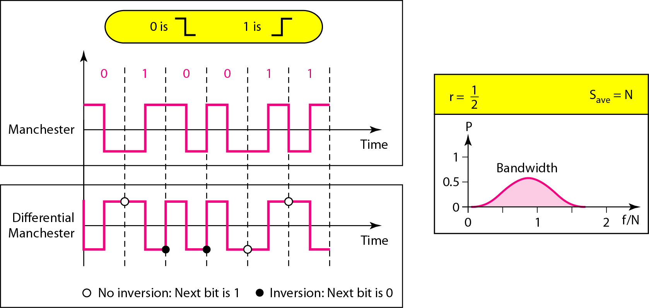
Biphase: Manchester and Differential Manchester
36
Notes:
Data Communication

Slide 37
Biphase: Manchester and Differential Manchester
The Manchester scheme overcomes several problems associated with NRZ-L, and differential Manchester overcomes several problems associated with NRZ-I.
First, there is no baseline wandering.
There is no DC component because each bit has a positive and negative voltage contribution.
The only drawback is the signal rate.
The signal rate for Manchester and differential Manchester is double that for NRZ.
37
Notes:
Data Communication

Slide 38
Biphase: Manchester and Differential Manchester
The reason is that there is always one transition at the middle of the bit and maybe one transition at the end of each bit.
Manchester and differential Manchester schemes are also called biphase schemes.
The minimum bandwidth of Manchester and differential Manchester is two times that of NRZ
38
Notes:
Data Communication

Slide 39
Bipolar Schemes
In bipolar encoding (sometimes called multilevel binary), there are three voltage levels: positive, negative, and zero.
The voltage level for one data element is at zero, while the voltage level for the other element alternates between positive and negative.
39
Notes:
Data Communication

Slide 40
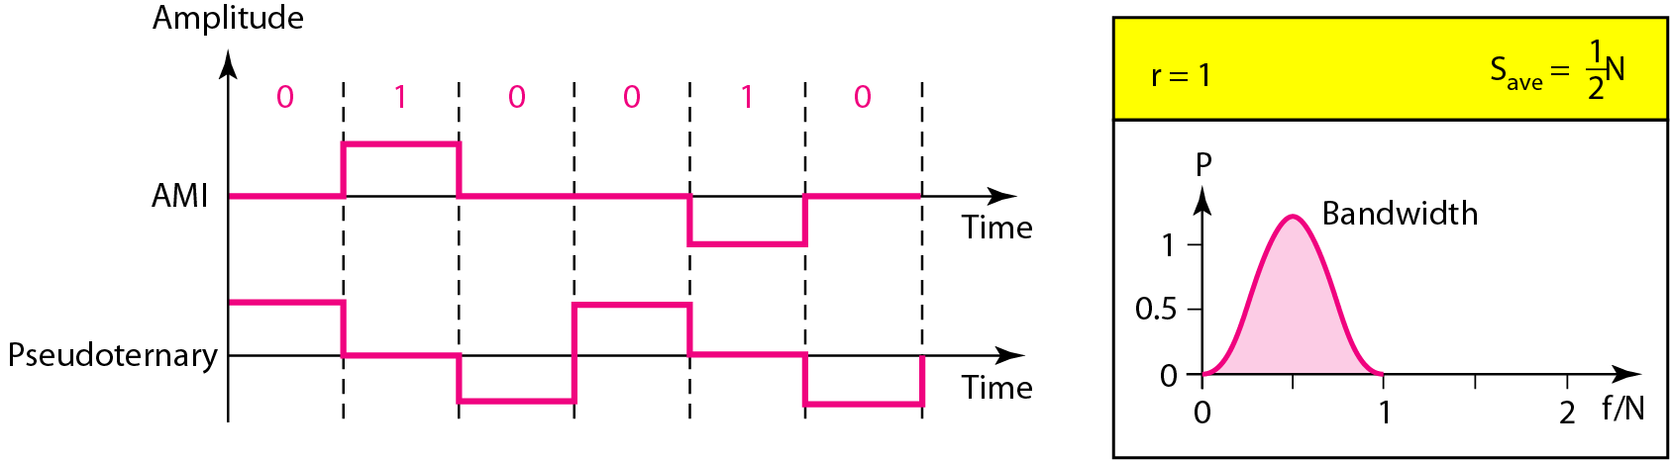
AMI and Pseudoternary
Figure shows two variations of bipolar encoding: AMI
and pseudoternary.
40
Notes:
Data Communication

Slide 41
Alternate Mark Inversion AMI and Pseudoternary
A common bipolar encoding scheme is called bipolar Alternate Mark Inversion (AMI).
In the term alternate mark inversion, the word mark comes from telegraphy and means 1.
So AMI means alternate 1 inversion.
A neutral zero voltage represents binary 0.
Binary 1s are represented by alternating positive and negative voltages.
41
Notes:
Data Communication

Slide 42
Alternate Mark Inversion AMI and Pseudoternary
A variation of AMI encoding is called pseudoternary in which the 1 bit is encoded as a zero voltage and the 0 bit is encoded as alternating positive and negative voltages
42
Notes:
Data Communication

Slide 43
Bipolar Schemes
The bipolar scheme was developed as an alternative to NRZ.
The bipolar scheme has the same signal rate as NRZ, but there is no DC component.
The NRZ scheme has most of its energy concentrated near zero frequency, which makes it unsuitable for transmission over channels with poor performance around this frequency.
The concentration of the energy in bipolar encoding is around frequency N/2.
43
Notes:
Data Communication

Slide 44
Why we do not have DC component in bipolar encoding?
If we have a long sequence of 1s, the voltage level alternates between positive and negative; it is not constant.
Therefore, there is no DC component.
For a long sequence of 0s, the voltage remains constant, but its amplitude is zero, which is the same as having no DC component.
In other words, a sequence that creates a constant zero voltage does not have a DC component.
44
Notes:
Data Communication

Slide 45
Bipolar Schemes
AMI is commonly used for long-distance communication, but it has a synchronization problem when a long sequence of 0s is present in the data.
45
Notes:
Data Communication

Slide 46
Multilevel Schemes
The desire to increase the data speed or decrease the required bandwidth has resulted in the creation of many schemes.
The goal is to increase the number of bits per baud by encoding a pattern of m data elements into a pattern of n signal elements.
We only have two types of data elements (0s and 1s), which means that a group of m data elements can produce a combination of 2^{m} data patterns.
46
Notes:
Data Communication

Slide 47
Multilevel Schemes
We can have different types of signal elements by allowing different signal levels. If we have L different levels, then we can produce L^{n} combinations of signal patterns.
If 2^{m} =L^{n}, then each data pattern is encoded into one signal pattern.
If 2^{m} < L^{n}, data patterns occupy only a subset of signal patterns.
The subset can be carefully designed to prevent baseline wandering, to provide synchronization, and to detect errors that occurred during data transmission.
47
Notes:
Data Communication

Slide 48
Multilevel Schemes
Data encoding is not possible if 2^{m} > L^{n} because some of the data patterns cannot be encoded.
The code designers have classified these types of coding as mBnL,
where m - the length of the binary pattern,
B - binary data,
n - the length of the signal pattern, and
L - the number of levels in the signaling.
48
Notes:
Data Communication

Slide 49
Multilevel Schemes
A letter is often used in place of L: B (binary) for L =2, T (ternary) for L =3, and Q (quaternary) for L =4.
Note that the first two letters define the data pattern, and the second two define the signal pattern.
49
Notes:
Data Communication

Slide 50
Two binary, one quaternary (2B1Q)
It uses data patterns of size 2 and encodes the 2-bit patterns as one signal element belonging to a four-level signal.
In this type of encoding m=2, n=1, and L=4 (quaternary).
Figure shows an example of a 2B1Q signal.
50
Notes:
Data Communication

Slide 51
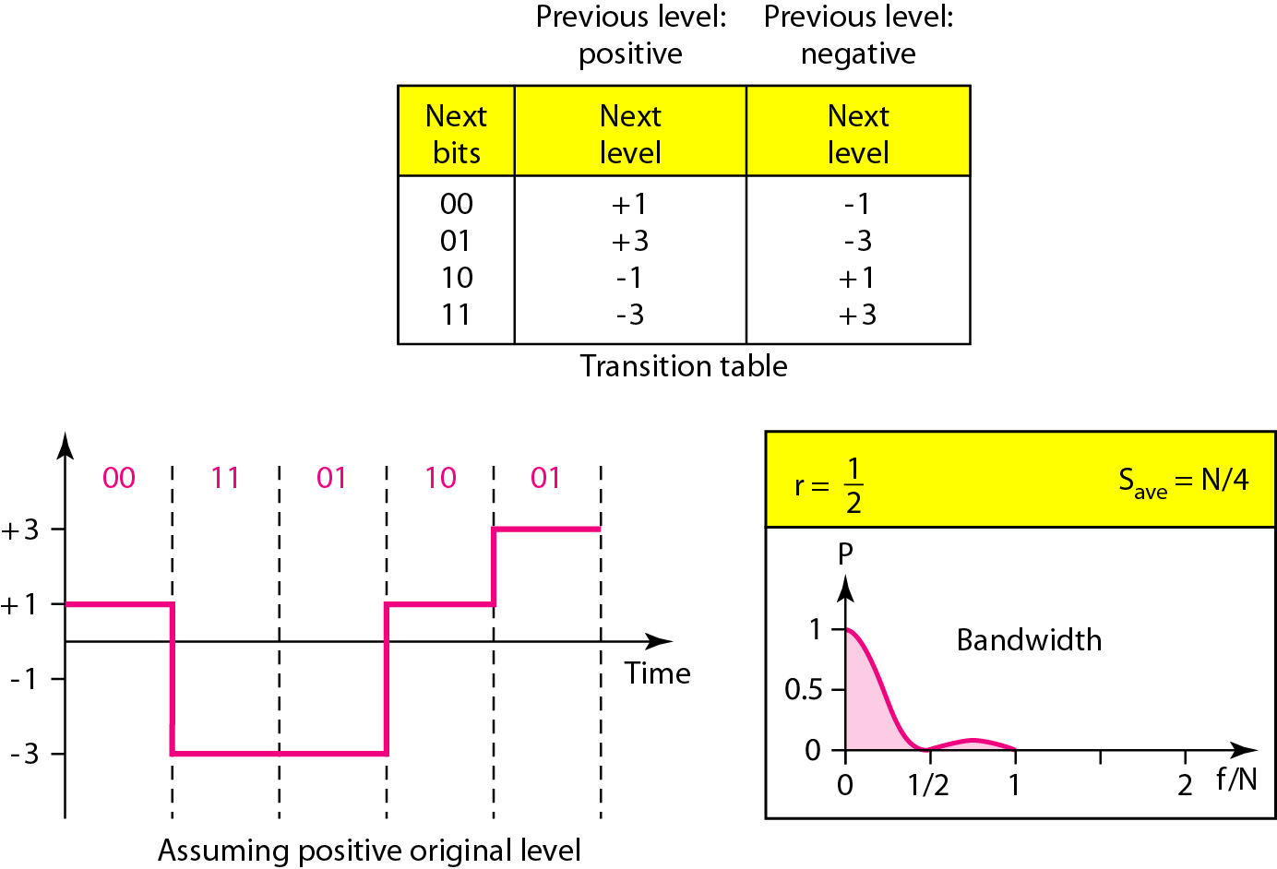
Two binary, one quaternary (2B1Q)
51
Notes:
Data Communication

Slide 52
Two binary, one quaternary (2BIQ)
The average signal rate of 2B1Q is S =N/4.
we can send data 2 times faster than by using NRZ-L.
However, 2BlQ uses four different signal levels, which means the receiver has to discern four different thresholds.
The reduced bandwidth comes with a price.
There are no redundant signal patterns in this scheme because 2² =4¹.
52
Notes:
Data Communication

Slide 53
Two binary, one quaternary (2BIQ)
2B1Q is used in DSL (Digital Subscriber Line) technology to provide a high-speed connection to the Internet by using subscriber telephone lines.
53
Notes:
Data Communication

Slide 54
eight binary, six ternary (8B6T).
This code is used with 100BASE-4T cable
The idea is to encode a pattern of 8 bits as a pattern of 6 signal elements, where the signal has three levels (ternary).
In this type of scheme, we can have 2⁸ =256 different data patterns and 3⁶ =478 different signal patterns.
There are 478 - 256 =222 redundant signal elements that provide synchronization and error detection.
Part of the redundancy is also used to provide DC balance.
54
Notes:
Data Communication

Slide 55
eight binary, six ternary (8B6T).
Each signal pattern has a weight of 0 or +1 DC values.
This means that there is no pattern with the weight -1.
To make the whole stream DC-balanced, the sender keeps track of the weight.
If two groups of weight 1 are encountered one after another, the first one is sent as is, while the next one is totally inverted to give a weight of -1.
Figure shows an example of three data patterns encoded as three signal patterns.
55
Notes:
Data Communication

Slide 56
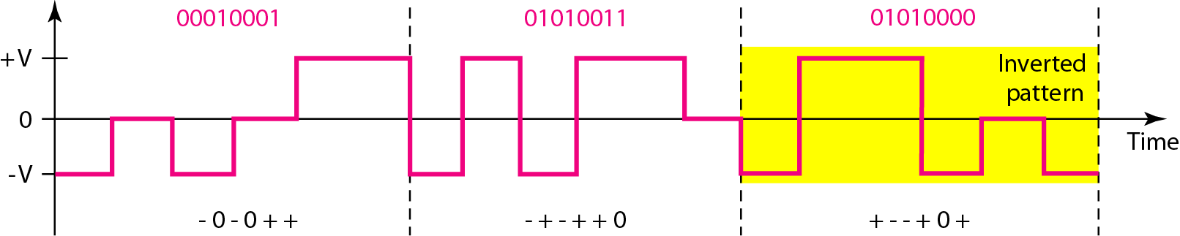
eight binary, six ternary (8B6T).
56
Notes:
Data Communication

Slide 57
eight binary, six ternary (8B6T).
The three possible signal levels are represented as -, 0, and +.
The first 8-bit pattern 00010001 is encoded as the signal pattern -0-0++ with weight 0; the second 8-bit pattern 01010011 is encoded as - + - + + 0 with weight +1.
The third bit pattern should be encoded as + - - + 0 + with weight +1.
To create DC balance, the sender inverts the actual signal.
57
Notes:
Data Communication

Slide 58
eight binary, six ternary (8B6T).
The receiver can easily recognize that this is an inverted pattern because the weight is -1.
The pattern is inverted before decoding.
The average signal rate of the scheme is theoretically S_{ave} = (1/2) X N X (6/8) ; in practice the minimum bandwidth is very close to 6N/8.
58
Notes:
Data Communication

Slide 59
4dimensional 5-level pulse amplitude modulation (4D-PAM5)
The 4D means that data is sent over four wires at the same time.
It uses five voltage levels, such as -2, -1, 0, 1, and 2.
However, one level, level 0, is used only for forward error detection
If we assume that the code is just one-dimensional, the four levels create something similar to 8B4Q.
In other words, an 8-bit word is translated to a signal element of four different levels.
The worst signal rate for this imaginary one-dimensional version is N X 4/8, or N/2.
59
Notes:
Data Communication

Slide 60
4dimensional 5-level pulse amplitude modulation (4D-PAM5)
The technique is designed to send data over four channels (four wires).
This means the signal rate can be reduced to N/8, a significant achievement.
All 8 bits can be fed into a wire simultaneously and sent by using one signal element.
The point here is that the four signal elements comprising one signal group are sent simultaneously in a four-dimensional setting.
Figure shows the imaginary one-dimensional and the actual four-dimensional implementation.
60
Notes:
Data Communication

Slide 61
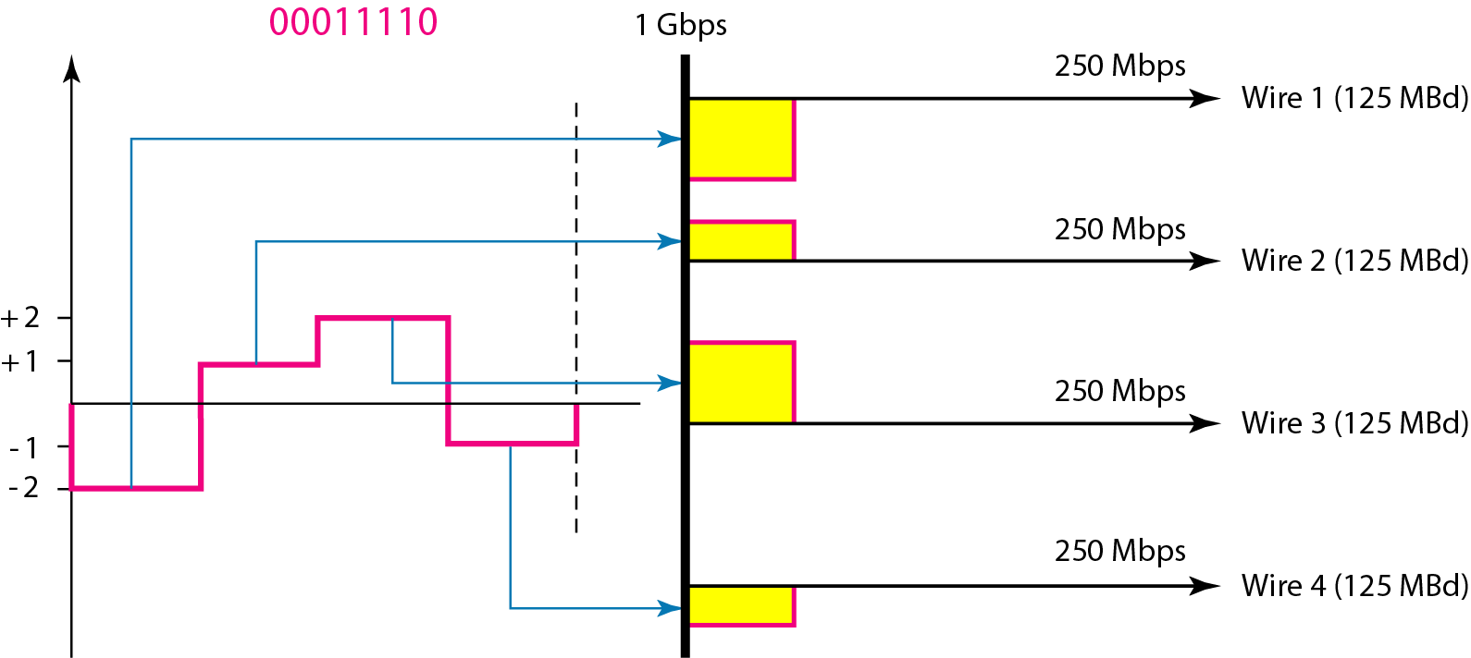
4dimensional 5-level pulse amplitude modulation (4D-PAM5)
61
Notes:
Data Communication

Slide 62
4dimensional 5-level pulse amplitude modulation (4D-PAM5)
Gigabit LANs use this technique to send 1-Gbps data over four copper cables that can handle 125 Mbaud.
This scheme has a lot of redundancy in the signal pattern because 2⁸ data patterns are matched to 4⁴ = 256 signal patterns.
The extra signal patterns can be used for other purposes such as error detection.
62
Notes:
Data Communication

Slide 63
Multiline Transmission: MLT-3
NRZ-I and differential Manchester are classified as differential encoding but use two transition rules to encode binary data (no inversion, inversion).
If we have a signal with more than two levels, we can design a differential encoding scheme with more than two transition rules.
MLT-3 is one of them. The multiline transmission, three level (MLT-3) scheme uses three levels (+V, 0, and -V) and three transition rules to move between the levels.
63
Notes:
Data Communication

Slide 64
Multiline Transmission: MLT-3
If the next bit is 0, there is no transition.
If the next bit is 1 and the current level is not 0, the next level is 0.
If the next bit is 1 and the current level is 0, the next level is the opposite of the last nonzero level.
The behavior ofMLT-3 can best be described by the state diagram shown in Figure
64
Notes:
Data Communication

Slide 65
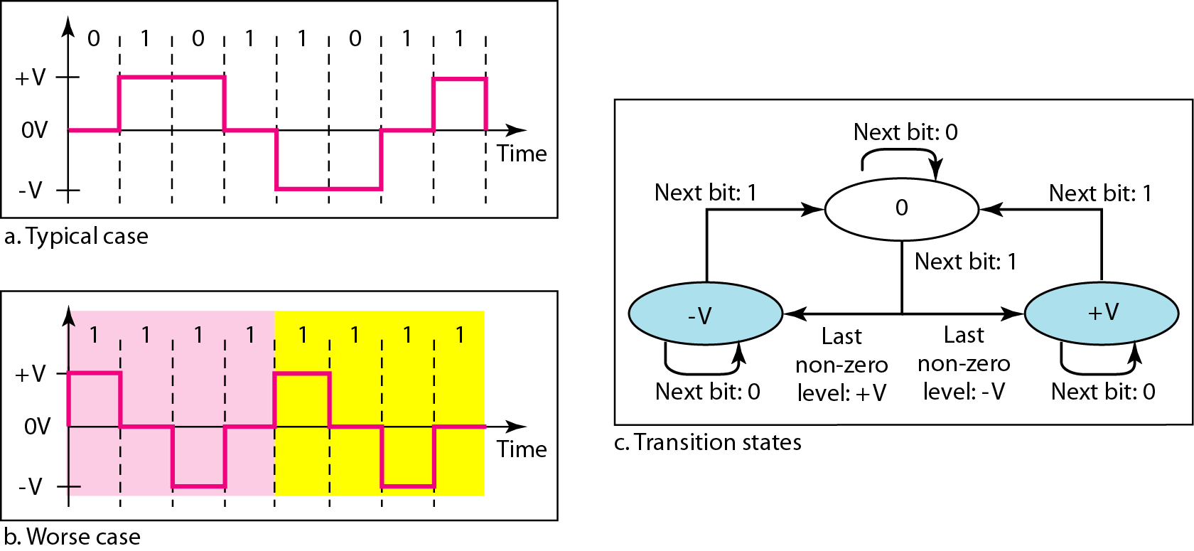
Multiline Transmission: MLT-3
65
Notes:
Data Communication

Slide 66
why we need to use MLT-3?
a scheme that maps one bit to one signal element.
The signal rate is the same as that for NRZ-I, but with greater complexity (three levels and complex transition rules).
It turns out that the shape of the signal in this scheme helps to reduce the required bandwidth.
Let us look at the worst-case scenario, a sequence of 1’s.
In this case, the signal element pattern +VO-VO is repeated every 4 bits.
66
Notes:
Data Communication

Slide 67
why we need to use MLT-3?
A nonperiodic signal has changed to a periodic signal with the period equal to 4 times the bit duration.
This worst-case situation can be simulated as an analog signal with a frequency one-fourth of the bit rate.
In other words, the signal rate for MLT-3 is one-fourth the bit rate.
This makes MLT-3 a suitable choice when we need to send 100 Mbps on a copper wire that cannot support more than 32 MHz (frequencies above this level create electromagnetic emissions).
67
Notes:
Data Communication

Slide 68
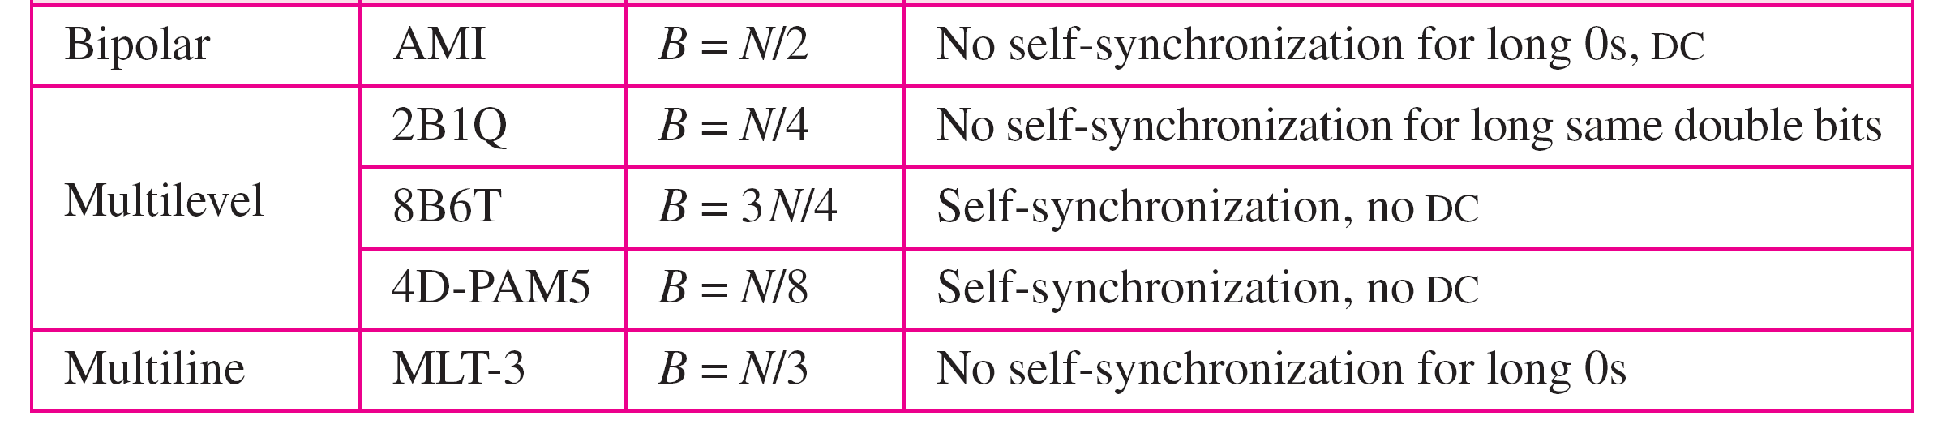
Summary of Line Coding Schemes
68
Notes:
Data Communication

Slide 69
Block Coding
We need redundancy to ensure synchronization and to provide some kind of inherent error detecting.
Block coding can give us this redundancy and improve the performance of line coding.
In general, block coding changes a block of m bits into a block of n bits, where n is larger than m.
Block coding is referred to as an mB/nB encoding technique.
The slash in block encoding (for example, 4B/5B) distinguishes block encoding from multilevel encoding (for example, 8B6T), which is written without a slash.
69
Notes:
Data Communication

Slide 70
Block Coding
Block coding normally involves three steps: division, substitution, and combination.
In the division step, a sequence of bits is divided into groups of m bits. For example, in 4B/5B encoding, the original bit sequence is divided into 4-bit groups.
The heart of block coding is the substitution step.
In this step, we substitute an m-bit group for an n-bit group.
For example, in 4B/5B encoding we substitute a 4-bit code for a 5-bit group.
70
Notes:
Data Communication

Slide 71
Block Coding
Finally, the n-bit groups are combined together to form a stream.
The new stream has more bits than the original bits.
Figure shows the procedure.
71
Notes:
Data Communication

Slide 72
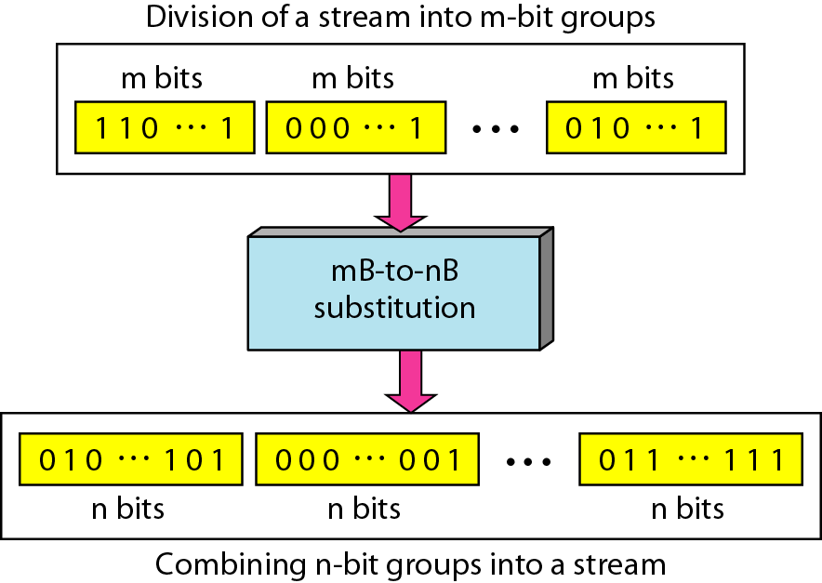
Block Coding : Concept
72
Notes:
Data Communication

Slide 73
4 binary/5 binary (4B/5B) coding scheme
It was designed to be used in combination with NRZ-I.
NRZ-I has a good signal rate, one-half that of the biphase, but it has a synchronization problem.
A long sequence of as can make the receiver clock lose synchronization.
One solution is to change the bit stream, prior to encoding with NRZ-I, so that it does not have a long stream of as.
The 4B/5B scheme achieves this goal.
73
Notes:
Data Communication

Slide 74
4 binary/5 binary (4B/5B) coding scheme
The block-coded stream does not have more that three consecutive as.
At the receiver, the NRZ-I encoded digital signal is first decoded into a stream of bits and then decoded to remove the redundancy.
Figure shows the idea.
74
Notes:
Data Communication

Slide 75
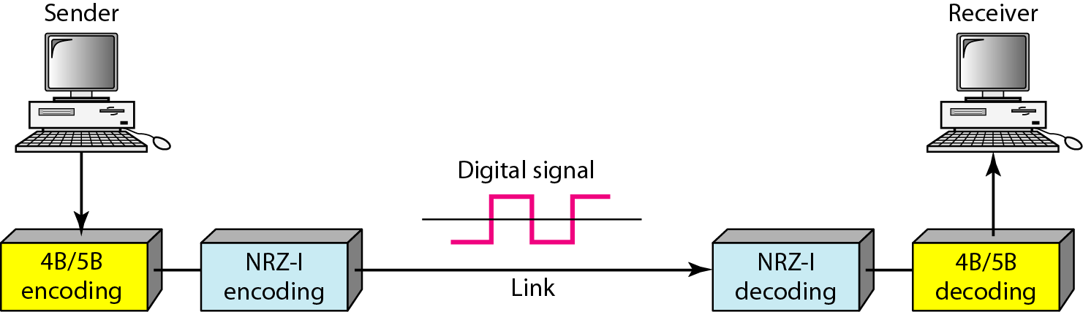
4 binary/5 binary (4B/5B) coding scheme
Using block coding 4B/5B with NRZ-I line coding scheme
75
Notes:
Data Communication

Slide 76
4 binary/5 binary (4B/5B) coding scheme
In 4B/5B, the 5-bit output that replaces the 4-bit input has no more than one leading zero (left bit) and no more than two trailing zeros (right bits).
So when different groups are combined to make a new sequence, there are never more than three consecutive as.
Table shows the corresponding pairs used in 4B/5B encoding.
76
Notes:
Data Communication

Slide 77
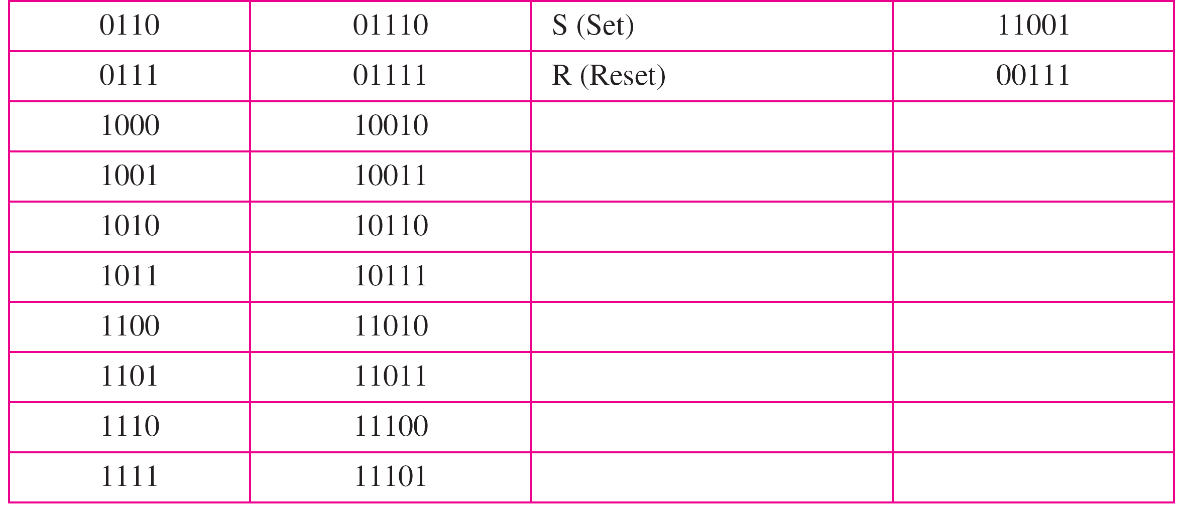
4 binary/5 binary (4B/5B) coding scheme
77
Notes:
Data Communication

Slide 78
4 binary/5 binary (4B/5B) coding scheme
Note that the first two columns pair a 4-bit group with a 5-bit group.
A group of 4 bits can have only 16 different combinations while a group of 5 bits can have 32 different combinations.
This means that there are 16 groups that are not used for 4B/5B encoding.
Some of these unused groups are used for control purposes; the others are not used at all.
78
Notes:
Data Communication

Slide 79
4 binary/5 binary (4B/5B) coding scheme
The latter provide a kind of error detection.
If a 5-bit group arrives that belongs to the unused portion of the table, the receiver knows that there is an error in the transmission.
79
Notes:
Data Communication

Slide 80
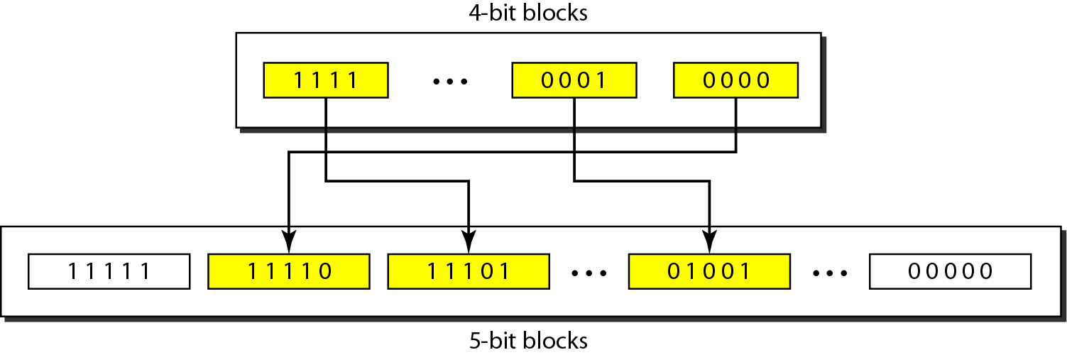
An example of substitution in 4B/5B coding
80
Notes:
Data Communication

Slide 81
ANALOG-TO-DIGITAL CONVERSION
81
Notes:
Data Communication

Slide 82
Sometimes, however, we have an analog signal such as one created by a microphone or camera.
A digital signal is superior to an analog signal.
The tendency today is to change an analog signal to digital data.
In this section we describe two techniques, pulse code modulation and delta modulation.
After the digital data are created (digitization), we can use one of the techniques described in Section to convert the digital data to a digital signal.
82
Notes:
Data Communication

Slide 83
Pulse Code Modulation (PCM)
The most common technique to change an analog signal to digital data (digitization) is called pulse code modulation (PCM).
A PCM encoder has three processes, as shown in Figure
The analog signal is sampled.
The sampled signal is quantized.
The quantized values are encoded as streams of bits.
83
Notes:
Data Communication

Slide 84
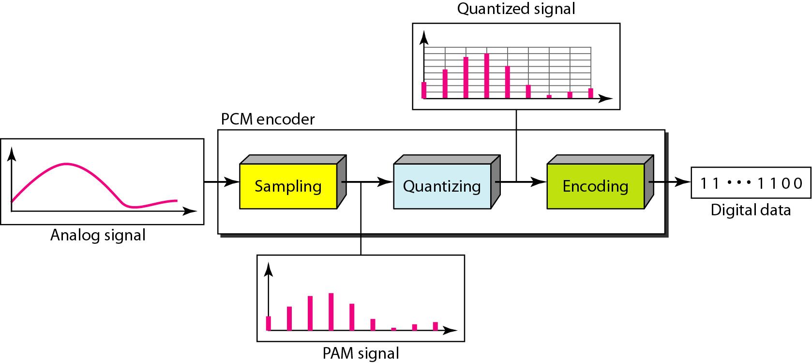
Components of PCM encoder
84
Notes:
Data Communication

Slide 85
Sampling
The first step in PCM is sampling.
The analog signal is sampled every Ts s, where Ts is the sample interval or period.
The inverse of the sampling interval is called the sampling rate or sampling frequency and denoted by f_{s} is, where is = 1/Ts
There are three sampling methods : ideal, natural, and flat-top-as shown in Figure
85
Notes:
Data Communication

Slide 86
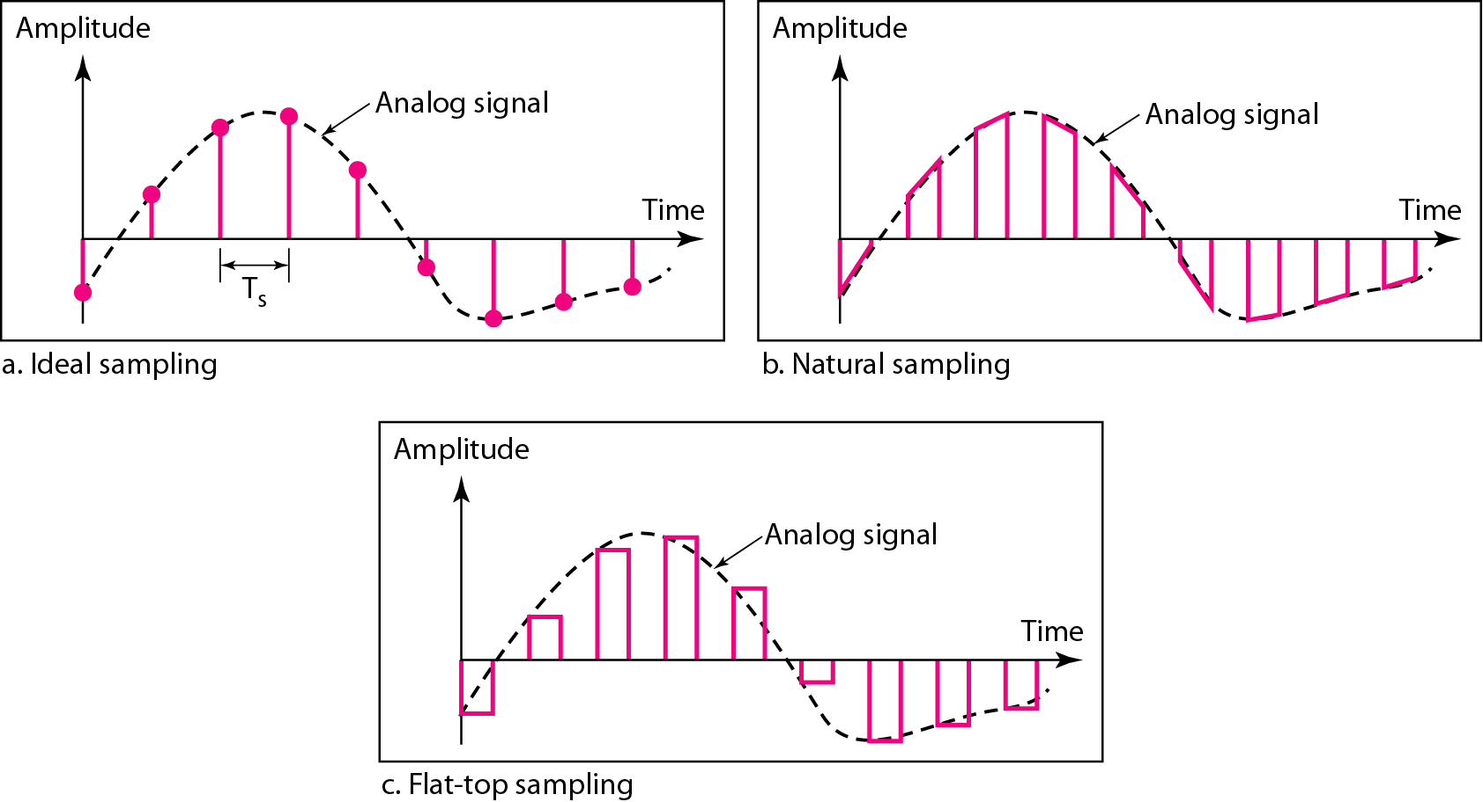
Three different sampling methods for PCM
86
Notes:
Data Communication

Slide 87
Sampling
In ideal sampling, pulses from the analog signal are sampled.
This is an ideal sampling method and cannot be easily implemented.
In natural sampling, a high-speed switch is turned on for only the small period of time when the sampling occurs.
The result is a sequence of samples that retains the shape of the analog signal.
The most common sampling method, called sample and hold, however, creates flat-top samples by using a circuit.
87
Notes:
Data Communication

Slide 88
Sampling
The sampling process is sometimes referred to as pulse amplitude modulation (PAM).
We need to remember, however, that the result is still an analog signal with non integral values
88
Notes:
Data Communication

Slide 89
Sampling Rate
One important consideration is the sampling rate or frequency.
What are the restrictions on Ts?
This question was elegantly answered by Nyquist.
According to the Nyquist theorem, to reproduce the original analog signal, one necessary condition is that the sampling rate be at least twice the highest frequency in the original signal.
89
Notes:
Data Communication

Slide 90
Quantization
The result of sampling is a series of pulses with amplitude values between the maximum and minimum amplitudes of the signal.
The set of amplitudes can be infinite with non-integral values between the two limits.
These values cannot be used in the encoding process.
90
Notes:
Data Communication

Slide 91
The following are the steps in quantization:
The original analog signal has instantaneous amplitudes between V_{min} and V_{max}
Divide the range into L zones, each of height ∆ (delta)
∆ = V_{max} – V_{min}/L
Assign quantized values of 0 to L-1 to the midpoint of each zone
We approximate the value of the sample amplitude to the quantized values.
91
Notes:
Data Communication

Slide 92
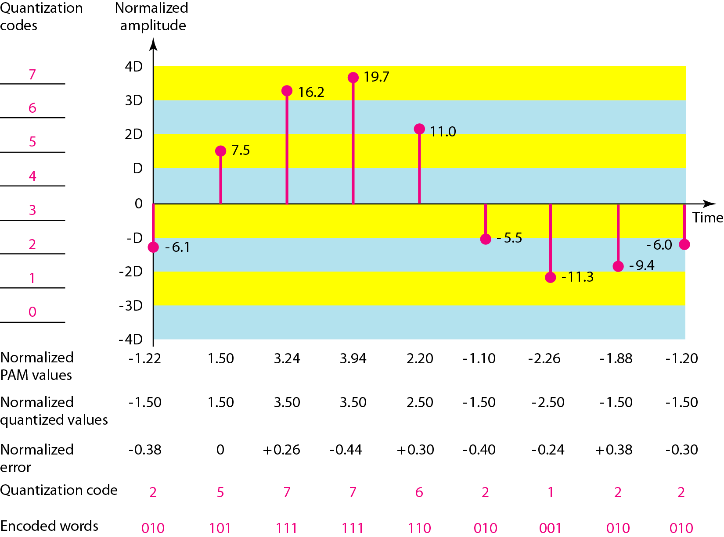
Quantization and encoding of a sampled signal
92
Notes:
Data Communication

Slide 93
Quantization
We have shown only nine samples using ideal sampling (for simplicity).
The value at the top of each sample in the graph shows the actual amplitude.
In the chart, the first row is the normalized value for each sample (actual amplitude/ ∆).
The quantization process selects the quantization value from the middle of each zone.
This means that the normalized quantized values (second row) are different from the normalized amplitudes.
93
Notes:
Data Communication

Slide 94
Quantization
The difference is called the normalized error (third row).
The fourth row is the quantization code for each sample based on the quantization levels at the left of the graph.
The encoded words (fifth row) are the final products of the conversion.
94
Notes:
Data Communication

Slide 95
Quantization
As a simple example, assume that we have a sampled signal and the sample amplitudes are between -20 and +20 V.
We decide to have eight levels (L = 8).
This means that ∆ =5 V.
95
Notes:
Data Communication

Slide 96
Encoding
The last step in PCM is encoding.
After each sample is quantized and the number of bits per sample is decided, each sample can be changed to an n_{b} -bit code word.
In Figure the encoded words are shown in the last row.
A quantization code of 2 is encoded as 010; 5 is encoded as 101; and so on.
96
Notes:
Data Communication

Slide 97
Encoding
Note that the number of bits for each sample is determined from the number of quantization levels.
If the number of quantization levels is L, the number of bits is n_{b} =log2 L.
In our example L is 8 and n_{b} is therefore 3. The bit rate can be found from the formula
Bit rate = Sampling rate x No. of bits per sample
Bit rate = f_{s} x n_{b}
97
Notes:
Data Communication

Slide 98
We want to digitize the human voice. What is the bit rate, assuming 8 bits per sample?
Solution
The human voice normally contains frequencies from 0 to 4000 Hz. So the sampling rate and bit rate are calculated as follows:
Sampling rate = 2* Nyquist rate
98
Notes:
Data Communication

Slide 99
Transmission Modes
99
Notes:
Data Communication

Slide 100
Transmission Modes
when we are considering the transmission of data from one device to another is the wiring, and of primary concern when we are considering the wiring is the data stream.
Do we send 1 bit at a time; or do we group bits into larger groups and, if so, how?
The transmission of binary data across a link can be accomplished in either parallel or serial mode.
In parallel mode, multiple bits are sent with each clock tick.
100
Notes:
Data Communication

Slide 101
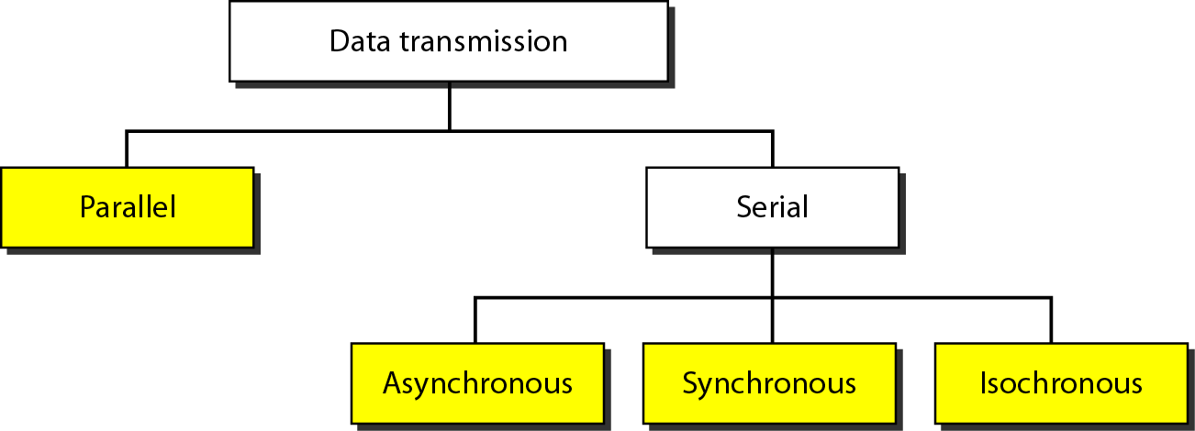
Transmission Modes
In serial mode, 1 bit is sent with each clock tick.
While there is only one way to send parallel data, there are three subclasses of serial transmission: asynchronous, synchronous, and isochronous.
101
Notes:
Data Communication

Slide 102
Parallel Transmission
Binary data, consisting of 1s and 0s, may be organized into groups of n bits each.
Computers produce and consume data in groups of bits much as we conceive of and use spoken language in the form of words rather than letters.
By grouping, we can send data n bits at a time instead of 1. This is called parallel transmission.
102
Notes:
Data Communication

Slide 103
Parallel Transmission
The mechanism for parallel transmission is a conceptually simple one: Use n wires to send n bits at one time.
That way each bit has its own wire, and all n bits of one group can be transmitted with each clock tick from one device to another.
Figure shows how parallel transmission works for n =8.
Typically, the eight wires are bundled in a cable with a connector at each end.
103
Notes:
Data Communication

Slide 104
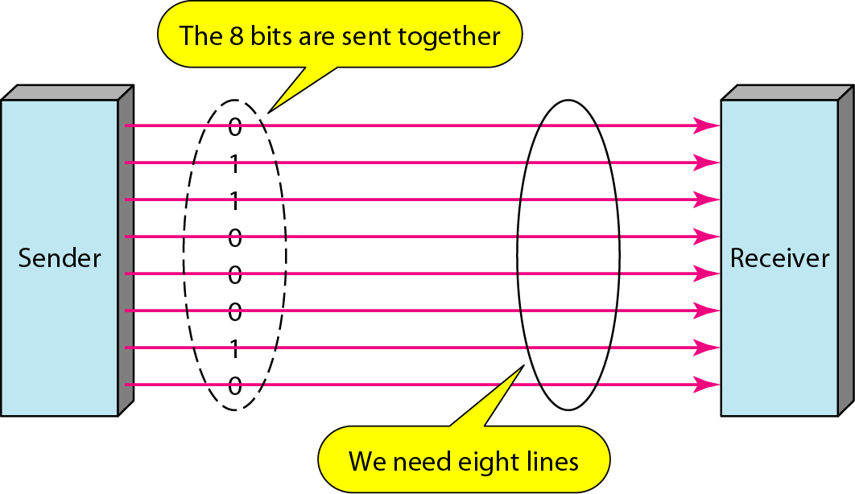
Parallel Transmission
104
Notes:
Data Communication

Slide 105
Parallel Transmission
The advantage of parallel transmission is speed.
All else being equal, parallel transmission can increase the transfer speed by a factor of n over serial transmission
But there is a significant disadvantage: cost.
Parallel transmission requires n communication lines (wires) just to transmit the data stream.
Because this is expensive, parallel transmission is usually limited to short distances.
105
Notes:
Data Communication

Slide 106
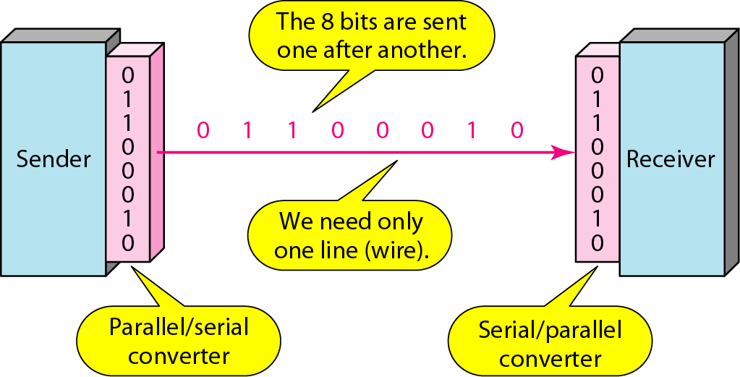
Serial Transmission
In serial transmission one bit follows another, so we need only one communication channel rather than n to transmit data between two communicating devices (see Figure)
106
Notes:
Data Communication

Slide 107
Serial Transmission
The advantage of serial over parallel transmission is that with only one communication channel, serial transmission reduces the cost of transmission over parallel by roughly a factor of n.
Since communication within devices is parallel, conversion devices are required at the interface between the sender and the line (parallel-to-serial) and between the line and the receiver (serial-to-parallel).
Serial transmission occurs in one of three ways: asynchronous, synchronous, and isochronous.
107
Notes:
Data Communication

Slide 108
Asynchronous Transmission
Asynchronous transmission is so named because the timing of a signal is unimportant.
Instead, information is received and translated by agreed upon patterns.
As long as those patterns are followed, the receiving device can retrieve the information without regard to the rhythm in which it is sent.
Patterns are based on grouping the bit stream into bytes.
108
Notes:
Data Communication

Slide 109
Asynchronous Transmission
Each group, usually 8 bits, is sent along the link as a unit.
The sending system handles each group independently, relaying it to the link whenever ready, without regard to a timer
Without synchronization, the receiver cannot use timing to predict when the next group will arrive.
To alert the receiver to the arrival of a new group, therefore, an extra bit is added to the beginning of each byte.
109
Notes:
Data Communication

Slide 110
Asynchronous Transmission
This bit, usually a 0, is called the start bit.
To let the receiver know that the byte is finished, 1 or more additional bits are appended to the end of the byte.
These bits, usually 1s, are called stop bits.
By this method, each byte is increased in size to at least 10 bits, of which 8 bits is information and 2 bits or more are signals to the receiver.
110
Notes:
Data Communication

Slide 111
Asynchronous Transmission
In addition, the transmission of each byte may then be followed by a gap of varying duration.
This gap can be represented either by an idle channel or by a stream of additional stop bits.
The start and stop bits and the gap alert the receiver to the beginning and end of each byte and allow it to synchronize with the data stream.
This mechanism is called asynchronous because, at the byte level, the sender and receiver do not have to be synchronized.
111
Notes:
Data Communication

Slide 112
Asynchronous Transmission
But within each byte, the receiver must still be synchronized with the incoming bit stream.
Some synchronization is required, but only for the duration of a single byte.
The receiving device resynchronizes at the onset of each new byte.
When the receiver detects a start bit, it sets a timer and begins counting bits as they come in.
After n bits, the receiver looks for a stop bit.
As soon as it detects the stop bit, it waits until it detects the next start bit.
112
Notes:
Data Communication

Slide 113
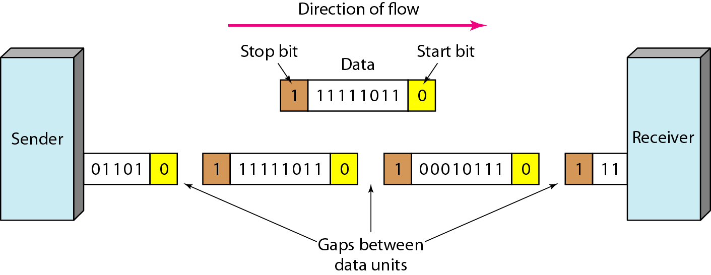
Asynchronous Transmission
Figure is illustration of asynchronous transmission. In this example, the start bits are as, the stop bits are 1s, and the gap is represented by an idle line rather than by additional stop bits.
113
Notes:
Data Communication

Slide 114
Asynchronous Transmission
It an attractive choice for situations such as low-speed communication.
For example, the connection of a keyboard to a computer is a natural application for asynchronous transmission.
A user types only one character at a time, types extremely slowly in data processing terms, and leaves unpredictable gaps of time between each character.
114
Notes:
Data Communication

Slide 115
Synchronous Transmission
In synchronous transmission, the bit stream is combined into longer "frames," which may contain multiple bytes.
Each byte, however, is introduced onto the transmission link without a gap between it and the next one.
It is left to the receiver to separate the bit stream into bytes for decoding purposes.
Data are transmitted as an unbroken string of 1s and 0s, and the receiver separates that string into the bytes, or characters, it needs to reconstruct the information.
115
Notes:
Data Communication

Slide 116
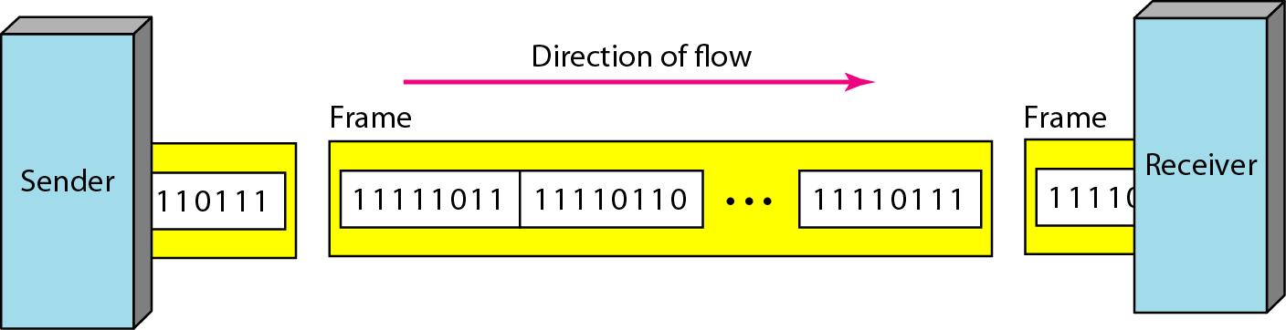
Synchronous Transmission
We have drawn in the divisions between bytes.
In reality, those divisions do not exist; the sender puts its data onto the line as one long string.
116
Notes:
Data Communication

Slide 117
Synchronous Transmission
the sender puts its data onto the line as one long string.
If the sender wishes to send data in separate bursts, the gaps between bursts must be filled with a special sequence of 0s and 1s that means idle.
The receiver counts the bits as they arrive and groups them in 8-bit units
117
Notes:
Data Communication

Slide 118
Synchronous Transmission
Without gaps and start and stop bits, there is no built-in mechanism to help the receiving device adjust its bit synchronization midstream.
Timing becomes very important, therefore, because the accuracy of the received information is completely dependent on the ability of the receiving device to keep an accurate count of the bits as they come in.
118
Notes:
Data Communication

Slide 119
Synchronous Transmission
The advantage of synchronous transmission is speed.
With no extra bits or gaps to introduce at the sending end and remove at the receiving end, and, by extension, with fewer bits to move across the link, synchronous transmission is faster than asynchronous transmission.
For this reason, it is more useful for high-speed applications such as the transmission of data from one computer to another.
119
Notes:
Data Communication

Slide 120
Synchronous Transmission
Byte synchronization is accomplished in the data link layer.
Although there is no gap between characters in synchronous serial transmission, there may be uneven gaps between frames.
120
Notes:
Data Communication

Slide 121
Isochronous
In real-time audio and video, in which uneven delays between frames are not acceptable, synchronous transmission fails.
Eg : TV images are broadcast at the rate of 30 images per second; they must be viewed at the same rate.
If each image is sent by using one or more frames, there should be no delays between frames.
For this type of application, synchronization between characters is not enough; the entire stream of bits must be synchronized.
The isochronous transmission guarantees that the data arrive at a fixed rate.
121
Notes:
Data Communication

