Slide 1
Wired LANs: Ethernet
1
Notes:
Data Communication

Slide 2
Introduction
LAN is designed for a limited geographic area such as a building or a campus.
LAN can be used as an isolated network to connect computers in an organization for the sole purpose of sharing resources
Most LANs today are also linked to WAN or the Internet.
LAN has seen several technologies such as Ethernet, Token Ring, Token Bus, FDDI, and ATM LAN.
Some of these technologies survived for a while, but Ethernet is by far the dominant technology.
2
Notes:
Data Communication

Slide 3
IEEE STANDARDS
In 1985, the Computer Society of the IEEE started a project, called Project 802, to set standards to enable intercommunication among equipment from a variety of manufacturers.
Project 802 is a way of specifying functions of the physical layer and the data link layer of major LAN protocols.
The relationship of the 802 Standard to the traditional OSI model is shown in Figure
3
Notes:
Data Communication

Slide 4
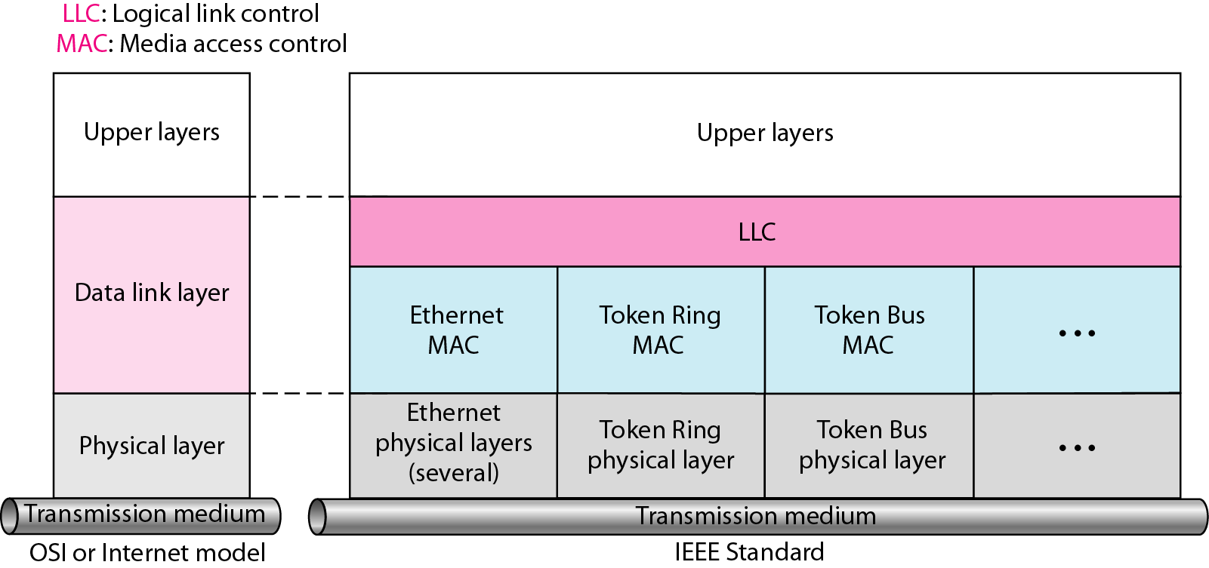
IEEE STANDARDS
4
Notes:
Data Communication

Slide 5
Data Link Layer
The data link layer in the IEEE standard is divided into two sub-layers: LLC and MAC.
Logical Link Control (LLC)
Same as DLC ( data Link Control)
Data link control handles framing, flow control, and error control
A single LLC protocol can provide interconnectivity between different LANs because it makes the MAC sub-layer transparent.
Figure ( Previous) shows one single LLC protocol serving several MAC protocols.
5
Notes:
Data Communication

Slide 6
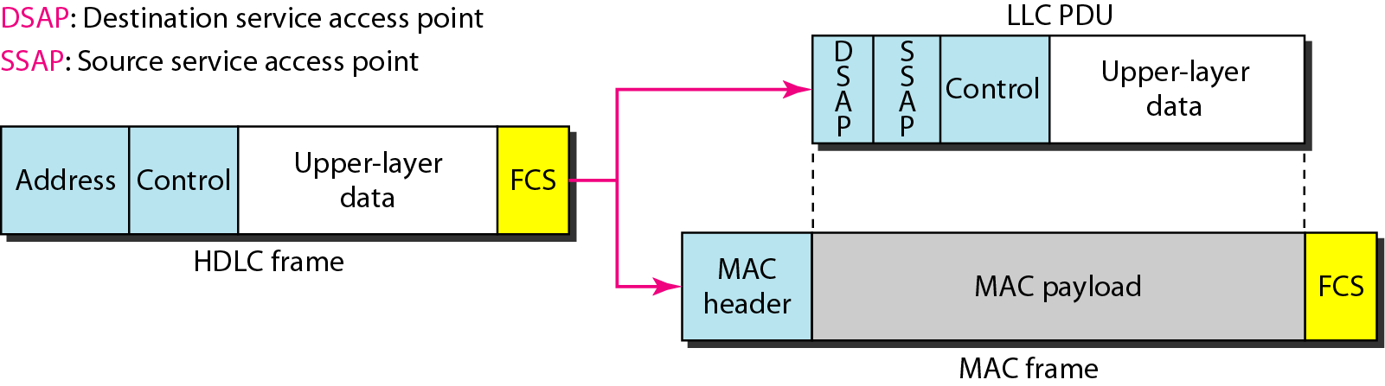
Data Link Layer
A frame defined in HDLC is divided into a PDU at the LLC sub-layer and a frame at the MAC sublayer, as shown in Figure
Destination service access point (DSAP) and
The source service access point (SSAP).
6
Notes:
Data Communication

Slide 7
Data Link Layer
Media Access Control (MAC)
IEEE Project 802 has created a sublayer called media access control that defines the specific access method for each LAN.
For example, it defines CSMA/CD method for Ethernet LANs and the token-passing method for Token Ring and Token Bus LANs.
Part of the framing function is also handled by the MAC layer.
In contrast to the LLC, MAC contains a number of distinct modules; each defines the access method and the framing format specific to the corresponding LAN protocol.
7
Notes:
Data Communication

Slide 8
STANDARD ETHERNET
The original Ethernet was created in 1976 at Xerox's Palo Alto Research Center (PARC).
Since then, it has gone through four generations:
Standard Ethernet (10 Mbps),
Fast Ethernet (100 Mbps),
Gigabit Ethernet (1 Gbps), and
Ten-Gigabit Ethernet (10 Gbps),
8
Notes:
Data Communication

Slide 9
STANDARD ETHERNET - MAC Sublayer
In Standard Ethernet, the MAC sub-layer governs the operation of the access method.
It also frames data received from the upper layer and passes them to the physical layer
9
Notes:
Data Communication

Slide 10
STANDARD ETHERNET - Frame Format
The Ethernet frame contains seven fields: preamble, SFD, DA, SA, length or type of protocol data unit (PDU), upper-layer data, and the CRC.
Ethernet does not provide any mechanism for acknowledging received frames, making it what is known as an unreliable medium.
Acknowledgments must be implemented at the higher layers.
The format of the MAC frame is shown in Figure
10
Notes:
Data Communication

Slide 11
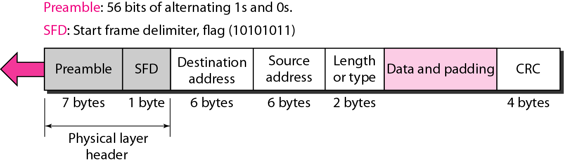
STANDARD ETHERNET - Frame Format
Provided by IEEE 802.3
802.3 MAC Frame Format
11
Notes:
Data Communication

Slide 12
STANDARD ETHERNET - Frame Format
Preamble
The first field of the 802.3 frame contains 7 bytes (56 bits) of alternating 0s and 1s that alerts the receiving system to the coming frame and enables it to synchronize its input timing.
The pattern provides only an alert and a timing pulse.
The 56-bit pattern allows the stations to miss some bits at the beginning of the frame.
The preamble is actually added at the physical layer and is not (formally) part of the frame.
12
Notes:
Data Communication

Slide 13
STANDARD ETHERNET - Frame Format
Start frame delimiter (SFD)
The second field (1 byte: 10101011) signals the beginning of the frame.
The SFD warns the station or stations that this is the last chance for synchronization.
The last 2 bits is 11 and alerts the receiver that the next field is the destination address.
Destination address (DA)
The DA field is 6 bytes and contains the physical address of the destination station or stations to receive the packet.
13
Notes:
Data Communication

Slide 14
STANDARD ETHERNET - Frame Format
Source address (SA)
The SA field is also 6 bytes and contains the physical address of the sender of the packet.
Length or type
This field is defined as a type field or length field.
The original Ethernet used this field as the type field to define the upper-layer protocol using the MAC frame.
The IEEE standard used it as the length field to define the number of bytes in the data field.
Both uses are common today.
14
Notes:
Data Communication

Slide 15
STANDARD ETHERNET - Frame Format
Data
This field carries data encapsulated from the upper-layer protocols.
It is a minimum of 46 and a maximum of 1500 bytes
CRC
The last field contains error detection information, in this case a CRC-32
15
Notes:
Data Communication

Slide 16
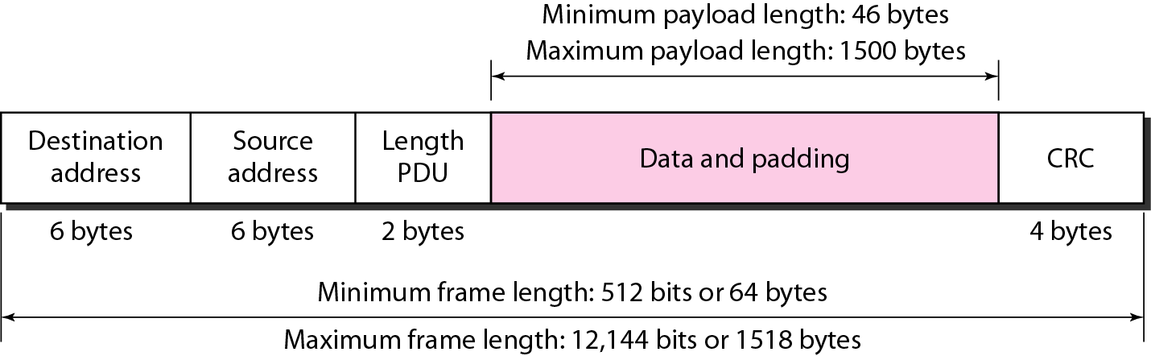
STANDARD ETHERNET - Frame Format
Figure : Minimum and maximum lengths
16
Notes:
Data Communication

Slide 17
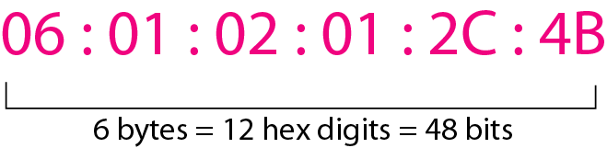
STANDARD ETHERNET - Addressing
Each station on an Ethernet network (such as a PC, workstation, or printer) has its own network interface card (NIC).
The NIC fits inside the station and provides the station with a 6-byte physical address.
As shown in Figure, the Ethernet address is 6 bytes (48 bits), normally written in hexadecimal notation, with a colon between the bytes.
17
Notes:
Data Communication

Slide 18
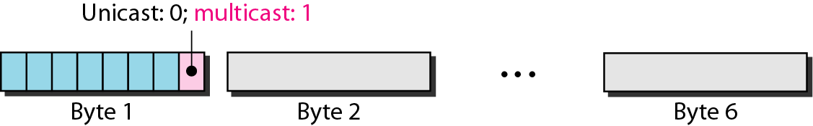
STANDARD ETHERNET - Addressing
The least significant bit of the first byte defines the type of address.
If the bit is 0, the address is unicast; otherwise, it is multicast.
The broadcast destination address is a special case of the multicast address in which all bits are 1s
Figure : Unicast and multicast addresses
18
Notes:
Data Communication

Slide 19
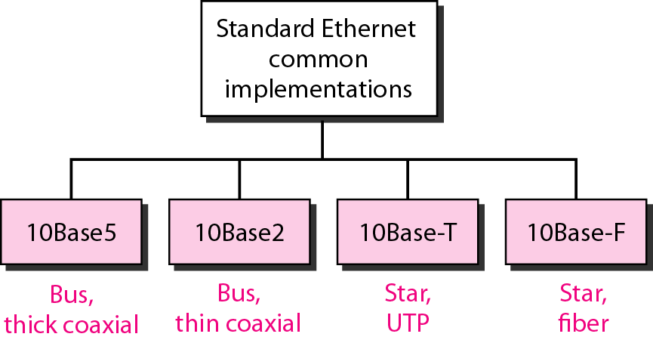
STANDARD ETHERNET - Physical Layer
The Standard Ethernet defines several physical layer implementations; four of the most common, are shown in Figure
19
Notes:
Data Communication

Slide 20
10Base5: Thick Ethernet
The first implementation is called 10BaseS, thick Ethernet, or Thicknet.
The nickname derives from the size of the cable, which is roughly the size of a garden hose and too stiff to bend with your hands.
10Base5 was the first Ethernet specification to use a bus topology with an external transceiver (transmitter/receiver) connected via a tap to a thick coaxial cable.
Figure shows a schematic diagram of a 10Base5 implementation.
20
Notes:
Data Communication

Slide 21
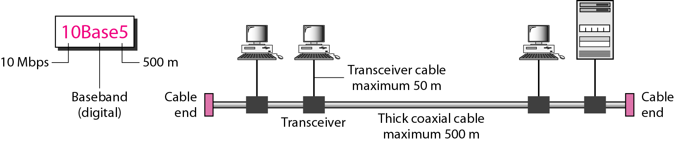
10Base5: Thick Ethernet
The transceiver is responsible for transmitting, receiving, and detecting collisions.
The transceiver is connected to the station via a transceiver cable that provides separate paths for sending and receiving.
collision can only happen in the coaxial cable.
21
Notes:
Data Communication

Slide 22
10Base2: Thin Ethernet
The second implementation is called 10Base2, thin Ethernet, or Cheapernet.
It also uses a bus topology, but the cable is much thinner and more flexible.
The cable can be bent to pass very close to the stations.
In this case, the transceiver is normally part of the network interface card (NIC), which is installed inside the station.
Figure shows the schematic diagram of a 10Base2 implementation.
22
Notes:
Data Communication

Slide 23
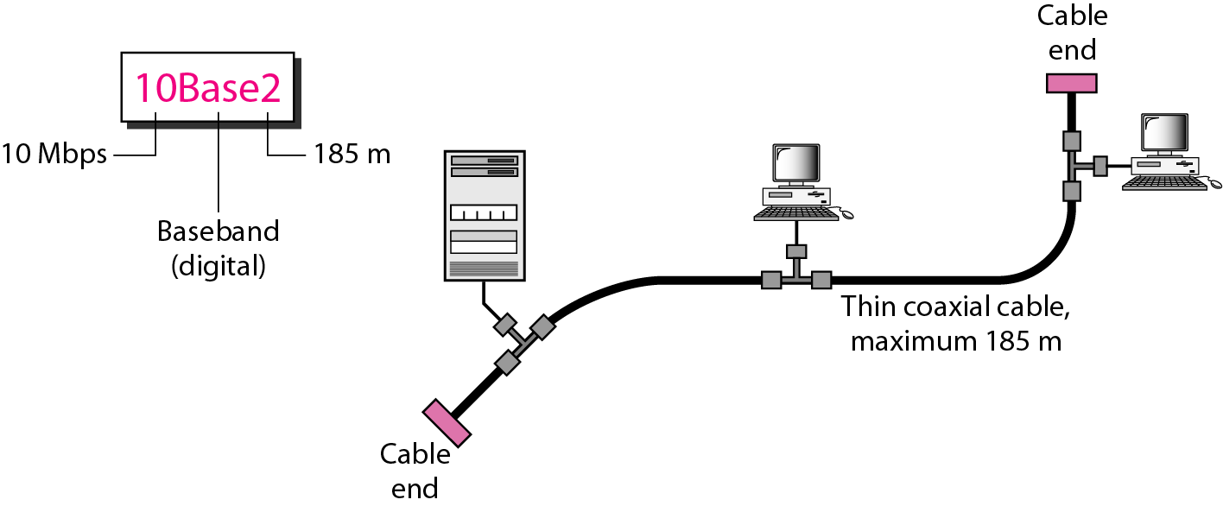
10Base2: Thin Ethernet
23
Notes:
Data Communication

Slide 24
10Base2: Thin Ethernet
The collision occurs in the thin coaxial cable.
This implementation is more cost effective than 10Base5 because thin coaxial cable is less expensive than thick coaxial and the tee connections are much cheaper than taps.
Installation is simpler because the thin coaxial cable is very flexible.
However, the length of each segment cannot exceed 185 m (close to 200 m) due to the high level of attenuation in thin coaxial cable.
24
Notes:
Data Communication

Slide 25
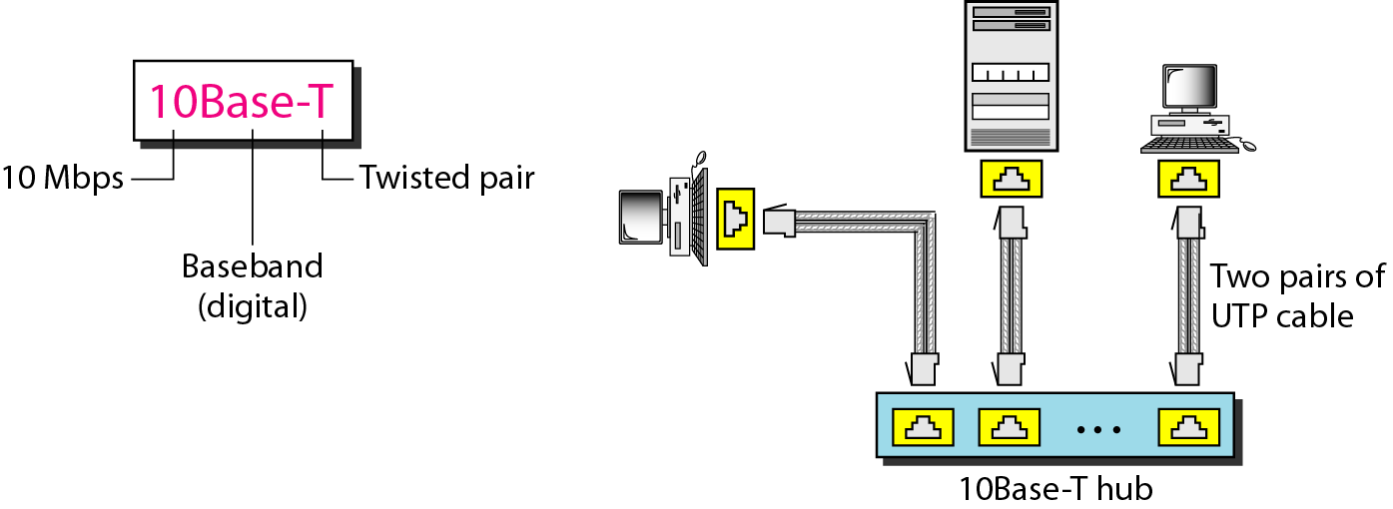
10Base-T: Twisted-Pair Ethernet
The third implementation is called 10Base-T or twisted-pair Ethernet.
10Base-T uses a physical star topology.
The stations are connected to a hub via two pairs of twisted cable, as shown in Figure
25
Notes:
Data Communication

Slide 26
10Base-T: Twisted-Pair Ethernet
Two pairs of twisted cable create two paths (one for sending and one for receiving) between the station and the hub.
Any collision here happens in the hub.
Compared to 10Base5 or 10Base2, we can see that the hub actually replaces the coaxial cable as far as a collision is concerned.
The maximum length of the twisted cable here is defined as 100 m, to minimize the effect of attenuation in the twisted cable.
26
Notes:
Data Communication

Slide 27
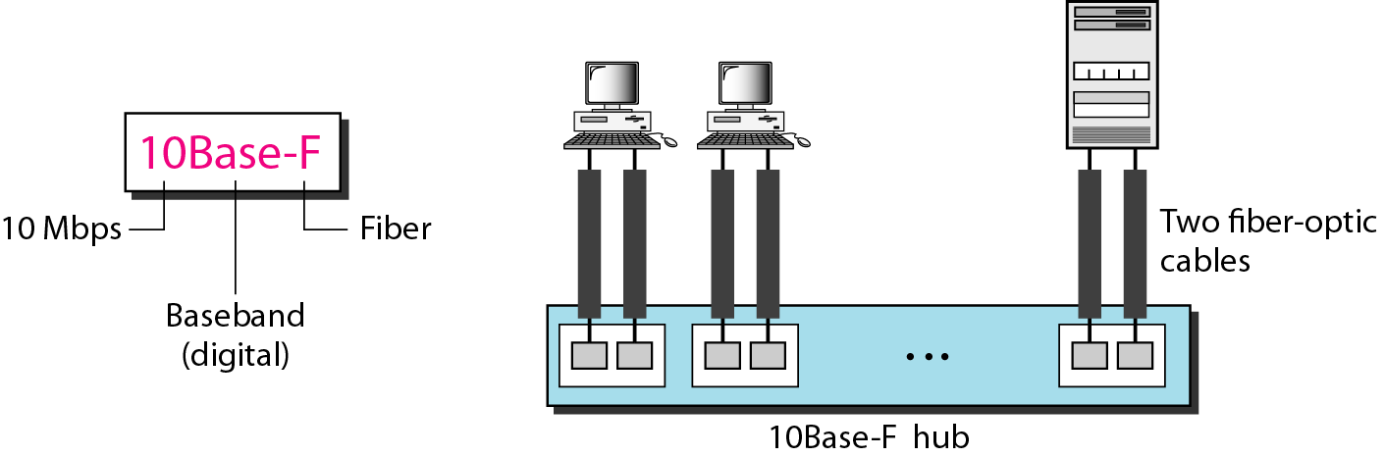
10Base-F: Fiber Ethernet
Although there are several types of optical fiber 10-Mbps Ethernet, the most common is called 10Base-F.
It uses a star topology to connect stations to a hub.
The stations are connected to the hub using two fiber-optic cables, as shown in Figure
27
Notes:
Data Communication

Slide 28
Summary
Table : Summary of Standard Ethernet implementations
28
Notes:
Data Communication

Slide 29
FAST ETHERNET
Fast Ethernet was designed to compete with LAN protocols such as FDDI or Fiber Channel.
IEEE created Fast Ethernet under the name 802.3u.
Fast Ethernet is backward-compatible with Standard Ethernet, but it can transmit data 10 times faster at a rate of 100 Mbps.
The goals of Fast Ethernet summarized as follows:
1. Upgrade the data rate to 100 Mbps.
2. Make it compatible with Standard Ethernet.
3. Keep the same 48-bit address.
4. Keep the same frame format.
5. Keep the same minimum and maximum frame lengths
29
Notes:
Data Communication

Slide 30
FAST ETHERNET - MAC Sublayer
A decision was made to drop the bus topologies and keep only the star topology.
For the star topology, there are two choices, as we saw before: half duplex and full duplex.
In the half-duplex approach, the stations are connected via a hub; in the full-duplex approach, the connection is made via a switch with buffers at each port.
The access method is the same (CSMA/CD) for the half-duplex approach; for full-duplex Fast Ethernet, there is no need for CSMA/CD.
However, the implementations keep CSMA/CD for backward compatibility with Standard Ethernet
30
Notes:
Data Communication

Slide 31
FAST ETHERNET - autonegotiation
A new feature added to Fast Ethernet is called autonegotiation.
It allows a station or a hub a range of capabilities.
Autonegotiation allows two devices to negotiate the mode or data rate of operation.
It was designed particularly for the following purposes:
To allow incompatible devices to connect to one another. For example, a device with a maximum capacity of 10 Mbps can communicate with a device with a 100 Mbps capacity (but can work at a lower rate).
To allow one device to have multiple capabilities.
To allow a station to check a hub's capabilities.
31
Notes:
Data Communication

Slide 32
FAST ETHERNET – Physical Layer
The physical layer in Fast Ethernet is more complicated than the one in Standard Ethernet.
We briefly discuss some features of this layer.
32
Notes:
Data Communication

Slide 33
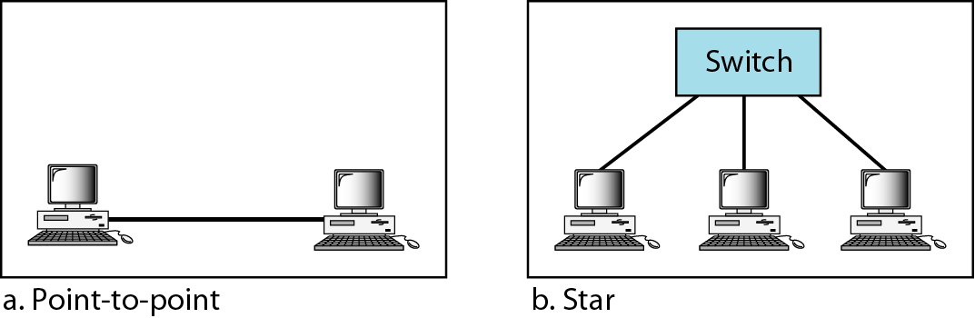
FAST ETHERNET – Physical Layer - Topology
If there are only two stations, they can be connected point-to-point.
Three or more stations need to be connected in a star topology with a hub or a switch at the center, as shown in Figure
33
Notes:
Data Communication

Slide 34
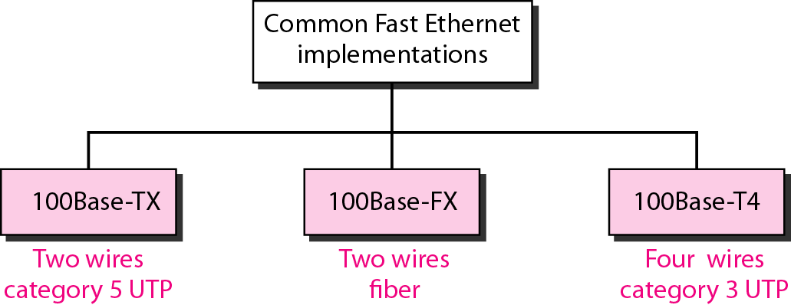
FAST ETHERNET – Implementation
34
Notes:
Data Communication

Slide 35
Summary of Fast Ethernet implementations
35
Notes:
Data Communication

Slide 36
GIGABIT ETHERNET
The need for an even higher data rate resulted in the design of the Gigabit Ethernet protocol (1000 Mbps).
The IEEE committee calls the Standard 802.3z.
The goals of the Gigabit Ethernet design as follows:
1. Upgrade the data rate to 1 Gbps.
2. Make it compatible with Standard or Fast Ethernet.
3. Use the same 48-bit address.
4. Use the same frame format.
5. Keep the same minimum and maximum frame lengths.
6. To support autonegotiation as defined in Fast Ethernet
36
Notes:
Data Communication

Slide 37
GIGABIT ETHERNET - MAC Sublayer
A main consideration in the evolution of Ethernet was to keep the MAC sublayer untouched.
However, to achieve a data rate 1 Gbps, this was no longer possible.
Gigabit Ethernet has two distinctive approaches for medium access: half-duplex and full-duplex
37
Notes:
Data Communication

Slide 38
GIGABIT ETHERNET - MAC Sublayer
Full-Duplex Mode
In the full-duplex mode of Gigabit Ethernet, there is no collision; the maximum length of the cable is determined by the signal attenuation in the cable.
Half-Duplex Mode
Gigabit Ethernet can also be used in half-duplex mode, although it is rare.
In this case, a switch can be replaced by a hub, which acts as the common cable in which a collision might occur.
The half-duplex approach uses CSMAlCD
38
Notes:
Data Communication

Slide 39
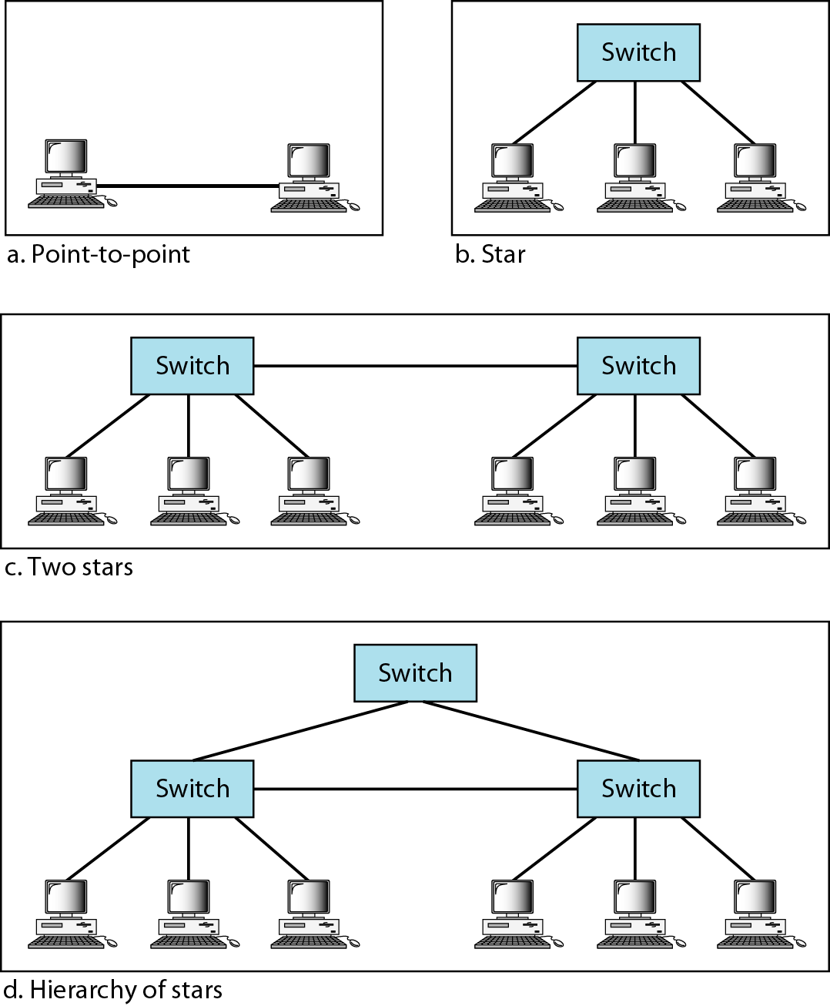
GIGABIT ETHERNET - Physical Layer - Topology
39
Notes:
Data Communication

Slide 40
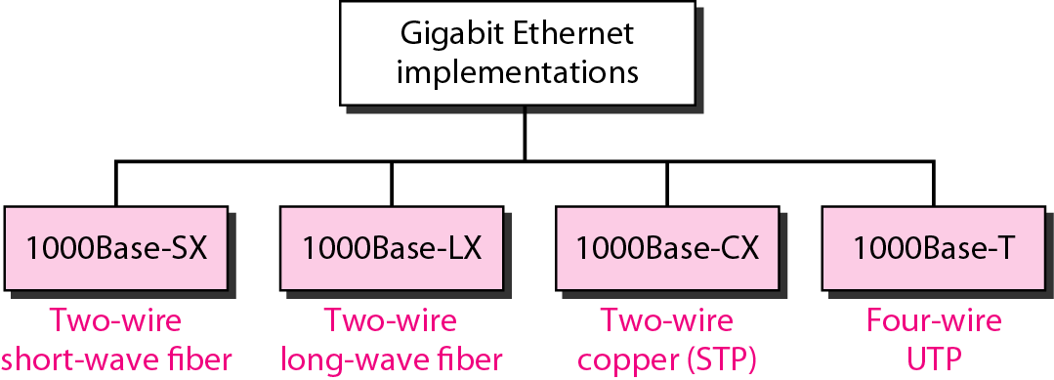
GIGABIT ETHERNET - Implementation
40
Notes:
Data Communication

Slide 41
GIGABIT ETHERNET - Summary
41
Notes:
Data Communication

Slide 42
Ten-Gigabit Ethernet
The IEEE committee created Ten-Gigabit Ethernet and called it Standard 802.3ae.
The goals of the Ten-Gigabit Ethernet design can be summarized as follows:
1. Upgrade the data rate to 10 Gbps.
2. Make it compatible with Standard, Fast, and Gigabit Ethernet.
3. Use the same 48-bit address.
4. Use the same frame format.
5. Keep the same minimum and maximum frame lengths.
42
Notes:
Data Communication

Slide 43
Ten-Gigabit Ethernet
6. Allow the interconnection of existing LANs into a metropolitan area network (MAN) or a wide area network (WAN).
7. Make Ethernet compatible with technologies such as Frame Relay and ATM
43
Notes:
Data Communication

Slide 44
Ten-Gigabit Ethernet - MAC Sublayer
Ten-Gigabit Ethernet operates only in full duplex mode which means there is no need for contention; CSMA/CD is not used in Ten-Gigabit Ethernet.
44
Notes:
Data Communication

Slide 45
Ten-Gigabit Ethernet - Physical Layer
The physical layer in Ten-Gigabit Ethernet is designed for using fiber-optic cable over long distances.
Three implementations are the most common: 10GBase-S, 10GBase-L, and 10GBase-E.
Table shows a summary of the Ten-Gigabit Ethernet implementations.
45
Notes:
Data Communication

