Slide 1
Transmission Media
1
Notes:
Data Communication

Slide 2
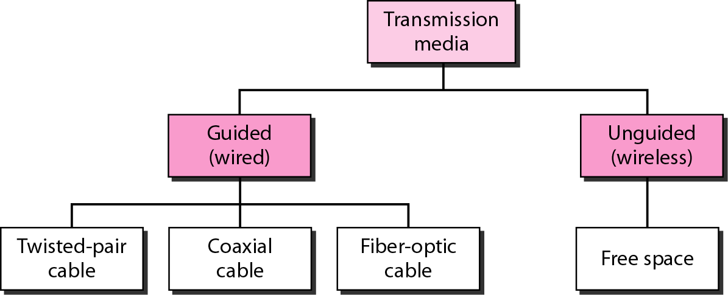
Classes of transmission media
2
Notes:
Data Communication

Slide 3
GUIDED MEDIA
A signal traveling along any of these media is directed and contained by the physical limits of the medium.
Twisted-pair and coaxial cable use metallic (copper) conductors that accept and transport signals in the form of electric current.
Optical fiber is a cable that accepts and transports signals in the form of light.
3
Notes:
Data Communication

Slide 4
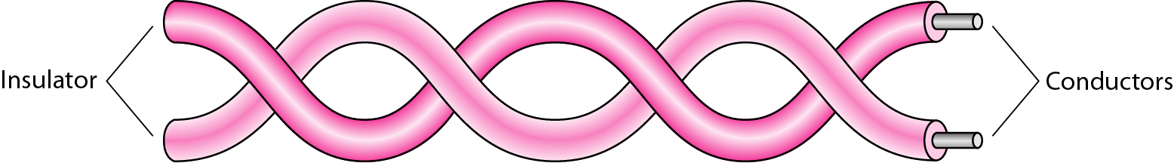
Twisted-Pair Cable
A twisted pair consists of two conductors (normally copper), each with its own plastic insulation, twisted together, as shown in Figure
4
Notes:
Data Communication

Slide 5
Twisted-Pair Cable
One of the wires is used to carry signals to the receiver, and the other is used only as a ground reference.
The receiver uses the difference between the two.
In addition to the signal sent by the sender on one of the wires, interference (noise) and crosstalk may affect both wires and create unwanted signals.
If the two wires are parallel, the effect of these unwanted signals is not the same in both wires because they are at different locations relative to the noise or crosstalk sources (e,g., one is closer and the other is farther).
5
Notes:
Data Communication

Slide 6
Twisted-Pair Cable
This results in a difference at the receiver.
By twisting the pairs, a balance is maintained.
Twisting makes it probable that both wires are equally affected by external influences (noise or crosstalk).
This means that the receiver, which calculates the difference between the two, receives no unwanted signals.
The unwanted signals are mostly canceled out.
6
Notes:
Data Communication

Slide 7
Unshielded Versus Shielded Twisted-Pair Cable
The most common twisted-pair cable used in communications is referred to as Unshielded Twisted-Pair (UTP).
IBM has also produced a version of twisted-pair cable for its use called shielded twisted-pair (STP).
STP cable has a metal foil covering that encases each pair of insulated conductors.
Although metal casing improves the quality of cable by preventing the penetration of noise or crosstalk, it is bulkier and more expensive.
7
Notes:
Data Communication

Slide 8
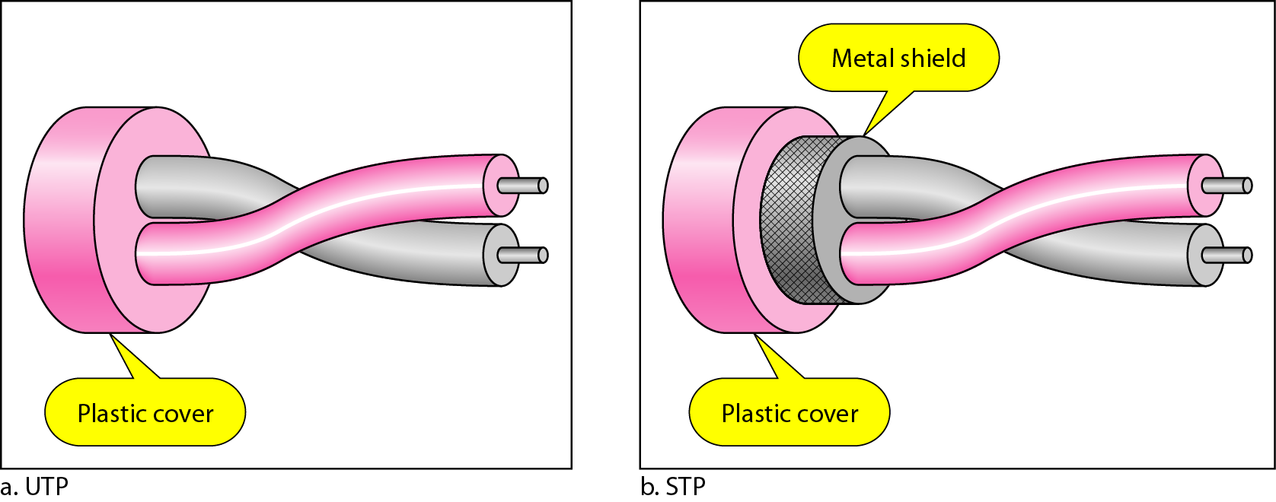
Unshielded Versus Shielded Twisted-Pair Cable
Figure shows the difference between UTP and STP.
Our discussion focuses primarily on UTP because STP is seldom used outside of IBM.
8
Notes:
Data Communication

Slide 9
Categories
The Electronic Industries Association (EIA) has developed standards to classify unshielded twisted-pair cable into seven categories.
Categories are determined by cable quality, with 1 as the lowest and 7 as the highest.
Each EIA category is suitable for specific uses.
Table shows these categories.
9
Notes:
Data Communication

Slide 10
Categories
10
Notes:
Data Communication

Slide 11
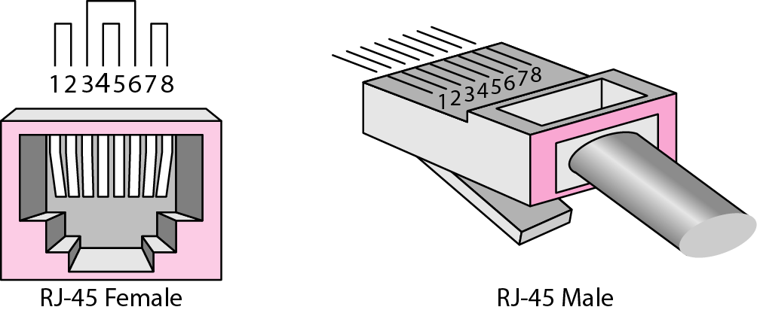
Connectors
The most common UTP connector is RJ45 (RJ stands for registered jack), as shown in Figure
The RJ45 is a keyed connector, meaning the connector can be inserted in only one way.
11
Notes:
Data Communication

Slide 12
Performance
One way to measure the performance of twisted-pair cable is to compare attenuation versus frequency and distance.
A twisted-pair cable can pass a wide range of frequencies.
However, Figure shows that with increasing frequency, the attenuation, measured in decibels per kilometer (dB/km), sharply increases with frequencies above 100 kHz.
Note that gauge is a measure of the thickness of the wire.
12
Notes:
Data Communication

Slide 13
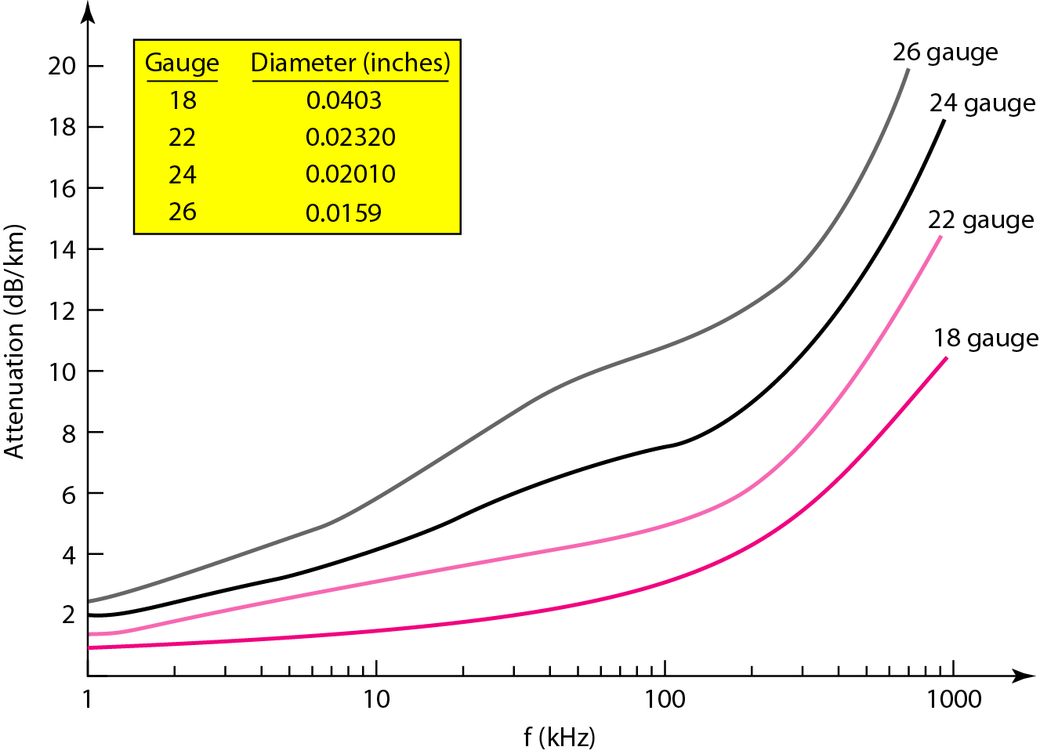
Performance
13
Notes:
Data Communication

Slide 14
Coaxial Cable
Coaxial cable (or coax) carries signals of higher frequency ranges than those in twisted-pair cable
Instead of having two wires, coax has a central core conductor of solid or stranded wire (usually copper) enclosed in an insulating sheath, which is, in turn, encased in an outer conductor of metal foil, braid, or a combination of the two.
The outer metallic wrapping serves both as a shield against noise and as the second conductor, which completes the circuit.
14
Notes:
Data Communication

Slide 15
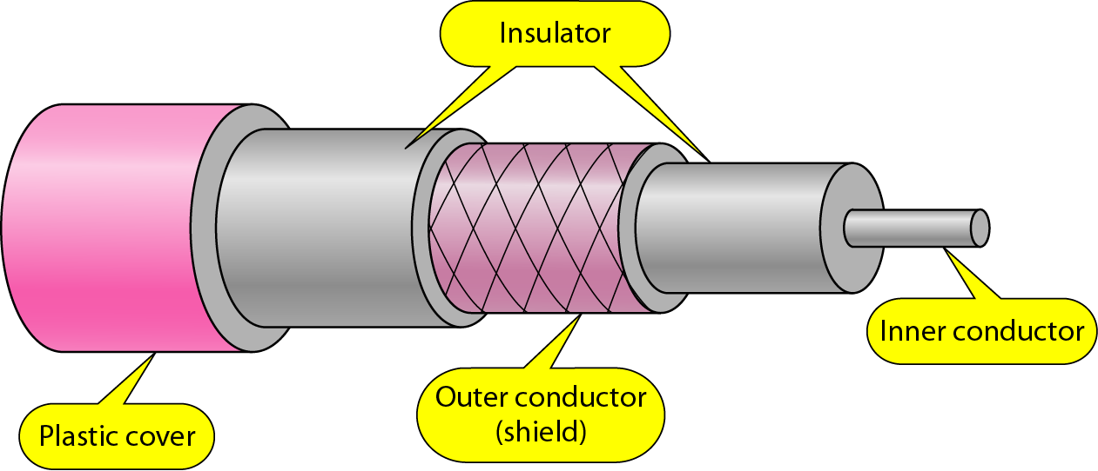
Coaxial Cable
This outer conductor is also enclosed in an insulating sheath, and the whole cable is protected by a plastic cover (see Figure)
15
Notes:
Data Communication

Slide 16
Coaxial Cable Standards
Coaxial cables are categorized by their Radio Government (RG) ratings.
Each RG number denotes a unique set of physical specifications, including the wire gauge of the inner conductor, the thickness and type of the inner insulator, the construction of the shield, and the size and type of the outer casing.
Each cable defined by an RG rating is adapted for a specialized function, as shown in Table.
16
Notes:
Data Communication

Slide 17
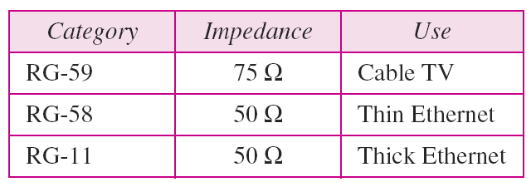
Coaxial Cable Standards
17
Notes:
Data Communication

Slide 18
Coaxial Cable Connectors
To connect coaxial cable to devices, we need coaxial connectors.
The most common type of connector used today is the Bayone-Neill-Concelman (BNC), connector.
Figure shows three popular types of these connectors:
The BNC connector,
The BNC T connector, and
The BNC terminator.
18
Notes:
Data Communication

Slide 19
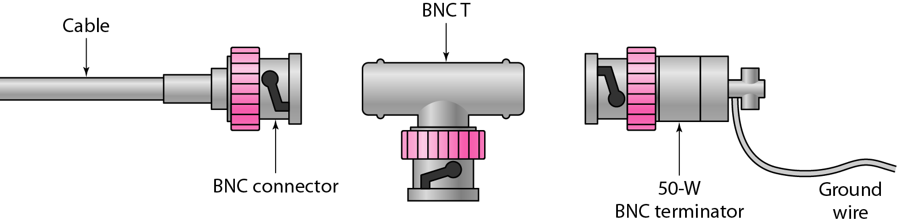
Coaxial Cable Connectors
19
Notes:
Data Communication

Slide 20
Coaxial Cable Connectors
The BNC connector is used to connect the end of the cable to a device, such as a TV set.
The BNC T connector is used in Ethernet networks to branch out to a connection to a computer or other device.
The BNC terminator is used at the end of the cable to prevent the reflection of the signal.
20
Notes:
Data Communication

Slide 21
Performance
As we did with twisted-pair cables, we can measure the performance of a coaxial cable.
We notice in Figure that the attenuation is much higher in coaxial cables than in twisted-pair cable.
Although coaxial cable has a much higher bandwidth, the signal weakens rapidly and requires the frequent use of repeaters.
21
Notes:
Data Communication

Slide 22
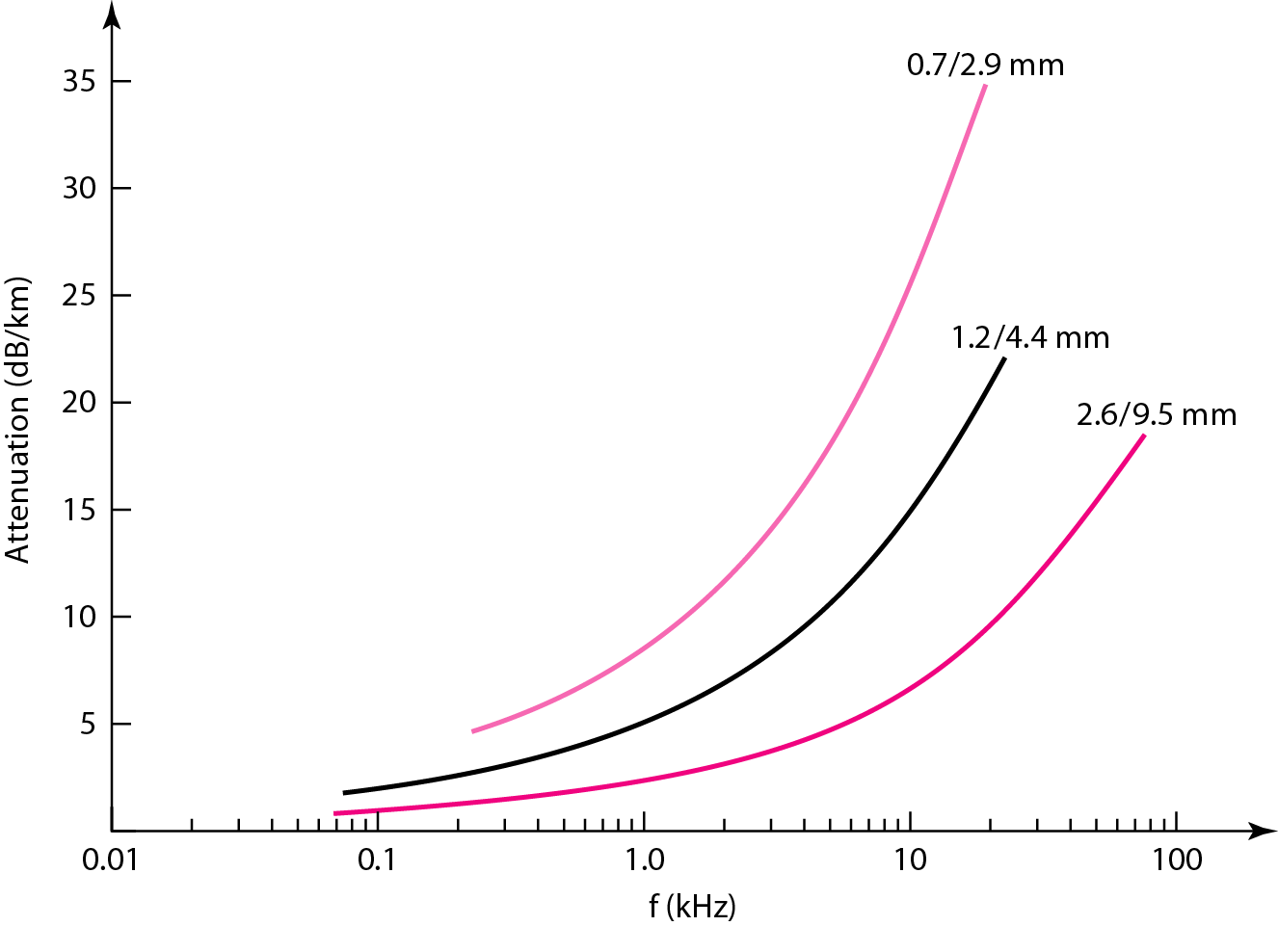
Performance
22
Notes:
Data Communication

Slide 23
Applications
Coaxial cable was widely used in analog telephone networks where a single coaxial network could carry 10,000 voice signals.
It was used in digital telephone networks where a single coaxial cable could carry digital data up to 600 Mbps.
However, coaxial cable in telephone networks has largely been replaced today with fiber-optic cable.
23
Notes:
Data Communication

Slide 24
Applications
Cable TV networks also use coaxial cables.
In the traditional cable TV network, the entire network used coaxial cable.
Later, cable TV providers replaced most of the media with fiber-optic cable; hybrid networks use coaxial cable only at the network boundaries, near the consumer premises.
Cable TV uses RG-59 coaxial cable.
24
Notes:
Data Communication

Slide 25
Applications
Another common application of coaxial cable is in traditional Ethernet LANs
Because of its high bandwidth, and consequently high data rate, coaxial cable was chosen for digital transmission in early Ethernet LANs.
The 10Base-2, or Thin Ethernet, uses RG-58 coaxial cable with BNC connectors to transmit data at 10 Mbps with a range of 185 m.
The 10Base5, or Thick Ethernet, uses RG-11 (thick coaxial cable) to transmit 10 Mbps with a range of 5000 m.
Thick Ethernet has specialized connectors.
25
Notes:
Data Communication

Slide 26
Fiber-Optic Cable
A fiber-optic cable is made of glass or plastic and transmits signals in the form of light.
To understand optical fiber, we first need to explore several aspects of the nature of light.
Light travels in a straight line as long as it is moving through a single uniform substance.
If a ray of light traveling through one substance suddenly enters another substance (of a different density), the ray changes direction.
Figure shows how a ray of light changes direction when going from a more dense to a less dense substance.
26
Notes:
Data Communication

Slide 27
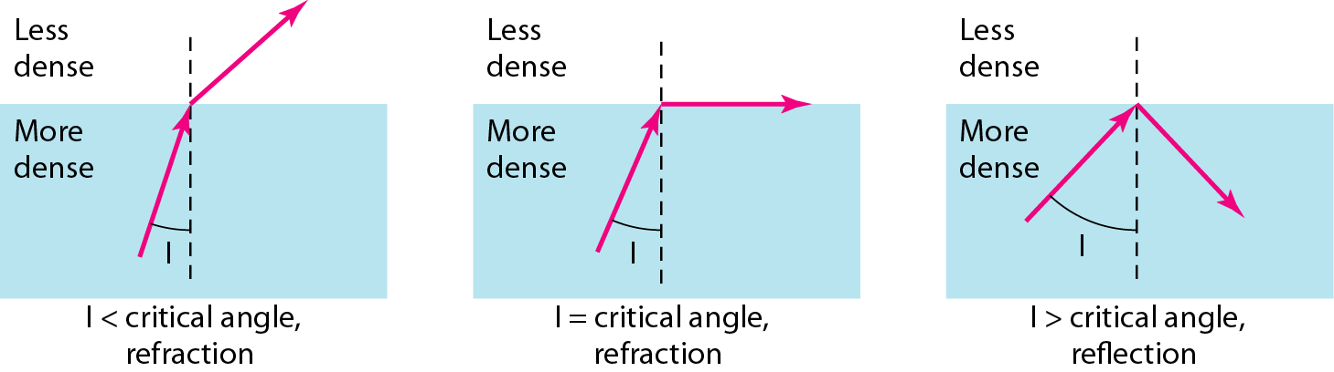
Fiber-Optic Cable
Figure : Bending of light ray
27
Notes:
Data Communication

Slide 28
Fiber-Optic Cable
As the figure shows, if the angle of incidence I (the angle the ray makes with the line perpendicular to the interface between the two substances) is less than the critical angle, the ray refracts and moves closer to the surface.
If the angle of incidence is equal to the critical angle, the light bends along the interface.
If the angle is greater than the critical angle, the ray reflects (makes a turn) and travels again in the denser substance.
Note that the critical angle is a property of the substance, and its value differs from one substance to another.
28
Notes:
Data Communication

Slide 29
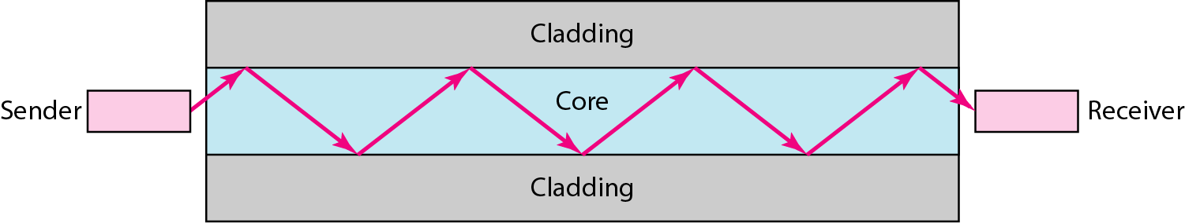
Fiber-Optic Cable
Optical fibers use reflection to guide light through a channel.
A glass or plastic core is surrounded by a cladding of less dense glass or plastic.
The difference in density of the two materials must be such that a beam of light moving through the core is reflected off the cladding instead of being refracted into it.
See Figure
29
Notes:
Data Communication

Slide 30
Propagation Modes
Current technology supports two modes (multimode and single mode) for propagating light along optical channels, each requiring fiber with different physical characteristics.
Multimode can be implemented in two forms: step-index or graded-index (see Figure).
30
Notes:
Data Communication

Slide 31
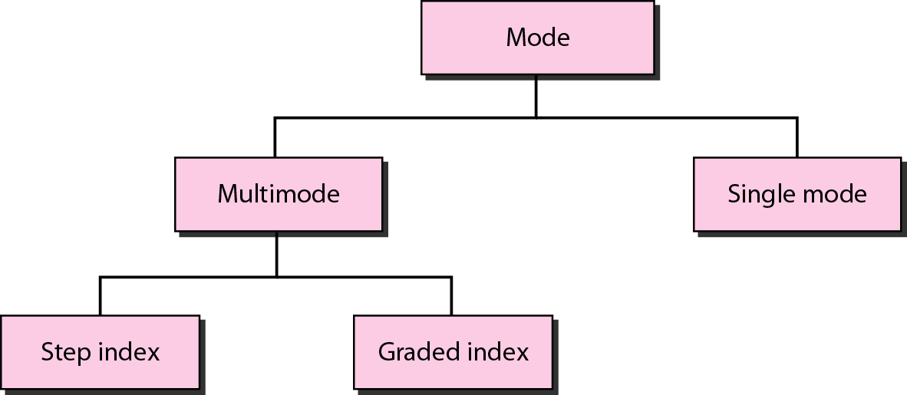
Propagation Modes
31
Notes:
Data Communication

Slide 32
Multimode
Multimode is so named because multiple beams from a light source move through the core in different paths.
How these beams move within the cable depends on the structure of the core, as shown in Figure
32
Notes:
Data Communication

Slide 33
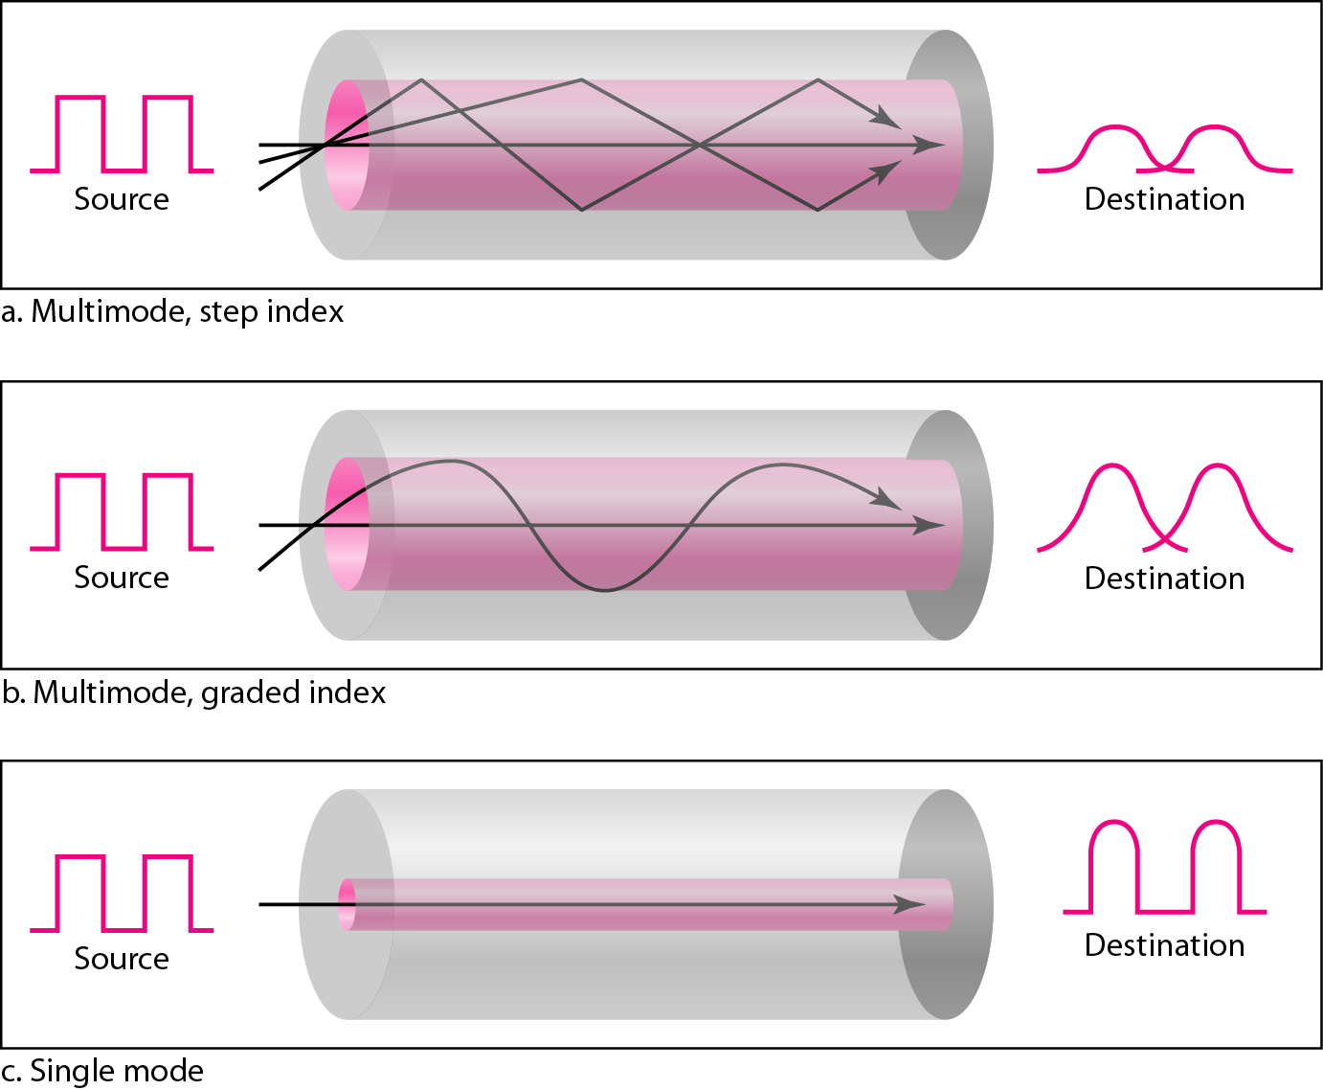
Multimode
33
Notes:
Data Communication

Slide 34
Multimode – Step-Index
In multimode step-index fiber, the density of the core remains constant from the center to the edges.
A beam of light moves through this constant density in a straight line until it reaches the interface of the core and the cladding.
At the interface, there is an abrupt change due to a lower density; this alters the angle of the beam's motion.
The term step index refers to the suddenness of this change, which contributes to the distortion of the signal as it passes through the fiber.
34
Notes:
Data Communication

Slide 35
Multimode – Graded-Index
In this, decreases this distortion of the signal through the cable.
The word index here refers to the index of refraction.
The index of refraction is related to density.
A graded-index fiber, therefore, is one with varying densities.
Density is highest at the center of the core and decreases gradually to its lowest at the edge.
Figure shows the impact of this variable density on the propagation of light beams.
35
Notes:
Data Communication

Slide 36
Single-Mode
Single-mode uses step-index fiber and a highly focused source of light that limits beams to a small range of angles, all close to the horizontal.
The single mode fiber itself is manufactured with a much smaller diameter than that of multimode fiber, and with substantially lower density (index of refraction).
The decrease in density results in a critical angle that is close enough to 90° to make the propagation of beams almost horizontal.
In this case, propagation of different beams is almost identical, and delays are negligible.
36
Notes:
Data Communication

Slide 37
Single-Mode
All the beams arrive at the destination "together" and can be recombined with little distortion to the signal
37
Notes:
Data Communication

Slide 38
Fiber Sizes
Optical fibers are defined by the ratio of the diameter of their core to the diameter of their cladding, both expressed in micrometers.
The common sizes are shown in Table
38
Notes:
Data Communication

Slide 39
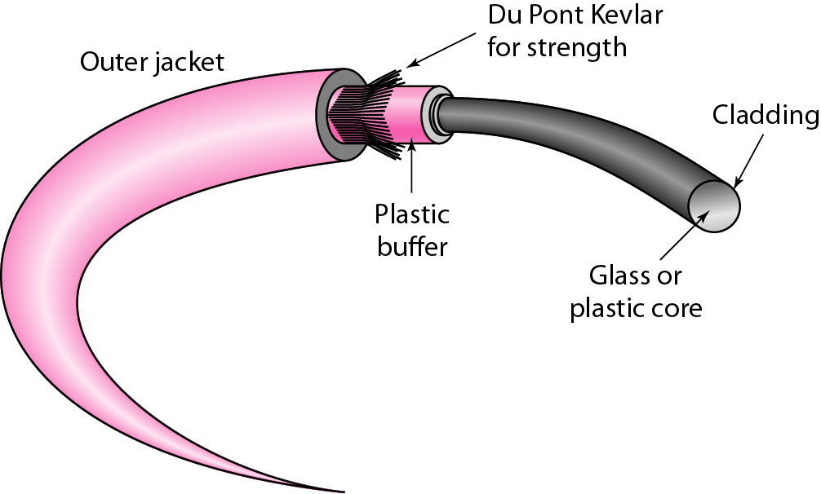
Cable Composition
Figure shows the composition of a typical fiber-optic cable.
39
Notes:
Data Communication

Slide 40
Cable Composition
The outer jacket is made of either PVC or Teflon.
Inside the jacket are Kevlar strands to strengthen the cable.
Kevlar is a strong material used in the fabrication of bulletproof vests.
Below the Kevlar is another plastic coating to cushion the fiber.
The fiber is at the center of the cable, and it consists of cladding and core.
40
Notes:
Data Communication

Slide 41
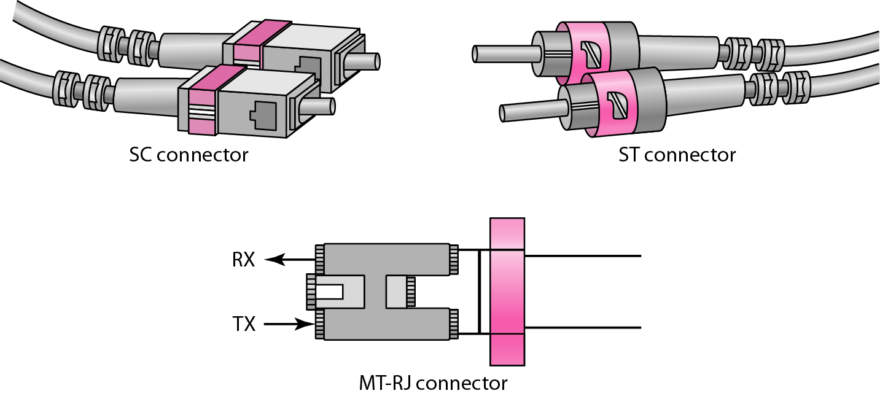
Fiber-Optic Cable Connectors
There are three types of connectors for fiber-optic cables, as shown in Figure
41
Notes:
Data Communication

Slide 42
Fiber-Optic Cable Connectors
The subscriber channel (SC) connector
It is used for cable TV
It uses a push/pull locking system
The straight-tip (ST) connector
It is used for connecting cable to networking devices.
It uses a bayonet locking system and is more reliable than SC.
MT-RJ
It is a connector that is the same size as RJ45.
42
Notes:
Data Communication

Slide 43
Performance
The plot of attenuation versus wavelength in Figure shows a very interesting phenomenon in fiber-optic cable.
Attenuation is flatter than in the case of twisted-pair cable and coaxial cable.
The performance is such that we need fewer (actually 10 times less) repeaters when we use fiber-optic cable.
43
Notes:
Data Communication

Slide 44
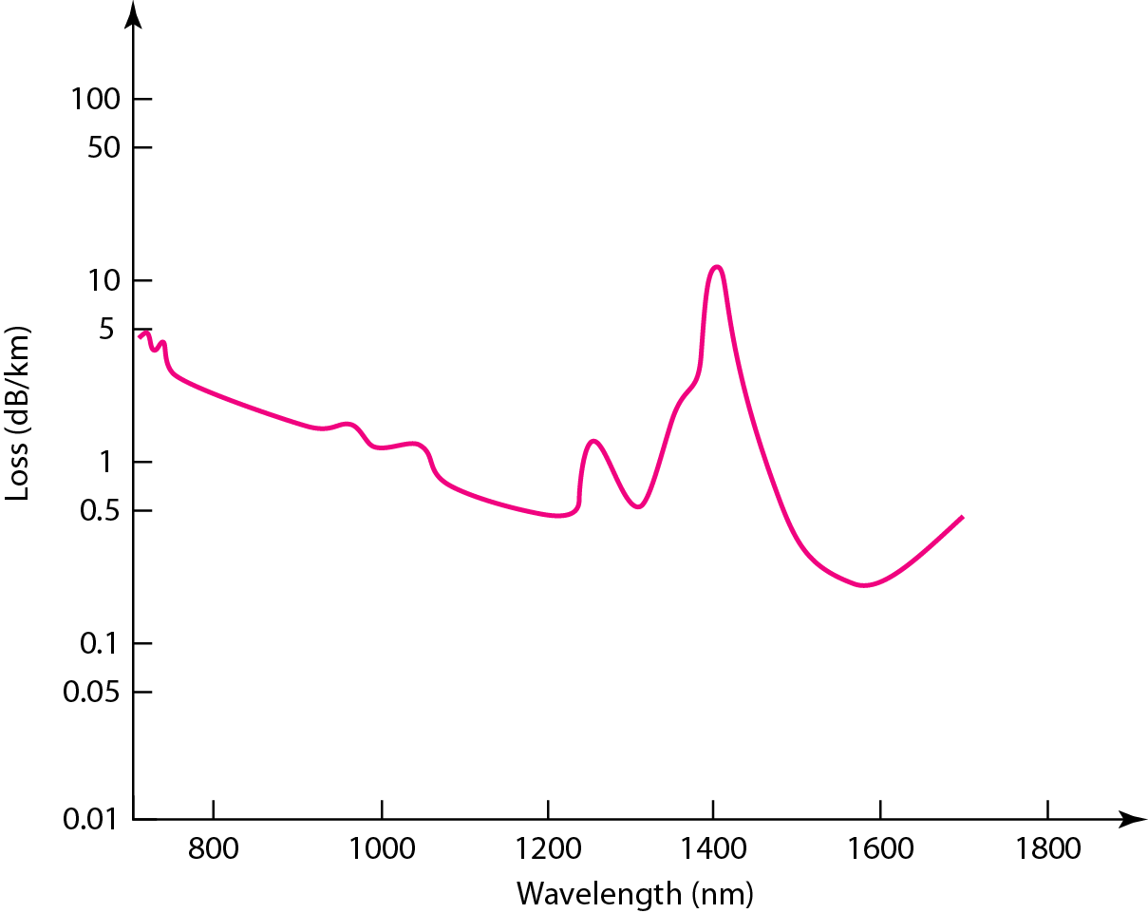
Performance
44
Notes:
Data Communication

Slide 45
Applications
Fiber-optic cable is often found in backbone networks because its wide bandwidth is cost-effective.
Today, with wavelength-division multiplexing (WDM), we can transfer data at a rate of 1600 Gbps.
The SONET network provides such a backbone.
Some cable TV companies use a combination of optical fiber and coaxial cable, thus creating a hybrid network.
Optical fiber provides the backbone structure while coaxial cable provides the connection to the user premises.
45
Notes:
Data Communication

Slide 46
Applications
This is a cost-effective configuration since the narrow bandwidth requirement at the user end does not justify the use of optical fiber.
Local-area networks such as 100Base-FX network (Fast Ethernet) and 1000Base-X also use fiber-optic cable.
46
Notes:
Data Communication

Slide 47
Advantages of Optical Fiber
Higher bandwidth
Fiber-optic cable can support dramatically higher bandwidths (and hence data rates) than either twisted-pair or coaxial cable.
Currently, data rates and bandwidth utilization over fiber-optic cable are limited not by the medium but by the signal generation and reception technology available.
Resistance to corrosive materials
Glass is more resistant to corrosive materials than copper.
47
Notes:
Data Communication

Slide 48
Advantages of Optical Fiber
Less signal attenuation
Fiber-optic transmission distance is significantly greater than that of other guided media.
A signal can run for 50 km without requiring regeneration.
We need repeaters every 5 km for coaxial or twisted-pair cable.
Immunity to electromagnetic interference
Electromagnetic noise cannot affect fiber-optic cables.
48
Notes:
Data Communication

Slide 49
Advantages of Optical Fiber
Light weight
Fiber-optic cables are much lighter than copper cables.
Greater immunity to tapping
Fiber-optic cables are more immune to tapping than copper cables.
Copper cables create antenna effects that can easily be tapped.
49
Notes:
Data Communication

Slide 50
Disadvantages of Optical Fiber
Installation and maintenance
Fiber-optic cable is a relatively new technology.
Its installation and maintenance require expertise that is not yet available everywhere
Unidirectional light propagation
Propagation of light is unidirectional
If we need bidirectional communication, two fibers are needed.
50
Notes:
Data Communication

Slide 51
Disadvantages of Optical Fiber
Cost
The cable and the interfaces are relatively more expensive than those of other guided media.
If the demand for bandwidth is not high, often the use of optical fiber cannot be justified
51
Notes:
Data Communication

