Slide 1
Bandwidth Utilization:
Multiplexing and Spreading
1
Notes:
Data Communication

Slide 2
Introduction
Bandwidth utilization is the wise use of available bandwidth to achieve specific goals.
Efficiency can be achieved by multiplexing;
Privacy and antijamming can be achieved by spreading.
2
Notes:
Data Communication

Slide 3
MULTIPLEXING
Whenever the bandwidth of a medium linking two devices is greater than the bandwidth needs of the devices, the link can be shared.
Multiplexing is the set of techniques that allows the simultaneous transmission of multiple signals across a single data link.
As data and telecommunications use increases, so does traffic.
We can accommodate this increase by continuing to add individual links each time a new channel is needed; or we can install higher-bandwidth links and use each to carry multiple signals.
3
Notes:
Data Communication

Slide 4
MULTIPLEXING
Today's technology includes high-bandwidth media such as optical fiber and terrestrial and satellite microwaves.
Each has a bandwidth far in excess of that needed for the average transmission signal.
If the bandwidth of a link is greater than the bandwidth needs of the devices connected to it, the bandwidth is wasted.
An efficient system maximizes the utilization of all resources; bandwidth is one of the most precious resources we have in data communications.
4
Notes:
Data Communication

Slide 5
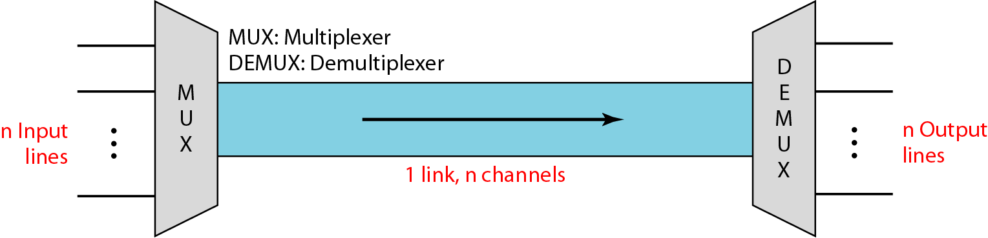
MULTIPLEXING
In a multiplexed system, n lines share the bandwidth of one link.
Figure shows the basic format of a multiplexed system.
Figure : Dividing a link into channels
5
Notes:
Data Communication

Slide 6
MULTIPLEXING
The lines on the left direct their transmission streams to a multiplexer (MUX), which combines them into a single stream (many-to-one).
At the receiving end, that stream is fed into a demultiplexer (DEMUX), which separates the stream back into its component transmissions (one-to-many) and directs them to their corresponding lines.
In the figure, the word link refers to the physical path.
The word channel refers to the portion of a link that carries a transmission between a given pair of lines.
One link can have many (n) channels
6
Notes:
Data Communication

Slide 7
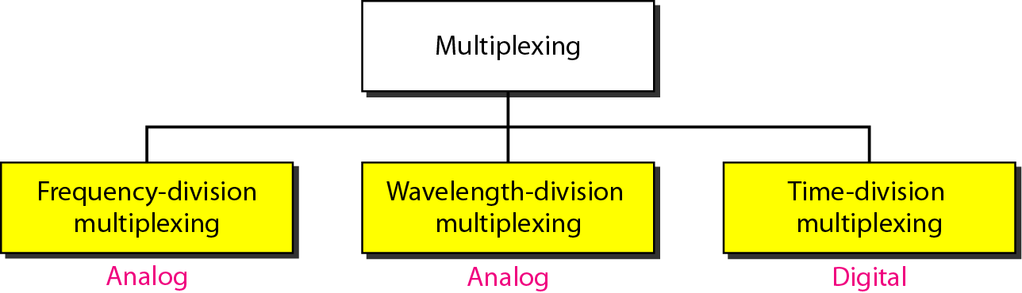
Basic Multiplexing Techniques:
The first two are techniques designed for analog signals, the third, for digital signals.
7
Notes:
Data Communication

Slide 8
Frequency-Division Multiplexing (FDM)
FDM is an analog technique that can be applied when the bandwidth of a link (in hertz) is greater than the combined bandwidths of the signals to be transmitted.
In FDM, signals generated by each sending device modulate different carrier frequencies.
These modulated signals are then combined into a single composite signal that can be transported by the link.
Carrier frequencies are separated by sufficient bandwidth to accommodate the modulated signal.
These bandwidth ranges are the channels through which the various signals travel.
8
Notes:
Data Communication

Slide 9
Frequency-Division Multiplexing (FDM)
Channels can be separated by strips of unused bandwidth-guard bands-to prevent signals from overlapping.
In addition, carrier frequencies must not interfere with the original data frequencies
Figure gives a conceptual view of FDM.
In this illustration, the transmission path is divided into three parts, each representing a channel that carries one transmission
9
Notes:
Data Communication

Slide 10
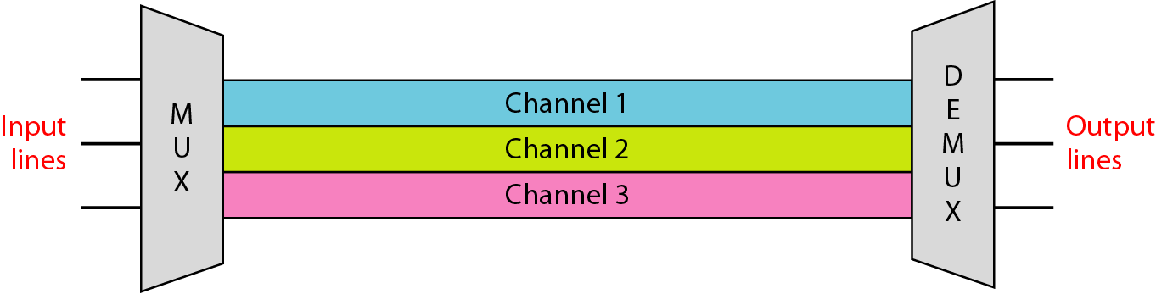
Frequency-Division Multiplexing (FDM)
10
Notes:
Data Communication

Slide 11
Frequency-Division Multiplexing (FDM)
We consider FDM to be an analog multiplexing technique; however, this does not mean that FDM cannot be used to combine sources sending digital signals.
A digital signal can be converted to an analog signal (with the techniques discussed in class) before FDM is used to multiplex them.
11
Notes:
Data Communication

Slide 12
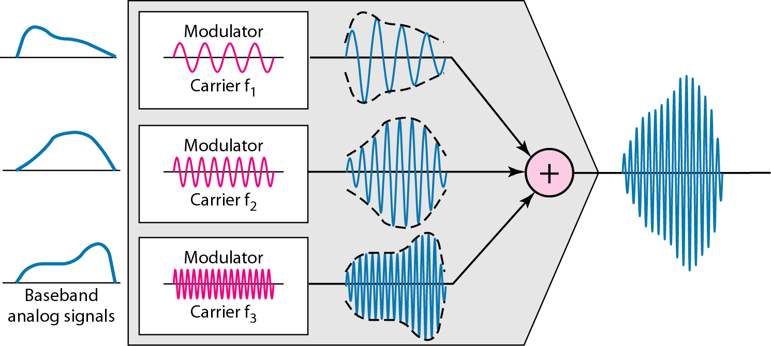
Multiplexing Process
Figure is a conceptual illustration of the multiplexing process.
12
Notes:
Data Communication

Slide 13
Multiplexing Process
Each source generates a signal of a similar frequency range.
Inside the multiplexer, these similar signals modulates different carrier frequencies (f₁, f₂, and f₃).
The resulting modulated signals are then combined into a single composite signal that is sent out over a media link that has enough bandwidth to accommodate it.
13
Notes:
Data Communication

Slide 14
Demultiplexing Process
The demultiplexer uses a series of filters to decompose the multiplexed signal into its constituent component signals.
The individual signals are then passed to a demodulator that separates them from their carriers and passes them to the output lines.
Figure is a conceptual illustration of demultiplexing process
14
Notes:
Data Communication

Slide 15
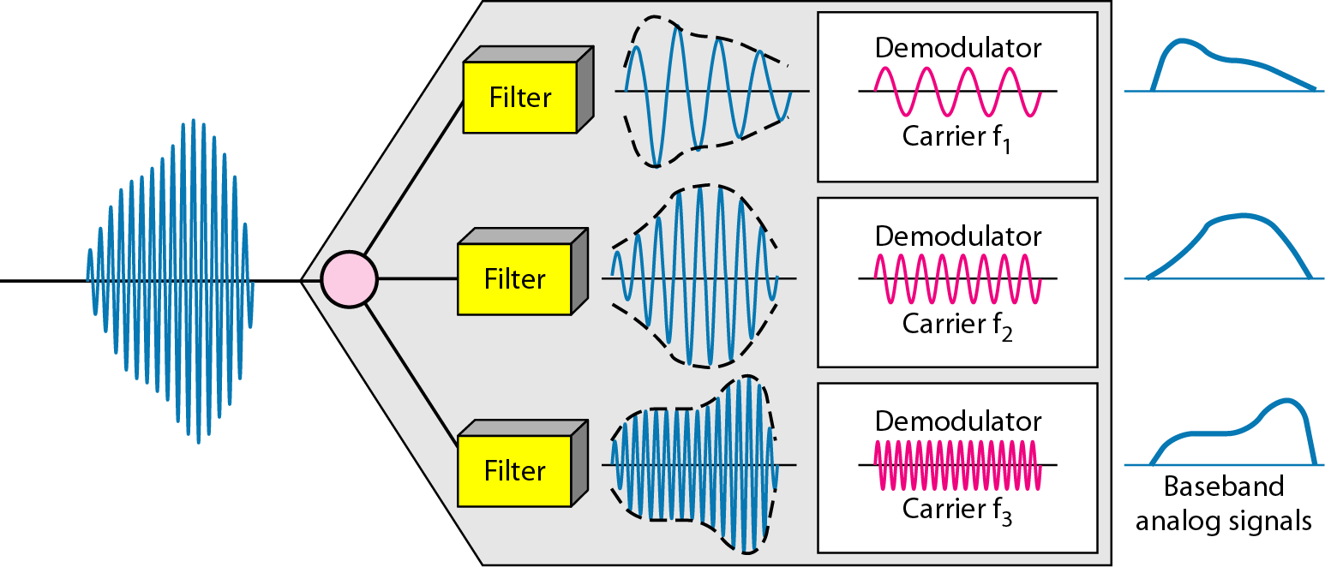
Demultiplexing Process
15
Notes:
Data Communication

Slide 16
Assume that a voice channel occupies a bandwidth of 4 kHz. We need to combine three voice channels into a link with a bandwidth of 12 kHz, from 20 to 32 kHz. Show the configuration, using the frequency domain. Assume there are no guard bands.
16
Notes:
Data Communication

Slide 17
Assume that a voice channel occupies a bandwidth of 4 kHz. We need to combine three voice channels into a link with a bandwidth of 12 kHz, from 20 to 32 kHz. Show the configuration, using the frequency domain. Assume there are no guard bands.
Solution
We shift (modulate) each of the three voice channels to a different bandwidth, as shown in Figure (MUX).
We use the 20- to 24-kHz bandwidth for the first channel, the 24- to 28-kHz bandwidth for the second channel, and the 28- to 32-kHz bandwidth for the third one.
Then we combine them as shown in Figure (DEMUX).
17
Notes:
Data Communication

Slide 18
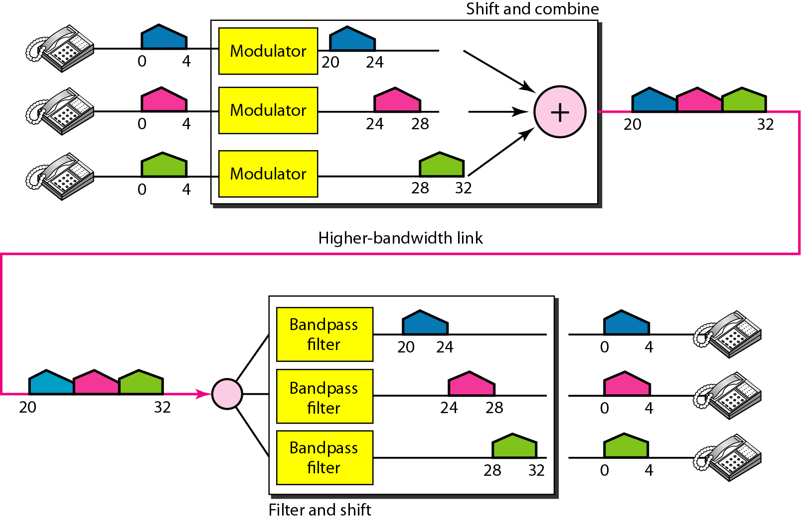
18
Notes:
Data Communication

Slide 19
Five channels, each with a 100-kHz bandwidth, are to be multiplexed together. What is the minimum bandwidth of the link if there is a need for a guard band of 10 kHz between the channels to prevent interference?
19
Notes:
Data Communication

Slide 20
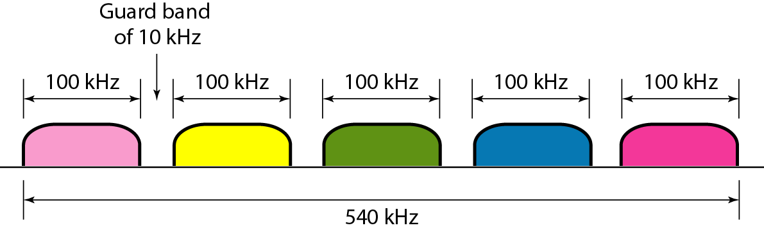
Five channels, each with a 100-kHz bandwidth, are to be multiplexed together. What is the minimum bandwidth of the link if there is a need for a guard band of 10 kHz between the channels to prevent interference?
Solution
For five channels, we need at least four guard bands.
This means that the required bandwidth is at least
5 × 100 + 4 × 10 = 540 kHz, As shown in Figure
20
Notes:
Data Communication

Slide 21
Wavelength-Division Multiplexing
WDM is designed to use the high-data-rate capability of fiber-optic cable.
The optical fiber data rate is higher than the data rate of metallic transmission cable.
Using a fiber-optic cable for one single line wastes the available bandwidth.
Multiplexing allows us to combine several lines into one.
21
Notes:
Data Communication

Slide 22
Wavelength-Division Multiplexing
WDM is conceptually the same as FDM, except that the multiplexing and demultiplexing involve optical signals transmitted through fiber-optic channels.
The idea is the same:
We are combining different signals of different frequencies.
The difference is that the frequencies are very high.
22
Notes:
Data Communication

Slide 23
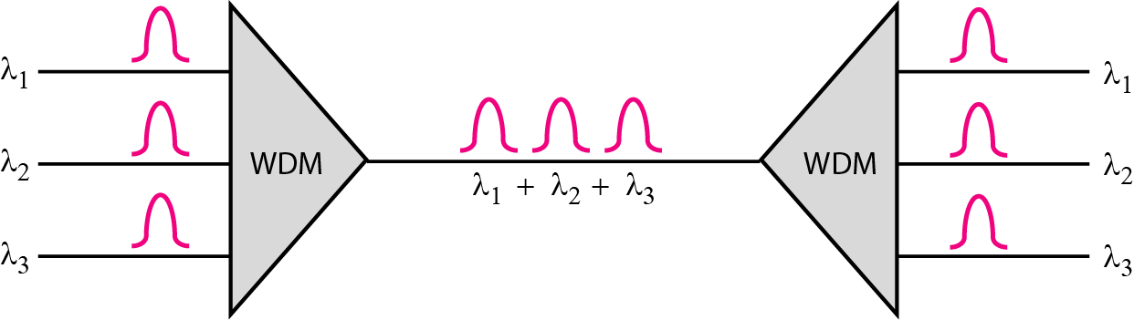
Wavelength-Division Multiplexing
Figure gives a conceptual view of a WDM multiplexer and demultiplexer.
23
Notes:
Data Communication

Slide 24
Wavelength-Division Multiplexing
Very narrow bands of light from different sources are combined to make a wider band of light.
At the receiver, the signals are separated by the demultiplexer.
WDM is an analog multiplexing technique to combine optical signals.
24
Notes:
Data Communication

Slide 25
Wavelength-Division Multiplexing
We want to combine multiple light sources into one single light at the multiplexer and do the reverse at the demultiplexer.
The combining and splitting of light sources are easily handled by a prism.
Recall from basic physics that a prism bends a beam of light based on the angle of incidence and the frequency.
25
Notes:
Data Communication

Slide 26
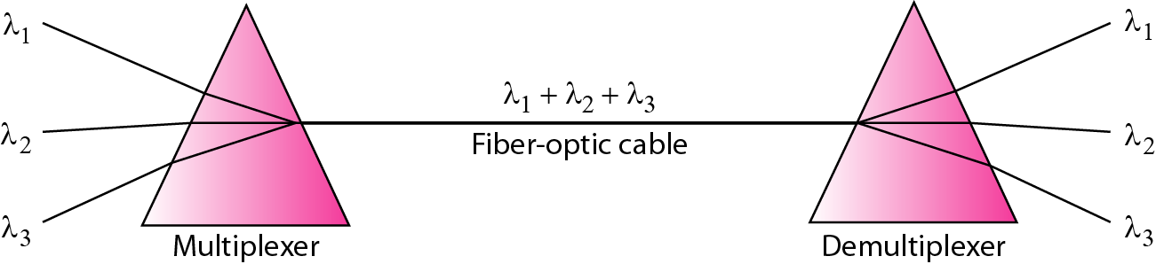
Wavelength-Division Multiplexing
Using this technique, a multiplexer can be made to combine several input beams of light, each containing a narrow band of frequencies, into one output beam of a wider band of frequencies.
A demultiplexer can also be made to reverse the process.
Figure shows the concept
26
Notes:
Data Communication

Slide 27
Wavelength-Division Multiplexing
One application of WDM is the SONET network in which multiple optical fiber lines are multiplexed and demultiplexed.
A new method, called Dense WDM (DWDM), can multiplex a very large number of channels by spacing channels very close to one another.
It achieves even greater efficiency.
27
Notes:
Data Communication

Slide 28
Time-Division Multiplexing (TDM)
TDM is a digital process that allows several connections to share the high bandwidth of a link
Instead of sharing a portion of the bandwidth as in FDM, time is shared.
Each connection occupies a portion of time in the link.
Figure gives a conceptual view of TDM.
28
Notes:
Data Communication

Slide 29
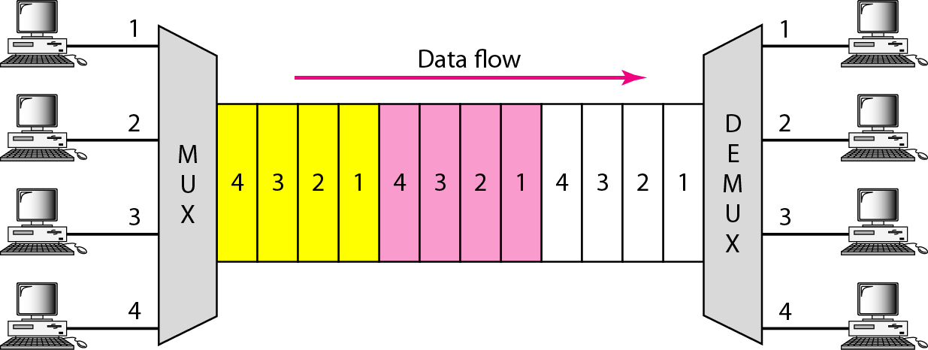
Time-Division Multiplexing (TDM)
In the figure, portions of signals 1,2,3, and 4 occupy the link sequentially.
29
Notes:
Data Communication

Slide 30
Time-Division Multiplexing (TDM)
The delivery is fixed and unvarying, unlike switching.
TDM is, in principle, a digital multiplexing technique.
Digital data from different sources are combined into one timeshared link.
30
Notes:
Data Communication

Slide 31
Time-Division Multiplexing (TDM)
However, this does not mean that the sources cannot produce analog data; analog data can be sampled, changed to digital data, and then multiplexed by using TDM.
We can divide TDM into two different schemes: synchronous and statistical.
In synchronous TDM, each input connection has an allotment in the output even if it is not sending data.
31
Notes:
Data Communication

Slide 32
Time Slots and Frames
In synchronous TDM, the data flow of each input connection is divided into units, where each input occupies one input time slot.
A unit can be 1 bit, one character, or one block of data.
Each input unit becomes one output unit and occupies one output time slot.
However, the duration of an output time slot is n times shorter than the duration of an input time slot.
If an input time slot is T s, the output time slot is T/n s, where n is the number of connections.
32
Notes:
Data Communication

Slide 33
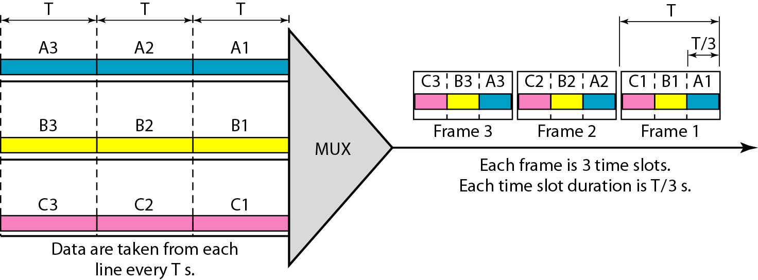
Time Slots and Frames
A unit in the output connection has a shorter duration; it travels faster
Figure shows an example of synchronous TDM where n is 3.
33
Notes:
Data Communication

Slide 34
Time Slots and Frames
In synchronous TDM, a round of data units from each input connection is collected into a frame
If we have n connections, a frame is divided into n time slots and one slot is allocated for each unit, one for each input line.
If the duration of the input unit is T, the duration of each slot is T/n and the duration of each frame is T.
The data rate of the output link must be n times the data rate of a connection to guarantee the flow of data.
34
Notes:
Data Communication

Slide 35
Interleaving
TDM can be visualized as two fast-rotating switches, one on the multiplexing side and the other on the demultiplexing side.
The switches are synchronized and rotate at the same speed, but in opposite directions.
On the multiplexing side, as the switch opens in front of a connection, that connection has the opportunity to send a unit onto the path.
This process is called interleaving.
On the demultiplexing side, as the switch opens in front of a connection, that connection has the opportunity to receive a unit from the path.
35
Notes:
Data Communication

Slide 36
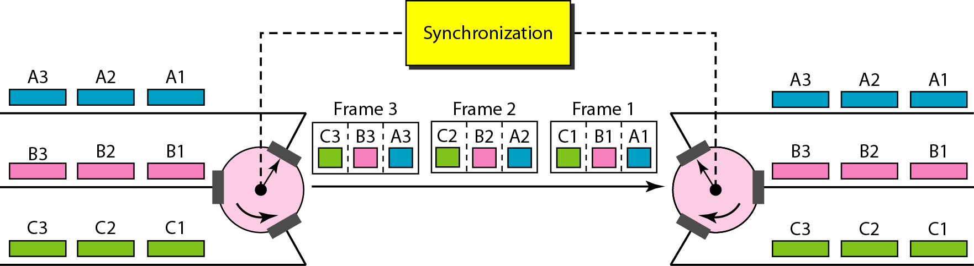
Interleaving
Figure shows the interleaving process .
In this figure, we assume that no switching is involved and that the data from the first connection at the multiplexer site go to the first connection at the demultiplexer
36
Notes:
Data Communication

Slide 37
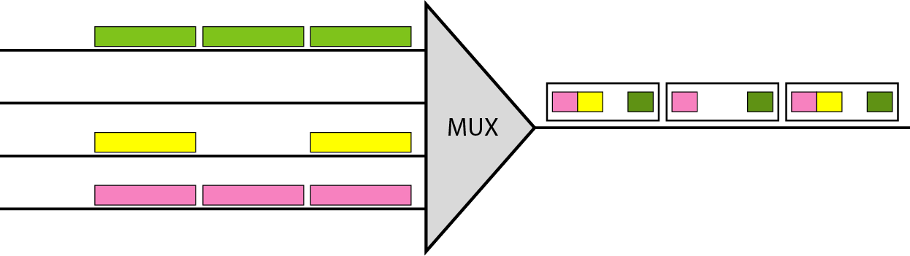
Empty Slots
Synchronous TDM is not as efficient as it could be.
If a source does not have data to send, the corresponding slot in the output frame is empty.
Figure shows a case in which one of the input lines has no data to send and one slot in another input line has discontinuous data.
37
Notes:
Data Communication

Slide 38
Empty Slots
The first output frame has three slots filled, the second frame has two slots filled, and the third frame has three slots filled.
No frame is full.
We learn in the next section that statistical TDM can improve the efficiency by removing the empty slots from the frame.
38
Notes:
Data Communication

Slide 39
Data Rate Management
One problem with TDM is how to handle a disparity in the input data rates.
In all our discussion so far, we assumed that the data rates of all input lines were the same.
However, if data rates are not the same, three strategies, or a combination of them, can be used.
We call these three strategies multilevel multiplexing, multiple-slot allocation, and pulse stuffing.
39
Notes:
Data Communication

Slide 40
Multilevel Multiplexing
Multilevel multiplexing is a technique used when the data rate of an input line is a multiple of others.
For example, in Figure, we have two inputs of 20 kbps and three inputs of 40 kbps.
The first two input lines can be multiplexed together to provide a data rate equal to the last three.
A second level of multiplexing can create an output of 160 kbps.
40
Notes:
Data Communication

Slide 41
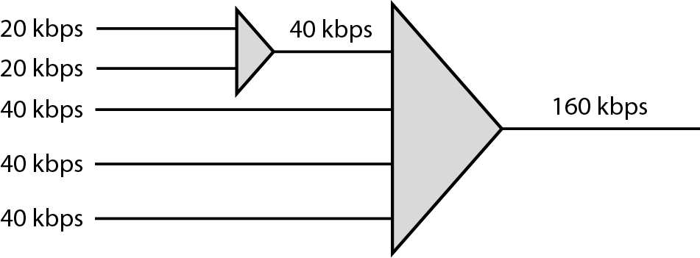
Multilevel Multiplexing
Multilevel multiplexing is a technique used when the data rate of an input line is a multiple of others.
For example, in Figure, we have two inputs of 20 kbps and three inputs of 40 kbps.
41
Notes:
Data Communication

Slide 42
Multilevel Multiplexing
The first two input lines can be multiplexed together to provide a data rate equal to the last three.
A second level of multiplexing can create an output of 160 kbps.
Multiple-Slot Allocation
Sometimes it is more efficient to allot more than one slot in a frame to a single input line.
For example, we might have an input line that has a data rate that is a multiple of another input.
42
Notes:
Data Communication

Slide 43
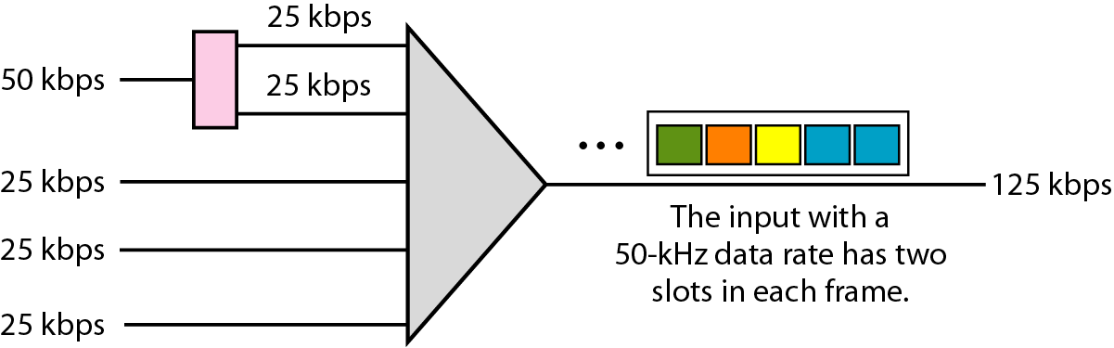
Multiple-Slot Allocation
In Figure, the input line with a 50 kbps data rate can be given two slots in the output.
We insert a serial-to-parallel converter in the line to make two inputs out of one.
43
Notes:
Data Communication

Slide 44
Pulse Stuffing
Sometimes the bit rates of sources are not multiple integers of each other.
Therefore, neither of the above two techniques can be applied.
One solution is to make the highest input data rate the dominant data rate and then add dummy bits to the input lines with lower rates.
This will increase their rates.
This technique is called pulse stuffing, bit padding, or bit stuffing.
44
Notes:
Data Communication

Slide 45
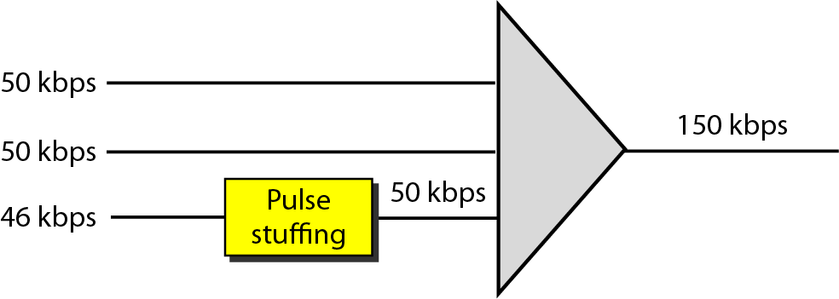
Pulse Stuffing
The idea is shown in Figure 6.21.
The input with a data rate of 46 is pulse-stuffed to increase the rate to 50 kbps.
Now multiplexing can take place.
45
Notes:
Data Communication

Slide 46
Frame Synchronizing
The implementation of TDM is not as simple as that of FDM.
Synchronization between the multiplexer and demultiplexer is a major issue.
If the multiplexer and the demultiplexer are not synchronized, a bit belonging to one channel may be received by the wrong channel.
For this reason, one or more synchronization bits are usually added to the beginning of each frame.
46
Notes:
Data Communication

Slide 47
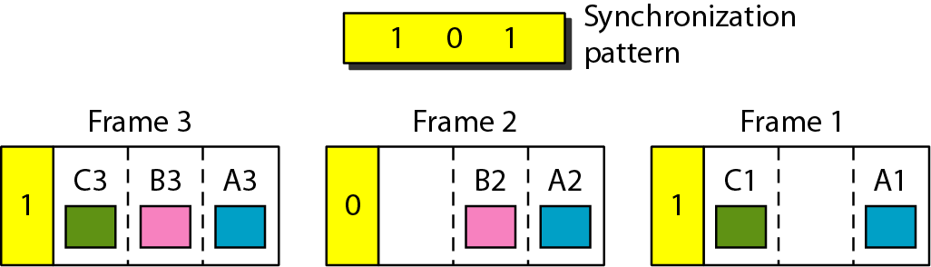
Frame Synchronizing
These bits, called framing bits, follow a pattern, frame to frame, that allows the demultiplexer to synchronize with the incoming stream so that it can separate the time slots accurately.
This synchronization information consists of 1 bit per frame, alternating between 0 and 1, as shown in Figure
47
Notes:
Data Communication

Slide 48
Frame Synchronizing
These bits, called framing bits, follow a pattern, frame to frame, that allows the demultiplexer to synchronize with the incoming stream so that it can separate the time slots accurately.
This synchronization information consists of 1 bit per frame, alternating between 0 and 1, as shown in Figure
48
Notes:
Data Communication

Slide 49
Synchronous TDM Applications
Some second-generation cellular telephone companies use synchronous TDM.
For example, the digital version of cellular telephony divides the available bandwidth into 30-kHz bands.
For each band, TDM is applied so that six users can share the band.
This means that each 30 kHz band is now made of six time slots, and the digitized voice signals of the users are inserted in the slots.
Using TDM, the number of telephone users in each area is now 6 times greater.
DS ( Digital Signal ) Service
49
Notes:
Data Communication

Slide 50
Statistical Time-Division Multiplexing
In synchronous TDM, each input has a reserved slot in the output frame.
This can be inefficient if some input lines have no data to send.
In statistical time-division multiplexing, slots are dynamically allocated to improve bandwidth efficiency.
Only when an input line has a slot's worth of data to send is it given a slot in the output frame.
In statistical multiplexing, the number of slots in each frame is less than the number of input lines.
50
Notes:
Data Communication

Slide 51
Statistical Time-Division Multiplexing
The multiplexer checks each input line in round robin fashion; it allocates a slot for an input line if the line has data to send; otherwise, it skips the line and checks the next line.
Figure shows a synchronous and a statistical TDM example.
In the former, some slots are empty because the corresponding line does not have data to send.
In the latter, however, no slot is left empty as long as there are data to be sent by any input line.
51
Notes:
Data Communication

Slide 52
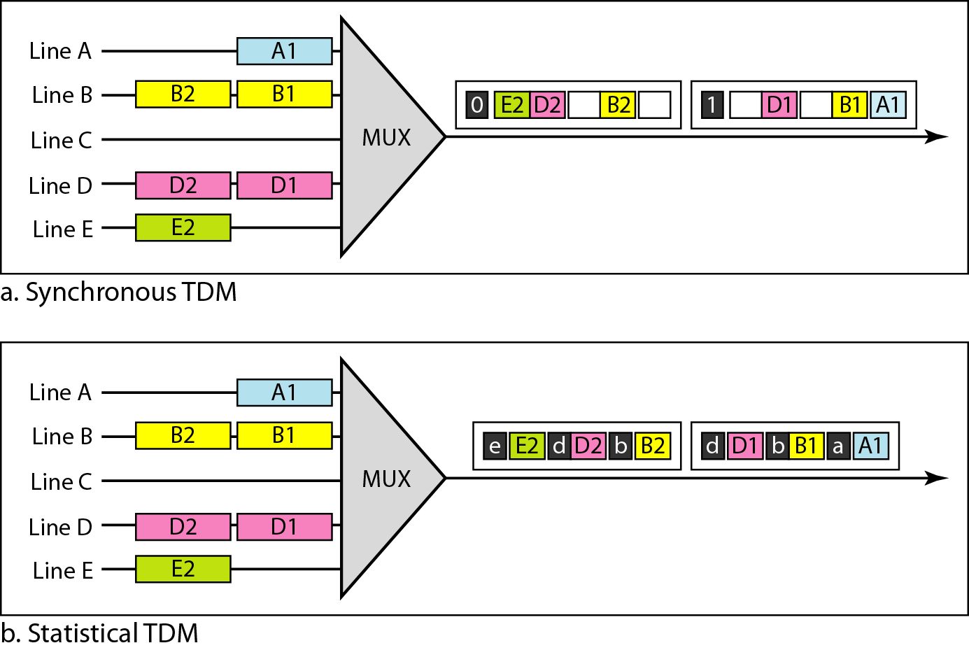
Statistical Time-Division Multiplexing
52
Notes:
Data Communication

Slide 53
Statistical TDM - Addressing
Figure also shows a major difference between slots in synchronous TDM and statistical TDM.
An output slot in synchronous TDM is totally occupied by data; in statistical TDM, a slot needs to carry data as well as the address of the destination.
In synchronous TDM, there is no need for addressing; synchronization and pre assigned relationships between the inputs and outputs serve as an address.
53
Notes:
Data Communication

Slide 54
Statistical TDM - Addressing
If the multiplexer and the demultiplexer are synchronized, this is guaranteed.
In statistical multiplexing, there is no fixed relationship between the inputs and outputs because there are no pre assigned or reserved slots.
We need to include the address of the receiver inside each slot to show where it is to be delivered.
The addressing in its simplest form can be n bits to define N different output lines with n =log₂ N.
For example, for eight different output lines, we need a 3-bit address.
54
Notes:
Data Communication

Slide 55
Slot Size
Since a slot carries both data and an address in statistical TDM, the ratio of the data size to address size must be reasonable to make transmission efficient.
For example, it would be inefficient to send 1 bit per slot as data when the address is 3 bits.
In statistical TDM, a block of data is usually many bytes while the address is just a few bytes.
55
Notes:
Data Communication

Slide 56
No Synchronization Bit
There is another difference between synchronous and statistical TDM, but this time it is at the frame level.
The frames in statistical TDM need not be synchronized, so we do not need synchronization bits.
56
Notes:
Data Communication

Slide 57
Bandwidth
In statistical TDM, the capacity of the link is normally less than the sum of the capacities of each channel.
The designers of statistical TDM define the capacity of the link based on the statistics of the load for each channel.
If on average only x percent of the input slots are filled, the capacity of the link reflects this.
Of course, during peak times, some slots need to wait.
57
Notes:
Data Communication

