Slide 1
Network Models
1
Notes:
Data Communication

Slide 2
Layered Tasks
We use the concept of layers in our daily life.
As an example, let us consider two friends who communicate through postal mail.
The process of sending a letter to a friend would be complex if there were no services available from the post office.
Figure shows the steps in this task.
2
Notes:
Data Communication

Slide 3
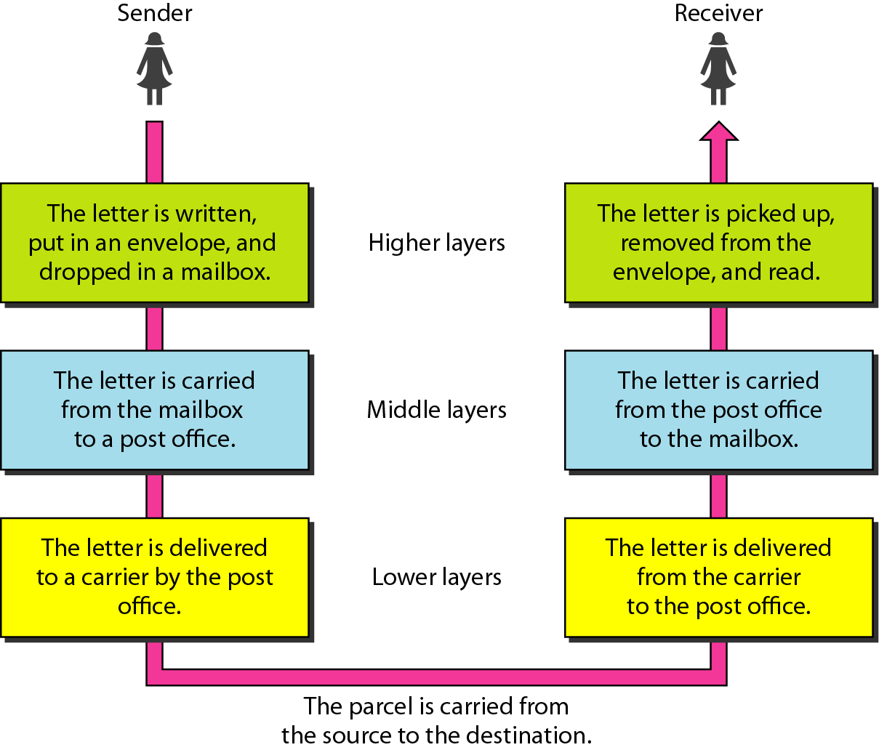
Layered Tasks
Figure :Tasks involved in sending a letter
3
Notes:
Data Communication

Slide 4
At the Sender Side
Higher layer
The sender writes the letter, inserts the letter in an envelope, writes the sender and receiver addresses, and drops the letter in a mailbox.
Middle layer
The letter is picked up by a letter carrier and delivered to the post office.
Lower layer
The letter is sorted at the post office; a carrier transports the letter.
4
Notes:
Data Communication

Slide 5
On the way
The letter is then on its way to the recipient.
On the way to the recipient's local post office, the letter may actually go through a central office.
In addition, it may be transported by truck, train, airplane, boat, or a combination of these.
5
Notes:
Data Communication

Slide 6
At the Receiver Side
Lower layer
The carrier transports the letter to the post office.
Middle layer
The letter is sorted and delivered to the recipient's mailbox.
Higher layer
The receiver picks up the letter, opens the envelope, and reads it
6
Notes:
Data Communication

Slide 7
Hierarchy
According to our analysis, there are three different activities at the sender site and another three activities at the receiver site.
The task of transporting the letter between the sender and the receiver is done by the carrier.
7
Notes:
Data Communication

Slide 8
Services
Each layer at the sending site uses the services of the layer immediately below it.
The sender at the higher layer uses the services of the middle layer.
The middle layer uses the services of the lower layer.
The lower layer uses the services of the carrier.
8
Notes:
Data Communication

Slide 9
The Layered Model
The layered model that dominated data communications and networking literature before 1990 was the Open Systems Interconnection (OSI) model.
Everyone believed that the OSI model would become the ultimate standard for data communications, but this did not happen.
The TCP/IP protocol suite became the dominant commercial architecture because it was used and tested extensively in the Internet; the OSI model was never fully implemented.
9
Notes:
Data Communication

Slide 10
The OSI Model
Established in 1947, the International Standards Organization (ISO) is a multinational body dedicated to worldwide agreement on international standards.
An ISO standard that covers all aspects of network communications is the Open Systems Interconnection model.
It was first introduced in the late 1970s.
An open system is a set of protocols that allows any two different systems to communicate regardless of their underlying architecture.
10
Notes:
Data Communication

Slide 11
The OSI Model
The purpose of the OSI model is to show how to facilitate communication between different systems without requiring changes to the logic of the underlying hardware and software.
The OSI model is not a protocol; it is a model for understanding and designing a network architecture that is flexible, robust, and interoperable
11
Notes:
Data Communication

Slide 12
The OSI Model
The OSI model is a layered framework for the design of network systems that allows communication between all types of computer systems.
It consists of seven separate but related layers, each of which defines a part of the process of moving information across a network (see Figure).
An understanding of the fundamentals of the OSI model provides a solid basis for exploring data communications.
12
Notes:
Data Communication

Slide 13
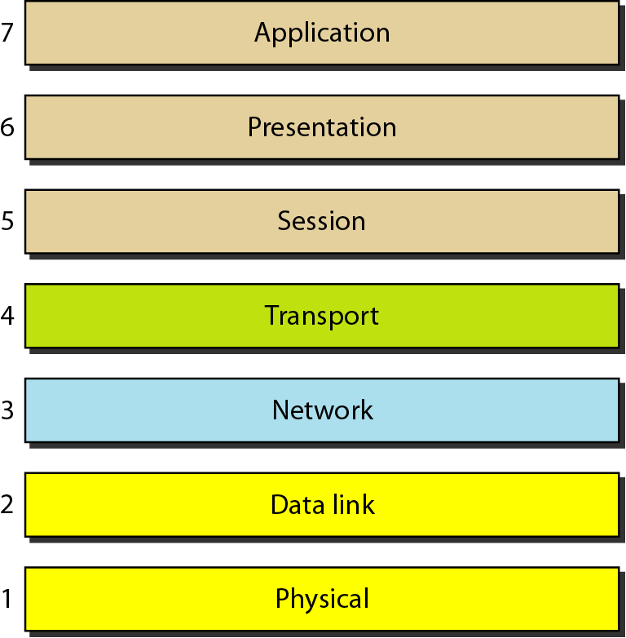
The OSI Model
13
Notes:
Data Communication

Slide 14
Layered Architecture
The OSI model is composed of seven ordered layers.
The layers involved when a message is sent from device A to device B.
As the message travels from A to B, it may pass through many intermediate nodes.
These intermediate nodes usually involve only the first three layers of the OSI model ( as shown in figure).
14
Notes:
Data Communication

Slide 15
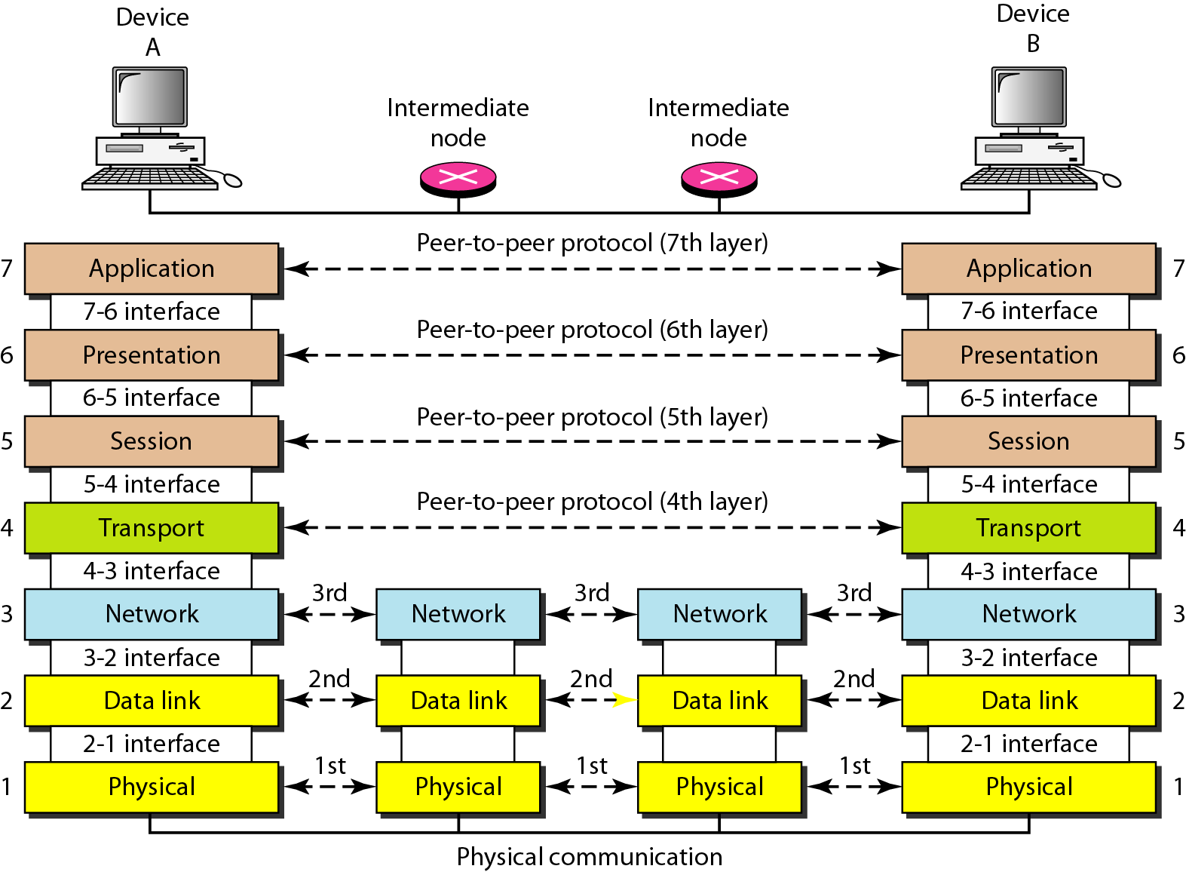
The interaction between layers in the OSI model
15
Notes:
Data Communication

Slide 16
Layered Architecture
Each layer defines a family of functions distinct from those of the other layers.
By defining and localizing functionality in this fashion, the designers created an architecture that is both comprehensive and flexible.
Most importantly, the OSI model allows complete interoperability between otherwise incompatible systems.
16
Notes:
Data Communication

Slide 17
Layered Architecture
Within a single machine, each layer calls upon the services of the layer just below it.
Between machines, layer x on one machine communicates with layer x on another machine. This communication is governed by an agreed-upon series of rules and conventions called protocols.
The processes on each machine that communicate at a given layer are called peer-to-peer processes.
Communication between machines is therefore a peer-to-peer process using the protocols appropriate to a given layer.
17
Notes:
Data Communication

Slide 18
Peer-to-Peer Processes
At the physical layer, communication is direct
In Figure, device A sends a stream of bits to device B (through intermediate nodes).
At the higher layers, however, communication must move down through the layers on device A, over to device B, and then back up through the layers.
Each layer in the sending device adds its own information to the message it receives from the layer just above it and passes the whole package to the layer just below it.
18
Notes:
Data Communication

Slide 19
Peer-to-Peer Processes
At layer First, the entire package is converted to a form that can be transmitted to the receiving device.
At the receiving machine, the message is unwrapped layer by layer, with each process receiving and removing the data meant for it.
19
Notes:
Data Communication

Slide 20
Interfaces between layers
The passing of the data and network information down through the layers of the sending device and back up through the layers of the receiving device is made possible by an interface between each pair of adjacent layers.
Each interface defines the information and services a layer must provide for the layer above it.
Well-defined interfaces and layer functions provide modularity to a network.
20
Notes:
Data Communication

Slide 21
Interfaces between layers
As long as a layer provides the expected services to the layer above it, the specific implementation of its functions can be modified or replaced without requiring changes to the surrounding layers.
21
Notes:
Data Communication

Slide 22
Organization of the Layers
Layers physical, data link, and network are the network support layers; they deal with the physical aspects of moving data from one device to another (such as electrical specifications, physical connections, physical addressing, and transport timing and reliability).
Layers session, presentation, and application can be thought of as the user support layers; they allow interoperability among unrelated software systems.
22
Notes:
Data Communication

Slide 23
Organization of the Layers
The transport layer and data link are the two subgroups and ensures that what the lower layers have transmitted is in a form that the upper layers can use.
The upper OSI layers are almost always implemented in software; lower layers are a combination of hardware and software, except for the physical layer, which is mostly hardware.
23
Notes:
Data Communication

Slide 24
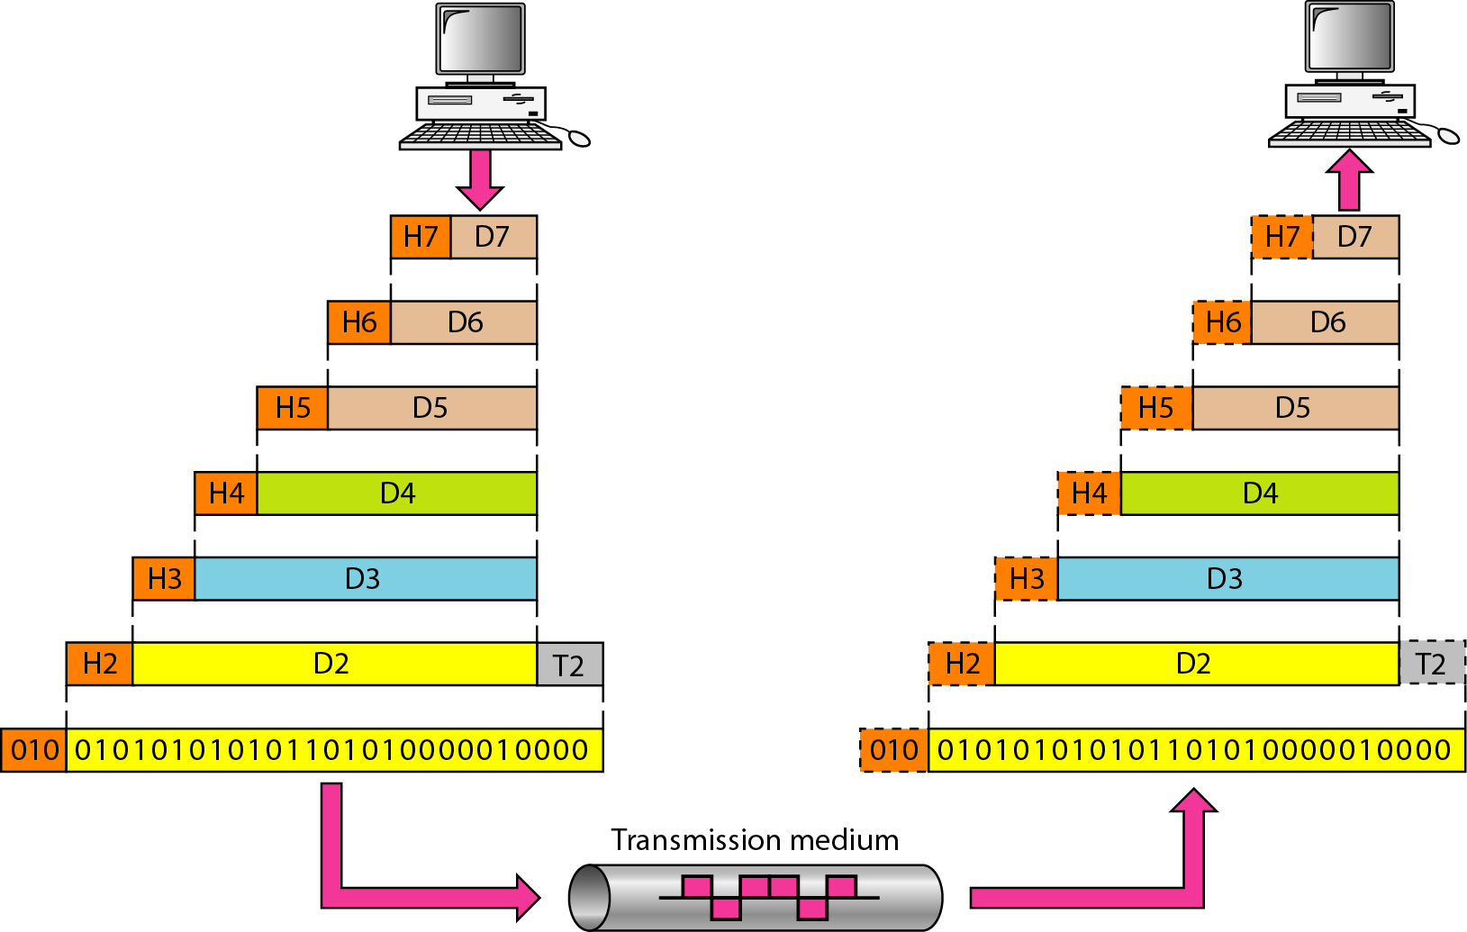
An exchange using the OSI model
24
Notes:
Data Communication

Slide 25
Organization of the Layers
In Figure, which gives an overall view of the OSI layers, D7 means the data unit at layer 7, D6 means the data unit at layer 6, and so on.
The process starts at layer 7 (the application layer), then moves from layer to layer in descending, sequential order.
At each layer, a header, or possibly a trailer, can be added to the data unit.
25
Notes:
Data Communication

Slide 26
Organization of the Layers
Commonly, the trailer is added only at layer 2.
When the formatted data unit passes through the physical layer (layer 1), it is changed into an electromagnetic signal and transported along a physical link
26
Notes:
Data Communication

Slide 27
Organization of the Layers
Upon reaching its destination, the signal passes into layer 1 and is transformed back into digital form.
The data units then move back up through the OSI layers.
As each block of data reaches the next higher layer, the headers and trailers attached to it at the corresponding sending layer are removed, and actions appropriate to that layer are taken.
By the time it reaches layer 7, the message is again in a form appropriate to the application and is made available to the recipient
27
Notes:
Data Communication

Slide 28
Encapsulation
A packet (header and data) at level 7 is encapsulated in a packet at level 6.
The whole packet at level 6 is encapsulated in a packet at level 5, and so on.
The data portion of a packet at level N - 1 carries the whole packet (data and header and maybe trailer) from level N. The concept is called encapsulation.
Level N - 1 is not aware of which part of the encapsulated packet is data and which part is the header or trailer. For level N - 1, the whole packet coming from level N is treated as one integral unit.
28
Notes:
Data Communication

Slide 29
Layers in the OSI model
Physical Layer Data Link Layer
Network Layer
Transport Layer
Session Layer
Presentation Layer
Application Layer
29
Notes:
Data Communication

Slide 30
Physical Layer
The physical layer coordinates the functions required to carry a bit stream over a physical medium.
It deals with the mechanical and electrical specifications of the interface and transmission medium.
It also defines the procedures and functions that physical devices and interfaces have to perform for transmission to Occur.
Figure shows the position of the physical layer with respect to the transmission medium and the data link layer
30
Notes:
Data Communication

Slide 31
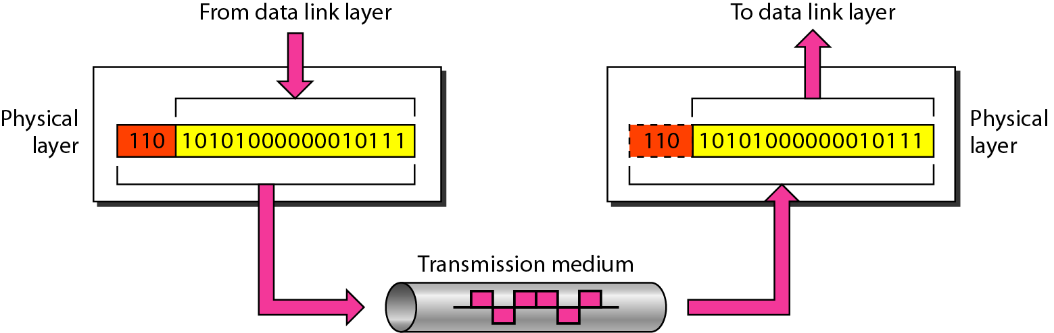
Physical Layer
31
Notes:
Data Communication

Slide 32
Physical Layer
Physical characteristics of interfaces and medium
It defines the characteristics of the interface between the devices and the transmission medium.
It also defines the type of transmission medium.
Representation of bits
The physical layer data consists of a stream of bits (sequence of 0s or 1s) with no interpretation.
To be transmitted, bits must be encoded into signals electrical or optical.
It defines the type of encoding (how 0s and 1s are changed to signals).
32
Notes:
Data Communication

Slide 33
Physical Layer
Data rate
The transmission rate-the number of bits sent each second-is also defined by the physical layer.
It defines the duration of a bit, which is how long it lasts.
Synchronization of bits
The sender and receiver not only must use the same bit rate but also must be synchronized at the bit level.
The sender and the receiver clocks must be synchronized.
33
Notes:
Data Communication

Slide 34
Physical Layer
Line configuration
It is concerned with the connection of devices to the media.
In a point-to-point configuration, two devices are connected through a dedicated link.
In a multipoint configuration, a link is shared among several devices.
34
Notes:
Data Communication

Slide 35
Physical Layer
Physical topology
It defines how devices are connected to make a network.
Devices can be connected by using mesh, star, ring bus, or hybrid topology
35
Notes:
Data Communication

Slide 36
Physical Layer
Transmission mode
It also defines the direction of transmission between two devices: simplex, half-duplex, or full-duplex.
In simplex mode, only one device can send; the other can only receive. The simplex mode is a one-way communication.
In the half-duplex mode, two devices can send and receive, but not at the same time.
In a full-duplex (or simply duplex) mode, two devices can send and receive at the same time.
36
Notes:
Data Communication

Slide 37
Data Link Layer
The data link layer transforms the physical layer, a raw transmission facility, to a reliable link.
It makes the physical layer appear error-free to the upper layer (network layer).
Figure shows the relationship of the data link layer to the network and physical layers.
37
Notes:
Data Communication

Slide 38
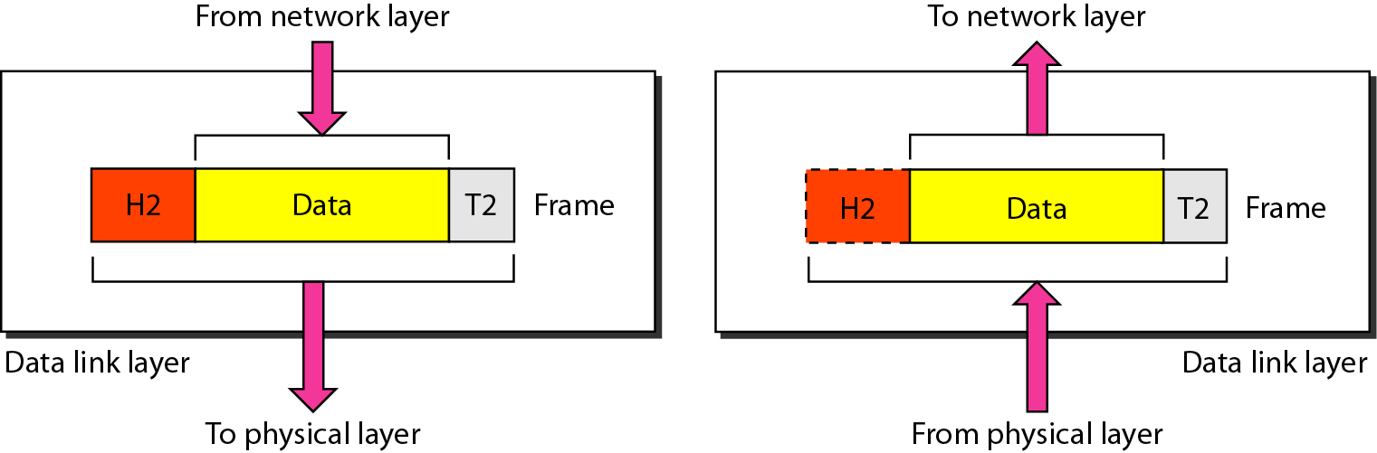
Data Link Layer
38
Notes:
Data Communication

Slide 39
Data Link Layer
Framing
It divides the stream of bits received from the network layer into manageable data units called frames.
Physical addressing
If frames are to be distributed to different systems on the network, the data link layer adds a header to the frame to define the sender and/or receiver of the frame.
If the frame is intended for a system outside the sender's network, the receiver address is the address of the device that connects the network to the next one.
39
Notes:
Data Communication

Slide 40
Data Link Layer
Flow control
If the rate at which the data are absorbed by the receiver is less than the rate at which data are produced in the sender, the data link layer imposes a flow control mechanism to avoid overwhelming the receiver.
Error control
It adds reliability to the physical layer by adding mechanisms to detect and retransmit damaged or lost frames.
It also uses a mechanism to recognize duplicate frames. Error control is normally achieved through a trailer added to the end of the frame.
40
Notes:
Data Communication

Slide 41
Data Link Layer
Access control
When two or more devices are connected to the same link, data link layer protocols are necessary to determine which device has control over the link at any given time
41
Notes:
Data Communication

Slide 42
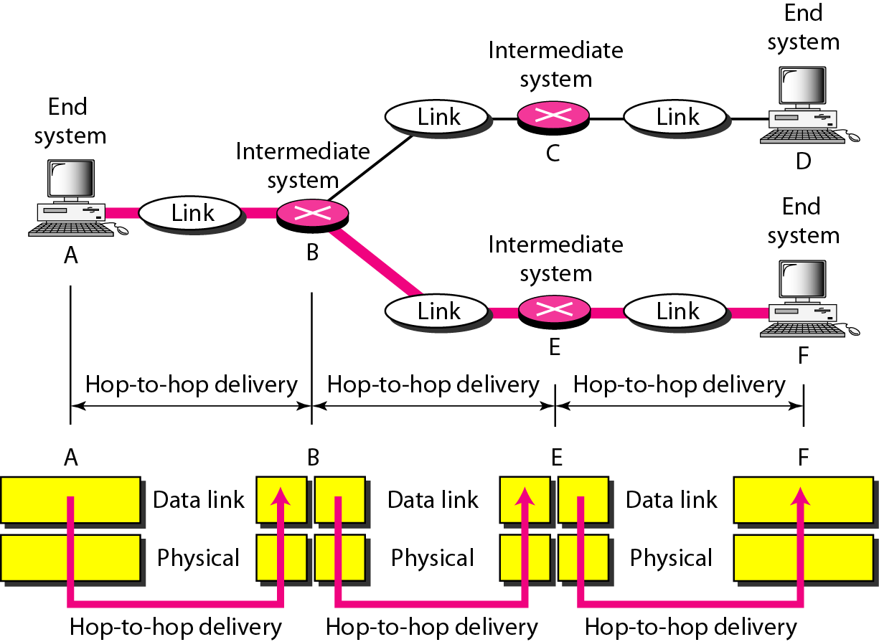
Data Link Layer
Hop-to-hop (node-to-node) delivery
42
Notes:
Data Communication

Slide 43
Hop-to-hop (node-to-node) delivery
As the figure shows, communication at the data link layer occurs between two adjacent nodes.
To send data from A to F, three partial deliveries are made.
First, the data link layer at A sends a frame to the data link layer at B (a router).
Second, the data link layer at B sends a new frame to the data link layer at E.
Finally, the data link layer at E sends a new frame to the data link layer at F.
Note that the frames that are exchanged between the three nodes have different values in the headers.
43
Notes:
Data Communication

Slide 44
Hop-to-hop (node-to-node) delivery
The frame from A to B has B as the destination address and A as the source address.
The frame from B to E has E as the destination address and B as the source address.
The frame from E to F has F as the destination address and E as the source address.
The values of the trailers can also be different if error checking includes the header of the frame.
44
Notes:
Data Communication

Slide 45
Network Layer
It is responsible for the source-to-destination delivery of a packet, possibly across multiple networks (links).
Whereas the data link layer oversees the delivery of the packet between two systems on the same network (links), the network layer ensures that each packet gets from its point of origin to its final destination.
If two systems are connected to the same link, there is usually no need for a network layer.
However, if the two systems are attached to different networks (links) with connecting devices between the networks (links), there is often a need for the network layer to accomplish source-to-destination delivery.
45
Notes:
Data Communication

Slide 46
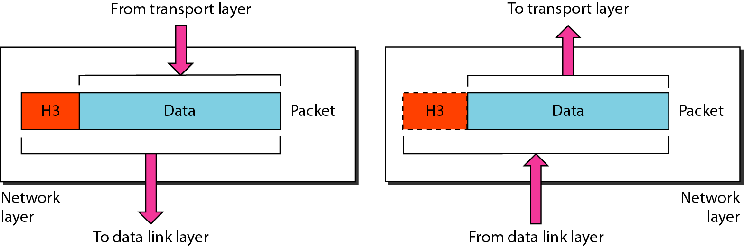
Network Layer
46
Notes:
Data Communication

Slide 47
Network Layer
Logical addressing
The physical addressing implemented by the data link layer handles the addressing problem locally.
If a packet passes the network boundary, we need another addressing system to help distinguish the source and destination systems.
The network layer adds a header to the packet coming from the upper layer that, among other things, includes the logical addresses of the sender and receiver.
47
Notes:
Data Communication

Slide 48
Network Layer
Routing
When independent networks or links are connected to create internetworks (network of networks) or a large network, the connecting devices (called routers or switches) route or switch the packets to their final destination.
One of the functions of the network layer is to provide this mechanism.
48
Notes:
Data Communication

Slide 49
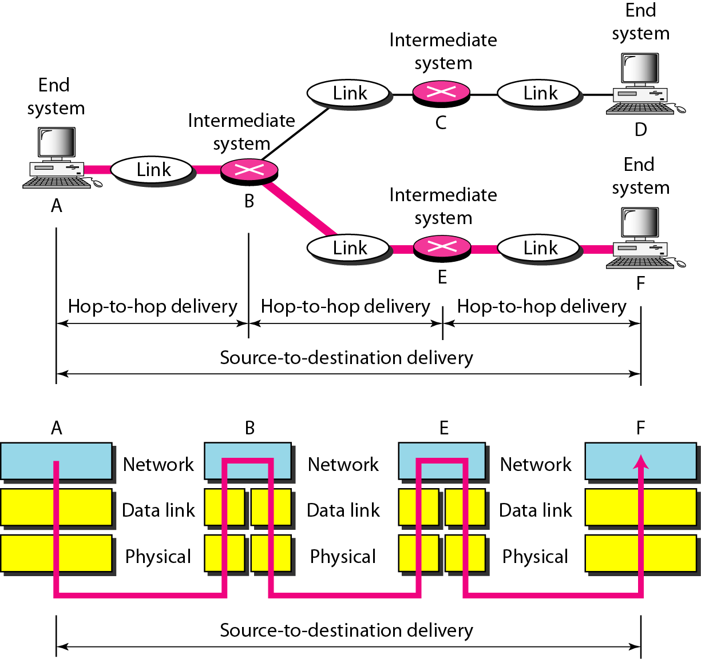
Network Layer : S to D (end-to-end)delivery
49
Notes:
Data Communication

Slide 50
Network Layer : S to D (end-to-end)delivery
As the figure shows, now we need a source-to-destination delivery.
The NL at A sends the packet to the NL at B.
When the packet arrives at router B, the router makes a decision based on the final destination (F) of the packet.
Router B uses its routing table to find that the next hop is router E.
The NL at B, therefore, sends the packet to the network layer at E.
The NL at E, in turn, sends the packet to the network layer at F.
50
Notes:
Data Communication

Slide 51
Transport Layer
It is responsible for process-to-process delivery of the entire message.
A process is an application program running on a host.
Whereas the network layer oversees source-to-destination delivery of individual packets, it does not recognize any relationship between those packets.
It treats each one independently, as though each piece belonged to a separate message, whether or not it does.
51
Notes:
Data Communication

Slide 52
Transport Layer
The transport layer, on the other hand, ensures that the whole message arrives intact and in order, overseeing both error control and flow control at the source-to-destination level.
Figure shows the relationship of the transport layer to the network and session layers.
52
Notes:
Data Communication

Slide 53
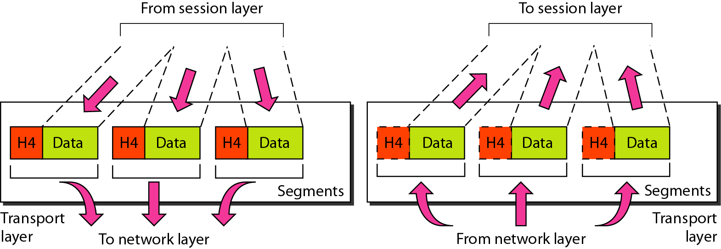
Transport Layer
53
Notes:
Data Communication

Slide 54
Transport Layer
Service-point addressing
Computers often run several programs at the same time.
For this reason, source-to-destination delivery means delivery not only from one computer to the next but also from a specific process (running program) on one computer to a specific process (running program) on the other.
The transport layer header must therefore include a type of address called a service-point address (or port address)
54
Notes:
Data Communication

Slide 55
Transport Layer
The network layer gets each packet to the correct computer; the transport layer gets the entire message to the correct process on that computer.
Segmentation and reassembly
A message is divided into transmittable segments, with each segment containing a sequence number.
These numbers enable the transport layer to reassemble the message correctly upon arriving at the destination and to identify and replace packets that were lost in transmission.
55
Notes:
Data Communication

Slide 56
Transport Layer
Connection control
The TL can be either connectionless or connection-oriented.
A connectionless treats each segment as an independent packet and delivers at the destination machine.
A connection-oriented makes a connection with the destination machine first before delivering the packets.
After all the data are transferred, the connection is terminated.
56
Notes:
Data Communication

Slide 57
Transport Layer
Flow control
Like DLL, the TL is responsible for flow control.
Flow control at this layer is performed end to end rather than across a single link.
Error control
Like DLL, the TL is responsible for error control.
Error control at this layer is performed process-to-process rather than across a single link.
The sending transport layer makes sure that the entire message arrives at the receiving transport layer without error (damage, loss, or duplication).
Error correction is usually achieved through retransmission.
57
Notes:
Data Communication

Slide 58
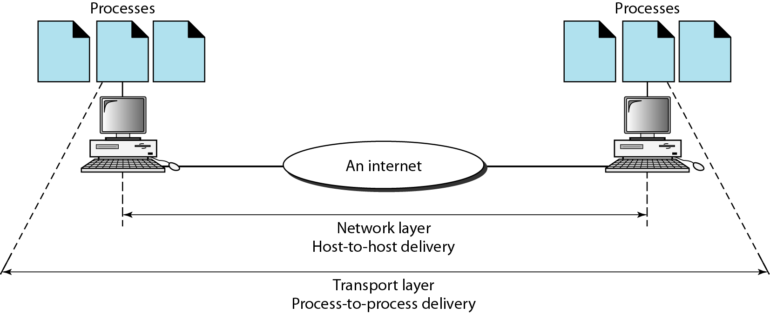
Process-to-process delivery of a message
58
Notes:
Data Communication

Slide 59
Session Layer
The services provided by the first three layers (physical, data link, and network) are not sufficient for some processes.
The session layer is the network dialog controller.
It establishes, maintains, and synchronizes the interaction among communicating systems
59
Notes:
Data Communication

Slide 60
Session Layer
Dialog control
The session layer allows two systems to enter into a dialog.
It allows the communication between two processes to take place in either half-duplex (one way at a time) or full-duplex (two ways at a time) mode.
60
Notes:
Data Communication

Slide 61
Session Layer
Synchronization
It allows a process to add checkpoints, or synchronization points, to a stream of data.
For example
If a system is sending a file of 2000 pages, it is advisable to insert checkpoints after every 100 pages to ensure that each 100-page unit is received and acknowledged independently.
In this case, if a crash happens during the transmission of page 523, the only pages that need to
be resent after system recovery are pages 501 to 523. Pages previous to 501 need not be resent.
61
Notes:
Data Communication

Slide 62
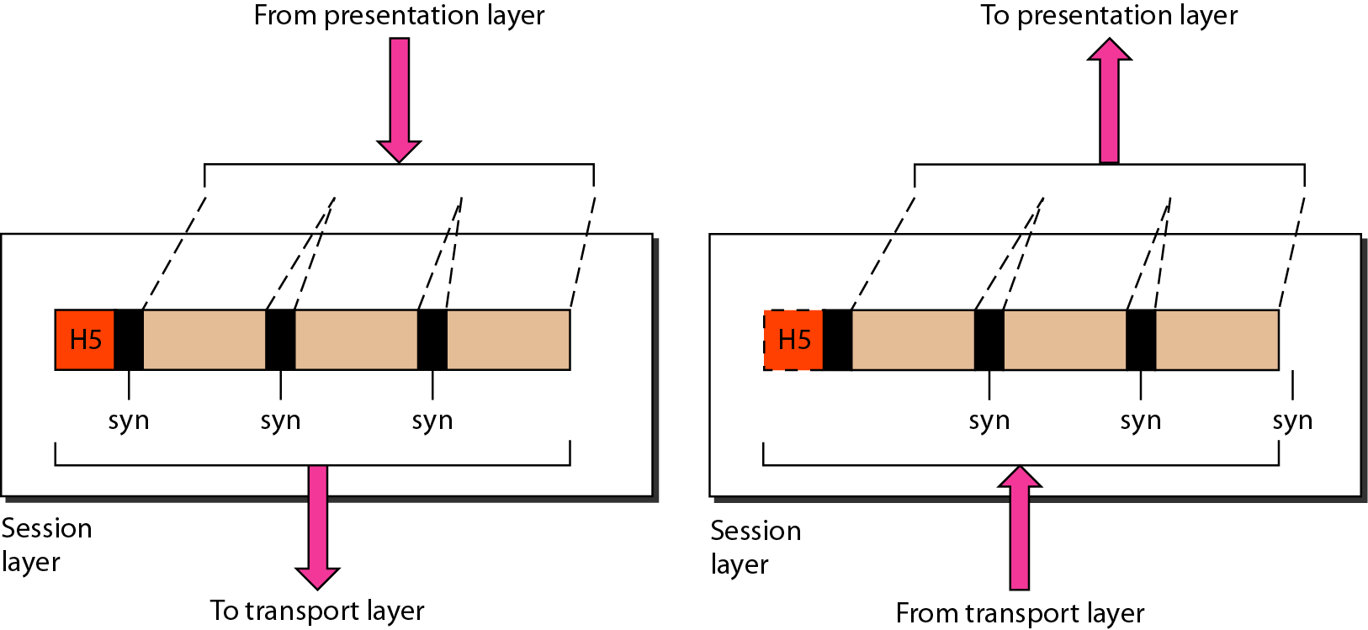
Session Layer
Figure illustrates the relationship of the session layer to the transport and presentation layers.
62
Notes:
Data Communication

Slide 63
Presentation Layer
The presentation layer is concerned with the syntax and semantics of the information exchanged between two systems.
Figure shows the relationship between the presentation layer and the application and session layers.
63
Notes:
Data Communication

Slide 64
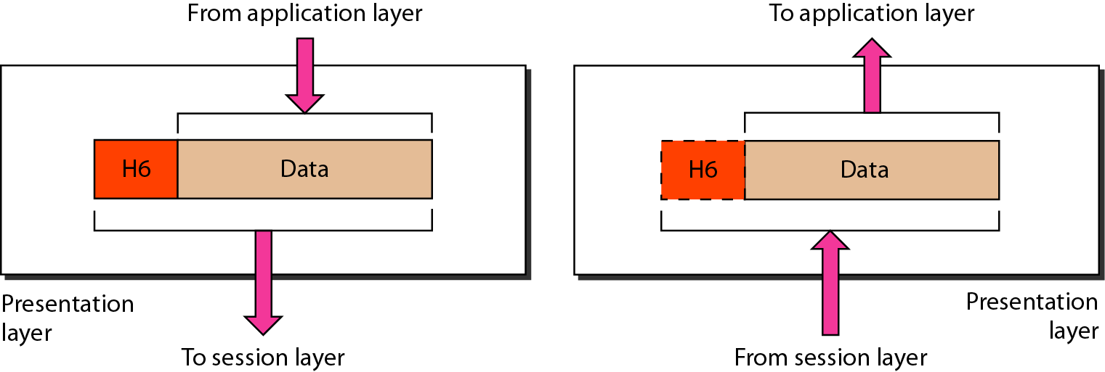
Presentation Layer
64
Notes:
Data Communication

Slide 65
Presentation Layer
Translation
The processes (running programs) in two systems are usually exchanging information in the form of character strings, numbers, and so on.
The information must be changed to bit streams before being transmitted.
Because different computers use different encoding systems, the presentation layer is responsible for interoperability between these different encoding methods.
65
Notes:
Data Communication

Slide 66
Presentation Layer
The presentation layer at the sender changes the information from its sender-dependent format into a common format.
The presentation layer at the receiving machine changes the common format into its receiver-dependent format.
66
Notes:
Data Communication

Slide 67
Presentation Layer
Encryption
To carry sensitive information, a system must be able to ensure privacy.
Encryption means that the sender transforms the original information to another form and sends the resulting message out over the network.
Decryption reverses the original process to transform the message back to its original form.
67
Notes:
Data Communication

Slide 68
Presentation Layer
Compression
Data compression reduces the number of bits contained in the information.
Data compression becomes particularly important in the transmission of multimedia such as text, audio, and video.
68
Notes:
Data Communication

Slide 69
Application Layer
It enables the user, whether human or software, to access the network.
It provides user interfaces and support for services such as Electronic mail, remote file access and transfer, shared database management, and other types of distributed information services.
69
Notes:
Data Communication

Slide 70
Application Layer
Figure shows the relationship of the application layer to the user and the presentation layer of the many application services available, the figure shows only three:
XAOO (message-handling services),
X.500 (directory services), and
File Transfer Access, and Management (FTAM).
The user in this example employs XAOO to send an e-mail message.
70
Notes:
Data Communication

Slide 71
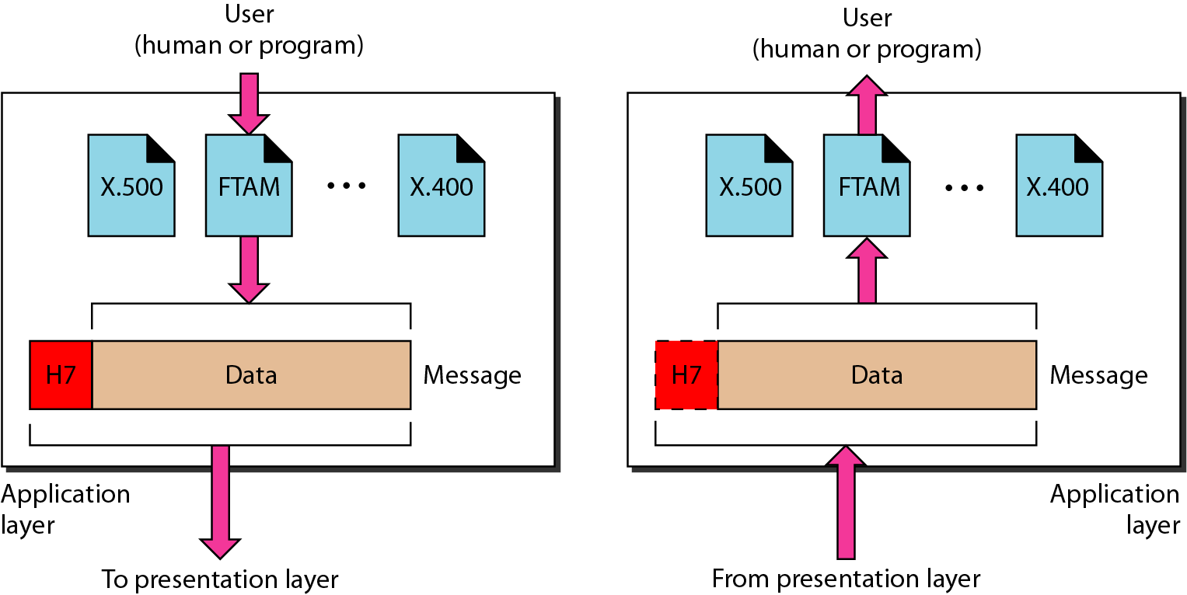
Application Layer
71
Notes:
Data Communication

Slide 72
Application Layer
Network virtual terminal
it is a software version of a physical terminal, and it allows a user to log on to a remote host.
To do so, the application creates a software emulation of a terminal at the remote host.
The user's computer talks to the software terminal which, in turn, talks to the host, and vice versa.
The remote host believes it is communicating with one of its own terminals and allows the user to log on.
72
Notes:
Data Communication

Slide 73
Application Layer
File transfer, access, and management
This application allows a user to access files in a remote host (to make changes or read data), to retrieve files from a remote computer for use in the local computer, and to manage or control files in a remote computer locally.
73
Notes:
Data Communication

Slide 74
Application Layer
Mail services
This application provides the basis for e-mail forwarding and storage.
Directory services
This application provides distributed database sources and access for global information about various objects and services.
74
Notes:
Data Communication

Slide 75
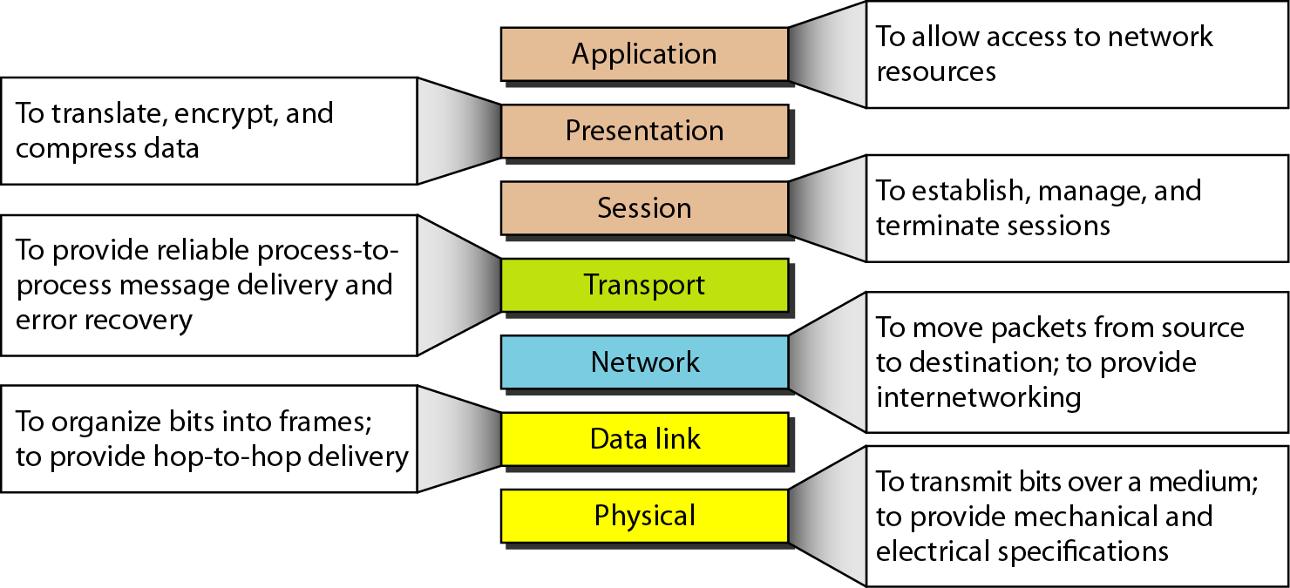
Summary of the OSI model Layers
75
Notes:
Data Communication

Slide 76
TCP/IP Protocol Suite
The TCP/IP protocol suite was developed prior to the OSI model.
Therefore, the layers in the TCP/IP protocol suite do not exactly match those in the OSI model.
The original TCP/IP protocol suite was defined as having four layers:
Host-to-network Layer,
Internet Layer,
Transport layer and
Application layer
76
Notes:
Data Communication

Slide 77
TCP/IP Protocol Suite
However, when TCP/IP is compared to OSI, we can say that the host-to-network layer is equivalent to the combination of the physical and data link layers.
The internet layer is equivalent to the network layer, and the application layer is roughly doing the job of the session, presentation, and application layers with the transport layer in TCP/IP taking care of part of the duties of the session layer.
77
Notes:
Data Communication

Slide 78
TCP/IP Protocol Suite
The TCPIIP protocol suite is made of five layers: physical, data link, network, transport, and application.
The first four layers provide physical standards, network interfaces, internetworking, and transport functions that correspond to the first four layers of the OSI model.
The three topmost layers in the OSI model, however, are represented in TCP/IP by a single layer called the application layer (see Figure).
78
Notes:
Data Communication

Slide 79
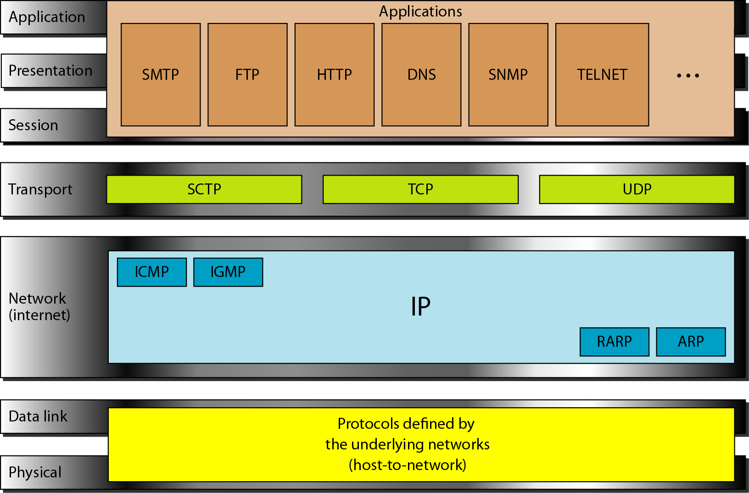
OSI and TCP/IP Model
79
Notes:
Data Communication

Slide 80
TCP/IP Protocol Suite
TCP/IP is a hierarchical protocol made up of interactive modules, each of which provides a specific functionality; however, the modules are not necessarily interdependent.
Whereas the OSI model specifies which functions belong to each of its layers, the layers of the TCP/IP protocol suite contain relatively independent protocols that can be mixed and matched depending on the needs of the system.
The term hierarchical means that each upper-level protocol is supported by one or more lower-level protocols.
80
Notes:
Data Communication

Slide 81
TCP/IP Protocol Suite
At the transport layer, TCP/IP defines three protocols:
Transmission Control Protocol (TCP),
User Datagram Protocol (UDP), and
Stream Control Transmission Protocol (SCTP)
At the network layer, the main protocol defined by TCP/IP is the Internetworking Protocol (IP); there are also some other protocols that support data movement in this layer.
81
Notes:
Data Communication

Slide 82
Physical and Data Link Layers
At the physical and data link layers, TCP/IP does not define any specific protocol.
It supports all the standard and proprietary protocols.
A network in a TCP/IP internetwork can be a Local-Area Network (LAN) or a Wide-Area Network(WAN).
82
Notes:
Data Communication

Slide 83
Network Layer
At the network layer (or, more accurately, the internetwork layer), TCP/IP supports the Internetworking Protocol. IP, in turn, uses four supporting protocols: ARP, RARP, ICMP, and IGMP.
83
Notes:
Data Communication

Slide 84
Internetworking Protocol (IP)
The IP is the transmission mechanism used by the TCP/IP protocols.
It is an unreliable and connectionless protocol-a best-effort delivery service.
The term best effort means that IP provides no error checking or tracking.
IP assumes the unreliability of the underlying layers and does its best to get a transmission through to its destination, but with no guarantees.
84
Notes:
Data Communication

Slide 85
Internetworking Protocol (IP)
IP transports data in packets called datagrams, each of which is transported separately.
Datagrams can travel along different routes and can arrive out of sequence or be duplicated.
IP does not keep track of the routes and has no facility for reordering datagrams once they arrive at their destination.
85
Notes:
Data Communication

Slide 86
ARP and RARP
Address Resolution Protocol (ARP)
It is used to associate a logical address with a physical address.
In LAN, each device on a link is identified by a physical address, usually imprinted on the NIC.
ARP is used to find the physical address of the node when its Internet address is known.
Reverse Address Resolution Protocol (RARP)
RARP allows a host to discover its Internet address when it knows only its physical address.
It is used when a computer is connected to a network for the first time or when a diskless computer is booted.
86
Notes:
Data Communication

Slide 87
ICMP and IGMP
Internet Control Message Protocol (ICMP)
The ICMP is a mechanism used by hosts and gateways to send notification of datagram problems back to the sender.
ICMP sends query and error reporting messages.
Internet Group Message Protocol (IGMP)
The IGMP is used to facilitate the simultaneous transmission of a message to a group of recipients.
87
Notes:
Data Communication

Slide 88
Transport Layer
Traditionally the transport layer was represented in TCP/IP by two protocols: TCP and UDP.
IP is a host-to-host protocol, meaning that it can deliver a packet from one physical device to another.
UDP and TCP are transport level protocols responsible for delivery of a message from a process (running program) to another process.
A new transport layer protocol, SCTP, has been devised to meet the needs of some newer applications
88
Notes:
Data Communication

Slide 89
Transport Layer : UDP
The User Datagram Protocol (UDP) is the simpler of the two standard TCP/IP transport protocols.
It is a process-to-process protocol that adds only port addresses, checksum, error control, and length information to the data from the upper layer.
89
Notes:
Data Communication

Slide 90
Transport Layer : TCP
The Transmission Control Protocol (TCP) provides full transport-layer services to applications.
TCP is a reliable stream transport protocol.
The term stream, in this context, means connection-oriented
A connection must be established between both ends of a transmission before either can transmit data.
At the sending end of each transmission, TCP divides a stream of data into smaller units called segments.
Each segment includes a sequence number for reordering after receipt, together with an acknowledgment number for the segments received.
90
Notes:
Data Communication

Slide 91
Transport Layer : TCP
Segments are carried across the internet inside of IP datagrams. At the receiving end, TCP collects each datagram as it comes in and reorders the transmission based on sequence numbers.
91
Notes:
Data Communication

Slide 92
Transport Layer : SCTP
The Stream Control Transmission Protocol (SCTP) provides support for newer applications such as voice over the Internet.
It is a transport layer protocol that combines the best features of UDP and TCP.
92
Notes:
Data Communication

Slide 93
Application Layer
The application layer in TCPIIP is equivalent to the combined session, presentation, and application layers in the OSI model.
Many protocols are defined at this layer such as
HTTP(S)
FTP
SMTP
93
Notes:
Data Communication

Slide 94
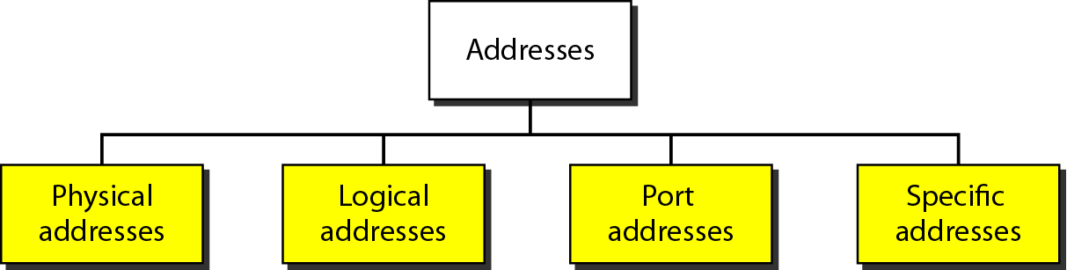
Addressing in TCP/IP
Four levels of addresses are used in an internet employing the TCP/IP protocols:
Physical (link) Addresses,
Logical (IP) Addresses,
Port Addresses, and
Specific Addresses
94
Notes:
Data Communication

Slide 95
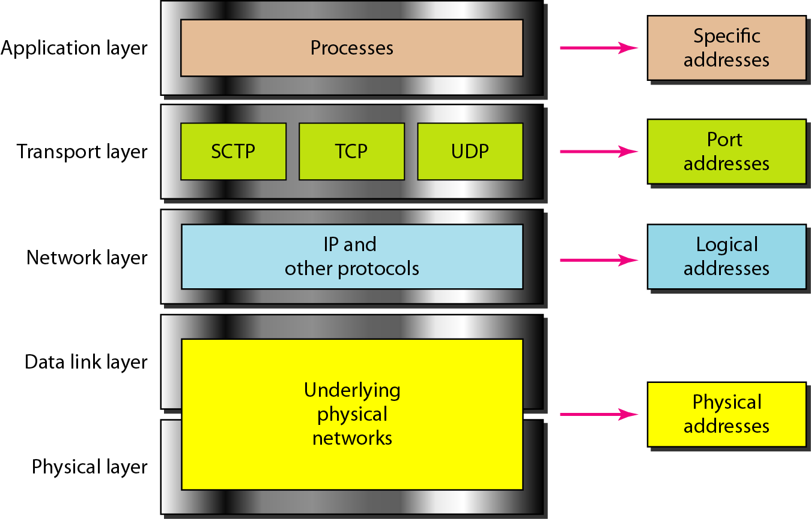
Addressing in TCP/IP
95
Notes:
Data Communication

Slide 96
Physical Address
It also known as the link address, is the address of a node as defined by its LAN or WAN.
It is included in the frame used by the data link layer.
It is the lowest-level address.
The physical addresses have authority over the network (LAN or WAN).
The size and format of these addresses vary depending on the network.
For example, Ethernet uses a 6-byte (48-bit) physical address that is imprinted on the NIC.
LocalTalk (Apple), however, has a 1-byte dynamic address that changes each time the station comes up.
96
Notes:
Data Communication

Slide 97
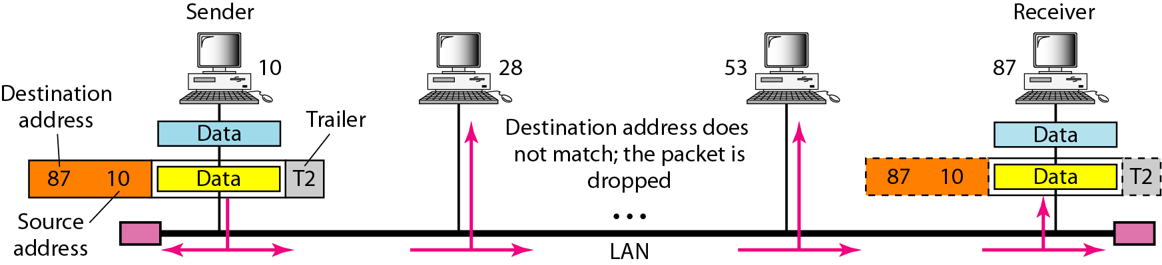
Physical Address
97
Notes:
Data Communication

Slide 98
Logical Address
These are necessary for universal communications that are independent of underlying physical networks.
Physical addresses are not adequate in an internetwork environment where different networks can have different address formats.
A universal addressing system is needed in which each host can be identified uniquely, regardless of the underlying physical network.
The logical addresses are designed for this purpose.
A logical address in the Internet is currently a 32-bit address that can uniquely define a host connected to the Internet. No two publicly addressed and visible hosts on the Internet can have the same IP address.
98
Notes:
Data Communication

Slide 99
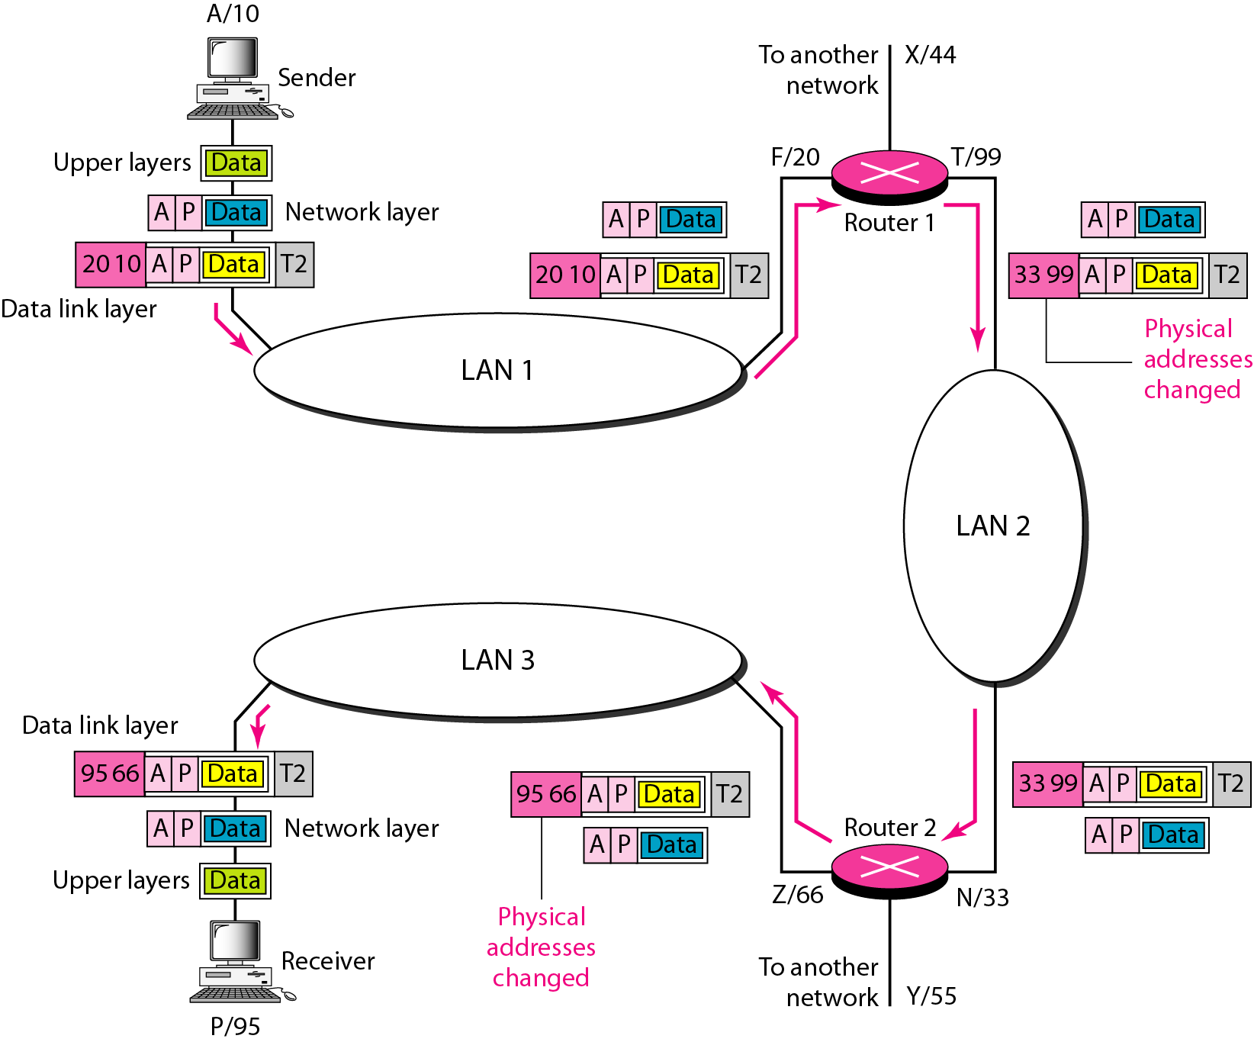
Logical Address
99
Notes:
Data Communication

Slide 100
Port Address
The IP address and the physical address are necessary for a quantity of data to travel from a source to the destination host.
However, arrival at the destination host is not the final objective of data communications on the Internet.
A system that sends nothing but data from one computer to another is not complete.
Today, computers are devices that can run multiple processes at the same time.
The end objective of Internet communication is a process communicating with another process.
100
Notes:
Data Communication

Slide 101
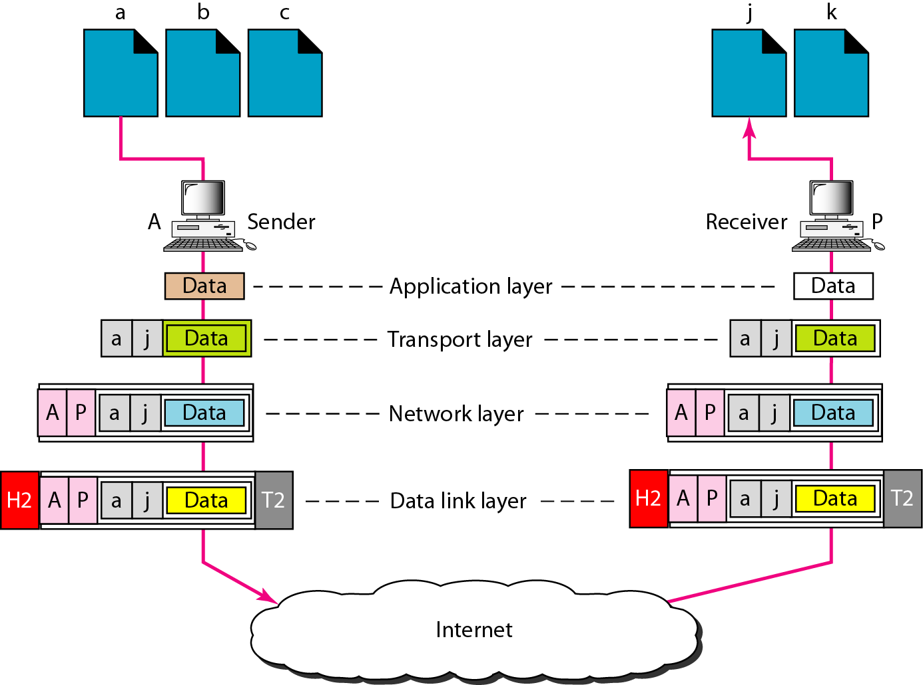
Port Address
101
Notes:
Data Communication

Slide 102
Specific Address
Some applications have user-friendly addresses that are designed for that specific address.
Examples include the e-mail address (for example, forouzan@fhda.edu) and the Universal Resource Locator (URL) (for example, www.mhhe.com).
These addresses, however, get changed to the corresponding port and logical addresses by the sending computer.
102
Notes:
Data Communication

