Slide 1
Data Link Control
1
Notes:
Data Communication

Slide 2
Introduction
Data link control functions include framing, flow and error control, and software implemented protocols that provide smooth and reliable transmission of frames between nodes.
To implement data link control, we need protocols.
Each protocol is a set of rules that need to be implemented in software and run by the two nodes involved in data exchange at the data link layer.
2
Notes:
Data Communication

Slide 3
FRAMING
Framing in the data link layer separates a message from one source to a destination, or from other messages to other destinations, by adding a sender address and a destination address.
The destination address defines where the packet is to go; the sender address helps the recipient acknowledge the receipt.
Although the whole message could be packed in one frame, that is not normally done.
One reason is that a frame can be very large, making flow and error control very inefficient.
3
Notes:
Data Communication

Slide 4
FRAMING
When a message is carried in one very large frame, even a single-bit error would require the retransmission of the whole message.
When a message is divided into smaller frames, a single-bit error affects only that small frame.
Frames can be of fixed or variable size
4
Notes:
Data Communication

Slide 5
Fixed-Size Framing
In fixed-size framing, there is no need for defining the boundaries of the frames; the size itself can be used as a delimiter.
An example of this type of framing is the ATM wide-area network, which uses frames of fixed size called cells.
5
Notes:
Data Communication

Slide 6
Variable-Size Framing
In variable-size framing, we need a way to define the end of the frame and the beginning of the next.
Historically, two approaches were used for this purpose: a character-oriented approach and a bit-oriented approach
6
Notes:
Data Communication

Slide 7
Character-Oriented Protocols
In a character-oriented protocol, data to be carried are 8-bit characters from a coding system such as ASCII
The header, which normally carries the source and destination addresses and other control information, and the trailer, which carries error detection or error correction redundant bits, are also multiples of 8 bits.
To separate one frame from the next, an 8-bit (1-byte) flag is added at the beginning and the end of a frame.
The flag, composed of protocol-dependent special characters, signals the start or end of a frame.
Figure shows the format of a frame in a character-oriented protocol.
7
Notes:
Data Communication

Slide 8
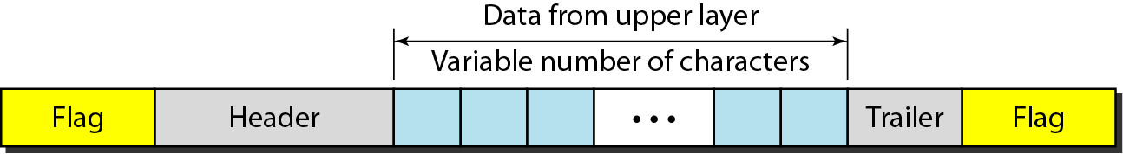
Character-Oriented Protocols
A frame in a character-oriented protocol
8
Notes:
Data Communication

Slide 9
Character-Oriented Protocols
Character-oriented framing was popular when only text was exchanged by the data link layers.
The flag could be selected to be any character not used for text communication.
Now, however, we send other types of information such as graphs, audio, and video.
Any pattern used for the flag could also be part of the information.
If this happens, the receiver, when it encounters this pattern in the middle of the data, thinks it has reached the end of the frame.
9
Notes:
Data Communication

Slide 10
Bit-Oriented Protocols
In a bit-oriented protocol, the data section of a frame is a sequence of bits to be interpreted by the upper layer as text, graphic, audio, video, and so on.
However, in addition to headers (and possible trailers), we still need a delimiter to separate one frame from the other.
Most protocols use a special 8-bit pattern flag 01111110 as the delimiter to define the beginning and the end of the frame, as shown in Figure.
10
Notes:
Data Communication

Slide 11
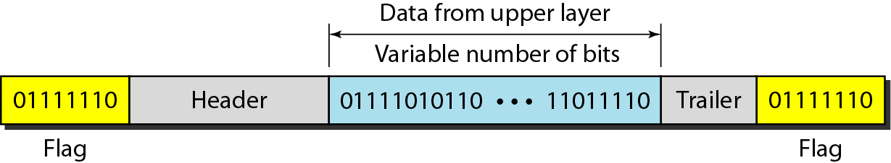
Bit-Oriented Protocols
A frame in a bit-oriented protocol
11
Notes:
Data Communication

Slide 12
FLOW AND ERROR CONTROL
The most important responsibilities of the data link layer are flow control and error control.
Collectively, these functions are known as data link control.
12
Notes:
Data Communication

Slide 13
Flow Control
Flow control coordinates the amount of data that can be sent before receiving an acknowledgment and is one of the most important duties of the data link layer.
In most protocols, flow control is a set of procedures that tells the sender how much data it can transmit before it must wait for an acknowledgment from the receiver.
The flow of data must not be allowed to overwhelm the receiver.
Any receiving device has a limited speed at which it can process incoming data and a limited amount of memory in which to store incoming data.
13
Notes:
Data Communication

Slide 14
Flow Control
The receiving device must be able to inform the sending device before those limits are reached and to request that the transmitting device send fewer frames or stop temporarily.
Incoming data must be checked and processed before they can be used.
The rate of such processing is often slower than the rate of transmission.
For this reason, each receiving device has a block of memory, called a buffer, reserved for storing incoming data until they are processed.
14
Notes:
Data Communication

Slide 15
Flow Control
If the buffer begins to fill up, the receiver must be able to tell the sender to halt transmission until it is once again able to receive.
15
Notes:
Data Communication

Slide 16
Error Control
Error control is both error detection and error correction.
It allows the receiver to inform the sender of any frames lost or damaged in transmission and coordinates the retransmission of those frames by the sender.
In the data link layer, the term error control refers primarily to methods of error detection and retransmission.
Error control in the data link layer is often implemented simply:
Any time an error is detected in an exchange, specified frames are retransmitted.
This process is called automatic repeat request (ARQ)
16
Notes:
Data Communication

Slide 17
Flow and Error Control Mechanisms / Protocols
"Stop-and-Wait" protocol
"stop-n-wait" (sometimes known as "positive acknowledgement with retransmission") is the fundamental technique to provide reliable transfer under unreliable packet delivery system.
17
Notes:
Data Communication

Slide 18
"Stop-and-Wait" protocol - Normal operation
After transmitting one packet, the sender waits for an acknowledgment (ACK) from the receiver before transmitting the next one.
In this way, the sender can recognize that the previous packet is transmitted successfully and we could say "stop-n-wait" guarantees reliable transfer between nodes.
To support this feature, the sender keeps a record of each packet it sends.
Also, to avoid confusion caused by delayed or duplicated ACKs, "stop-n-wait" sends each packets with unique sequence numbers and receives that numbers in each ACKs.
18
Notes:
Data Communication

Slide 19
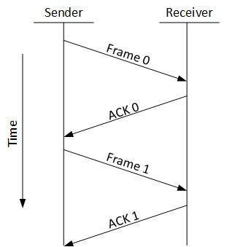
"Stop-and-Wait" protocol - Normal operation
19
Notes:
Data Communication

Slide 20
"Stop-and-Wait" protocol - Timeout
If the sender doesn't receive ACK for previous sent packet after a certain period of time, the sender times out and retransmits that packet again.
There are two cases when the sender doesn't receive ACK; One is when the ACK is lost and the other is when the frame itself is not transmitted.
To support this feature, the sender keeps timer per each packet.
20
Notes:
Data Communication

Slide 21
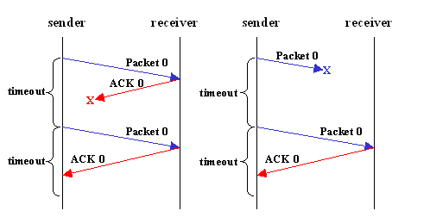
"Stop-and-Wait" protocol - Timeout
21
Notes:
Data Communication

Slide 22
"Stop-and-Wait" protocol - Timeout
If the sender doesn't receive ACK for previous sent packet after a certain period of time, the sender times out and retransmits that packet again.
There are two cases when the sender doesn't receive ACK; One is when the ACK is lost and the other is when the frame itself is not transmitted.
To support this feature, the sender keeps timer per each packet. ( Stop – and – wait ARQ)
22
Notes:
Data Communication

Slide 23
"Stop-and-Wait" protocol - Shortcoming
The main shortcoming of the stop-and-wait algorithm is that it allows the sender to have only one outstanding frame on the link at a time.
The sender should wait till it gets an ACK of previous frame before it sends next frame.
As a result, it wastes a substantial amount of network bandwidth.
To improve efficiency while providing reliability, "sliding window" protocol is appeared
23
Notes:
Data Communication

Slide 24
Go-Back-N ARQ
Stop and wait ARQ mechanism does not utilize the resources at their best.
When the acknowledgement is received, the sender sits idle and does nothing.
In Go-Back-N ARQ method, both sender and receiver maintain a window.
24
Notes:
Data Communication

Slide 25
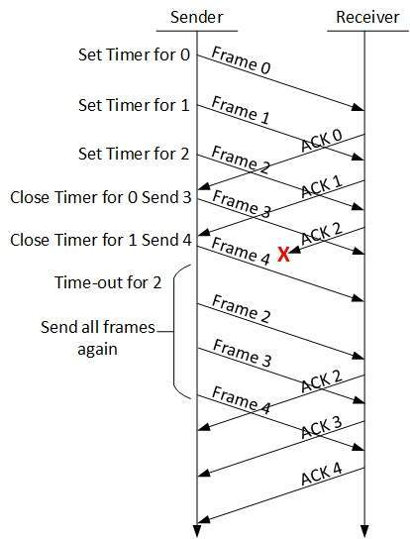
Go-Back-N ARQ
25
Notes:
Data Communication

Slide 26
Go-Back-N ARQ
The sending-window size enables the sender to send multiple frames without receiving the acknowledgement of the previous ones.
The receiving-window enables the receiver to receive multiple frames and acknowledge them.
The receiver keeps track of incoming frame’s sequence number.
When the sender sends all the frames in window, it checks up to what sequence number it has received positive acknowledgement.
26
Notes:
Data Communication

Slide 27
Go-Back-N ARQ
If all frames are positively acknowledged, the sender sends next set of frames.
If sender finds that it has received NACK or has not receive any ACK for a particular frame, it retransmits all the frames after which it does not receive any positive ACK.
27
Notes:
Data Communication

Slide 28
Selective Repeat ARQ
In Go-back-N ARQ, it is assumed that the receiver does not have any buffer space for its window size and has to process each frame as it comes.
This enforces the sender to retransmit all the frames which are not acknowledged
28
Notes:
Data Communication

Slide 29
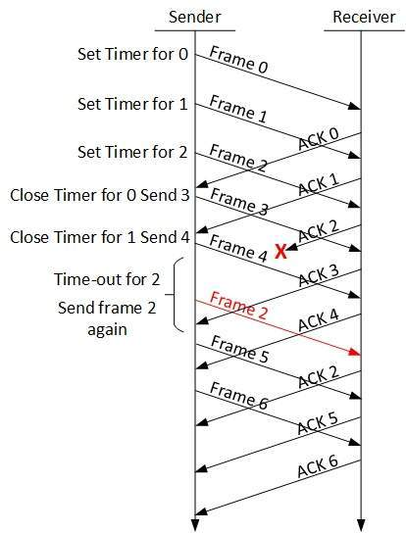
Selective Repeat ARQ
In Selective-Repeat ARQ, the receiver while keeping track of sequence numbers, buffers the frames in memory and sends NACK for only frame which is missing or damaged.
The sender in this case, sends only packet for which NACK is received.
29
Notes:
Data Communication

Slide 30
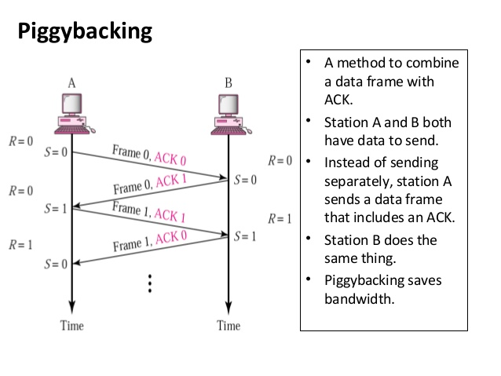
30
Notes:
Data Communication

Slide 31
High-level Data Link Control (HDLC)
High-level Data Link Control (HDLC) is a bit-oriented protocol for communication over point-to-point and multipoint links.
It implements the ARQ mechanisms
31
Notes:
Data Communication

Slide 32
HDLC- Configurations and Transfer Modes
HDLC provides two common transfer modes that can be used in different configurations:
Normal Response Mode (NRM) and
Asynchronous Balanced Mode (ABM).
32
Notes:
Data Communication

Slide 33
Normal Response Mode (NRM)
In normal response mode (NRM), the station configuration is unbalanced.
We have one primary station and multiple secondary stations.
A primary station can send commands; a secondary station can only respond.
The NRM is used for both point-to-point and multiple-point links, as shown in Figure.
33
Notes:
Data Communication

Slide 34
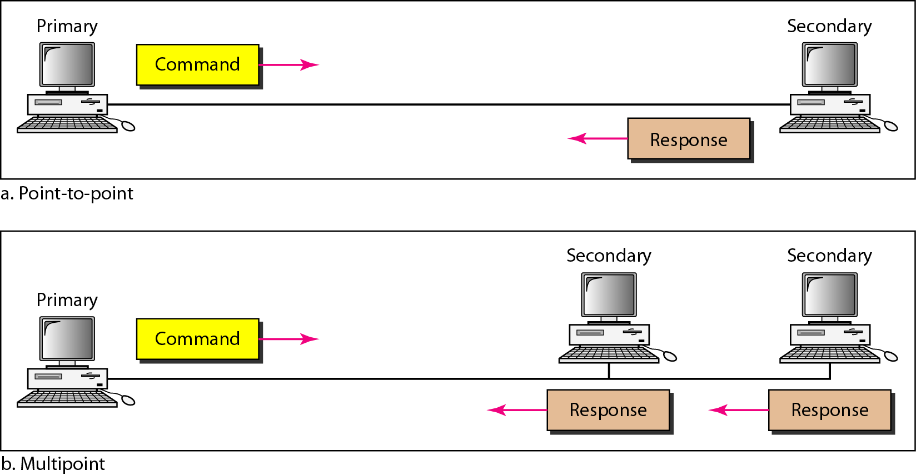
Normal Response Mode (NRM)
34
Notes:
Data Communication

Slide 35
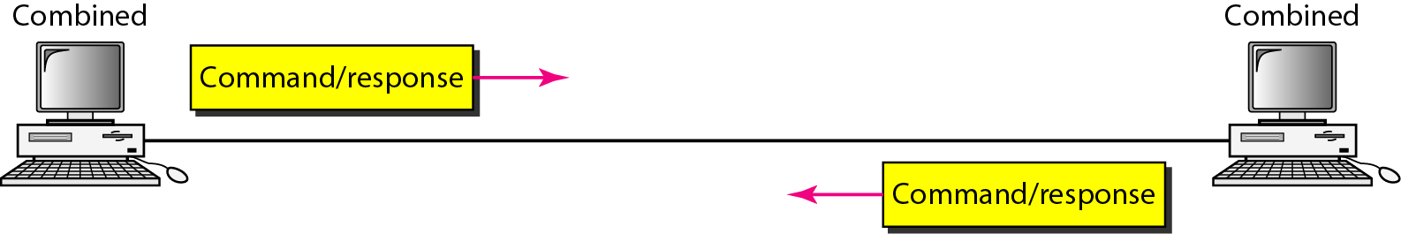
Asynchronous Balanced Mode (ABM)
In asynchronous balanced mode (ABM), the configuration is balanced.
The link is point-to-point, and each station can function as a primary and a secondary (acting as peers), as shown in Figure
This is the common mode today
35
Notes:
Data Communication

Slide 36
HDLC - Frames
To provide the flexibility necessary to support all the options possible in the modes and configurations just described, HDLC defines three types of frames:
Information frames (I-frames),
Supervisory frames (S-frames), and
Unnumbered frames (V-frames).
Each type of frame serves as an envelope for the transmission of a different type of message.
36
Notes:
Data Communication

Slide 37
HDLC - Frames
I-frames are used to transport user data and control information relating to user data (piggybacking).
S-frames are used only to transport control information.
U-frames are reserved for system management.
Information carried by U-frames is intended for managing the link itself.
37
Notes:
Data Communication

Slide 38
HDLC - Frame Format
Each frame in HDLC may contain up to six fields, as shown in Figure.
A beginning flag field, an address field, a control field, an information field, a frame check sequence (FCS) field, and an ending flag field.
In multiple-frame transmissions, the ending flag of one frame can serve as the beginning flag of the next frame.
38
Notes:
Data Communication

Slide 39
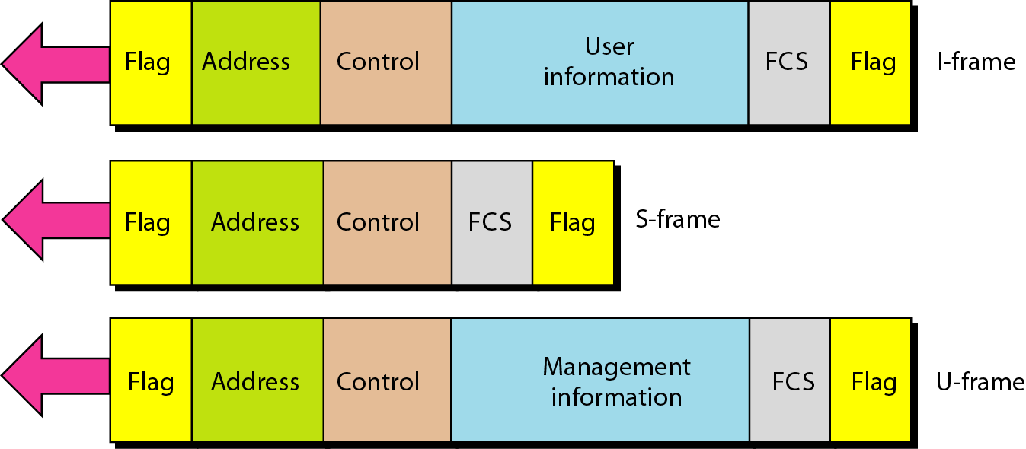
HDLC - Frame Format
39
Notes:
Data Communication

Slide 40
HDLC - Frame Fields
Flag field
The flag field of an HDLC frame is an 8-bit sequence with the bit pattern 01111110 that identifies both the beginning and the end of a frame and serves as a synchronization pattern for the receiver.
40
Notes:
Data Communication

Slide 41
HDLC - Frame Fields
Address field
HDLC frame contains the address of the secondary station.
If a primary station created the frame, it contains a to address.
If a secondary creates the frame, it contains a from address.
An address field can be 1 byte or several bytes long, depending on the needs of the network.
One byte can identify up to 128 stations
41
Notes:
Data Communication

Slide 42
HDLC - Frame Fields
Control field
The control field is a 1- or 2-byte segment of the frame used for flow and error control.
The interpretation of bits in this field depends on the frame type.
Information field
The information field contains the user's data from the network layer or management information.
Its length can vary from one network to another.
42
Notes:
Data Communication

Slide 43
HDLC - Frame Fields
FCS field
The frame check sequence (FCS) is the HDLC error detection field.
It can contain either a 2- or 4-byte ITU-T CRC.
43
Notes:
Data Communication

Slide 44
POINT-TO-POINT PROTOCOL
Although HDLC is a general protocol that can be used for both point-to-point and multipoint configurations, one of the most common protocols for point-to-point access is the Point-to-Point Protocol (PPP).
Today, millions of Internet users who need to connect their home computers to the server of an Internet service provider use PPP.
The majority of these users have a traditional modem; they are connected to the Internet through a telephone line, which provides the services of the physical layer.
44
Notes:
Data Communication

Slide 45
POINT-TO-POINT PROTOCOL
But to control and manage the transfer of data, there is a need for a point-to-point protocol at the data link layer.
PPP is by far the most common.
45
Notes:
Data Communication

Slide 46
PPP provides several services:
PPP defines the format of the frame to be exchanged between devices.
PPP defines how two devices can negotiate the establishment of the link and the exchange of data.
PPP defines how network layer data are encapsulated in the data link frame.
PPP defines how two devices can authenticate each other.
PPP provides multiple network layer services supporting a variety of network layer protocols.
46
Notes:
Data Communication

Slide 47
PPP provides several services:
PPP provides connections over multiple links.
PPP provides network address configuration. This is particularly useful when a home user needs a temporary network address to connect to the Internet.
47
Notes:
Data Communication

Slide 48
On the other hand, to keep PPP simple, several services are missing:
PPP does not provide flow control. A sender can send several frames one after another with no concern about overwhelming the receiver.
PPP has a very simple mechanism for error control. A CRC field is used to detect errors. If the frame is corrupted, it is silently discarded; the upper-layer protocol needs to take care of the problem. Lack of error control and sequence numbering may cause a packet to be received out of order.
3. PPP does not provide a sophisticated addressing mechanism to handle frames in a
multipoint configuration
48
Notes:
Data Communication

Slide 49
On the other hand, to keep PPP simple, several services are missing:
PPP does not provide a sophisticated addressing mechanism to handle frames in a multipoint configuration
49
Notes:
Data Communication

Slide 50
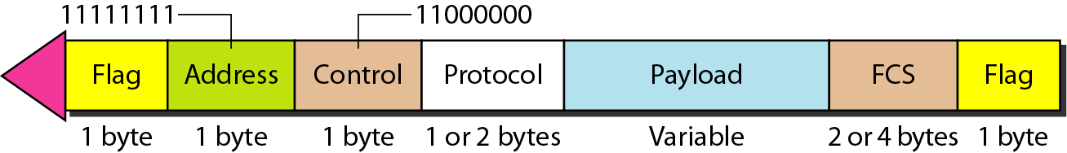
PPP - Framing
PPP is a byte-oriented protocol.
Framing is done according to byte oriented protocols
50
Notes:
Data Communication

Slide 51
PPP - Frame Format
Flag
A PPP frame starts and ends with a I-byte flag with the bit pattern 01111110.
PPP is a byte-oriented protocol; HDLC is a bit-oriented protocol.
The flag is treated as a byte
Address
The address field in this protocol is a constant value and set to 11111111 (broadcast address).
During negotiation, the two parties may agree to omit this byte.
51
Notes:
Data Communication

Slide 52
PPP - Frame Format
Control
This field is set to the constant value 11000000 (imitating unnumbered frames in HDLC).
PPP does not provide any flow control.
Error control is also limited to error detection.
This means that this field is not needed at all, and again, the two parties can agree, during negotiation, to omit this byte.
52
Notes:
Data Communication

Slide 53
PPP - Frame Format
Protocol
The protocol field defines what is being carried in the data field: either user data or other information.
This field is by default 2 bytes long, but the two parties can agree to use only 1 byte
FCS
The frame check sequence (FCS) is simply a 2-byte or 4-byte standard CRC.
53
Notes:
Data Communication

Slide 54
PPP - Frame Format
Payload field
This field carries either the user data or other information
The data field is a sequence of bytes with the default of a maximum of 1500 bytes; but this can be changed during negotiation.
The data field is byte stuffed if the flag byte pattern appears in this field.
Because there is no field defining the size of the data field, padding is needed if the size is less than the maximum default value or the maximum negotiated value
54
Notes:
Data Communication

Slide 55
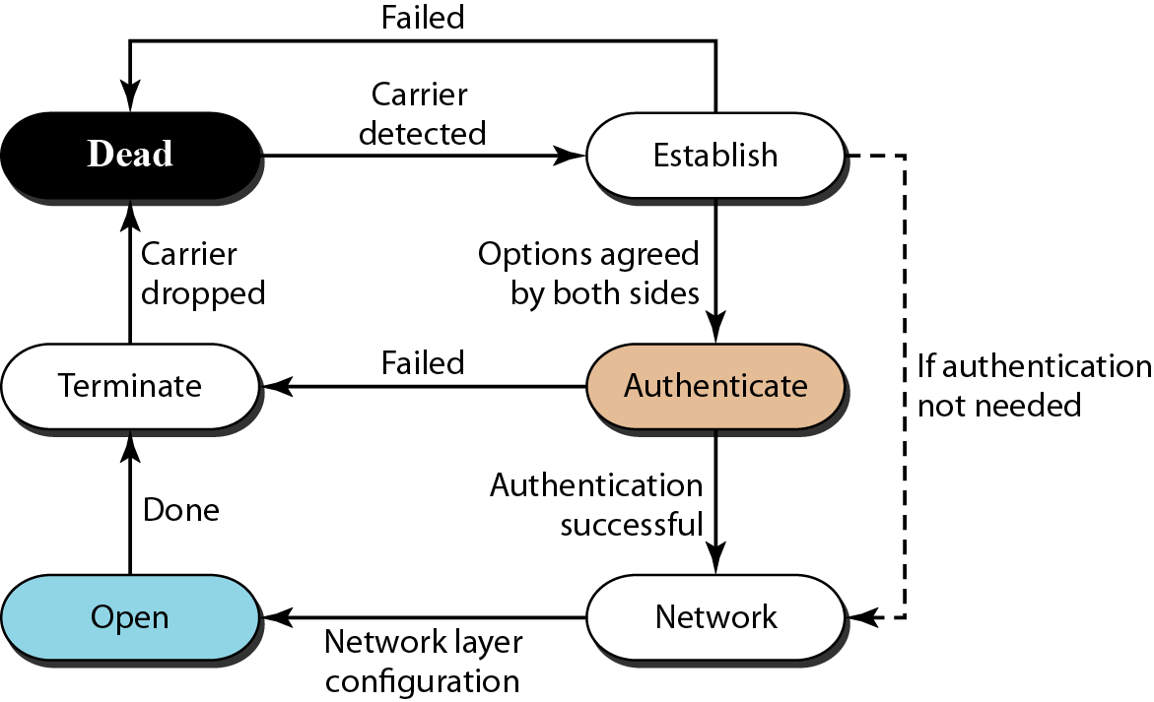
PPP - Transition Phases
A PPP connection goes through phases which can be shown in a transition phase diagram (see Figure).
55
Notes:
Data Communication

Slide 56
PPP - Transition Phases
Dead
In the dead phase the link is not being used.
There is no active carrier (at the physical layer) and the line is quiet.
56
Notes:
Data Communication

Slide 57
PPP - Transition Phases
Establish
When one of the nodes starts the communication, the connection goes into this phase.
In this phase, options are negotiated between the two parties.
If the negotiation is successful, the system goes to the authentication phase (if authentication is required) or directly to the networking phase.
The link control protocol packets, are used for this purpose.
Several packets may be exchanged here.
57
Notes:
Data Communication

Slide 58
PPP - Transition Phases
Authenticate
The authentication phase is optional; the two nodes may decide, during the establishment phase, not to skip this phase.
However, if they decide to proceed with authentication, they send several authentication packets
If the result is successful, the connection goes to the networking phase; otherwise, it goes to the termination phase.
58
Notes:
Data Communication

Slide 59
PPP - Transition Phases
Network
In the network phase, negotiation for the network layer protocols takes place.
PPP specifies that two nodes establish a network layer agreement before data at the network layer can be exchanged.
The reason is that PPP supports multiple protocols at the network layer.
If a node is running multiple protocols simultaneously at the network layer, the receiving node needs to know which protocol will receive the data.
59
Notes:
Data Communication

Slide 60
PPP - Transition Phases
Open
In the open phase, data transfer takes place.
When a connection reaches this phase, the exchange of data packets can be started.
The connection remains in this phase until one of the endpoints wants to terminate the connection.
Terminate
In the termination phase the connection is terminated.
Several packets are exchanged between the two ends for house cleaning and closing the link.
60
Notes:
Data Communication

Slide 61
PPP - Multiplexing
Although PPP is a data link layer protocol, PPP uses another set of other protocols to establish the link, authenticate the parties involved, and carry the network layer data.
Three sets of protocols are defined to make PPP powerful:
the Link Control Protocol (LCP),
Two Authentication Protocols (APs), and
Several Network Control Protocols (NCPs).
61
Notes:
Data Communication

Slide 62
PPP - Multiplexing
At any moment, a PPP packet can carry data from one of these protocols in its data field, as shown in Figure
Note that there is one LCP, two APs, and several NCPs.
Data may also come from several different network layers
62
Notes:
Data Communication

Slide 63
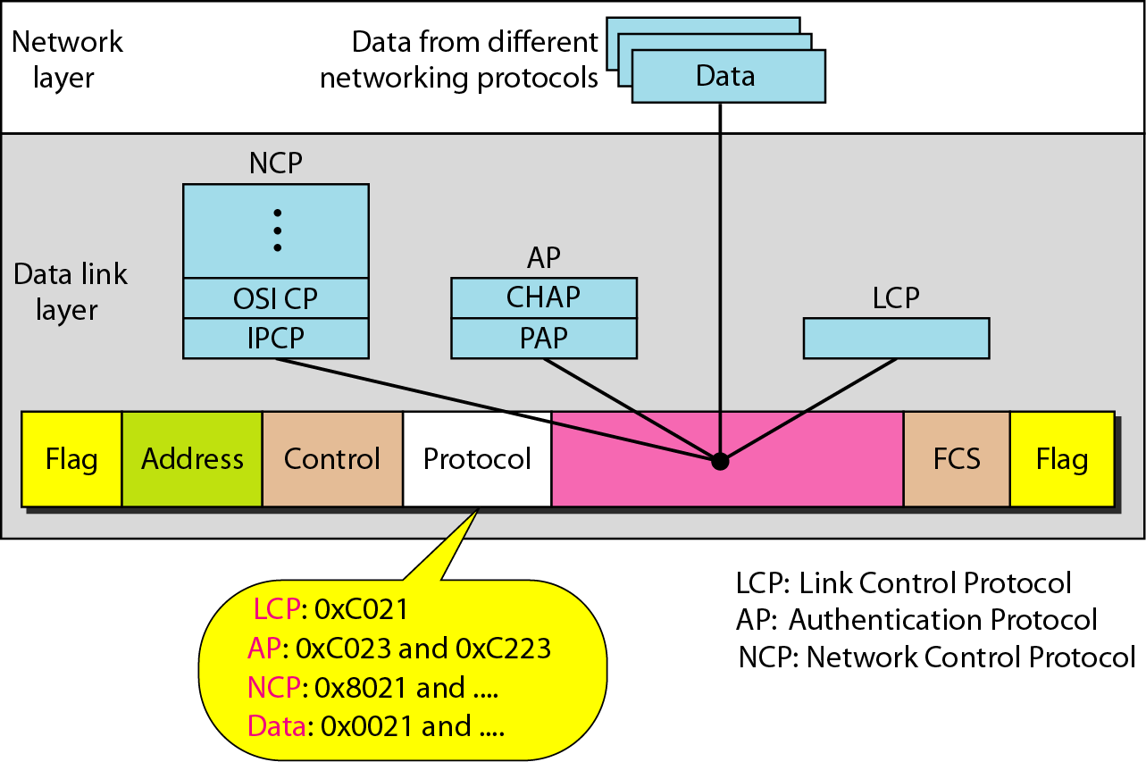
PPP - Multiplexing
63
Notes:
Data Communication

Slide 64
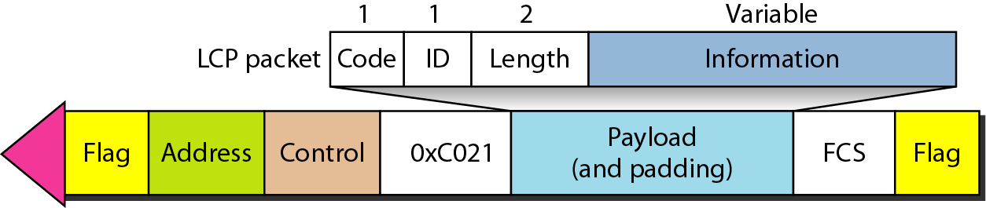
PPP Multiplexing - Link Control Protocol
LCP is responsible for establishing, maintaining, configuring, and terminating links.
It also provides negotiation mechanisms to set options between the two endpoints.
Both endpoints of the link must reach an agreement about the options before the link can be established.
See Figure
LCP packet encapsulated in a frame
64
Notes:
Data Communication

Slide 65
PPP Multiplexing - Link Control Protocol
All LCP packets are carried in the payload field of the PPP frame with the protocol field set to C021 in hexadecimal.
The code field defines the type of LCP packet.
There are 11 types of packets as shown in Table
65
Notes:
Data Communication

Slide 66
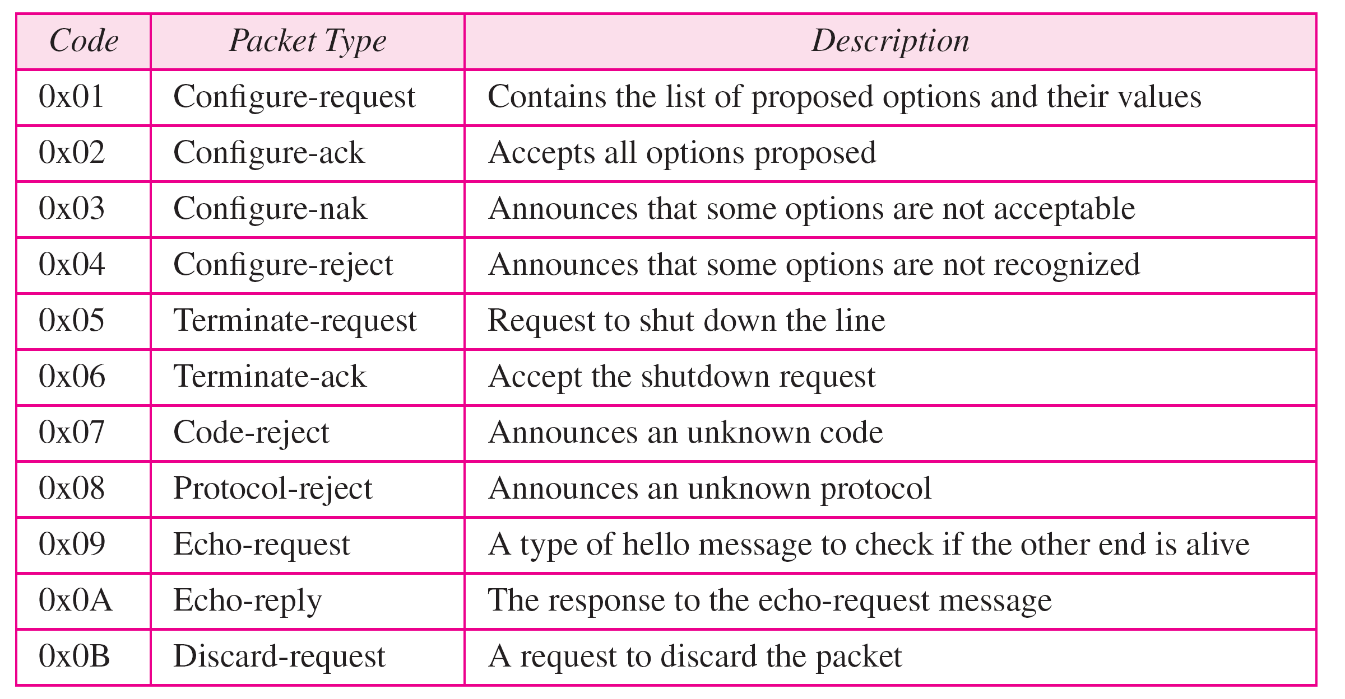
PPP Multiplexing - LCP Packets
66
Notes:
Data Communication

Slide 67
PPP Multiplexing - Link Control Protocol
There are three categories of packets.
The first category, comprising the first four packet types, is used for link configuration during the establish phase.
The second category, comprising packet types 5 and 6, is used for link termination during the termination phase.
The last five packets are used for link monitoring and debugging.
67
Notes:
Data Communication

Slide 68
PPP Multiplexing - Link Control Protocol
The ID field holds a value that matches a request with a reply.
One endpoint inserts a value in this field, which will be copied into the reply packet.
The length field defines the length of the entire LCP packet.
The information field contains information, such as options, needed for some LCP packets.
68
Notes:
Data Communication

Slide 69
PPP Multiplexing - Link Control Protocol
There are many options that can be negotiated between the two endpoints.
Options are inserted in the information field of the configuration packets.
In this case, the information field is divided into three fields: option type, option length, and option data.
We list some of the most common options in Table
69
Notes:
Data Communication

Slide 70
PPP Multiplexing - Link Control Protocol
Common options
70
Notes:
Data Communication

Slide 71
PPP Multiplexing - Authentication Protocols
Authentication plays a very important role in PPP because PPP is designed for use over dial-up links where verification of user identity is necessary.
Authentication means validating the identity of a user who needs to access a set of resources.
PPP has created two protocols for authentication:
Password Authentication Protocol (PAP) and
Challenge Handshake Authentication Protocol (CHAP)
Note that these protocols are used during the authentication phase.
71
Notes:
Data Communication

Slide 72
PPP Authentication Protocols - PAP
The Password Authentication Protocol (PAP) is a simple authentication procedure with a two-step process:
The user who wants to access a system sends an authentication identification (usually the user name) and a password.
The system checks the validity of the identification and password and either accepts or denies connection.
72
Notes:
Data Communication

Slide 73
PPP Authentication Protocols - PAP
Figure shows the three types of packets used by PAP and how they are actually exchanged.
When a PPP frame is carrying any PAP packets, the value of the protocol field is OxC023.
The three PAP packets are authenticate-request, authenticate-ack, and authenticate-nak.
The first packet is used by the user to send the user name and password.
The second is used by the system to allow access.
The third is used by the system to deny access.
73
Notes:
Data Communication

Slide 74
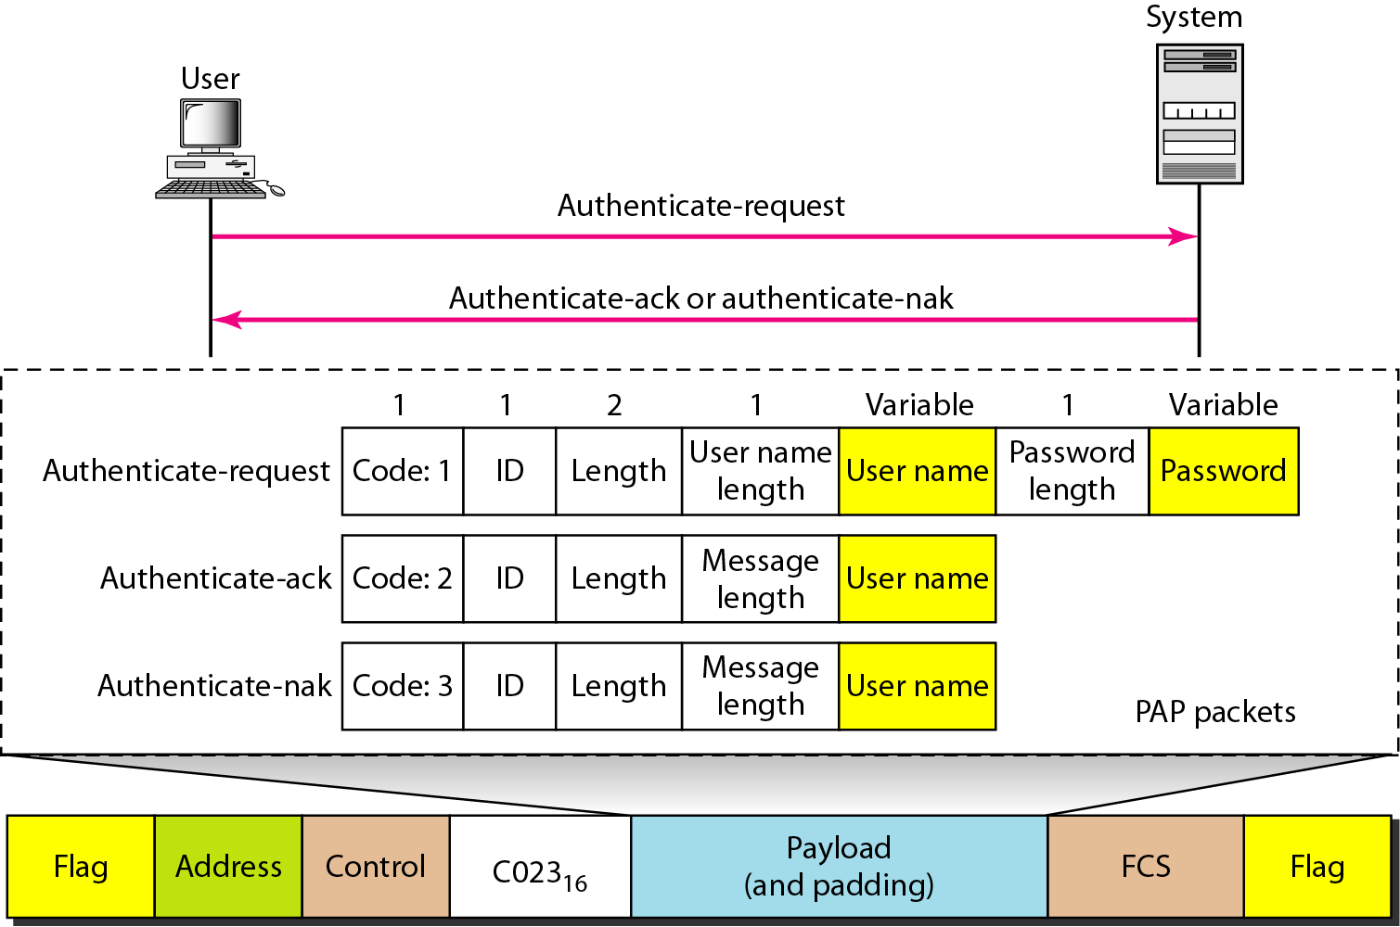
PPP Authentication Protocols - PAP
74
Notes:
Data Communication

Slide 75
PPP Authentication Protocols - CHAP
The Challenge Handshake Authentication Protocol (CHAP) is a three-way hand-shaking authentication protocol that provides greater security than PAP.
In this method, the password is kept secret; it is never sent online.
The system sends the user a challenge packet containing a challenge value, usually a few bytes.
The user applies a predefined function that takes the challenge value and the user's own password and creates a result.
The user sends the result in the response packet to the system.
75
Notes:
Data Communication

Slide 76
PPP Authentication Protocols - CHAP
The system does the same.
It applies the same function to the password of the user (known to the system) and the challenge value to create a result.
If the result created is the same as the result sent in the response packet, access is granted; otherwise, it is denied.
CHAP is more secure than PAP, especially if the system continuously changes the challenge value.
Even if the intruder learns the challenge value and the result, the password is still secret.
Figure shows the packets and how they are used.
76
Notes:
Data Communication

Slide 77
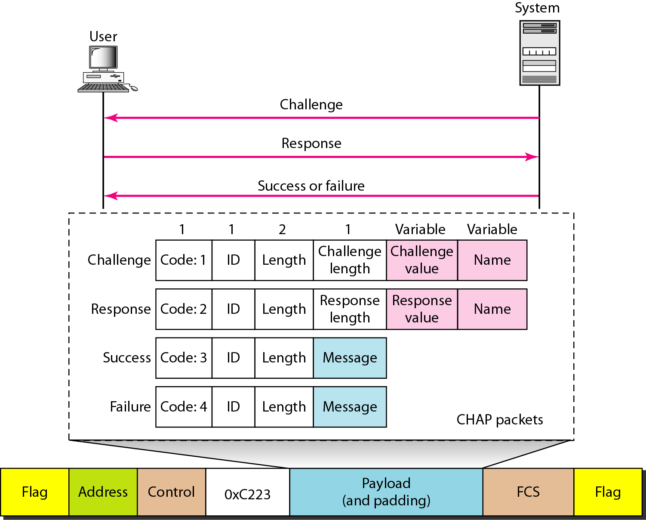
PPP Authentication Protocols - CHAP
77
Notes:
Data Communication

Slide 78
PPP Authentication Protocols - CHAP
CHAP packets are encapsulated in the PPP frame with the protocol value C223 in hexadecimal.
There are four CHAP packets: challenge, response, success, and failure.
The first packet is used by the system to send the challenge value.
The second is used by the user to return the result of the calculation.
The third is used by the system to allow access to the system.
The fourth is used by the system to deny access to the system.
78
Notes:
Data Communication

Slide 79
PPP - Network Control Protocols
PPP is a multiple-network layer protocol.
It can carry a network layer data packet from protocols defined by the Internet, OSI, Xerox, DECnet, AppleTalk, Novel, and so on.
To do this, PPP has defined a specific Network Control Protocol for each network protocol.
For example, IPCP (Internet Protocol Control Protocol) configures the link for carrying IP data packets.
Xerox CP does the same for the Xerox protocol data packets, and so on.
Note that none of the NCP packets carry network layer data; they just configure the link at the network layer for the incoming data.
79
Notes:
Data Communication

Slide 80
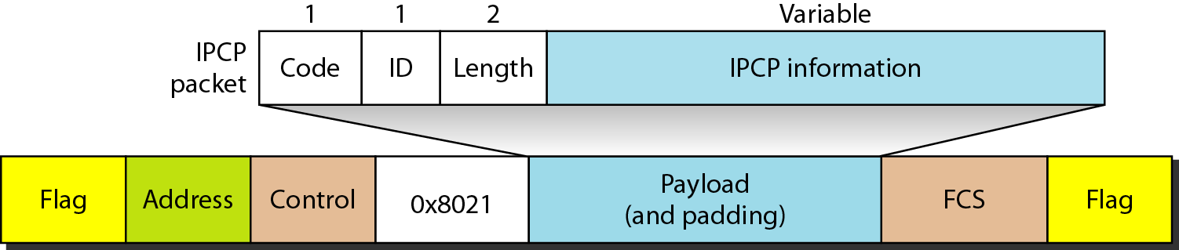
PPP - Network Control Protocols - IPCP
One NCP protocol is the Internet Protocol Control Protocol (IPCP).
This protocol configures the link used to carry IP packets in the Internet.
IPCP is especially of interest to us.
The format of an IPCP packet is shown in Figure
Note that the value of the protocol field in hexadecimal is 8021
80
Notes:
Data Communication

Slide 81
PPP - Network Control Protocols - IPCP
IPCP defines seven packets, distinguished by their code values, as shown in Table
81
Notes:
Data Communication

Slide 82
PPP - Network Control Protocols – Other Protocols
There are other NCP protocols for other network layer protocols.
The OSI Network Layer Control Protocol has a protocol field value of 8023; the Xerox NS IDP Control Protocol has a protocol field value of 8025; and so on.
The value of the code and the format of the packets for these other protocols are the same as shown in Table (IPCP Packets).
82
Notes:
Data Communication

Slide 83
PPP – Data from the Network Layer
After the network layer configuration is completed by one of the NCP protocols, the users can exchange data packets from the network layer.
Here again, there are different protocol fields for different network layers.
For example, if PPP is carrying data from the IP network layer, the field value is 0021 (note that the three rightmost digits are the same as for IPCP).
If PPP is carrying data from the OSI network layer, the value of the protocol field is 0023, and so on.
Figure shows the frame for IP.
83
Notes:
Data Communication

Slide 84
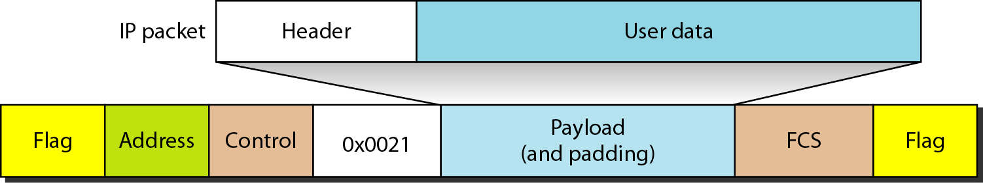
PPP – Data from the Network Layer
84
Notes:
Data Communication

Slide 85
Multilink PPP
PPP was originally designed for a single-channel point-to-point physical link.
The availability of multiple channels in a single point-to-point link motivated the development of Multilink PPP.
In this case, a logical PPP frame is divided into several actual PPP frames.
A segment of the logical frame is carried in the payload of an actual PPP frame, as shown in Figure.
To show that the actual PPP frame is carrying a fragment of a logical PPP frame, the protocol field is set to Ox003d.
85
Notes:
Data Communication

Slide 86
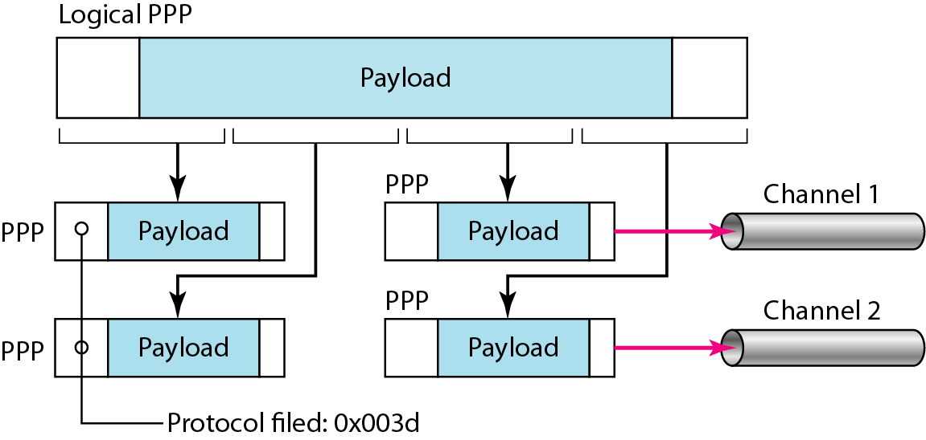
Multilink PPP
This new development adds complexity.
For example, a sequence number needs to be added to the actual PPP frame to show a fragment's position in the logical frame.
86
Notes:
Data Communication

