Slide 1
Switching
1
Notes:
Data Communication

Slide 2
Introduction
A network is a set of connected devices.
Whenever we have multiple devices, we have the problem of how to connect them to make one-to-one communication possible.
One solution is to make a point-to-point connection between each pair of devices (a mesh topology) or between a central device and every other device (a star topology).
These methods, however, are impractical and wasteful when applied to very large networks.
2
Notes:
Data Communication

Slide 3
Introduction
The number and length of the links require too much infrastructure to be cost-efficient, and the majority of those links would be idle most of the time.
Other topologies employing multipoint connections, such as a bus, are ruled out because the distances between devices and the total number of devices increase beyond the capacities of the media and equipment.
3
Notes:
Data Communication

Slide 4
Switching
A better solution is switching.
A switched network consists of a series of interlinked nodes, called switches.
Switches are devices capable of creating temporary connections between two or more devices linked to the switch.
In a switched network, some of these nodes are connected to the end systems (computers or telephones, for example).
Others are used only for routing
Figure shows a switched network.
4
Notes:
Data Communication

Slide 5
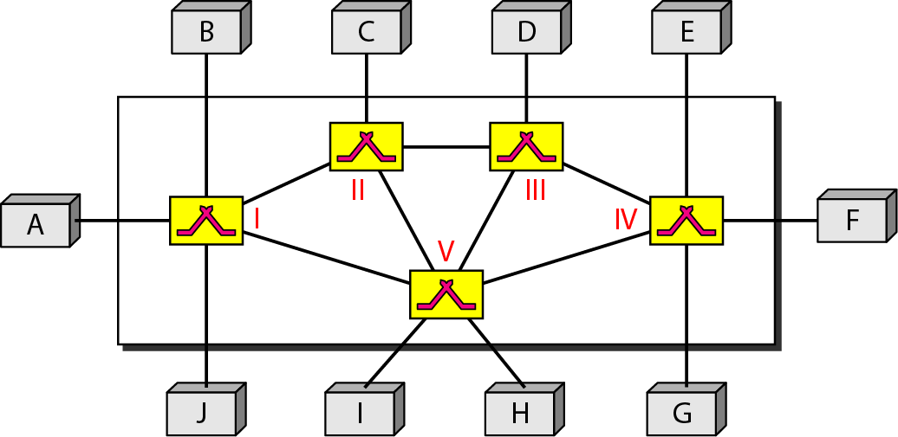
5
Notes:
Data Communication

Slide 6
Switching
The end systems (communicating devices) are labeled A, B, C, D, and so on, and the switches are labeled I, II, III, IV, and V.
Each switch is connected to multiple links.
6
Notes:
Data Communication

Slide 7
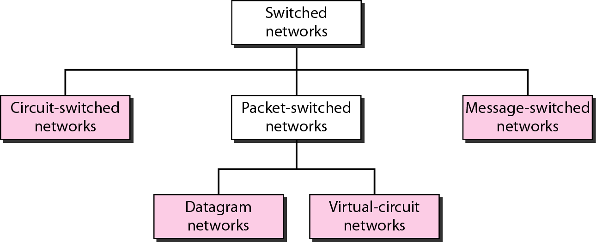
Methods of Switching
7
Notes:
Data Communication

Slide 8
CIRCUIT-SWITCHED NETWORKS
A circuit-switched network consists of a set of switches connected by physical links.
A connection between two stations is a dedicated path made of one or more links.
However, each connection uses only one dedicated channel on each link.
Each link is normally divided into n channels by using FDM or TDM
Figure shows a trivial circuit-switched network with four switches and four links.
Each link is divided into n (n is 3 in the figure) channels by using FDM or TDM.
8
Notes:
Data Communication

Slide 9
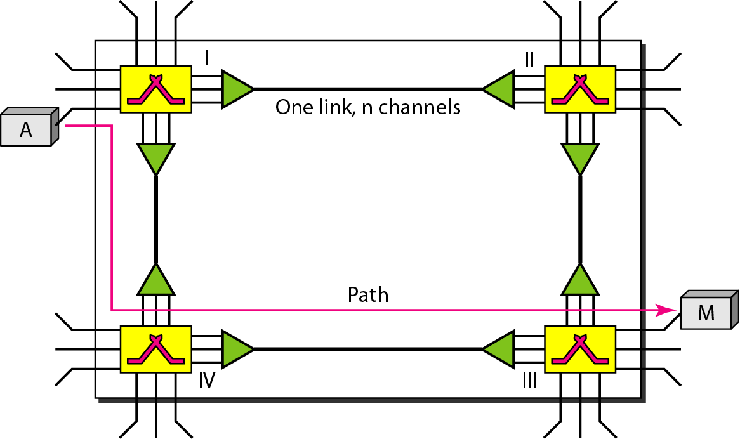
CIRCUIT-SWITCHED NETWORKS
9
Notes:
Data Communication

Slide 10
CIRCUIT-SWITCHED NETWORKS
We have explicitly shown the multiplexing symbols to emphasize the division of the link into channels even though multiplexing can be implicitly included in the switch fabric.
The end systems, such as computers or telephones, are directly connected to a switch.
We have shown only two end systems for simplicity.
10
Notes:
Data Communication

Slide 11
CIRCUIT-SWITCHED NETWORKS
When end system A needs to communicate with end system M, system A needs to request a connection to M that must be accepted by all switches as well as by M itself.
This is called the setup phase; a circuit (channel) is reserved on each link, and the combination of circuits or channels defines the dedicated path.
After the dedicated path made of connected circuits (channels) is established, data transfer can take place.
After all data have been transferred, the circuits are tear down.
11
Notes:
Data Communication

Slide 12
CIRCUIT-SWITCHED NETWORKS
We need to emphasize several points here:
Circuit switching takes place at the physical layer.
Before starting communication, the stations must make a reservation for the resources to be used during the communication.
These resources, such as channels (bandwidth in FDM and time slots in TDM), switch buffers, switch processing time, and switch input/output ports, must remain dedicated during the entire duration of data transfer until the teardown phase.
12
Notes:
Data Communication

Slide 13
CIRCUIT-SWITCHED NETWORKS
Data transferred between the two stations are not packetized (physical layer transfer of the signal).
The data are a continuous flow sent by the source station and received by the destination station, although there may be periods of silence.
There is no addressing involved during data transfer.
The switches route the data based on their occupied band (FDM) or time slot (TDM)
Of course, there is end-to-end addressing used during the setup phase.
13
Notes:
Data Communication

Slide 14
Three Phases
The actual communication in a circuit-switched network requires three phases:
Connection Setup,
Data Transfer, and
Connection Teardown.
14
Notes:
Data Communication

Slide 15
1. Setup Phase
Before the two parties can communicate, a dedicated circuit needs to be established.
The end systems are normally connected through dedicated lines to the switches, so connection setup means creating dedicated channels between the switches.
For example, in Figure, when system A needs to connect to system M, it sends a setup request that includes the address of system M, to switch I.
Switch I finds a channel between itself and switch IV that can be dedicated for this purpose.
15
Notes:
Data Communication

Slide 16
1. Setup Phase
Switch I then sends the request to switch IV, which finds a dedicated channel between itself and switch III.
Switch III informs system M of system A's intention at this time.
In the next step to making a connection, an acknowledgment from system M needs to be sent in the opposite direction to system A.
Only after system A receives this acknowledgment is the connection established.
Note that end-to-end addressing is required for creating a connection between the two end systems.
16
Notes:
Data Communication

Slide 17
2. Data Transfer Phase
After the establishment of the dedicated circuit (channels), the two parties can transfer data.
3. Teardown Phase
When one of the parties needs to disconnect, a signal is sent to each switch to release the resources.
17
Notes:
Data Communication

Slide 18
Efficiency
circuit-switched networks are not as efficient as the other two types of networks because resources are allocated during the entire duration of the connection.
These resources are unavailable to other connections.
In a telephone network, people normally terminate the communication when they have finished their conversation.
However, in computer networks, a computer can be connected to another computer even if there is no activity for a long time.
In this case, allowing resources to be dedicated means that other connections are deprived.
18
Notes:
Data Communication

Slide 19
Delay
Although a circuit-switched network normally has low efficiency, the delay in this type of network is minimal.
During data transfer the data are not delayed at each switch; the resources are allocated for the duration of the connection.
Figure shows the idea of delay in a circuit-switched network when only two switches are involved.
19
Notes:
Data Communication

Slide 20
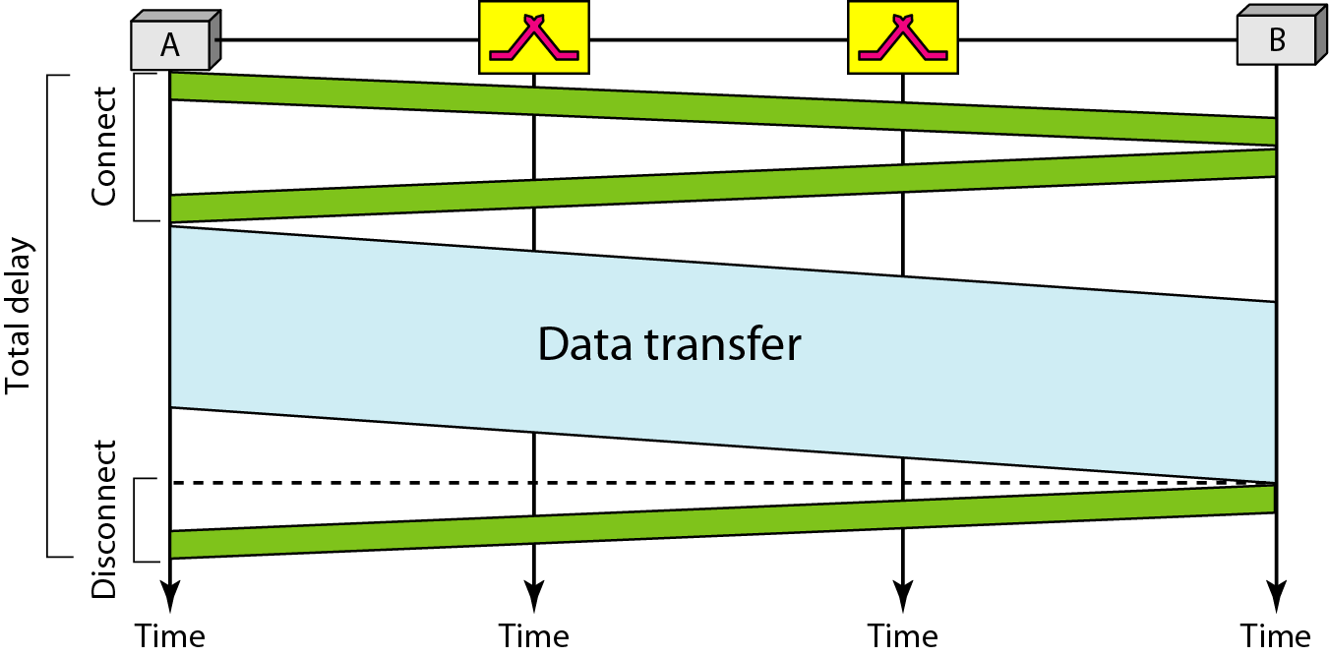
Delay
20
Notes:
Data Communication

Slide 21
Delay
As Figure shows, there is no waiting time at each switch.
The total delay is due to the time needed to create the connection, transfer data, and disconnect the circuit.
The delay caused by the setup is the sum of four parts: the propagation time of the source computer request (slope of the first gray box), the request signal transfer time (height of the first gray box), the propagation time of the acknowledgment from the destination computer (slope of the second gray box), and the signal transfer time of the acknowledgment (height of the second gray box).
21
Notes:
Data Communication

Slide 22
Delay
The delay due to data transfer is the sum of two parts: the propagation time (slope of the colored box) and data transfer time (height of the colored box), which can be very long.
The third box shows the time needed to tear down the circuit.
22
Notes:
Data Communication

