Slide 1
DATAGRAM NETWORKS
1
Notes:
Data Communication

Slide 2
Introduction
In data communications, we need to send messages from one end system to another.
If the message is going to pass through a packet-switched network, it needs to be divided into packets of fixed or variable size.
The size of the packet is determined by the network and the governing protocol.
In packet switching, there is no resource allocation for a packet.
There is no reserved bandwidth on the links, and there is no scheduled processing time for each packet.
2
Notes:
Data Communication

Slide 3
Introduction
Resources are allocated on demand.
The allocation is done on a first-come, first-served basis.
When a switch receives a packet, no matter what is the source or destination, the packet must wait if there are other packets being processed.
As with other systems in our daily life, this lack of reservation may create delay.
For example, if we do not have a reservation at a restaurant, we might have to wait.
3
Notes:
Data Communication

Slide 4
Introduction
In a datagram network, each packet is treated independently of all others.
Even if a packet is part of a multipacket transmission, the network treats it as though it existed alone.
Packets in this approach are referred to as datagrams.
Datagram switching is normally done at the network layer.
Figure shows how the datagram approach is used to deliver four packets from station A to station X.
The switches in a datagram network are traditionally referred to as routers.
That is why we use a different symbol for the switches in the figure.
4
Notes:
Data Communication

Slide 5
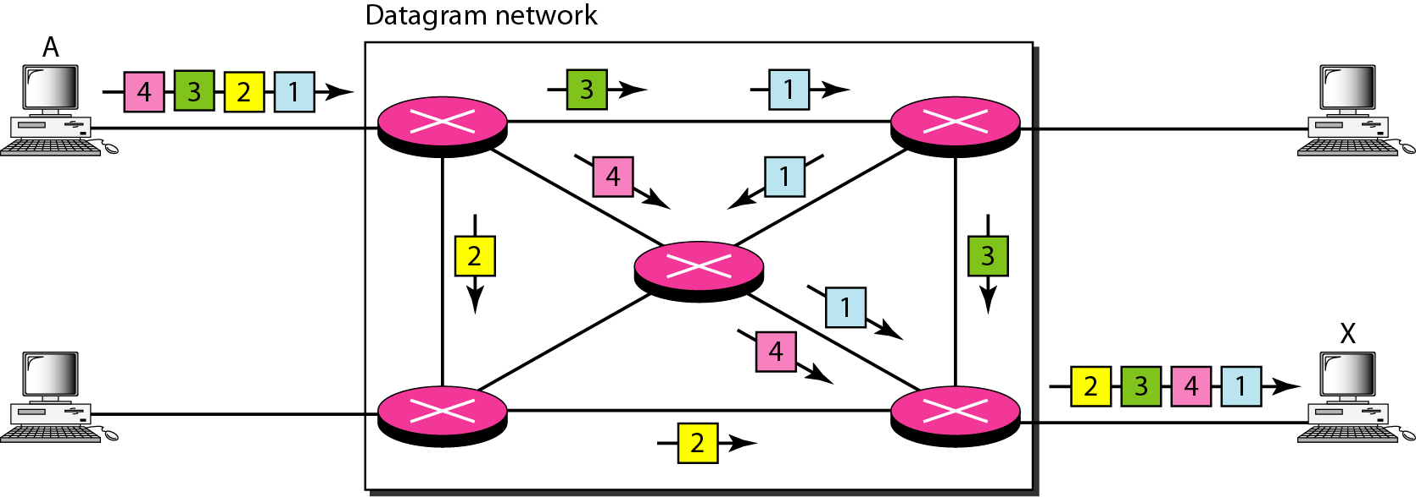
A datagram network with four switches (routers)
5
Notes:
Data Communication

Slide 6
Introduction
In this example, all four packets (or datagrams) belong to the same message, but may travel different paths to reach their destination.
This is so because the links may be involved in carrying packets from other sources and do not have the necessary bandwidth available to carry all the packets from A to X.
This approach can cause the datagrams of a transmission to arrive at their destination out of order with different delays between the packets.
Packets may also be lost or dropped because of a lack of resources.
6
Notes:
Data Communication

Slide 7
Introduction
In most protocols, it is the responsibility of an upper-layer protocol to reorder the datagrams or ask for lost datagrams before passing them on to the application
The datagram networks are sometimes referred to as connectionless networks.
The term connectionless here means that the switch (packet switch) does not keep information about the connection state.
There are no setup or teardown phases.
Each packet is treated the same by a switch regardless of its source or destination.
7
Notes:
Data Communication

Slide 8
Routing Table
If there are no setup or teardown phases, how are the packets routed to their destinations in a datagram network?
In this type of network, each switch (or packet switch) has a routing table which is based on the destination address.
The routing tables are dynamic and are updated periodically.
The destination addresses and the corresponding forwarding output ports are recorded in the tables.
8
Notes:
Data Communication

Slide 9
Routing Table
This is different from the table of a circuit-switched network in which each entry is created when the setup phase is completed and deleted when the teardown phase is over.
Figure shows the routing table for a switch.
9
Notes:
Data Communication

Slide 10
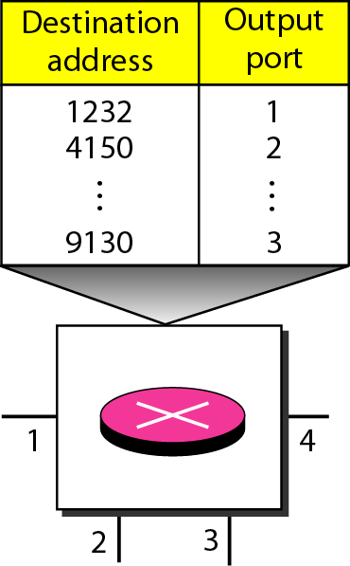
Routing Table
10
Notes:
Data Communication

Slide 11
Destination Address
Every packet in a datagram network carries a header that contains, among other information, the destination address of the packet.
When the switch receives the packet, this destination address is examined; the routing table is consulted to find the corresponding port through which the packet should be forwarded.
This address, remains the same during the entire journey of the packet.
11
Notes:
Data Communication

Slide 12
Efficiency
The efficiency of a datagram network is better than that of a circuit-switched network; resources are allocated only when there are packets to be transferred.
If a source sends a packet and there is a delay of a few minutes before another packet can be sent, the resources can be reallocated during these minutes for other packets from other sources.
12
Notes:
Data Communication

Slide 13
Delay
There may be greater delay in a datagram network than in a virtual-circuit network.
Although there are no setup and teardown phases, each packet may experience a wait at a switch before it is forwarded.
In addition, since not all packets in a message necessarily travel through the same switches, the delay is not uniform for the packets of a message.
Figure gives an example of delay in a datagram network for one single packet.
13
Notes:
Data Communication

Slide 14
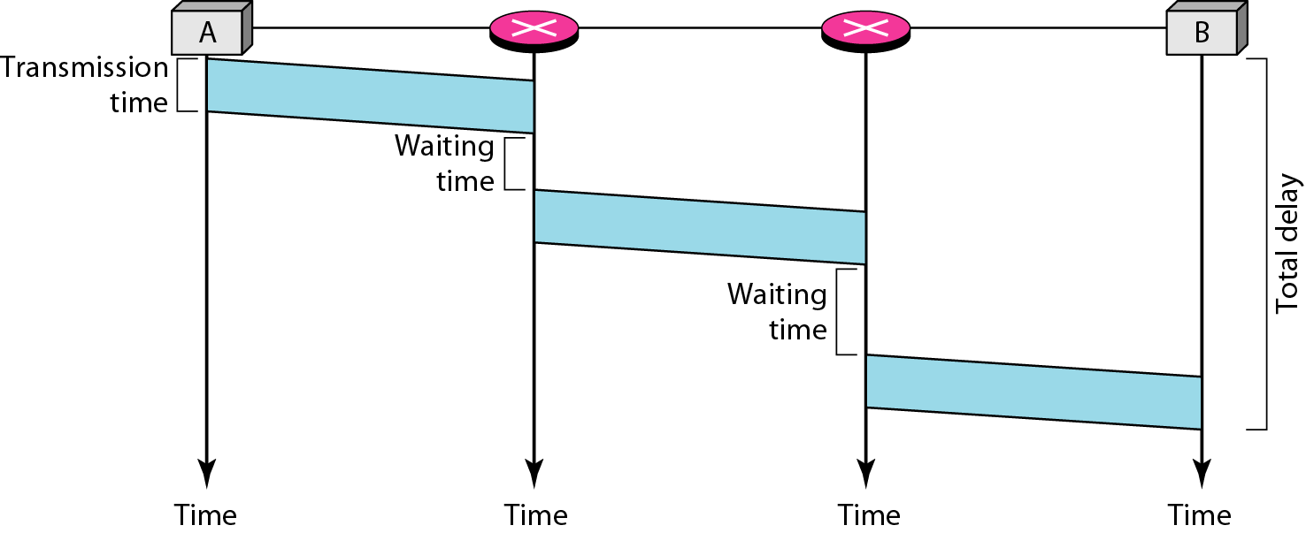
Delay
14
Notes:
Data Communication

Slide 15
Delay
The packet travels through two switches.
There are three transmission times (3T), three propagation delays (slopes 3't of the lines), and two waiting times (W1 + w2)'
We ignore the processing time in each switch.
The total delay is
Total delay =3T + 3t + W1 + W2
15
Notes:
Data Communication

Slide 16
Datagram Networks in the Internet
the Internet has chosen the datagram approach to switching at the network layer.
It uses the universal addresses defined in the network layer to route packets from the source to the destination
Switching in the Internet is done by using the datagram approach to packet switching at the network layer.
16
Notes:
Data Communication

