Slide 1
UNGUIDED MEDIA: WIRELESS
1
Notes:
Data Communication

Slide 2
UNGUIDED MEDIA: WIRELESS
Unguided media transport electromagnetic waves without using a physical conductor
This type of communication is often referred to as wireless communication.
Signals are normally broadcast through free space and thus are available to anyone who has a device capable of receiving them
Figure shows the part of the electromagnetic spectrum, ranging from 3 kHz to 900 THz, used for wireless communication
2
Notes:
Data Communication

Slide 3
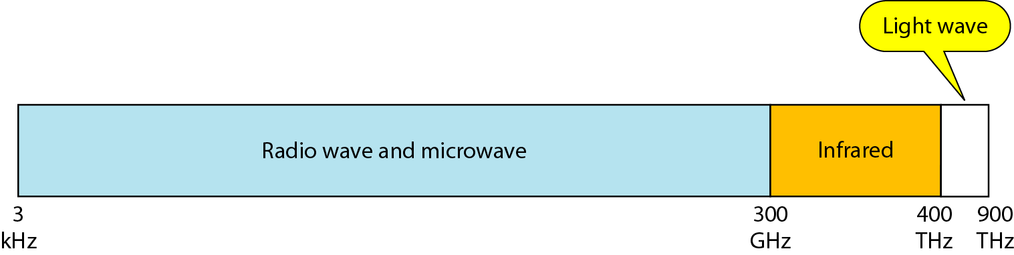
UNGUIDED MEDIA: WIRELESS
3
Notes:
Data Communication

Slide 4
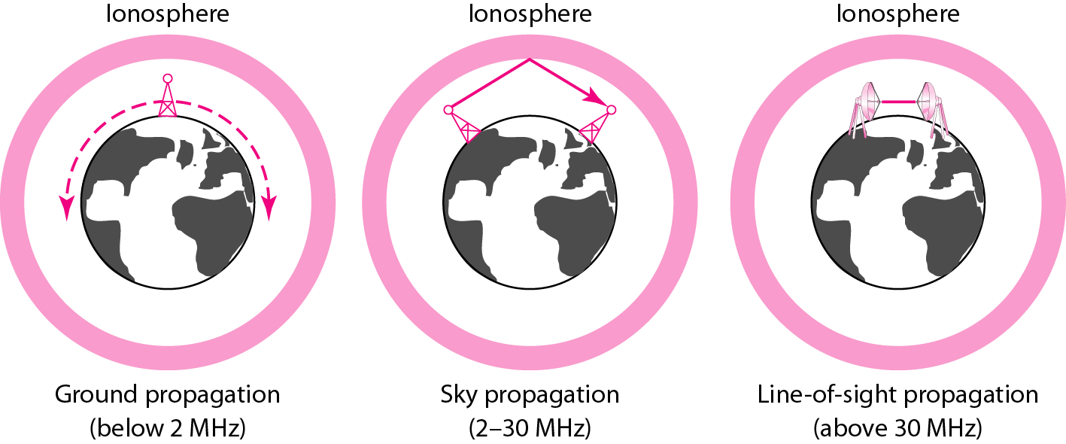
UNGUIDED MEDIA: Propagation Modes
Unguided signals can travel from the source to destination in several ways: ground propagation, sky propagation, and line-of-sight propagation, as shown in Figure
4
Notes:
Data Communication

Slide 5
Ground Propagation
In ground propagation, radio waves travel through the lowest portion of the atmosphere, hugging the earth.
These low-frequency signals emanate in all directions from the transmitting antenna and follow the curvature of the planet.
Distance depends on the amount of power in the signal
The greater the power, the greater the distance.
5
Notes:
Data Communication

Slide 6
Sky Propagation
In sky propagation, higher-frequency radio waves radiate upward into the ionosphere (the layer of atmosphere where particles exist as ions) where they are reflected back to earth.
This type of transmission allows for greater distances with lower output power.
6
Notes:
Data Communication

Slide 7
Line of Sight Propagation
In line-of-sight propagation, very high-frequency signals are transmitted in straight lines directly from antenna to antenna.
Antennas must be directional, facing each other, and either tall enough or close enough together not to be affected by the curvature of the earth.
It is tricky because radio transmissions cannot be completely focused.
7
Notes:
Data Communication

Slide 8
Bands
The section of the electromagnetic spectrum defined as radio waves and microwaves is divided into eight ranges, called bands, each regulated by government authorities.
These bands are rated from very low frequency (VLF) to extremely high frequency (EHF).
Table lists these bands, their ranges, propagation methods, and some applications.
8
Notes:
Data Communication

Slide 9
Bands
9
Notes:
Data Communication

Slide 10
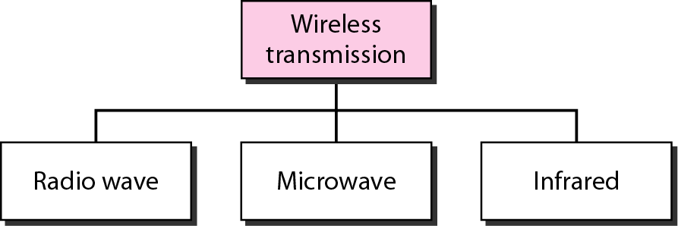
Wireless Transmission Waves
We can divide wireless transmission into three broad groups: radio waves, microwaves, and infrared waves.
10
Notes:
Data Communication

Slide 11
Wireless Transmission Waves
Although there is no clear-cut demarcation between radio waves and microwaves
Electromagnetic waves ranging in frequencies between 3 kHz and 1 GHz are normally called radio waves
Waves ranging in frequencies between 1 and 300 GHz are called microwaves.
However, the behavior of the waves, rather than the frequencies, is a better criterion for classification.
11
Notes:
Data Communication

Slide 12
Radio Waves
Radio waves, for the most part, are omni directional.
When an antenna transmits radio waves, they are propagated in all directions.
The sending and receiving antennas do not have to be aligned.
A sending antenna sends waves that can be received by any receiving antenna.
The omnidirectional property has a disadvantage, too
The radio waves transmitted by one antenna are susceptible to interference by another antenna that may send signals using the same frequency or band.
12
Notes:
Data Communication

Slide 13
Radio Waves
Radio waves, particularly those waves that propagate in the sky mode, can travel long distances.
This makes radio waves a good candidate for long-distance broadcasting such as AM radio.
Radio waves, particularly those of low and medium frequencies, can penetrate walls.
This characteristic can be both an advantage and a disadvantage.
It is an advantage because, for example, an AM radio can receive signals inside a building.
13
Notes:
Data Communication

Slide 14
Radio Waves
It is a disadvantage because we cannot isolate a communication to just inside or outside a building.
The radio wave band is relatively narrow, just under 1 GHz, compared to the microwave band.
When this band is divided into sub bands, the sub bands are also narrow, leading to a low data rate for digital communications.
Almost the entire band is regulated by authorities (e.g., the FCC in the United States).
Using any part of the band requires permission from the authorities.
14
Notes:
Data Communication

Slide 15
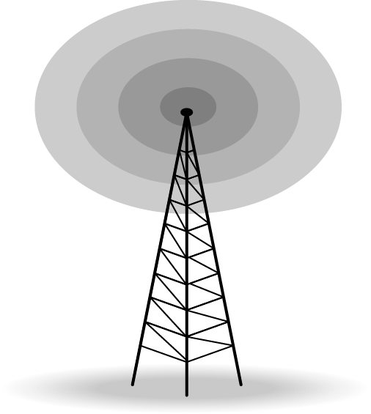
Omnidirectional Antenna
Radio waves use omnidirectional antennas that send out signals in all directions
Based on the wavelength, strength, and the purpose of transmission, we can have several types of antennas
Figure shows an omnidirectional antenna.
15
Notes:
Data Communication

Slide 16
Applications
The omnidirectional characteristics of radio waves make them useful for multicasting, in which there is one sender but many receivers.
AM and FM radio, television, maritime radio, cordless phones, and paging are examples of multicasting
16
Notes:
Data Communication

Slide 17
Microwaves
Electromagnetic waves having frequencies between 1 and 300 GHz are called microwaves.
Microwaves are unidirectional.
When an antenna transmits microwave waves, they can be narrowly focused.
The sending and receiving antennas need to be aligned
The unidirectional property has an obvious advantage
A pair of antennas can be aligned without interfering with another pair of aligned antennas.
17
Notes:
Data Communication

Slide 18
Characteristics of Microwave Propagation
Microwave propagation is line-of-sight
Since the towers with the mounted antennas need to be in direct sight of each other, towers that are far apart need to be very tall
The curvature of the earth as well as other blocking obstacles do not allow two short towers to communicate by using microwaves.
Repeaters are often needed for long distance communication
18
Notes:
Data Communication

Slide 19
Characteristics of Microwave Propagation
Very high-frequency microwaves cannot penetrate walls
This characteristic can be a disadvantage if receivers are inside buildings.
The microwave band is relatively wide, almost 299 GHz. Therefore wider sub bands can be assigned, and a high data rate is possible
Use of certain portions of the band requires permission from authorities.
19
Notes:
Data Communication

Slide 20
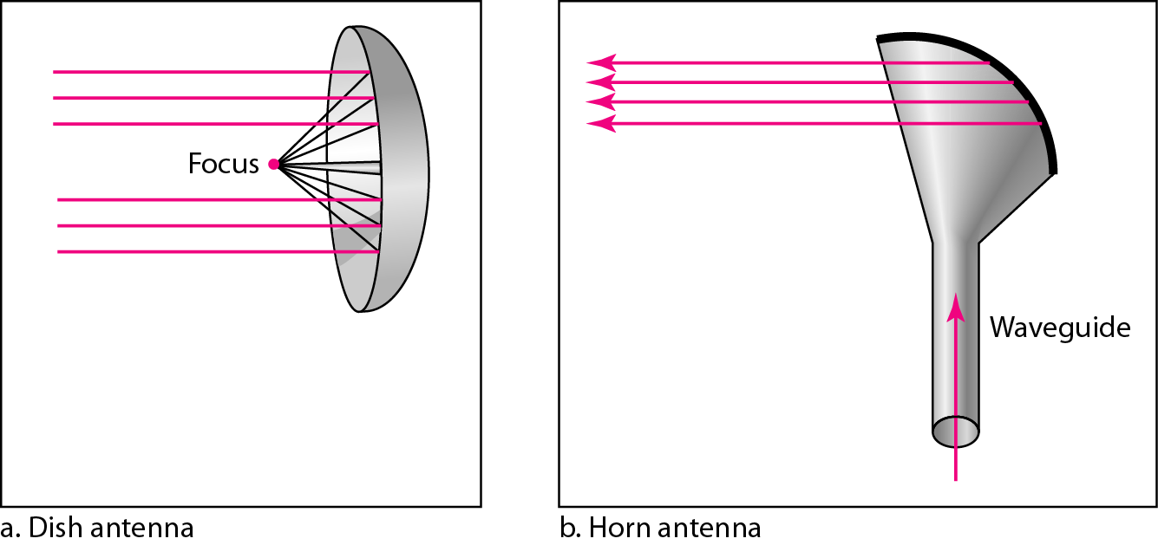
Unidirectional Antenna
Microwaves need unidirectional antennas that send out signals in one direction.
Two types of antennas are used for microwave communications: the parabolic dish and the horn (see Figure ).
20
Notes:
Data Communication

Slide 21
Unidirectional Antenna
A parabolic dish antenna is based on the geometry of a parabola:
Every line parallel to the line of symmetry (line of sight) reflects off the curve at angles such that all the lines intersect in a common point called the focus.
The parabolic dish works as a funnel, catching a wide range of waves and directing them to a common point.
In this way, more of the signal is recovered than would be possible with a single-point receiver
Outgoing transmissions are broadcast through a horn aimed at the dish.
21
Notes:
Data Communication

Slide 22
Unidirectional Antenna
The microwaves hit the dish and are deflected outward in a reversal of the receipt path
A horn antenna looks like a gigantic scoop.
Outgoing transmissions are broadcast up a stem (resembling a handle) and deflected outward in a series of narrow parallel beams by the curved head.
Received transmissions are collected by the scooped shape of the horn, in a manner similar to the parabolic dish, and are deflected down into the stem
22
Notes:
Data Communication

Slide 23
Applications
Microwaves, due to their unidirectional properties, are very useful when unicast (one-to-one) communication is needed between the sender and the receiver.
They are used in cellular phones, satellite networks, and wireless LANs
23
Notes:
Data Communication

Slide 24
Infrared
Infrared waves, with frequencies from 300 GHz to 400 THz (wavelengths from 1 mm to 770 nm), can be used for short-range communication.
Infrared waves, having high frequencies, cannot penetrate walls.
This advantageous characteristic prevents interference between one system and another; a short-range communication system in one room cannot be affected by another system in the next room.
When we use our infrared remote control, we do not interfere with the use of the remote by our neighbors.
24
Notes:
Data Communication

Slide 25
Infrared
However, this same characteristic makes infrared signals useless for long-range communication.
In addition, we cannot use infrared waves outside a building because the sun's rays contain infrared waves that can interfere with the communication.
25
Notes:
Data Communication

Slide 26
Applications
The infrared band, almost 400 THz, has an excellent potential for data transmission.
Such a wide bandwidth can be used to transmit digital data with a very high data rate.
The Infrared Data Association (IrDA), an association for sponsoring the use of infrared waves, has established standards for using these signals for communication between devices such as keyboards, mice, PCs, and printers.
26
Notes:
Data Communication

Slide 27
Applications
For example, some manufacturers provide a special port called the IrDA port that allows a wireless keyboard to communicate with a PC.
The standard originally defined a data rate of 75 kbps for a distance up to 8 m.
The recent standard defines a data rate of 4 Mbps.
Infrared signals defined by IrDA transmit through line of sight; the IrDA port on the keyboard needs to point to the PC for transmission to occur.
27
Notes:
Data Communication

