Slide 1
Connecting LANs, Backbone Networks, and Virtual LANs
1
Notes:
Data Communication

Slide 2
Introduction
LANs do not normally operate in isolation.
They are connected to one another or to the Internet.
To connect LANs, or segments of LANs, we use connecting devices.
Connecting devices can operate in different layers of the Internet model.
2
Notes:
Data Communication

Slide 3
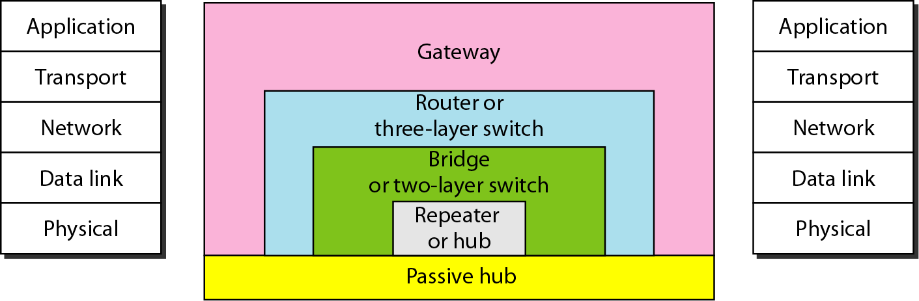
CONNECTING DEVICES
we divide connecting devices into five different categories based on the layer in which they operate in a network, as shown in Figure
3
Notes:
Data Communication

Slide 4
CONNECTING DEVICES
The five categories contain devices which defined as
Those which operate below the physical layer such as a passive hub.
Those which operate at the physical layer (a repeater or an active hub).
Those which operate at the physical and data link layers (a bridge or a two-layer switch).
Those which operate at the physical, data link, and network layers (a router or a three-layer switch).
Those which can operate at all five layers (a gateway).
4
Notes:
Data Communication

Slide 5
Passive Hubs
A passive hub is just a connector.
It connects the wires coming from different branches.
In a star-topology Ethernet LAN, a passive hub is just a point where the signals coming from different stations collide; the hub is the collision point.
This type of a hub is part of the media; its location in the Internet model is below the physical layer.
5
Notes:
Data Communication

Slide 6
Repeaters
A repeater is a device that operates only in the physical layer.
Signals that carry information within a network can travel a fixed distance before attenuation endangers the integrity of the data.
A repeater receives a signal and, before it becomes too weak or corrupted, regenerates the original bit pattern.
The repeater then sends the refreshed signal.
A repeater can extend the physical length of a LAN, as shown in Figure.
6
Notes:
Data Communication

Slide 7
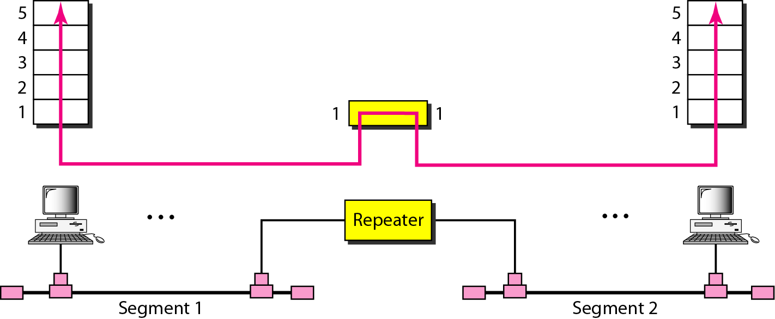
Repeaters
A repeater connecting two segments of a LAN
7
Notes:
Data Communication

Slide 8
Repeaters
A repeater does not actually connect two LANs; it connects two segments of the same LAN.
The segments connected are still part of one single LAN.
A repeater is not a device that can connect two LANs of different protocols.
8
Notes:
Data Communication

Slide 9
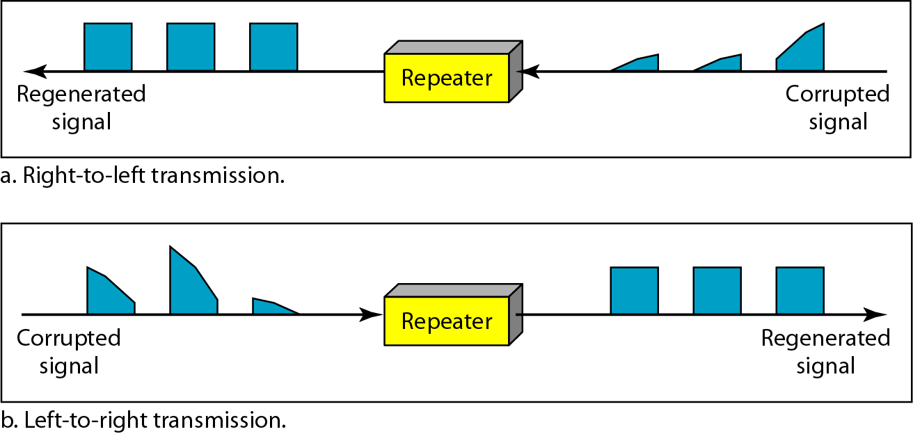
Function of Repeater
A repeater forwards every frame; it has no filtering capability.
A repeater is a regenerator, not an amplifier.
9
Notes:
Data Communication

Slide 10
Active Hubs
An active hub is actually a multipart repeater.
It is normally used to create connections between stations in a physical star topology.
However, hubs can also be used to create multiple levels of hierarchy, as shown in Figure .
The hierarchical use of hubs removes the length limitation of 10Base-T (100 m).
10
Notes:
Data Communication

Slide 11
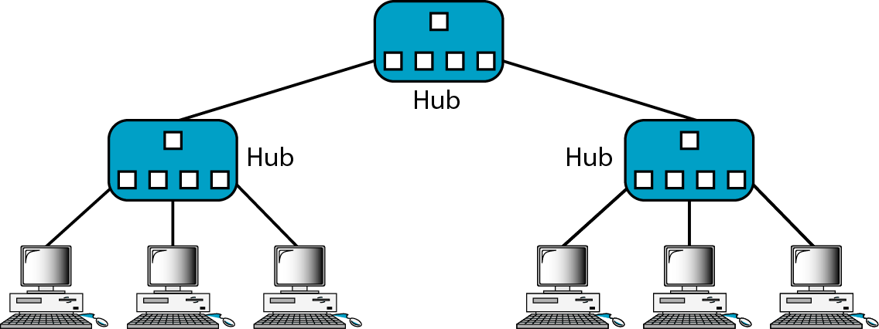
Active Hubs
Figure : A hierarchy of hubs
11
Notes:
Data Communication

Slide 12
Bridges
A bridge operates in both the physical and the data link layer.
As a physical layer device, it regenerates the signal it receives.
As a data link layer device, the bridge can check the physical (MAC) addresses (source and destination) contained in the frame.
12
Notes:
Data Communication

Slide 13
What is the difference in functionality between a bridge and a repeater?
A bridge has filtering capability.
It can check the destination address of a frame and decide if the frame should be forwarded or dropped.
If the frame is to be forwarded, the decision must specify the port.
A bridge has a table that maps addresses to ports.
13
Notes:
Data Communication

Slide 14
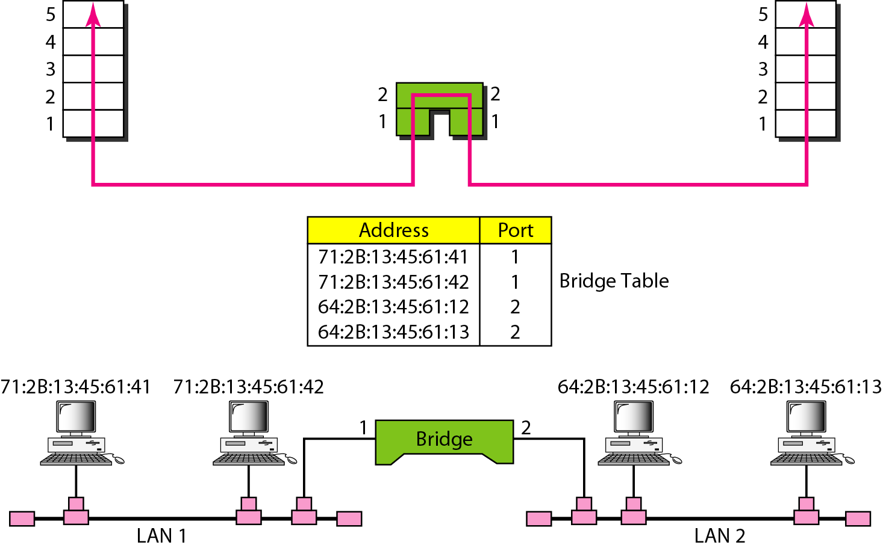
Bridges
Let us give an example. In Figure, two LANs are connected by a bridge.
14
Notes:
Data Communication

Slide 15
Transparent Bridges
A transparent bridge is a bridge in which the stations are completely unaware of the bridge's existence.
If a bridge is added or deleted from the system, reconfiguration of the stations is unnecessary.
According to the IEEE 802.1 d specification, a system equipped with transparent bridges must meet three criteria:
Frames must be forwarded from one station to another.
The forwarding table is automatically made by learning frame movements in the network.
Loops in the system must be prevented.
15
Notes:
Data Communication

Slide 16
Transparent Bridges
Forwarding
A transparent bridge must correctly forward the frames
Learning
The earliest bridges had forwarding tables that were static.
The systems administrator would manually enter each table entry during bridge setup.
Although the process was simple, it was not practical.
If a station was added or deleted, the table had to be modified manually.
16
Notes:
Data Communication

Slide 17
Bridges Connecting Different LANs
Theoretically a bridge should be able to connect LANs using different protocols at the data link layer, such as an Ethernet LAN to a wireless LAN.
However, there are many issues to be considered:
Frame format
Each LAN type has its own frame format (compare an Ethernet frame with a wireless LAN frame).
Data rate
Each LAN type has its own data rate.
The bridge must buffer the frame to compensate for this difference.
17
Notes:
Data Communication

Slide 18
Bridges Connecting Different LANs
Maximum data size
If an incoming frame's size is too large for the destination LAN, the data must be fragmented into several frames.
The data then need to be reassembled at the destination.
However, no protocol at the data link layer allows the fragmentation and reassembly of frames.
The bridge must therefore discard any frames too large for its system
18
Notes:
Data Communication

Slide 19
Bridges Connecting Different LANs
Bit order
Each LAN type has its own strategy in the sending of bits.
Some send the most significant bit in a byte first; others send the least significant bit first.
Security
Some LANs, such as wireless LANs, implement security measures in the data link layer.
Other LANs, such as Ethernet, do not.
19
Notes:
Data Communication

Slide 20
Bridges Connecting Different LANs
Security often involves encryption
When a bridge receives a frame from a wireless LAN, it needs to decrypt the message before forwarding it to an Ethernet LAN.
Multimedia support
Some LANs support multimedia and the quality of services needed for this type of communication; others do not.
20
Notes:
Data Communication

Slide 21
Two-Layer Switches
When we use the term switch, we must be careful because a switch can mean two different things.
We must clarify the term by adding the level at which the device operates.
We can have a two-layer switch or a three-layer switch.
A three-layer switch is used at the network layer; it is a kind of router.
The two-layer switch performs at the physical and data link layers.
21
Notes:
Data Communication

Slide 22
Two-Layer Switches
A two-layer switch is a bridge, a bridge with many ports and a design that allows better (faster) performance.
A bridge with a few ports can connect a few LANs together.
A bridge with many ports may be able to allocate a unique port to each station, with each station on its own independent entity.
This means no competing traffic (no collision in Ethernet).
22
Notes:
Data Communication

Slide 23
Two-Layer Switches
A two-layer switch, as a bridge does, makes a filtering decision based on the MAC address of the frame it received.
However, a two-layer switch can be more sophisticated.
It can have a buffer to hold the frames for processing.
It can have a switching factor that forwards the frames faster.
Some new two-layer switches, called cut-through switches, have been designed to forward the frame as soon as they check the MAC addresses in the header of the frame.
23
Notes:
Data Communication

Slide 24
Routers
A router is a three-layer device that routes packets based on their logical addresses (host-to-host addressing).
A router normally connects LANs and WANs in the Internet and has a routing table that is used for making decisions about the route.
The routing tables are normally dynamic and are updated using routing protocols.
Figure shows a part of the Internet that uses routers to connect LANs and WANs.
24
Notes:
Data Communication

Slide 25
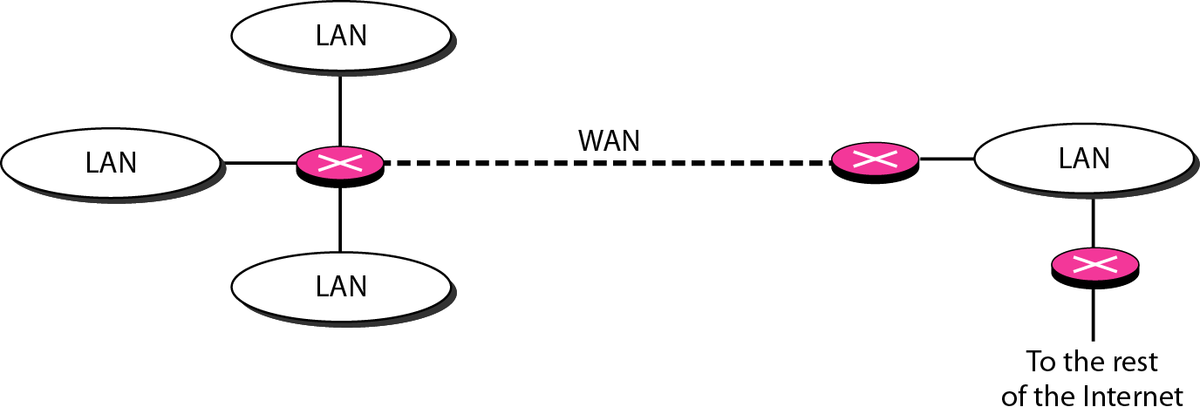
Routers
Figure : Routers connecting independent LANs and WANs
25
Notes:
Data Communication

Slide 26
Three-Layer Switches
A three-layer switch is a router, but a faster and more sophisticated.
The switching fabric in a three-layer switch allows faster table lookup and forwarding.
we use the terms router and three-layer switch interchangeably
26
Notes:
Data Communication

Slide 27
Gateway
Although some textbooks use the terms gateway and router interchangeably, most of the literature distinguishes between the two.
A gateway is normally a computer that operates in all five layers of the Internet or seven layers of OSI model.
A gateway takes an application message, reads it, and interprets it.
This means that it can be used as a connecting device between two internetworks that use different models.
27
Notes:
Data Communication

Slide 28
Gateway
For example, a network designed to use the OSI model can be connected to another network using the Internet model.
The gateway connecting the two systems can take a frame as it arrives from the first system, move it up to the OSI application layer, and remove the message.
Gateways can provide security.
The gateway is used to filter unwanted application-layer messages.
28
Notes:
Data Communication

Slide 29
VIRTUAL LANs
A station is considered part of a LAN if it physically belongs to that LAN.
The criterion of membership is geographic.
What happens if we need a virtual connection between two stations belonging to two different physical LANs?
We can roughly define a virtual local area network (VLAN) as a local area network configured by software, not by physical wiring.
29
Notes:
Data Communication

Slide 30
VIRTUAL LANs
Let us use an example to elaborate on this definition.
Figure shows a switched LAN in an engineering firm in which 10 stations are grouped into three LANs that are connected by a switch.
The first four engineers work together as the first group, the next three engineers work together as the second group, and the last three engineers work together as the third group.
The LAN is configured to allow this arrangement.
30
Notes:
Data Communication

Slide 31
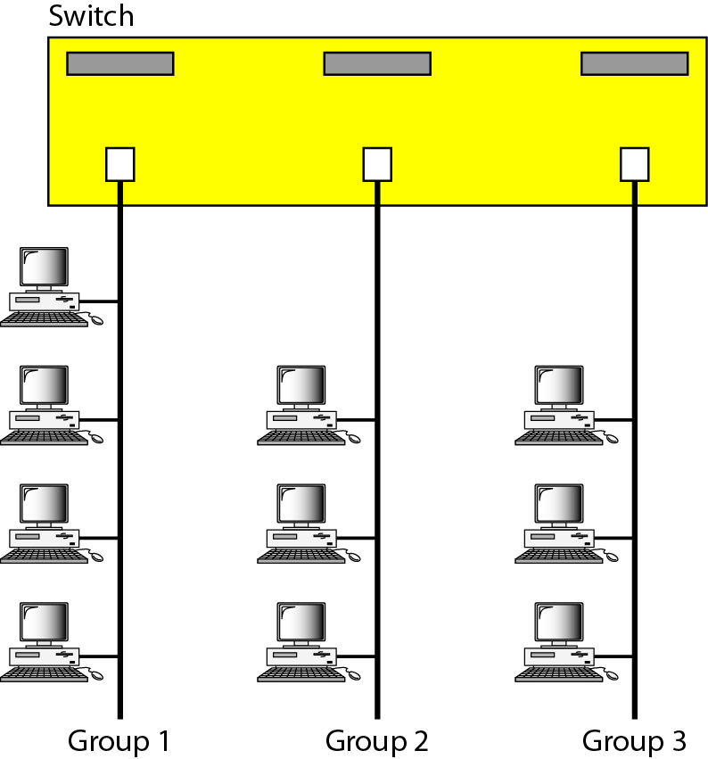
VIRTUAL LANs
31
Notes:
Data Communication

Slide 32
VIRTUAL LANs
But what would happen if the administrators needed to move two engineers from the first group to the third group, to speed up the project being done by the third group?
The LAN configuration would need to be changed.
The network technician must rewire.
The problem is repeated if, in another week, the two engineers move back to their previous group.
In a switched LAN, changes in the work group mean physical changes in the network configuration.
32
Notes:
Data Communication

Slide 33
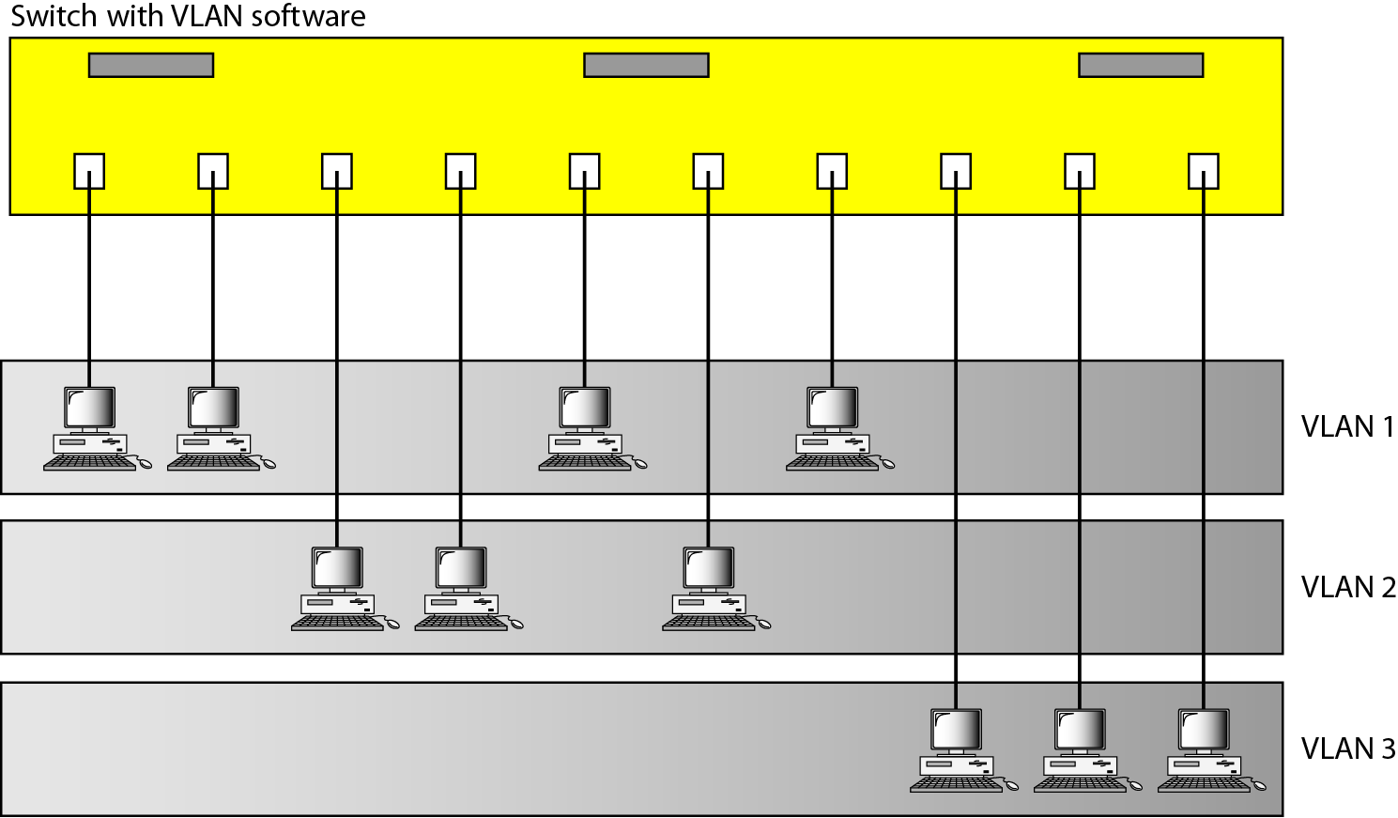
VIRTUAL LANs
Figure shows the same switched LAN divided into VLANs.
33
Notes:
Data Communication

Slide 34
VIRTUAL LANs
The whole idea of VLAN technology is to divide a LAN into logical, instead of physical, segments.
A LAN can be divided into several logical LANs called VLANs.
Each VLAN is a work group in the organization.
If a person moves from one group to another, there is no need to change the physical configuration.
The group membership in VLANs is defined by software, not hardware.
Any station can be logically moved to another VLAN.
All members belonging to a VLAN can receive broadcast messages sent to that particular VLAN.
34
Notes:
Data Communication

Slide 35
VIRTUAL LANs
This means if a station moves from VLAN 1 to VLAN 2, it receives broadcast messages sent to VLAN 2, but no longer receives broadcast messages sent to VLAN 1.
It is obvious that the problem in our previous example can easily be solved by using VLANs.
Moving engineers from one group to another through software is easier than changing the configuration of the physical network.
VLAN technology even allows the grouping of stations connected to different switches in a VLAN.
35
Notes:
Data Communication

Slide 36
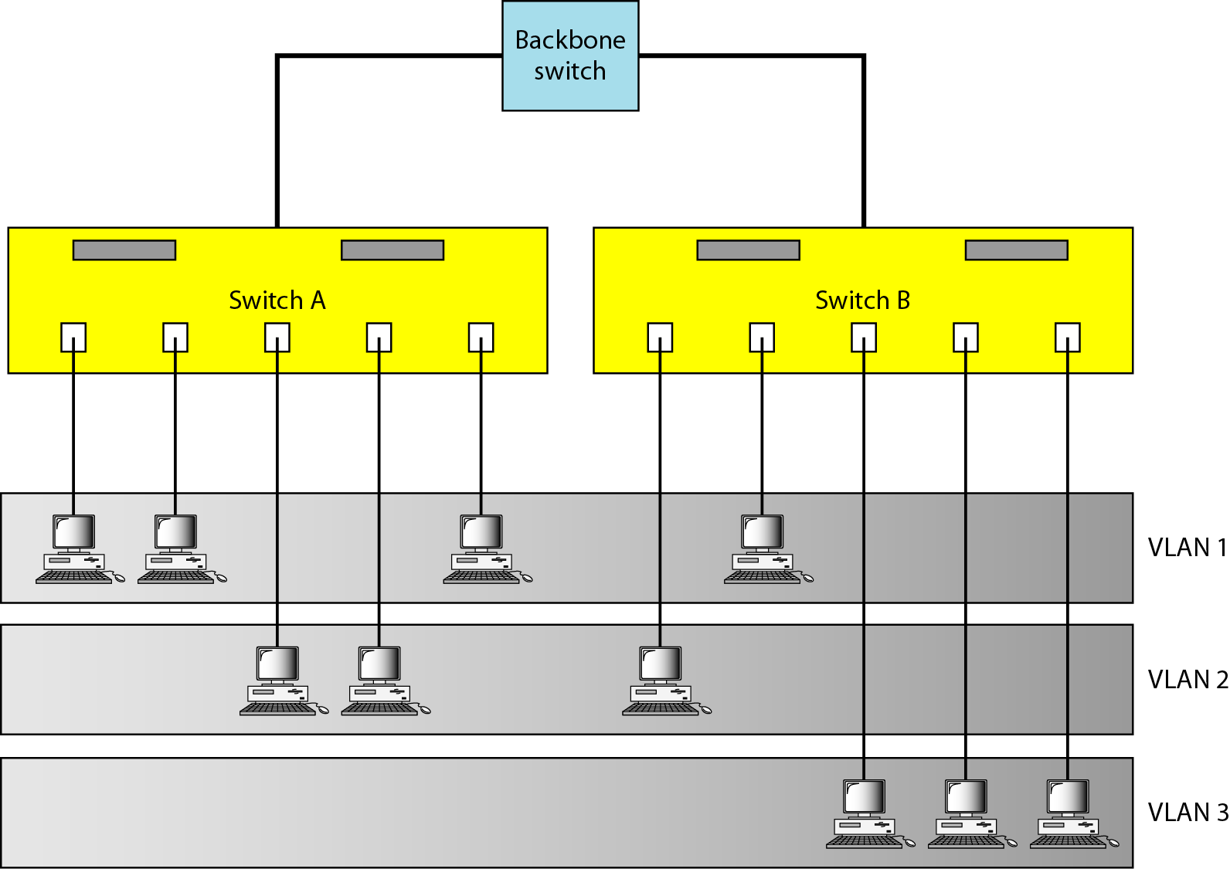
VIRTUAL LANs
Figure shows a backbone local area network with two switches and three VLANs.
Stations from switches A and B belong to each VLAN.
36
Notes:
Data Communication

Slide 37
VIRTUAL LANs
This is a good configuration for a company with two separate buildings.
Each building can have its own switched LAN connected by a backbone.
People in the first building and people in the second building can be in the same work group even though they are connected to different physical LANs
From these three examples, we can define a VLAN characteristic: VLANs group stations belonging to one or more physical LANs into broadcast domains.
The stations in a VLAN communicate with one another as though they belonged to a physical segment.
37
Notes:
Data Communication

Slide 38
VIRTUAL LANs - Membership
What characteristic can be used to group stations in a VLAN?
Vendors use different characteristics such as port numbers, MAC addresses, IP addresses, IP multicast addresses, or a combination of two or more of these.
Port Numbers
Some VLAN vendors use switch port numbers as a membership characteristic.
For example, the administrator can define that stations connecting to ports 1, 2, 3, and 7 belong to VLAN 1; stations connecting to ports 4, 10, and 12 belong to VLAN 2; and so on.
38
Notes:
Data Communication

Slide 39
VIRTUAL LANs - Membership
MAC Addresses
Some VLAN vendors use the 48-bit MAC address as a membership characteristic.
For example, the administrator can stipulate that stations having MAC addresses E21342A12334 and F2A123BCD341belong to VLAN 1.
IP Addresses
Some VLAN vendors use the 32-bit IP address as a membership characteristic.
For example, the administrator can stipulate that stations having IP addresses 181.34.23.67, 181.34.23.72, 181.34.23.98, and 181.34.23.112 belong to VLAN 1.
39
Notes:
Data Communication

Slide 40
VIRTUAL LANs - Membership
Multicast IP Addresses
Some VLAN vendors use the multicast IP address as a membership characteristic.
Multicasting at the IP layer is now translated to multicasting at the data link layer.
Combination
Recently, the software available from some vendors allows all these characteristics to be combined.
The administrator can choose one or more characteristics when installing the software.
In addition, the software can be reconfigured to change the settings.
40
Notes:
Data Communication

Slide 41
VIRTUAL LANs - Configuration
How are the stations grouped into different VLANs?
Stations are configured in one of three ways:
Manual,
Semiautomatic, and
Automatic.
41
Notes:
Data Communication

Slide 42
VLANs – Configuration - Manual
In a manual configuration, the network administrator uses the VLAN software to manually assign the stations into different VLANs at setup.
Later migration from one VLAN to another is also done manually.
Note that this is not a physical configuration; it is a logical configuration.
The term manually here means that the administrator types the port numbers, the IP addresses, or other characteristics, using the VLAN software.
42
Notes:
Data Communication

Slide 43
VLANs – Configuration - Automatic
In an automatic configuration, the stations are automatically connected or disconnected from a VLAN using criteria defined by the administrator.
For example, the administrator can define the project number as the criterion for being a member of a group.
When a user changes the project, he or she automatically migrates to a new VLAN.
43
Notes:
Data Communication

Slide 44
VLANs – Configuration - Semiautomatic
A semiautomatic configuration is somewhere between a manual configuration and an automatic configuration.
Usually, the initializing is done manually, with migrations done automatically
44
Notes:
Data Communication

Slide 45
Communication Between Switches
In a multi-switched backbone, each switch must know not only which station belongs to which VLAN, but also the membership of stations connected to other switches.
For example, in Figure (VLAN), switch A must know the membership status of stations connected to switch B, and switch B must know the same about switch A.
Three methods have been devised for this purpose:
Table maintenance,
Frame tagging, and
Time-division multiplexing.
45
Notes:
Data Communication

Slide 46
Table Maintenance
In this method, when a station sends a broadcast frame to its group members, the switch creates an entry in a table and records station membership.
The switches send their tables to one another periodically for updating.
46
Notes:
Data Communication

Slide 47
Frame Tagging
In this method, when a frame is traveling between switches, an extra header is added to the MAC frame to define the destination VLAN.
The frame tag is used by the receiving switches to determine the VLANs to be receiving the broadcast message.
47
Notes:
Data Communication

Slide 48
Time-Division Multiplexing (TDM)
In this method, the connection (trunk) between switches is divided into timeshared channels
For example, if the total number of VLANs in a backbone is five, each trunk is divided into five channels.
The traffic destined for VLAN 1 travels in channel1, the traffic destined for VLAN 2 travels in channel 2, and so on.
The receiving switch determines the destination VLAN by checking the channel from which the frame arrived.
48
Notes:
Data Communication

Slide 49
VLANs – Advantages
Cost and Time Reduction
VLANs can reduce the migration cost of stations going from one group to another.
Physical reconfiguration takes time and is costly.
Instead of physically moving one station to another segment or even to another switch, it is much easier and quicker to move it by using software.
49
Notes:
Data Communication

Slide 50
VLANs – Advantages
Creating Virtual Work Groups
VLANs can be used to create virtual work groups.
For example, in a campus environment, professors working on the same project can send broadcast messages to one another without the necessity of belonging to the same department.
This can reduce traffic if the multicasting capability of IP was previously used.
50
Notes:
Data Communication

Slide 51
VLANs – Advantages
Security
VLANs provide an extra measure of security.
People belonging to the same group can send broadcast messages with the guaranteed assurance that users in other groups will not receive these messages.
51
Notes:
Data Communication

