Slide 1
Error Detection and Correction
1
Notes:
Data Communication

Slide 2
Introduction
Networks must be able to transfer data from one device to another with acceptable accuracy.
For most applications, a system must guarantee that the data received are identical to the data transmitted.
Any time data are transmitted from one node to the next, they can become corrupted in passage.
Many factors can alter one or more bits of a message.
Some applications require a mechanism for detecting and correcting errors.
2
Notes:
Data Communication

Slide 3
Introduction
Some applications can tolerate a small level of error.
For example, random errors in audio or video transmissions may be tolerable, but when we transfer text, we expect a very high level of accuracy.
3
Notes:
Data Communication

Slide 4
Types of Errors
In a single-bit error, a 0 is changed to a 1 or a 1 to a 0.
In a burst error, multiple bits are changed.
4
Notes:
Data Communication

Slide 5
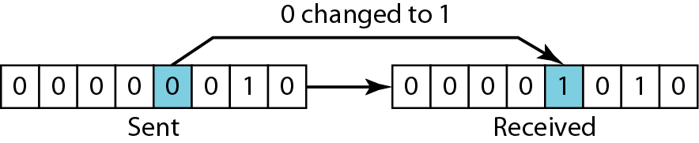
Single-Bit Error
The term single-bit error means that only 1 bit of a given data unit is changed from 1 to 0 or from 0 to 1
Figure shows the effect of a single-bit error on a data unit.
To understand the impact of the change, imagine that each group of 8 bits is an ASCII character
5
Notes:
Data Communication

Slide 6
Burst Error
The term burst error means that 2 or more bits in the data unit have changed from 1 to 0 or from 0 to 1.
Figure shows the effect of a burst error on a data unit.
In this case, 0100010001000011 was sent, but 0101110101100011 was received.
Note that a burst error does not necessarily mean that the errors occur in consecutive bits.
The length of the burst is measured from the first corrupted bit to the last corrupted bit.
Some bits in between may not have been corrupted.
6
Notes:
Data Communication

Slide 7
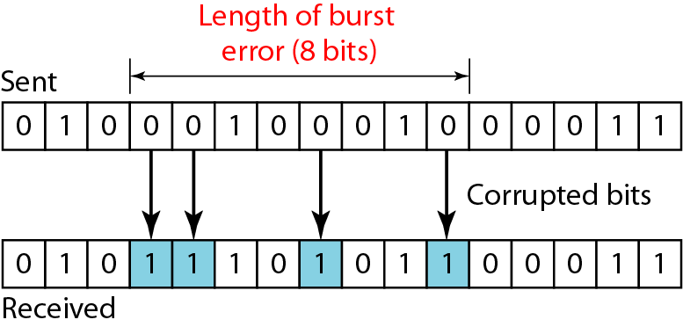
Burst Error
7
Notes:
Data Communication

Slide 8
Burst Error
A burst error is more likely to occur than a single-bit error.
The duration of noise is normally longer than the duration of 1 bit, which means that when noise affects data, it affects a set of bits.
The number of bits affected depends on the data rate and duration of noise.
8
Notes:
Data Communication

Slide 9
Redundancy
The central concept in detecting or correcting errors is redundancy.
To be able to detect or correct errors, we need to send some extra bits with our data.
These redundant bits are added by the sender and removed by the receiver.
Their presence allows the receiver to detect or correct corrupted bits.
9
Notes:
Data Communication

Slide 10
Detection Versus Correction
In error correction, we need to know the exact number of bits that are corrupted and more importantly, their location in the message.
The number of the errors and the size of the message are important factors.
If we need to correct one single error in an 8-bit data unit, we need to consider eight possible error locations; if we need to correct two errors in a data unit of the same size, we need to consider 28 possibilities.
You can imagine the receiver's difficulty in finding 10 errors in a data unit of 1000 bits.
10
Notes:
Data Communication

Slide 11
Forward Error Correction Versus Retransmission
There are two main methods of error correction.
Forward error correction (FEC) is the process in which the receiver tries to guess the message by using redundant bits.
Correction by retransmission is a technique in which the receiver detects the occurrence of an error and asks the sender to resend the message.
Resending is repeated until a message arrives that the receiver believes is error-free
11
Notes:
Data Communication

Slide 12
Coding
Redundancy is achieved through various coding schemes.
The sender adds redundant bits through a process that creates a relationship between the redundant bits and the actual data bits.
The receiver checks the relationships between the two sets of bits to detect or correct the errors.
The ratio of redundant bits to the data bits and the robustness of the process are important factors in any coding scheme.
Figure shows the general idea of coding.
12
Notes:
Data Communication

Slide 13
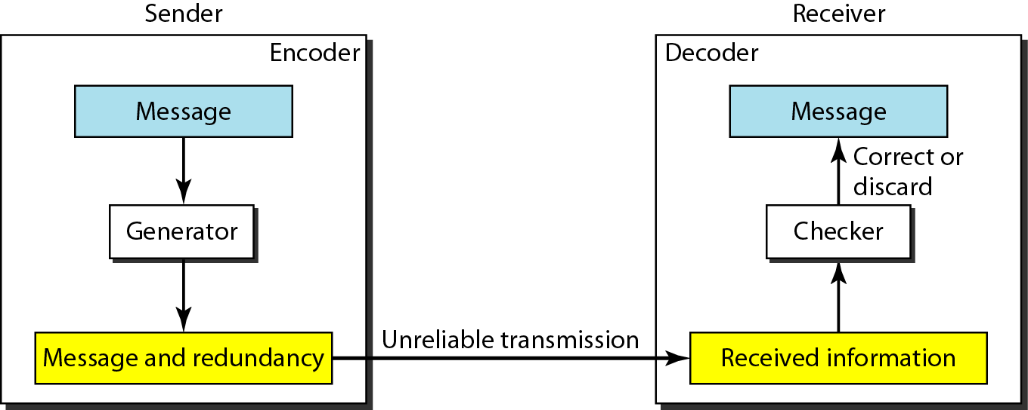
Coding
Figure : The structure of encoder and decoder
13
Notes:
Data Communication

Slide 14
Coding
We can divide coding schemes into two broad categories:
Block coding and
Convolution coding.
we concentrate on block coding; convolution coding is more complex and beyond the scope
14
Notes:
Data Communication

Slide 15
Modular Arithmetic – Modulo-2 Arithmetic
In this arithmetic, the modulus N is 2.
We can use only 0 and 1.
Operations in this arithmetic are very simple.
The following shows how we can add or subtract 2 bits.
Adding:
0+0=0
0+1=1
1+0=1
1+1=0
15
Notes:
Data Communication

Slide 16
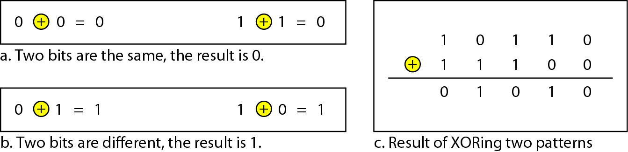
Modular Arithmetic
Subtracting:
0-0=0
0-1=1
1-0=1
1-1=0
Figure : XORing of two single bits or two words
16
Notes:
Data Communication

Slide 17
BLOCK CODING
In block coding, we divide our message into blocks, each of k bits, called datawords.
We add r redundant bits to each block to make the length n = k + r.
The resulting n-bit blocks are called codewords.
How the extra r bits is chosen or calculated is something we will discuss later.
For the moment, it is important to know that we have a set of datawords, each of size k, and a set of codewords, each of size of n.
With k bits, we can create a combination of 2^{k} datawords; with n bits, we can create a combination of 2^{n} codewords.
17
Notes:
Data Communication

Slide 18
BLOCK CODING
Since n > k, the number of possible codewords is larger than the number of possible datawords.
The block coding process is one-to-one; the same dataword is always encoded as the same codeword.
This means that we have 2^{n} - 2^{k} codewords that are not used.
We call these codewords invalid or illegal.
Figure shows the situation.
18
Notes:
Data Communication

Slide 19
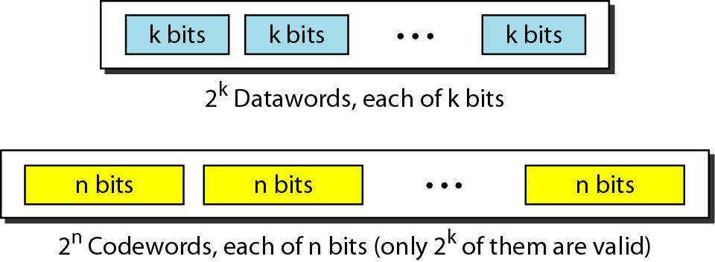
BLOCK CODING
Figure : Datawords and codewords in block coding
19
Notes:
Data Communication

Slide 20
Detection
Error detection uses the concept of redundancy, which means adding extra bits for detecting errors at the destination.
20
Notes:
Data Communication

Slide 21
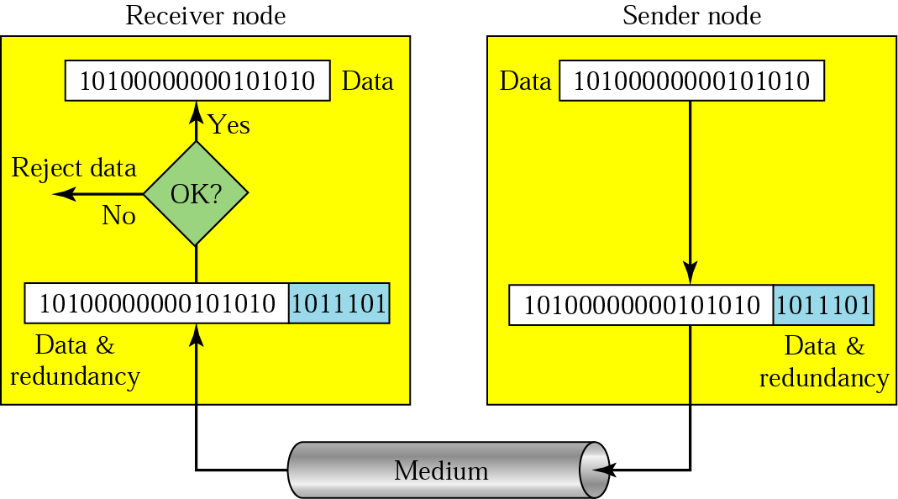
Redundancy
21
Notes:
Data Communication

Slide 22
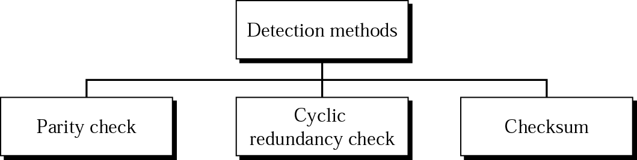
Detection Methods
22
Notes:
Data Communication

Slide 23
Parity Check – Simple parity or 1 D parity check
The most common and least expensive mechanism for error- detection is the simple parity check.
In this technique, a redundant bit called parity bit, is appended to every data unit so that the number of 1s in the unit (including the parity becomes even).
Blocks of data from the source are subjected to a check bit or Parity bit generator form, where a parity of 1 is added to the block if it contains an odd number of 1’s (ON bits) and 0 is added if it contains an even number of 1’s.
At the receiving end the parity bit is computed from the received data bits and compared with the received parity bit, as shown in Fig.
23
Notes:
Data Communication

Slide 24
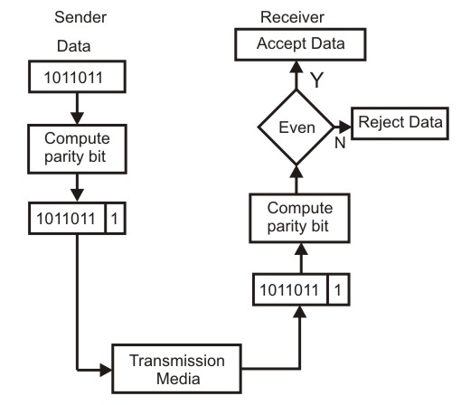
Parity Check – Simple parity or 1 D parity check
24
Notes:
Data Communication

Slide 25
Parity Check – Simple parity or 1 D parity check
This scheme makes the total number of 1’s even, that is why it is called even parity checking.
Considering a 4-bit word, different combinations of the data words and the corresponding code words are given in Table
Note that for the sake of simplicity, we are discussing here the even-parity checking, where the number of 1’s should be an even number.
It is also possible to use odd-parity checking, where the number of 1’s should be odd.
25
Notes:
Data Communication

Slide 26
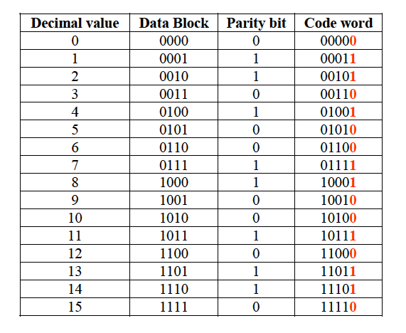
Parity Check – Simple parity or 1 D parity check
26
Notes:
Data Communication

Slide 27
Parity Check – Simple parity or 1 D parity check
Suppose the sender wants to send the word “world”.
In ASCII the five characters are coded as
1110111 (w) 1101111(o) 1110010 (r)
1101100 (l) 1100100 (D)
Each of first 4 characters has an even number of 1’s, so the parity bit is 0. The last character has an odd number of 1’s, so parity bit is 1 to make total number of 1s even
The following shows the actual bits sent
11101110 11011110 11100100 11011000 11001001
27
Notes:
Data Communication

Slide 28
Parity Check – Simple parity or 1 D parity check
Now suppose the word world in Example is received by the receiver without being corrupted in transmission.
11101110 11011110 11100100 11011000 11001001
The receiver counts the 1s in each character and comes up with even numbers (6, 6, 4, 4, 4). The data are accepted.
28
Notes:
Data Communication

Slide 29
Parity Check – Simple parity or 1 D parity check
Now suppose the word world in Example 1 is corrupted during transmission.
11111110 11011110 11101100 11011000 11001001
The receiver counts the 1s in each character and comes up with even and odd numbers (7, 6, 5, 4, 4).
The receiver knows that the data are corrupted, discards them, and asks for retransmission.
29
Notes:
Data Communication

Slide 30
Parity Check – Performance
It can detects all single bit error.
It can also detects bust errors as long as the total number of bits changed is odd (i.e. 1,3,5 etc)
This method can not detects errors where total number bits changed is even
It can detect burst errors only if the total number of errors in each data unit is odd.
30
Notes:
Data Communication

Slide 31
Two-dimension Parity Check
Performance can be improved by using two-dimensional parity check, which organizes the block of bits in the form of a table.
Parity check bits are calculated for each row, which is equivalent to a simple parity check bit.
Parity check bits are also calculated for all columns then both are sent along with the data.
At the receiving end these are compared with the parity bits calculated on the received data.
This is illustrated in Fig.
31
Notes:
Data Communication

Slide 32
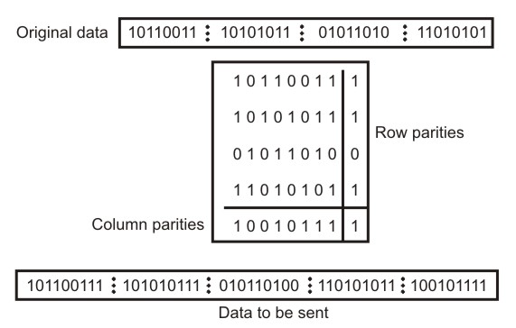
Two-dimension Parity Check
32
Notes:
Data Communication

Slide 33
Two-dimension Parity Check
Suppose the following block is sent:
10101001 00111001 11011101 11100111 10101010 However, it is hit by a burst noise of length 8, and some bits are corrupted.
10100011 10001001 11011101 11100111 10101010
When the receiver checks the parity bits, some of the bits do not follow the even-parity rule and the whole block is discarded.
10100011 10001001 11011101 11100111 10101010
( Parity bits)
33
Notes:
Data Communication

Slide 34
Two-dimension Parity Check
Two- Dimension Parity Checking increases the likelihood of detecting burst errors.
As we have shown in Fig that a 2-D Parity check of n bits can detect a burst error of n bits.
A burst error of more than n bits is also detected by 2-D Parity check with a high-probability.
34
Notes:
Data Communication

Slide 35
Two-dimension Parity Check
Two- Dimension Parity Checking increases the likelihood of detecting burst errors.
As we have shown in Fig that a 2-D Parity check of n bits can detect a burst error of n bits.
A burst error of more than n bits is also detected by 2-D Parity check with a high-probability.
35
Notes:
Data Communication

Slide 36
Two-dimension Parity Check
If two bits in one data unit are damaged and two bits in exactly same position in another data unit are also damaged, the 2-D Parity check checker will not detect an error.
For example, if two data units: 11001100 and 10101100.
If first and second from last bits in each of them is changed, making the data units as 01001110 and 00101110, the error cannot be detected by 2-D Parity check.
36
Notes:
Data Communication

Slide 37
Checksum
The sender follows these steps:
The unit is divided into k sections, each of n bits.
All sections are added using one’s complement to get the sum.
The sum is complemented and becomes the checksum.
The checksum is sent with the data.
37
Notes:
Data Communication

Slide 38
Checksum
The receiver follows these steps:
The unit is divided into k sections, each of n bits.
All sections are added using one’s complement to get the sum.
The sum is complemented.
If the result is zero, the data are accepted: otherwise, rejected.
38
Notes:
Data Communication

Slide 39
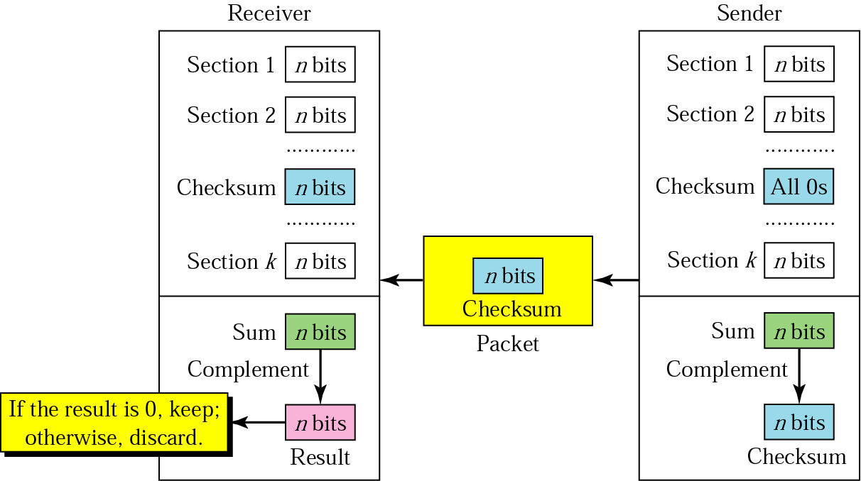
Checksum
39
Notes:
Data Communication

Slide 40
Checksum
Suppose the following block of 16 bits is to be sent using a checksum of 8 bits.
10101001 00111001
The numbers are added using one’s complement
10101001
00111001 ------------ Sum 11100010
Checksum 00011101
The pattern sent is 10101001 00111001 00011101
40
Notes:
Data Communication

Slide 41
Checksum
Now suppose the receiver receives the pattern sent in Example and there is no error.
10101001 00111001 00011101
When the receiver adds the three sections, it will get all 1s, which, after complementing, is all 0s and shows that there is no error.
10101001
00111001
00011101
Sum 11111111
Complement 00000000 means that the pattern is OK.
41
Notes:
Data Communication

Slide 42
Checksum
Now suppose there is a burst error of length 5 that affects 4 bits.
10101111 11111001 00011101
When the receiver adds the three sections, it gets
10101111
11111001
00011101
Partial Sum 1 11000101
Carry 1
Sum 11000110
Complement 00111001 the pattern is corrupted.
42
Notes:
Data Communication

Slide 43
Checksum – Performance
The checksum detects all errors involving an odd number of bits.
It also detects most errors involving even number of bits.
43
Notes:
Data Communication

Slide 44
Cyclic Redundancy Checks (CRC)
CRC is the most powerful and easy to implement technique.
Unlike checksum scheme, which is based on addition, CRC is based on binary division.
In CRC, a sequence of redundant bits, called cyclic redundancy check bits, are appended to the end of data unit so that the resulting data unit becomes exactly divisible by a second, predetermined binary number.
44
Notes:
Data Communication

Slide 45
Cyclic Redundancy Checks (CRC)
At the destination, the incoming data unit is divided by the same number.
If at this step there is no remainder, the data unit is assumed to be correct and is therefore accepted.
A remainder indicates that the data unit has been damaged in transit and therefore must be rejected.
The generalized technique can be explained as follows.
45
Notes:
Data Communication

Slide 46
Cyclic Redundancy Checks (CRC)
If a k bit message is to be transmitted, the transmitter generates an r-bit sequence, known as Frame Check Sequence (FCS) so that the (k+r) bits are actually being transmitted.
Now this r-bit FCS is generated by dividing the original number, appended by r zeros, by a predetermined number.
This number, which is (r+1) bit in length, can also be considered as the coefficients of a polynomial, called Generator Polynomial.
46
Notes:
Data Communication

Slide 47
Cyclic Redundancy Checks (CRC)
The remainder of this division process generates the r-bit FCS.
On receiving the packet, the receiver divides the (k+r) bit frame by the same predetermined number and if it produces no remainder, it can be assumed that no error has occurred during the transmission.
Operations at both the sender and receiver end are shown in Fig.
47
Notes:
Data Communication

Slide 48
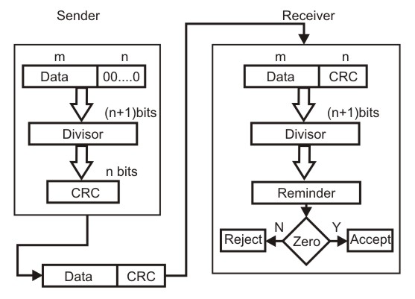
Cyclic Redundancy Checks (CRC)
48
Notes:
Data Communication

Slide 49
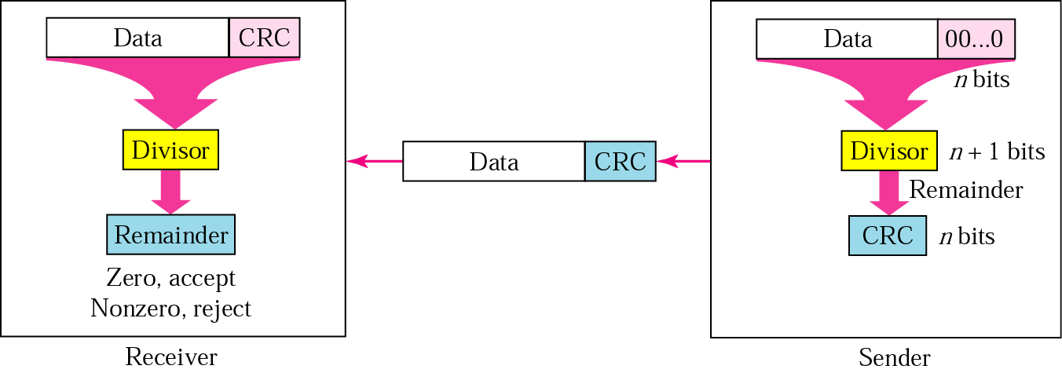
Cyclic Redundancy Checks (CRC)
49
Notes:
Data Communication

Slide 50
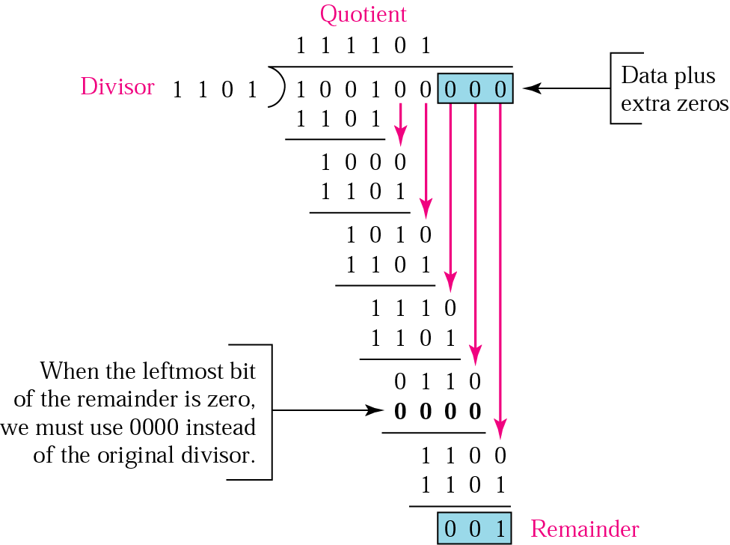
Binary division in a CRC generator
50
Notes:
Data Communication

Slide 51
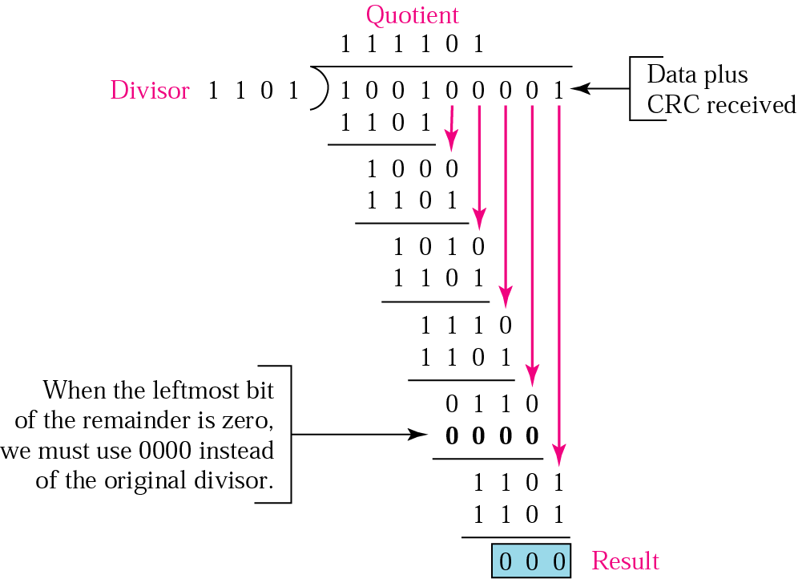
Binary division in CRC checker
51
Notes:
Data Communication

Slide 52
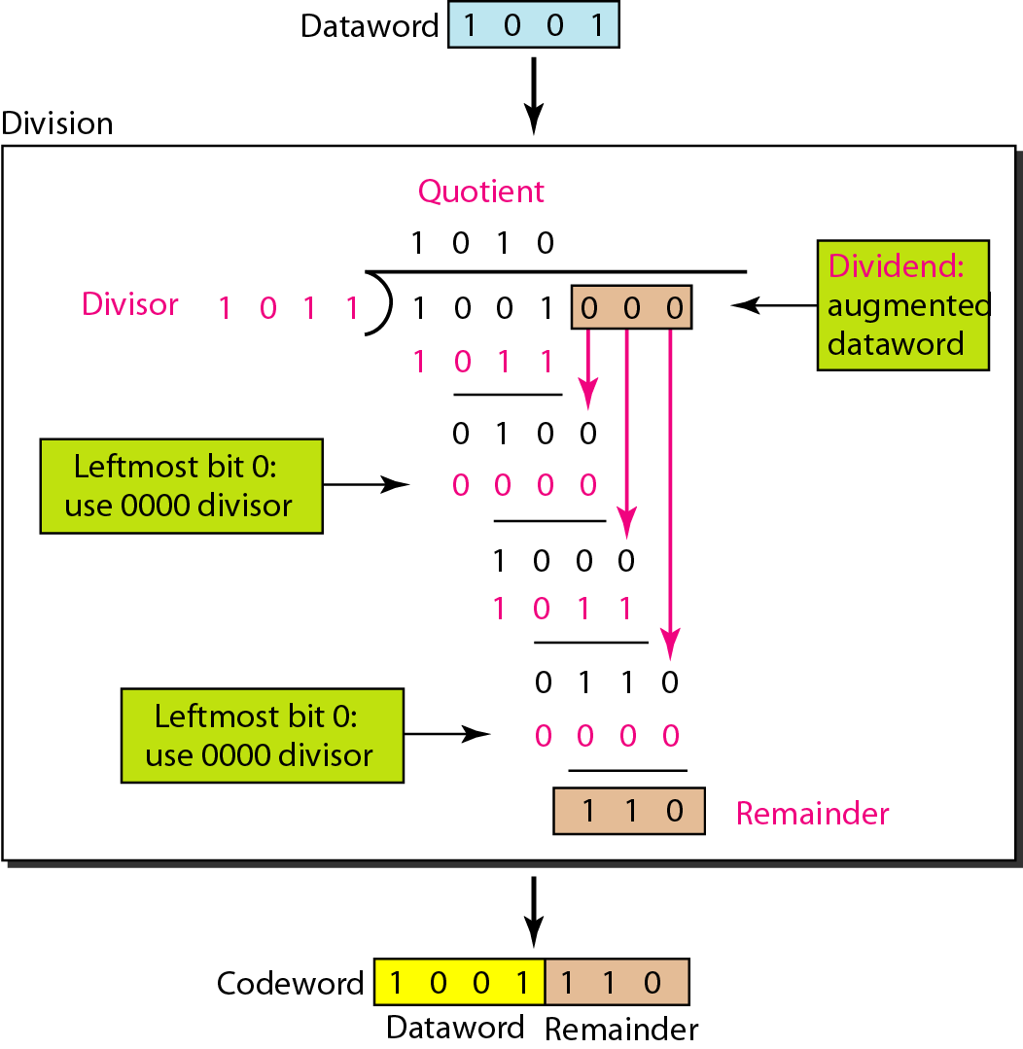
Binary division in CRC Generator
52
Notes:
Data Communication

Slide 53
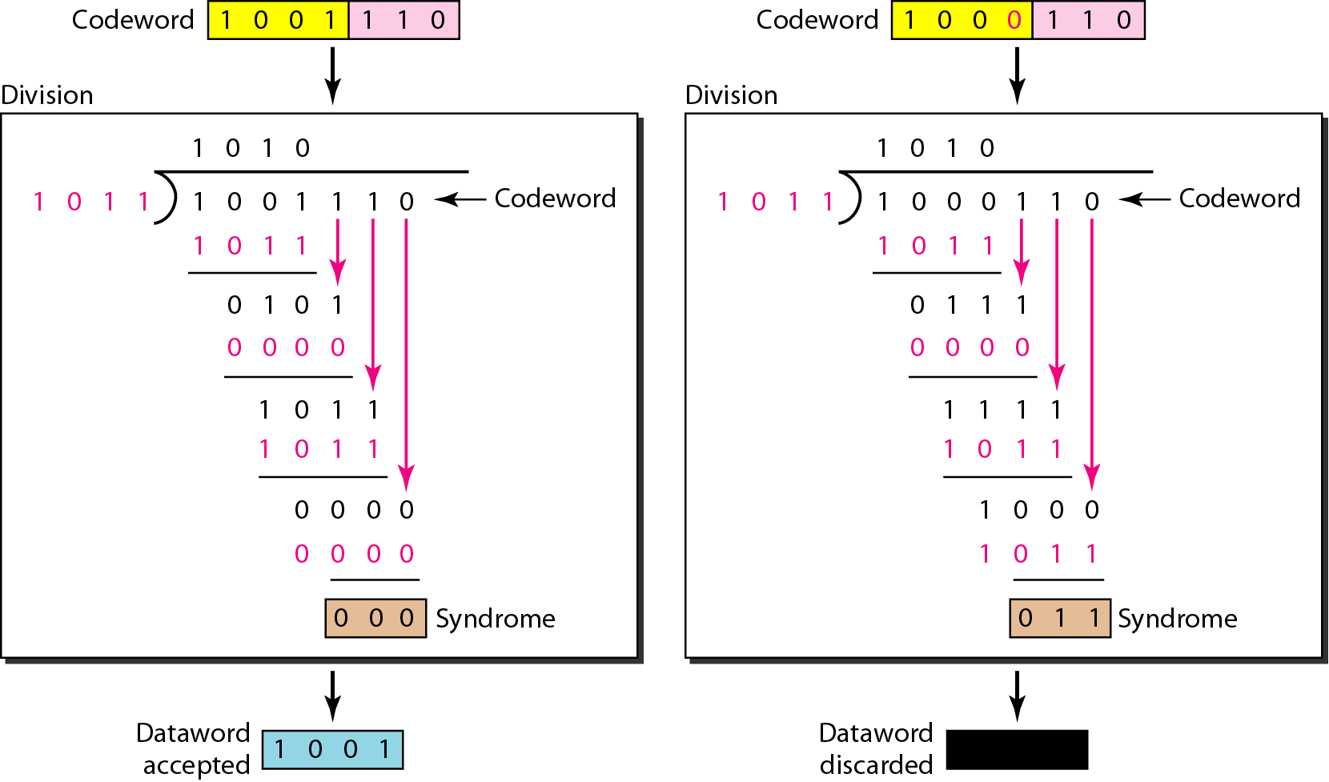
Division in the CRC decoder for two cases
53
Notes:
Data Communication

Slide 54
Polynomials
A better way to understand cyclic codes and how they can be analyzed is to represent them as polynomials.
A pattern of 0s and 1s can be represented as a polynomial with coefficients of 0 and 1.
The power of each term shows the position of the bit; the coefficient shows the value of the bit.
Figure shows a binary pattern and its polynomial representation.
In Figure ( 1st ) we show how to translate a binary pattern to a polynomial; in Figure (2nd) we show how the polynomial can be shortened by removing all terms with zero coefficients and replacing x¹ by x and x⁰ by 1.
54
Notes:
Data Communication

Slide 55
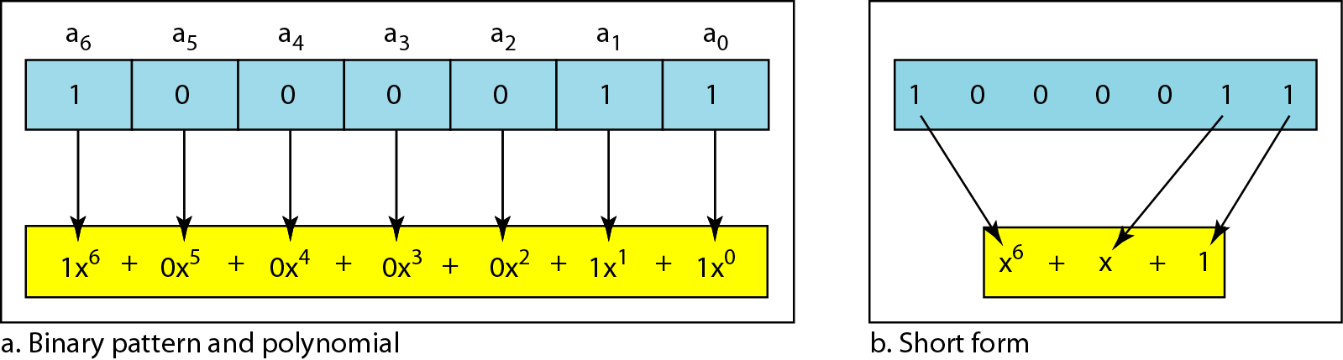
Polynomials
55
Notes:
Data Communication

Slide 56
Polynomials
Figure ( b ) shows one immediate benefit; a 7-bit pattern can be replaced by three terms.
The benefit is even more conspicuous when we have a polynomial such as x23 + X3 + 1. Here the bit pattern is 24 bits in length (three Is and twenty-one Os) while the polynomial is just three terms
56
Notes:
Data Communication

Slide 57
Polynomials
Figure ( b ) shows one immediate benefit; a 7-bit pattern can be replaced by three terms.
The benefit is even more conspicuous when we have a polynomial such as x23 + X3 + 1. Here the bit pattern is 24 bits in length (three Is and twenty-one Os) while the polynomial is just three terms
57
Notes:
Data Communication

Slide 58
Degree of Polynomials
The degree of a polynomial is the highest power in the polynomial.
For example, the degree of the polynomial x6 + x + 1 is 6.
Note that the degree of a polynomial is 1 less that the number of bits in the pattern.
The bit pattern in this case has 7 bits
58
Notes:
Data Communication

Slide 59
Standard Polynomials
59
Notes:
Data Communication

Slide 60
Performance
CRC is a very effective error detection technique.
CRC can detect all single-bit errors
CRC can detect all double-bit errors (three 1’s)
CRC can detect any odd number of errors (X+1)
CRC can detect all burst errors of less than the degree of the polynomial.
CRC detects most of the larger burst errors with a high probability.
For example CRC-12 detects 99.97% of errors with a length 12 or more.
60
Notes:
Data Communication

Slide 61
Error Correction
It can be handled in several ways
The two most common are
Error Correction by Retransmission
Forward Error Correction
61
Notes:
Data Communication

Slide 62
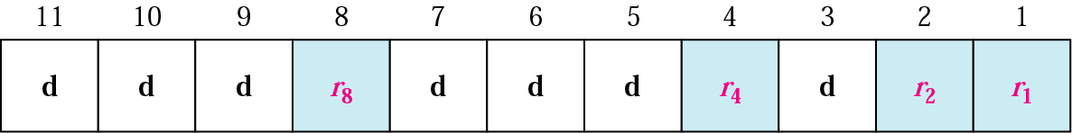
Hamming Code
Hamming provides a practical solution
It can be applied to data units of any length and uses the relationship between data and redundancy bits
For example, a 7-bit ASCII code requires 4 redundancy bits that can be added to the end of the data units
In Figure, these bits are placed in position 1,2,4, and 8
For clarity, we refer to these bits as r1,r2,r4 and r8
Positions of redundancy bits in Hamming code
62
Notes:
Data Communication

Slide 63
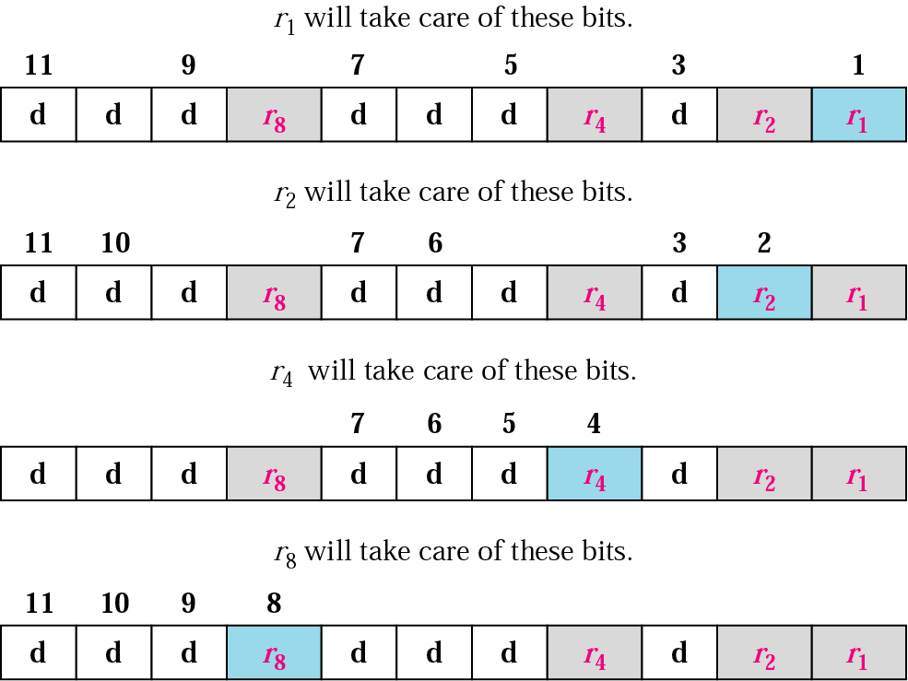
Hamming Code – Redundancy bits calculation
63
Notes:
Data Communication

Slide 64
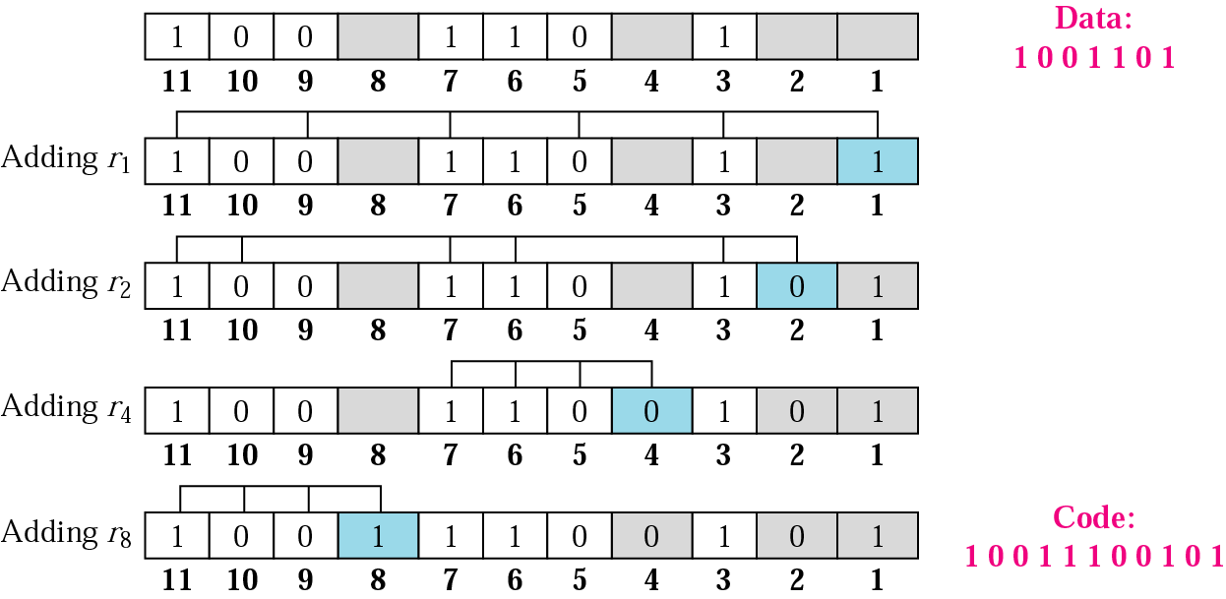
Hamming Code – Example of Redundancy bits calculation Odd -1 and even 0
64
Notes:
Data Communication

Slide 65
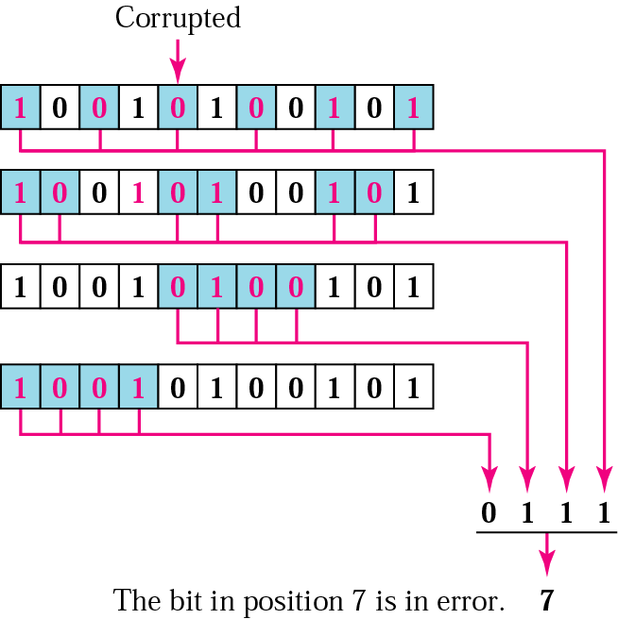
Hamming Code – Example of Redundancy bits calculation Odd -1 and even 0
65
Notes:
Data Communication

