Slide 1
MULTIPLE ACCESS
1
Notes:
Data Communication

Slide 2
Introduction
When nodes or stations are connected and use a common link, called a multipoint or broadcast link, we need a multiple-access protocol to coordinate access to the link.
The problem of controlling the access to the medium is similar to the rules of speaking in an assembly.
The procedures guarantee that the right to speak is upheld and ensure that two people do not speak at the same time, do not interrupt each other, do not monopolize the discussion, and so on.
2
Notes:
Data Communication

Slide 3
Introduction
The situation is similar for multipoint networks.
Many formal protocols have been devised to handle access to a shared link.
We categorize them into three groups.
Protocols belonging to each group are shown in Figure
3
Notes:
Data Communication

Slide 4
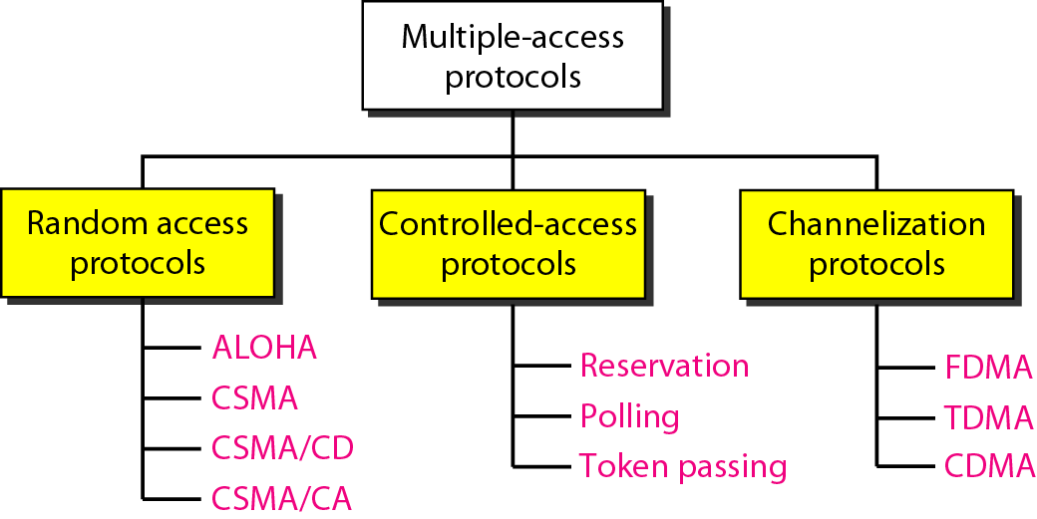
Introduction
4
Notes:
Data Communication

Slide 5
RANDOM ACCESS
In random access or contention methods, no station is superior to another station and none is assigned the control over another.
No station permits, or does not permit, another station to send.
At each instance, a station that has data to send uses a procedure defined by the protocol to make a decision on whether or not to send.
This decision depends on the state of the medium (idle or busy).
5
Notes:
Data Communication

Slide 6
RANDOM ACCESS
Each station can transmit when it desires on the condition that it follows the predefined procedure, including the testing of the state of the medium.
Two features give this method its name.
First, there is no scheduled time for a station to transmit.
Transmission is random among the stations.
That is why these methods are called random access.
Second, no rules specify which station should send next.
Stations compete with one another to access the medium.
That is why these methods are also called contention methods.
6
Notes:
Data Communication

Slide 7
RANDOM ACCESS
In a random access method, each station has the right to the medium without being controlled by any other station.
However, if more than one station tries to send, there is an access conflict-collision-and the frames will be either destroyed or modified.
To avoid access conflict or to resolve it when it happens, each station follows a procedure that answers the following questions:
7
Notes:
Data Communication

Slide 8
RANDOM ACCESS
When can the station access the medium?
What can the station do if the medium is busy?
How can the station determine the success or failure of the transmission?
What can the station do if there is an access conflict?
The random access methods we study in this chapter have evolved from a very interesting protocol known as ALOHA, which used a very simple procedure called multiple access (MA).
8
Notes:
Data Communication

Slide 9
RANDOM ACCESS
The method was improved with the addition of a procedure that forces the station to sense the medium before transmitting. This was called carrier sense multiple access.
This method later evolved into two parallel methods: carrier sense multiple access with collision detection (CSMA/CD) and carrier sense multiple access with collision avoidance (CSMA/CA).
CSMA/CD tells the station what to do when a collision is detected.
CSMA/CA tries to avoid the collision.
9
Notes:
Data Communication

Slide 10
ALOHA
ALOHA, the earliest random access method, was developed at the University of Hawaii in early 1970.
It was designed for a radio (wireless) LAN, but it can be used on any shared medium.
It is obvious that there are potential collisions in this arrangement.
The medium is shared between the stations.
When a station sends data, another station may attempt to do so at the same time.
The data from the two stations collide and become garbled.
10
Notes:
Data Communication

Slide 11
Pure ALOHA
The original ALOHA protocol is called pure ALOHA.
This is a simple, but elegant protocol.
The idea is that each station sends a frame whenever it has a frame to send.
However, since there is only one channel to share, there is the possibility of collision between frames from different stations.
Figure shows an example of frame collisions in pure ALOHA.
11
Notes:
Data Communication

Slide 12
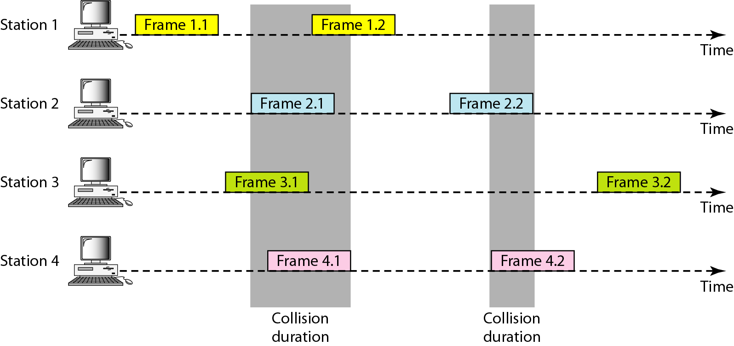
Pure ALOHA
Figure : Frames in a pure ALOHA network
12
Notes:
Data Communication

Slide 13
Pure ALOHA
There are four stations that contend with one another for access to the shared channel.
The figure shows that each station sends two frames; there are a total of eight frames on the shared medium.
Some of these frames collide because multiple frames are in contention for the shared channel.
Figure shows that only two frames survive: frame 1.1 from station 1 and frame 3.2 from station 3.
We need to mention that even if one bit of a frame coexists on the channel with one bit from another frame, there is a collision and both will be destroyed
13
Notes:
Data Communication

Slide 14
Pure ALOHA
It is obvious that we need to resend the frames that have been destroyed during transmission.
The pure ALOHA protocol relies on acknowledgments from the receiver.
When a station sends a frame, it expects the receiver to send an acknowledgment.
If the acknowledgment does not arrive after a time-out period, the station assumes that the frame (or the acknowledgment) has been destroyed and resends the frame.
14
Notes:
Data Communication

Slide 15
Pure ALOHA
A collision involves two or more stations.
If all these stations try to resend their frames after the time-out, the frames will collide again.
Pure ALOHA dictates that when the time-out period passes, each station waits a random amount of time before resending its frame.
The randomness will help avoid more collisions.
We call this time the back-off time T_{B}.
15
Notes:
Data Communication

Slide 16
Pure ALOHA
Pure ALOHA has a second method to prevent congesting the channel with retransmitted frames.
After a maximum number of retransmission attempts K_{max} a station must give up and try later.
Figure shows the procedure for pure ALOHA based on the above strategy.
16
Notes:
Data Communication

Slide 17
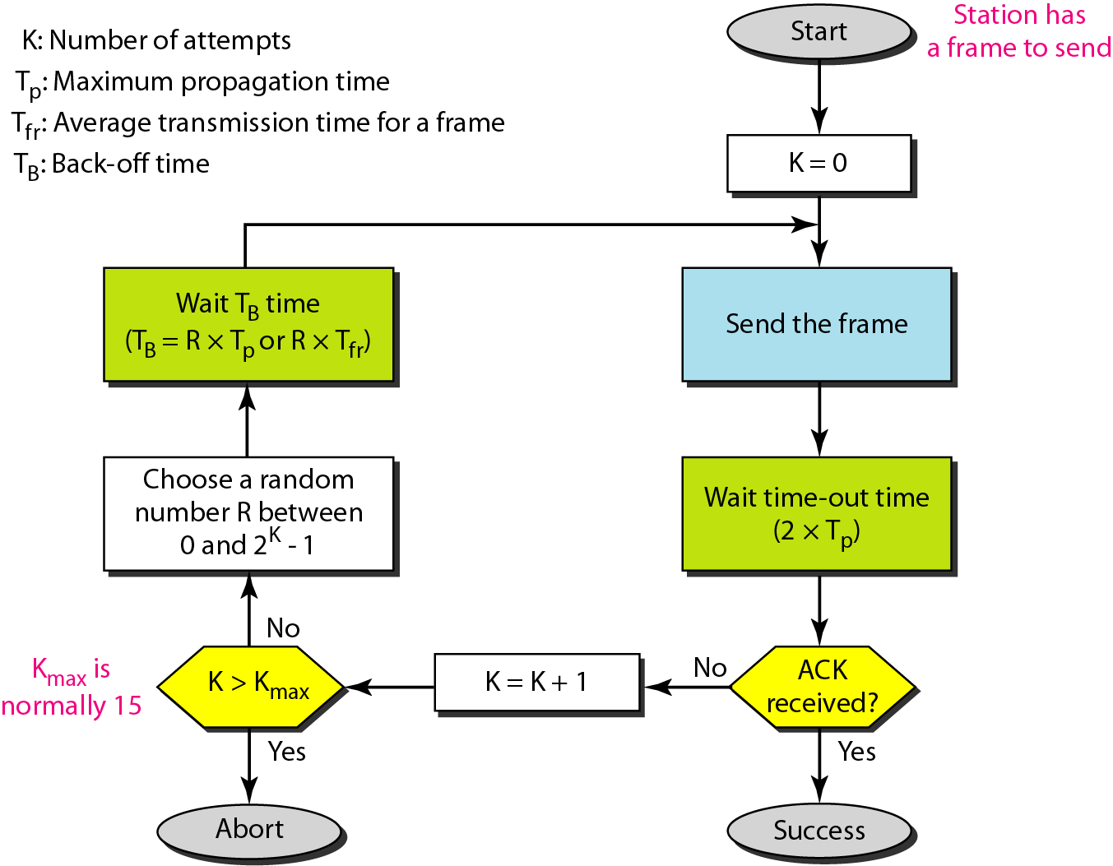
Pure ALOHA - Procedure for pure ALOHA protocol
17
Notes:
Data Communication

Slide 18
Pure ALOHA
The time-out period is equal to the maximum possible round-trip propagation delay, which is twice the amount of time required to send a frame between the two most widely separated stations (2 x Tp)
The back-off time TB is a random value that normally depends on K (the number of attempted unsuccessful transmissions).
The formula for T_{B} depends on the implementation.
One common formula is the binary exponential back-off.
18
Notes:
Data Communication

Slide 19
Pure ALOHA
In this method, for each retransmission, a multiplier in the range 0 to 2^{K} - 1 is randomly chosen and multiplied by Tp (maximum propagation time) or T_{fr} (the average time required to send out a frame) to find T_{B}
Note that in this procedure, the range of the random numbers increases after each collision.
The value of K_{max} is usually chosen as 15.
19
Notes:
Data Communication

Slide 20
Pure ALOHA - Vulnerable time
Let us find the length of time, the vulnerable time, in which there is a possibility of collision.
We assume that the stations send fixed-length frames with each frame taking T_{fr} to send.
Figure shows the vulnerable time for station A.
20
Notes:
Data Communication

Slide 21
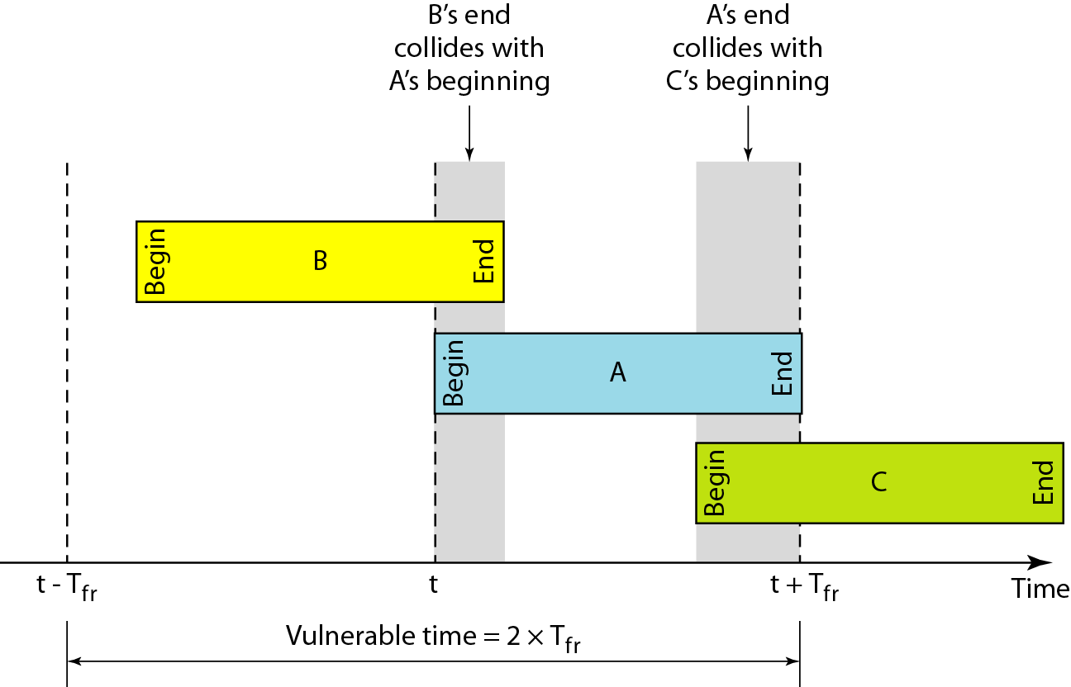
Pure ALOHA - Vulnerable time
21
Notes:
Data Communication

Slide 22
Pure ALOHA - Vulnerable time
Station A sends a frame at time t.
Now imagine station B has already sent a frame between t - T_{fr} and t.
This leads to a collision between the frames from station A and station B.
The end of B's frame collides with the beginning of A's frame.
On the other hand, suppose that station C sends a frame between t and t + T_{fr} .
Here, there is a collision between frames from station A and station C. The beginning of C's frame collides with the end of A's frame.
22
Notes:
Data Communication

Slide 23
Pure ALOHA - Vulnerable time
Looking at Figure, we see that the vulnerable time, during which a collision may occur in pure ALOHA, is 2 times the frame transmission time.
Pure ALOHA vulnerable time = 2 x T_{fr}
23
Notes:
Data Communication

Slide 24
Pure ALOHA - Throughput
Throughput Let us call G the average number of frames generated by the system during one frame transmission time.
Then it can be proved that the average number of successful transmissions for pure ALOHA is
S = G x e-^{2G}.
The maximum throughput Smax is 0.184, for G = 1.
24
Notes:
Data Communication

Slide 25
Slotted ALOHA
Pure ALOHA has a vulnerable time of 2 x Tfr .
This is so because there is no rule that defines when the station can send.
A station may send soon after another station has started or soon before another station has finished.
Slotted ALOHA was invented to improve the efficiency of pure ALOHA.
In slotted ALOHA we divide the time into slots of Tfr s and force the station to send only at the beginning of the time slot.
Figure shows an example of frame collisions in slotted ALOHA.
25
Notes:
Data Communication

Slide 26
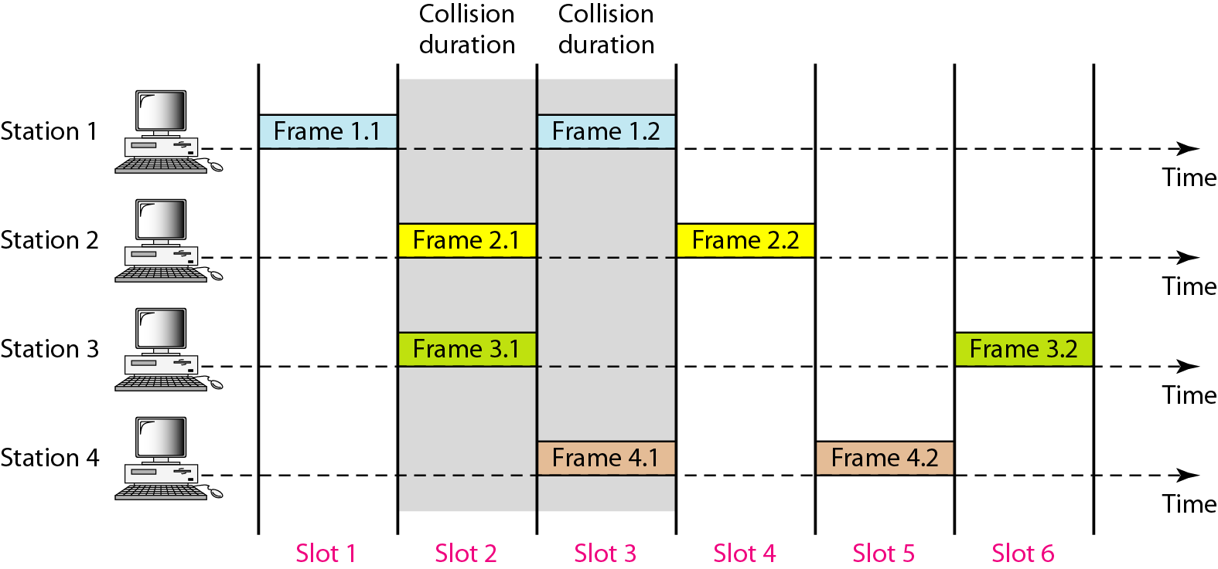
Slotted ALOHA
Frames in a slotted ALOHA network
26
Notes:
Data Communication

Slide 27
Slotted ALOHA
Because a station is allowed to send only at the beginning of the synchronized time slot, if a station misses this moment, it must wait until the beginning of the next time slot.
This means that the station which started at the beginning of this slot has already finished sending its frame.
Of course, there is still the possibility of collision if two stations try to send at the beginning of the same time slot.
However, the vulnerable time is now reduced to one-half, equal to Tfr Figure shows the situation.
27
Notes:
Data Communication

Slide 28
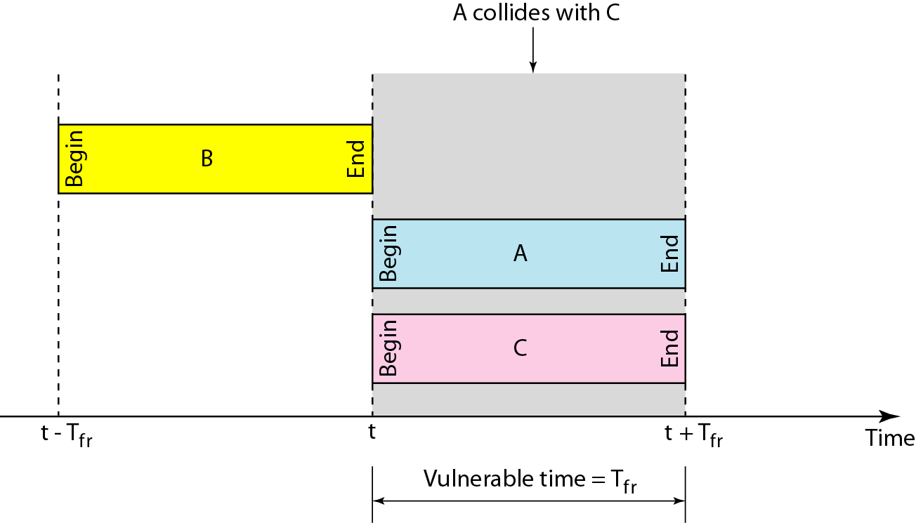
Slotted ALOHA
28
Notes:
Data Communication

Slide 29
Slotted ALOHA - Throughput
It can be proved that the average number of successful transmissions for slotted ALOHA is S = G x e-^{G}.
The maximum throughput Smax is 0.368, when G = 1.
29
Notes:
Data Communication

Slide 30
Carrier Sense Multiple Access (CSMA)
To minimize the chance of collision and, therefore, increase the performance, the CSMA method was developed.
The chance of collision can be reduced if a station senses the medium before trying to use it.
Carrier sense multiple access (CSMA) requires that each station first listen to the medium (or check the state of the medium) before sending.
CSMA is based on the principle "sense before transmit" or "listen before talk."
30
Notes:
Data Communication

Slide 31
Carrier Sense Multiple Access (CSMA)
CSMA can reduce the possibility of collision, but it cannot eliminate it.
The reason for this is shown in Figure, a space and time model of a CSMA network.
Stations are connected to a shared channel (usually a dedicated medium).
The possibility of collision still exists because of propagation delay; when a station sends a frame, it still takes time (although very short) for the first bit to reach every station and for every station to sense it.
31
Notes:
Data Communication

Slide 32
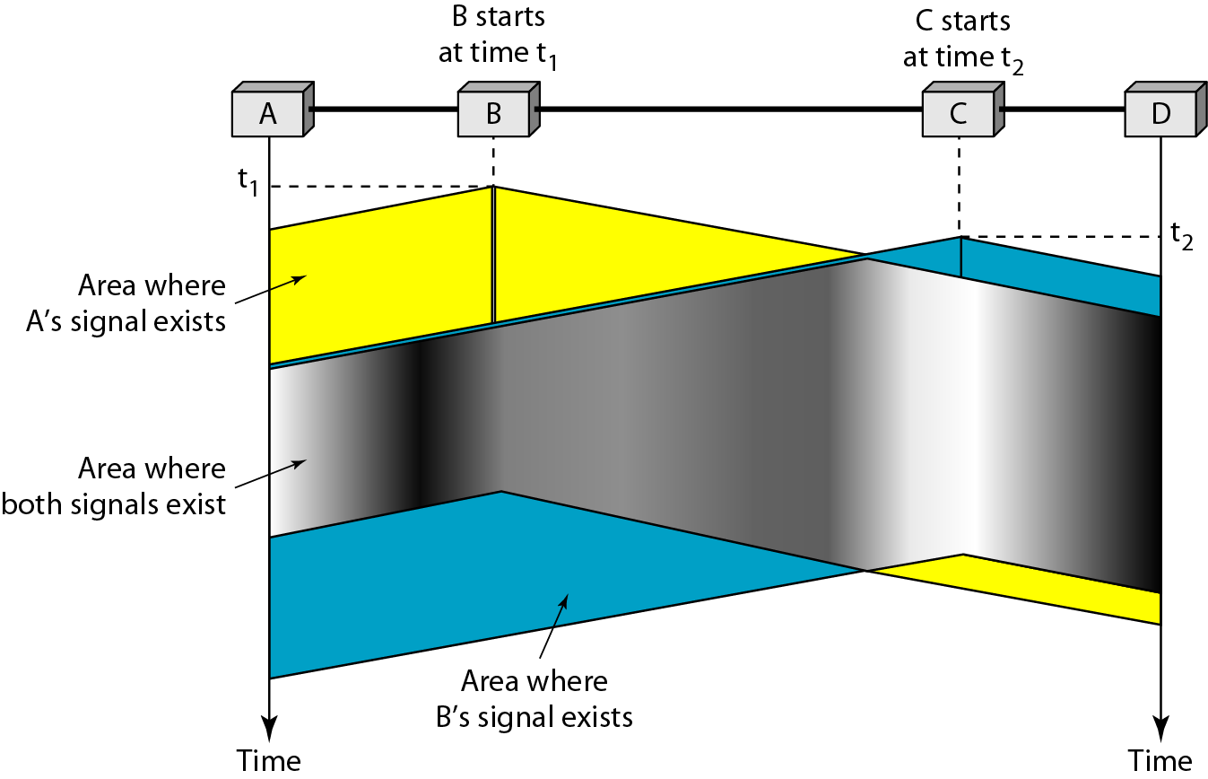
CSMA – Space/time model of collision in CSMA
32
Notes:
Data Communication

Slide 33
Carrier Sense Multiple Access (CSMA)
A station may sense the medium and find it idle, only because the first bit sent by another station has not yet been received.
At time t1 station B senses the medium and finds it idle, so it sends a frame.
At time t2 (t2> t1) station C senses the medium and finds it idle because, at this time, the first bits from station B have not reached station C.
Station C also sends a frame.
The two signals collide and both frames are destroyed.
33
Notes:
Data Communication

Slide 34
CSMA - Vulnerable Time
The vulnerable time for CSMA is the propagation time Tp
This is the time needed for a signal to propagate from one end of the medium to the other.
When a station sends a frame, and any other station tries to send a frame during this time, a collision will result.
But if the first bit of the frame reaches the end of the medium, every station will already have heard the bit and will refrain from sending.
Figure shows the worst case
34
Notes:
Data Communication

Slide 35
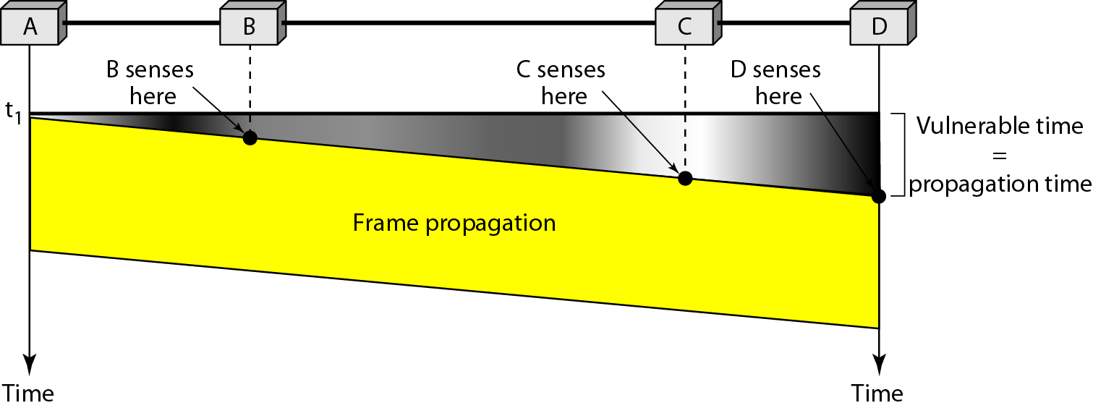
CSMA - Vulnerable Time
The leftmost station A sends a frame at time t1 which reaches the rightmost station D at time t1 + Tp .
The gray area shows the vulnerable area in time and space.
35
Notes:
Data Communication

Slide 36
CSMA - Persistence Methods
What should a station do if the channel is busy?
What should a station do if the channel is idle?
Three methods have been devised to answer these questions:
the 1-persistent method,
the non-persistent method, and
the p-persistent method
The behavior of three persistence methods when a station finds a channel busy.
36
Notes:
Data Communication

Slide 37
CSMA – 1-Persistence Method
Simple and straightforward.
In this method, after the station finds the line idle, it sends its frame immediately (with probability I).
This method has the highest chance of collision because two or more stations may find the line idle and send their frames immediately.
Ethernet uses this method.
37
Notes:
Data Communication

Slide 38
CSMA – Non-Persistence Method
A station that has a frame to send senses the line.
If the line is idle, it sends immediately.
If the line is not idle, it waits a random amount of time and then senses the line again.
The non-persistent approach reduces the chance of collision because it is unlikely that two or more stations will wait the same amount of time and retry to send simultaneously.
However, this method reduces the efficiency of the network because the medium remains idle when there may be stations with frames to send
38
Notes:
Data Communication

Slide 39
CSMA – p-Persistence Method
It is used if the channel has time slots with a slot duration equal to or greater than the maximum propagation time.
The p-persistent approach combines the advantages of the other two strategies.
It reduces the chance of collision and improves efficiency.
In this method, after the station finds the line idle it follows these steps:
With probability p, the station sends its frame.
39
Notes:
Data Communication

Slide 40
CSMA – p-Persistence Method
2. With probability q = 1 - p, the station waits for the beginning of the next time slot and checks the line again.
a. If the line is idle, it goes to step 1.
b. If the line is busy, it acts as though a collision has occurred and uses the back-off procedure.
40
Notes:
Data Communication

Slide 41
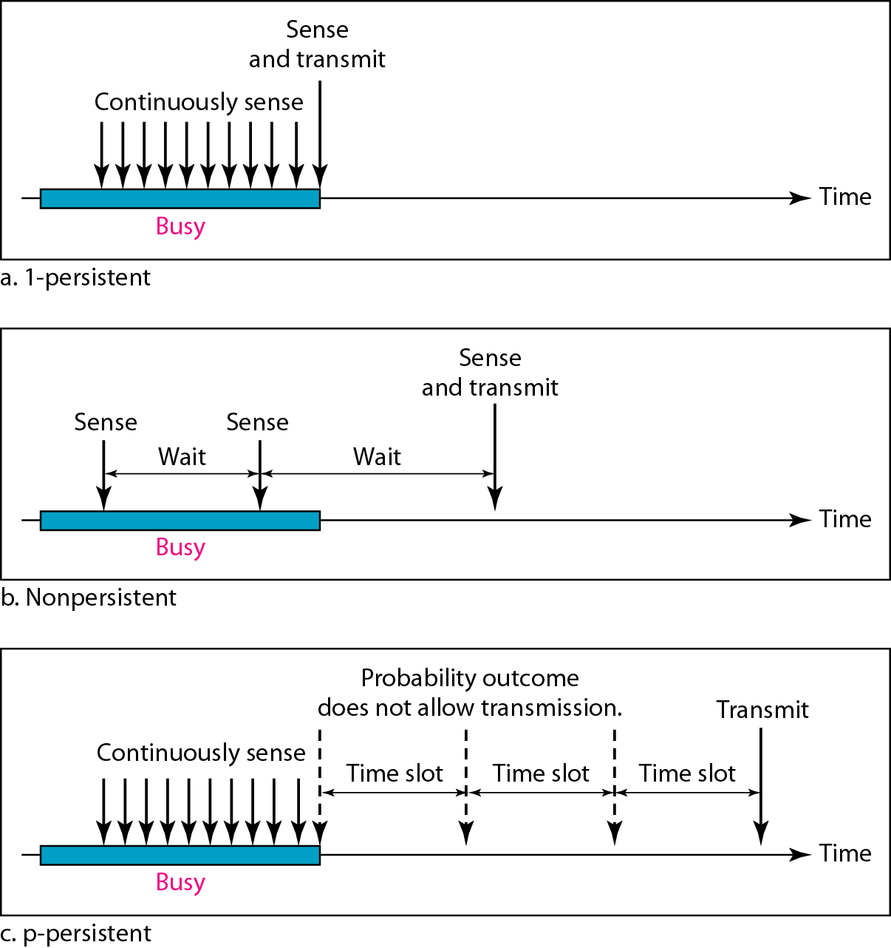
Persistence Methods - Behavior of three persistence methods
41
Notes:
Data Communication

Slide 42
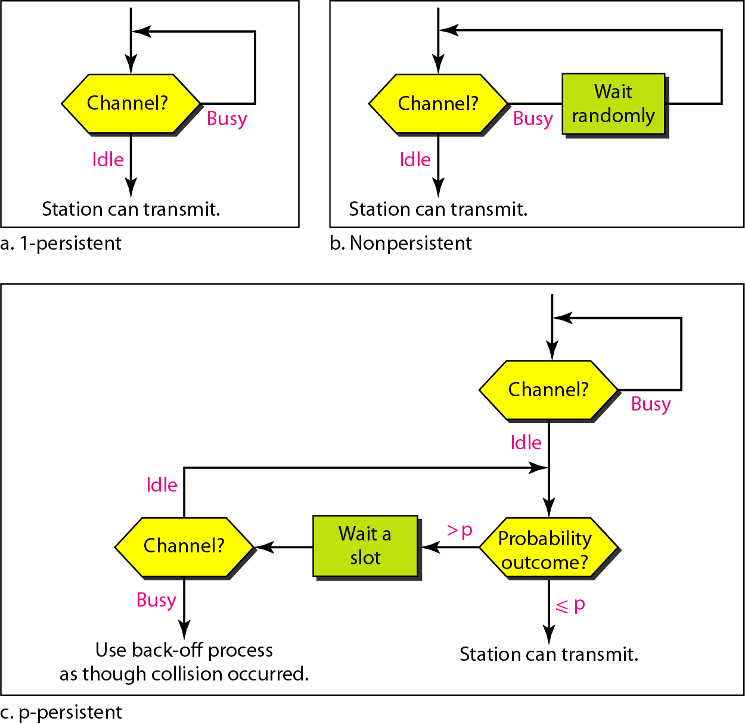
Flow diagram for three persistence methods
42
Notes:
Data Communication

Slide 43
Carrier Sense Multiple Access with Collision Detection (CSMA/CD)
The CSMA method does not specify the procedure following a collision.
CSMA/CD augments the algorithm to handle the collision
In this method, a station monitors the medium after it sends a frame to see if the transmission was successful.
If so, the station is finished. If, however, there is a collision, the frame is sent again
To better understand CSMA/CD, let us look at the first bits transmitted by the two stations involved in the collision.
43
Notes:
Data Communication

Slide 44
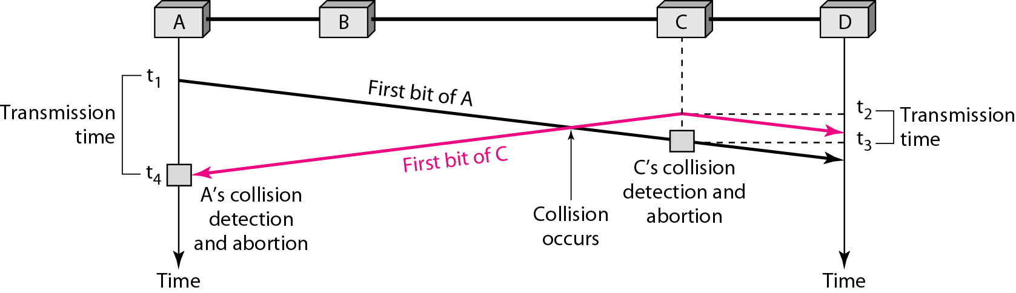
Carrier Sense Multiple Access with Collision Detection (CSMA/CD)
Although each station continues to send bits in the frame until it detects the collision, we show what happens as the first bits collide.
In Figure, stations A and C are involved in the collision.
44
Notes:
Data Communication

Slide 45
CSMA/CD
At time t1, station A has executed its persistence procedure and starts sending the bits of its frame.
At time t2, station C has not yet sensed the first bit sent by A.
Station C executes its persistence procedure and starts sending the bits in its frame, which propagate both to the left and to the right.
The collision occurs sometime after time t2 Station C detects a collision at time t3 when it receives the first bit of A's frame.
Station C immediately (or after a short time, but we assume immediately) aborts transmission.
45
Notes:
Data Communication

Slide 46
CSMA/CD
Station A detects collision at time t4 when it receives the first bit of C's frame; it also immediately aborts transmission.
Looking at the figure, we see that A transmits for the duration t4 – t1; C transmits for the duration t3 - t2
Later we show that, for the protocol to work, the length of any frame divided by the bit rate in this protocol must be more than either of these durations.
At time t4, the transmission of A’s frame, though incomplete, is aborted; at time t3, the transmission of B's frame, though incomplete, is aborted.
46
Notes:
Data Communication

Slide 47
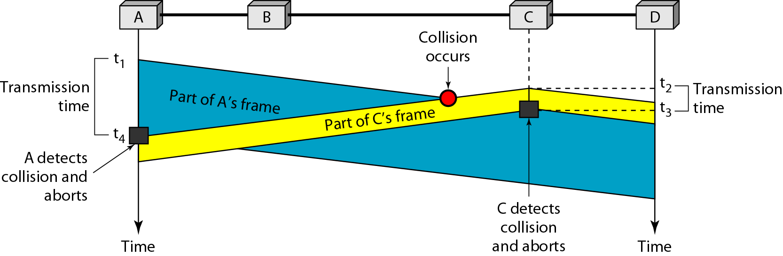
CSMA/CD
We know the time durations for the two transmissions, we can show a more complete graph in Figure
47
Notes:
Data Communication

Slide 48
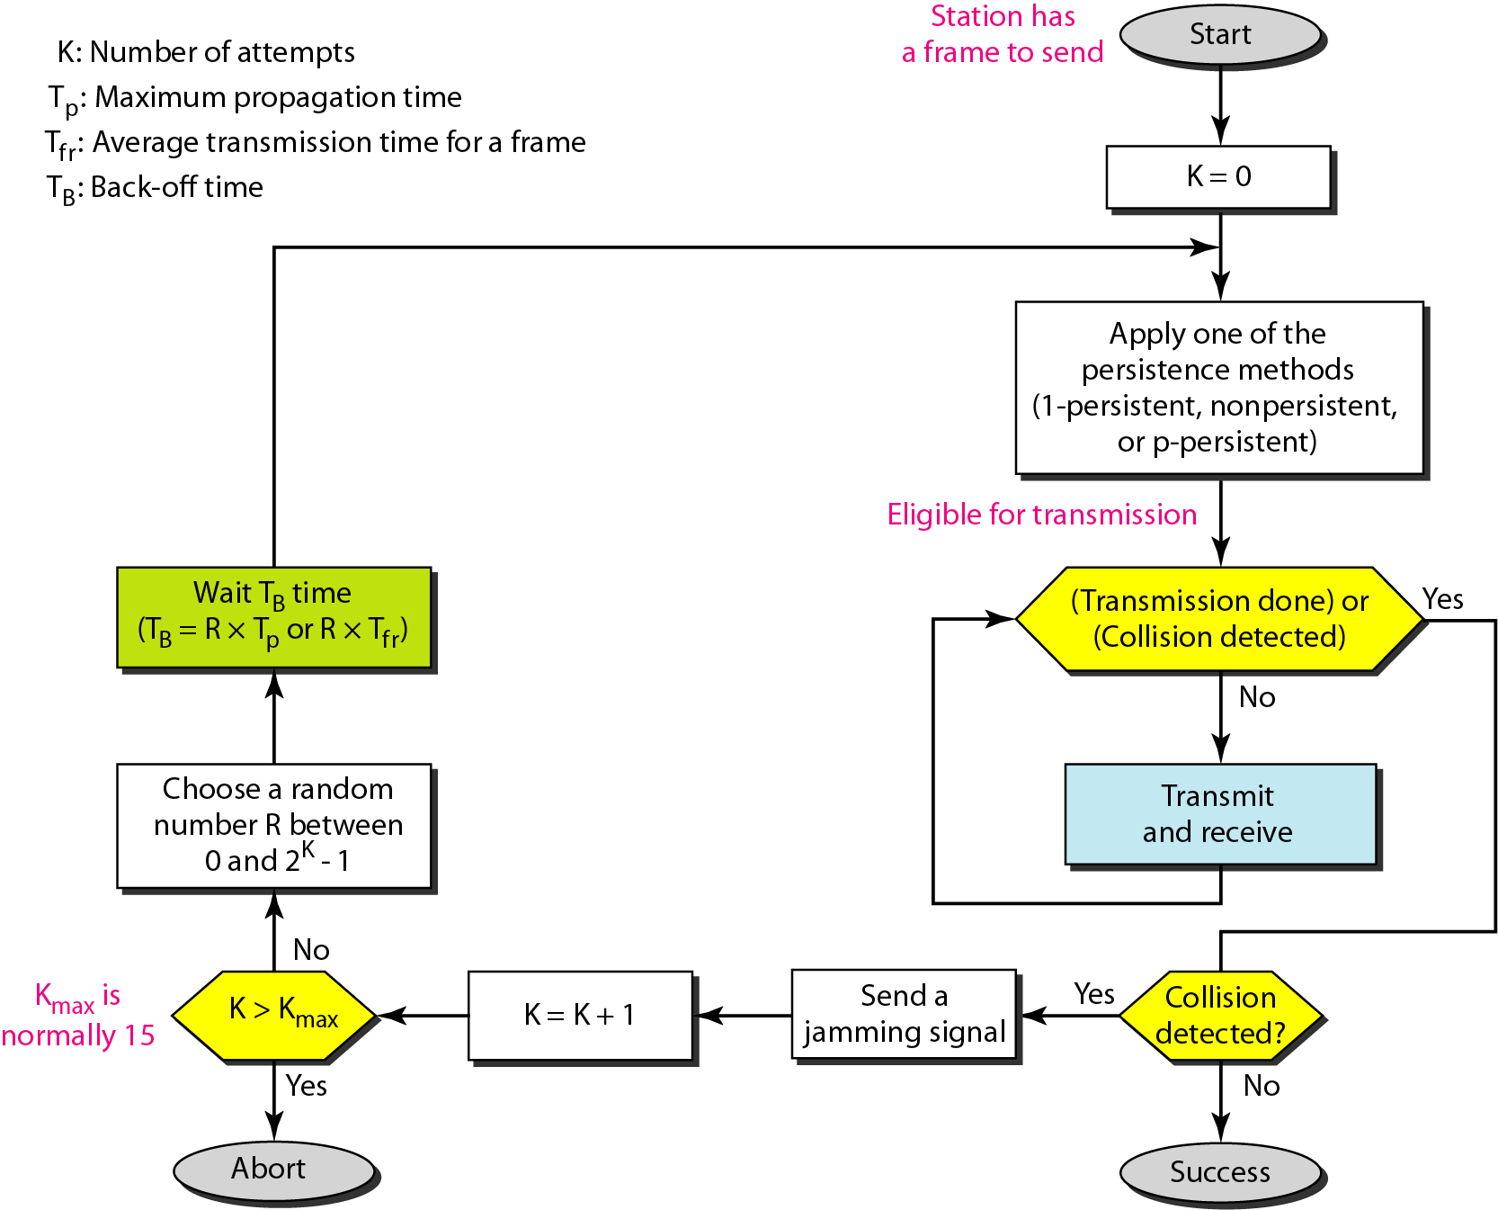
CSMA/CD – Procedure
48
Notes:
Data Communication

Slide 49
CSMA/CD - Procedure
It is similar to the one for the ALOHA protocol, but there are differences.
The first difference is the addition of the persistence process.
We need to sense the channel before we start sending the frame by using one of the persistence processes we discussed previously (non-persistent, 1-persistent, or p-persistent).
The corresponding box can be replaced by one of the persistence processes
49
Notes:
Data Communication

Slide 50
CSMA/CD - Procedure
The second difference is the frame transmission.
In ALOHA, we first transmit the entire frame and then wait for an acknowledgment.
In CSMA/CD, transmission and collision detection is a continuous process.
We do not send the entire frame and then look for a collision.
The station transmits and receives continuously and simultaneously (using two different ports).
We use a loop to show that transmission is a continuous process.
50
Notes:
Data Communication

Slide 51
CSMA/CD - Procedure
We constantly monitor in order to detect one of two conditions: either transmission is finished or a collision is detected.
Either event stops transmission.
When we come out of the loop, if a collision has not been detected, it means that transmission is complete; the entire frame is transmitted.
Otherwise, a collision has occurred.
51
Notes:
Data Communication

Slide 52
CSMA/CD - Procedure
The third difference is the sending of a short jamming signal that enforces the collision in case other stations have not yet sensed the collision.
52
Notes:
Data Communication

Slide 53
CSMA/CD – Energy Level
We can say that the level of energy in a channel can have three values: zero, normal, and abnormal.
At the zero level, the channel is idle.
At the normal level, a station has successfully captured the channel and is sending its frame.
At the abnormal level, there is a collision and the level of the energy is twice the normal level.
A station that has a frame to send or is sending a frame needs to monitor the energy level to determine if the channel is idle, busy, or in collision mode.
Figure shows the situation.
53
Notes:
Data Communication

Slide 54
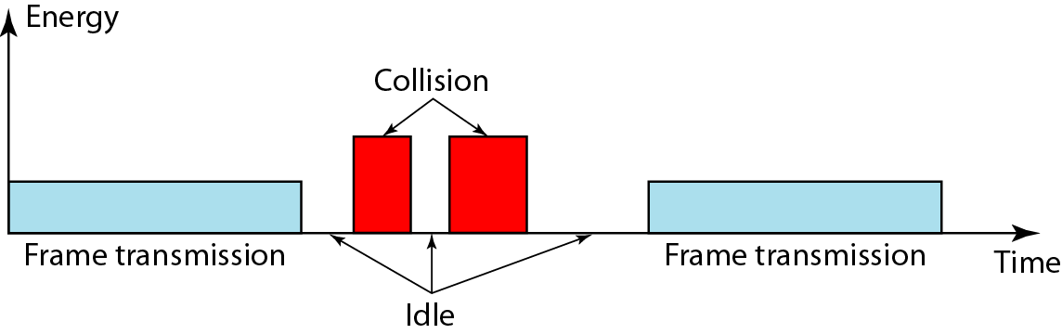
CSMA/CD – Energy Level
54
Notes:
Data Communication

Slide 55
CSMA/CD – Throughput
The throughput of CSMA/CD is greater than that of pure or slotted ALOHA.
The maximum throughput occurs at a different value of G and is based on the persistence method and the value of p in the p-persistent approach.
For 1-persistent method the maximum throughput is around 50% when G =1.
For non-persistent method, the maximum throughput can go up to 90 % when G is between 3 and 8.
55
Notes:
Data Communication

Slide 56
Carrier Sense Multiple Access with Collision Avoidance (CSMA/CA)
In a wireless network, much of the sent energy is lost in transmission.
The received signal has very little energy.
Therefore, a collision may add only 5 to 10 percent additional energy.
This is not useful for effective collision detection.
We need to avoid collisions on wireless networks because they cannot be detected.
Carrier sense multiple access with collision avoidance (CSMA/CA) was invented for this network.
56
Notes:
Data Communication

Slide 57
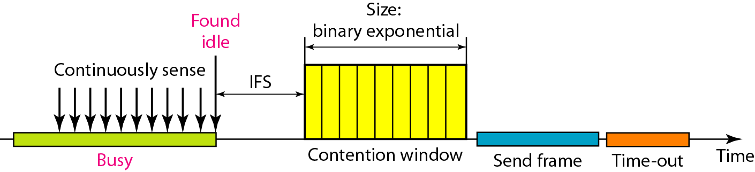
Carrier Sense Multiple Access with Collision Avoidance (CSMA/CA)
Collisions are avoided through the use of CSMA/CA's three strategies: the inter-frame space, the contention window, and acknowledgments, as shown in Figure
Figure : Timing in CSMA/CA
57
Notes:
Data Communication

Slide 58
CSMA/CA - Interframe Space (IFS)
First, collisions are avoided by deferring transmission even if the channel is found idle.
When an idle channel is found, the station does not send immediately.
It waits for a period of time called the interframe space or IFS.
Even though the channel may appear idle when it is sensed, a distant station may have already started transmitting.
The distant station's signal has not yet reached this station.
58
Notes:
Data Communication

Slide 59
CSMA/CA - Interframe Space (IFS)
The IFS time allows the front of the transmitted signal by the distant station to reach this station.
If after the IFS time the channel is still idle, the station can send, but it still needs to wait a time equal to the contention time
The IFS variable can also be used to prioritize stations or frame types.
For example, a station that is assigned a shorter IFS has a higher priority.
59
Notes:
Data Communication

Slide 60
CSMA/CA - Contention Window
The contention window is an amount of time divided into slots.
A station that is ready to send chooses a random number of slots as its wait time.
The number of slots in the window changes according to the binary exponential back-off strategy.
It is set to one slot the first time and then doubles each time the station cannot detect an idle channel after the IFS time.
This is very similar to the p-persistent method except that a random outcome defines the number of slots taken by the waiting station.
60
Notes:
Data Communication

Slide 61
CSMA/CA - Contention Window
The contention window is that the station needs to sense the channel after each time slot.
However, if the station finds the channel busy, it does not restart the process; it just stops the timer and restarts it when the channel is sensed as idle.
This gives priority to the station with the longest waiting time
61
Notes:
Data Communication

Slide 62
CSMA/CA - Acknowledgment
With all these precautions, there still may be a collision resulting in destroyed data.
In addition, the data may be corrupted during the transmission.
The positive acknowledgment and the time-out timer can help guarantee that the receiver has received the frame.
62
Notes:
Data Communication

Slide 63
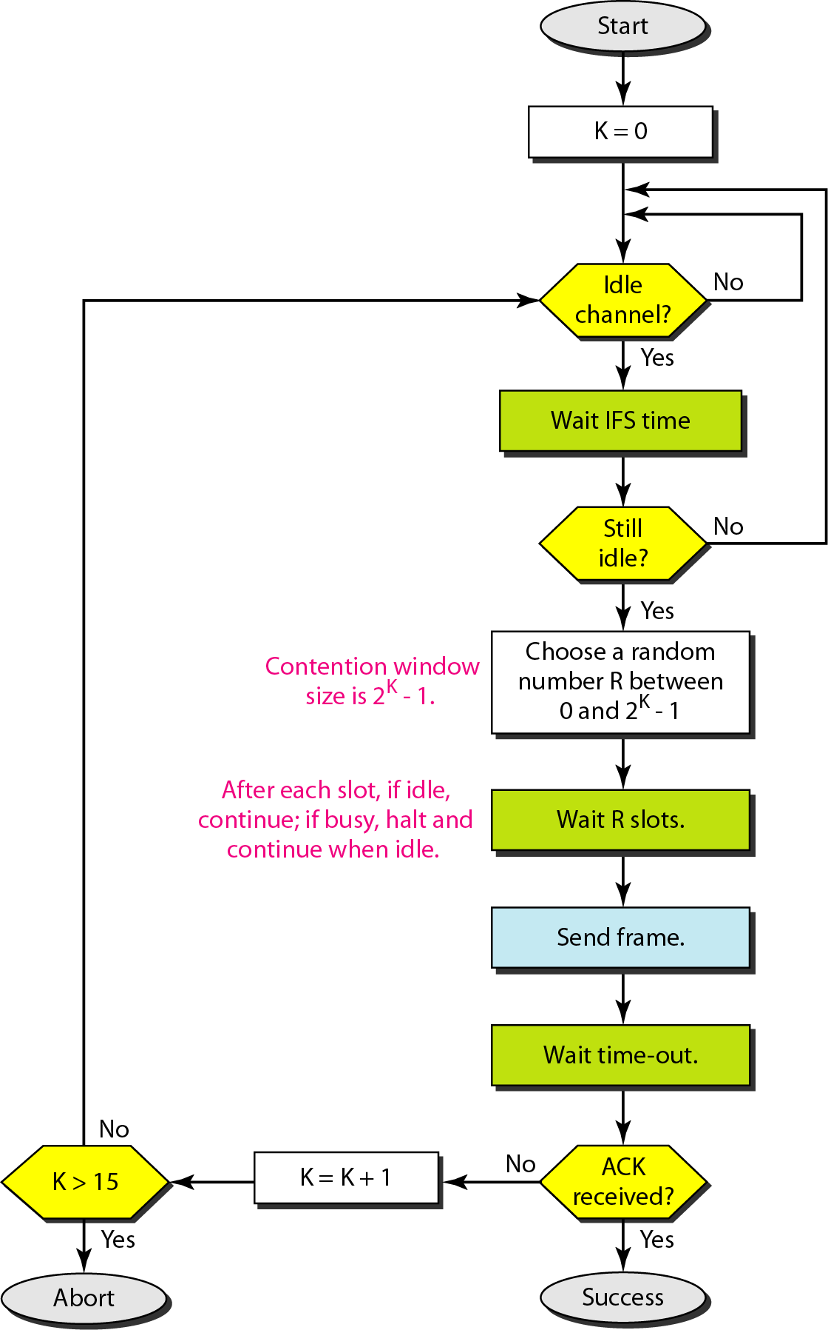
CSMA/CA - Procedure
63
Notes:
Data Communication

Slide 64
CSMA/CA - Procedure
The channel needs to be sensed before and after the IFS.
The channel also needs to be sensed during the contention time.
For each time slot of the contention window, the channel is sensed.
If it is found idle, the timer continues; if the channel is found busy, the timer is stopped and continues after the timer becomes idle again.
64
Notes:
Data Communication

Slide 65
CONTROLLED ACCESS
In controlled access, the stations consult one another to find which station has the right to send.
A station cannot send unless it has been authorized by other stations.
We discuss three popular controlled-access methods
65
Notes:
Data Communication

Slide 66
Reservation
In the reservation method, a station needs to make a reservation before sending data.
Time is divided into intervals.
In each interval, a reservation frame precedes the data frames sent in that interval.
If there are N stations in the system, there are exactly N reservation mini-slots in the reservation frame.
Each mini-slot belongs to a station.
When a station needs to send a data frame, it makes a reservation in its own mini-slot.
The stations that have made reservations can send their data frames after the reservation frame.
66
Notes:
Data Communication

Slide 67
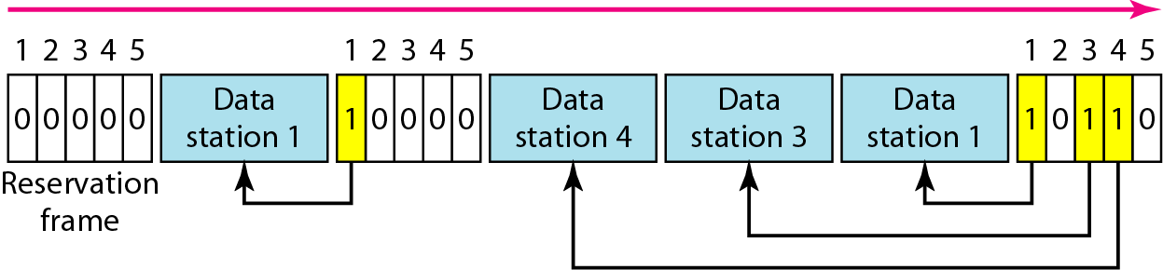
Reservation
Figure shows a situation with five stations and a five-mini-slot reservation frame.
In the first interval, only stations 1, 3, and 4 have made reservations.
In the second interval, only station 1 has made a reservation.
67
Notes:
Data Communication

Slide 68
Polling
Polling works with topologies in which one device is designated as a primary station and the other devices are secondary stations.
All data exchanges must be made through the primary device even when the ultimate destination is a secondary device.
The primary device controls the link; the secondary devices follow its instructions.
It is up to the primary device to determine which device is allowed to use the channel at a given time.
The primary device, therefore, is always the initiator of a session (see Figure )
68
Notes:
Data Communication

Slide 69
Polling
If the primary wants to receive data, it asks the secondaries if they have anything to send; this is called poll function.
If the primary wants to send data, it tells the secondary to get ready to receive; this is called select function.
69
Notes:
Data Communication

Slide 70
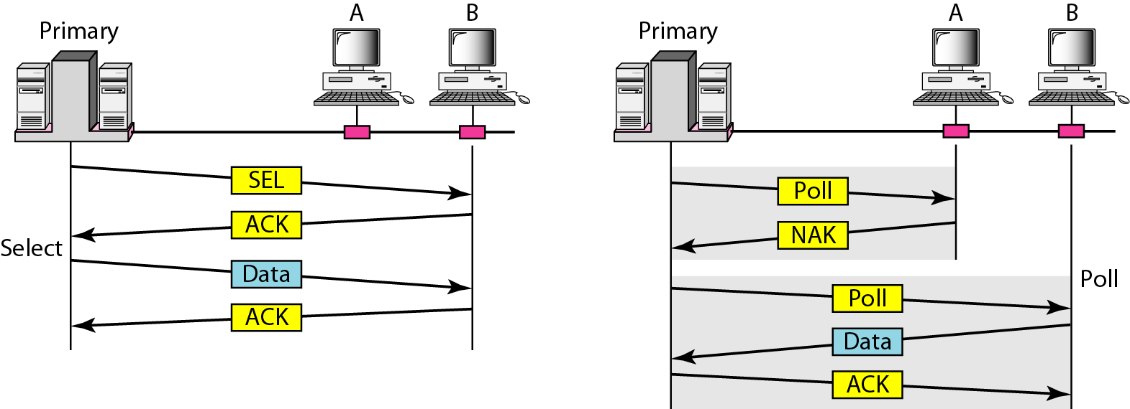
Polling
Figure : Select and poll functions in polling access method
70
Notes:
Data Communication

Slide 71
Token Passing
In the token-passing method, the stations in a network are organized in a logical ring.
For each station, there is a predecessor and a successor.
The predecessor is the station which is logically before the station in the ring; the successor is the station which is after the station in the ring.
The current station is the one that is accessing the channel now.
The right to this access has been passed from the predecessor to the current station.
The right will be passed to the successor when the current station has no more data to send.
71
Notes:
Data Communication

Slide 72
Token Passing - Logical Ring
In a token-passing network, stations do not have to be physically connected in a ring; the ring can be a logical one.
Figure show four different physical topologies that can create a logical ring
72
Notes:
Data Communication

Slide 73
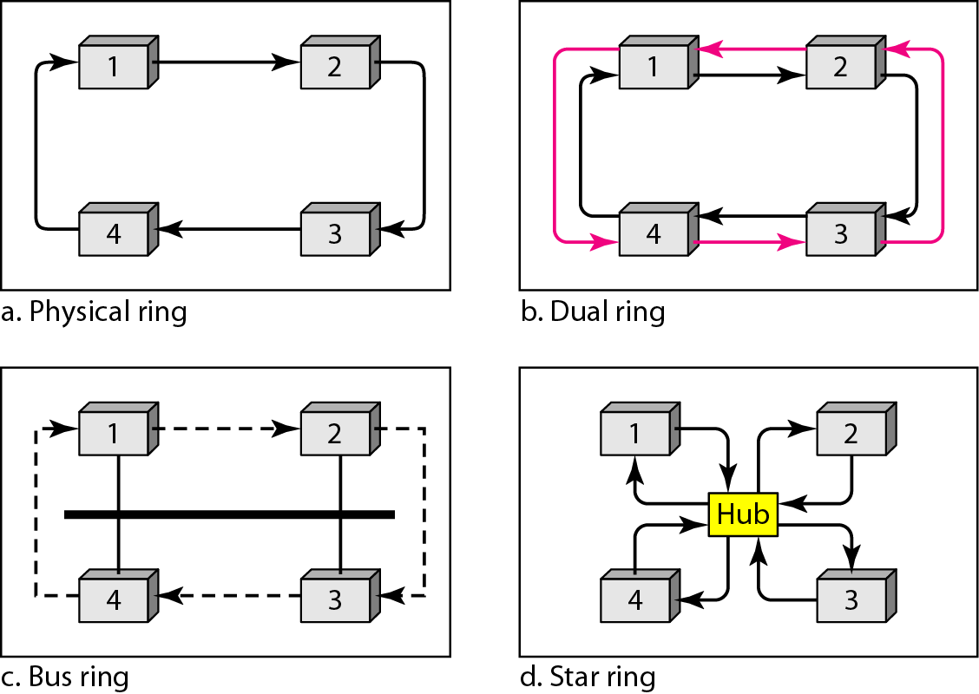
Token Passing - Logical Ring
73
Notes:
Data Communication

Slide 74
CHANNELIZATION
Channelization is a multiple-access method in which the available bandwidth of a link is shared in time, frequency, or through code, between different stations.
In this section, we discuss three channelization protocols: FDMA, TDMA, and CDMA.
74
Notes:
Data Communication

Slide 75
Frequency-Division Multiple Access (FDMA)
In FDMA, the available bandwidth is divided into frequency bands.
Each station is allocated a band to send its data.
Each band is reserved for a specific station, and it belongs to the station all the time.
Each station also uses a band-pass filter to confine the transmitter frequencies.
To prevent station interferences, the allocated bands are separated from one another by small guard bands.
Figure shows the idea of FDMA.
75
Notes:
Data Communication

Slide 76
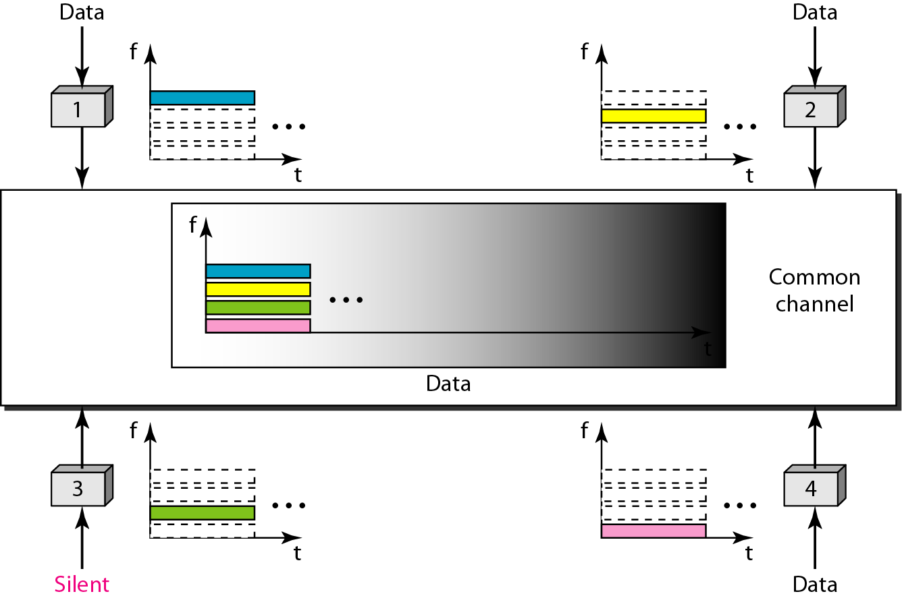
Frequency-Division Multiple Access (FDMA)
76
Notes:
Data Communication

Slide 77
Time-Division Multiple Access (TDMA)
In TDMA, the stations share the bandwidth of the channel in time.
Each station is allocated a time slot during which it can send data.
Each station transmits its data in is assigned time slot.
Figure shows the idea behind TDMA.
77
Notes:
Data Communication

Slide 78
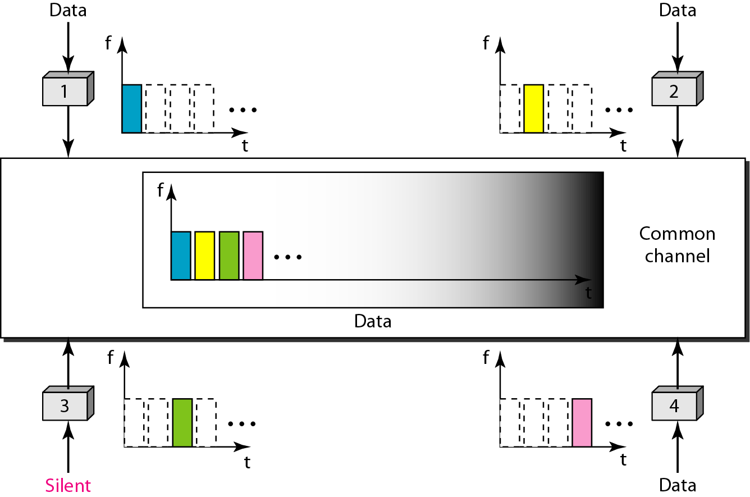
Time-Division Multiple Access (TDMA)
78
Notes:
Data Communication

Slide 79
Time-Division Multiple Access (TDMA)
The main problem with TDMA lies in achieving synchronization between the different stations.
Each station needs to know the beginning of its slot and the location of its slot.
This may be difficult because of propagation delays introduced in the system if the stations are spread over a large area.
To compensate for the delays, we can insert guard times.
Synchronization is normally accomplished by having some synchronization bits (normally referred to as preamble bits) at the beginning of each slot.
79
Notes:
Data Communication

Slide 80
Code-Division Multiple Access (CDMA)
CDMA was conceived several decades ago.
Recent advances in electronic technology have finally made its implementation possible.
CDMA differs from FDMA because only one channel occupies the entire bandwidth of the link.
It differs from TDMA because all stations can send data simultaneously; there is no timesharing.
80
Notes:
Data Communication

Slide 81
CDMA - Analogy
CDMA simply means communication with different codes.
For example, in a large room with many people, two people can talk in English if nobody else understands English.
Another two people can talk in Chinese if they are the only ones who understand Chinese, and so on.
The common channel, the space of the room in this case, can easily allow communication between several couples, but in different languages (codes).
81
Notes:
Data Communication

Slide 82
CDMA - Idea
Let us assume we have four stations 1, 2, 3, and 4 connected to the same channel.
The data from station 1 are d1 , from station 2 are d2, and so on.
The code assigned to the first station is c1, to the second is c2, and so on.
We assume that the assigned codes have two properties.
1. If we multiply each code by another, we get O.
2. If we multiply each code by itself, we get 4 (the number of stations).
82
Notes:
Data Communication

Slide 83
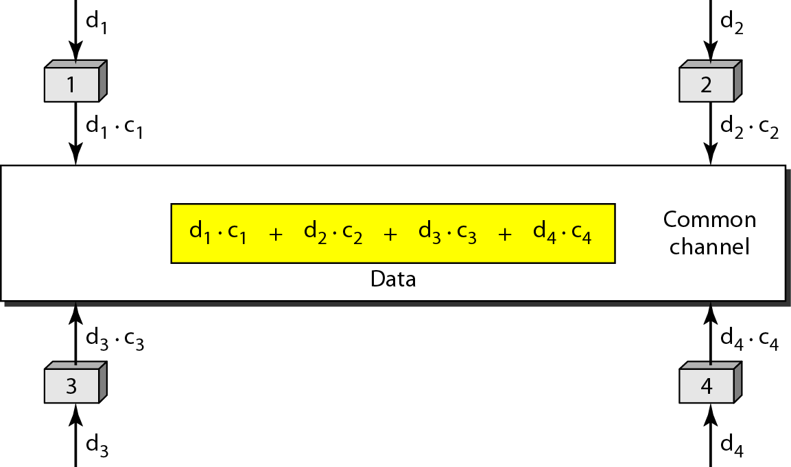
CDMA - Idea
With these two properties in mind, let us see how the above four stations can send data using the same common channel, as shown in Figure.
83
Notes:
Data Communication

Slide 84
CDMA - Idea
Station 1 multiplies its data by its code to get d1. c1
Station 2 multiplies its data by its code to get d2 . C2 and so on.
The data that go on the channel are the sum of all these terms, as shown in the box.
Any station that wants to receive data from one of the other three multiplies the data on the channel by the code of the sender.
For example, suppose stations 1 and 2 are talking to each other.
Station 2 wants to hear what station 1 is saying.
84
Notes:
Data Communication

Slide 85
CDMA - Idea
It multiplies the data on the channel by c1 the code of station 1.
Because (c1 . c1) is 4, but (c2 . c1), (c3 . c1), and (c4 . c1) are all 0s, station 2 divides the result by 4 to get the data from station 1.
Data = (d1.c1 + d2.c2 + d3.c3 + d4.c4 ) .c1
Data = d1.c1.c1 + d2.c2.c1 + d2.c2.c1 + d3.c3.c1+ d4.c4.c1
Data = 4 d1
85
Notes:
Data Communication

Slide 86
CDMA - Chips
CDMA is based on coding theory.
Each station is assigned a code, which is a sequence of numbers called chips, as shown in Figure
Data Representation
86
Notes:
Data Communication

Slide 87
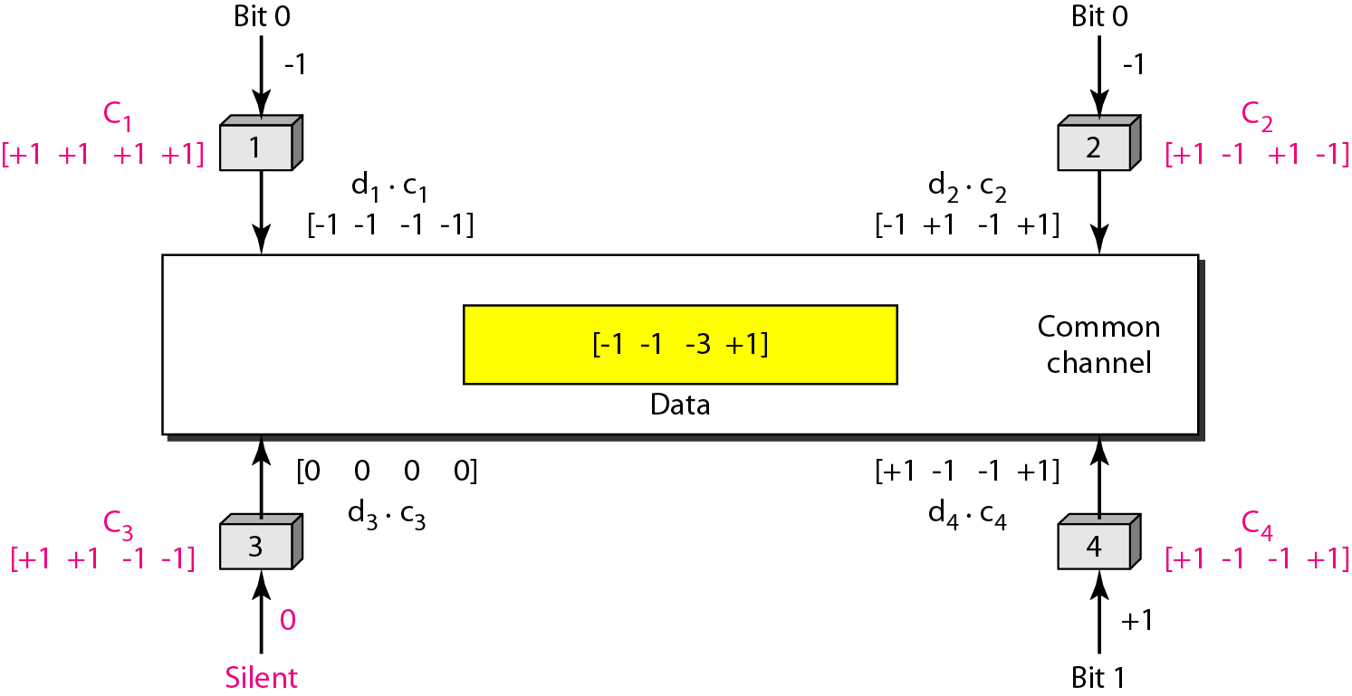
CDMA – Sharing Channel
87
Notes:
Data Communication

Slide 88
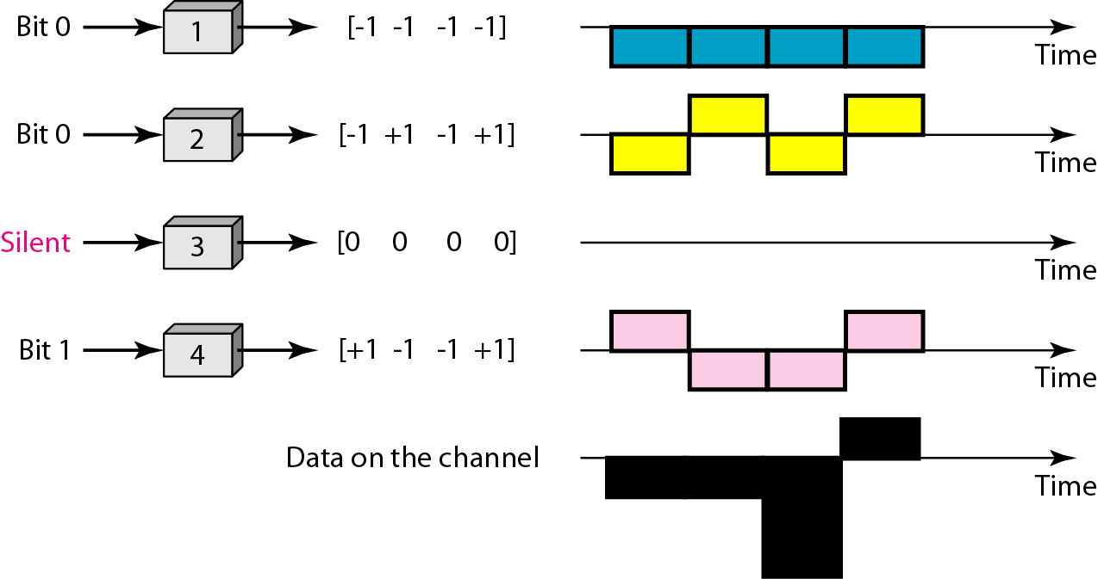
CDMA – Signal level – Signal Generation
88
Notes:
Data Communication

Slide 89
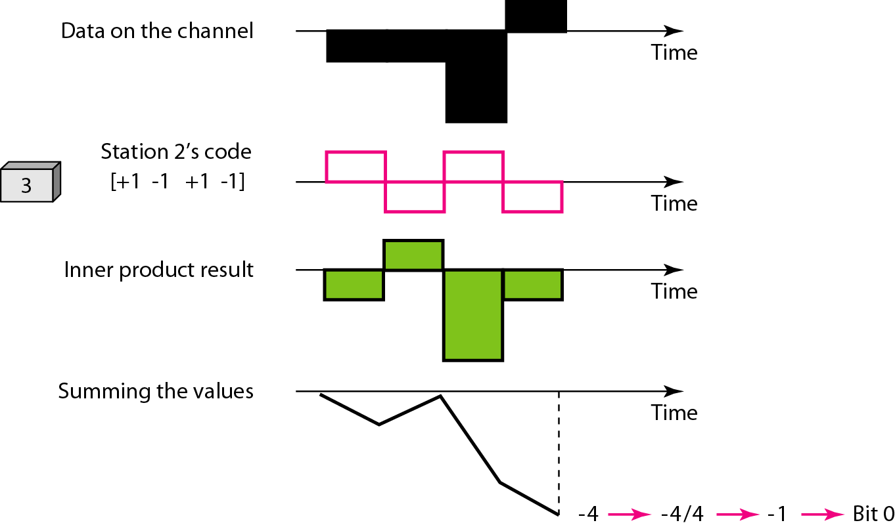
CDMA – Signal level – Decoding
89
Notes:
Data Communication

Slide 90
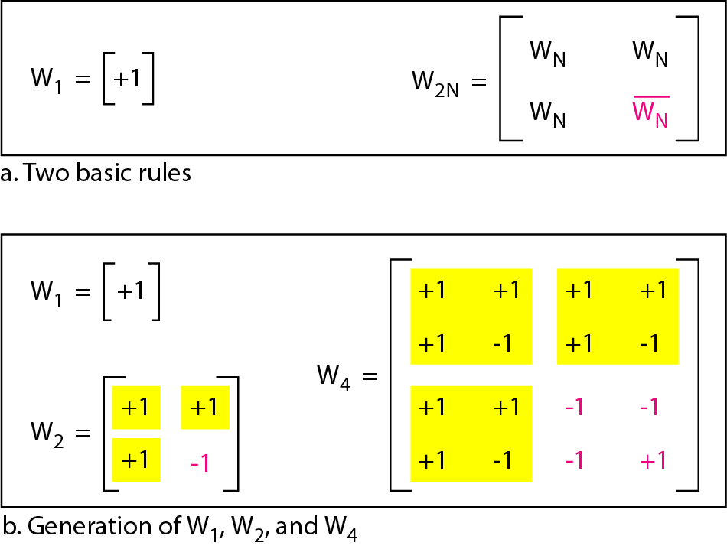
CDMA – Sequence Generation
90
Notes:
Data Communication

