Slide 1
Digital to Analog Conversion
1
Notes:
Data Communication

Slide 2
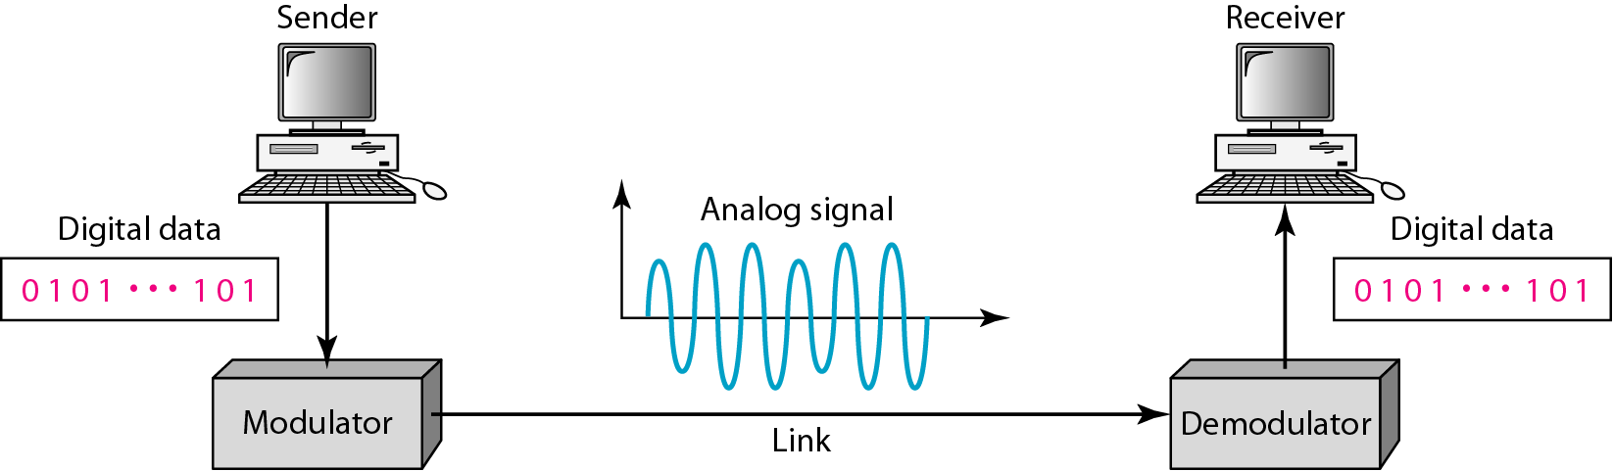
Introduction
Digital-to-analog conversion is the process of changing one of the characteristics of an analog signal based on the information in digital data.
Figure shows the relationship between the digital information, the digital-to-analog modulating process, and the resultant analog signal.
2
Notes:
Data Communication

Slide 3
Introduction
A sine wave is defined by three characteristics: amplitude, frequency, and phase.
When we vary anyone of these characteristics, we create a different version of that wave.
So, by changing one characteristic of a simple electric signal, we can use it to represent digital data.
Any of the three characteristics can be altered in this way, giving us at least three mechanisms for modulating digital data into an analog signal:
3
Notes:
Data Communication

Slide 4
Introduction
Amplitude Shift Keying (ASK),
Frequency Shift Keying (FSK), and
Phase Shift Keying (PSK).
In addition, there is a fourth (and better) mechanism that combines changing both the amplitude and phase, called quadrature amplitude modulation (QAM).
QAM is the most efficient of these options and is the mechanism commonly used today
4
Notes:
Data Communication

Slide 5
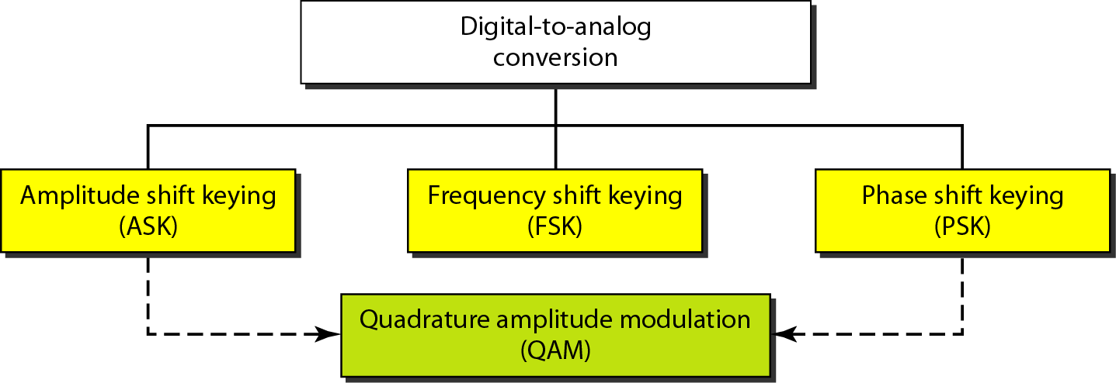
Introduction
5
Notes:
Data Communication

Slide 6
Aspects of Digital-to-Analog Conversion
Basic issues must be reviewed: bit and baud rates and the carrier signal.
Data Element Versus Signal Element
A data element as the smallest piece of information to be exchanged, the bit.
A signal element as the smallest unit of a signal that is constant.
The nature of the signal element is a little bit different in analog transmission.
6
Notes:
Data Communication

Slide 7
Data Rate Versus Signal Rate
We can define the data rate (bit rate) and the signal rate (baud rate) as we did for digital transmission.
The relationship between them is
S=N x (1/r) baud
where N is the data rate (bps) and
r is the number of data elements carried in one signal
element.
The value of r in analog transmission is r =log₂L, where L is the type of signal element, not the level
7
Notes:
Data Communication

Slide 8
Data Rate Versus Signal Rate
Bit rate is the number of bits per second.
Baud rate is the number of signal elements per second.
In the analog transmission of digital data, the baud rate is less than or equal to the bit rate
8
Notes:
Data Communication

Slide 9
An analog signal carries 4 bits per signal element. If 1000 signal elements are sent per second, find the bit rate( Data rate)
9
Notes:
Data Communication

Slide 10
An analog signal carries 4 bits per signal element. If 1000 signal elements are sent per second, find the bit rate( Data rate)
Solution
In this case, r = 4, S = 1000, and N is unknown. We can find the value of N from
10
Notes:
Data Communication

Slide 11
An analog signal has a bit rate of 8000 bps and a baud rate of 1000 baud. How many data elements are carried by each signal element? How many signal elements do we need?
11
Notes:
Data Communication

Slide 12
An analog signal has a bit rate of 8000 bps and a baud rate of 1000 baud. How many data elements are carried by each signal element? How many signal elements do we need?
Solution
In this example, S = 1000, N = 8000, and r and L are unknown. We find first the value of r and then the value of L.
12
Notes:
Data Communication

Slide 13
Bandwidth
The required bandwidth for analog transmission of digital data is proportional to the signal rate except for FSK, in which the difference between the carrier signals needs to be added.
13
Notes:
Data Communication

Slide 14
Carrier Signal
In analog transmission, the sending device produces a high-frequency signal that acts as a base for the information signal.
This base signal is called the carrier signal or carrier frequency.
The receiving device is tuned to the frequency of the carrier signal that it expects from the sender.
Digital information then changes the carrier signal by modifying one or more of its characteristics (amplitude, frequency, or phase).
This kind of modification is called modulation (shift keying).
14
Notes:
Data Communication

Slide 15
Amplitude Shift Keying (ASK)
In amplitude shift keying, the amplitude of the carrier signal is varied to create signal elements.
Both frequency and phase remain constant while the amplitude changes
15
Notes:
Data Communication

Slide 16
Binary ASK (BASK)
Although we can have several levels (kinds) of signal elements, each with a different amplitude, ASK is normally implemented using only two levels.
This is referred to as binary amplitude shift keying or on-off keying (OOK).
The peak amplitude of one signal level is 0; the other is the same as the amplitude of the carrier frequency.
Figure gives a conceptual view of binary ASK.
16
Notes:
Data Communication

Slide 17
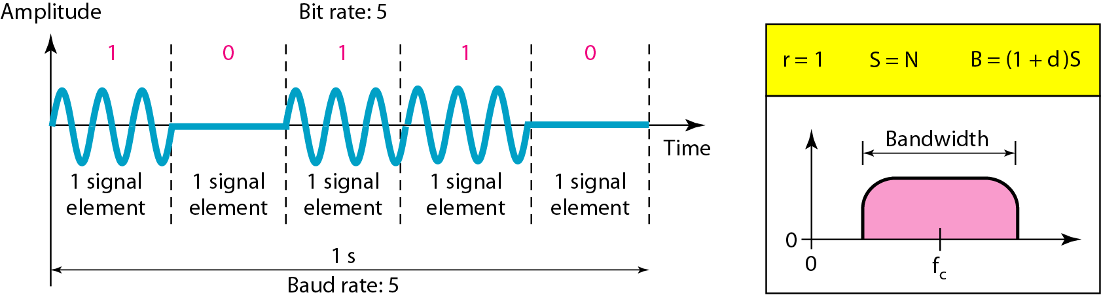
Binary ASK (BASK)
17
Notes:
Data Communication

Slide 18
Bandwidth for ASK
The bandwidth is proportional to the signal rate (baud rate).
However, there is normally another factor involved, called d, which depends on the modulation and filtering process.
The value of d is between 0 and 1.
The bandwidth can be expressed as shown, where S is the signal rate and the B is the bandwidth
B = (1+d) x S
18
Notes:
Data Communication

Slide 19
Bandwidth for ASK
The middle of the bandwidth is where f_{c} the carrier frequency, is located.
If we have a bandpass channel available, we can choose our f_{c} so that the modulated signal occupies that bandwidth.
This is in fact the most important advantage of digital to- analog conversion
19
Notes:
Data Communication

Slide 20
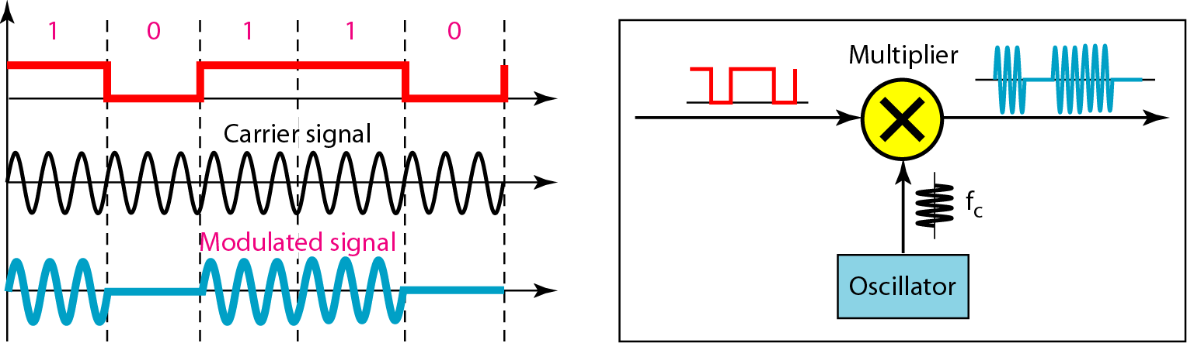
Implementation
Figure shows how we can simply implement binary ASK.
20
Notes:
Data Communication

Slide 21
Implementation
If digital data are presented as a unipolar NRZ digital signal with a high voltage of 1V and a low voltage of 0V, the implementation can achieved by multiplying the NRZ digital signal by the carrier signal coming from an oscillator
When the amplitude of the NRZ signal is 1, the amplitude of the carrier frequency is held; when the amplitude of the NRZ signal is 0, the amplitude of the carrier frequency is zero
21
Notes:
Data Communication

Slide 22
We have an available bandwidth of 100 kHz which spans from 200 to 300 kHz. What are the carrier frequency and the bit rate if we modulated our data by using ASK with d = 1 and r=1?
22
Notes:
Data Communication

Slide 23
We have an available bandwidth of 100 kHz which spans from 200 to 300 kHz. What are the carrier frequency and the bit rate if we modulated our data by using ASK with d = 1 and r=1?
Solution
The middle of the bandwidth is located at 250 kHz. This means that our carrier frequency can be at f_{c} = 250 kHz. We can use the formula for bandwidth to find the bit rate (with d = 1 and r = 1).
23
Notes:
Data Communication

Slide 24
Frequency Shift Keying (FSK)
In frequency shift keying, the frequency of the carrier signal is varied to represent data.
The frequency of the modulated signal is constant for the duration of one signal element, but changes for the next signal element if the data element changes.
Both peak amplitude and phase remain constant for all signal elements.
24
Notes:
Data Communication

Slide 25
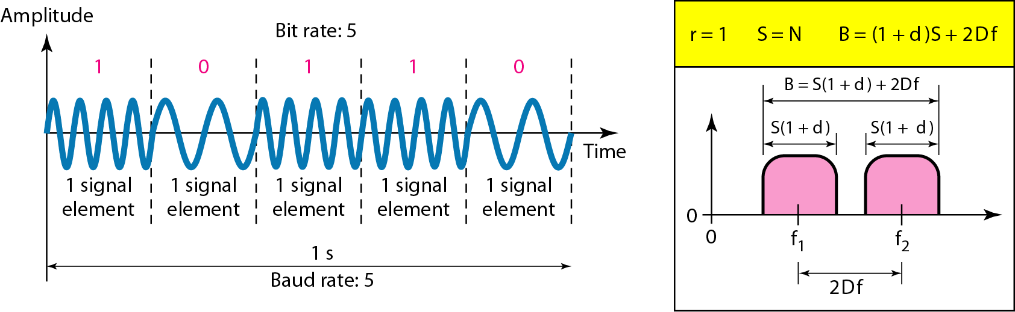
Binary FSK (BFSK)
One way to think about binary FSK (or BFSK) is to consider two carrier frequencies.
In Figure, we have selected two carrier frequencies f₁ and f₂.
25
Notes:
Data Communication

Slide 26
Binary FSK (BFSK)
We use the first carrier if the data element is 0; we use the second if the data element is 1.
However, note that this is an unrealistic example used only for demonstration purposes.
Normally the carrier frequencies are very high, and the difference between them is very small
As Figure shows, the middle of one bandwidth is f₁ and the middle of the other is f₂. Both f₁ and f₂ are ∆f apart from the midpoint between the two bands.
The difference between the two frequencies is 2∆f
26
Notes:
Data Communication

Slide 27
Bandwidth for BFSK
Again the carrier signals are only simple sine waves, but the modulation creates a nonperiodic composite signal with continuous frequencies.
We can think of FSK as two ASK signals, each with its own carrier frequency (f₁ and f₂).
If the difference between the two frequencies is 2∆f, then the required bandwidth is
B = (1+d) x S x 2∆f
27
Notes:
Data Communication

Slide 28
We have an available bandwidth of 100 kHz which spans from 200 to 300 kHz. What should be the carrier frequency and the bit rate if we modulated our data by using FSK with d = 1?
28
Notes:
Data Communication

Slide 29
We have an available bandwidth of 100 kHz which spans from 200 to 300 kHz. What should be the carrier frequency and the bit rate if we modulated our data by using FSK with d = 1?
Solution
Bandwidth B= 100kHz
but we are modulating by using FSK. The midpoint of the band is at 250 kHz. We choose 2Δf to be 50 kHz; this means
29
Notes:
Data Communication

Slide 30
Implementation
There are two implementations of BFSK: noncoherent and coherent.
In noncoherent BFSK, there may be discontinuity in the phase when one signal element ends and the next begins.
In coherent BFSK, the phase continues through the boundary of two signal elements.
Noncoherent BFSK can be implemented by treating BFSK as two ASK modulations and using two carrier frequencies.
30
Notes:
Data Communication

Slide 31
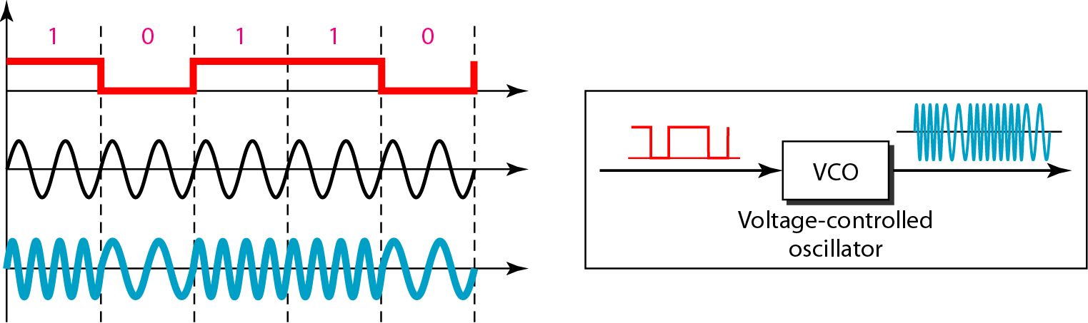
Implementation
Coherent BFSK can be implemented by using one voltage-controlled oscillator (VCO) that changes its frequency according to the input voltage.
Figure shows the simplified idea behind the second implementation.
31
Notes:
Data Communication

Slide 32
Implementation
The input to the oscillator is the unipolar NRZ signal.
When the amplitude of NRZ is zero, the oscillator keeps its regular frequency; when the amplitude is positive, the frequency is increased.
32
Notes:
Data Communication

Slide 33
Multilevel FSK
MFSK is not uncommon with the FSK method.
We can use more than two frequencies.
For example, we can use four different frequencies f₁, f₂ , f₃ and f₄ to send 2 bits at a time.
To send 3 bits at a time, we can use eight frequencies. And so on.
However, we need to remember that the frequencies need to be 2∆f apart.
33
Notes:
Data Communication

Slide 34
Phase Shift Keying (PSK)
In phase shift keying, the phase of the carrier is varied to represent two or more different signal elements.
Both peak amplitude and frequency remain constant as the phase changes.
Today, PSK is more common than ASK or FSK.
34
Notes:
Data Communication

Slide 35
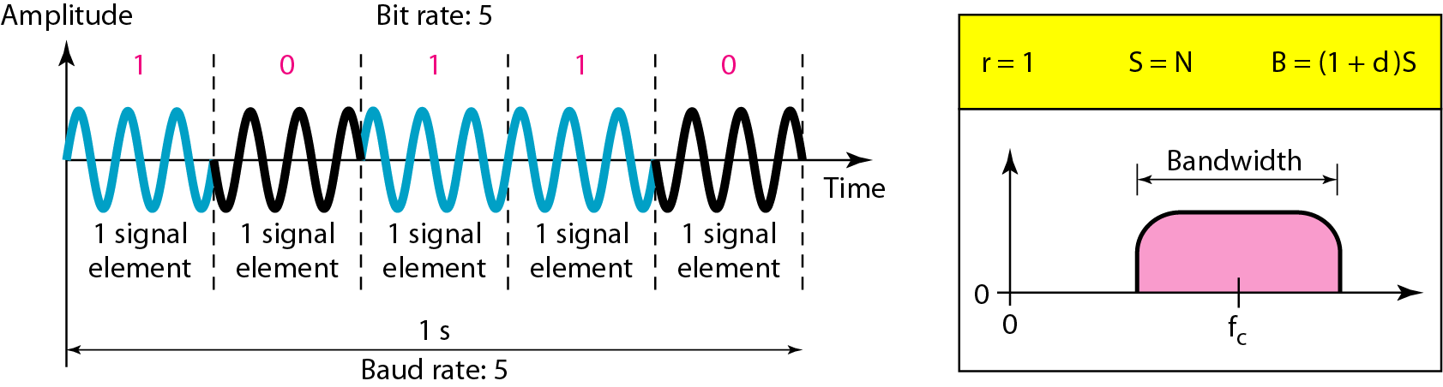
Binary PSK (BPSK)
The simplest PSK is binary PSK, in which we have only two signal elements, one with a phase of 0°, and the other with a phase of 180°.
Figure gives a conceptual view of PSK.
35
Notes:
Data Communication

Slide 36
Binary PSK (BPSK)
Binary PSK is as simple as binary ASK with one big advantage-it is less susceptible to noise.
In ASK, the criterion for bit detection is the amplitude of the signal; in PSK, it is the phase.
Noise can change the amplitude easier than it can change the phase.
PSK is less susceptible to noise than ASK.
PSK is superior to FSK because we do not need two carrier signals
36
Notes:
Data Communication

Slide 37
Bandwidth
The bandwidth is the same as that for binary ASK, but less than that for BFSK.
No bandwidth is wasted for separating two carrier signals.
37
Notes:
Data Communication

Slide 38
Implementation
The implementation of BPSK is as simple as that for ASK.
The reason is that the signal element with phase 180° can be seen as the complement of the signal element with phase 0°.
This gives us a clue on how to implement BPSK.
We use the same idea we used for ASK but with a polar NRZ signal instead of a unipolar NRZ signal, as shown in Figure.
38
Notes:
Data Communication

Slide 39
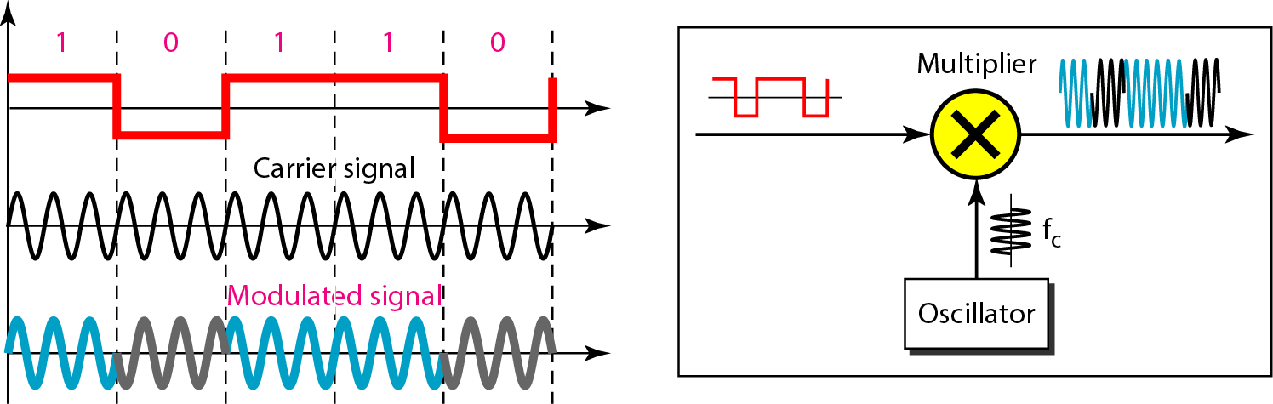
Implementation
The polar NRZ signal is multiplied by the carrier frequency; the 1 bit (positive voltage) is represented by a phase starting at 0°; the a bit (negative voltage) is represented by a phase starting at 180°.
39
Notes:
Data Communication

Slide 40
Quadrature PSK (QPSK)
The simplicity of BPSK enticed designers to use 2 bits at a time in each signal element, thereby decreasing the baud rate and eventually the required bandwidth.
The scheme is called quadrature PSK or QPSK because it uses two separate BPSK modulations; one is in-phase, the other quadrature (out-of-phase).
40
Notes:
Data Communication

Slide 41
Quadrature PSK (QPSK)
The incoming bits are first passed through a serial-to-parallel conversion that sends one bit to one modulator and the next bit to the other modulator.
If the duration of each bit in the incoming signal is T, the duration of each bit sent to the corresponding BPSK signal is 2T.
The bit to each BPSK signal has one-half the frequency of the original signal.
Figure shows the idea.
41
Notes:
Data Communication

Slide 42
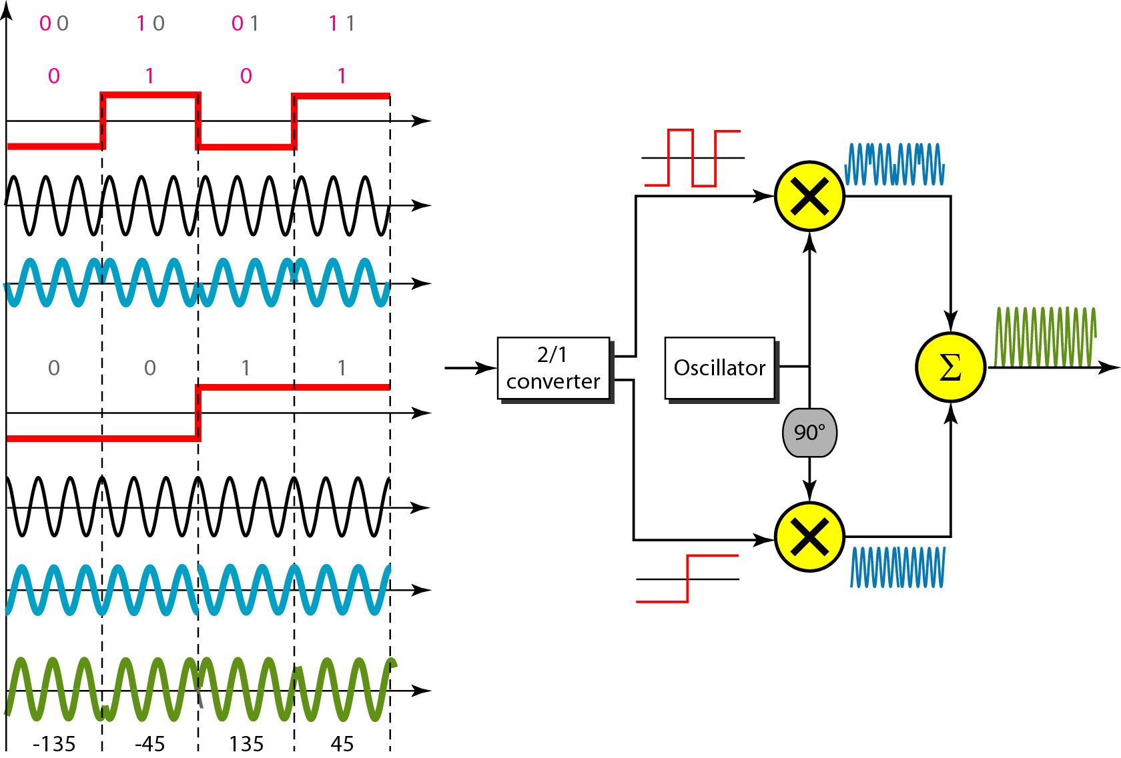
QPSK and its implementations
42
Notes:
Data Communication

Slide 43
QPSK and its implementations
The two composite signals created by each multiplier are sine waves with the same frequency, but different phases.
When they are added, the result is another sine wave, with one of four possible phases: 45°, -45°, 135°, and -135°.
There are four kinds of signal elements in the output signal (L = 4), so we can send 2 bits per signal element (r =2).
43
Notes:
Data Communication

Slide 44
Find the bandwidth for a signal transmitting at 12 Mbps for QPSK. The value of d = 0.
Solution
For QPSK, 2 bits is carried by one signal element.
This means that r = 2.
So the signal rate (baud rate) is S = N × (1/r) = 6 Mbaud.
With a value of d = 0, we have B = S = 6 MHz.
44
Notes:
Data Communication

Slide 45
ANALOG-TO-ANALOG CONVERSION
45
Notes:
Data Communication

Slide 46
Analog-to-Analog Conversion
Analog-to-analog conversion, or analog modulation, is the representation of analog information by an analog signal.
One may ask why we need to modulate an analog signal; it is already analog.
Modulation is needed if the medium is bandpass in nature or if only a bandpass channel is available to us. An example is radio.
The government assigns a narrow bandwidth to each radio station.
46
Notes:
Data Communication

Slide 47
Analog-to-Analog Conversion
The analog signal produced by each station is a low-pass signal, all in the same range.
To be able to listen to different stations, the low-pass signals need to be shifted, each to a different range.
Analog-to-analog conversion can be accomplished in three ways:
47
Notes:
Data Communication

Slide 48
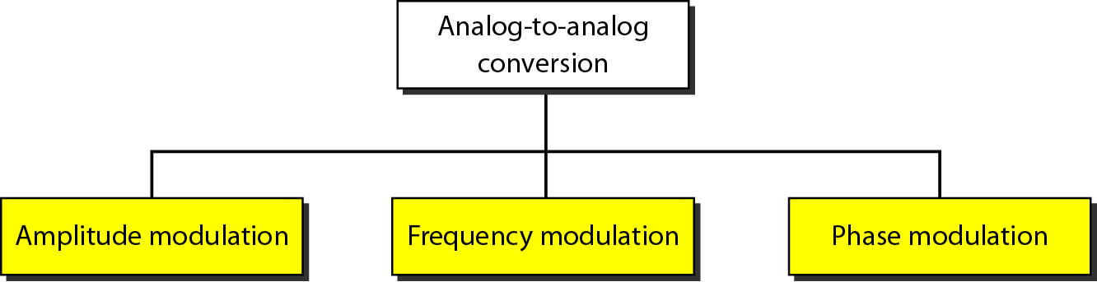
Analog-to-Analog Conversion
48
Notes:
Data Communication

Slide 49
Amplitude Modulation
the carrier signal is modulated so that its amplitude varies with the changing amplitudes of the modulating signal.
The frequency and phase of the carrier remain the same; only the amplitude changes to follow variations in the information.
Figure shows how this concept works.
The modulating signal is the envelope of the carrier.
49
Notes:
Data Communication

Slide 50
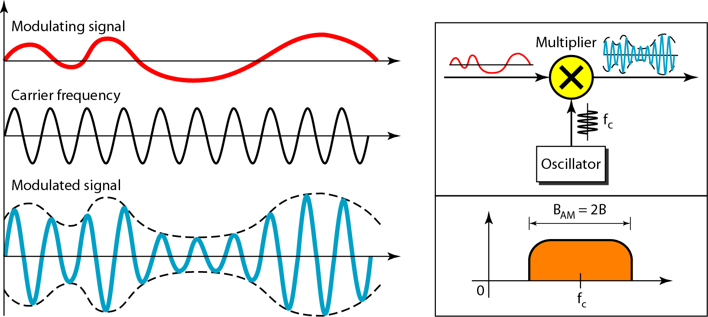
Amplitude Modulation
50
Notes:
Data Communication

Slide 51
Amplitude Modulation
AM is normally implemented by using a simple multiplier because the amplitude of the carrier signal needs to be changed according to the amplitude of the modulating signal.
51
Notes:
Data Communication

Slide 52
AM Bandwidth
The modulation creates a bandwidth that is twice the bandwidth of the modulating signal and covers a range centered on the carrier frequency.
However, the signal components above and below the carrier frequency carry exactly the same information.
For this reason, some implementations discard one-half of the signals and cut the bandwidth in half.
52
Notes:
Data Communication

Slide 53
Standard BW Allocation for AM Radio
The bandwidth of an audio signal (speech and music) is usually 5 kHz.
Therefore, an AM radio station needs a bandwidth of 10kHz.
In fact, the Federal Communications Commission (FCC) allows 10 kHz for each AM station.
AM stations are allowed carrier frequencies anywhere between 530 and 1700 kHz (1.7 MHz).
53
Notes:
Data Communication

Slide 54
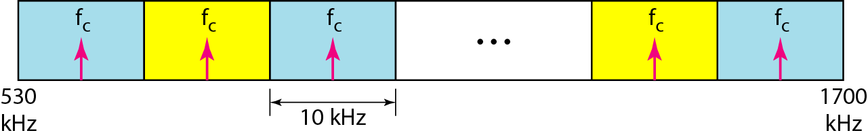
Standard BW Allocation for AM Radio
However, each station's carrier frequency must be separated from those on either side of it by at least 10 kHz (one AM bandwidth) to avoid interference.
If one station uses a carrier frequency of 1100 kHz, the next station's carrier frequency cannot be lower than 1110 kHz
54
Notes:
Data Communication

Slide 55
Frequency Modulation
In FM , the frequency of the carrier signal is modulated to follow the changing voltage level (amplitude) of the modulating signal.
The peak amplitude and phase of the carrier signal remain constant, but as the amplitude of the information signal changes, the frequency of the carrier changes correspondingly.
Figure shows the relationships of the modulating signal, the carrier signal, and the resultant FM signal.
55
Notes:
Data Communication

Slide 56
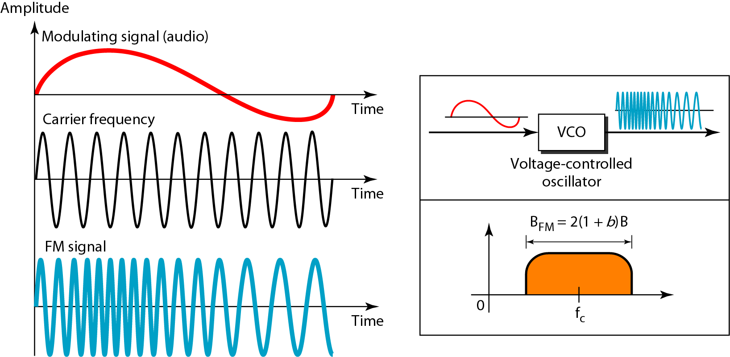
Frequency Modulation
56
Notes:
Data Communication

Slide 57
Frequency Modulation
FM is normally implemented by using a voltage-controlled oscillator as with FSK.
The frequency of the oscillator changes according to the input voltage which is the amplitude of the modulating signal
57
Notes:
Data Communication

Slide 58
FM Bandwidth
The actual bandwidth is difficult to determine exactly, but it can be shown empirically that it is several times that of the analog signal or 2(1 + β) B where β is a factor depends on modulation technique with a common value of 4.
58
Notes:
Data Communication

Slide 59
Standard BW Allocation for FM Radio
The bandwidth of an audio signal (speech and music) broadcast in stereo is almost 15 kHz.
The FCC allows 200 kHz (0.2 MHz) for each station.
This mean β = 4 with some extra guard band.
FM stations are allowed carrier frequencies anywhere between 88 and 108 MHz.
Stations must be separated by at least 200 kHz to keep their bandwidths from overlapping.
To create even more privacy, the FCC requires that in a given area, only alternate bandwidth allocations may be used.
59
Notes:
Data Communication

Slide 60
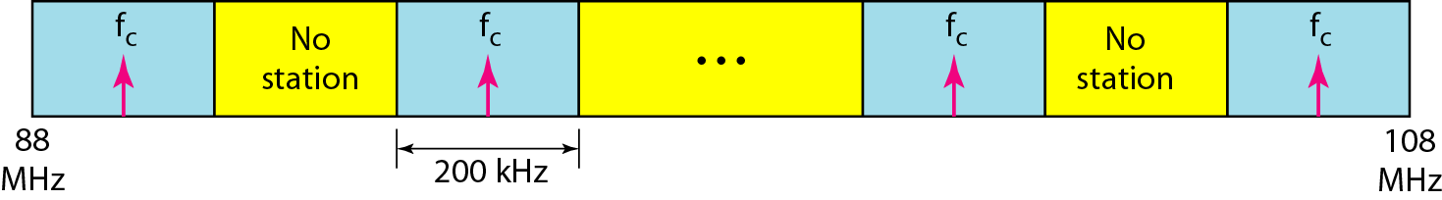
Standard BW Allocation for FM Radio
The others remain unused to prevent any possibility of two stations interfering with each other.
Given 88 to 108 MHz as a range, there are 100 potential FM bandwidths in an area, of which 50 can operate at anyone time.
Figure illustrates this concept.
60
Notes:
Data Communication

Slide 61
Phase Modulation
The phase of the carrier signal is modulated to follow the changing voltage level (amplitude) of the modulating signal.
The peak amplitude and frequency of the carrier signal remain constant, but as the amplitude of the information signal changes, the phase of the carrier changes correspondingly.
PM is the same as FM with one difference.
In FM, the instantaneous change in the carrier frequency is proportional to the amplitude of the modulating signal;
61
Notes:
Data Communication

Slide 62
Phase Modulation
in PM the instantaneous change in the carrier frequency is proportional to the derivative of the amplitude of the modulating signal.
Figure shows the relationships of the modulating signal, the carrier signal, and the resultant PM signal.
62
Notes:
Data Communication

Slide 63
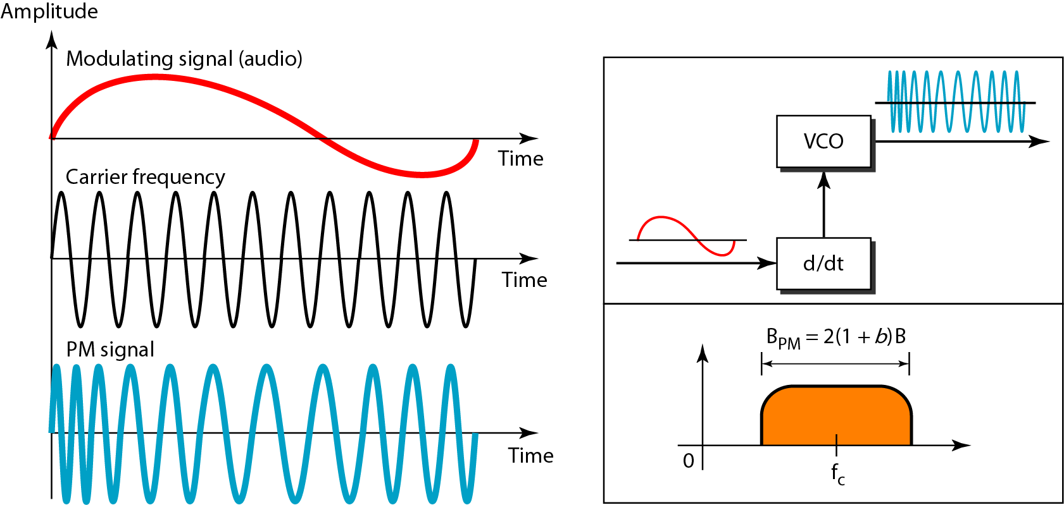
Phase Modulation
63
Notes:
Data Communication

Slide 64
Phase Modulation
PM is normally implemented by using a voltage-controlled oscillator along with a derivative.
The frequency of the oscillator changes according to the derivative of the input voltage which is the amplitude of the modulating signal.
64
Notes:
Data Communication

Slide 65
Phase Modulation bandwidth
The actual bandwidth is difficult to determine exactly, but it can be shown empirically that it is several times that of the analog signal.
Although, the formula shows the same bandwidth for FM and PM, the value of β is lower in the case of PM (around 1 for narrowband and 3 for wideband).
65
Notes:
Data Communication

