Slide 1
SPREAD SPECTRUM
1
Notes:
Data Communication

Slide 2
Spread Spectrum (SS)
Multiplexing combines signals from several sources to achieve bandwidth efficiency; the available bandwidth of a link is divided between the sources.
In Spread Spectrum (SS), we also combine signals from different sources to fit into a larger bandwidth, but our goals are somewhat different.
SS is designed to be used in wireless applications (LANs and WANs).
In these types of applications, we have some concerns that out weight bandwidth efficiency.
2
Notes:
Data Communication

Slide 3
Spread Spectrum (SS)
In wireless applications, all stations use air (or a vacuum) as the medium for communication.
Stations must be able to share this medium without interception by an eavesdropper and without being subject to jamming from a malicious intruder (in military operations, for example).
To achieve these goals, spread spectrum techniques add redundancy; they spread the original spectrum needed for each station.
3
Notes:
Data Communication

Slide 4
Spread Spectrum (SS)
If the required bandwidth for each station is B, spread spectrum expands it to Bss such that Bss >> B.
The expanded bandwidth allows the source to wrap its message in a protective envelope for a more secure transmission.
Figure shows the idea of spread spectrum
4
Notes:
Data Communication

Slide 5
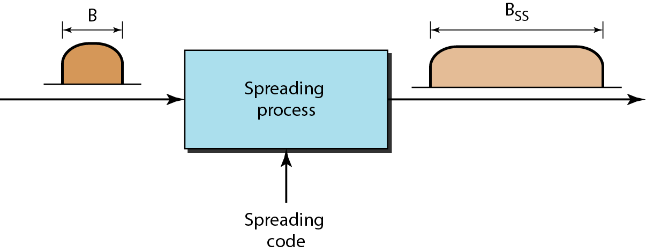
Spread Spectrum (SS)
5
Notes:
Data Communication

Slide 6
Spread Spectrum (SS)
Spread spectrum achieves its goals through two principles:
The bandwidth allocated to each station needs to be, by far, larger than what is needed. This allows redundancy.
The expanding of the original bandwidth B to the bandwidth Bss must be done by a process that is independent of the original signal ( i.e. the spreading process occurs after the signal is created by the source.)
6
Notes:
Data Communication

Slide 7
Spread Spectrum (SS)
After the signal is created by the source, the spreading process uses a spreading code and spreads the bandwidth.
The figure shows the original bandwidth B and the spreaded bandwidth Bss.
The spreading code is a series of numbers that look random, but are actually a pattern.
There are two techniques to spread the bandwidth:
Frequency Hopping Spread Spectrum (FHSS) and
Direct Sequence Spread Spectrum (DSSS).
7
Notes:
Data Communication

Slide 8
Frequency Hopping Spread Spectrum (FHSS)
FHSS technique uses M different carrier frequencies that are modulated by the source signal.
At one moment, the signal modulates one carrier frequency; at the next moment, the signal modulates another carrier frequency.
Although the modulation is done using one carrier frequency at a time, M frequencies are used in the long run.
The bandwidth occupied by a source after spreading is B_{FHSS} »B.
8
Notes:
Data Communication

Slide 9
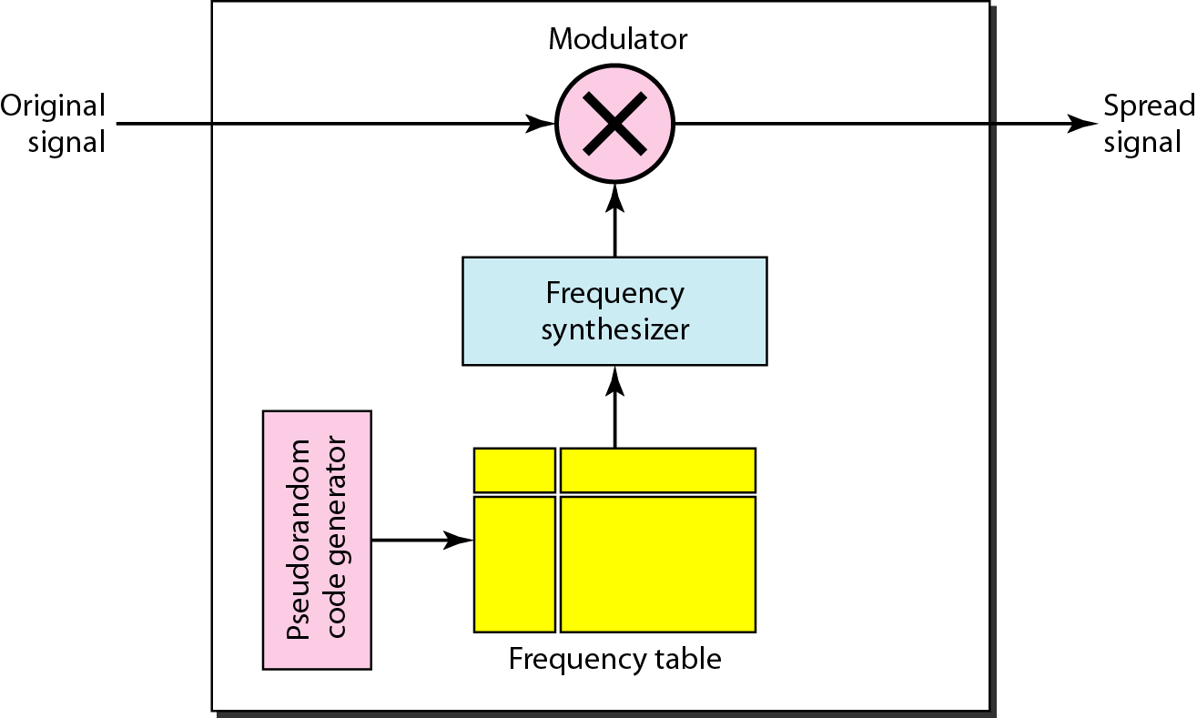
Frequency Hopping Spread Spectrum (FHSS)
Figure shows the general layout for FHSS.
9
Notes:
Data Communication

Slide 10
Frequency Hopping Spread Spectrum (FHSS)
A pseudorandom code generator, called Pseudorandom Noise (PN), creates a k-bit pattern for every hopping period T_{h}.
The frequency table uses the pattern to find the frequency to be used for this hopping period and passes it to the frequency synthesizer.
The frequency synthesizer creates a carrier signal of that frequency, and the source signal modulates the carrier signal.
10
Notes:
Data Communication

Slide 11
Frequency Hopping Spread Spectrum (FHSS)
Suppose we have decided to have eight hopping frequencies.
This is extremely low for real applications and is just for illustration.
In this case, M is 8 and k is 3.
The pseudorandom code generator will create eight different 3-bit patterns.
These are mapped to eight different frequencies in the frequency table (see Figure)
11
Notes:
Data Communication

Slide 12
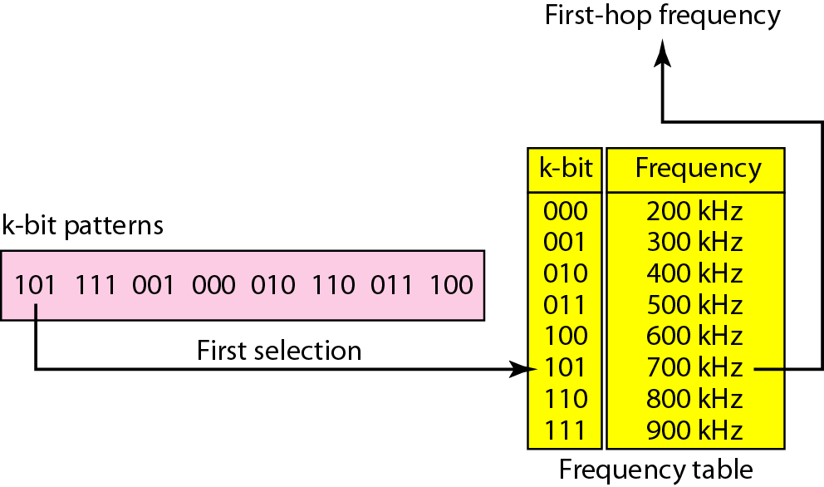
Frequency Selection in FHSS
12
Notes:
Data Communication

Slide 13
Frequency Hopping Spread Spectrum (FHSS)
The pattern for this station is 101, 111, 001, 000, 010, 011, 100.
Note that the pattern is pseudorandom it is repeated after eight hoppings.
This means that at hopping period 1, the pattern is 101.
The frequency selected is 700 kHz; the source signal modulates this carrier frequency.
The second k-bit pattern selected is 111, which selects the 900-kHz carrier; the eighth pattern is 100, the frequency is 600 kHz.
13
Notes:
Data Communication

Slide 14
Frequency Hopping Spread Spectrum (FHSS)
After eight hoppings, the pattern repeats, starting from 101 again.
Figure shows how the signal hops around from carrier to carrier.
We assume the required bandwidth of the original signal is 100 kHz.
14
Notes:
Data Communication

Slide 15
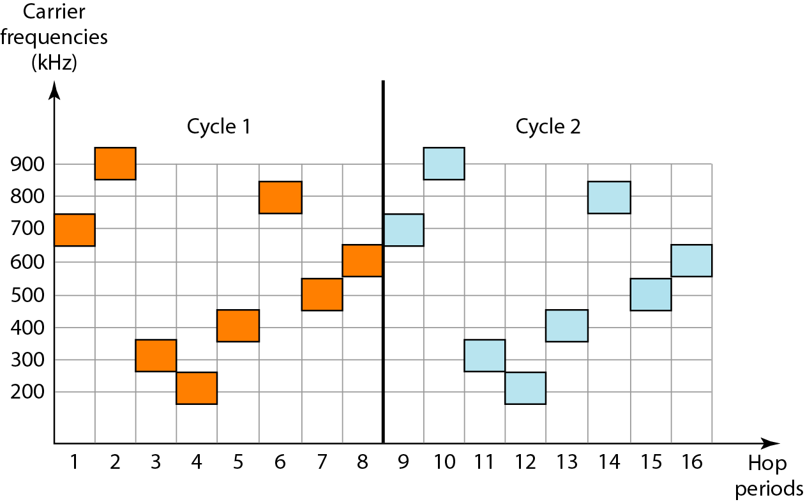
FHSS Cycles
15
Notes:
Data Communication

Slide 16
Frequency Hopping Spread Spectrum (FHSS)
It can be shown that this scheme can accomplish the previously mentioned goals.
If there are many k-bit patterns and the hopping period is short, a sender and receiver can have privacy.
If an intruder tries to intercept the transmitted signal, she can only access a small piece of data because he does not know the spreading sequence to quickly adapt herself to the next hop.
The scheme has also an anti jamming effect.
A malicious sender may be able to send noise to jam the signal for one hopping period (randomly), but not for the whole period.
16
Notes:
Data Communication

Slide 17
FHSS – Bandwidth Sharing
If the number of hopping frequencies is M, we can multiplex M channels into one by using the same Bss bandwidth.
This is possible because a station uses just one frequency in each hopping period; M - 1 other frequencies can be used by other M - 1 stations.
In other words, M different stations can use the same Bss if an appropriate modulation technique such as multiple FSK (MFSK) is used.
FHSS is similar to FDM, as shown in Figure.
17
Notes:
Data Communication

Slide 18
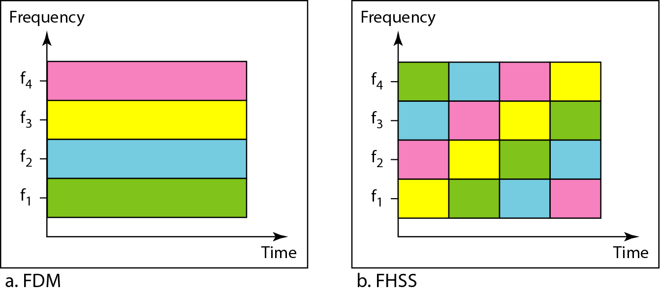
FHSS – Bandwidth Sharing
18
Notes:
Data Communication

Slide 19
FHSS – Bandwidth Sharing
Figure shows an example of four channels using FDM and four channels using FHSS.
In FDM, each station uses 1/M of the bandwidth, but the allocation is fixed; in FHSS, each station uses 1/M of the bandwidth, but the allocation changes hop to hop.
19
Notes:
Data Communication

Slide 20
Direct Sequence Spread Spectrum (DSSS)
DSSS technique also expands the bandwidth of the original signal, but the process is different.
In DSSS, we replace each data bit with n bits using a spreading code.
In other words, each bit is assigned a code of n bits, called chips, where the chip rate is n times that of the data bit.
Figure shows the concept of DSSS.
20
Notes:
Data Communication

Slide 21
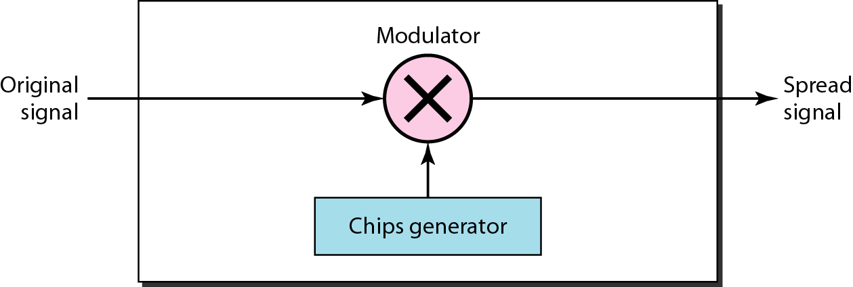
Direct Sequence Spread Spectrum (DSSS)
21
Notes:
Data Communication

Slide 22
Direct Sequence Spread Spectrum (DSSS)
let us consider the sequence used in a wireless LAN, the famous Barker sequence where n is 11.
We assume that the original signal and the chips in the chip generator use polar NRZ encoding.
Figure shows the chips and the result of multiplying the original data by the chips to get the spread signal.
22
Notes:
Data Communication

Slide 23
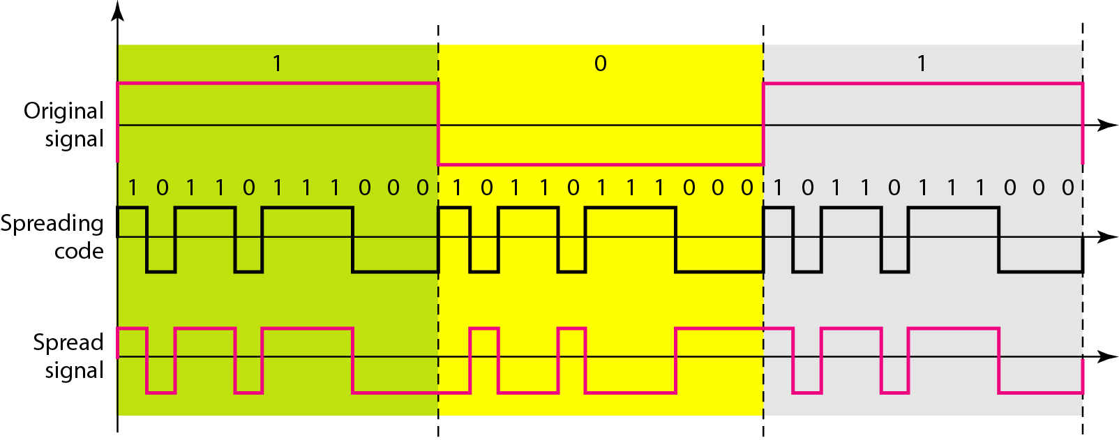
Direct Sequence Spread Spectrum (DSSS)
23
Notes:
Data Communication

Slide 24
Direct Sequence Spread Spectrum (DSSS)
In Figure , the spreading code is 11 chips having the pattern 10110111000 (in this case).
If the original signal rate is N, the rate of the spread signal is 1/N.
This means that the required bandwidth for the spread signal is 11 times larger than the bandwidth of the original signal.
The spread signal can provide privacy if the intruder does not know the code.
It can also provide immunity against interference if each station uses a different code.
24
Notes:
Data Communication

