Slide 1
VIRTUAL-CIRCUIT NETWORKS
1
Notes:
Data Communication

Slide 2
Introduction
A virtual-circuit network is a cross between a circuit-switched network and a datagram network.
It has some characteristics of both.
As in a circuit-switched network, there are setup and teardown phases in addition to the data transfer phase.
Resources can be allocated during the setup phase, as in a circuit-switched network, or on demand, as in a datagram network.
2
Notes:
Data Communication

Slide 3
Introduction
As in a datagram network, data are packetized and each packet carries an address in the header.
However, the address in the header has local jurisdiction, not end-to-end jurisdiction.
The reader may ask how the intermediate switches know where to send the packet if there is no final destination address carried by a packet.
As in a circuit-switched network, all packets follow the same path established during the connection.
3
Notes:
Data Communication

Slide 4
Introduction
A virtual-circuit network is normally implemented in the data link layer, while a circuit-switched network is implemented in the physical layer and a datagram network in the network layer.
4
Notes:
Data Communication

Slide 5
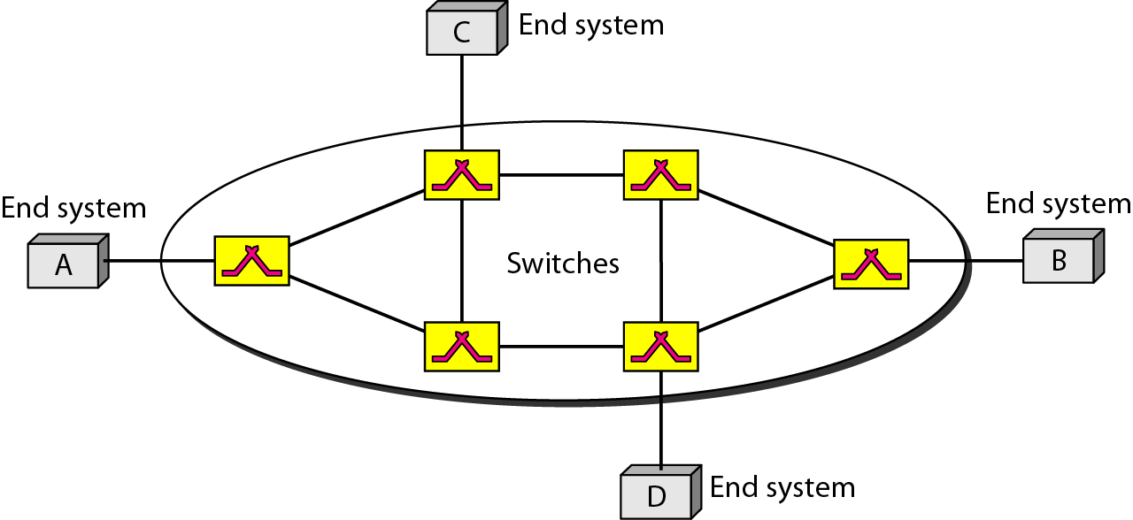
Virtual-Circuit Network
Figure is an example of a virtual-circuit network
5
Notes:
Data Communication

Slide 6
Virtual-Circuit Network
The network has switches that allow traffic from sources to destinations.
A source or destination can be a computer, packet switch, bridge, or any other device that connects other networks
6
Notes:
Data Communication

Slide 7
Addressing
In a virtual-circuit network, two types of addressing are involved:
Global and
Local (virtual-circuit identifier)
7
Notes:
Data Communication

Slide 8
Global Addressing
A source or a destination needs to have a global address-an address that can be unique in the scope of the network or internationally if the network is part of an international network.
However, we will see that a global address in virtual-circuit networks is used only to create a virtual-circuit identifier,
8
Notes:
Data Communication

Slide 9
Virtual-Circuit Identifier (VCI)
The identifier that is actually used for data transfer is called the virtual-circuit identifier (VCl).
A VCI, unlike a global address, is a small number that has only switch scope; it is used by a frame between two switches.
When a frame arrives at a switch, it has a VCI; when it leaves, it has a different VCl.
Figure shows how the VCI in a data frame changes from one switch to another.
Note that a VCI does not need to be a large number since each switch can use its own unique set of VCls.
9
Notes:
Data Communication

Slide 10
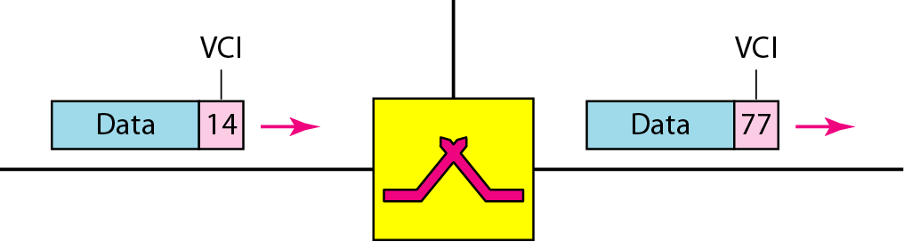
Virtual-Circuit Identifier (VCI)
10
Notes:
Data Communication

Slide 11
Three Phases
As in a circuit-switched network, a source and destination need to go through three phases in a virtual-circuit network: setup, data transfer, and teardown.
In the setup phase, the source and destination use their global addresses to help switches make table entries for the connection.
In the teardown phase, the source and destination inform the switches to delete the corresponding entry.
Data transfer occurs between these two phases.
We first discuss the data transfer phase, which is more straightforward; we then talk about the setup and teardown phases.
11
Notes:
Data Communication

Slide 12
Data Transfer Phase
To transfer a frame from a source to its destination, all switches need to have a table entry for this virtual circuit.
The table, in its simplest form, has four columns.
The switch holds four pieces of information for each virtual circuit that is already set up.
We show later how the switches make their table entries, but for the moment we assume that each switch has a table with entries for all active virtual circuits.
Figure shows such a switch and its corresponding table.
12
Notes:
Data Communication

Slide 13
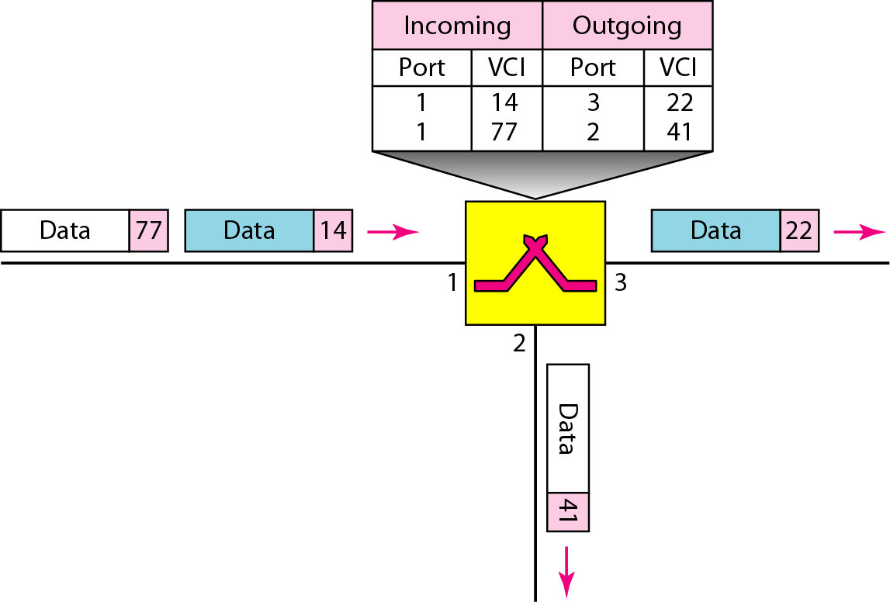
Data Transfer Phase
13
Notes:
Data Communication

Slide 14
Data Transfer Phase
Figure shows a frame arriving at port 1 with a VCI of 14.
When the frame arrives, the switch looks in its table to find port 1 and a VCI of 14.
When it is found, the switch knows to change the VCI to 22 and send out the frame from port 3.
14
Notes:
Data Communication

Slide 15
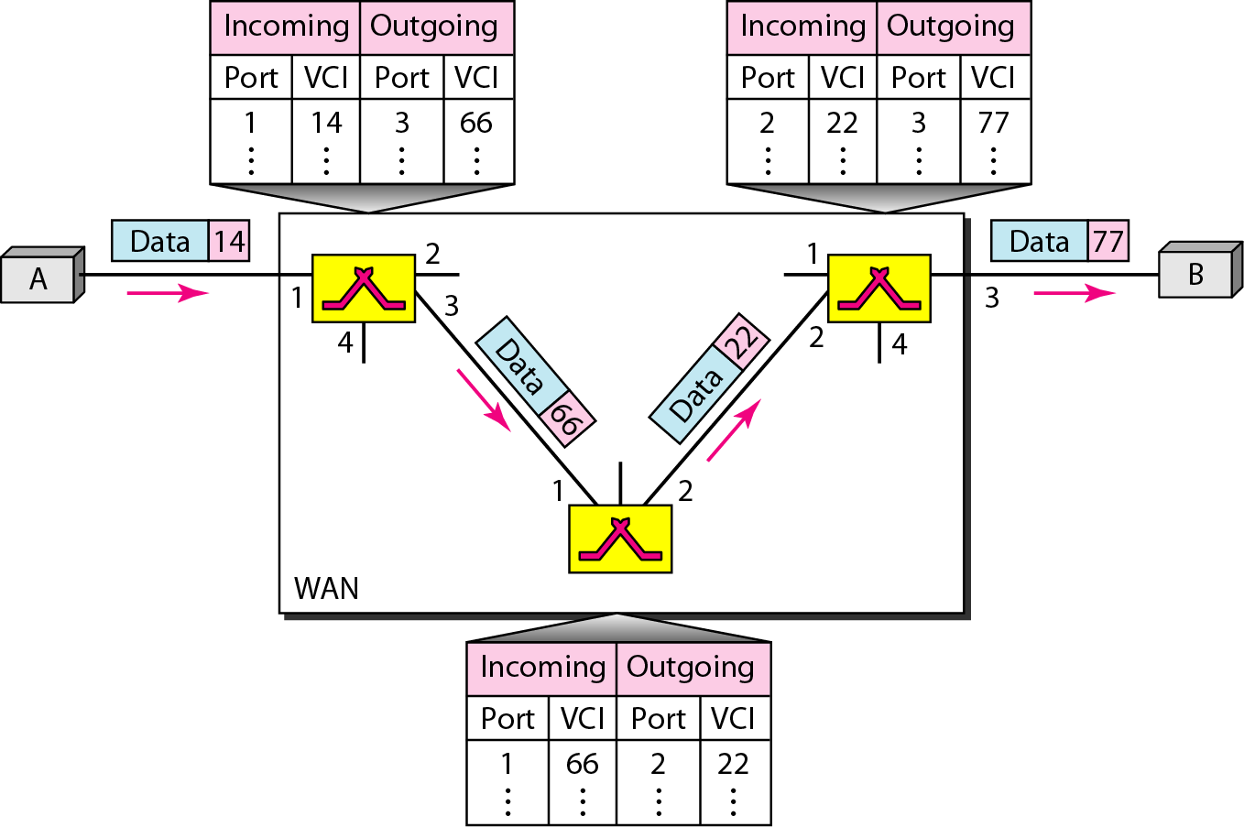
Data Transfer Phase
Figure shows how a frame from source A reaches destination B and how its VCI changes during the trip. Each switch changes the VCI and routes the frame
15
Notes:
Data Communication

Slide 16
Data Transfer Phase
The data transfer phase is active until the source sends all its frames to the destination.
The procedure at the switch is the same for each frame of a message.
The process creates a virtual circuit, not a real circuit, between the source and destination
16
Notes:
Data Communication

Slide 17
Setup Phase
In the setup phase, a switch creates an entry for a virtual circuit.
For example, suppose source A needs to create a virtual circuit to B.
Two steps are required: the setup request and the acknowledgment.
17
Notes:
Data Communication

Slide 18
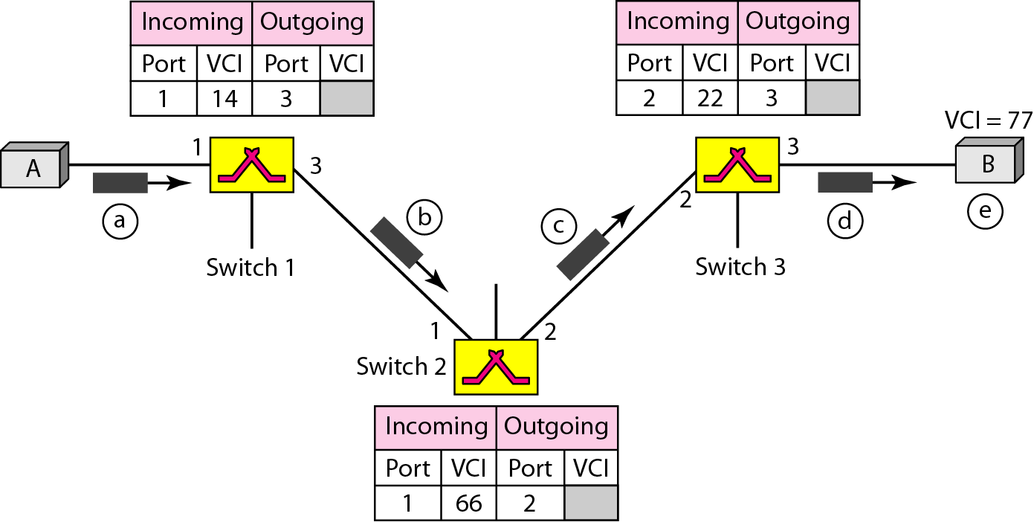
Setup Phase - Setup Request
A setup request frame is sent from the source to the destination. Figure shows the process.
18
Notes:
Data Communication

Slide 19
Setup Phase - Setup Request
Source A sends a setup frame to switch 1.
Switch 1 receives the setup request frame.
It knows that a frame going from A to B goes out through port 3.
The switch, in the setup phase, acts as a packet switch; it has a routing table which is different from the switching table.
For the moment, assume that it knows the output port.
The switch creates an entry in its table for this virtual circuit, but it is only able to fill three of the four columns
19
Notes:
Data Communication

Slide 20
Setup Phase - Setup Request
The switch assigns the incoming port (1) and chooses an available incoming VCI (14) and the outgoing port (3).
It does not yet know the outgoing VCI, which will be found during the acknowledgment step.
The switch then forwards the frame through port 3 to switch 2.
Switch 2 receives the setup request frame.
The same events happen here as at switch 1; three columns of the table are completed: in this case, incoming port (1), incoming VCI (66), and outgoing port (2).
20
Notes:
Data Communication

Slide 21
Setup Phase - Setup Request
Switch 3 receives the setup request frame. Again, three columns are completed: incoming port (2), incoming VCI (22), and outgoing port (3).
Destination B receives the setup frame, and if it is ready to receive frames from A, it assigns a VCI to the incoming frames that come from A, in this case 77.
This VCI lets the destination know that the frames come from A, and not other sources
21
Notes:
Data Communication

Slide 22
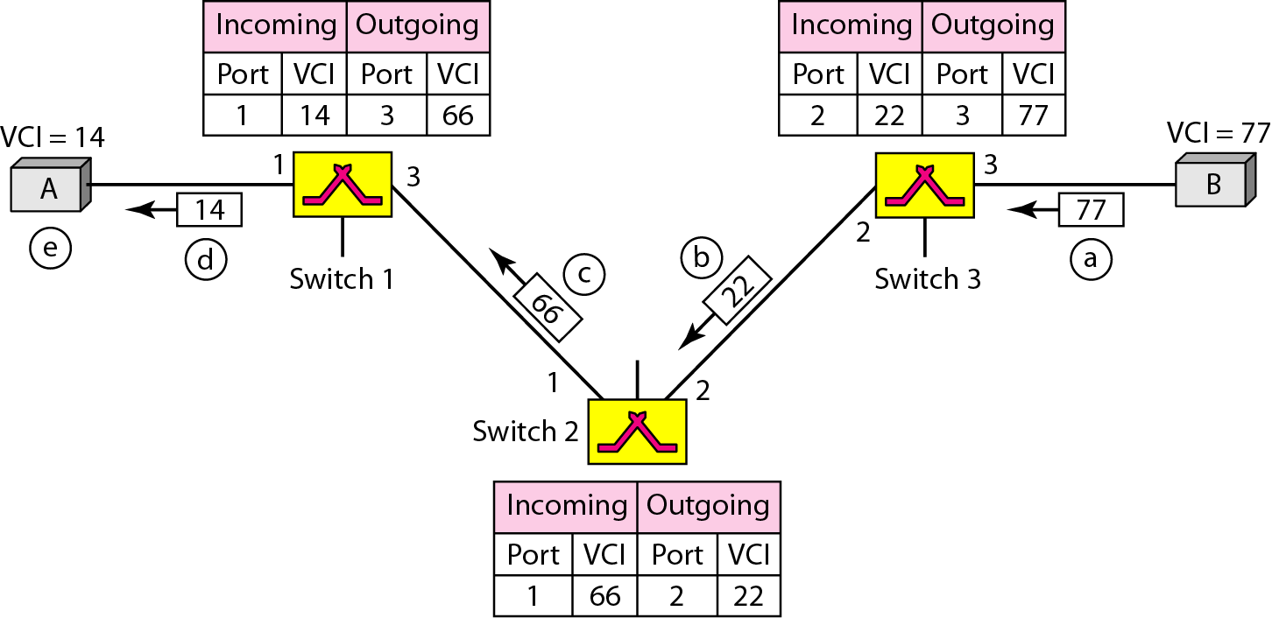
Setup Phase – Acknowledgment
A special frame, called the acknowledgment frame, completes the entries in the switching tables.
Figure shows the process.
22
Notes:
Data Communication

Slide 23
Setup Phase – Acknowledgment
The destination sends an acknowledgment to switch 3.
The acknowledgment carries the global source and destination addresses so the switch knows which entry in the table is to be completed.
The frame also carries VCI 77, chosen by the destination as the incoming VCI for frames from A.
Switch 3 uses this VCI to complete the outgoing VCI column for this entry.
Note that 77 is the incoming VCI for destination B, but the outgoing VCI for switch 3.
23
Notes:
Data Communication

Slide 24
Setup Phase – Acknowledgment
2. Switch 3 sends an acknowledgment to switch 2 that contains its incoming VCI in the table, chosen in the previous step.
Switch 2 uses this as the outgoing VCI in the table.
3. Switch 2 sends an acknowledgment to switch 1 that contains its incoming VCI in the table, chosen in the previous step.
Switch 1 uses this as the outgoing VCI in the table.
24
Notes:
Data Communication

Slide 25
Setup Phase – Acknowledgment
4. Finally switch 1 sends an acknowledgment to source A that contains its incoming VCI in the table, chosen in the previous step.
5. The source uses this as the outgoing VCI for the data frames to be sent to destination B.
25
Notes:
Data Communication

Slide 26
Teardown Phase
In this phase, source A, after sending all frames to B, sends a special frame called a teardown request.
Destination B responds with a teardown confirmation frame.
All switches delete the corresponding entry from their tables.
26
Notes:
Data Communication

Slide 27
Efficiency
Resource reservation in a virtual-circuit network can be made during the setup or can be on demand during the data transfer phase.
In the first case, the delay for each packet is the same; in the second case, each packet may encounter different delays.
There is one big advantage in a virtual-circuit network even if resource allocation is on demand.
The source can check the availability of the resources, without actually reserving it.
27
Notes:
Data Communication

Slide 28
Efficiency
Consider a family that wants to dine at a restaurant
Although the restaurant may not accept reservations (allocation of the tables is on demand), the family can call and find out the waiting time.
This can save the family time and effort.
In virtual-circuit switching, all packets belonging to the same source and destination travel the same path; but the packets may arrive at the destination with different delays if resource allocation is on demand
28
Notes:
Data Communication

Slide 29
Delay in Virtual-Circuit Networks
In a virtual-circuit network, there is a one-time delay for setup and a one-time delay for teardown.
If resources are allocated during the setup phase, there is no wait time for individual packets.
Figure shows the delay for a packet traveling through two switches in a virtual-circuit network.
29
Notes:
Data Communication

Slide 30
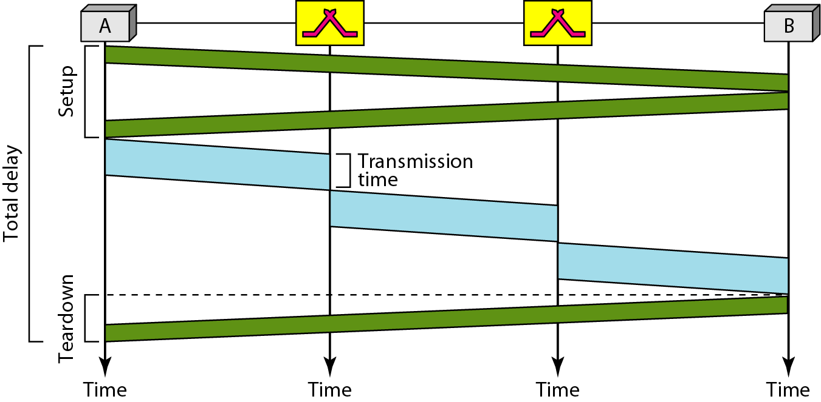
Delay in Virtual-Circuit Networks
30
Notes:
Data Communication

Slide 31
Delay in Virtual-Circuit Networks
The packet is traveling through two switches (routers)
There are three transmission times (3T), three propagation times (3זּ), data transfer depicted by the sloping lines, a setup delay (which includes transmission and propagation in two directions), and a teardown delay (which includes transmission and propagation in one direction).
We ignore the processing time in each switch.
Total delay = 3T+ 3זּ + setup delay + teardown delay
31
Notes:
Data Communication

Slide 32
Delay in Virtual-Circuit Networks
The packet is traveling through two switches (routers)
There are three transmission times (3T), three propagation times (3זּ), data transfer depicted by the sloping lines, a setup delay (which includes transmission and propagation in two directions), and a teardown delay (which includes transmission and propagation in one direction).
We ignore the processing time in each switch.
Total delay = 3T+ 3זּ + setup delay + teardown delay
32
Notes:
Data Communication

