Slide 1
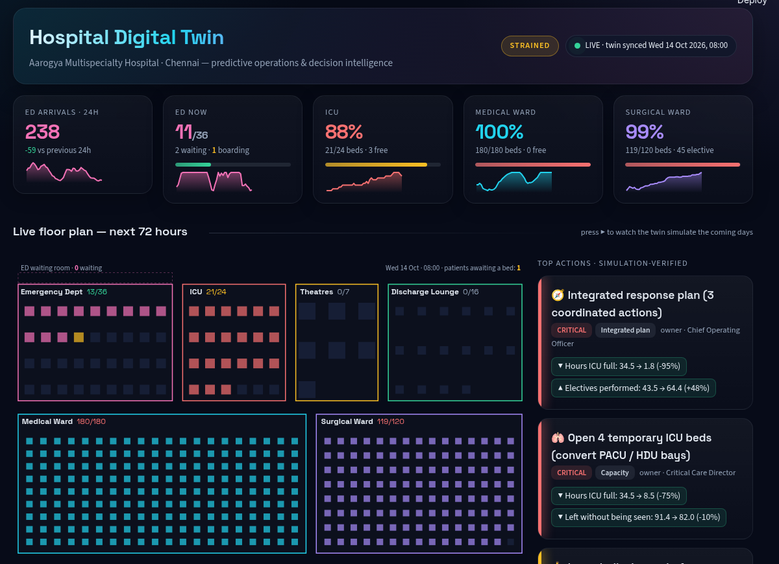
SCOPE · VIT CHENNAI
MediTwin
AI-Powered Hospital Digital Twin for Predictive Healthcare Operations and Decision Intelligence
Forecast
Simulate
Optimise
Recommend
Shresth Kumar Gupta · 23BCE1578
Arnav Kamra · 23BCE1706
School of Computer Science and Engineering

Slide 2
THE PROBLEM
Hospitals run on yesterday's numbers
▸ Reactive operations. Bed crises, ED crowding and cancelled surgery are noticed only after they happen.
▸ Siloed decisions. Nursing rosters, theatre lists and bed management are planned separately, though they compete for the same beds.
▸ No safe place to test. A new policy (surge beds, diversion, deferring electives) can only be tried on real patients.
▸ Fragmented research. Most work does forecasting, simulation or optimisation, rarely all three, and almost never verifies its advice.
MEDICAL WARD NOW
ICU FULL NEXT WEEK
100%
34 h
180 / 180 beds
if nothing changes
LEFT WITHOUT BEING SEEN
ELECTIVES CANCELLED
91
30
per week, ED
per week, no bed
Baseline 7-day projection of the twin from its live state (Wed 14 Oct 2026, 08:00).
MediTwin · AI-Powered Hospital Digital Twin
02 / 16

Slide 3
OBJECTIVES
What MediTwin sets out to do
01
02
03
04
Forecast
Mirror
Optimise
Recommend
Predict ED arrivals and ICU / ward / ED occupancy 14 days ahead, with calibrated uncertainty and explanations.
Hold a live digital twin of every bed, queue and patient, and simulate the hospital forward from that exact state.
Turn forecasts into nurse rosters, theatre lists and patient transfers that respect real constraints.
Propose actions and test each one in the twin first. Only advice that helps is shown.
Novelty: all four layers in one loop. Every recommendation is re-simulated and reported with its KPI change and 90% confidence interval before anyone sees it.
MediTwin · AI-Powered Hospital Digital Twin
03 / 16

Slide 4
HOW IT FITS TOGETHER
System architecture
Hospital data
2 yrs · 165k encounters
ADT-style snapshot
Pre-processing
hourly / daily series
calendar · holidays
ML forecasting
SARIMA · LightGBM
ensemble · SHAP
Digital twin
live state of every
bed, queue, patient
Simulation
SimPy discrete-event
Monte Carlo · CRN
verify
Optimisation
CP-SAT roster · CP-SAT electives
LP redistribution
AI recommendation engine
detect → propose → simulate → score
Interfaces
Streamlit · FastAPI
One command builds the full twin in ~72 s: hospital-twin build → generate history → back-test 4 models × 5 targets → fit + explain → optimise → project 24 futures → verify recommendations.
MediTwin · AI-Powered Hospital Digital Twin
04 / 16

Slide 5
DATA
A realistic synthetic hospital
BEDS
ENCOUNTERS
THEATRES
ESI LEVELS
360
164,594
7
5
ED 36 · ICU 24 · Med 180 · Surg 120
730 days of history
+ 16-chair discharge lounge
triage, LWBS patience, boarding
Demand reflects Chennai
Why it is credible
▸ Weekly cycle and hour-of-day profile
▸ North-east monsoon fever season, summer heat, winter respiratory wave
▸ Indian public holidays and a Diwali trauma spike
▸ AR(1) day-to-day noise and random mass-casualty events
▸ History is produced by running demand through the simulator, so occupancy, boarding and cancellations respect real capacity limits
▸ Fictional hospital (Aarogya Multispecialty, Chennai): no patient data used
▸ Real HL7 / FHIR ADT feeds would replace the generator without other changes
MediTwin · AI-Powered Hospital Digital Twin
05 / 16

Slide 6
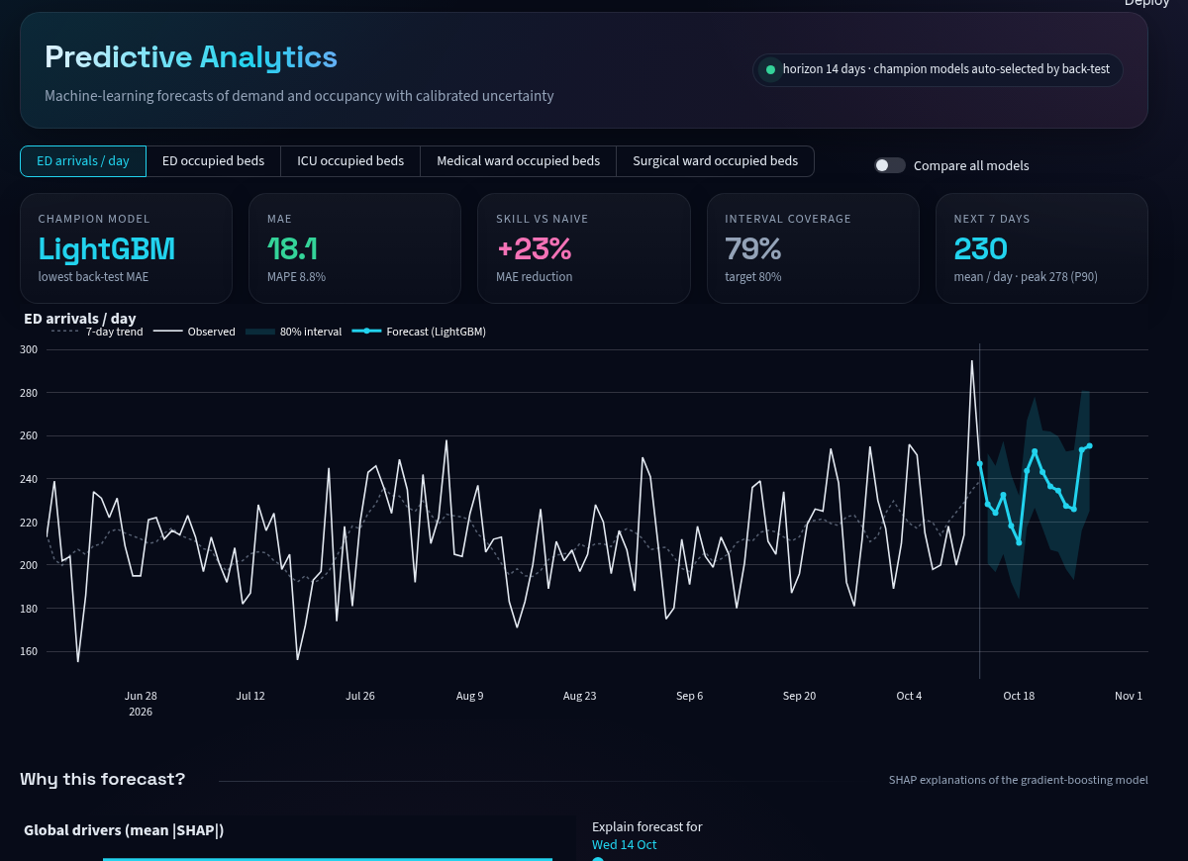
ML FORECASTING
Forecasting with calibrated uncertainty
▸ 4 models: seasonal naive, SARIMA with holiday regressors, recursive LightGBM, ensemble
▸ Rolling back-test: 10 origins × 14-day horizon picks a champion per target
▸ 80% bands calibrated on back-test residuals
▸ SHAP explains the drivers of every forecast day
Target | Champion | MAPE | Skill | Cover
ED arrivals | LightGBM | 8.8% | +23% | 79%
ED census | LightGBM | 10.6% | +28% | 81%
ICU census | Ensemble | 13.2% | +18% | 79%
Medical ward | Ensemble | 6.5% | +19% | 82%
Surgical ward | LightGBM | 9.9% | +24% | 81%
Skill = MAE reduction vs seasonal naive. Cover = actuals inside the 80% band.
MediTwin · AI-Powered Hospital Digital Twin
06 / 16

Slide 7
DIGITAL TWIN + SIMULATION
The live digital twin
▸ Snapshot of every bed, queue and patient: unit, elapsed stay, acuity
▸ Warm start: simulations begin from now, sampling remaining LOS from truncated log-normals
▸ SimPy model: ESI triage, LWBS, doctor shifts, boarding and outliers, emergency and elective theatres, ICU exit-block, discharge window, lounge
▸ Monte Carlo: 24 futures, demand drawn from the forecast band, common random numbers for fair comparisons
▸ Animated floor plan plays the next 72 h bed by bed
MediTwin · AI-Powered Hospital Digital Twin
07 / 16

Slide 8
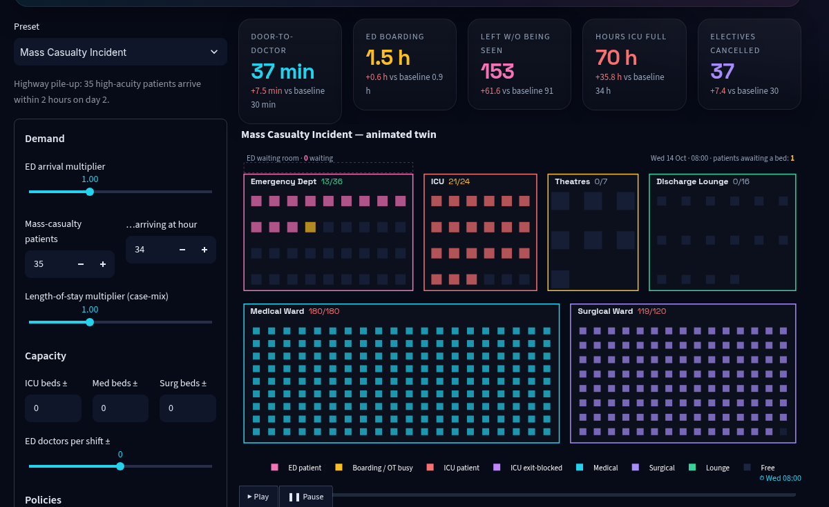
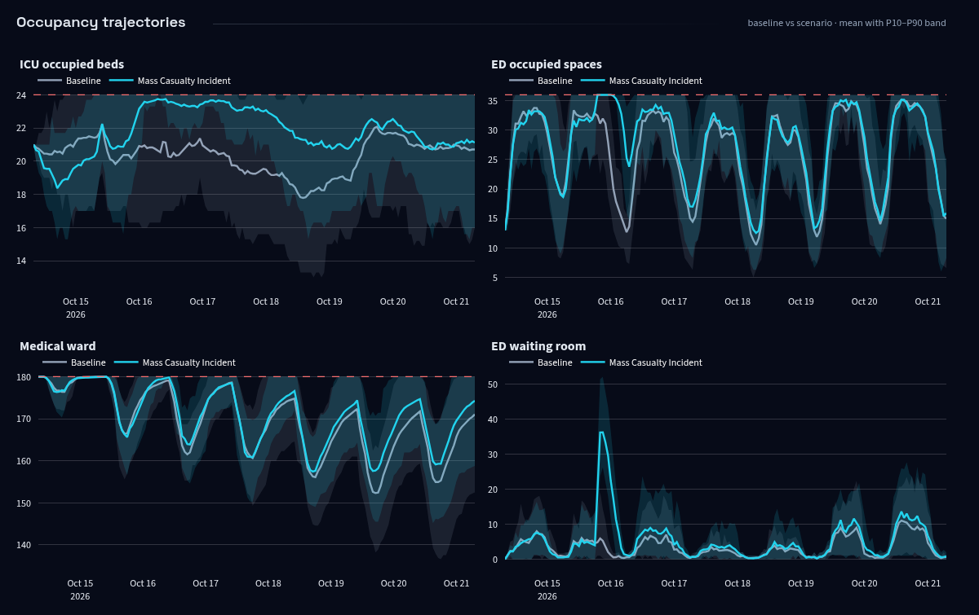
WHAT-IF SIMULATION
Scenario Lab: stress-test before it happens
Mass casualty preset: 35 high-acuity patients arrive 2 hours into day 2. Door-to-doctor rises to 37 min and ICU is full for 70 h. Other presets: monsoon fever surge, ICU bed closure, staff shortage, festival week. One click generates an AI response plan for the scenario.
MediTwin · AI-Powered Hospital Digital Twin
08 / 16

Slide 9
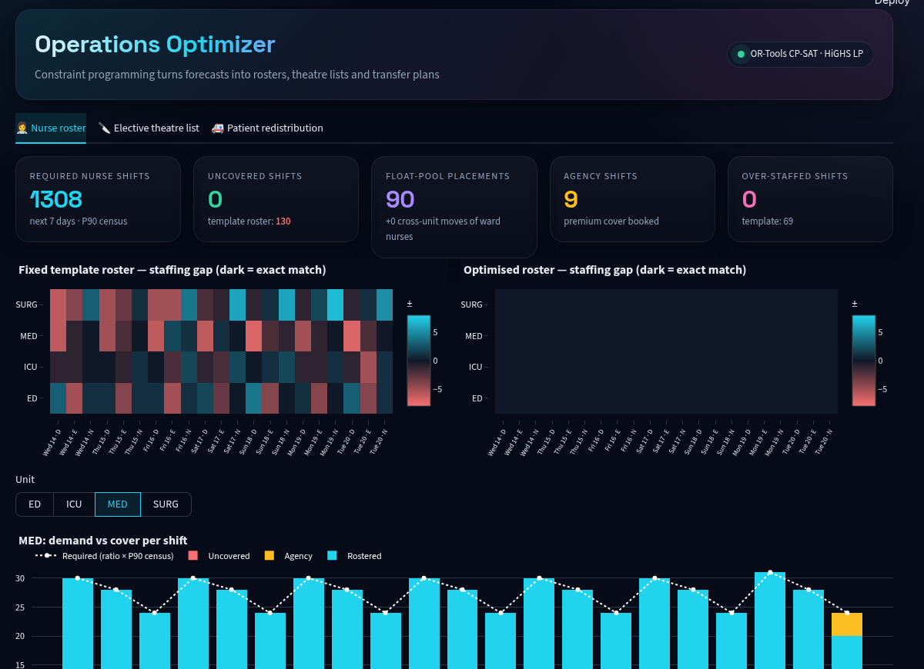
OPERATIONS RESEARCH
Optimisation: from forecast to plan
Nurse roster
0
OR-Tools CP-SAT
≤ 1 shift / day, no night → day, contracted hours, night cap, float pool, agency
uncovered shifts
template: 130
Elective list
0
OR-Tools CP-SAT
theatre hours + post-op ICU and ward beds against forecast emergency load
bed-overflow days
FIFO: 11
Redistribution
LP
SciPy LP (HiGHS)
moves excess patients to outlier beds or partner hospitals at minimum cost
optimal transfers
MediTwin · AI-Powered Hospital Digital Twin
09 / 16

Slide 10
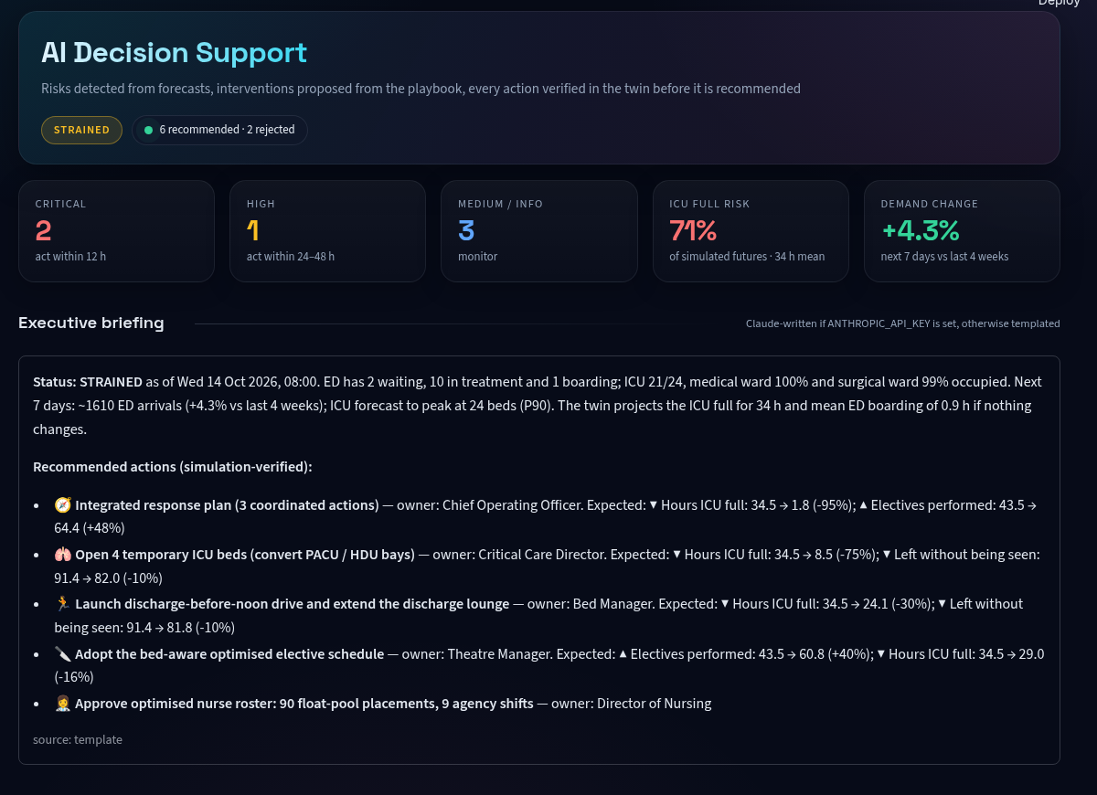
DECISION INTELLIGENCE
AI recommendations, verified by simulation
Detect
risks in forecasts and twin projections
Propose
playbook actions with owner and urgency
Simulate
re-run the twin with each action (CRN)
Score
weighted KPI benefit with 90% CI
Bundle
combine winners and re-verify as one plan
Verdict | Action | Simulated effect | Score
Accept | Integrated response plan | ICU full 34.5 → 1.8 h | 185
Accept | Open 4 temporary ICU beds | ICU full −75% | 85
Accept | Discharge-before-noon drive | ICU full −30% | 85
Accept | Bed-aware elective schedule | electives +40% | 73
Accept | Optimised nurse roster | 0 uncovered shifts | 18
Reject | Extra ED physician | cost > benefit | −17
Reject | Defer 30% of electives | lost surgery outweighs gain | −51
MediTwin · AI-Powered Hospital Digital Twin
10 / 16

Slide 11
ABLATION
Results: AI plan vs reactive operations
Under stress | Reactive | AI plan
Door-to-doctor (MCI) | 37 min | 19 min
ED boarding (ICU closure) | 2.3 h | 0.4 h
LWBS (monsoon) | 606 | 245
LWBS (ICU closure) | 172 | 24
Electives cancelled (MCI) | 37 | 21
3.5–19×
fewer ICU-full hours across every stress scenario, with shorter ED waits and fewer patients leaving unseen.
MediTwin · AI-Powered Hospital Digital Twin
11 / 16

Slide 12
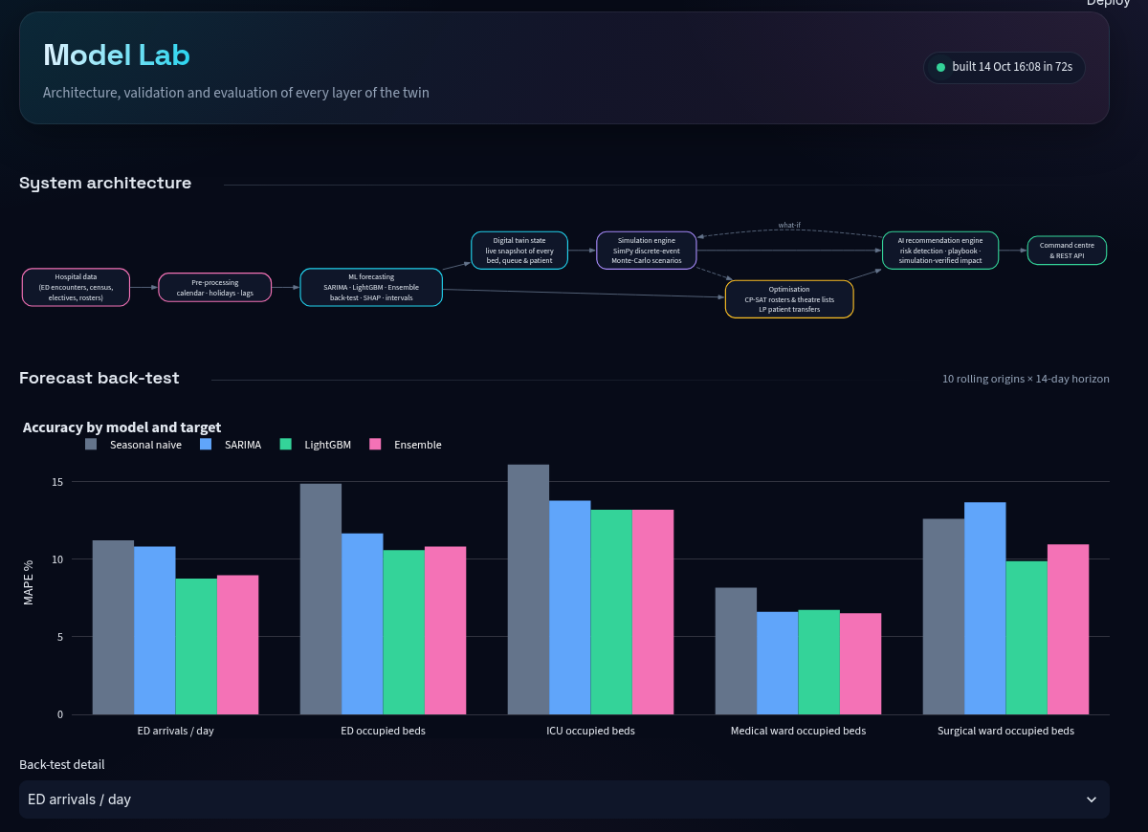
VALIDATION
Can we trust the twin?
Twin replay: last 8 weeks of observed demand
Series | Observed | Twin | MAPE
ED arrivals / h | 8.92 | 8.95 | 6.1%
ED census | 22.9 | 23.2 | 8.2%
ICU census | 19.5 | 20.3 | 14.1%
Medical ward | 153.3 | 156.0 | 5.0%
Surgical ward | 89.1 | 94.7 | 10.2%
Optimisers vs simple rules
Metric | Rule-based | Optimised
Uncovered nurse shifts (7 d) | 130 | 0
Electives: bed-overflow days | 11 | 0
Electives: P1 cases scheduled | 77% | 94%
Model Lab page: architecture, back-test detail, twin validation, optimisation benchmarks and ablation, regenerated by hospital-twin evaluate.
MediTwin · AI-Powered Hospital Digital Twin
12 / 16

Slide 13
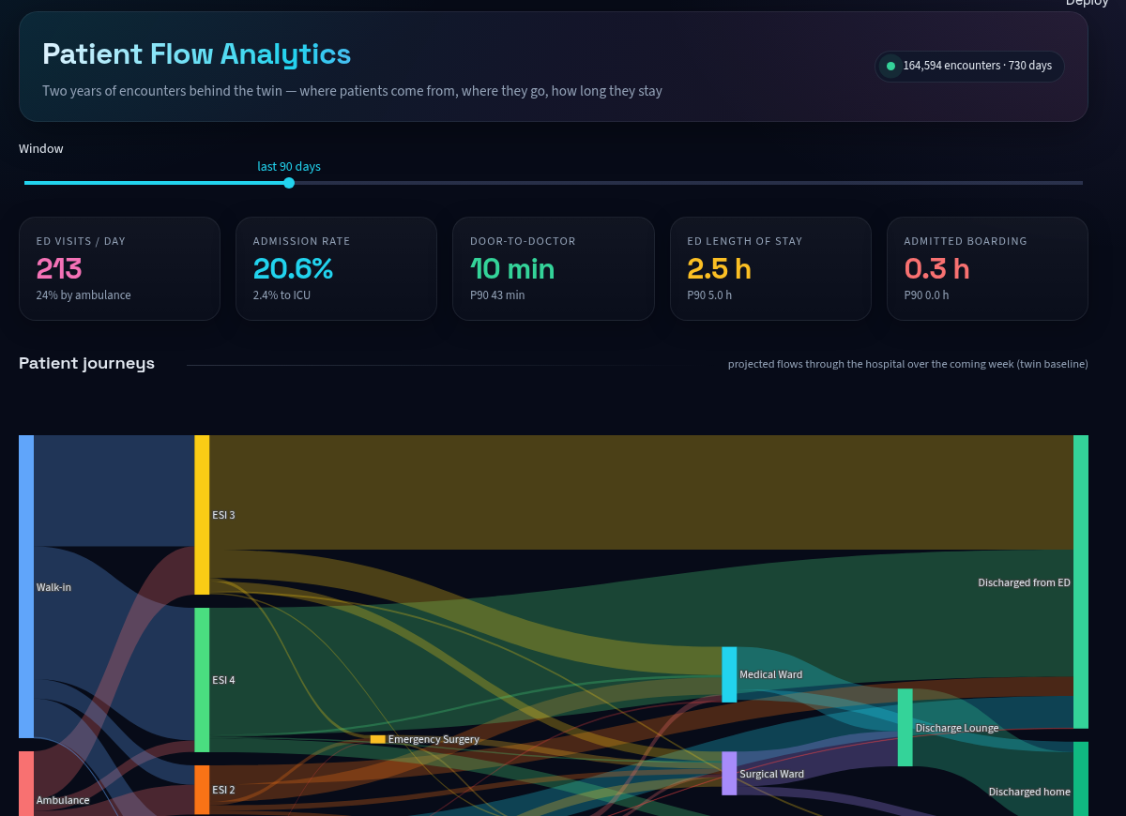
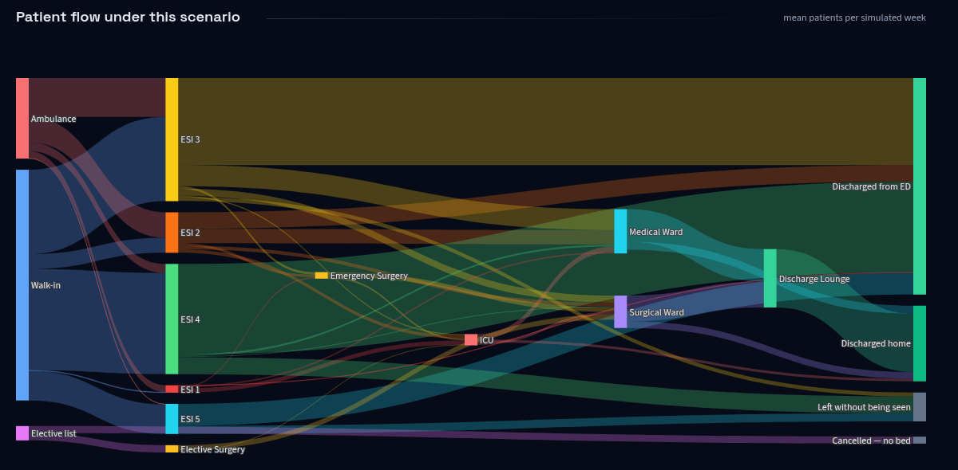
INTERFACES
The command centre
REST API (FastAPI): GET /state · /forecast/{target} · /roster · /electives
POST /simulate · /recommendations
Command Center
Forecasts
Scenario Lab
Optimizer
AI Recommendations
Patient Flow
Model Lab
MediTwin · AI-Powered Hospital Digital Twin
13 / 16

Slide 14
IMPLEMENTATION
Technology stack
Language & build
Python 3.12 · uv · pytest (17 tests)
Forecasting
statsmodels SARIMAX · LightGBM · SHAP · scikit-learn
Simulation
SimPy discrete-event · joblib parallel Monte Carlo
Optimisation
Google OR-Tools CP-SAT · SciPy linprog (HiGHS)
Decision layer
simulation-verified playbook · optional Claude-written executive brief
Interfaces
Streamlit · Plotly (animated floor plan, Sankey, maps) · FastAPI
uv run hospital-twin build · evaluate · app · api
MediTwin · AI-Powered Hospital Digital Twin
14 / 16

Slide 15
NEXT STEPS
Limitations and future work
Limitations
Future work
▸ Patient data is synthetic. Volumes are plausible for an Indian tertiary hospital, but it is not a real record.
▸ Twin validation is partly self-consistent, because history comes from the same simulator.
▸ Nurse staffing is optimised but does not slow care inside the simulator (ED doctors do).
▸ Partner-hospital capacity is static and fictional.
▸ Connect live HL7 / FHIR ADT feeds and validate against a partner hospital.
▸ Model nurse workload in the simulator, so roster gaps affect patient flow.
▸ Reinforcement learning for sequential bed-management policies.
▸ Live regional bed availability for inter-hospital transfers.
MediTwin · AI-Powered Hospital Digital Twin
15 / 16

Slide 16
Thank you
Forecast → Simulate → Optimise → Recommend
github.com/Arnav717/hospital-digital-twin
Shresth Kumar Gupta (23BCE1578) · Arnav Kamra (23BCE1706)
SCOPE, VIT Chennai
MediTwin · AI-Powered Hospital Digital Twin
16 / 16

