Slide 1
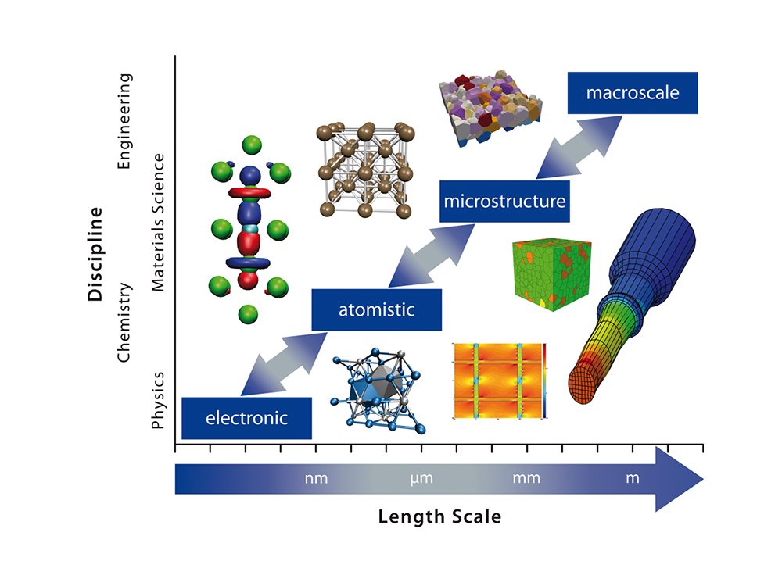
MLL213: Materials Modelling
Prof N S Harsha Gunda
Department of Materials Science and Engineering
IIT Delhi
Office: 306H, Academic Complex West
Email: gnsharsha@iitd.ac.in

Slide 2
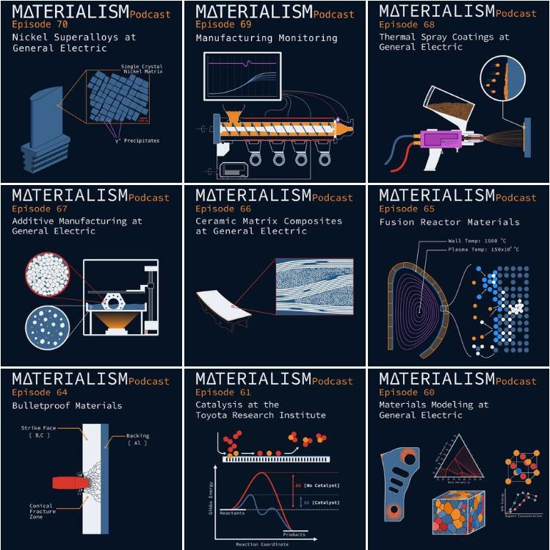
Materialism Podcast
In this podcast, Taylor and Andrew investigate the past, present, and future of materials science and engineering. Topic areas ranging from cutting-edge materials technology, the history of different materials, the commercialization of new materials, and exciting advances in processing and characterization are all covered in detail.
Website: https://materialismpodcast.com/index.html
Spotify:
https://open.spotify.com/show/4ZQEna4EJro xLYteCserNG?nd=1

Slide 3
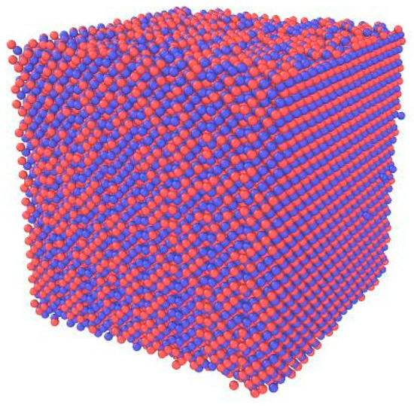
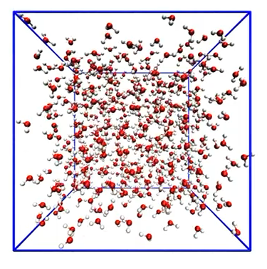
Molecular Dynamics
Atomistic Simulations
Inter atomic potential
Newtonian mechanics
F = ma
Simulate millions of atoms at a time.

Slide 4
MD Implementation
Assign particle positions
Assign particle velocities
Specify type of ensemble
Specify potential
Initialize
Force calculation using current position
Integration and updating of positions and velocities after Δt
Run
Termination based on preset criteria
Use 6N variables to evaluate properties and visualize
Average properties
Analyse

Slide 5
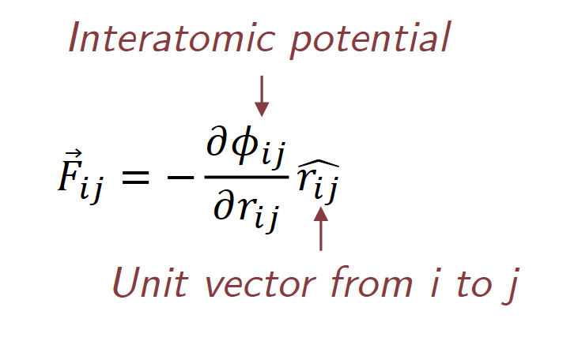
Force Calculation
Origin of Force
External:
  The external force on each atom (if any) needs to be pre-assigned
Interatomic Force :
Internal:
  Due to bonding i.e., the gradient in potential energy
  Each atom is bonded with every other and each of these bonds is in a different state of being stretched (or compressed)

Slide 6
Interatomic Potentials

Slide 7
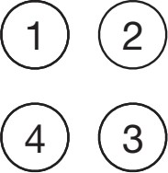
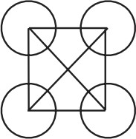



Interactions between atoms
External field
Pair potential
Three-body
…….

Slide 8
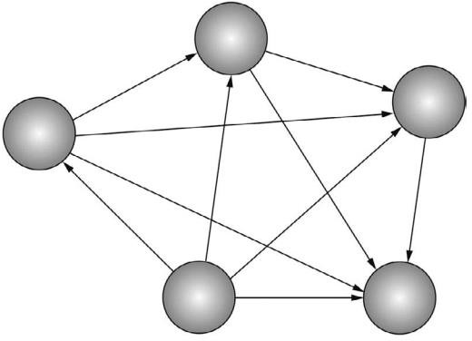



Central-Force potentials
We will come across a number of systems in which the interaction potential between two particles is a function only of the distance between them – these are called central-force potentials

Slide 9
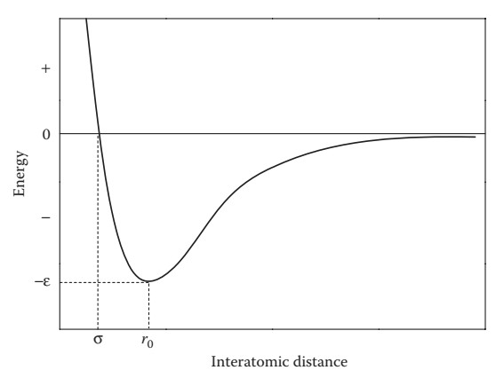

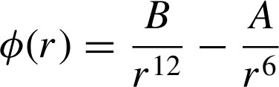
Lennard-Jones (LJ) pair potential
A typical example is the Lennard−Jones potential (Lennard−Jones 1924)
parameter ε is the lowest energy of the potential curve (≡ well depth, cohesive energy), parameter σ is the interatomic distance at which the potential is zero
At equilibrium interatomic distance, r₀, two forces are balanced to a net force of zero, and the corresponding energy becomes minimum (dU_{LJ}/dr = 0)

Slide 10

Mie Potential
Improvements can be made to the Lennard-Jones potential by adding additional parameters. One approach would be to have the exponents in the 1/r¹² and 1/r⁶ parts of the potential be adjustable parameters, i.e., instead of r⁻¹², perhaps r⁻¹¹ would be a better description of the short- range interactions in some systems.
A variation of the Lennard-Jones form, called the Mie potential (or the mn Lennard-Jones potential), takes this approach, replacing 1/r¹² with 1/r^{m} and 1/r⁶ with 1/r^{n}. Writing the Mie potential as

Slide 11
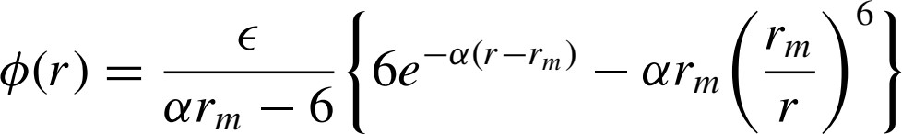


Other potentials
Buckingham potential
𝜙 𝑟 = 𝐴𝑒^{−𝛼𝑟} − ^{𝐶}
_{𝑟}6
Often used for Ionic systems where electrostatic interactions are included.

Slide 12
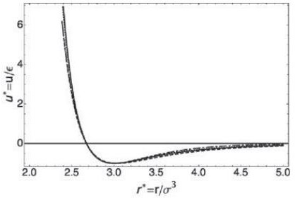
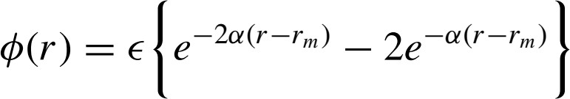
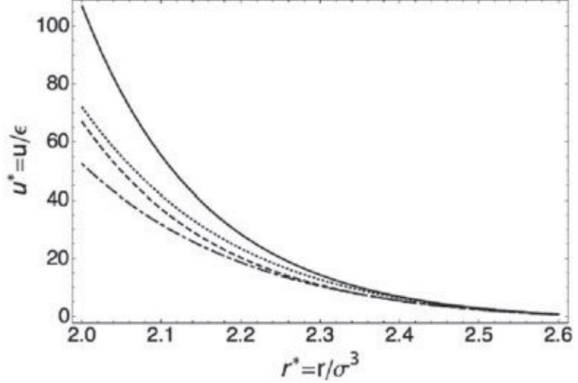

Other potentials
Morse potential
r_{m} is the position of the minimum,є is the well depth, and α governs the shape of the potential. The Morse potential has a very soft repulsive wall and is sometimes used to model interatomic interactions in metals.
The interaction at long range falls off much more quickly than the van der Waals energy
LJ

Slide 13
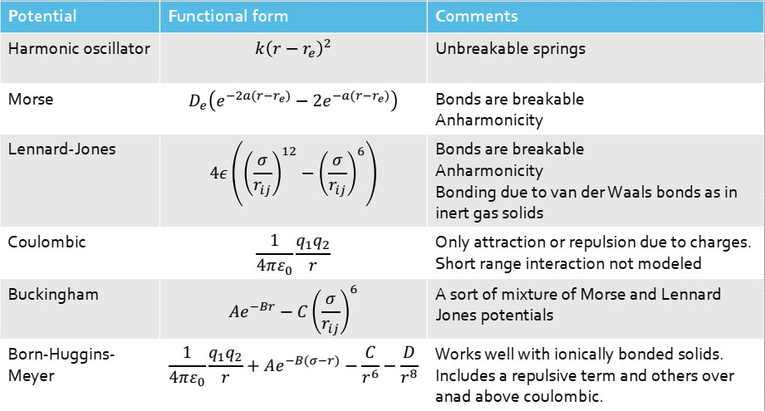
Summary of Central force potentials

Slide 14
Advantages & disadvantages of CFP
Advantages
  Simplicity
  Ability to make easy models and hypothetical systems
  Computational ease
Disadvantages
  Problem of accuracy
  The use of the common Lennard-Jones potential limited to inert gases, where no electrons are available for bonding & atoms are attracted to each other only through van der Waals forces.
  Problems in metallically, ionically and covalently bonded systems with respect to cohesive energy, elastic constants, etc.

Slide 15
Many-body potentials
Many of these potentials are also called bond order potentials
Based on Pauling’s concept of bond-order, i.e., the strength of a chemical bond depends on the bonding environment, including the number of bonds and possibly also angles and bond length
General equation of form…
^{𝜙}𝑖𝑗 ^{= 𝜙}𝑟𝑒𝑝𝑢𝑙𝑠𝑖𝑣𝑒^{(𝑟}𝑖𝑗^{) + 𝑏}𝑖𝑗𝑘^{𝜙}𝑎𝑡𝑡𝑟𝑎𝑐𝑡𝑖𝑣𝑒^{(𝑟}𝑖𝑗⁾
Different types of bond order potentials
  Embedded Atom Method (EAM) or Glue potentials: Based on effective medium theory
  Finnis-Sinclair Potential: Based on the tight-binding theory (linear combination of atomic orbitals or LCAO)
  Tersoff and Stillinger-Weber potential: Incorporate bond directionality

Slide 16
Embedded Atom Method (EAM) potential
Typically, applicable for free-electron, sp-bonded, close-packed metals.
Also called glue potential (electrons as the glue holding nuclei together)
  Closely related to the effective medium theory
  Each atom is assumed to be embedded in the electron gas contributed by the atoms in the neighborhood. The local electron density is determined by the neighborhood
Each ion-core is associated with it’s own screening cloud of valence electrons → pseudo atoms
The pair potential is determined by ion-ion interactions and the extent of screening.
The higher the electron density, the greater the screening → smaller is the effective size of the pseudo atom and the weaker the ion-ion interaction → stronger the bonding

Slide 17
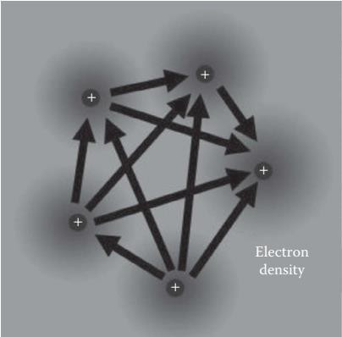
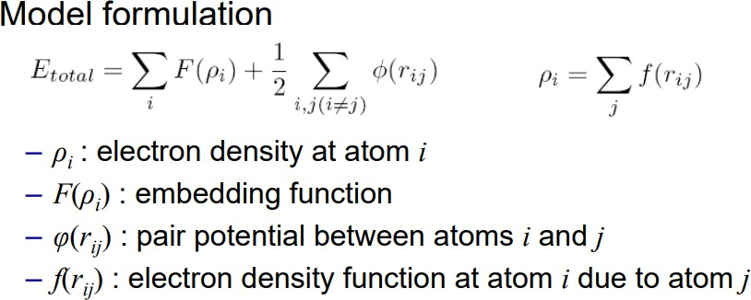
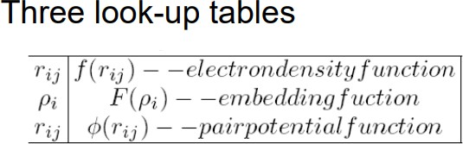
Embedded Atom Model (EAM) potential
Metals have ionized atom cores with a “sea” of
delocalized valence electrons
Pairwise repulsive term due to electrostatic ion- core interactions
Attractive “embedding” energy dependent on the local electron density where the atom is embedded

Slide 18
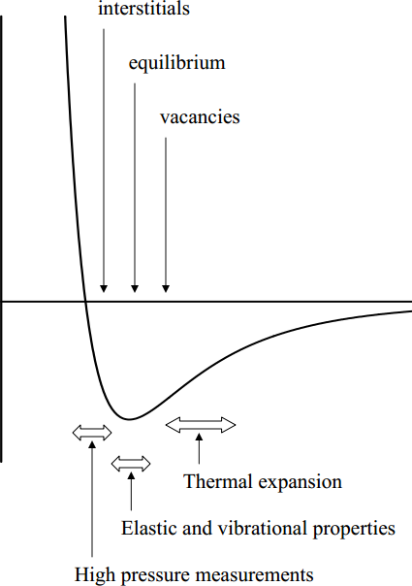
EAM potentials
The pairwise and embedding functions are often determined by fitting to experimental data.
The functions can also be fit to data from first-principles calculations using information such as forces and cohesive energies of arbitrary crystal structures (e.g. BCC Nickel, HCP Gold)
Features:
  Captures the effect of coordination on bond-strength.
  C12/C44 values predicted close to reality
  Computational cost is only twice that of pair potentials
  Works well only sp sp-bonded metals.

Slide 19
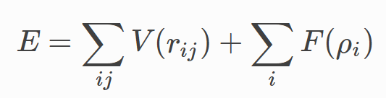
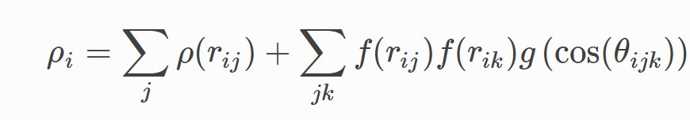
Modified-EAM potentials
Generalization of the embedded atom method.
MEAM potentials include angular-dependent interactions, which enter via the electron density term.
These potentials can describe directional bonding, which is most apparent in covalent materials such as silicon and diamond, but also in e.g., body-centered cubic (BCC) metals
where the angular dependence enters via the electron density term

Slide 20
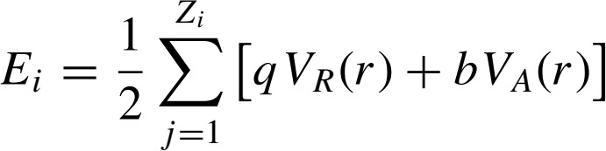
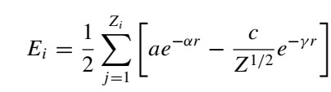
Bond order potentials (Covalent solids)
Bond order potentials:
  To represent the bonding in a solid, it seems reasonable to assume that the strength of the bonding between nearest-neighbor atoms should decrease with the number of nearest neighbors, Z, as there are only so many electrons that can be distributed in the bonds
      Abell assumed that

Slide 21
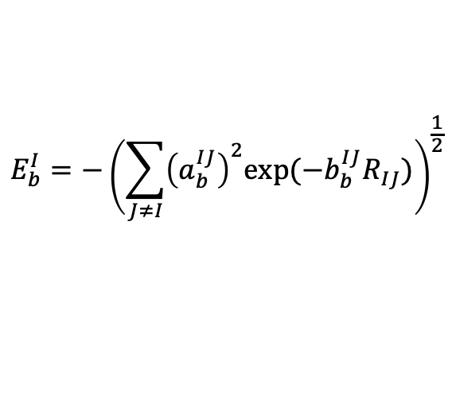
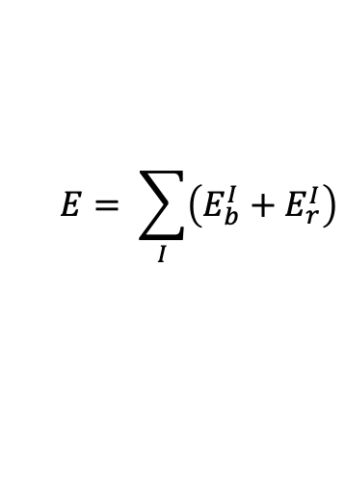
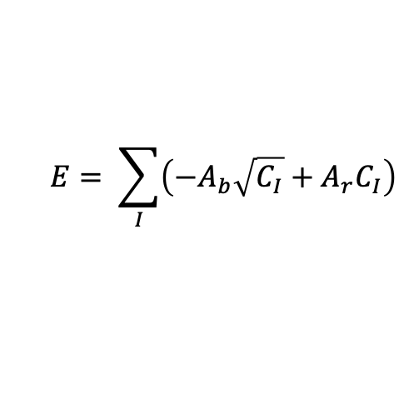
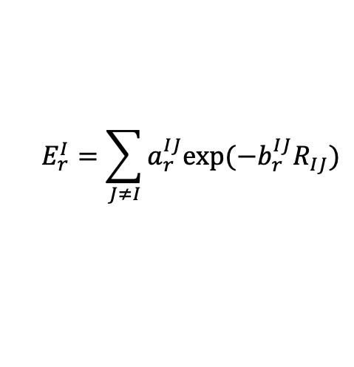
Finnis-Sinclair Potentials
It has advanced potential compared to Lennard-Jones. The repulsive and bonding terms are as follows
$$E_{b}^{I}=−{\left(\sum_{J≠I}{{\left(a_{b}^{IJ}\right)}^{2}exp⁡(−b_{b}^{IJ}R_{IJ})}\right)}^{\frac{1}{2}}$$
Bonding term
$$E= \sum_{I}{\left(E_{b}^{I}+E_{r}^{I}\right)}$$
where
$$E_{r}^{I}=\sum_{J≠I}{a_{r}^{IJ}exp⁡(−b_{r}^{IJ}R_{IJ})}$$
Repulsion term
I = atom indices
If it’s a fixed mono-atomic crystal, the formula reduces to
$$E= \sum_{I}{\left(−A_{b}\sqrt{C_{I}}+A_{r}C_{I}\right)}$$
For 1st nearest neighbor

Slide 22
Advantages & Limitations (MBP)
Advantages
  Significantly superior to pairwise potentials in terms of accuracy and transferability
  Computationally efficient (time scales as N²) , and one can go up to a billion atoms
and a few 100s of nanoseconds
Limitations
  Transferability is an issue
  Potential development for new systems is an issue. Particularly for multi- component system
  Qualitative trends are more believable than quantity

