Slide 1

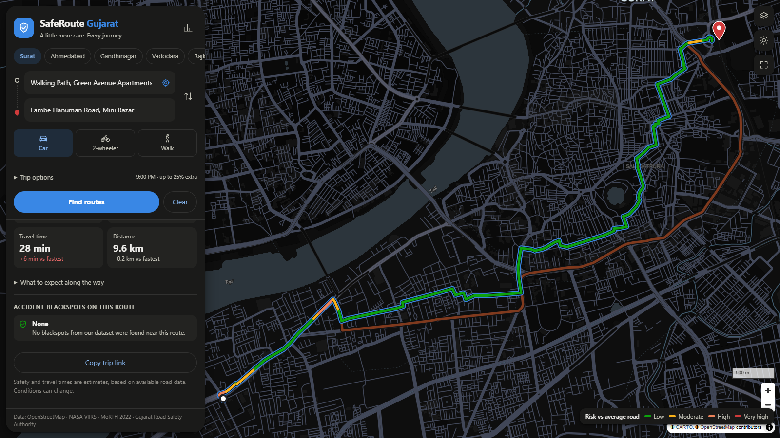
SafeRoute Gujarat
SVNIT · Department of Civil Engineering
Safety-oriented route optimisation for Surat, Ahmedabad, Gandhinagar, Vadodara and Rajkot
TEAM
Our working prototype: fastest vs. safety route, Surat at 9 pm
Chinta Lakshya
Civil · Survey & data collection
Damerla Akshara
Civil · Theory & data sources
Arnav Balodi
CSE · Risk modelling & routing
Veer Kishan Whabi
ECE · UI/UX & backend
Supervisor Prof. Shriniwas Arkatkar
Notes:
PRESENTER: Veer (about 20 seconds) · RUNNING TIME 0:00–0:20
Good morning. We are presenting SafeRoute Gujarat, our mini project under Prof. Arkatkar.
The original proposal had three objectives: safety, AQI and efficiency. AQI and efficiency were taken up by other teams, so our team owns the SAFETY objective. Travel time and distance still appear in our work, but only so that every safe route can be compared fairly with the normal fastest route.
In one line: Google Maps shows you the fastest route. Our system shows that same route next to a safer alternative, and explains exactly why the alternative is safer and what it costs in extra minutes.
The screenshot on the right is our working prototype, not a mock-up. It covers five cities: Surat, Ahmedabad, Gandhinagar, Vadodara and Rajkot.
Over the next 15 minutes each of us will present our own part. I'll first introduce who did what.

Slide 2




Team contributions
Damerla Akshara
Chinta Lakshya
Arnav Balodi
Veer Kishan Whabi
Civil
Theory & data sources
Civil
Survey & field data
CSE
Risk modelling & routing
ECE
UI/UX & backend
Literature review: HSM, Indo-HCM
Collected crash statistics & 22 blackspots
Safety factors used in the model
Designed and ran the commuter survey
100 responses, SVNIT–Station corridor
Traffic-flow formulas: BPR, Webster
Road-network risk model & calibration
Turn-aware A* routing engine
Validation on 400 simulated trips
Map interface & route comparison
API layer & input validation
Charts, dark mode, mobile layout
Notes:
PRESENTER: Veer (about 50 seconds) · 0:20–1:10
Our professor asked that each member's contribution be clear, so here is the split.
Akshara (Civil) handled the theory: the literature review covering the MoRTH accident reports, the Highway Safety Manual and Indo-HCM. Akshara also collected the crash statistics and the 22 accident blackspots with their sources.
Chinta (Civil) ran the primary data collection: a questionnaire on the SVNIT to Surat Railway Station corridor with 100 responses and its analysis. Chinta also worked out the traffic-flow formulas: BPR travel time and Webster signal delay.
Arnav (CSE) built the modelling and routing core: the model that gives every road and junction a risk value, calibrates it to official crash totals, and the A* search that finds the safest route within a time budget. Arnav also ran the validation.
I (Veer, ECE) built the user interface and part of the backend: the Google Maps-style map, route cards, charts, the API that connects them, and the input checks that keep it robust.
Order: problem, evidence, survey and formulas, then the model, then the system, then results. The timing for each slide is in its notes; the whole talk is about 14.5 minutes plus questions.

Slide 3



Why a safety-first route
1,112
people killed on roads in these four cities in a single year
20.4%
of India's crashes happen between 6 and 9 pm, the busiest crash window
0
mainstream navigation apps that rank routes by safety
Notes:
PRESENTER: Akshara (about 50 seconds) · 1:10–2:00
Why safety? These are official figures from the Ministry of Road Transport and Highways, Road Accidents in India 2022.
In 2022, Ahmedabad recorded 1,711 road accidents and 488 deaths. Surat recorded 683 accidents and 293 deaths, Rajkot 498 and 150, Vadodara 478 and 181. Together that is 1,112 deaths in one year in the four cities our system covers.
Severity is very high. In Surat 293 of 683 crashes were fatal, about 43 deaths per 100 crashes, above the national average of about 37.
The second card is about timing. Nationally, 20.4% of crashes happen between 6 and 9 pm, the single worst window. That is why our model changes with the time of day.
The key point: crashes come from factors that can be anticipated and altered, so they are predictable and preventable. Navigation apps already know road class, speed and junction layout, but use them only to minimise time. We use the same information to minimise risk.

Slide 4
What the evidence says about road risk
Finding | How we used it in the model
Crashes come from road, environment and traffic factors AASHTO Highway Safety Manual | Road class & speed, lighting & hour, traffic exposure (AADT) set each road's risk
Right-turn vs through-traffic conflicts dominate at T-junctions Indo-HCM (2017) conflict studies | A right turn across traffic costs 1.6× a straight move; U-turn 2.2×
Vulnerable road users: 48% of road deaths MoRTH | Separate two-wheeler and pedestrian risk profiles
Crashes cluster at blackspots MoRTH 500 m definition; GRSA audits | 22 blackspots, Empirical Bayes weighting
Delay rises sharply as V/C approaches 1 Traffic-flow theory: BPR, Webster | Travel time rises with hourly V/C; signal delay at junctions
Road features change crash rates HSM crash modification factors | Factors for lighting, bridges, medians and surface
5 E's: Engineering, Enforcement, Emergency, Evaluation Road-safety management framework | Safer route choice, police proximity, nearest hospital, validation study
Notes:
PRESENTER: Akshara (about 1 minute) · 2:00–3:00
Before the data, this slide shows the evidence our design is built on, from our literature review and data collection.
Crashes come from road, environment and traffic factors; the Highway Safety Manual finds roadway factors present in about a third of crashes. These become our road-class crash frequencies, lighting and time-of-day factors, and an exposure term from traffic volume.
Indo-HCM conflict studies show that the main conflict at T-junctions is between right-turning and through vehicles. That is why our router penalises a right turn at 1.6× a straight move and a U-turn at 2.2×.
MoRTH data shows pedestrians, cyclists and two/three-wheelers account for 48% of road deaths. So we have separate two-wheeler and walking modes with their own risk curves.
Crashes cluster at blackspots, which MoRTH defines as 500 m stretches with repeated serious crashes; we use 22 documented ones. From traffic-flow theory, delay rises sharply as volume approaches capacity, which drives our travel times.
Finally, the HSM's crash modification factors and the 5 E's of road safety: our route choice is engineering, and we also show police proximity (enforcement), the nearest hospital (emergency care), and a validation study (evaluation).

Slide 5
Commuter survey: who answered
100
99%
97%
61 / 39
responses collected
SVNIT students & scholars
aged under 30
male / female (%)
Notes:
PRESENTER: Chinta (about 50 seconds) · 3:00–3:50
To ground the project in real commuter experience, we ran a questionnaire on one corridor we all know: SVNIT to Surat Railway Station.
We collected 100 responses. 99% are SVNIT students or scholars, 97% are under 30, and the split is 61% male and 39% female. So this represents young campus commuters, not all of Surat, and we say that openly.
Left chart: 40% mainly use auto-rickshaws, 25% cars or cabs, 20% two-wheelers and 15% BRTS. Many of our respondents are passengers or two-wheeler riders, the most vulnerable groups.
Right chart: 45% don't stick to one route, they switch based on live traffic in Google Maps. 34% usually take Route A via Dumas Road and Ring Road, 18% Route B via Athwa Lines and Chowk Bazaar, and 3% Route C via VIP Road and Udhna Darwaja.
So people already let an app choose their route. If the app considered safety, their choices would change too.

Slide 6



What commuters told us
57.9%
45.1%
How this shaped the model
would take a 2–3 minute longer route if it is safer, cleaner and less congested
named rash driving or speeding near intersections as the top hazard
A small, capped detour
Users accept minutes, not a long detour, so safety routes respect a time limit
n = 95; another 38.9% said “depends on urgency”
n = 91; then traffic conflicts 23.1%, missing crossings 15.4%
Junctions matter most
Speeding and conflicts at intersections become junction and turning risk
31%
67.4%
said Station Approach Road has the worst congestion
face a typical delay of 5–15 minutes on this corridor
A real test corridor
SVNIT to station became our case study
n = 100; SVNIT Circle / Kargil Chowk 28%, Ring Road flyover 14%
n = 95; 28.4% report under 5 minutes
Notes:
PRESENTER: Chinta (about 55 seconds) · 3:50–4:45
Four findings shaped the design.
1. 57.9% of 95 respondents would take a route 2 to 3 minutes longer if it were safer, cleaner and less congested. Another 38.9% said it depends on urgency, and very few refused outright. So a safety route is acceptable if the time cost is small. That is why our engine caps the detour and also offers a "balanced" route.
2. The most reported hazard was rash driving or speeding near intersections, 45.1% of 91 answers, then traffic conflicts 23.1% and missing pedestrian crossings 15.4%. Danger concentrates at junctions, so the model scores every junction and every turn, not just road length.
3. Station Approach Road was the most reported congestion point at 31%, then SVNIT Circle / Kargil Chowk at 28% and the Ring Road flyover / Sahara Darwaja stretch at 14%.
4. 67.4% face 5 to 15 minutes of delay, and the most common reason for choosing a route was shortest travel time (32%).
Important caveat: these are reported experiences, not measurements. They guide the design. The objective numbers come from the official data on the next slides.

Slide 7
Data we collected
Source | What we took | Used for
OpenStreetMap | 23,273 km of roads, 2.3 lakh junctions, road class, one-ways, signals, police, hospitals | The road network itself
NASA VIIRS night lights | Satellite night-time brightness, median of 8 clear nights (Dec 2025 – Feb 2026) | Is a road lit at night?
MoRTH Road Accidents 2022 | City crash totals, crashes by time of day, bridges and junction types | Calibrating the risk model
Accident blackspots | 22 geo-located sites with crash and death counts: GRSA audit, State Traffic Branch, MoRTH NH list | Raising risk at known danger spots
Commuter survey | 100 responses on the SVNIT – Surat Station corridor | Design priorities & case study
22
verified blackspots on the map
Ahmedabad 15 · Vadodara 4
Gandhinagar 1 · Surat 1 · Rajkot 1
Worst: Jambuva bridge, NH-48 Vadodara: 36 crashes, 30 deaths (2016–18)
4 sites we could not pin down exactly were dropped, not guessed
Notes:
PRESENTER: Akshara (about 50 seconds) · 4:45–5:35
Five data sources feed the system, all public and all cited.
1. OpenStreetMap gives the road network: 23,273 km across the four regions, about 2.3 lakh junctions, plus road class, one-ways, signals, police stations and hospitals.
2. OpenStreetMap has almost no street-light data for Gujarat. So we used NASA's VIIRS satellite night-lights, taking the median of eight clear winter nights to remove clouds and moonlight. A bright road at night is probably lit.
3. MoRTH Road Accidents in India 2022 gives each city's total crashes, the time-of-day pattern, and how much more severe crashes on bridges are.
4. Accident blackspots: 22 locations with real crash and death counts, from the Gujarat Road Safety Authority's Ahmedabad audit, the State Traffic Branch festive-season list, and MoRTH's national-highway blackspot annexure. The worst is the Jambuva bridge on NH-48 in Vadodara: 36 crashes and 30 deaths in three years. We could not reliably locate four sites, so we dropped them rather than guess.
5. Our own commuter survey.
Coverage is uneven: Ahmedabad has 15 blackspots, Rajkot only one. That is a limitation of public data, not of the method.

Slide 8


Safety formulas used in the model
Speed decides severity
Nilsson power model · v₀ = 40 km/h, urban posted limit
Lighting and road features
Highway Safety Manual crash modification factors
φ = share of crashes that are fatal (MoRTH 2022). At 80 km/h harm is 8× that at 40 km/h; fatal crashes alone 16×.
p = chance the road is lit, d(h) = darkness at hour h. Bridge × 1.25, divided road × 0.80, unpaved × 1.30.
Turns at junctions
Indo-HCM (2017) conflict studies
Crash history at blackspots
Empirical Bayes (Hauer, HSM) · 500 m MoRTH stretch
k = 0.75 left, 1.00 straight, 1.60 right, 2.20 U-turn: a right turn crosses the opposing stream. Signal × 0.70.
Blends recorded crashes with the model's prediction (Y = years of record). Jambuva bridge → × 11.3.
Notes:
SPEAKER: Akshara · about 1 minute 10 seconds · 5:35–6:45
These are the exact formulas the model uses.
1. Severity: Nilsson's power model. Severity is weighted between an injury term with speed squared and a fatal term with speed to the fourth. φ = 0.33 is the fraction of crashes that are fatal in our cities, from MoRTH 2022: Ahmedabad 0.29, Vadodara 0.38, Surat 0.43. The reference speed of 40 km/h is the typical urban posted limit. At 80 km/h total harm is about 8× that at 40 km/h, and fatal crashes alone 16×. So a fast flyover is not automatically better just because it is quicker.
2. Lighting and road features use Highway Safety Manual crash modification factors. Lighting reduces night injury crashes by 28%, so an unlit road at night costs 1/0.72 = 1.39×, scaled by how likely the road is to be lit and how dark it is at that hour. Bridges get 1.25×, which matches MoRTH: bridges have 3.0% of crashes but 4.6% of deaths.
3. Turns: the right-turn conflict documented in Indo-HCM studies. Left 0.75, straight 1.0, right 1.6, U-turn 2.2. Signals reduce junction risk to 0.70 and roundabouts to 0.60.
4. Empirical Bayes at blackspots. The weight w depends on how many crashes the model already predicts there and over how many years of record. A long, bad record like the Jambuva bridge gets ×11.3.

Slide 9






Traffic-flow and scoring formulas
Travel time vs V/C
Bureau of Public Roads (1964)
Signal delay
Webster's uniform delay
Time-of-day risk
MoRTH 2022, Table 7.3
V/C = peak V/C of the road class × hourly demand. At V/C = 1, travel time is 15% higher.
Cycle C = 90 s, green ratio λ = 0.45, x = degree of saturation. Busy signal ≈ 23 s.
Risk per vehicle-km: 00–06 h ≈ 1.3×, 09–12 h ≈ 0.8×, 21–24 h ≈ 1.16×.
Pedestrian fatality
Rosén & Sander (2009)
Calibration to MoRTH
City crash totals, 2022
Safety score (0–100)
Route safety index
Chance a struck pedestrian dies: 1.5% at 30 km/h, 8% at 50, 18% at 60.
Scales the model so predicted yearly crashes equal the official total (Surat 683).
r = route risk per km, r̄ = average road. 70 = average road, higher is safer.
Notes:
SPEAKER: Chinta · about 1 minute · 6:45–7:45
The safety formulas tell us how dangerous a road is. These six turn that into travel time and a single score.
1. Travel time uses the BPR curve: free-flow time × (1 + 0.15 (V/C)⁴). V/C comes from the road class and an hourly demand profile, so the same trip is slower at 9 am than at 2 am.
2. Signals add Webster's uniform delay with a 90-second cycle and 45% green. A busy signal costs about 23 seconds.
3. Time-of-day risk is MoRTH's share of crashes in each 3-hour window divided by the share of traffic in that window. Per kilometre driven, midnight to 6 am is about 1.3× riskier, late morning about 0.8×.
4. For walking we use the Rosén and Sander pedestrian fatality curve: 1.5% at 30 km/h, 8% at 50, 18% at 60. Pedestrians are among the most vulnerable road users.
5. Calibration: one constant k scales everything so each city's predicted crashes equal the MoRTH total, 683 for Surat.
6. Finally, the safety score on every route card: 70 means an average road, and higher is safer.

Slide 10



The risk model, step by step
Road graph
›
Features
›
Risk per edge
›
Calibrate
›
Add history
›
Safety score
OSM roads become a directed graph
Speed, class, lighting, signals, bridges
Crash frequency × severity × time of day
Totals match MoRTH 2022 crashes
Empirical Bayes at 22 blackspots
0–100 per route; 70 = average road
2.3 lakh
6.0 lakh
4 regions
3 modes
junctions modelled
directed road links
5 cities, 23,273 km
car, two-wheeler, walk
Statistical model, calibrated to official totals. It is not a trained machine-learning model: Gujarat has no public geo-coded crash records to train one on.
Notes:
PRESENTER: Arnav (about 1 minute) · 7:45–8:45
My part: turning the theory and data into numbers a computer can route on.
Step 1: OpenStreetMap roads become a directed graph. Junctions are nodes and road segments are edges, with one edge per direction so one-ways are respected.
Step 2: each edge gets its features: speed limit or class default, road class, a lighting probability from the satellite data, whether it is a bridge or divided, nearby bus stops, and how busy the roadside is.
Step 3: risk per edge is crash frequency × the Nilsson severity term × a time-of-day factor from MoRTH's table, then the lighting and road-feature CMFs shown earlier. Junctions get their own risk depending on number of arms, signal control and which turn you make.
Step 4, calibration: we scale everything so the predicted yearly crashes in each city exactly equal the MoRTH 2022 total, for example 683 for Surat. So the absolute numbers are anchored to reality.
Step 5: at the 22 blackspots, Empirical Bayes raises the risk. Jambuva bridge gets ×11, Odhav Ring Road ×3.1.
Step 6: a route's risk per km becomes a 0 to 100 score where 70 means an average road.
To be precise: this is a calibrated statistical model, not a trained ML model. Training one needs geo-coded crash records, which are not public for Gujarat. That is our main next step.

Slide 11




Routing engine: turn-aware A* search
Cost of a route
Every query returns
Fastest the normal Google-Maps-style route
R = risk, T = time; R₀, T₀ = the fastest route's values; λ = the user's safety slider
Balanced best trade-off point
Searches turns, not just roads Each move between two roads is costed, so right turns and U-turns are penalised. Stops zig-zag routes through lanes.
Safest lowest risk within the detour cap
Guaranteed optimal The heuristic never overestimates, so A* finds the true best route; checked against Dijkstra.
48 / 48
~0.25 s
Detour cap If the safest route is more than 25% slower, λ is lowered step by step until it fits.
A* = Dijkstra optimum
median full plan
Pareto front → Balanced route We solve for several λ values and pick the knee: the most risk removed per extra minute.
Notes:
PRESENTER: Arnav (about 1 minute 10 seconds) · 8:45–9:55
The cost function. Risk and time have different units, so we divide each by the fastest route's own value. That makes both a percentage of the normal trip. λ is the safety slider in the app: at λ = 0.5, one percent extra time is worth exactly one percent less risk.
Four design points.
1. We search over turns, not just roads. The search state is "which road did I arrive on", so every manoeuvre is costed separately and a right turn across traffic costs more than going straight. Without this, the safest route zig-zags through dozens of residential lanes.
2. It is provably optimal. A*'s heuristic, straight-line distance at maximum speed plus minimum risk per metre, never overestimates, so A* returns the true optimum. We verified it against SciPy's Dijkstra: 48 out of 48 cases matched exactly.
3. Detour cap. The survey said people accept a few minutes, not a long detour. If the safest route is more than 25% slower, we lower λ by bisection until it fits.
4. We compute the trade-off curve (Pareto front) and pick its knee as the Balanced route: the point that removes the most risk per extra minute.
Each query returns Fastest, Balanced and Safest in about a quarter of a second on graphs of up to 2 lakh edges.

Slide 12



System architecture
Data pipeline
Python, run once
Prebuilt graphs
NumPy files
Backend API
FastAPI
Web interface
MapLibre + JavaScript
→
→
→
Download OSM & satellite data
Geocode blackspots
Build risk graph per city
Takes about 1 minute
~28 MB for 5 cities
Works offline once built
No live API needed to route
/route /search /reverse
/layers /network (heatmap)
Validates every input
Caches costs per hour
Google-Maps-style map
Route cards & charts
Desktop, mobile, dark mode
57 automated tests passing
400 simulated trips in validation
Open data only, all sources cited
Notes:
PRESENTER: Veer (about 50 seconds) · 9:55–10:45
How the pieces connect, left to right.
1. Data pipeline: Python scripts that run once. They download OpenStreetMap and satellite data, geocode the blackspots, and build the risk graph for each city in about a minute in total.
2. The output is a set of NumPy files, about 28 MB for all five cities. Once built, nothing live is needed to route. This answers the viva question "what if an API fails?": routing still works.
3. Backend: FastAPI. /route plans the trip, /search finds places (local gazetteer, even acronyms like "svnit"), /reverse names a clicked point, /layers serves blackspots, police and hospitals, /network serves the risk heatmap. Every input is validated: bad coordinates, impossible hours or a city outside our five return a clear error instead of a crash. Per-hour costs are cached so repeat queries are fast.
4. The web interface uses MapLibre for the map and plain JavaScript, with no build step.
Quality: 57 automated tests pass, covering formulas, optimality, API validation and HTTP behaviour. The validation uses 400 simulated trips. All data is open and cited.

Slide 13
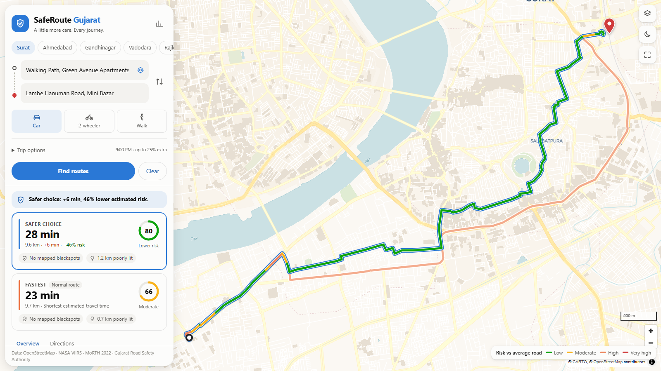


The interface
Search, click or locate
Places, landmarks, map clicks or GPS
Mode, time and priority
Car, two-wheeler or walk; departure hour; safety slider; detour limit
Three routes, one glance
Score, extra minutes and % lower risk on each card
Explains the choice
Blackspots, dark stretches, risky turns and a risk-along-route chart
Works everywhere
Mobile bottom sheet, dark mode, shareable trip links
Live prototype: SVNIT → Surat Railway Station by car at 9 pm
Notes:
PRESENTER: Veer (about 1 minute) · 10:45–11:45
This is the real interface, planning SVNIT to Surat Railway Station by car at 9 pm.
The goal was a page that feels familiar to anyone who uses Google Maps, but answers a different question.
Left panel: pick a city, then enter start and destination by search, map click, or the locate button. Choose car, two-wheeler or walking. The time slider matters because risk changes with the hour, and at night the lighting factors switch on. The safety-priority slider is λ in the cost function, and you can set a maximum detour.
Results: up to three cards, Safest in blue, Balanced in green, Fastest in orange. Each shows travel time, extra minutes versus the fastest route, percentage lower risk and a 0 to 100 safety score. The selected route is coloured along its length by risk level, so you can see where the dangerous stretch is.
Explainability: the tabs show where the risk comes from, which blackspots the route passes, turn-by-turn directions with risk per step, and a risk-along-route chart. A map layer marks all 22 blackspots, and clicking one shows its crash record and source.
It also has a mobile layout, dark mode and shareable trip links.
(If time allows, switch to the live demo here.)

Slide 14

Case study: SVNIT → Surat Station
Route (car, 9 pm) | Time | Extra | Score | Risk vs fastest
Fastest | 22.5 min | – | 66 | –
Balanced | 25.0 min | +2.5 min | 76 | −37%
Safest | 28.0 min | +5.5 min | 80 | −46%
Survey meets model
57.9%
of commuters would accept 2–3 extra minutes
+2.5 min
is what the Balanced route costs here, for 37% lower modelled risk
Why the routes differ
Fastest stays on high-speed flyovers (Majura Gate, Udhna Darwaja, Ring Road): 91% on arterials
Balanced leaves the flyover chain and uses Nanawat Main Road: only 42% on arterials
Same pattern at 9 am and for two-wheelers: 40–48% lower risk for the safest route
Notes:
PRESENTER: Chinta (about 55 seconds) · 11:45–12:40
Here the survey and the model meet, on the same corridor our 100 respondents travel.
Planned by car at 9 pm, the fastest route takes 22.5 minutes and scores 66. The Balanced route takes 25 minutes, 2.5 minutes more, scores 76 and has 37% lower modelled risk. The Safest route takes 28 minutes and has 46% lower risk.
Why? The fastest route stays on the high-speed flyover chain: Majura Gate, Udhna Darwaja and the Ring Road flyover, which respondents named as a congestion point. 91% of it is on arterials. The Balanced route leaves that chain and goes through Nanawat Main Road, with only 42% on arterials, so speeds and crash severity are lower.
The link to our data: 57.9% of commuters said they'd accept 2 to 3 extra minutes for a safer route. The Balanced route costs 2.5 minutes. So the trade-off the model offers is one most respondents said they want.
The same pattern holds at 9 am and for two-wheelers, with 40 to 48% lower risk for the safest route.
The next step is field validation: timing these routes ourselves and doing a safety audit, which is in our plan.

Slide 15
Validation: 400 simulated trips
−26.9%
+3.5 min
average modelled risk
average extra travel time
107 → 41
70 → 78
times a route passed a blackspot
average safety score
Night gains are larger: darkness and higher night-time speeds make the gap between routes bigger.
Notes:
PRESENTER: Arnav (about 50 seconds) · 12:40–13:30
To test the method beyond one corridor we ran a seeded simulation. In each city we picked 25 random origin-destination pairs between 3 and 15 km apart, and planned each one for car and two-wheeler, at 9 am and 10 pm. That is 400 trips with default settings.
Results: on average the safest route had 26.9% lower modelled risk for 3.5 extra minutes, about 13.5% more travel time. Average safety score rose from 70 to 78. Across all trips, passes through documented blackspots fell from 107 to 41.
The chart shows the night effect: in every city the reduction is larger at 10 pm. Rajkot goes from 25.5% by day to 33.4% at night. Darkness and higher night speeds make the difference between routes bigger.
One honest finding we report in the documentation: at night the safety route sometimes carries slightly more poorly lit distance, because the model prefers slower local roads and the satellite lighting data is too coarse to separate neighbouring streets. Municipal streetlight data would fix that.
And the obvious caveat: these are modelled risks. Real validation needs geo-coded crash data, which is our next step.

Slide 16

Limitations and next steps
What we can't claim yet
Next steps
Risk is modelled and calibrated, not observed street-by-street
Blackspot data is uneven: 15 in Ahmedabad, 1 in Rajkot
Satellite lighting (~500 m) can't separate neighbouring streets
Survey represents SVNIT commuters, not all of Surat
No inter-city routing; AQI belongs to the other team
Field validation
Time Routes A, B, C in the field; road-safety audit of the corridor
Data-driven crash model
Train a crash-frequency model once geo-coded (iRAD) crash data is available
Deployment
Hosted demo and phone-friendly version for a pilot with students
Integration
Combine safety with the AQI and efficiency objectives
Notes:
PRESENTER: Akshara (about 40 seconds) · 13:30–14:10
We want to be clear about what this work does and does not show.
Limitations. First, the risk numbers are modelled. They are calibrated to official crash totals, but they are not observed crash rates for individual streets. Second, public blackspot data is uneven: Ahmedabad has 15 documented sites, Rajkot only one. Third, the satellite lighting data has about 500 m resolution, so it cannot tell two neighbouring streets apart. Fourth, the survey represents SVNIT commuters. Finally, we route within one city, and AQI belongs to the other team.
Next steps, each with an owner:
- Field validation: time Routes A, B and C in the field and do a road-safety audit of the corridor, so the case study has measured data behind it.
- Data-driven crash model: replace the hand-set crash frequencies with a trained crash-frequency model once geo-coded crash records from MoRTH's iRAD system are available.
- Deployment: host the demo and make it phone-friendly for a pilot with students.
- Finally, we combine our safety objective with the AQI and efficiency teams' work, which was the original multi-objective goal.

Slide 17

Thank you
Questions and live demo
5 cities
−27%
+3.5 min
22
one safety router
modelled risk
average cost
blackspots mapped
Chinta Lakshya · Arnav Balodi · Damerla Akshara · Veer Kishan Whabi
Notes:
PRESENTER: Chinta (about 20 seconds) · 14:10–14:30, then questions
To summarise: one safety router for five Gujarat cities, built on public data and established traffic-safety formulas. On average it cuts modelled risk by about 27% for 3.5 extra minutes and maps 22 documented blackspots.
Thank you. We're happy to take questions, and we can show the live demo.
LIKELY QUESTIONS (all members):
- "Why not Dijkstra?" Same optimum (verified 48/48). A* is faster with an admissible heuristic, and our version also costs turns.
- "How do you combine risk and time?" Divide each by the fastest route's value, so both are percentages of the normal trip (slide 11).
- "Where is the crash data from?" MoRTH 2022 city totals for calibration, plus 22 sourced blackspots (slide 7).
- "Is this machine learning?" No, it is a calibrated statistical model. ML needs geo-coded crash records; that is a next step.
- "What if a live API fails?" Routing runs fully on prebuilt local graphs.
- "How do you know it's safer?" It is a model-based comparison. Field timing, a road-safety audit and iRAD data are how we would validate.

