Slide 1
NETWORK TOPOLOGY
BY Arnav Rao

Slide 2
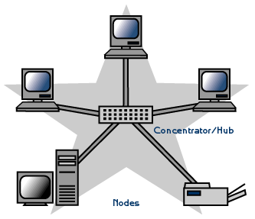
Star topology
A star may be a topology for a Local Area Network (LAN) during which all nodes are individually connected to a central connection point, sort of a hub or a switch. A star takes more cable than e.g. a bus, but the benefit is that if a cable fails, just one node is going to be brought down. Each device within the network is connected to a central device called a hub. If one device wants to send data to another device, it’s to first send the info to the hub then the hub transmits that data to the designated device. The number of links required to connect nodes in the star topology is N where N is the number of nodes.

Slide 3
STAR TOPOLOGY
ADVANTAGES
DISADVANTAGES
It is very reliable – if one cable or device fails then all the others will still work
It is high-performing as no data collisions can occur
Less expensive because each device only need one I/O port and wishes to be connected with hub with one link.
Easier to put in
Robust in nature
Easy fault detection because the link are often easily identified.
No disruptions to the network when connecting or removing devices.
Each device requires just one port i.e. to attach to the hub.
If N devices are connected to every other in star, then the amount of cables required to attach them is N. So, it’s easy to line up.
Requires more cable than a linear bus .
If the connecting network device (network switch) fails, nodes attached are disabled and can’t participate in network communication.
More expensive than linear bus topology due to the value of the connecting devices (network switches)
If hub goes down everything goes down, none of the devices can work without hub.
Hub requires more resources and regular maintenance because it’s the central system of star .
Extra hardware is required (hubs or switches) which adds to cost
Performance is predicated on the one concentrator i.e. hub.

Slide 4
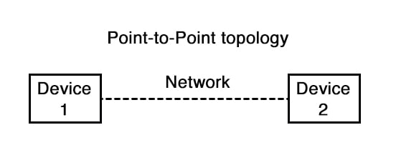
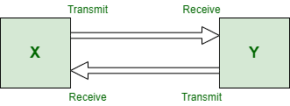
POINT TO POINT Topology
This is the kind of topology that relies upon two functions i.e. Transmit and Receive. It is a type of communication network between two communication nodes where there is one transmitter and on the other end, there is the receiver. It is a kind of communication medium which have two endpoints or end nodes. They provide high bandwidth with a dedicated communication connection between two systems.

Slide 5
POINT TO POINT Topology vs star topology
Point to point link | Star topology
It grows in several ways. | It helps in providing easy access for service.
This is the type of link which basically relies upon two functions only transmit and receive. | Only one device is there for per connection.
Each station or nodes receives exactly from one transmitter. | It is very reliable.
Each transmitter transmits to exactly one receiver. | It has a centralized control for the problem diagnosis.
Both the transmit and receive operation can occur over separate wires. | It has simple access protocols.
It is the type of high bandwidth network. | It has a very long cable length network.
Very fast network topology as compared to the other network types. | All of the dependency is there on the central node.
It is very simple and easy in connectivity. | It is a high performing as there are no collisions on data.
Helps in providing low latency. | It is very easy to detect faults and remove parts.
It is very easy to maintain and handle. | It is more expensive than other network topologies.
Their nodes can be replaced within a seconds very easily. | It is very easy to install and wire.

Slide 6
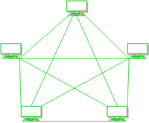
Mesh topology
In mesh, all the computers are interconnected to every other during a network. Each computer not only sends its own signals but also relays data from other computers. The nodes are connected to every other completely via a dedicated link during which information is travel from nodes to nodes and there are N(N-1)/2 links in mesh if there are N nodes. Every node features a point-to-point connection to the opposite node. The connections within the mesh are often wired or wireless.

Slide 7
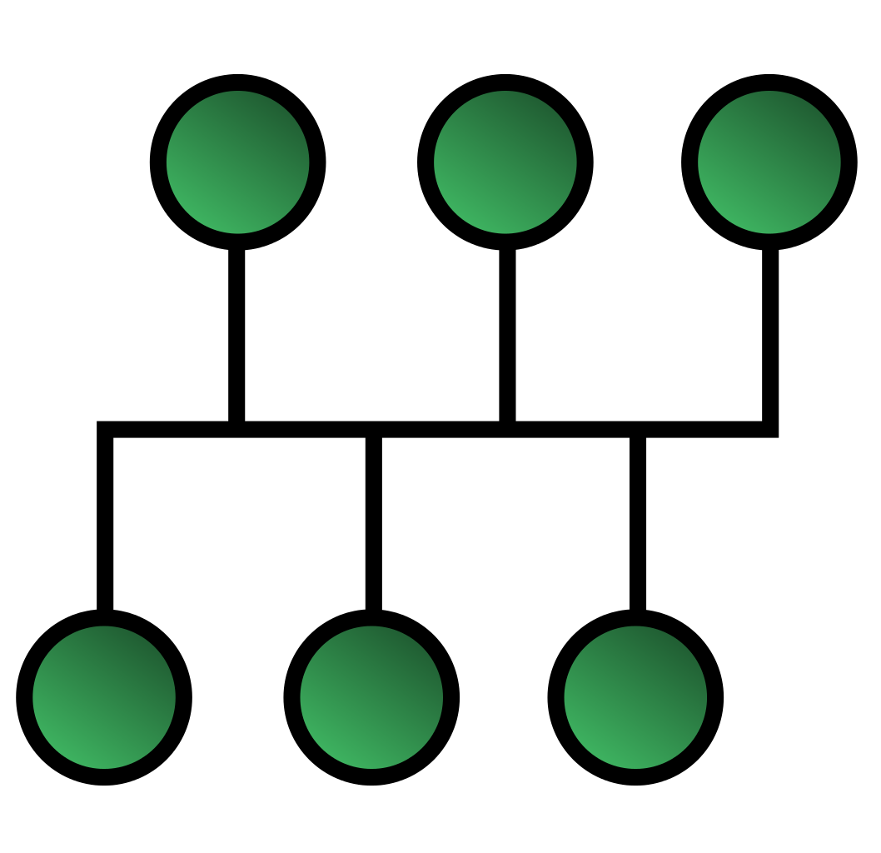
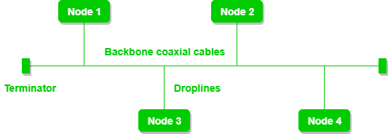
BUS topology
Bus topology is a network type in which every computer and network device is connected to a single cable. It is bi-directional. It is a multi-point connection and a non-robust topology because if the backbone fails the topology crashes. In Bus Topology, various MAC (Media Access Control) protocols are followed by LAN ethernet connections like TDMA, Pure Aloha, CDMA, Slotted Aloha, etc.

Slide 8
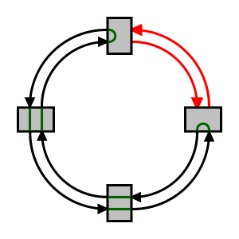
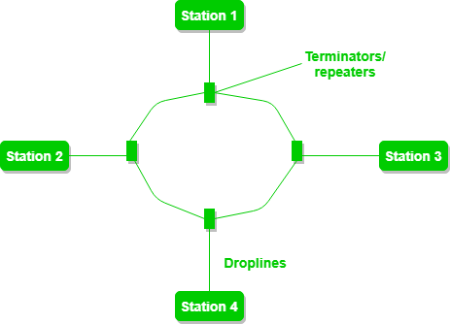
Ring topology
A number of repeaters are used for Ring topology with a large number of nodes, because if someone wants to send some data to the last node in the ring topology with 100 nodes, then the data will have to pass through 99 nodes to reach the 100th node. Hence to prevent data loss repeaters are used in the network.
The data flows in one direction, i.e.., it is unidirectional, but it can be made bidirectional by having 2 connections between each Network Node, it is called Dual Ring Topology. In-Ring Topology, the Token Ring Passing protocol is used by the workstations to transmit the data.

Slide 9
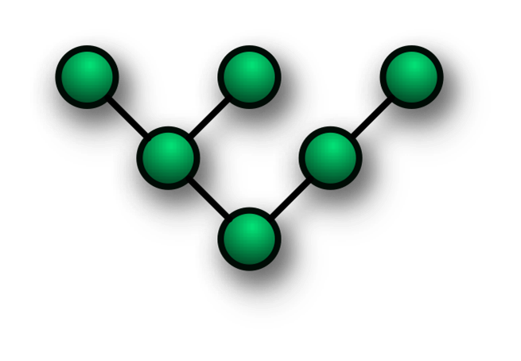
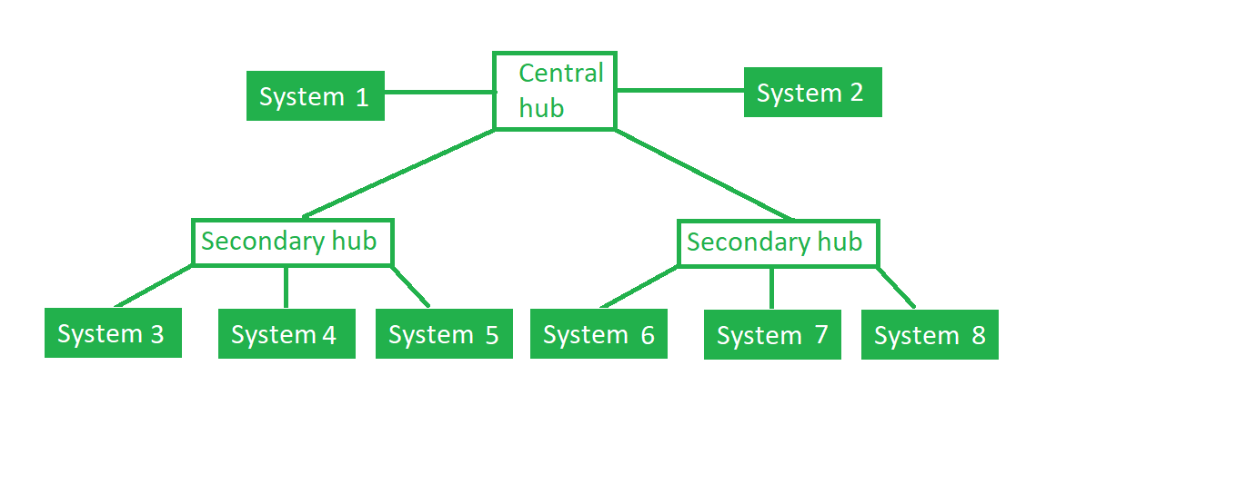
tree topology
This topology is the variation of the Star topology. This topology has a hierarchical flow of data. In Tree Topology, protocols like DHCP and SAC (Standard Automatic Configuration ) are used.

