Slide 1

UE20CS302 – Machine Intelligence
Mini Project
Movie Recommendation System
Team No: B10
Project Guide : Dr. Alpha Vijayan
Project Team with SRNs :
VIJITH BG PES2UG20CS402
ARNAV KUMAR PES2UG20CS403
SAMAY JAIN PES2UG20CS405

Slide 2
Problem Statement
Recommender systems encompass a class of techniques and algorithms that can suggest “relevant” items to users. They help in predicting future behavior based on past behaviour of a user through a multitude of techniques. We now live in what some call the “era of abundance”. For any given product, there are thousands of options available to choose from. Recommender systems help to provide a personalized platform and help the user find something they like or want as a recommendation. Some people like genre specific movies be it a mystery, comedy, or sci-fi, while others focus on lead actors, actress and directors. When we take all these factors into account, it’s difficult to generalize a movie and say that everyone would like it.

Slide 3
Application and Uses
– Recommender System helps the user, find items of their interest. – Helps the item provider to deliver their items to the right user. – To identify the most relevant products for each user. – Showcase personalised content to each user. – Suggest top offers and discounts to the right user. – Websites can improve user-engagement. – It increases revenues for business through increased consumption.

Slide 4
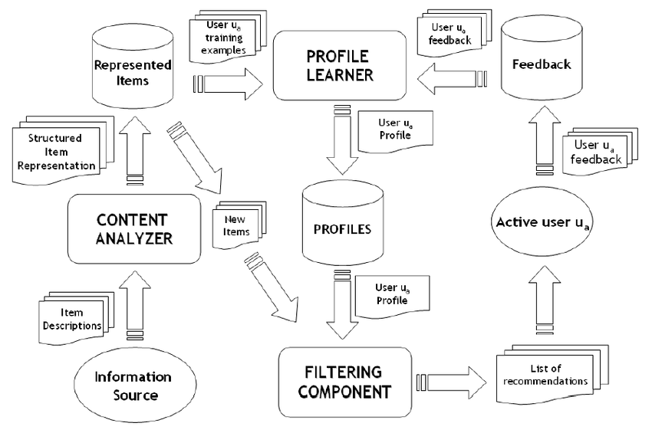
High Level Architecture

Slide 5
Literature Survey
Title of the paper | Year of Publication | Journal/Conference Name | Advantages | Limitations
Movie Recommendation System Using Cosine Similarity with Sentiment Analysis | 2021 | Third International Conference on Inventive Research in Computing Applications (ICIRCA) | Cosine similarity is used over many other available similarities for the recommendation system because it has better computing time and efficiency than others | The existing models do not display all the information related to the movie. Most of the existing models do not consider Sentiment Analysis. The existing models don't contain any history of the users for providing the recommendation. The recommendations provided by the existing models are not personalized and does not cater to all the requirements of the user. Some of the existing models use very limited datasets.
Item-Based Collaborative Filtering in Movie Recommendation in Real time | 2018 | First International Conference on Secure Cyber Computing and Communication (ICSCCC) | Movie recommender system has been described, which basically uses item-based technique of collaborative filtering to provide the recommendations of items, which is dynamic and will learn from the positive feedback. | Jun Wang et al; proposed the algorithm that unify the item based and content based collaborative filtering. They represented a fusion framework that is able to solve the prediction problem more accurate and also solve the problem related to the data sparsity and new user problem.
Analysis of Movie Recommendation Systems; with and without considering the low rated movies | 2020 | International Conference on Emerging Trends in Information Technology and Engineering (ic-ETITE) | Comparison of the predictions we get when all the movies are considered, with the predictions that we get when movies that are always rated below average is done. | The existing models do not display all the information related to the particular movie. Most of the existing models do not consider Sentiment Analysis. The existing models don't contain any history of the users for providing the recommendation. The recommendations provided by the existing models are not personalized and does not cater to all the requirements of the user. Some of the existing models use very limited datasets.

Slide 6
Title of the paper | Year of Publication | Journal/Conference Name | Advantages | Limitations
Movie Recommendation System Using Collaborative Filtering | 2018 | IEEE 9th International Conference on Software Engineering and Service Science (ICSESS) | This paper is organized as follows: First, a brief overview of a few relevant, recent research done in the space of recommender system will be discussed. Second, we will present the understanding on the technique of collaborative filtering. Third, the data preparation and data analysis approach using Mahout will be discussed. Finally, a qualitative evaluation on the techniques used will be presented. | 1) New User Problem is concerned with the scenario when a new user is added to the recommender system. There are no ratings provided by him/her for any movie in the system yet. This is also called a User Cold Start. 2) There is a concern that no new item is recommended. It can be understood as an Item Cold Start problem. 3) Expensive to do at runtime as for each user, neighbourhood is dynamic with new ratings from different users. Therefore, the former requires cache data storage, latter requires a dedicated processing server.
Movie Recommender System Based on Percentage of View | 2019 | 5th Conference on Knowledge Based Engineering and Innovation (KBEI) | The precision is the ratio of number of common items of recommendation list and test list of the user to the size of recommendation list for the user. | The existing models do not display all the information related to the particular movie. Most of the existing models do not consider Sentiment Analysis. The existing models don't contain any past history of the users for providing the recommendation.
An improved approach for movie recommendation system | 2017 | International Conference on I-SMAC (IoT in Social, Mobile, Analytics and Cloud) (I-SMAC) | scalability and quality of the movie recommendation system as compared to the implementation of pure content based approach or pure collaborative approach individually on three different Movie lens datasets. | Genetic Algorithm Cosine Similarity Measure: The cosine similarity for two vectors is a measure that calculates the cosine of the angle between them

Slide 7
Title of the paper | Year of Publication | Journal/Conference Name | Advantages | Limitations
A Neural Engine for Movie Recommendation System | 2018 | 4th International Conference on Electrical Engineering and Information & Communication Technology (iCEEiCT) | mean square error(MSE), mean absolute error (MAE) and mean relative error (MRE), were exploiting to demonstrates prediction accuracy of our NERS approach. And, the simulation results show that, our system achieved better performance compare to other methods | 1) New User Problem is concerned with the scenario when a new user is added to the recommender system. There are no ratings provided by him/her for any movie in the system yet. This is also called a User Cold Start. 2) There is a concern that no new item is recommended. It can be understood as an Item Cold Start problem. 3) Expensive to do at runtime as for each user, the neighborhood is dynamic with new ratings from different users. Therefore, the former requires cache data storage, latter requires a dedicated processing server.
A content-based movie recommender system based on temporal user preferences | 2017 | 3rd Iranian Conference on Intelligent Systems and Signal Processing (ICSPIS) | the proposed method after extracting user interests from user profile, the priority of each interest is inferred as the user preference. We evaluated the proposed method with MovieLens dataset. Experimental results show that the proposed method improved the accuracy of movie recommendation. | One limitation of content based filtering are that it can only make recommendations based on existing interests of the user, it does not consider the fact that what do other users think of an item, thus low quality item recommendations may occur sometimes. Sometime, Content Overspecialization also occurs in which content similar to the one already present in the User’s list is not recommended to the User
IRJET- MOVIE RECOMMENDATION SYSTEM USING MACHINE LEARNING | 2021 | IRJET, 2021. Volume: 08 Issue: 04 | Apr 2021, e-ISSN: 2395-0056, p-ISSN: 2395-0072 | method for computing similarity measure in recommendations systems are cosine similarity measure | One main disadvantage of cosine similarity is that the magnitude of vectors is not taken into account, merely their direction. In practice, this means that the differences in values are not fully taken into account. Other limitation found was that the model can only make recommendations based on existing interests of the user. In other words, the model has limited ability to expand on the users' existing interests.

Slide 8
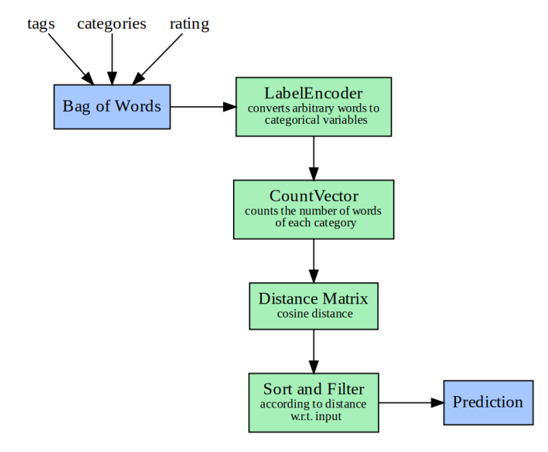
Proposed Approach

Slide 9
Results and Discussion
From the 3 models that we have approached for, Collaborative filtering was found to be more accurate but the only drawback of it is there should user history and item history (Cold Start problem), therefore further implementation of the same is covered as a future scope for our project.
Demographic filtering was found to be least accurate due to which it is not used in any recommender system.
Content Based recommender advantage was that it didn’t require user watch history or item history, it gave recommendation purely based on title and similarity index (used cosine similarity). The recommendations for users was by suggesting them movies that have similar key features like the vote average, genre, cast, director, movie title.

Slide 10
Conclusion
In collaborative filtering, we have a problem of sparsity of data. Very few users rate the same movie.
We can use Clustering algorithms like K-Means to cluster items or users or both based on their attributes.

Slide 11
References
[1] H. Khatter, N. Goel, N. Gupta and M. Gulati, "Movie Recommendation System Using Cosine Similarity with Sentiment Analysis," 2021 Third International Conference on Inventive Research in Computing Applications (ICIRCA), 2021, pp. 597-603, doi: 10.1109/ICIRCA51532.2021.9544794.
[2] M. K. Kharita, A. Kumar and P. Singh, "Item-Based Collaborative Filtering in Movie Recommendation in Real time," 2018 First International Conference on Secure Cyber Computing and Communication (ICSCCC), 2018, pp. 340-342, doi: 10.1109/ICSCCC.2018.8703362.
[3] M. M. Reddy, R. S. Kanmani and B. Surendiran, "Analysis of Movie Recommendation Systems; with and without considering the low rated movies," 2020 International Conference on Emerging Trends in Information Technology and Engineering (ic-ETITE), 2020, pp. 1-4, doi: 10.1109/ic-ETITE47903.2020.453
[4] C. -S. M. Wu, D. Garg and U. Bhandary, "Movie Recommendation System Using Collaborative Filtering," 2018 IEEE 9th International Conference on Software Engineering and Service Science (ICSESS), 2018, pp. 11-15, doi: 10.1109/ICSESS.2018.8663822.
[5] R. E. Nakhli, H. Moradi and M. A. Sadeghi, "Movie Recommender System Based on Percentage of View," 2019 5th Conference on Knowledge Based Engineering and Innovation (KBEI), 2019, pp. 656-660, doi: 10.1109/KBEI.2019.8734976.
[6] S. Agrawal and P. Jain, "An improved approach for movie recommendation system," 2017 International Conference on I-SMAC (IoT in Social, Mobile, Analytics and Cloud) (I-SMAC), 2017, pp. 336-342, doi: 10.1109/I-SMAC.2017.8058367.
[7] M. A. Hossain and M. N. Uddin, "A Neural Engine for Movie Recommendation System," 2018 4th International Conference on Electrical Engineering and Information & Communication Technology (iCEEiCT), 2018, pp. 443-448, doi: 10.1109/CEEICT.2018.8628128.
[8] B. R. Cami, H. Hassanpour and H. Mashayekhi, "A content-based movie recommender system based on temporal user preferences," 2017 3rd Iranian Conference on Intelligent Systems and Signal Processing (ICSPIS), 2017, pp. 121-125, doi: 10.1109/ICSPIS.2017.8311601.
[9] Anuja Gaikwad, Samradnyee Kudalkar, Ashwin Jethawa. Journal, IRJET. “IRJET- MOVIE RECOMMENDATION SYSTEM USING MACHINE LEARNING.” IRJET, 2021. Volume: 08 Issue: 04 | Apr 2021, e-ISSN: 2395-0056, p-ISSN: 2395-0072

Slide 12
Thank You

