Slide 1
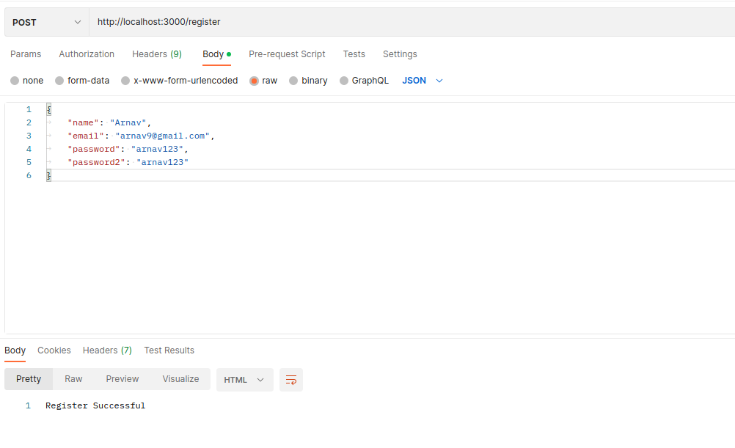
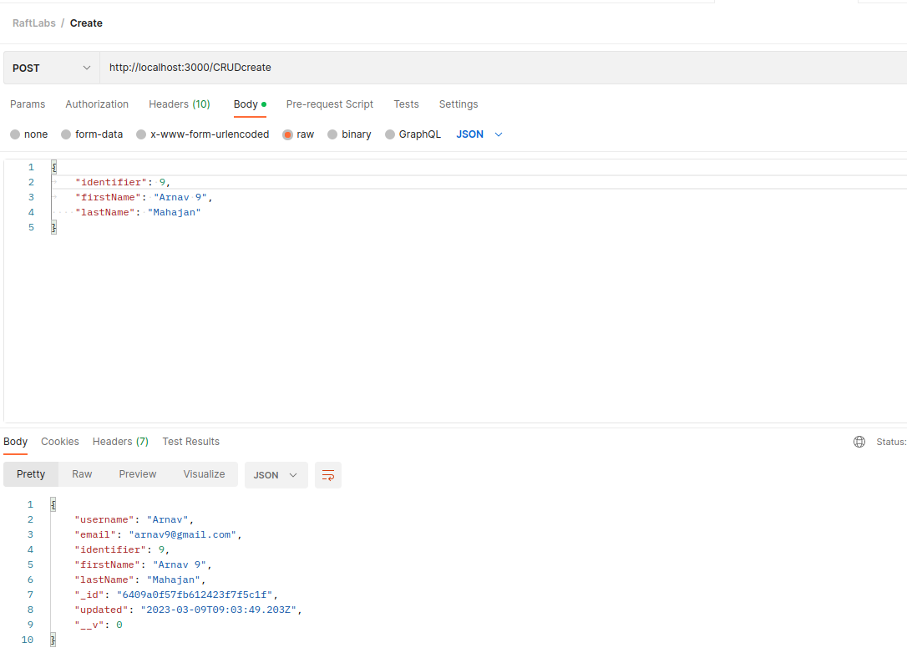
RaftLabs – Task 1

Slide 2

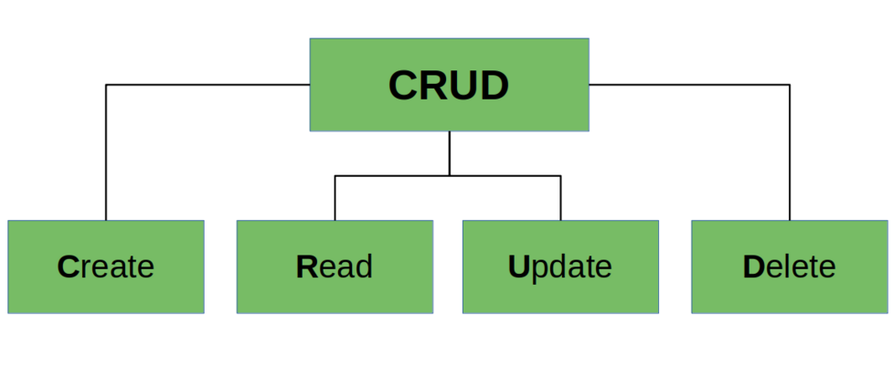
Brief
Built on Node.js as backend service and MongoDB as database
Created RESTful API’s for CRUD Operations
User authentication and authorization using JWT
Paging and sorting of data for easier accessbility
Caching of data less reload time

Slide 3
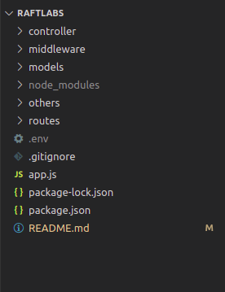
Github Repo and Demo
Github Repository
https://github.com/ArnavMahajan01/RaftLabs-CRUD

