Slide 1
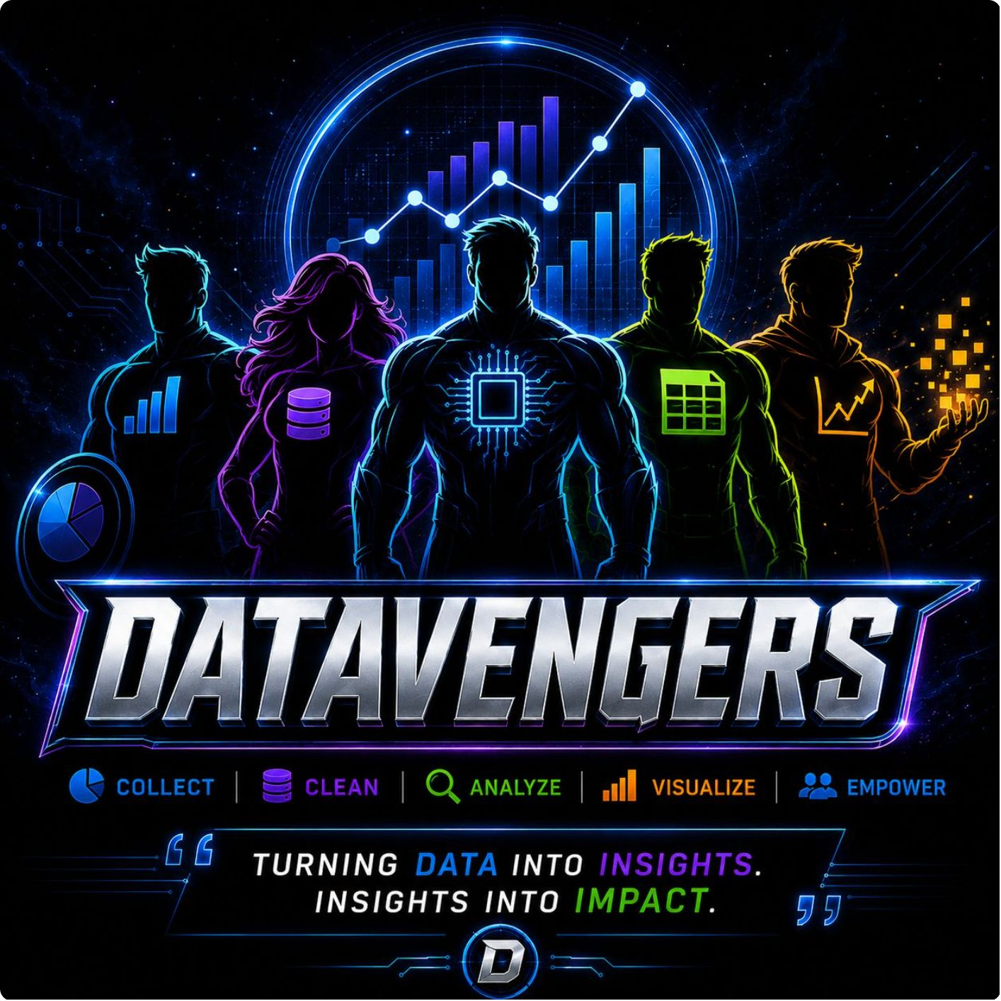

Slide 3


SQL APPLICATIONS IN ACTION
CAPTAIN'S LOG: DATA INTELLIGENCE
SQL helps teams find, organize, and understand data so they can make better decisions faster.
E-Commerce
See what people buy and which products sell best.
Customer Insights
Learn who your customers are and what they need.
Inventory
Keep track of stock so items are available when needed.
Sales Performance
Measure what is working and where to improve.
ASSEMBLE THE DATA. DECODE THE BUSINESS.

Slide 4
REAL-WORLD SQL USE CASES
Captain's Log: Data Defense and Strategy
E-Commerce Analytics
Healthcare Insight
Financial Fraud Detection
Identify top-selling products by region to optimize inventory and targeted marketing campaigns.
Analyze patient outcomes and treatment effectiveness to improve care protocols and resource allocation.
Detect unusual transaction patterns and flag potential fraudulent activities in real-time.
SELECT region, product, SUM(sales)
FROM sales_data
GROUP BY region, product
ORDER BY SUM(sales) DESC;
SELECT treatment, AVG(outcome_score)
FROM patient_records
GROUP BY treatment
HAVING COUNT(*) > 100;
SELECT user_id, transaction_value
FROM transactions
WHERE is_suspicious = TRUE
ORDER BY transaction_timestamp DESC;

Slide 5
ADVANCED SQL TECHNIQUES
CAPTAIN'S LOG: TACTICAL DATA MANEUVERS
WINDOW FUNCTIONS
SUBQUERIES
Compare rows without losing the original data.
Example: rank products
Benefit: Find top performers fast.
Use one query inside another to filter results.
Example: above-average spenders
Benefit: Narrow lists step by step.
CTEs (COMMON TABLE EXPRESSIONS)
JOINS
Break a big query into smaller, easy-to-read steps.
Example: churn risk check
Benefit: Easier to build and fix.
Combine data from different tables into one view.
Example: sales + customer data
Benefit: See the full picture.

Slide 6





SQL BEST PRACTICES & PERFORMANCE
CAPTAIN'S LOG: OPTIMIZING THE DATAFLOW
Index Optimization
Speed up query execution for faster insights.
Query Optimization
Write efficient SQL to minimize resource use.
Data Validation
Ensure data quality for reliable decisions.
Security
Protect sensitive data from unauthorized access.
Documentation
Maintain clear records for maintainability and collaboration.

Slide 7

DATAVENGERS
SQL SYSTEM / ANALYTICS DASHBOARD
Turning Data Into Decisions
RAW DATA
SQL
INSIGHTS
DECISIONS

Slide 8


Why we need?
ANALYTICS DASHBOARD
The world generates approximately 402-474 million terabytes of data every single day
TOO MUCH DATA
Millions of records, zero clarity
MULTIPLE TABLES
Scattered across systems
MANUAL ANALYSIS IS SLOW
Hours lost, decisions delayed
ANSWERS ARE HIDDEN
Business intelligence buried deep
WE NEED AN INTELLIGENCE SYSTEM.

Slide 9



What is an Analytics Dashboard?
An Analytics Dashboard is a visual screen that converts business data into useful information.
Shows KPIs, trends, comparisons, and insights
SQL works behind the scenes to retrieve and prepare the data
Data Layer
Relational database like PostgreSQL or Snowflake storing structured tables
Query Layer
SQL statements such as GROUP BY, JOIN, and CTEs extracting business metrics
Visualization Layer
Translates structured SQL result sets into visual components like bar charts, line graphs, and data tables.

Slide 10
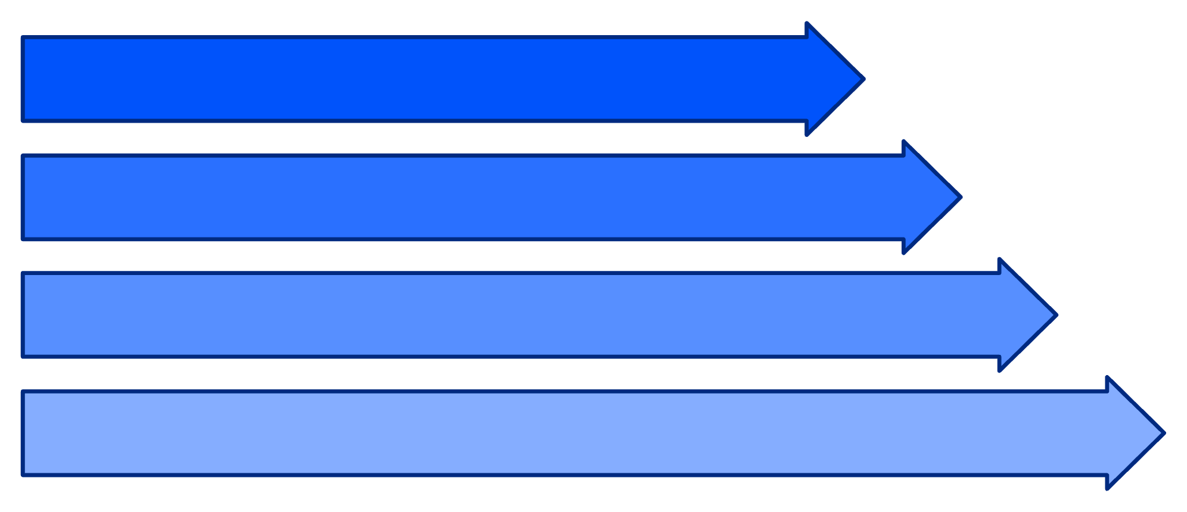
FROM SQL QUERY → BUSINESS INSIGHT
BUSINESS QUESTION
"Which products generate the most revenue?"
Sales Table
SQL Query
Group by Product
Top Products
🥇 Product A
🥈 Product B
🥉 Product C
₹8.4M Revenue
₹6.7M Revenue
₹5.2M Revenue

Slide 11






SQL → INSIGHT → ACTION
Raw Data
SQL Engine
Analytics
Dashboard
Decision
LOW SALES
→ Investigate the cause
TOP PRODUCT
→ Increase inventory
HIGH-VALUE CUSTOMER
→ Target with offers
SALES DROP
→ Take corrective action
ASSEMBLE THE DATA. DECODE THE BUSINESS.

Slide 12

S.H.I.E.L.D. ARCHIVES
SQL FOR LARGE DATASETS
Querying 500M+ Soviet & Red Room Surveillance Logs with Black Widow.

Slide 13


STRATEGIC INDEXING
B-TREE VS COMPOSITE INDEXES
B-Tree Indexes
Fast lookups, ordered data structure.
Composite Indexes
Multiple columns for complex queries.
Covering Indexes with INCLUDE clause
Avoid expensive row lookups by including all necessary columns.
SELECT operative_id, mission_date, target_location
FROM missions
WHERE operative_id = 'Natasha Romanoff' AND mission_date > '2023-01-01';

Slide 14

TABLE PARTITIONING: DIVIDE & CONQUER
BLACK WIDOW'S STRATEGIC DATA SPLITS
Range Partitioning by mission date
Organize data chronologically, query only relevant time periods
Hash Partitioning by operative ID
Distribute data evenly across partitions, parallel query execution
Partition Pruning
Database automatically skips irrelevant partitions during query execution

Slide 15
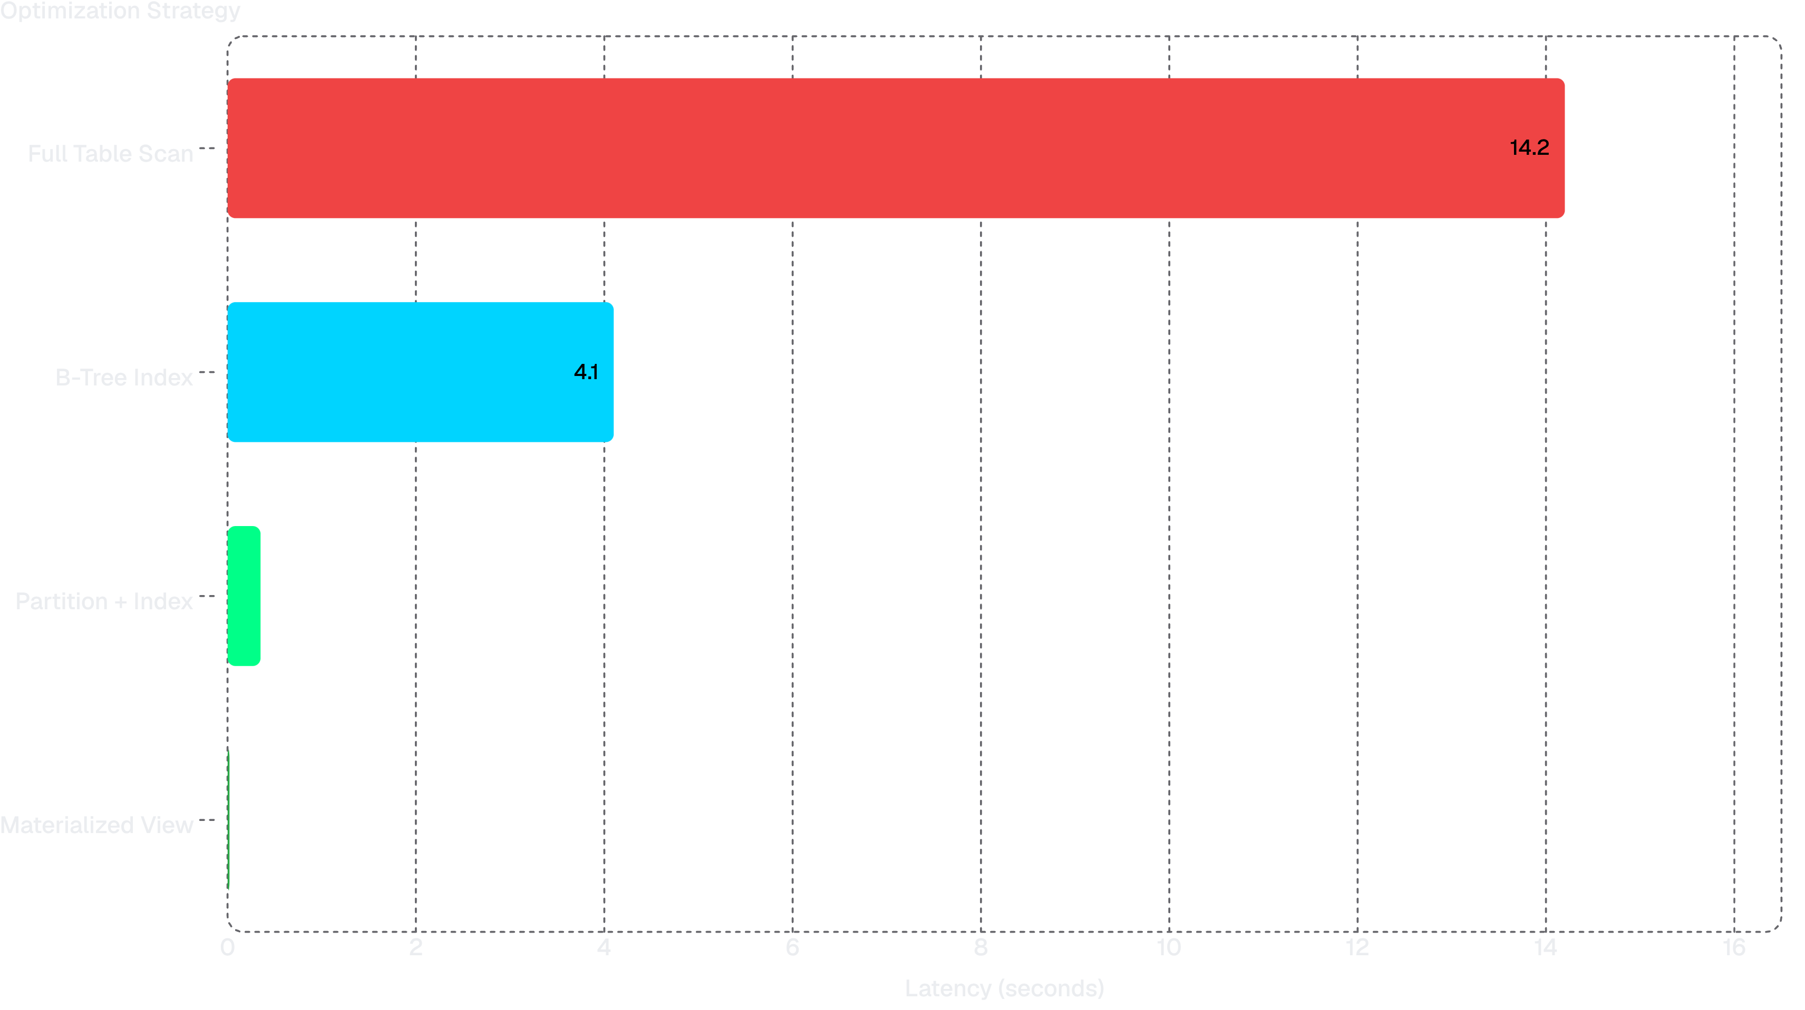
PERFORMANCE METRICS: THE EVIDENCE
Querying 500M+ Surveillance Logs
Black Widow's Arsenal: Each optimization technique compounds the benefits. Combining partitioning with indexes and materialized views achieves 710x faster query execution compared to full table scans.

Slide 16
ADVANCED QUERY TACTICS: FINAL MOVES
BLACK WIDOW'S OPERATIONAL STRATEGIES
1. Window Functions (DENSE_RANK)
2. Materialized Views
3. CTE Batching for Heavy Updates
Pre-compute expensive aggregations and store results
Rank operatives by mission count within each region
Use CTEs to organize multi-step updates efficiently
CREATE MATERIALIZED VIEW operative_summary AS SELECT operative_id, COUNT(*) AS total_missions, AVG(threat_level) AS avg_threat FROM missions GROUP BY operative_id;
SELECT operative_id, region, mission_count, DENSE_RANK() OVER (PARTITION BY region ORDER BY mission_count DESC) AS rank FROM operative_stats;
WITH updated_operatives AS (SELECT operative_id FROM missions WHERE status='completed' AND date > '2023-01-01') UPDATE operative_stats SET last_active = NOW() WHERE operative_id IN (SELECT operative_id FROM updated_operatives);
Benefit: Identify top performers per region without losing granularity
Benefit: Instant query results, refresh on schedule
Benefit: Cleaner code, better performance on large updates

Slide 17

SQL FOR DATA ANALYTICS
Turning Raw Data Into Meaningful Insights
SQL helps us explore and understand data.
It can filter, sort and organize information.
It can combine data from multiple tables.
It can calculate useful statistics.
SELECT category, SUM(sales)
FROM orders
GROUP BY category;
Finds total sales for each category.
SQL helps us find the story hidden inside data.

Slide 18






HOW SQL ANALYZES DATA
Turning Raw Data Into Meaningful Insights
WHERE
ORDER BY
GROUP BY
COUNT / SUM / AVG
Filter the required records.
Sort results.
Organize data into categories.
Calculate useful metrics.
JOIN
Combine information from different tables.
SELECT category, AVG(price)
FROM products
GROUP BY category;
Calculates the average price of each category.
SQL converts thousands of records into useful measurements.

Slide 19





FROM SQL RESULTS TO REPORTS
The Journey from Raw Data to Actionable Intelligence
DATABASE
SQL QUERY
ANALYSIS
REPORT
DECISION
SQL can generate various essential reports:
Daily sales report
Customer report
Product performance report
Monthly revenue report
Employee performance report

Slide 20

INVENTORY MANAGEMENT SYSTEM
KNOW WHAT YOU HAVE. KNOW WHAT YOU NEED.
Inventory Management System is a system used to:
Track products and stock
Record incoming and outgoing items
Monitor available quantities
Identify low-stock products
Keep inventory information organized
An online store uses an inventory system to know how many products are available before accepting an order.
Inventory management gives a business a clear view of its stock.

Slide 21
Database Design: Two Core Tables
The Core Data Foundation
Dim_Product Table
Fact_Purchases Table
product_id: Unique identifier for each product
product_name: Name of the product
brand: Brand of the product
category: Product category (e.g., Electronics)
subcategory: More specific category (e.g., Laptops)
price: Selling price of the product
rating_avg: Average customer rating
review_count: Number of customer reviews
date_added: Date product was added to inventory
stock_quantity: Current number of items in stock
stock_health_status: Status like 'Healthy', 'Low', 'Out of Stock'
total_inventory_valuation: Total value of current stock for this product
purchase_id: Unique identifier for each purchase transaction
order_id: Identifier for the overall customer order
product_id: Foreign key linking to Dim_Product
user_id: Identifier for the purchasing customer
order_date: Date of the purchase
order_day: Day of the month of the purchase
order_month: Month of the purchase
day_of_week: Day of the week of the purchase
quantity: Number of units purchased in this transaction
unit_price: Price per unit at the time of purchase
total_amount: Total amount for this specific transaction item
These tables form the backbone of the inventory system, tracking product details and all purchase events.

Slide 22
KEY SQL QUERIES
POWERING YOUR INVENTORY ANALYSIS
1. Identify Low-Stock Items
2. Calculate Total Inventory Value
3. Find Best-Selling Products
SELECT product_name, stock_quantity
FROM Dim_Product
WHERE stock_quantity < 50
ORDER BY stock_quantity;
SELECT dp.product_name, SUM(fp.quantity) AS units_sold
FROM Fact_Purchases fp
JOIN Dim_Product dp ON fp.product_id = dp.product_id
GROUP BY dp.product_name
ORDER BY units_sold DESC
LIMIT 5;
SELECT SUM(stock_quantity * price) AS total_inventory_value
FROM Dim_Product;
Determines the monetary value of all current stock.
Finds products needing restocking to prevent shortages.
Identifies the top 5 products by quantity sold for strategic planning.

Slide 23
HOW INVENTORY MANAGEMENT WORKS
Turning Raw Data Into Meaningful Insights
"100 units received → 100 in stock"
"20 units sold → 80 in stock"
"Stock reaches minimum level → Restock required"
The system keeps stock information updated as inventory changes.

Slide 24






WHY INVENTORY MANAGEMENT MATTERS
AVOID STOCKOUTS
REDUCE COSTS
IMPROVE ACCURACY
Know when products are running low.
Avoid keeping unnecessary stock.
Keep product quantities organized.
SAVE TIME
SUPPORT BETTER DECISIONS
Find inventory information quickly.
Use accurate stock information for planning.
CONTROL THE STOCK.
POWER THE BUSINESS.
Inventory management is essential for business success.

Slide 25
⚡ QUIZ TIME ⚡
TEST YOUR KNOWLEDGE
Can you decode the data like a true DATAVENGER?
7 Questions • 7 Challenges • 1 Mission

Slide 26
🧠 QUESTION 1 🧠
Which SQL clause is used to filter aggregated data, such as finding treatments where the patient count exceeds 100?
A) WHERE
B) HAVING
C) ORDER BY
D) GROUP BY
Think you know? Let's find out! 🎯

Slide 27
Answer:
B) HAVING
The WHERE clause filters individual rows before aggregation occurs, whereas the HAVING clause is specifically designed to filter groups after an aggregate function (like COUNT(*) > 100) has been applied.
Use WHERE for row-level filtering.
Use HAVING for group-level filtering after aggregation.

Slide 28
🔗 QUESTION 2 🔗
What is the primary benefit of using Common Table Expressions (CTEs) in complex SQL workflows?
A) They automatically encrypt table data
B) They replace the need for primary keys
C) They break large queries into smaller, easier-to-read steps
D) They prevent duplicate rows from being inserted
Can you spot the winner? 🏆

Slide 29
Answer: C) CTEs Break Queries Into Smaller Steps
CTEs (defined using WITH ... AS) allow developers to structure complex logic into named, modular sub-queries, making nested queries much easier to read, maintain, and debug.

Slide 30
📦 QUESTION 3 📦
How does an Inventory Management System primarily help a business reduce unnecessary holding costs?
A) By deleting older sales records automatically
B) By avoiding overstocking and keeping track of required stock levels
C) By eliminating the need for supplier invoices
D) By restricting customer access to product catalogs
Which one saves the money? 💵

Slide 31
Answer: B) Avoiding Overstocking & Tracking Stock Levels
An inventory management system tracks product movements, stock depletion, and minimum thresholds in real-time, preventing the business from tying up capital in excessive, unsold stock.

Slide 32
🏗️ QUESTION 4 🏗️
In an analytics dashboard architecture, which layer is responsible for running operations like GROUP BY, JOIN, and CTEs to extract business metrics?
A) Visualization Layer
B) Storage Hardware Layer
C) Query Layer
D) Presentation Layer
Where does the magic happen? ✨

Slide 33
Answer: C) Query Layer
The Data Layer stores the tables and the Visualization Layer renders the charts; the intermediate Query Layer executes SQL transformations (GROUP BY, JOIN, CTEs) to turn raw records into usable metrics.

Slide 34
📊 QUESTION 5 📊
Which SQL statement correctly calculates the average product price for each product category?
A) SELECT category, AVG(price) FROM products GROUP BY category;
B) SELECT category, SUM(price) FROM products WHERE AVG(price);
C) SELECT category, COUNT(price) FROM products ORDER BY category;
D) SELECT price, AVG(category) FROM products GROUP BY price;
Spot the correct syntax! 🎯

Slide 35
Answer: A) SELECT category, AVG(price) FROM products GROUP BY category;
Calculating an average by category requires grouping the records using GROUP BY category and applying the aggregate function AVG(price) on the numerical price column.

Slide 36
⚡ QUESTION 6 ⚡
What is the primary mechanism of Partition Pruning when running queries on partitioned tables?
A) It deletes unused partitions permanently to save disk space
B) It converts all non-clustered indexes into B-Tree structures
C) It automatically skips irrelevant partitions during query execution to boost speed
D) It merges multiple tables into a single partition at runtime
Which one speeds things up? 🚀

Slide 37
Answer: C) Automatically Skips Irrelevant Partitions
Partition pruning evaluates query filters (such as date ranges) and directs the query optimizer to scan only matching partitions while ignoring (pruning) the rest, drastically minimizing I/O overhead.

Slide 38
💾 QUESTION 7 💾
Why are Materialized Views preferred over standard queries for heavy analytics on massive datasets?
A) They re-run every underlying query from scratch for every user request
B) They pre-compute expensive aggregations and store results for instant retrieval
C) They automatically split records across separate cloud regions
D) They remove the need for SQL data types
Which one is the speed champion? 🏆

Slide 39
Answer: B) Pre-compute & Store Results for Instant Retrieval
Unlike standard views that re-execute complex joins and aggregations on every request, materialized views persist the query results on disk, delivering instant response times on datasets with hundreds of millions of rows.

Slide 40
Thank You! 🙏
Questions & Discussion
We've assembled the data. We've decoded the business. Now let's discuss what you've learned.
⚡ DATAVENGERS ⚡
ASSEMBLE THE DATA. DECODE THE BUSINESS.

