Slide 1
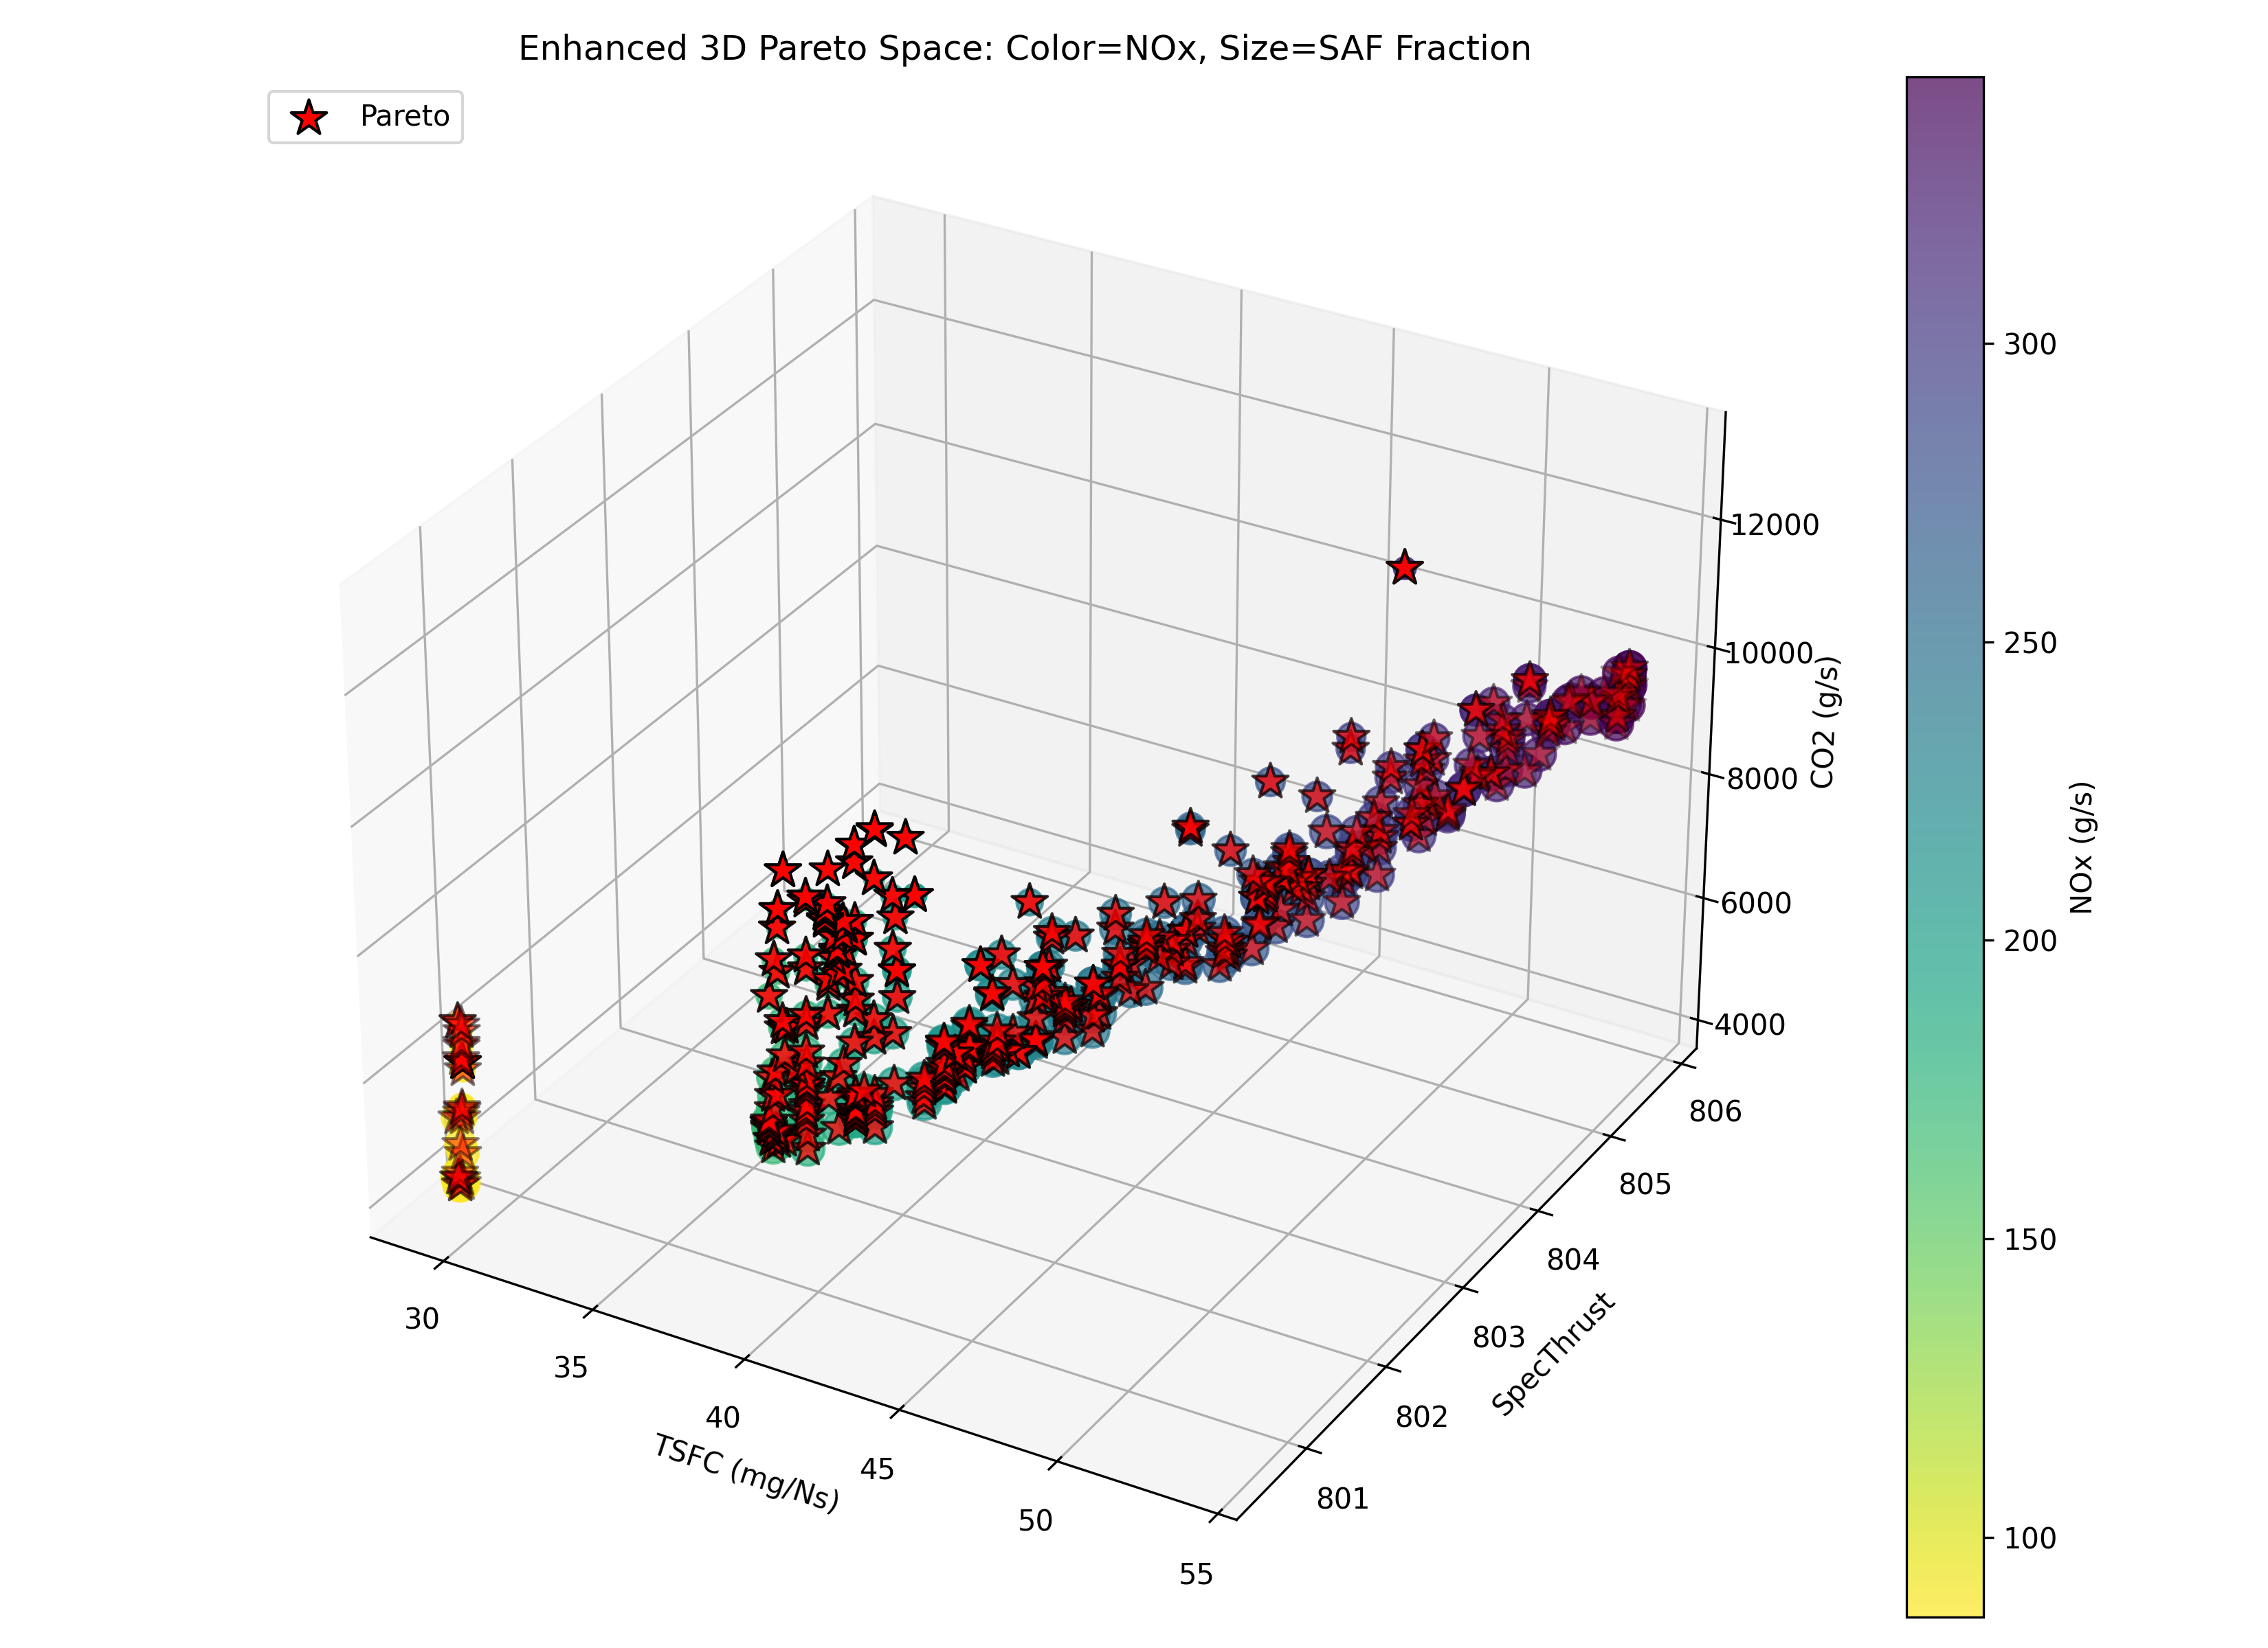
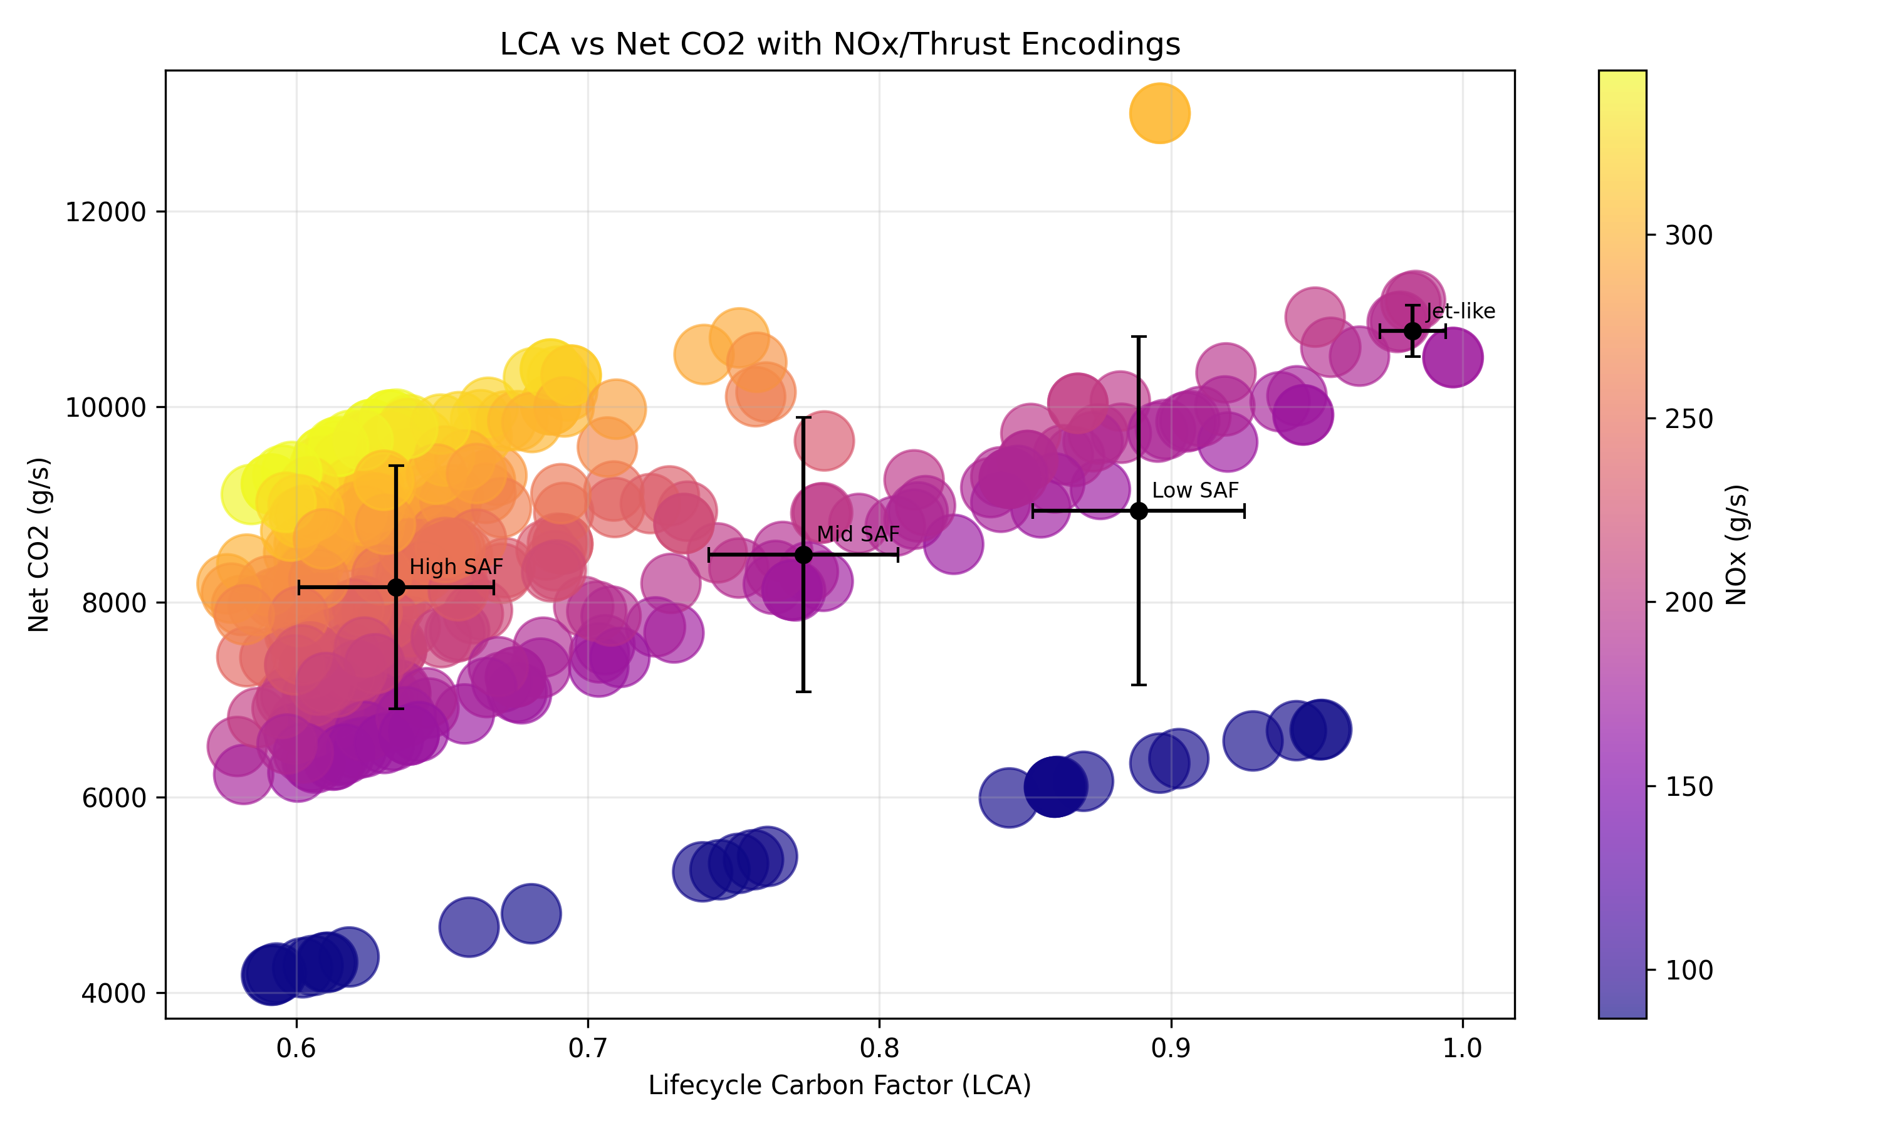
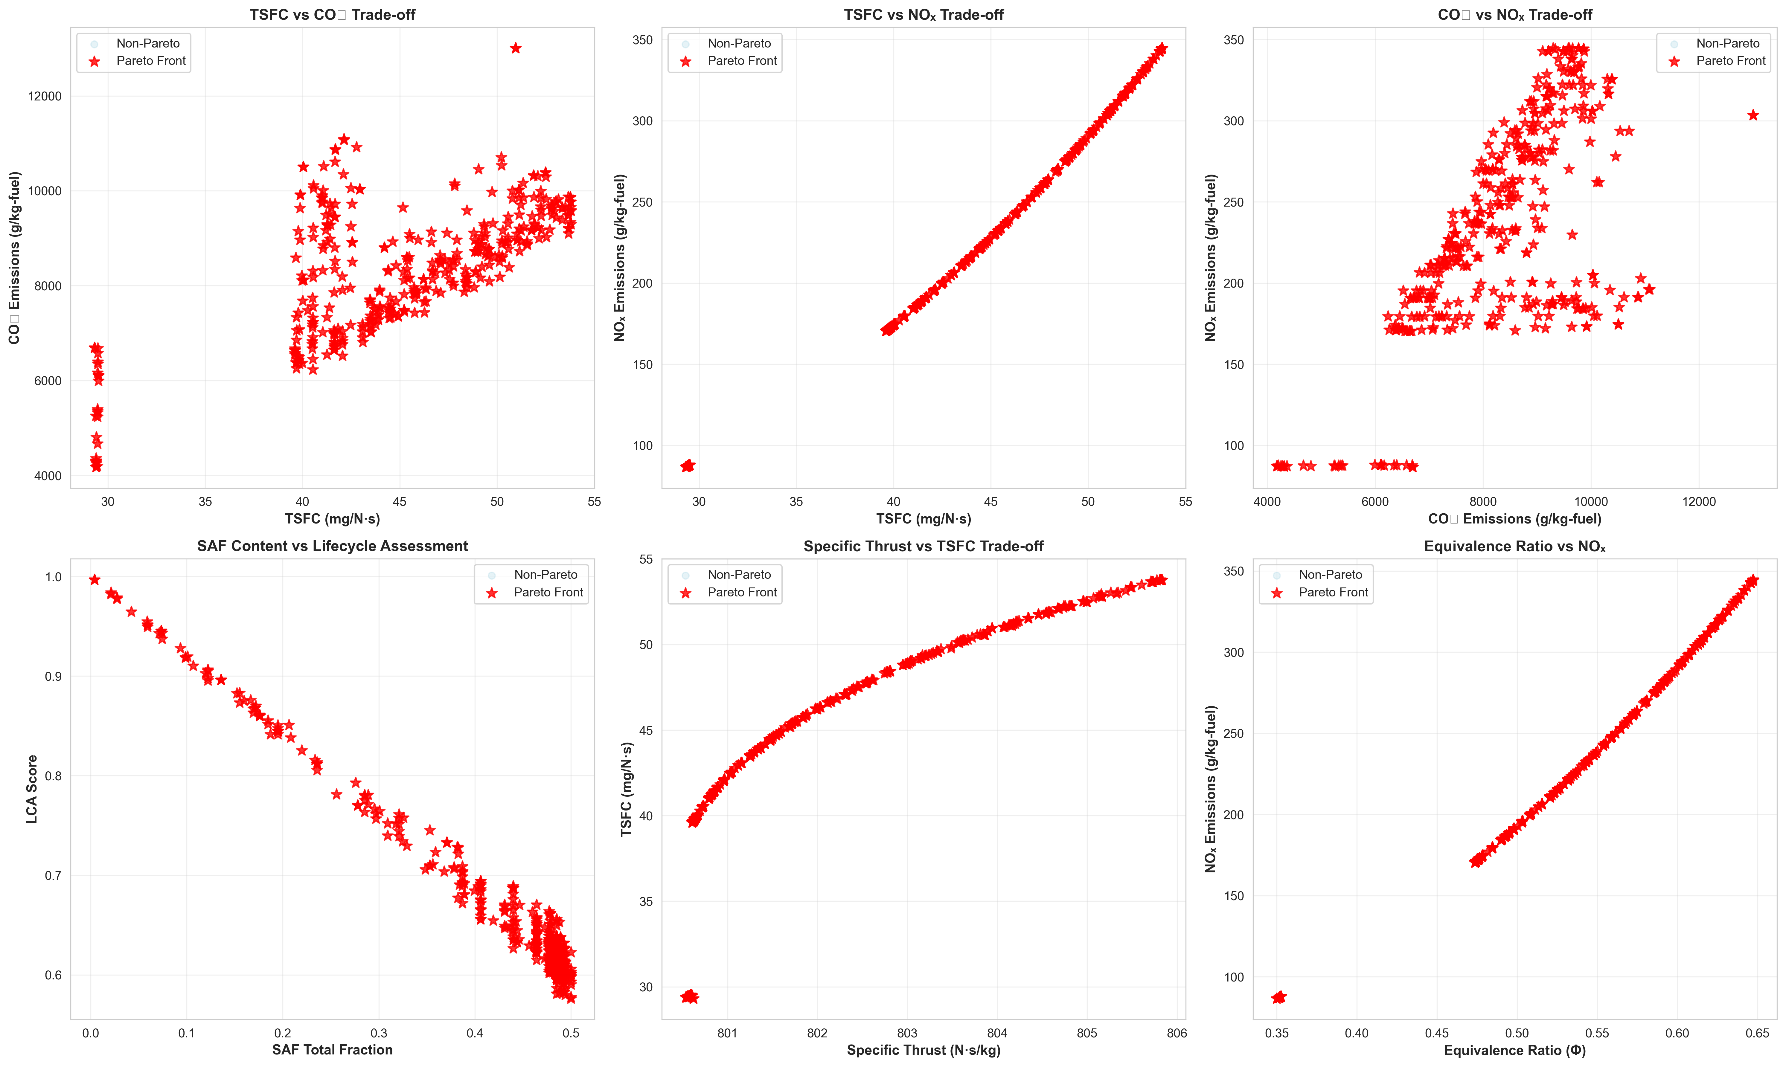
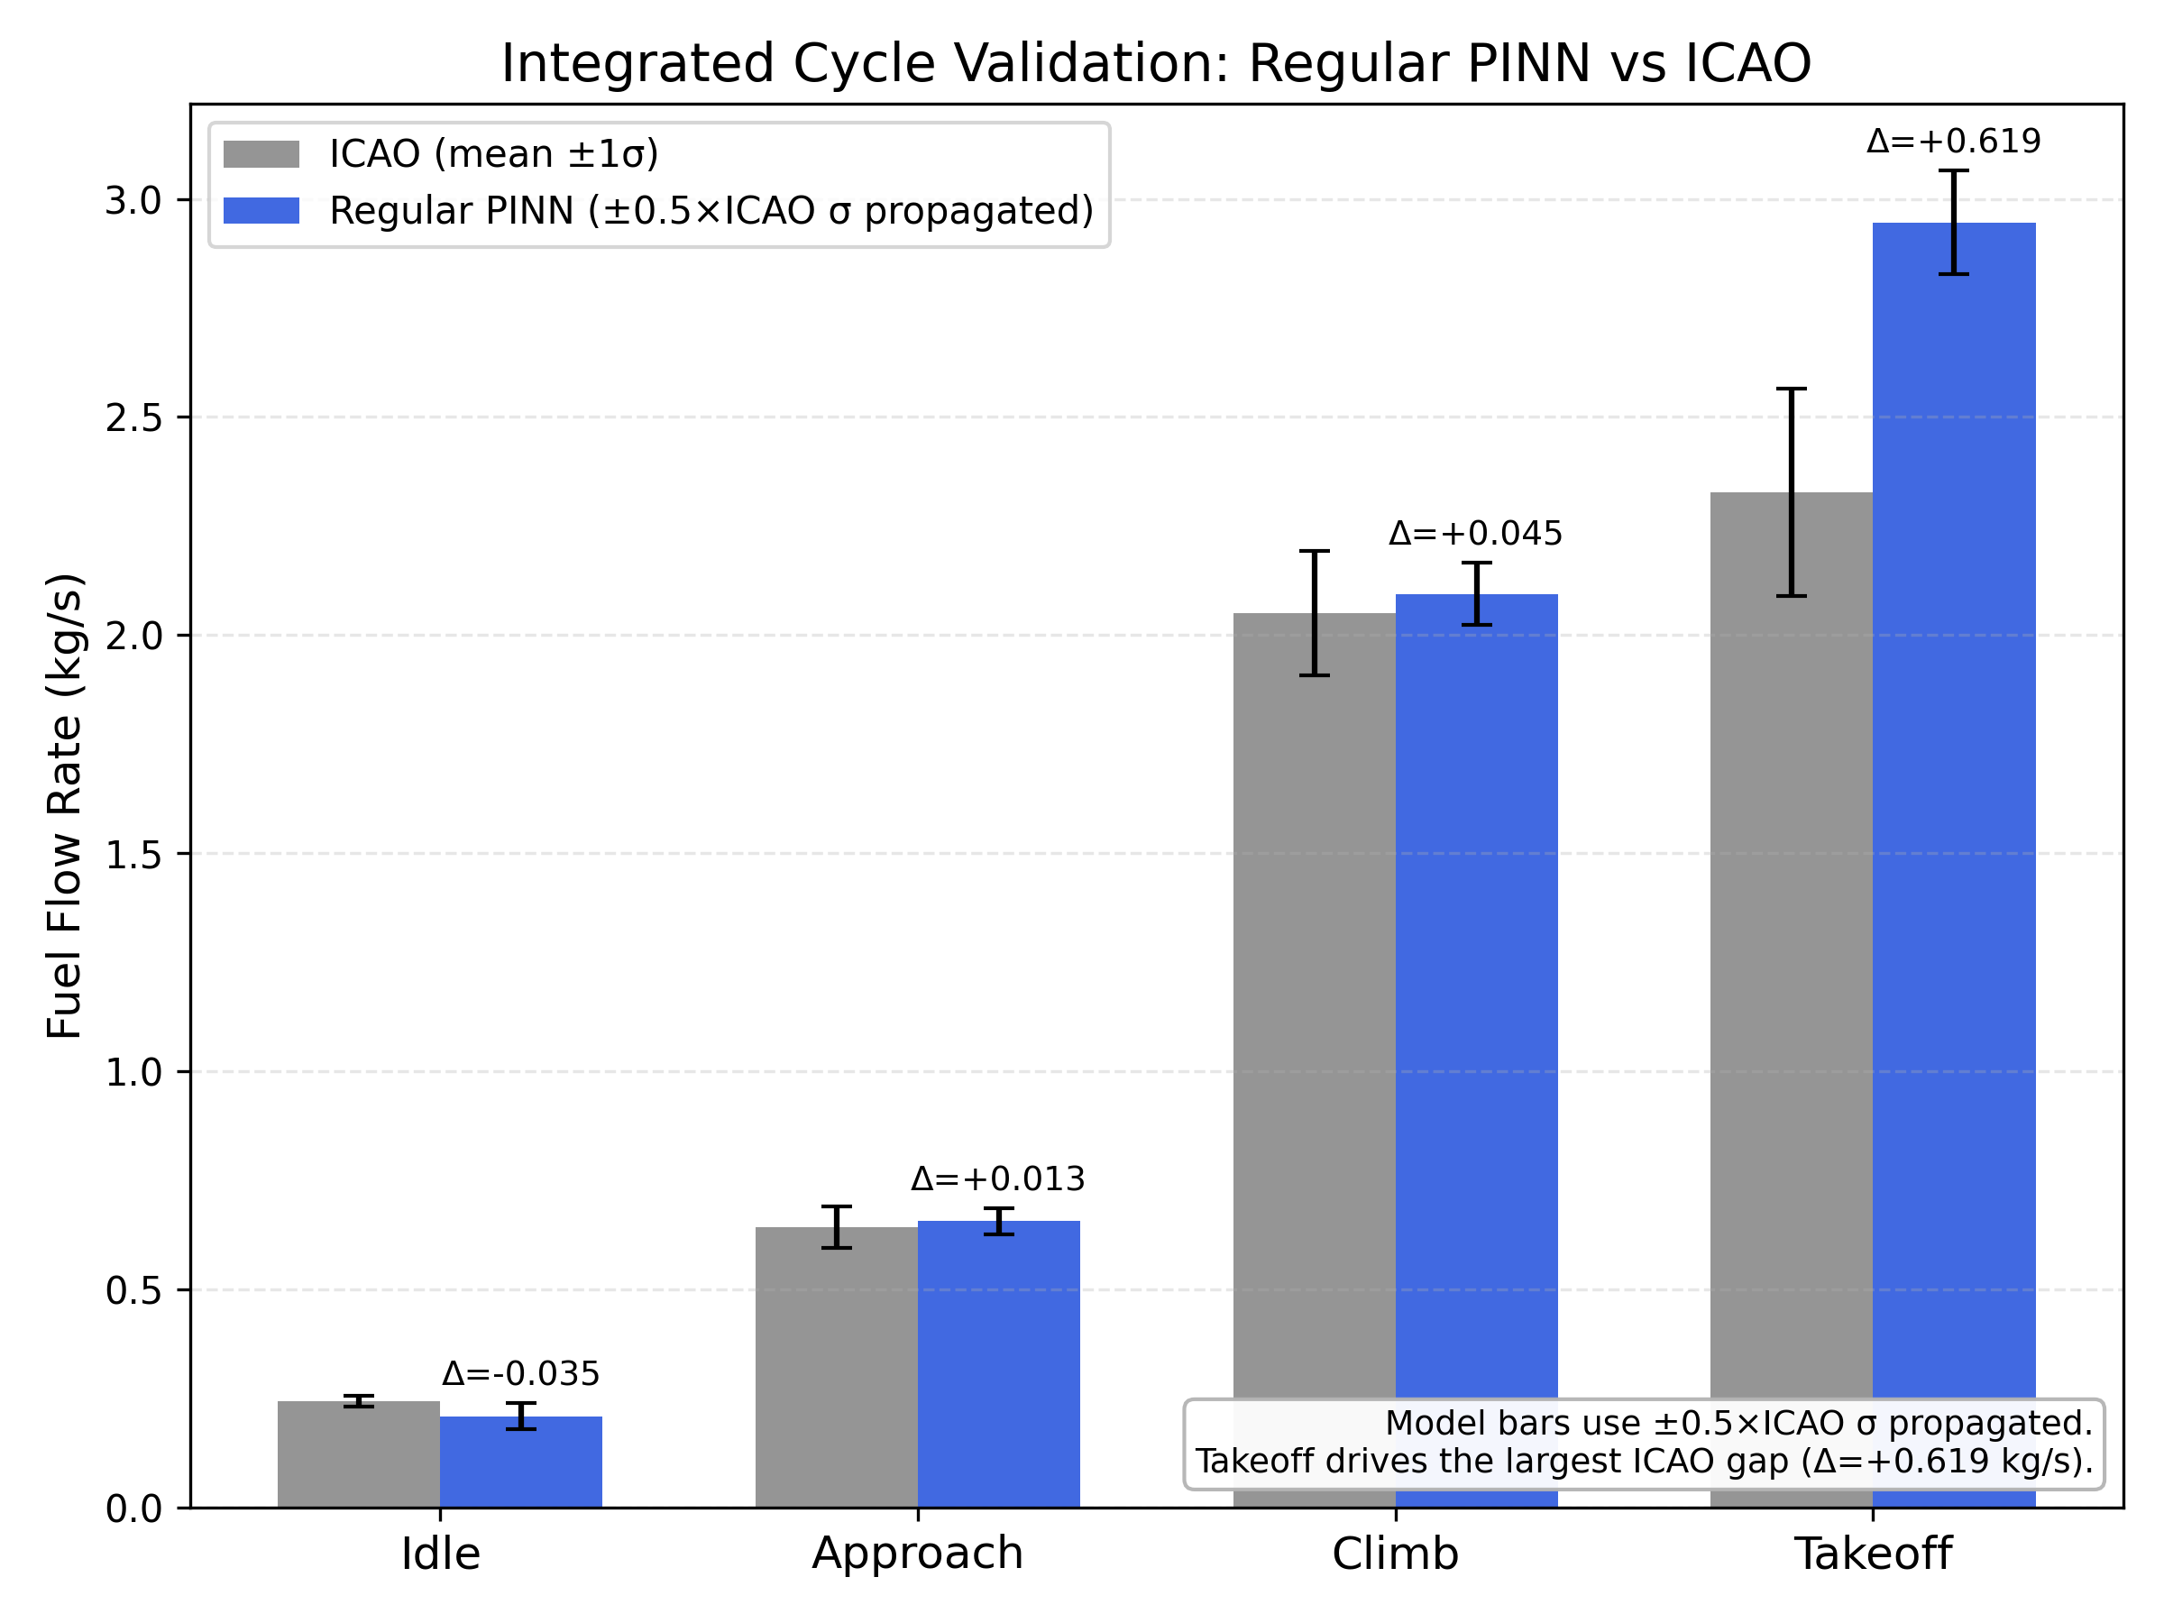
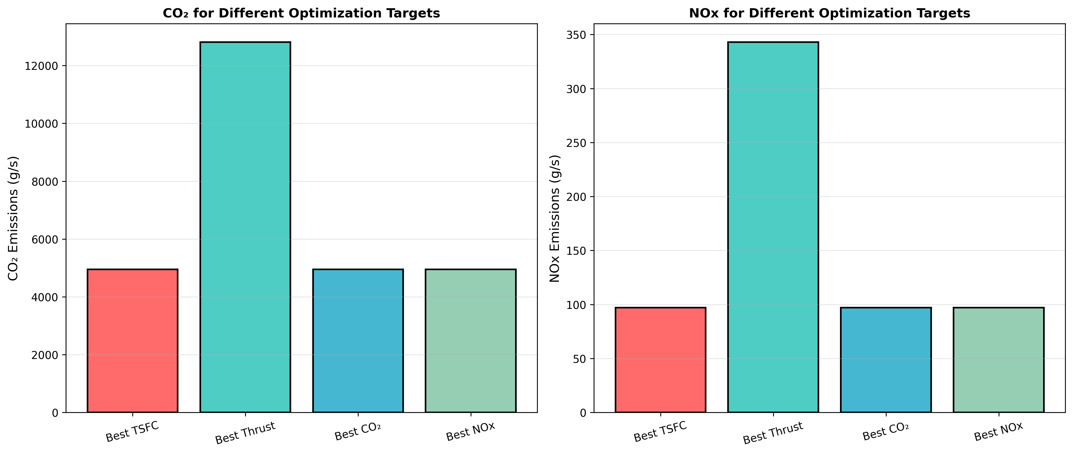
Multi-Objective Optimization of Sustainable Aviation Fuel (SAF) Blends
398 Pareto-Optimal Blends
Using a Physics- and Kinetics-Informed Turbofan Digital Twin
~51% Lifecycle CO₂ Reduction
Arnav Patil
1,000 Simulated Trials
Introduction
Methodology — Turbofan Digital Twin Pipeline
Key Quantitative Findings
Aviation contributes ~2.5% of global CO₂ emissions (ATAG, 2022), a share expected to grow without intervention.
Sustainable Aviation Fuels (SAF) — HEFA (hydroprocessed oils), ATJ (alcohol-to-jet), and FT-SPK (Fischer-Tropsch) — can reduce lifecycle CO₂ by up to 80% vs. Jet-A (Wang et al., 2024).
SAF performance and emissions depend critically on blend composition: thrust, TSFC, NOx, and lifecycle carbon all vary across the blend space.
Physical blend testing is expensive and slow. Standard CFD cannot efficiently screen thousands of blend combinations. A computational surrogate is needed.
Fuel Blend
Input
Cantera
Compressor
Cantera
Combustor
Turbine
PINN
Nozzle
PINN v4.0
Emissions
Model
Optuna
Optimizer
398
~51%
HEFA · FT-SPK
ATJ-SPK + Jet-A
≤50% SAF | 1,000 trials
Brayton cycle
Compression work
Fuel-dep. OPR → T, p
CRECK C1-C16
1,700+ reactions
Outputs: T, p, cp, R, γ
Fuel-dependent
neural surrogate
Exact continuity enforced
8D fuel-aware input
Physics gates active
BC err <0.5%
NOx: ICAO reg.
R²=0.9969
CO₂: LCA×3.16 kg/kg
1,000 trials
4 objectives
→ 398 Pareto blends
Pareto-optimal
SAF blends
Lifecycle CO₂
reduction (best blend)
Results · 1,000 Trials · 398 Pareto-Optimal SAF Blends Identified
71%
0.9969
4-objective optimization (minimize TSFC, CO₂, NOx; maximize specific thrust) over a continuous SAF blend space (HEFA, FT-SPK, ATJ-SPK fractions + Jet-A baseline). Pareto filtering retained 398 of 1,000 trials as non-dominated solutions. Specific thrust remained stable (800.5–805.8 N·s/kg, ±0.7%) across all 398 blends — confirming performance preservation.
Of Pareto blends
contain >40% SAF
NOx model R²
(ICAO LTO regression)
Representative Balanced Solution (from abstract)
SAF Total: 29.6% TSFC: 29.46 mg/(N·s)
Spec. Thrust: 800.6 N·s/kg NOx: 87.65 g/kg
LCA Factor: 0.762 (−23.8% vs. Jet-A baseline of 1.0)
Research Question
What SAF blend composition minimizes lifecycle CO₂ and NOx while preserving turbofan thrust and fuel efficiency under realistic thermodynamic constraints?
Conclusion
Objective
Build a fuel-aware turbofan digital twin — combining Cantera chemical kinetics with physics-informed neural networks — then identify Pareto-optimal SAF blends across a continuous blend space using multi-objective optimization.
Prior Work
Nath et al. (2023): PINNs predict gas flow dynamics and unknown parameters in diesel engines with limited, noisy data (Sci. Reports).
Ma et al. (2026): Locally-enhanced PINNs achieve <1% average wall-temperature error in aero-engine nozzle modeling (AST).
Şahin (2023): ANNs outperform XGBoost/SVM for NOx prediction in diesel/biodiesel/iso-pentanol blends (Heliyon).
Kuzhagaliyeva et al. (2022): AI + genetic algorithms design fuel mixtures from molecular descriptors, reducing lab testing cost (Commun. Chem.).
Gal et al. (2024): Holistic 0D/1D Cantera + 3D CFD for hydrogen ICE; holistic modeling essential for accuracy (Energies).
This work →: Direct Cantera + PINN integration for a turbofan (not ICE); 4-objective Pareto optimization across SAF blend space.
Fig. 1 — 3D Pareto Objective Space (TSFC · CO₂ · Specific Thrust)
Fig. 2 — Lifecycle Carbon Factor vs. Net CO₂ Emissions
Fig. 5 — 2D Pareto Trade-off Panels
TSFC vs. CO₂, NOx vs. TSFC, SAF content vs. LCA, and Phi vs. NOx. Pareto-optimal blends (★) show that low-TSFC and low-emissions objectives are co-aligned — a key design insight for practical SAF selection.
Each ★ is a Pareto-optimal blend: no improvement on one objective without worsening another. Color = NOx emission (g/s); marker size = SAF fraction. The 398 starred points cluster away from non-dominated trials. The lower-left region — low TSFC and low lifecycle CO₂ — represents the target zone for further SAF development. Specific thrust axis range (800–806 N·s/kg) confirms near-constant engine performance across all blends.
Higher SAF content → lower lifecycle carbon factor (LCA, x-axis) → lower net CO₂ (y-axis). Color = NOx (g/s). Low-NOx solutions (blue/purple) span the full SAF content range. Best blend: LCA ≈ 0.59, CO₂ ≈ 4,175 g/s — a ~51% reduction vs. the Jet-A baseline (~8,464 g/s). The labeled clusters (High SAF, Mid SAF, Low SAF, Jet-like) show how blend composition drives the emissions landscape. SAF content is the dominant lever for lifecycle carbon reduction (Wang et al., 2024).
398 Pareto-optimal blends identified from 1,000 simulated engine cycles — a search infeasible to conduct physically (Baghernejad & Aslanzadeh, 2022).
Best CO₂ blend (~49% SAF: HEFA + FT-SPK + ATJ-SPK) achieves ~51% lifecycle CO₂ reduction vs. Jet-A while maintaining specific thrust within ±0.7% — verifying performance preservation (Akdeniz et al., 2023).
71% of Pareto solutions contain >40% SAF, confirming high-SAF blends dominate the optimal performance-emissions region; fuel efficiency (TSFC) and emissions reduction are co-aligned objectives.
Validation — ICAO LTO Data
Dataset: 180 ICAO LTO records — Rolls-Royce Trent 1000
NOx model R² = 0.9969 MAPE = 11.3%
Future Work
Mode | ICAO (kg/s) | Model (kg/s) | Δ
Idle | 0.244 | 0.209 | −0.035 ✓
Approach | 0.643 | 0.656 | +0.013 ✓
Climb | 2.050 | 2.095 | +0.045 ✓
Takeoff | 2.327 | 2.946 | +0.619 ⚠
Experimental combustion testing of top Pareto blends (lab calorimetry or partner test stand).
Takeoff calibration: reduce +27% fuel flow overprediction via compressor map integration.
Extend to 2D planar nozzle (LE-PINN) once training instability is resolved (Ma et al., 2026).
Fleet-level lifecycle mission simulation with full altitude/payload/range profiles.
References
⚠ Takeoff limitation: +27% fuel-flow overprediction at max-throttle. Idle, Approach, and Climb — the three dominant LTO phases by flight time — are within ±5%.
NOx model:
ICAO multi-variable regression in log-space (scikit-learn). Fitted: NOx = 9.82 × OPR^0.207 × ṁ_fuel^0.951. R² = 0.9969 across 180 certified LTO records.
Akdeniz et al. (2023). Thermodynamic analyses of turbofan for dual-fueled ops. Energy 326, 136315.
Akiba et al. (2019). Optuna. KDD 2019. doi:10.1145/3292500.3330701
Alagumalai et al. (2021). NOx chemical kinetics in IC engines. Elsevier.
Baghernejad & Aslanzadeh (2022). Multi-objective optimization. Elsevier.
Cantera (n.d.). Open-source chemical kinetics. cantera.org
Frassoldati et al. (2015). n-Alkane oxidation kinetics. Combust. Flame 162(9).
Gal et al. (2024). H₂ combustion 0D/1D/3D-CFD. Energies 17(22).
Kuzhagaliyeva et al. (2022). AI fuel design. Commun. Chem. 5, 111.
Ma et al. (2026). LE-PINN for nozzle aerothermal. AST 168, 111002.
Nath et al. (2023). PINNs for diesel engines. Sci. Rep. 13, 13683.
Raissi et al. (2019). Physics-informed NNs. J. Comput. Phys. 378.
Rakesh et al. (2019). Jet engine performance analysis. IJEAT 8(6S2).
Sarathy et al. (2011). Iso-octane kinetics. Combust. Flame 158(12).
Şahin (2023). ML for biodiesel blends. Heliyon 9(11), e21365.
U.S. DOE (n.d.). Alternative Fuels Data Center: SAF. afdc.energy.gov
Wang et al. (2024). SAF opportunities. Carbon Capture Sci. Tech. 13.
Yang et al. (2020). Reaction mechanisms in combustion. PECS 79.
Zhang et al. (2018). n-Dodecane oxidation. Combust. Flame 197.
Fig. 3 — ICAO LTO Fuel Flow Validation (Rolls-Royce Trent 1000)
Fig. 4 — CO₂ and NOx by Optimization Target (Corner Pareto Solutions)
Digital twin predictions vs. 180 certified ICAO LTO records across four power modes. Grey = ICAO mean ± 1σ; blue = model prediction. Agreement is within ±5% at Idle (Δ=−0.035 kg/s), Approach (Δ=+0.013 kg/s), and Climb (Δ=+0.045 kg/s). Takeoff shows a +0.619 kg/s (+27%) overprediction — a known limitation at max-throttle extrapolation. Overall MAPE = 11.3%. Error bars use ±0.5×ICAO σ propagation (data per ICAO Engine Emissions Databank, 2021).
Comparison of CO₂ (left) and NOx (right) for the four extreme Pareto solutions. 'Best TSFC' achieves both the lowest CO₂ (~5,000 g/s) and lowest NOx (~95 g/s) — confirming that fuel efficiency and emissions reduction are co-aligned objectives. 'Best Thrust' carries the highest environmental cost. This finding indicates that optimizing for TSFC is an effective proxy for joint emissions reduction, a critical insight for practical SAF screening (Akdeniz et al., 2023).

