Slide 1

Look Lunatic: AI Fashion Recommendation
Project Roadmap & Execution Plan

Slide 2
Project Overview
Look Lunatic is an AI-powered fashion recommendation mobile application that suggests clothing , footwear , accessories and much more based on user preferences, body analysis, and facial recognition.

Slide 3
Goals and Objectives -
Revolutionising fashion for everyone .
Providing up to date and accessible fashion advice.
Using facial recognition in real time for feature detection on low end machines.
Providing an easy to use and responsive front end user interface.
Will also help in other unconventional fashion aspects such as – perfumes , accessories etc.

Slide 4
Technology Stack
• Frontend: React.js (Next.js) / Css
• Backend: Python
• Database: PostgreSQL / Firebase
• AI Models: GeminiAPI, MediaPipe,
• APIs: Flipkart, Amazon, Myntra

Slide 5
Working Process -
Registration ( Make new account or login in an existing account)
Enter personal info such as DOB, Height , Weight etc.
Engage in real time face scanning and determining important facial features such as eyebrow shape , eye shape etc.
Receive styling ideas regarding various aspects such as –
Clothes , footwear , cologne etc.

Slide 6
Business Market
The biggest source of revenue is planned to be advertisers that provide targeted advertising .
Providing API to other markets for fashion ideas .
Usage by people on their personal devices.
For aspiring fashion designers to get more ideas quickly and easily .

Slide 7
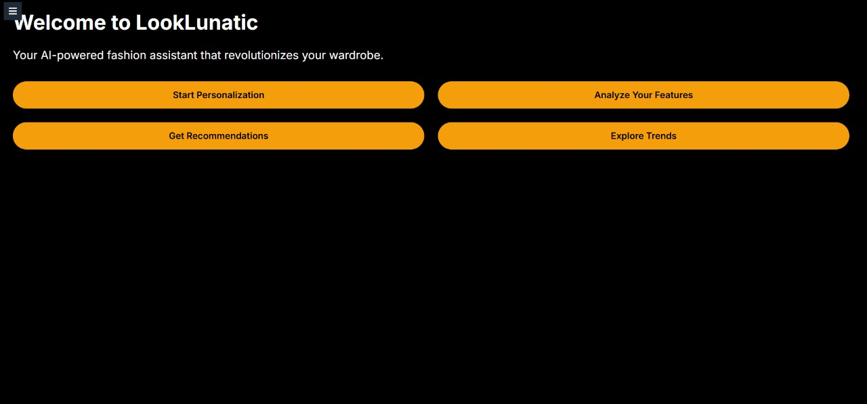
GLIMPSES OF USER INTERFACE

Slide 8
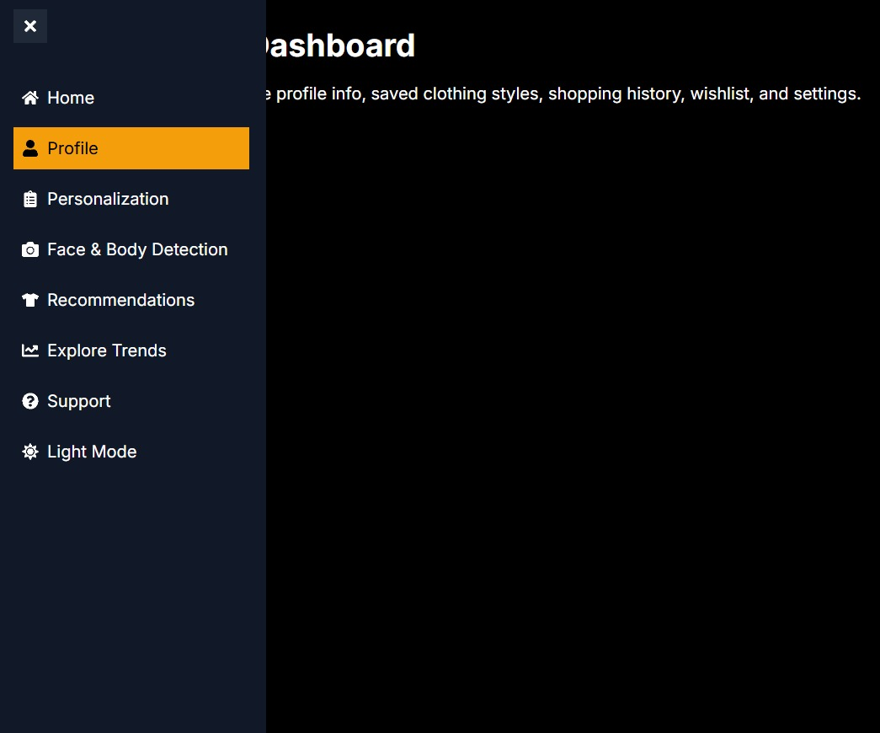

Slide 9
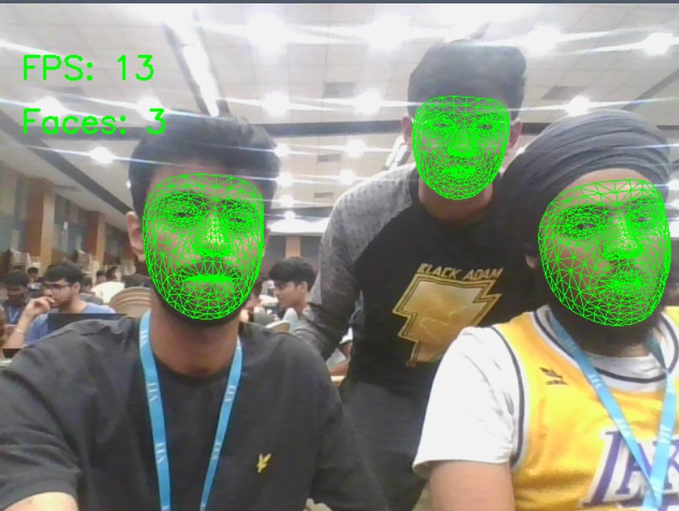
AI Face recognition ( To be integrated )

Slide 10
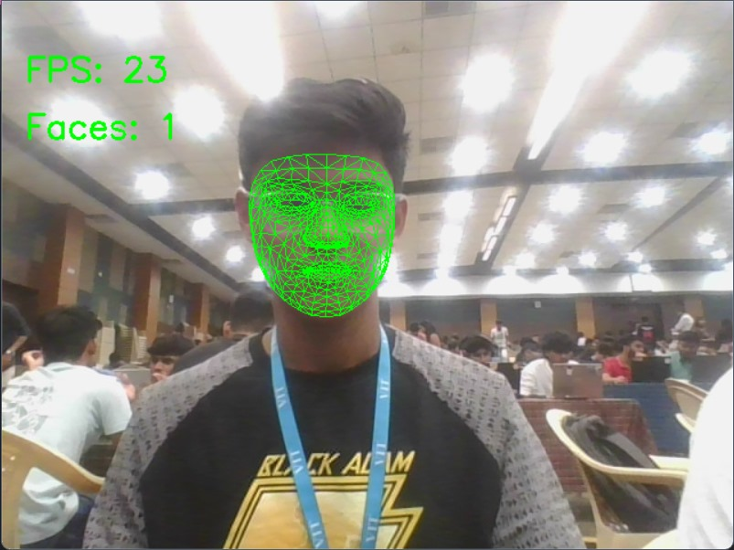
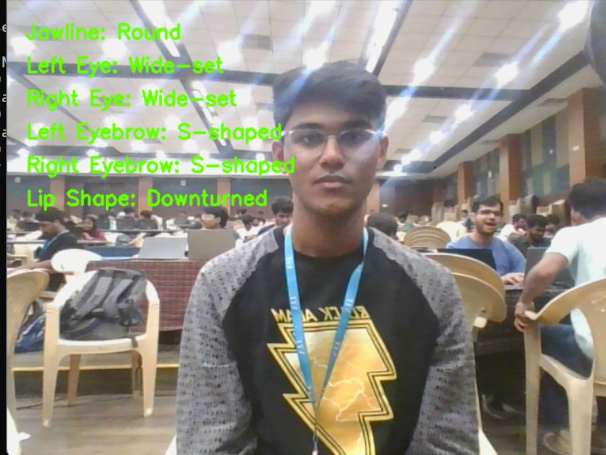
Face Features Recognition

