Slide 1
Dissertation
Topic – Churn Prediction
By

Slide 2
Goals
Prevent Churn Prediction
Improve marketing strategies to prevent churn
Reduce costs in retaining customers via coupon redemption technique

Slide 3
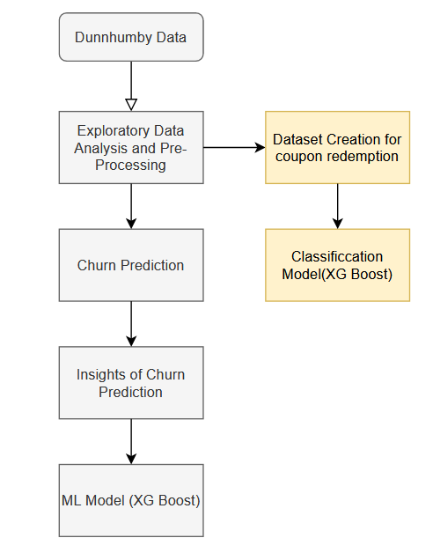
Exploratory Data Analysis
Exploring all the tables in the dataset and creating two different datasets for churn prediction and coupon redemption

Slide 4
Defining Churn
If customer does not buy for 2 weeks then it is said to be churned.

Slide 5
Insights of churn prediction
Exploring Demographics of churn prediction meaning which people are more likely to churn.

Slide 6
Creating Classification model
Creating a classification model for churn prediction which is XG Boost

Slide 7
Creating Classification model
Creating a classification model for coupon redemption which will help n marketing strategies to prevent churn prediction.

Slide 8
Thank you (Any Questions)

