Slide 1
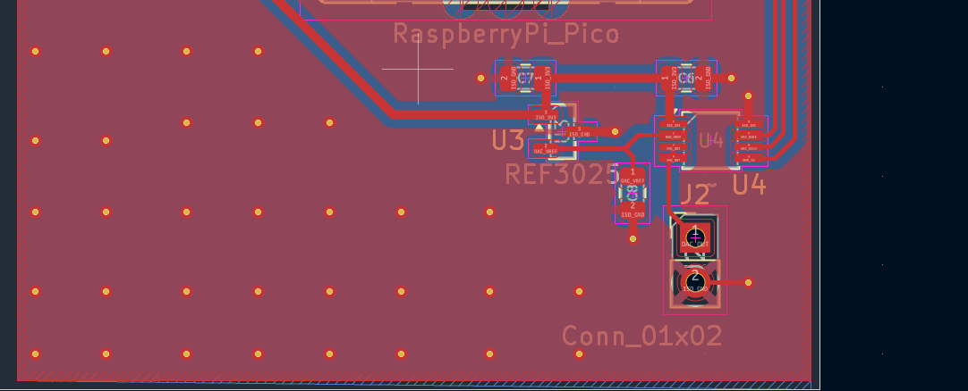
Band-Pass Filter PCB Integration
The band-pass filter is now incorporated into the daughter-card PCB design with the isolated control, reference, and DAC circuitry.
Current PCB layout showing the integrated analog section on the isolated side of the board.

Slide 2
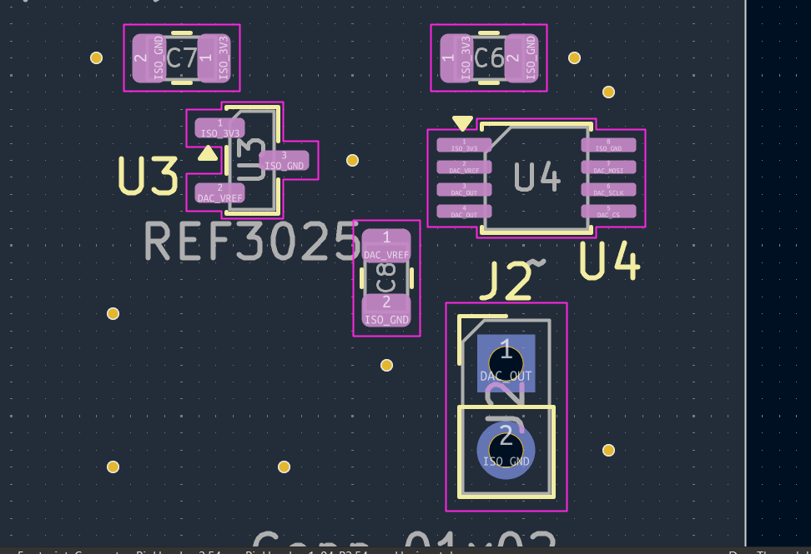
Integrated Analog / Filter Section
The filter and analog components are grouped near the DAC and reference circuitry to keep signal routing compact. ISO_GND remains separated from the non-isolated ground domain.
Board-level view
Close-up of reference / DAC area

Slide 3
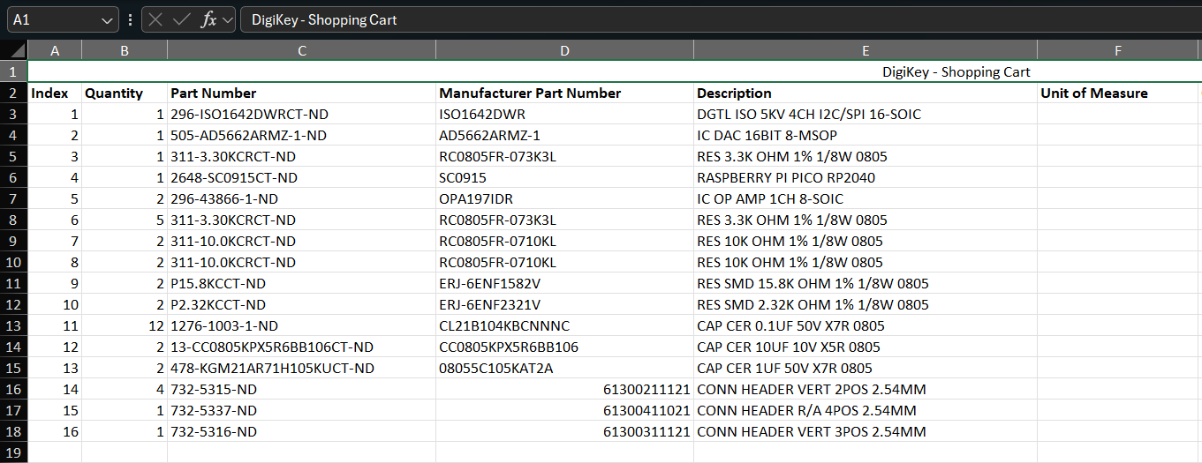
Parts Ordered
The order includes the ISO1642 isolator, AD5662 DAC, Raspberry Pi Pico, OPA197 op-amps, precision resistors, capacitors, and board headers needed for assembly.
DigiKey shopping cart / component list

Slide 4
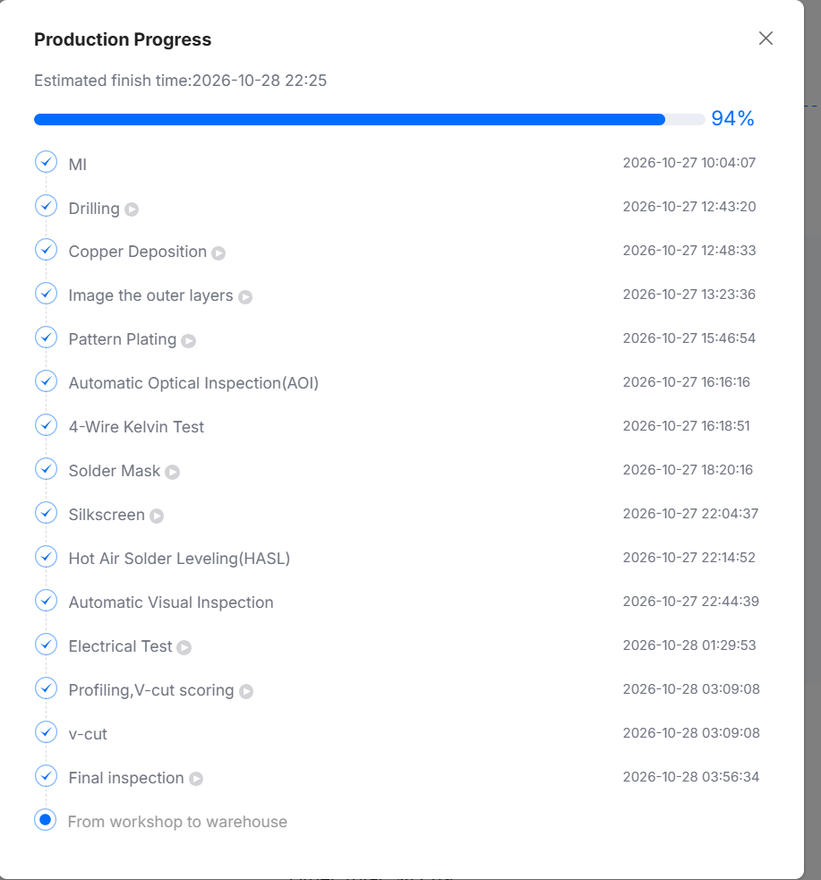
PCB Ordered from JLCPCB
The PCB order has completed fabrication, electrical test, and final inspection. At the time of this update, the boards were moving from the workshop to the warehouse.

Slide 5
Next Steps
After the boards and components arrive, the next stage is assembly and hardware bring-up. Testing will verify power rails, isolation, DAC operation, and the band-pass filter frequency response.
1
Assemble PCB
2
Bring-Up
3
Filter Test
Populate the ordered components and inspect solder joints.
Check power, grounds, isolation, and DAC communication.
Measure the band-pass response and compare it with the design target.

