Slide 1
Rail Metro Using Dijkstra Algorithm And ACO
Data Structures
Unordered Map
Priority Queue
Dynamic Array (vector)
Graph 📊

Slide 2
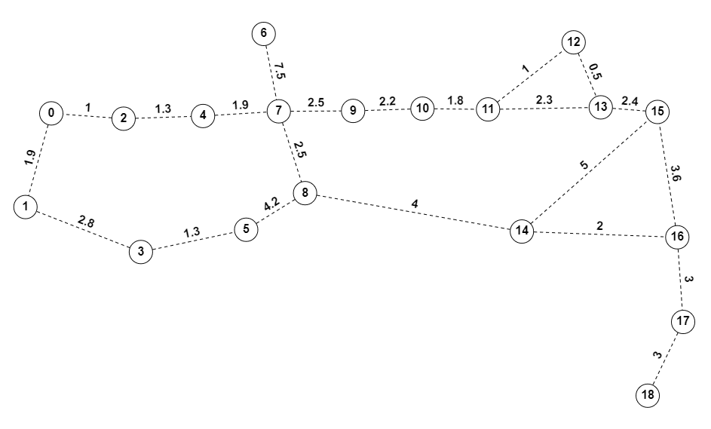

Slide 3
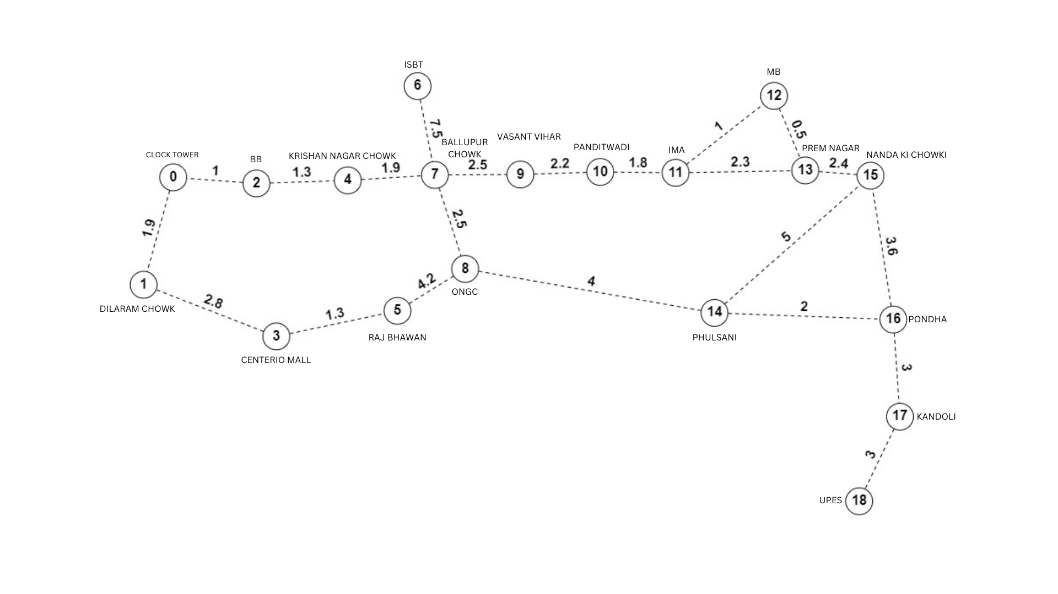

Slide 4
