Slide 1

RELIANCE T.U.P XII · ELIMINATION ROUND
JioMausam
We don’t build sensors.
We become the sensor.
A live, street-level weather map from Jio’s own network, and insurance that pays workers automatically when extreme weather stops their work.
Notes:
[0:00–0:12] You’ve just seen the idea. In the next three minutes: proof that it works on real network data, where we start and why, and exactly what we need from Reliance.

Slide 2

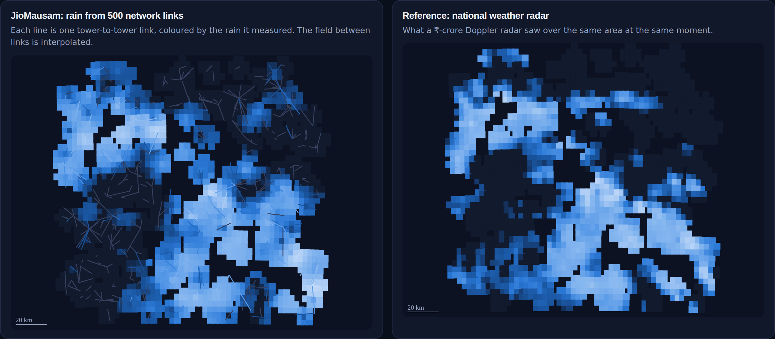
JioMausam
OUR WORKING PROTOTYPE
Same storm. Our network vs a radar.
500
real tower-to-tower microwave links, 1-minute signal data
0
radars, weather stations or new hardware on our side
Open the live prototype to replay the storm
Real data: 500 commercial microwave links, 13–14 May 2018 storm (pycomlink public example data). Reference: German Weather Service radar.
Notes:
[0:12–0:40] This is our working prototype, the JioMausam Control Room. On the left is rain mapped only from 500 real tower-to-tower radio links. On the right is a national weather radar that costs crores. Same storm, same moment. The shapes and the heavy patches match. We added nothing to the network to get this. (If the call allows, switch to the live prototype tab and press “Replay the storm”.)

Slide 3
JioMausam
THE PROOF
Tested on days it had never seen.
0.95
network-wide match with radar, hour by hour
0.88
typical single link on its own
91%
of rainy days caught, 4.6% false alarms
Calibrated once (×1.17) on days 1–3, tested on days 4–11. Payout rule (10 mm in 3 h) made the same decision as radar 94.6% of the time.
Notes:
[0:40–1:00] Here’s the honest test. We tuned one number on the first three days, then tested on eight days the model had never seen. Network-wide our rain matched the radar at 0.95. A single link on its own: 0.88. We caught 91% of rainy days with only 4.6% false alarms. And our payout rule made the same pay or no-pay decision as the radar 94.6% of the time.

Slide 4
JioMausam
THE INDIA LAYER
Indian weather tells us where to start.
Start where the triggers are.
Mumbai has about 12 heavy-rain days a year, so rain and riders come first. Nagpur’s and Ahmedabad’s danger is heat: that’s phase two.
Mumbai rain · 11.9 heavy days a year
Phase 1
Nagpur heat · 9.7 days ≥45°C
Phase 2
Ahmedabad heat · 5.4 days ≥45°C
Phase 2
IMD station reports 2000–2024 via NOAA. City prices for Kavach Basic: Mumbai ₹45, Nagpur ₹52, Ahmedabad ₹29 a month (₹300 a payout, max 5 days a year).
Notes:
[1:00–1:25] Indian operators don’t publish link data, so we went to 25 years of IMD station records. Two findings. Rain really is hyperlocal: on a third of Mumbai’s heavy-rain days, a station 20 km away got less than half as much. And each city has a different danger. Mumbai sees about 12 heavy-rain days a year, so that’s where we start: rain, riders, Mumbai. Nagpur and Ahmedabad face heat, which is our phase two.

Slide 5
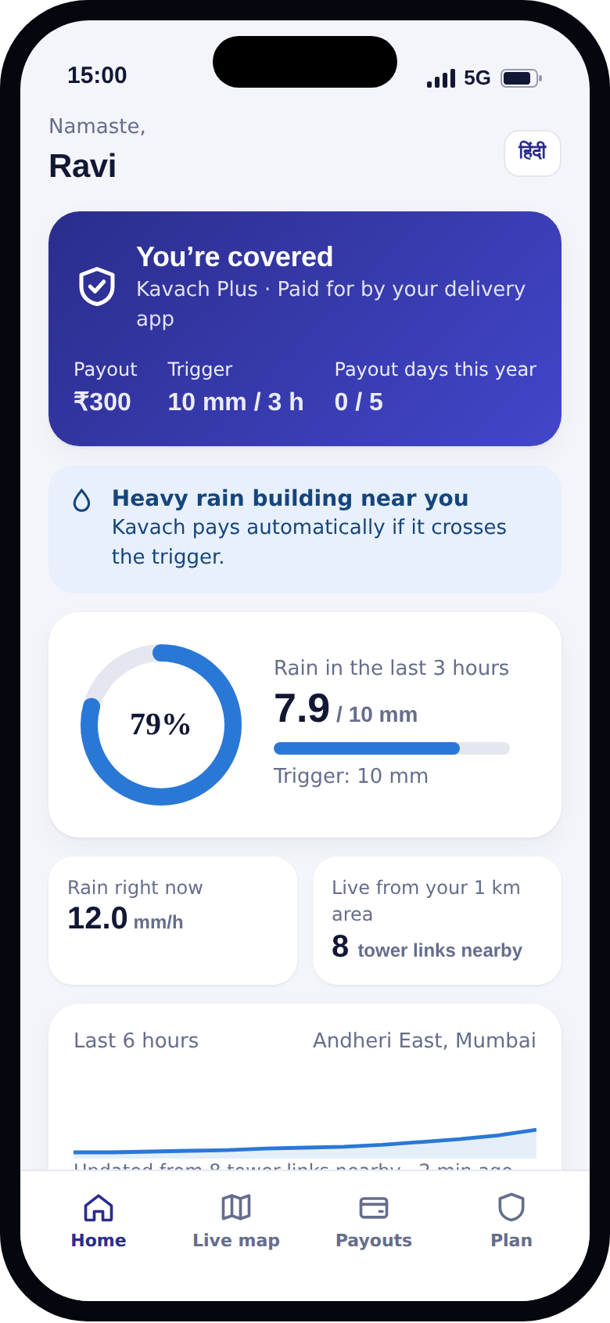
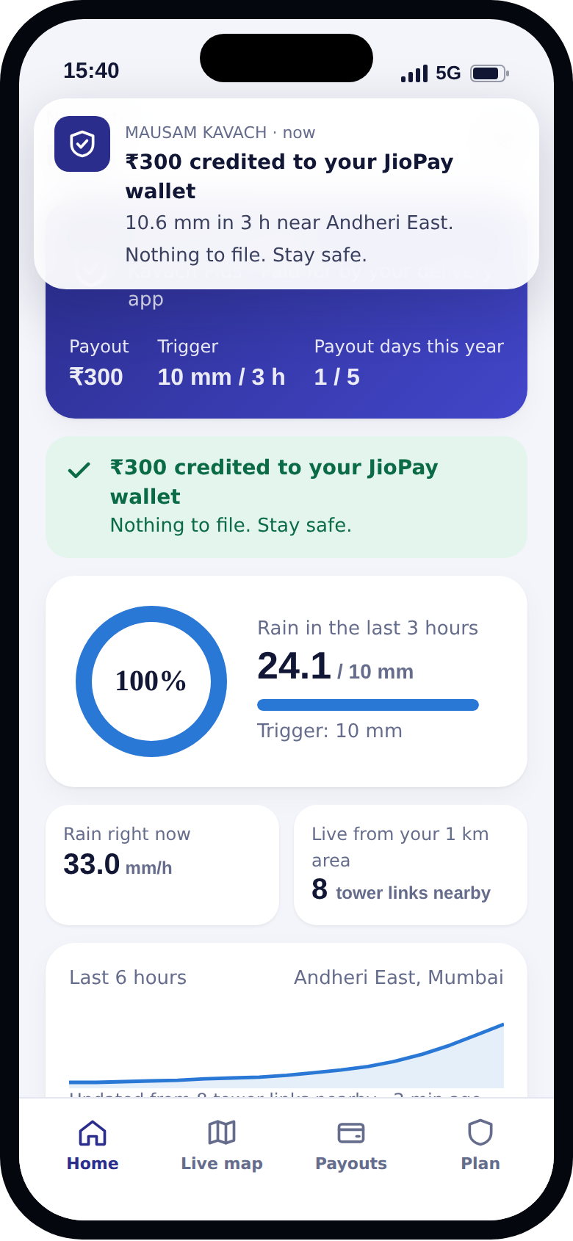
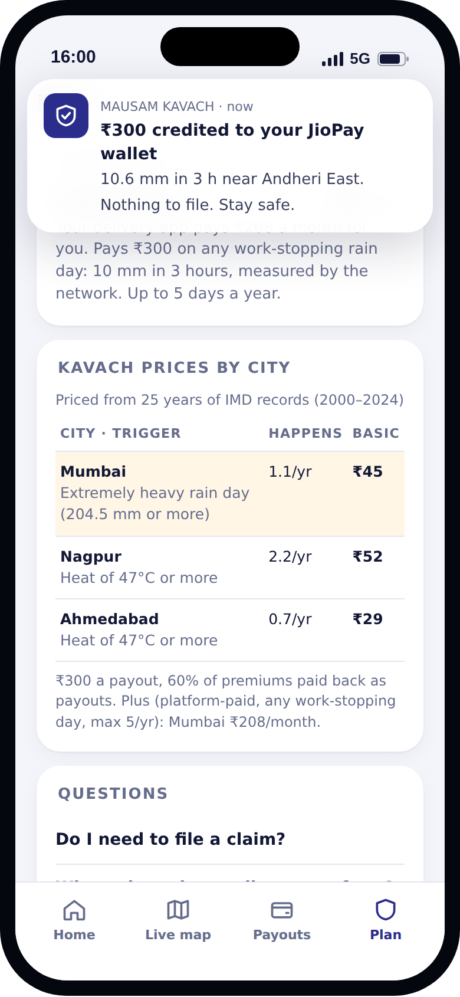
JioMausam
THE PRODUCT
What a worker actually sees.
1 Covered from their recharge. The ring fills as rain builds.
2 The network crosses the trigger. ₹300 lands in JioPay.
3 City prices, set from 25 years of IMD records.
Notes:
[1:25–1:50] This is the Mausam Kavach app. Ravi, a delivery rider in Andheri, is covered: his delivery app pays for it. As the towers around him measure the rain, the ring fills. The moment it crosses ten millimetres in three hours, three hundred rupees lands in his JioPay wallet, with the exact reading that triggered it. No form, no surveyor. It works in Hindi too.

Slide 6
JioMausam
THE BUSINESS
Riders first. Then everyone.
₹12.5 Cr
of premiums a year from one delivery app covering 50,000 Mumbai riders on Kavach Plus (₹208 a rider a month)
Kavach Plus · first
Delivery apps buy it for riders: ₹208 a rider a month in Mumbai, any work-stopping day, up to 5 a year.
Kavach Basic · phase 3
Individuals add it at recharge for ₹29–52 a month by city. 1% of Jio’s users = ₹174 Cr of premiums; Jio’s fees ₹26–44 Cr.
Premiums aren’t Jio’s revenue: a licensed insurer holds them. Jio keeps 15–25% as distribution and data fees, about ₹1.9–3.1 Cr here, and carries no insurance risk.
Data + customer zero
Insurers and state disaster agencies license the map: revenue that is Jio’s own. JioMart, New Energy and Jio use it first.
Illustrative. A licensed insurer underwrites through Jio Financial Services’ partners; Jio earns distribution and data fees and carries no insurance risk.
Notes:
[1:50–2:15] We start with riders, because one deal with one delivery app covers thousands of workers. Kavach Plus in Mumbai is about ₹208 a rider a month, so fifty thousand riders is about 12.5 crore of premiums a year. To be clear, premiums aren’t Jio’s revenue: a licensed insurer holds them, and Jio keeps fifteen to twenty-five percent as distribution and data fees. In phase three, anyone can add Kavach Basic at recharge; one percent of Jio’s users is 174 crore of premiums, or 26 to 44 crore in fees for Jio. On top of that, the data is Jio’s own revenue.

Slide 7
JioMausam
WHY RELIANCE, AND OUR ASK
Only Reliance holds every layer.
Sense Jio network, lakhs of sites
The ask: a 90-day coverage audit
Mumbai monsoon: rain, riders, one delivery app. Payouts in shadow mode, so no money moves yet.
Jio link logs for Mumbai
One JFS insurance partner and one delivery app
A five-person team. No new hardware.
Success: r ≥ 0.8 against IMD gauges, 80% of heavy-rain events caught, money in wallets within 6 hours.
Reach 500M+ users who recharge
Pay JioPay and JioFinance
Insure Jio Financial Services partners
Use JioMart, New Energy, Jio
Notes:
[2:15–2:35] Why only Reliance? It takes five layers: a network to sense, half a billion people to reach, a way to pay, an insurer, and businesses that use the data. Reliance is the only company with all five. Our ask is small: a ninety-day Mumbai coverage audit with Jio’s link logs, one insurance partner, one delivery app and five people. Payouts run in shadow mode, so no money moves until the regulator’s sandbox. It tests our two riskiest assumptions: link coverage and payout accuracy.

Slide 8
JioMausam
THE ROADMAP
Four phases. Rain first.
1
MONTHS 0–3
Coverage audit + shadow pilot
Mumbai: rain, riders, one delivery app. Payouts simulated; measure links and accuracy against IMD.
2
MONTHS 4–12
Sandbox + heat
Real payouts for one app’s riders in IRDAI’s sandbox. Heat module in Nagpur and Ahmedabad.
3
YEAR 2
Kavach Basic
At every recharge, priced city by city: ₹29–52 a month.
4
YEAR 3
National map
Every district. Data API for insurers, states and Reliance.
Notes:
[2:35–2:52] Four phases. Phase one is a Mumbai coverage audit with payouts in shadow mode: rain, riders, one delivery app. Phase two moves to real payouts in IRDAI’s sandbox and adds heatwaves in Nagpur and Ahmedabad. Phase three puts Kavach Basic on every recharge. Phase four is a national map with data for insurers and states.

Slide 9
India won’t adapt to climate change by building more.
It will adapt by listening to what it already has.
JioMausam
DIFFERENT BY DESIGN
Notes:
[2:52–3:00] India won’t adapt to climate change by building more. It will adapt by listening to what it already has. This is JioMausam. Thank you.

