Slide 1
Selecting an Ideal Neighbourhood

Slide 2
Introduction
In this problem we help a man choose which neighbourhood should he relocate to based on the his family members demand.

Slide 3
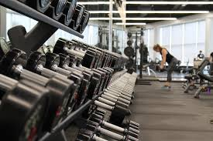
Wife Demands
The man’s wife says they should move in a neighbourhood that has a gym so that she could work as a trainer there

Slide 4
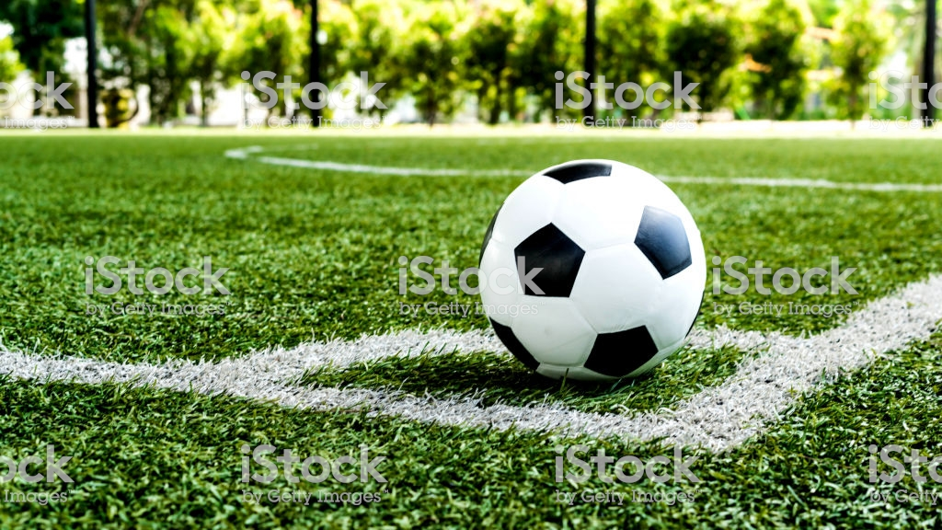
Son Demands
The says to his father that they should move to a neighbourhood that has a soccer field so that he can continue his practice and schooling simultaneously

Slide 5
Process
Firstly Download data.
Clean the data
Once this is done we used K means clustering to cluster data of top 200 venues (acc to foursquare) in North York and Brooklyn

Slide 6
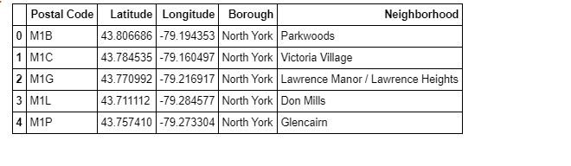
North York--Data

Slide 7
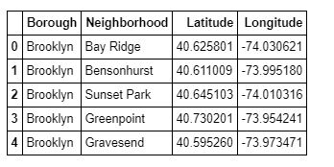
Brooklyn--Data

Slide 8
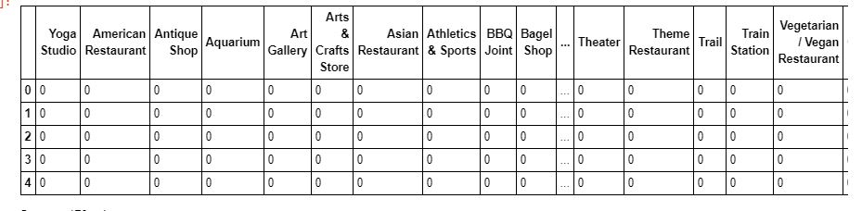
Top 200 venues in North York

Slide 9
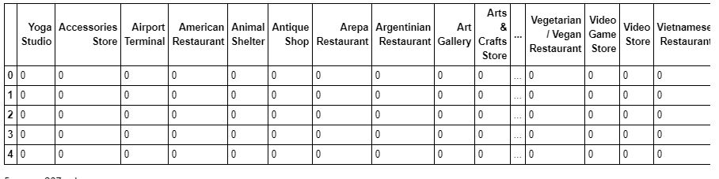
TOP 200 venues in Brooklyn

Slide 10
Clustering
Clustering of above data set as done using K-means algorithm
We set max limit of cluster to 3
So data was divided into 3 clusters

Slide 11

Result Set
The best result from our data set was found in cluster number ‘0’ of Brooklyn Data

Slide 12
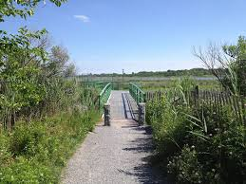
Marine Park was found the ideal neighbourhood for the man to relocate to.
It is close to his office has a gym and a Soccer Field in the top 200 venues on foursquare

