Slide 1














Principles of Computer System - 2
PROJECT - File Distribution System
By - Arnava Srivastava (B22AI009)
and Samay Mehar (B22AI048)

Slide 2

Overview
The File Sharing System is a distributed application that enables clients to interact with a central server to perform file-related operations such as uploading, downloading, and listing files in a directory.
The system incorporates concepts from Operating Systems (OS) and Computer Networks, including process synchronization and resource allocation, to ensure secure and efficient file sharing among multiple clients.

Slide 3
Client-Server Architecture: Implemented a client-server model where the server manages file storage and resource allocation, while clients interact with the server to perform file operations.
Socket Programming: Utilized TCP/IP sockets for communication between clients and the server over the network.
File Management: Supported file operations such as uploading and downloading, simulating file system functionalities.
Resource Allocation: Employed the Banker's algorithm to allocate and manage resources dynamically, preventing deadlock and ensuring safety.
Process Synchronization: Implemented Peterson's algorithm to handle critical sections for concurrent access to shared resources, ensuring mutual exclusion.
Concepts used in the project

Slide 4

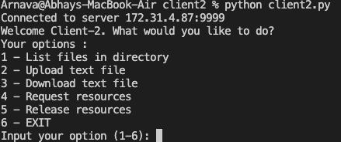
How to use ?
Run the “server_new.py” file to initiate the server and start listening for requests on the IP : 172.31.4.87 and port number : 9999
Next run the “client.py” code file (in separate terminal or computer) to connect to the server and use the implemented functionalities

Slide 5
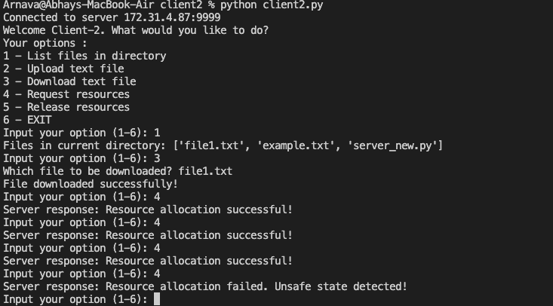
Demonstration and Results
Demo video clearly shows working of the client-server architecture. Below are some snippets of the results.
Here we see Client-2 operating with the network.
It successfully downloads and lists files from the server.
Also we see Banker’s Algorithm in action, wherein resources are safely allocated and it prompts whenever unsafe resources are allocated.

Slide 6
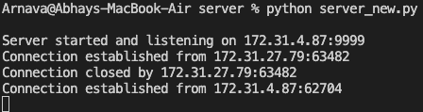
Demonstration and Results
Demo video clearly shows working of the client-server architecture. Below are some snippets of the results.
Above picture illustrates that the server handles multiple client requests from different IP’s. Thus, network connection is correctly implemented.

Slide 7

Applications in real - world scenarios
Cloud Storage Services:
Platforms like Dropbox, Google Drive, and OneDrive employ distributed systems to store and manage user files across multiple servers.
Collaborative Document Editing:
Applications such as Google Docs and Microsoft Office Online
Version Control Systems:
Version control systems like Git and Subversion allow developers to collaborate on software projects.

Slide 8
Thank you very much!

