Slide 1
STRATEGY CASE · INDIA QUICK COMMERCE
Fill the stores before you build more
A plan to add ₹1 lakh of daily sales to every Swiggy Instamart dark store, and why that is the cheapest way across break-even
Arnav Deshpande
₹5.52L
₹6.56L
arnavhpd@gmail.com
NOV per store per day today
after the plan
Independent analysis of public filings (Swiggy and Eternal shareholder letters, Zepto UDRHP). Baseline: Q1FY27, quarter to 30 June 2026. Not affiliated with any company.
Notes:
One-line pitch: Instamart doesn't need more stores yet, it needs fuller ones. This deck goes problem, root cause, plan, numbers, how I'd test it.

Slide 2
THE ANSWER, ON ONE PAGE
₹1 lakh more per store per day takes Instamart across contribution break-even for good, without a single new store
Problem
Instamart sells the same basket as Blinkit (₹508 vs ₹518 net) but each store sells ₹5.5L a day against ₹8.0L. 74% of the ₹71 per-order EBITDA gap to Blinkit is volume, not price.
+₹1.04L
NOV per store per day,
no new stores
Root cause
Capacity was built ahead of habit. Users order 2.83 times a month vs 3.47 at Blinkit, which is 63% of the throughput gap. Stores run at about 40% of capacity.
−0.3% → +0.8%
contribution margin, % of NOV
Plan
Four habit plays on the existing 1,171 stores: Morning Ritual + fresh, a Swiggy-to-Mart bridge, winning back lapsed users, and a bigger basket. Together +₹1.04L per store per day.
45% → 67%
Payoff
Contribution −0.3% → +0.8% of NOV. About ₹4,400 Cr more NOV a year, ~₹220 Cr net of programme cost, and 470 fewer stores needed to reach Swiggy's ₹60,000 Cr break-even scale.
stores contribution-positive
470
Not solved
Company-level EBITDA break-even still needs ~₹9.7L per store per day plus Swiggy's own per-order levers (ads, mix, inventory model). This is the first, cheapest step.
fewer stores to reach ₹60k Cr
(~₹1,176 Cr capex)
Q1FY27 filings; my model (model.py). Contribution-positive store share uses an assumed spread of store throughput, see appendix.
Arnav Deshpande · Instamart densification plan
2
Notes:
If I only get one minute, this is the slide. Lead with the problem in rupees per order, then the root cause, then the ask: fund a 60-store pilot.

Slide 3
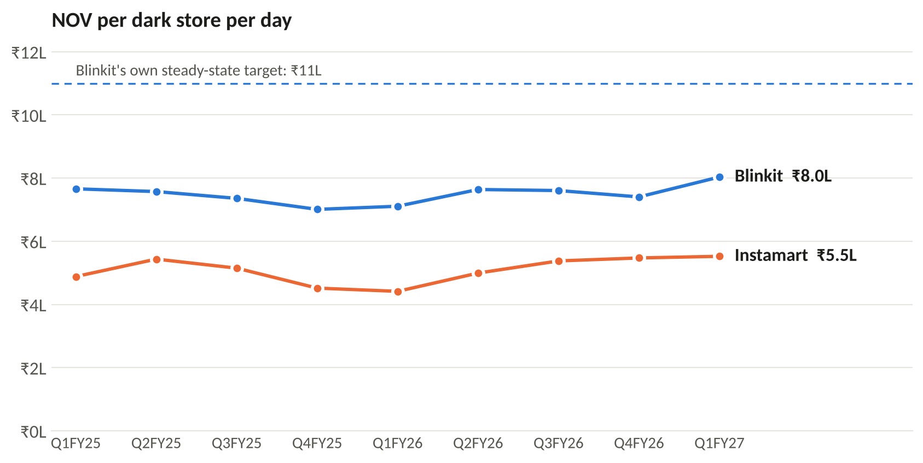
SITUATION
Same basket, emptier stores: an Instamart store sells 31% less a day than a Blinkit one
₹508 vs ₹518
net basket (AOV), Instamart vs Blinkit. Basically equal.
1,089 vs 1,552
orders per store per day
₹72k vs ₹38k
HQ, tech and brand cost carried per store-day
~40%
Instamart store utilisation (Swiggy, Q1FY27)
63% → 75%
Blinkit's share of the two players' combined NOV, Q1FY25 → Q1FY27
Swiggy and Eternal shareholder letters Q1FY25–Q1FY27. NOV per store-day computed as NOV ÷ average stores ÷ 91; tracks Blinkit's own published figure within ±4%.
Arnav Deshpande · Instamart densification plan
3
Notes:
The point of this slide: it is not a pricing or basket problem. The basket is the same. The stores are emptier.

Slide 4
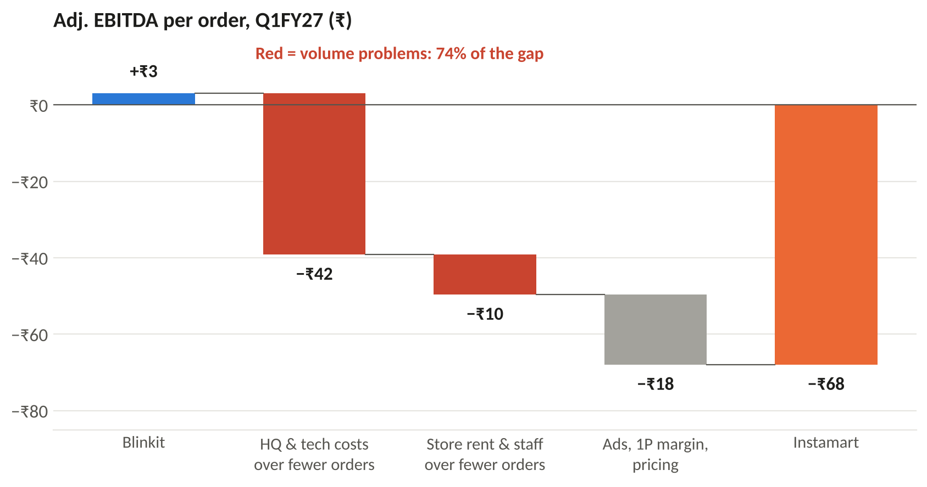
ROOT CAUSE · STEP 1 OF 3: WHERE THE LOSS SITS
Three-quarters of Instamart's ₹71 per-order gap to Blinkit comes from spreading costs over too few orders
How to read it
Blinkit makes +₹3 per order, Instamart loses ₹68.
₹42 of the gap: HQ, tech and brand costs are similar in rupees (₹762 Cr vs ₹805 Cr a quarter) but Instamart spreads them over a third of the orders.
₹10: the same rent and staff, fewer orders through the door.
₹18: genuinely per-order. Ads, Blinkit's inventory-led margin, discounts. Swiggy's own plan already targets this.
So the first question is not "how do we earn more per order" but "why are there so few orders per store".
Q1FY27. HQ cost = contribution minus Adj. EBITDA. Store rent and staff assumed at ₹38k per store-day for both players (see appendix). The residual is everything else inside contribution.
Arnav Deshpande · Instamart densification plan
4
Notes:
Waterfall from Blinkit to Instamart. Red bars are volume problems, grey is a margin problem. I split store cost using the same per-store-day cost for both, which is conservative for Blinkit.

Slide 5
ROOT CAUSE · STEP 2 OF 3: THE ISSUE TREE
Following the tree down, every branch that explains the gap ends at one thing: too few orders per user
Adj. EBITDA per store-day: −₹74k
vs Blinkit +₹3k
NOV per store-day: ₹5.52L
Blinkit ₹8.04L (−31%)
Contribution: −0.3% of NOV
Blinkit +5.3%
HQ cost per store-day: ₹72k
same ₹ as Blinkit, half the sales
Users / store
11.5k vs 13.0k
Orders / user
2.83 vs 3.47 /mo
Basket
₹508 vs ₹518
Store costs / order
₹35 vs ₹24
Ads, 1P, pricing
~₹18/order gap
Fixed by scale, i.e. more orders
on the same network
Read across the tree. Orange = explains the gap, tint = a consequence of it, grey = ruled out or already being worked on. Store-cost and HQ-cost problems shrink by themselves once orders per store rise, so the branch to attack is orders per user.
Q1FY27. Users per store = MTU ÷ stores. Orders/store/day = users per store × orders per user per month × 12 ÷ 365.
Arnav Deshpande · Instamart densification plan
5
Notes:
MECE split: EBITDA = NOV × contribution% − HQ cost. Basket is ruled out. Two of the three branches are really the same volume problem seen from the cost side.

Slide 6
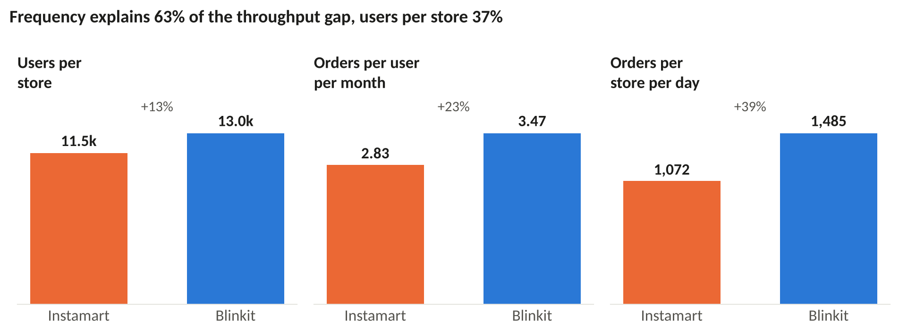
ROOT CAUSE · STEP 3 OF 3: FIVE WHYS
The root cause: Instamart built stores faster than it built the habit of ordering from them
1
Why do stores lose money?
They sell ₹5.5L a day; costs are set for ₹8L+.
2
Why so little per store?
1,089 orders a day against 1,552 at Blinkit, on the same basket.
3
Why so few orders?
Each user orders 2.83×/month vs 3.47×. Frequency is 63% of the gap, users per store 37%.
4
Why so infrequent?
It's a top-up and stock-up app, not a daily one: milk, eggs and vegetables still come from the kirana and the doodhwala. 39% of new users don't return in month one.
So the fix is a habit fix. Get the users already inside each store's radius to order one more time a month, and pull in the Swiggy users who live there but don't use Instamart.
5
Why?
316 stores opened in one quarter (Q4FY25) into catchments with no habit yet, then ~4M low-value users were cut. Capacity ran ahead of demand: ~40% utilisation.
Swiggy shareholder letters (Q4FY25 store additions, Q1FY26 on weaning off ~4M low-value users, Q1FY27 utilisation and M1 retention). The Q1FY26 user cut-off is the company's own explanation for the frequency drop.
Arnav Deshpande · Instamart densification plan
6
Notes:
Log split of orders per store per day into users per store and orders per user. The fifth why is where strategy comes in: it's a sequencing mistake, not a bad store.

Slide 7
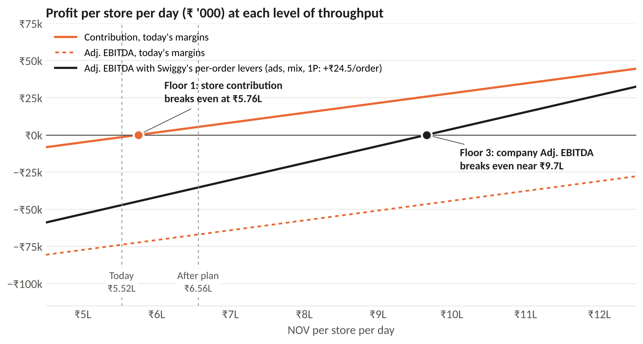
WHAT 'BREAK-EVEN' MEANS HERE
Break-even has three floors. ₹1 lakh more per store clears the first two; the third needs Swiggy's per-order levers too
1
Network contribution ≥ 0
Cleared
Average store clears ₹5.76L. Swiggy touched this in May-26 for one month. The plan holds it at +0.8%.
2
Most stores in the black
Cleared
Contribution-positive stores go from 45% to 67%.
3
Company Adj. EBITDA ≥ 0
Next
Needs ~₹9.7L per store per day once ads, mix and the inventory model land. Blinkit's own steady-state target is ₹11L.
My model. Store variable margin 6.6% of NOV; store rent and staff ₹38k/day; HQ cost ₹72.4k/store-day held flat (no new stores). Per-order levers from Swiggy's Q1FY27 bridge: ads ₹10, mix ₹10, inventory model ₹4.5.
Arnav Deshpande · Instamart densification plan
7
Notes:
Be upfront in an interview: ₹1 lakh alone does not make Swiggy profitable. It crosses the contribution line durably and it's the first quarter of the climb to EBITDA break-even.

Slide 8
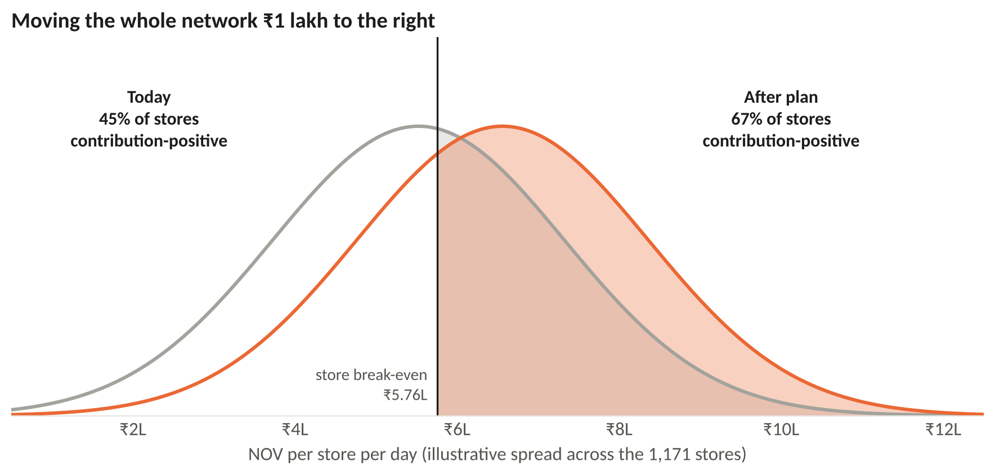
WHAT IT DOES TO THE NETWORK
Moving every store ₹1 lakh to the right turns two out of three stores contribution-positive, up from fewer than half
Why this matters more than the average.
A store that covers its own rent and staff can be left alone. A store that doesn't has to be fixed, moved or shut, and every one of those costs management time.
Not every store moves equally.
The plays work best where there are many households in the radius and the store is under-used. The pilot picks those first (slide 15).
Stores still below the line after a year are candidates for consolidation, not more spend.
Swiggy reported >45% of stores CM-positive in Q1FY27. The spread (normal, σ = ₹1.8L) is my assumption, chosen so the break-even line from the cost split reproduces that 45%. Store-level data would replace it.
Arnav Deshpande · Instamart densification plan
8
Notes:
45% to about two-thirds. If asked about the distribution: it's an assumption, calibrated to the one store-level number Swiggy discloses. I'd replace it with the store P&L table on day one.

Slide 9
DESIGNING THE FIX · CIRCLES
Working through CIRCLES from one store's catchment, the answer is a daily habit rather than a discount
C
Comprehend
Add ₹1L NOV per store per day on the 1,171 stores open today, inside four quarters. No new stores in the same micro-markets. Every added order must earn positive contribution. Speed is off the table: platforms were asked to drop the 10-minute promise in Jan-26.
I
Identify customers
Five people in one catchment: the daily-essentials household, the monthly stock-up planner, the late-night impulse buyer, the Swiggy food user who has never opened Instamart, and the one-time user who never came back.
R
Report needs
Milk before 7 am and vegetables they trust. Prices close to DMart for the big basket. No reason to open a second app. A first order that didn't disappoint (stock-outs, bruised fruit).
C
Cut
Rank by orders added per store-day × how habit-forming the behaviour is ÷ cost to margin. Frequency first: it is 63% of the gap.
L
List
Nine candidates, from a morning subscription slot to blanket free delivery (next slide).
E
Evaluate
Contribution per added order, cannibalisation of existing orders, peak-hour SLA risk, how easily Blinkit or Zepto can copy it.
S
Summarise
Four plays, +₹1.04L per store per day, contribution to +0.8% of NOV.
CIRCLES: Comprehend, Identify customers, Report needs, Cut through prioritisation, List solutions, Evaluate trade-offs, Summarise. Average store catchment = 13.5M MTU ÷ 1,171 stores ≈ 11.5k monthly users.
Arnav Deshpande · Instamart densification plan
9
Notes:
I used CIRCLES because the root cause is behavioural, so the fix has to start from the customer, not the P&L. The P&L tells you where to look; CIRCLES tells you what to build.

Slide 10
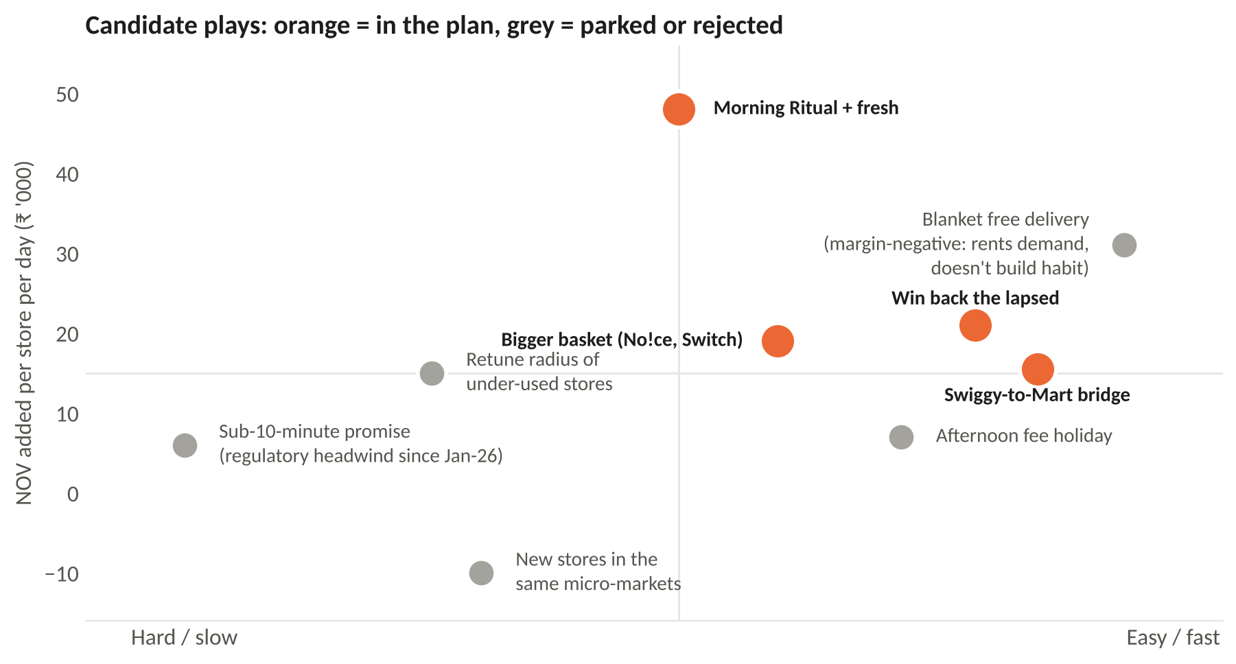
CUT THROUGH: WHAT GOES IN, WHAT STAYS OUT
Four plays make the cut. Blanket discounts would add more orders, but they rent demand instead of building it
Parked, not killed
Radius retune. With the 10-minute promise gone, an under-used store could serve a wider radius in 15–20 minutes. Big lever, but it needs rider and SLA work. Phase 2.
Afternoon fee holiday. Small on its own; folded into the morning-slot test as a variant.
Rejected
Blanket free delivery: margin-negative, and Blinkit can match it the next day.
Faster promise: regulatory headwind and no frequency evidence.
New stores in served micro-markets: splits existing demand and lowers throughput.
Impact = NOV per store per day from the sizing on slide 12; ease = my judgement of build time and operational risk. Blanket free delivery sized at Q2FY27-style pricing investments (~100 bps of CM).
Arnav Deshpande · Instamart densification plan
10
Notes:
The interesting rejection is blanket free delivery: it's the easiest and adds orders, but it doesn't change who the customer is, and it's the first thing a competitor copies.

Slide 11
LIST SOLUTIONS: THE FOUR PLAYS
Each play attacks a different reason a household inside the radius isn't ordering more
1
Morning Ritual + fresh
+₹48k · +95 orders/day
2
Swiggy-to-Mart bridge
+₹17k · +34 orders/day
Subscribe once to milk, bread, eggs, curd and a fruit-and-veg box, delivered 6–9 am on batched routes. Mornings are the quietest hours for a dark store, so this uses capacity that is already paid for. Scale Nectr (curated fresh produce, live in Bengaluru) to the top metros with a no-questions replacement promise.
About 12.7M people use Swiggy every month but not Instamart (26.2M platform users vs 13.5M). Offer tomorrow's milk on the food-tracking screen: one cart, one delivery fee, Swiggy One on both. Near-zero acquisition cost.
Target: Orders per user per month 2.83 → 3.08
Target: 8% of food-only users in a radius try Instamart
3
Win back the lapsed
+₹19k · +38 orders/day
4
Bigger basket
+₹19k · +₹15 net AOV
Roughly 4 in 10 new users don't come back in month one. Find out why per user (a stock-out on the first order, a late delivery, a price shock) and send the fix, not a blanket coupon. Capped cohort pricing, like the ₹9 store.
Private label (No!ce is already in more than 1 in 8 orders and is margin-accretive), 'finish the recipe' add-ons, and Maxxsaver thresholds set per store from its own basket data rather than one national number.
Target: ~580 users per store back at 2 orders/month
Target: Net AOV ₹508 → ₹523
Swiggy platform MTU 26.2M vs Instamart MTU 13.5M (Q1FY27). M1 retention 61% (Q1FY27). Nectr and No!ce from Swiggy's Q2FY27 letter. Per-store figures are averages; sizing on the next slide.
Arnav Deshpande · Instamart densification plan
11
Notes:
Morning Ritual is the anchor because it creates a daily reason to open the app and fills off-peak hours. The bridge is the cheapest acquisition Swiggy has: its own food users.

Slide 12
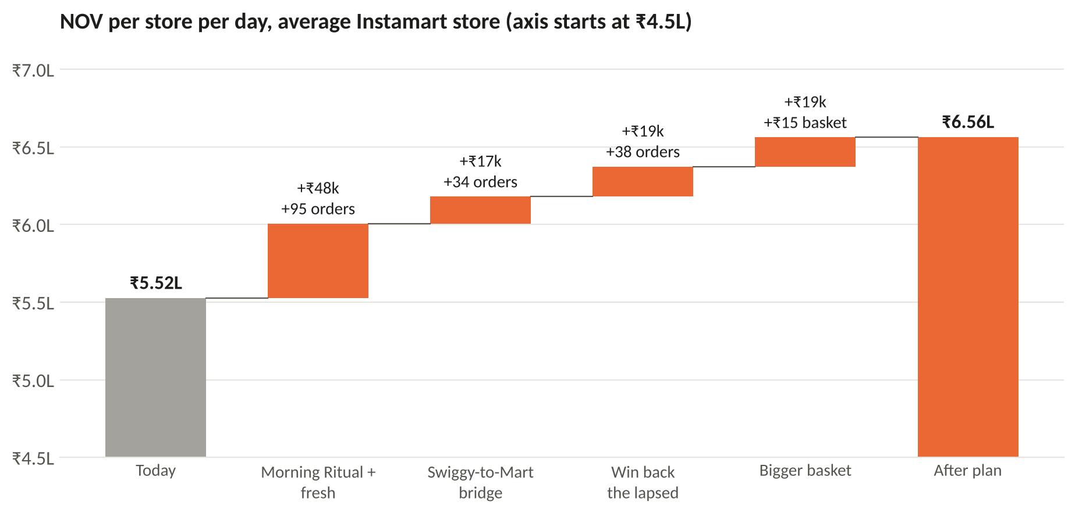
SIZING
Added up for an average store, the four plays take NOV from ₹5.52L to ₹6.56L a day
Assumption | Value
Users per store | 11.5k
Frequency uplift | +0.25 /month
Bridge converts | 520 users
Lapsed won back | 580 users
New users' frequency | 2.0 /month
Basket uplift | +₹15
Orders added | +167 /day
Utilisation after | ~46%
Even after the plan, stores run under half capacity. There is room to do this twice before a new store is needed.
Per-store catchment = 13.5M MTU ÷ 1,171 stores. Orders × ₹508 net AOV. Basket play applied to all orders after the other three. Utilisation scaled from Swiggy's ~40%.
Arnav Deshpande · Instamart densification plan
12
Notes:
Every input is in model.py. If someone challenges one, change it there and the deck rebuilds.

Slide 13
MEASURING IT · HEART
One north star, five HEART signals and three guardrails, so the habit is measured rather than assumed
 | Goal | Signal | Metric | Target
Happiness | People trust the morning and fresh orders | Fewer complaints on fresh | Fresh complaints per 1,000 orders; slot CSAT | Below today; CSAT ≥ 4.5
Engagement | Instamart becomes a daily app | More orders, more categories per user | Orders per MTU per month | 2.83 → 3.08
Adoption | The new behaviours get picked up | Sign-ups and first orders | % MTU on Morning Ritual; % food-only users trying Mart | 8–10%; 8%
Retention | First-timers stay | Users still ordering after a month | M1 retention; day-60 survival of won-back users | 61% → 65%; ≥ 40%
Task success | The order arrives complete and on time | Fewer substitutions and misses | Fill rate on top-200 SKUs; on-time % in 6–9 am slot | ≥ 98%; ≥ 95%
North star
NOV per store per day
₹5.52L → ₹6.52L+
Guardrails (stop if breached)
Contribution per added order ≥ ₹20 · peak-hour on-time % no worse than control · rider earnings per hour no lower than before
HEART: Happiness, Engagement, Adoption, Retention, Task success (Google's UX metrics framework). Targets are for pilot stores at day 120; baselines from Q1FY27 filings where public.
Arnav Deshpande · Instamart densification plan
13
Notes:
HEART keeps the plays honest. A morning slot that shows good adoption but bad task success (late milk) will kill the habit, so task success is the metric I'd watch first.

Slide 14
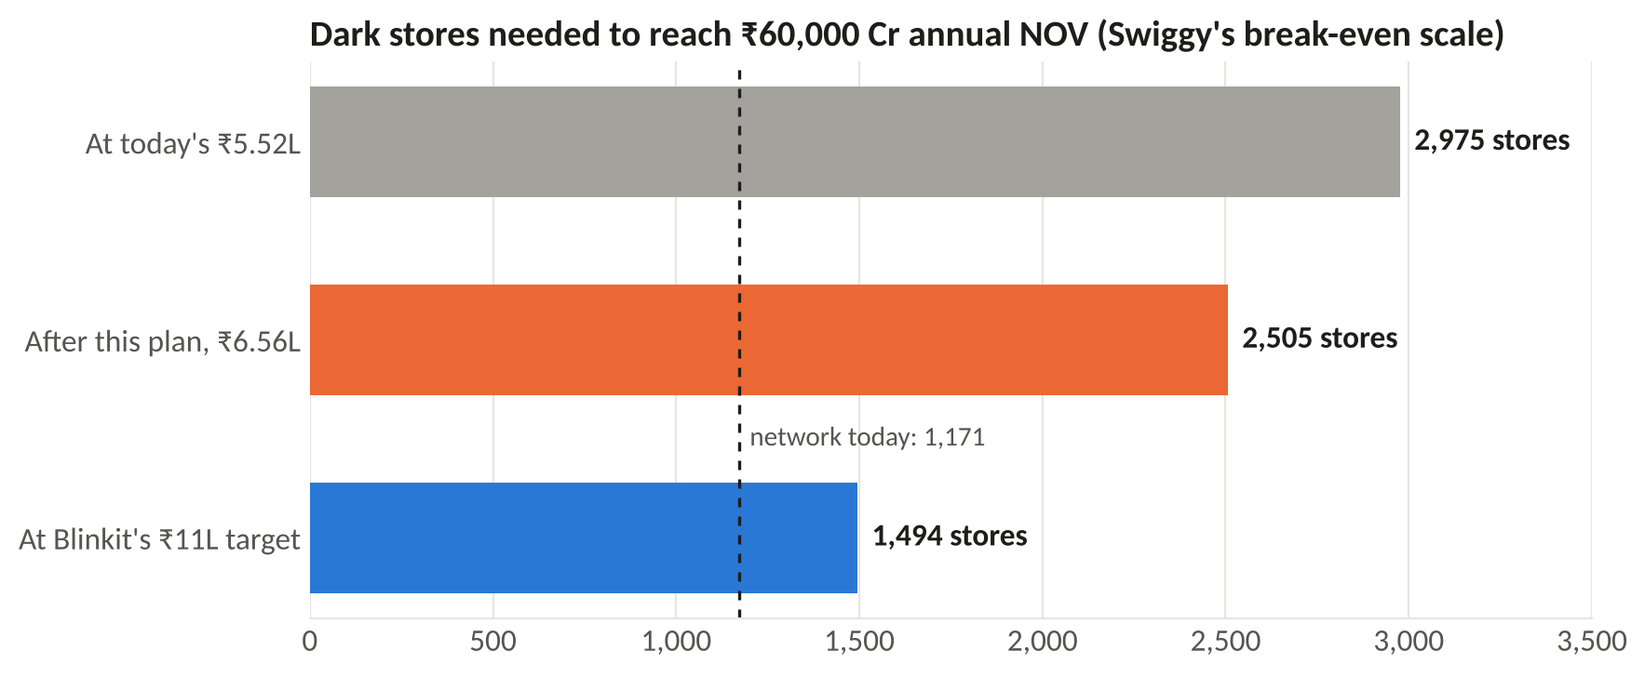
THE MONEY
About ₹220 Cr a year of net contribution, and ~470 fewer stores to build
Per year, whole network | ₹ Cr
Added NOV | +4,432
Contribution on it (6.6%) | +293
Programme spend (₹10 per added order) | −71
Net contribution | +221
Today's annualised Adj. EBITDA loss | −3,112
Net, if the plays deliver only half | +109
470
₹1,176 Cr
₹221 Cr closes about 7% of the EBITDA loss. That's honest, not heroic.
The bigger prize is on the right: the same ₹60,000 Cr of break-even NOV with 470 fewer stores, about ₹1,176 Cr of capex not spent.
fewer dark stores to reach
₹60,000 Cr of annual NOV
capex not spent, at ₹2.5 Cr
per store
Annualised on 1,171 stores. Marginal contribution = store variable margin (6.6%); store rent and staff are already paid. Capex at ₹2.5 Cr per store is Blinkit's guided figure; Instamart doesn't disclose its own.
Arnav Deshpande · Instamart densification plan
14
Notes:
Two kinds of value: the P&L uplift (small but immediate) and the capital it saves on the way to break-even scale (large). The second is the strategic argument.

Slide 15
HOW I'D ROLL IT OUT
Prove it in 60 stores, scale it in the metros, then make it the default, with a stop rule at every gate
Days 0–30
Set up
Days 30–120
Pilot
Days 120–240
Scale metros
Days 240–365
Default
Weekly store league table: NOV/store/day, utilisation by hour, fill rate
Pick 60 pilot + 60 matched control stores (same city, vintage, throughput band)
Freeze new stores where utilisation < 60%
Morning Ritual + bridge in Bengaluru and Pune pilot stores
Win-back and basket tests at user level inside them
Read difference-in-differences on NOV/store/day, CUPED on pre-period
Gate: ≥ +₹40k/store/day vs control, ≥ ₹20 contribution per added order
Roll out to the top 8 metros (most of the network's NOV)
Start radius-retune trial in the weakest stores
Whole network; morning slot and bridge become standard
Stores still below break-even: consolidate or relocate
Re-open expansion only where stores pass ~60% utilisation
Stop rule. If pilot stores are less than ₹20k a day ahead of control at day 120, or the added orders earn under ₹10 of contribution each, stop scaling and move the budget to radius retuning and store consolidation. A plan that can't say when it's wrong isn't a plan.
Store-level randomisation because the plays change store capacity, not just one user's experience. Messaging variants inside pilot stores are user-level A/B tests.
Arnav Deshpande · Instamart densification plan
15
Notes:
Sixty stores per arm is enough: stores are big units with stable daily sales, and CUPED on the 8-week pre-period removes most of the store-to-store noise.

Slide 16
RISKS
What could go wrong, and what would change my mind
Medium
Competitors match it
Blinkit (2,443 stores), Zepto, Flipkart Minutes (1,000+) and Amazon Now can copy a discount overnight. A subscription habit and the food-app bridge are much harder to copy.
High
Orders move rather than grow
The morning slot could just shift orders users would have placed anyway. Measure orders per user per month, never slot orders alone.
Medium
Morning ops are hard
Cold chain for milk, a 5:30 am shift, riders at dawn. Start with stores near dairy partners; batching raises rider earnings per hour.
Medium
Gig-worker cost rises
The new labour codes add 1–2% of turnover. Plays that raise drops per trip absorb it; plays that add single-item trips don't.
Low
My cost split is off
The ₹38k store cost is an estimate. At ₹30k–45k, and even at half delivery, contribution still ends positive.
Labour-code social security: 1–2% of turnover, capped at 5% of payouts (Nov-25). Competitor store counts: Business Standard, Aug-26.
Arnav Deshpande · Instamart densification plan
16
Notes:
The biggest risk is the second one. It's the most common way frequency programmes fool themselves.

Slide 17
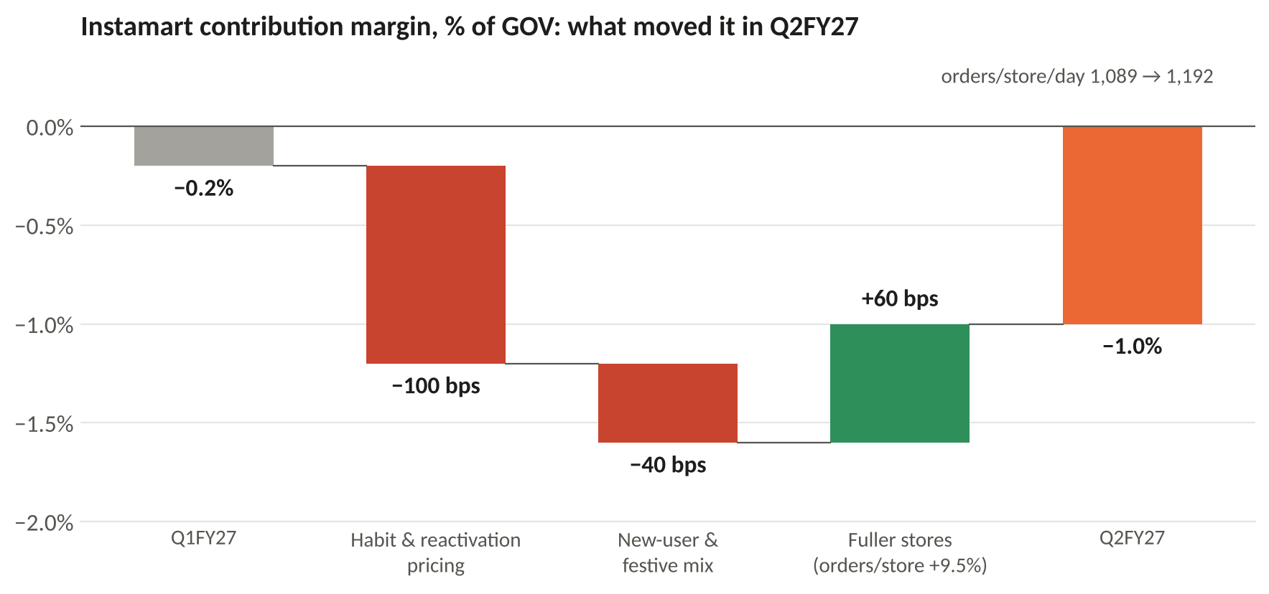
POSTSCRIPT: Q2FY27 CAME OUT WHILE I WAS WRITING THIS
The next quarter shows both halves of the argument: fuller stores paid off, discounts and new stores gave it back
Density worked. Orders per store rose 9.5% and Swiggy credits that with +60 bps of contribution. NOV per store per day reached about ₹6.0L, half of this plan's target in a single quarter.
Then it was spent. 100 bps went on habit and reactivation pricing, 40 bps on mix, and 69 new stores (as many as the previous three quarters together) carried start-up losses. Contribution fell to −1.0%.
Reading for this plan: the throughput lever is real and roughly the size I assumed (the 60 bps is one of the two ways I sized store cost). Buy the habit with product, not price, and hold the store count.
Swiggy Q2FY27 shareholder letter (Oct-26): orders per store per day 1,089 → 1,192; 69 stores added; CM bridge as disclosed by the company. NOV per store-day computed the same way as slide 3.
Arnav Deshpande · Instamart densification plan
17
Notes:
I kept Q1FY27 as the baseline so it matches the rest of the repo. Q2 is the out-of-sample check.

Slide 18
APPENDIX: ASSUMPTIONS AND SOURCES
Everything I had to assume, and where every number comes from
Assumption | Value | Basis
Store rent + staff | ₹38k/day | 4,200 sq ft × ~₹100/sq ft/month + ~30 staff; cross-checked on Q2FY27's 60 bps
Store variable margin | 6.6% | Implied by contribution and the line above
Spread of store sales | σ ₹1.8L | Reproduces '45% of stores CM-positive'
Programme spend | ₹10/order | About a third of marginal contribution
Capex per store | ₹2.5 Cr | Blinkit guidance; Instamart not disclosed
Per-order levers | ₹24.5 | Swiggy: ads ₹10, mix ₹10, inventory ₹4–5
Play inputs | slide 12 | Set in model.py; tests pin every headline number
Sources
Swiggy shareholder letters Q1FY26, Q4FY26, Q1FY27, Q2FY27 (swiggy.com/corporate)
Eternal shareholder letters Q3FY25, Q4FY25, Q1FY27, Q2FY27 (eternal.com/investor-relations)
Zepto abridged UDRHP, June 2026 (sebi.gov.in)
Business Standard on dark-store additions, Aug-26; TechCrunch on the 10-minute directive, Jan-26; Fisher Phillips on India's labour codes
Consulting structure: IIM Ahmedabad Consult Prep Book 2025–26 (profitability trees, phased recommendations)
Model, charts and this deck are rebuilt from code: densification-strategy/ in the case-study repo.
Arnav Deshpande · Instamart densification plan
18

Slide 19
Instamart doesn't need more stores yet. It needs a reason to order every morning.
Fund a 60-store pilot of Morning Ritual and the Swiggy-to-Mart bridge. If it clears +₹40k per store per day by day 120, scale it. If it doesn't, the stop rule says so.
Arnav Deshpande
arnavhpd@gmail.com

