Slide 1
Econometrics Project
Aryan Kaul - 2021136
Arnav Gupta - 2022100
Komal - 2022251
Prakhar - 2022360

Slide 2
Problem Statement
Understanding the factors influencing groundwater quality is essential for effective resource management and environmental protection. Economic growth, as measured by indicators such as Gross Domestic Product (GDP), can have both positive and negative impacts on groundwater quality. While economic development may lead to improved infrastructure and environmental regulations, it can also result in increased pollution and depletion of natural resources.
Moreover, income inequality, as reflected in measures like the Gini index, may cause disparities in access to clean water and environmental degradation. Therefore, investigating the relationship between economic growth, income inequality, and groundwater quality is critical for formulating sustainable development policies and interventions.
This project aims to investigate the relationship between Potassium concentration in groundwater and economic output in Indian districts from 2000 – 2019. Specifically, we seek to understand how variations in Potassium levels impact economic productivity at the district level. Here, we are analyzing the interplay between groundwater quality, and economic indicators.

Slide 3
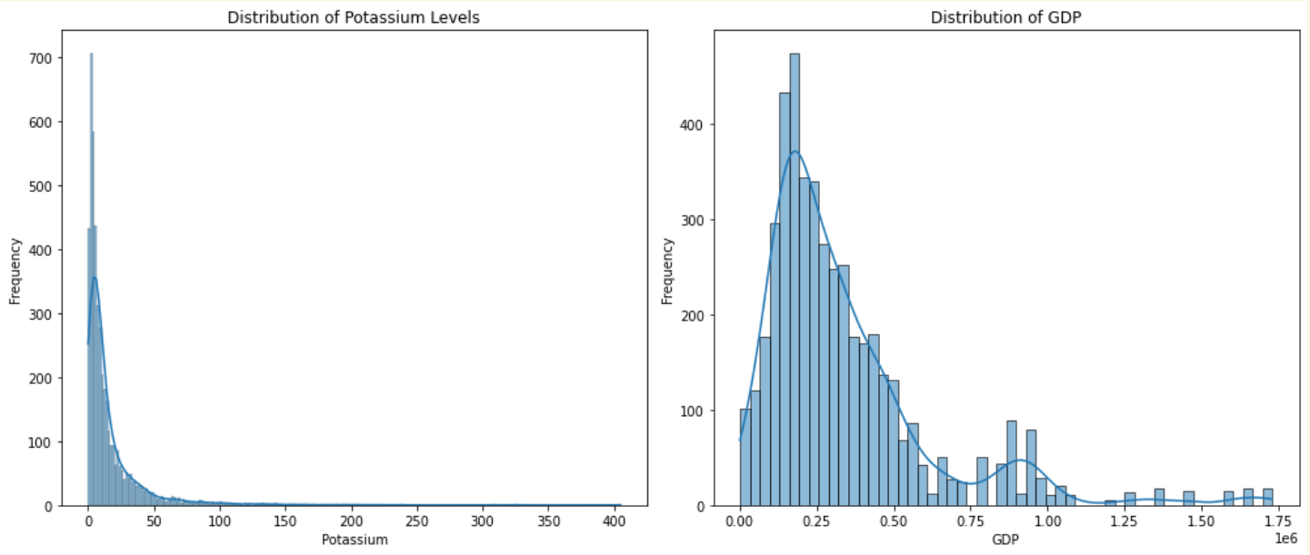
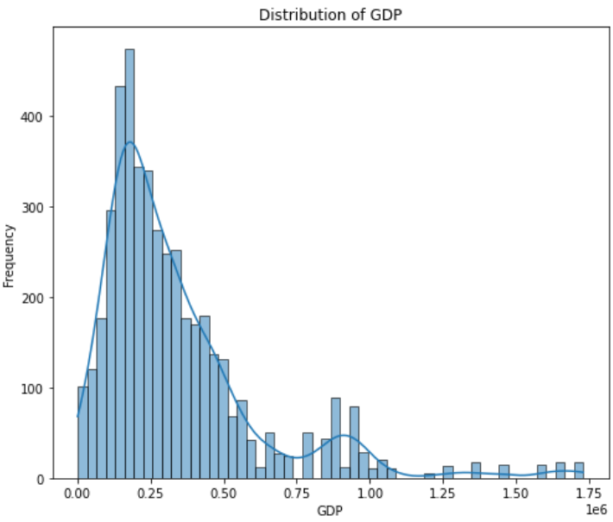
Dataset
The dataset comprises groundwater quality indicators measured across various Indian districts from 2000 to 2019. It includes parameters like chemical compounds, ions, metals, and contaminants. Additionally, it features state-year wise net state domestic product (SDP) data, offering insights into economic trends. Moreover, district-level Gini index values are included, providing information on income inequality within districts, thus offering socio-economic context.
Missing Values:
Potassium: 3,110 missing entries.
GDP: 20 missing entries.
Gini: 125 missing entries.
Skewness (Measure of data symmetry):
Potassium: Highly skewed (5.21), suggesting many high outliers.
GDP: Moderately skewed (1.77), suggesting a tail on the right.
Gini: Slightly skewed (0.80), hinting at a right tail.
Potential Outliers :
Potassium: 467 potential outliers.
GDP: 396 potential outliers.
Gini: 152 potential outliers.

Slide 4
Detailed statistics about the Dataset
Statistic | Potassium | GDP | Gini
Count | 4708 | 7798 | 7693
Mean | 15.87 | 329,604.00 | 0.267
Std Dev | 0.055 | 276,948.88 | 0.055
Min | 0.00 | 1,247.39 | 0.160
25% | 3.36 | 139,934.27 | 0.230
50%(Median) | 7.36 | 246,914.74 | 0.260
75% | 17.24 | 441,956.43 | 0.300
Max | 405.00 | 1,728,578.00 | 0.480

Slide 5
GWQ_{i,t} = β₀ + β₁SDP_{i,t} + u_{i,t}
Variable | Coefficient | Standard Error | t-Statistic | P-value | 0.025 | 0.975
Intercept | 16.9359 | 0.380 | 41.949 | 0.000 | 15.182 | 16.671
GDP | -2.945e-06 | 0.380 | -2.194 | 0.028 | -1.577 | -0.089
R squared | 0.001
F statistic | 4.815
P value for F statistic | 0.0283

Slide 6
Regression Analysis Summary
Model Description
Dependent Variable: Potassium (indicating groundwater quality)
Independent Variable: GDP (Gross Domestic Product)
Results Summary
R-squared: 0.001 - This indicates that only 0.1% of the variability in potassium levels is explained by GDP, suggesting a very weak relationship.
F-statistic: 6.470 with a p-value of 0.011 - This suggests that the overall model is statistically significant, although the explanatory power is very weak.
Coefficients:
Intercept: 17.048 (significant, p < 0.000)
GDP Coefficient: -0.000003344 (significant, p = 0.011) - Indicates a very small negative relationship between GDP and potassium levels.
Diagnostic Stats
Prob(Omnibus): Near zero, indicating that the residuals are not normally distributed.
Skewness: 5.189 - The positive value indicates a right-skewed distribution of residuals.
Kurtosis: 47.807 - A very high kurtosis value suggests a heavy tail or outliers in the distribution of residuals.

Slide 7
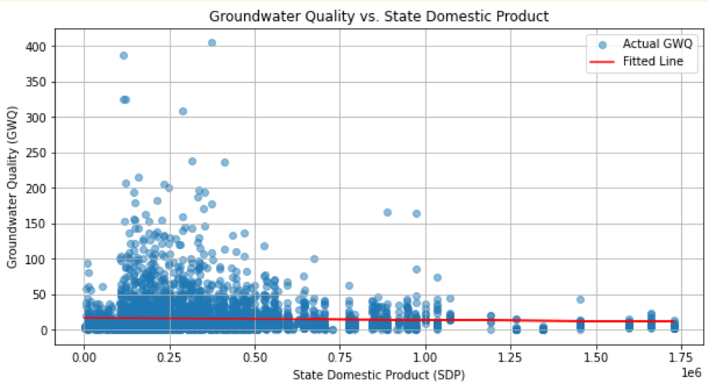
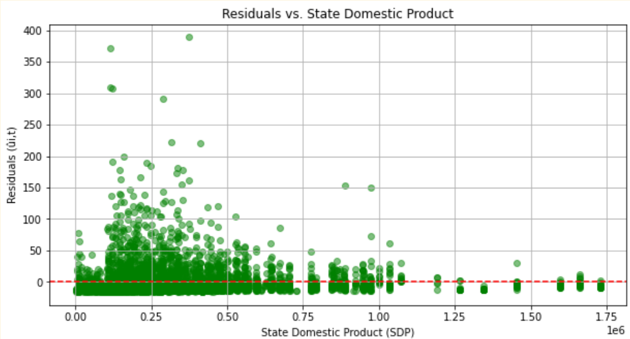
Plot analysis
1.Groundwater Quality vs. SDP Plot:
This plot shows a red fitted line that seems to slightly trend downwards, indicating a negative relationship between SDP and potassium levels.
The scatter of actual GWQ data points around the line is quite broad, suggesting high variability in potassium levels that is not captured by SDP alone.
2.Residuals vs. SDP Plot:
This plot ideally show residuals scattered randomly around the zero line without forming any patterns. The scatter appears to be non-random, with potential patterns suggesting that the linear model may not be the best fit for this data.

Slide 8
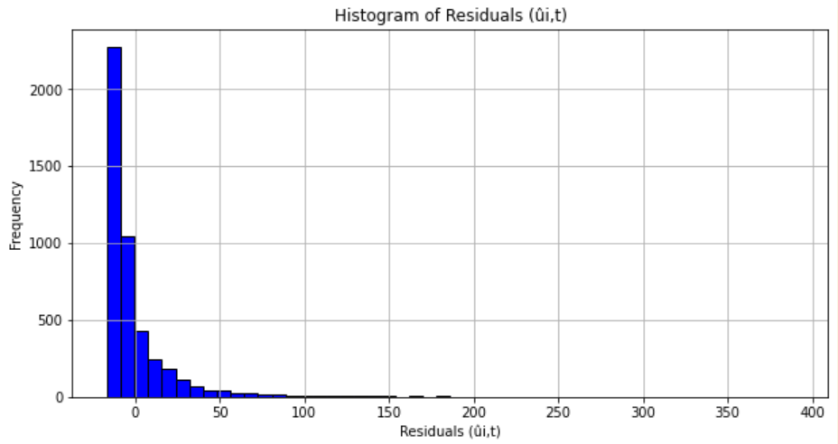
Interpretation
The plot of the histogram of the residuals confirms that the residuals meet the OLS assumption that their sum should equal zero, indicating that the model is correctly specified in terms of its intercept.
This analysis suggests that while the model may have other areas for improvement (as indicated by earlier diagnostics of residuals and fit), it fundamentally adheres to key OLS assumptions.
The very low R-squared value indicates that GDP is not a good predictor of groundwater quality as measured by potassium levels in this dataset. The significant p-values for the coefficients suggest a statistical relationship, but the practical significance might be minimal due to the very low effect size (coefficients).
The model diagnostics also indicate potential issues
with non-normality and presence of outliers or
influential points that could be distorting the
regression results.
Conclusion:
While the model detects a relationship, it may not capture
all dynamics affecting GWQ.
We could consider refining the model by adding variable
or applying non-linear models.

Slide 9
GWQ = β₀ + β₁Y + β₂Y²+ β₃Y³ + δ₁GINI +u
 | Coeff | Std Error | t | P > |t| | [0.025] | [0.975]
const | 5.99e-18 | 0.015 | 4.09e-16 | 1.000 | -0.029 | 0.029
GDP | 0.4866 | 0.089 | 5.463 | 0.000 | 0.312 | 0.661
GDP^2 | -1.0558 | 0.202 | -5.235 | 0.000 | -1.451 | -0.660
GDP^3 | 0.5702 | 0.128 | 4.461 | 0.000 | 0.320 | 0.821
Gini | 0.0554 | 0.015 | 3.778 | 0.000 | 0.027 | 0.084

Slide 10
Interpretations of the enhanced model
R squared | 0.012
F statistic | 14.52
P value for F statistic | 8.73e-12
Model Summary:
R-squared: 0.012, indicating that only about 1.2% of the variance in potassium is explained by the model. This is quite low, suggesting that either the model is not capturing all relevant variables or the relationship between potassium and GDP is very weak.
F-statistic: 14.52, with a very low probability (p < 0.0001), indicating that the model coefficients are statistically significant, despite the low explanatory power.
Coefficients:
GDP (linear term): Positive and significant, suggesting an initial increase in potassium with GDP.
GDP^2 (quadratic term): Negative and significant, indicating that the increase in potassium reverses at higher levels of GDP.
GDP^3 (cubic term): Positive and significant, hinting at a complex, non-linear relationship where potassium levels might increase again at even higher GDP levels.
Gini: Small positive coefficient, statistically significant, suggesting a slight increase in potassium levels with higher inequality.

Slide 11
Tackling outliers
 | R squared | F stat | P value for F stat
Before removing outliers | 0.012 | 14.52 | 8.73e-12
After removing outliers | 0.020 | 21.39 | 1.73e-17
Criteria for Outliers/Influential Observations:
1.High Leverage Threshold: Set as twice the ratio of the number of parameters (including the constant term) to the number of observations. Points above this threshold are considered to have high leverage.
2.High Cook's Distance Threshold: Set as four times the ratio of the number of parameters to the difference between the number of observations and the number of parameters minus one. Points above this threshold are considered to have high influence.
Actions Taken
Points identified either by high leverage or high Cook's distance are removed from the dataset.

Slide 12
Results of Non-linear Regression After Removing Outliers
Key Metrics:
R-squared (R²): This has increased to 0.018 from the previous analysis before outlier removal, indicating a slight improvement in the model's ability to explain the variability in potassium levels. It remains relatively low, suggesting other factors might be influencing potassium levels.
Adjusted R-squared: Similarly, this has also increased, which shows a better fit when adjusted for the number of predictors in the model.
F-statistic and p-value: The F-statistic is 19.99 with a highly significant p-value (2.48e-16), indicating that the model is statistically significant at explaining the variation in the response variable after removing influential observations.
Conclusion :
The increase in R-squared and adjusted R-squared post-outlier removal indicates a more reliable model. Thus the overall analysis shows a better model post-outlier removal, yet with room for improvement to fully capture the complex dynamics of economic growth and environmental quality as represented by potassium levels.

Slide 13
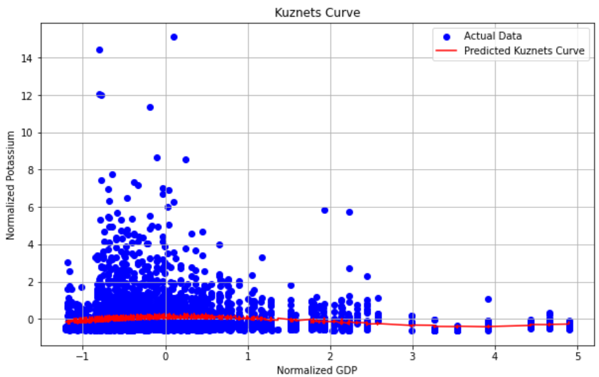
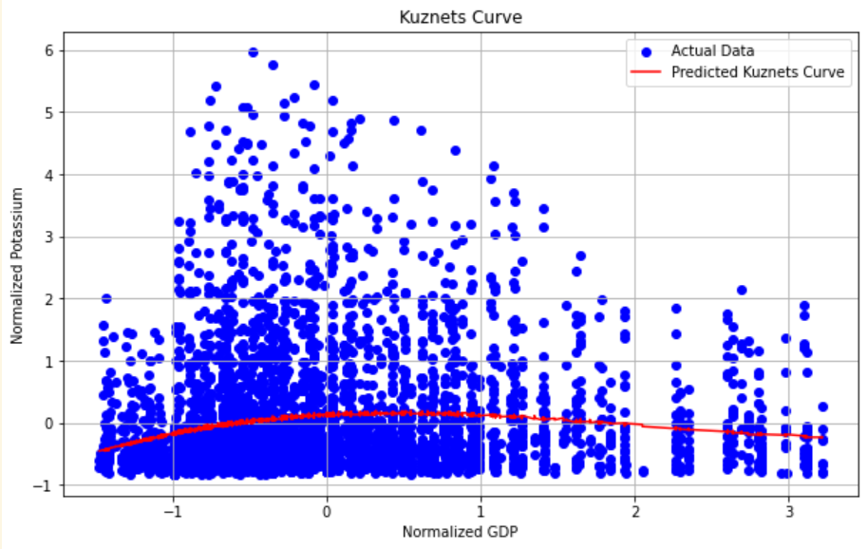
Relationship between economic growth (as measured by SDP) and
groundwater quality
The results align with the typical interpretation of the Environmental Kuznets Curve, showing an initial increase in environmental degradation with economic growth followed by improvement.
The impact of economic inequality (Gini coefficient) also points to socio-economic factors playing a significant role in environmental outcomes. Given the concerns about multicollinearity and the low R², further refinement of the model or additional data might be needed to provide better insights.

Slide 14
Results across various time periods
 | 2000-2004 | 2005-2009 | 2010-2014 | 2015-2018
R squared | 0.021 | 0.052 | 0.035 | 0.018
F stat | 4.823 | 17.20 | 11.59 | 5.141
P value for F stat | 0.000748 | 9.45e-14 | 3.01e-09 | 0.000417
Coefficient Trends: The signs of the coefficients for GDP, GDP², and GDP³ are consistent across the periods, indicating a similar shaped curve but varying magnitudes.
Significance: Most GDP polynomial terms are significant, especially the squared and cubed terms, across all time periods. This supports the presence of a non-linear relationship.
Conclusion:
The results indeed vary across different time periods, with varying levels of significance and effect sizes. This could imply changes in the economic-environmental relationship over time, possibly due to changes in economic policies, environmental regulations, or other macroeconomic factors.

Slide 15
Results across various regions in India
 | NORTHERN REGION | NORTH-EASTERN REGION | SOUTHERN REGION | WESTERN REGION | EASTERN REGION | CENTRAL REGION
R squared | 0.050 | 0.195 | 0.039 | 0.046 | 0.065 | 0.002
F stat | 16.88 | 14.09 | 4.920 | 7.024 | 12.12 | 0.5693
P value for F stat | 1.68×10^−13 | 2.63e-10 | 0.000678 | 1.59e-05 | 1.56e-09 | 0.685

Slide 16
Interpretation of Kuznets curve across regions within India
Observations and Comparison:
Model Fit: The models for the Southern and North-Eastern regions show relatively higher R-squared values, suggesting a better fit compared to other regions.
Variable Significance: GDP and its polynomial transformations tend to be significant across most regions except for the Central region where no variables are significant. This could indicate varying economic dynamics and their impact on environmental quality across different parts of India.
Gini Coefficient: The Gini coefficient is significant in the Eastern, North-Eastern, and Southern regions, indicating that income inequality may have more pronounced effects on environmental quality in these areas.
Overall Variation: There is a notable variation in the statistical significance and effect sizes of coefficients across regions, which suggests regional disparities in economic growth, income distribution, and environmental outcomes.
These results highlight the regional diversity in the relationship between economic growth and environmental degradation in India.

Slide 17
Econometric tests or data diagnostics employed
Handling Missing Data : used dropna() to remove any rows with missing values in the variables 'potassium', 'GDP', and 'Gini'.
Polynomial Feature Transformation : introduced polynomial terms of GDP (up to the third degree), in order to test for non-linear relationships between GDP and potassium levels. This allows the model to capture more complex patterns beyond simple linear associations, which is essential for examining theories like the environmental Kuznets curve.
Standardization of variables : used StandardScaler for making coefficients comparable and stabilizing the computation, which is important especially in non-linear models where higher powers of variables could dominate the model due to scale differences.
Outlier Detection : Removed outliers which was crucial because outliers can have a disproportionately large influence on regression results, especially in non-linear models.
Fitting the regression model using OLS; Documenting the P-values, R squared, F-statistic.
Impact on narrative :
Dropping all missing values might cause loss of data and could potentially introduce bias if the missingness is not random.
Statistical Significance vs. Practical Significance: While the model shows statistical significance (low p-values), the practical significance (low R-squared) indicates that GDP and inequality explain only a small fraction of the variations in potassium levels. This suggests that other factors might be at play or that the relationship is inherently weak.

Slide 18
Potential Limitations
1. Data Quality and Availability:
The analysis relies on the quality and availability of the dataset used. Incomplete or inaccurate data /null values and missing data present challenges in the analysis, potentially leading to biased estimates and reduced sample size affecting the reliability of the results. Additionally, the absence of certain variables or limited historical data may constrain the depth of the analysis.
2.Omitted Variable Bias:
The regression model may suffer from omitted variable bias, as it does not include all relevant variables that could influence groundwater quality. Omitted variables, such as agricultural practices, industrial emissions, and population growth, may bias the estimated coefficients of the included variables, leading to incorrect conclusions about the relationships under study.
3. Model Specification:
The decision to include polynomial terms up to the third degree is based on theoretical or empirical justification, but it might not be optimal.
4. Economic and Environmental Context :
Economic and environmental outcomes are influenced by a complex set of factors including policies, technological change, and societal values that can be difficult to capture fully in a single model.

